Slide 1

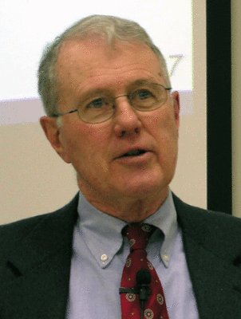
Foundations of Biblical Prophecy
Lecture 13B Hermeneutical Principles for Interpreting Prophetic Writings
Dr. Robert Vannoy
ReNarrated by Ted Hildebrandt
© 2023 Robert Vannoy & Ted Hildebrandt

Slide 2
Foundations of Biblical Prophecy
  5. Isaiah 11:10-12 …
    e. Oswalt’s Approach
    f. Alexander’s Approach
    g. Vannoy’s Approach
  6. Predictive Prophecy May Be Conditional
    a. Jer. 18:5-10
    b. 1 Kings 11 – Jeroboam
    c. 1 Kings 21:19-27 – Ahab
    d. Jonah
    e. Isaiah 38 – Hezekiah
    f. J. B. Payne on Conditionality

Slide 3
Foundations of Biblical Prophecy
  7. Kinds of Predictive Prophecy
    a. Direct Prediction
    b. Typological Prediction
      1. John Stek on Typology
      2. Mickelsen on Typology
      3. Vos on Typology
      4. Danger of Falling into Allegory
  Student Question
  Video based on audio from Dr. Vannoy’s class at Biblical Theological Seminary. It was renarrated because the original audio was scratchy and it was turned into video by Ted Hildebrandt for Biblicalelearning.org.

