Slide 1

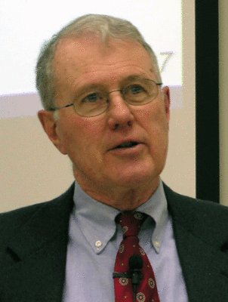
Foundations of Biblical Prophecy
Lecture 12 Date of Daniel, oral tradition
and writing Among the Prophets
Dr. Robert Vannoy
ReNarrated by Ted Hildebrandt
© 2023 Robert Vannoy & Ted Hildebrandt

Slide 2
Foundations of Biblical Prophecy
  Date of Daniel
    C. There are Alleged Late Linguistic Features
      1. Greek Loan Words
      2. Late Aramaic in Date
      3. Argument from Qumran Dead Sea Scrolls
      4. Conclusion
      Student Question: Why did Daniel write in Hebrew and Aramaic?

Slide 3
Foundations of Biblical Prophecy
  C. Were the Prophets Writers? -- The History of Traditions School
    1. H. S. Nyberg – Oral Transmission
    2. Harris Birkeland and individual books orally transmitted
    3. Eduard Nielsen – Oral Tradition and the Modern Problem Old Testament
    Introduction
      a. Synopsis of his thesis
        1. Memorization in Babylon
        2. Memorization of the Quran
        3. Johannan ben Zakkai – Mishnah memorized recited in prison camp
        4. Plato and Oral Memory
        5. Modern Reflections
        6. Israel and Memory and Writing

Slide 4
Foundations of Biblical Prophecy
  b. Assessment of Nielsen’s Thesis
    1. OT Oral tradition Examples: Exod 10:1-2
    2. Deut. 6:20-25
    3. Psalms 44 & 78
    4. Summary
    5. Written or Oral Legal Codes
    6. Written History – Numb. 33:2 …
    7. Writing Prophets Texts: 1 Chronicles 29:29; 2 Chron. 12:15, 32:32
    8. Psalm 77 as an example of Oral Tradition
    9. Joshua 24 as an example or Oral Tradition
    10. 2 Tim 3:8 as an example of Oral Tradition

Slide 5
Foundations of Biblical Prophecy
    b. Assessment of Nielsen’s Thesis
      11. Conclusion
  IX. Some Hermeneutical Principles for the Interpretation of
  Prophetic Writings
    A. Some General Characteristics of Predictive Prophecy
      1. The Purpose of Predictive Prophecy
      2. Function of Predictive Prophecy in Scripture
      3. Purpose of Predictive Prophecy

Slide 6
Foundations of Biblical Prophecy
    Video based on audio from Dr. Vannoy’s class at Biblical Theological Seminary. It was renarrated because the original audio was scratchy
    and it was turned into video by Ted Hildebrandt for Biblicalelearning.org.

