Slide 1

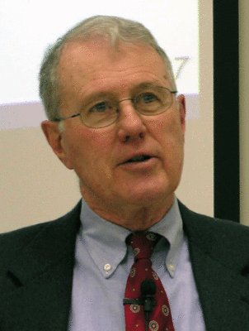
Foundations of Biblical Prophecy
Lecture 10 Prophets and the Cult,
Were the Prophets Writers?
Dr. Robert Vannoy
ReNarrated by Ted Hildebrandt
© 2023 Robert Vannoy & Ted Hildebrandt

Slide 2
Foundations of Biblical Prophecy
  A. Prophets Opposed Cult Review
    1. Some Statements Not Opposing the Cult
      a. Isaiah
      b. Jeremiah
      c. Is There a Cult-less Religion in the OT
        1. Cult Proscribed in the Pentateuch
        2. Prophets Condemned Heathenism in the Cult; Opus Operatum
          a) Hosea and Heathen Cultic Practices
          b) Ban on Empty Rituals

Slide 3
Foundations of Biblical Prophecy
  3. Amos 5:21-25 and the Cult
    a. McComiskey on Amos 5
    b. Ridderbos on Amos 5
  4. Jer. 7:21-23 and the Cult
    a. Rawl’s Response with Exod 19:5
    b. OT Allis’ Response: concerning → for the sake of
  5. Place of Ritual in Religion

Slide 4
Foundations of Biblical Prophecy
B. The Prophets Were Cultic Functionaries
  1. Explication of the View
    a. Aubrey R. Johnson
    b. Sigmund Mowinckel & Cultic Prophets
  2. Scriptural Support is Weak
  3. Assessment of the View
C. The View the Prophets Were Neither Anti-Cultic as Such, Not Cultic
Functionaries, but Simply Proclaimers of Divine Revelation

Slide 5
Foundations of Biblical Prophecy
VIII. The Composition of the Prophetic Books
  A. Traditional View
    1. Jeremiah 36:1-28
    2. Isaiah 30:8
  B. The Literary Critical School
    1. Isaiah 40-66 – Second Isaiah
      a. Rachel Margalioth
      b. R. N. Whybray
      c. Basis for Second Isaiah Argument
        1. The Concepts and Ideas Found in Isaiah 40-66 are said to differ
        significantly from Isa. 1-39

Slide 6
Foundations of Biblical Prophecy
      2. There is a Noticeable Difference in Language and Style
      3. The Historical Background of Chapters 40-66 is not the Historical
      Background of Isaiah’s Time
  d. Evaluation – Counter Arguments
    1. Concepts and Ideas Differ from the Second Part of the Book
    to the Uncontested First Part of the Book
    Video based on audio from Dr. Vannoy’s class at Biblical Theological Seminary. It was renarrated because the original audio was scratchy
    and it was turned into video by Ted Hildebrandt for Biblicalelearning.org.

