Slide 1
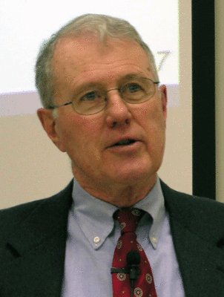
Deuteronomy: Specialized Studies
Lecture 13: Place of Centralization of Worship in Wellhausen’s Reconstruction of Israel’s Religious Development
Dr. Robert Vannoy
ReNarrated by Dr. Perry Phillips
© 2023 Robert Vannoy & Ted Hildebrandt

Slide 2

Deuteronomy: Specialized Studies
A. The Place of Centralization of Worship in Wellhausen’s Reconstruction of Israel’s Religious Development
1. Importance of Centralization of Worship in Wellhausen’s Hypothesis
2. Wellhausen’s System for Deut. 12 – Accepted by Some Evangelicals
3. Source Criticism and Deuteronomy 12
4. Wellhausen’s 3 Phases of the Place of Worship
  a. Multiple Altars Not linked to a specific place
  b. Early Prophets: Opposed Unbridled Cult Centers in Favor of Ethical Living
  c. Centralization in Jerusalem by Josiah (621 BC) – but it failed
  d. Post-exilic Centralization in Jerusalem succeeded

Slide 3
Deuteronomy: Specialized Studies
1. Wellhausen’s 3 Phases of Legal Codes
  a. Exodus 20:24-26 Multiple Altars
  b. Deuteronomy 12 (D) – Destruction of Pagan Altars, attempted Centralization
  c. Post-exilic (P) Centralization is assumed
  d. Wellhausen’s Method Summarized
  e. Problems with Wellhausen’s Approach – No Tabernacle
  f. Foundation of OT Religion Built on Canaanite Paganism [not Moses]
  g. Wellhausen’s Problem with the Prophets
  h. Student Questions

