Slide 1
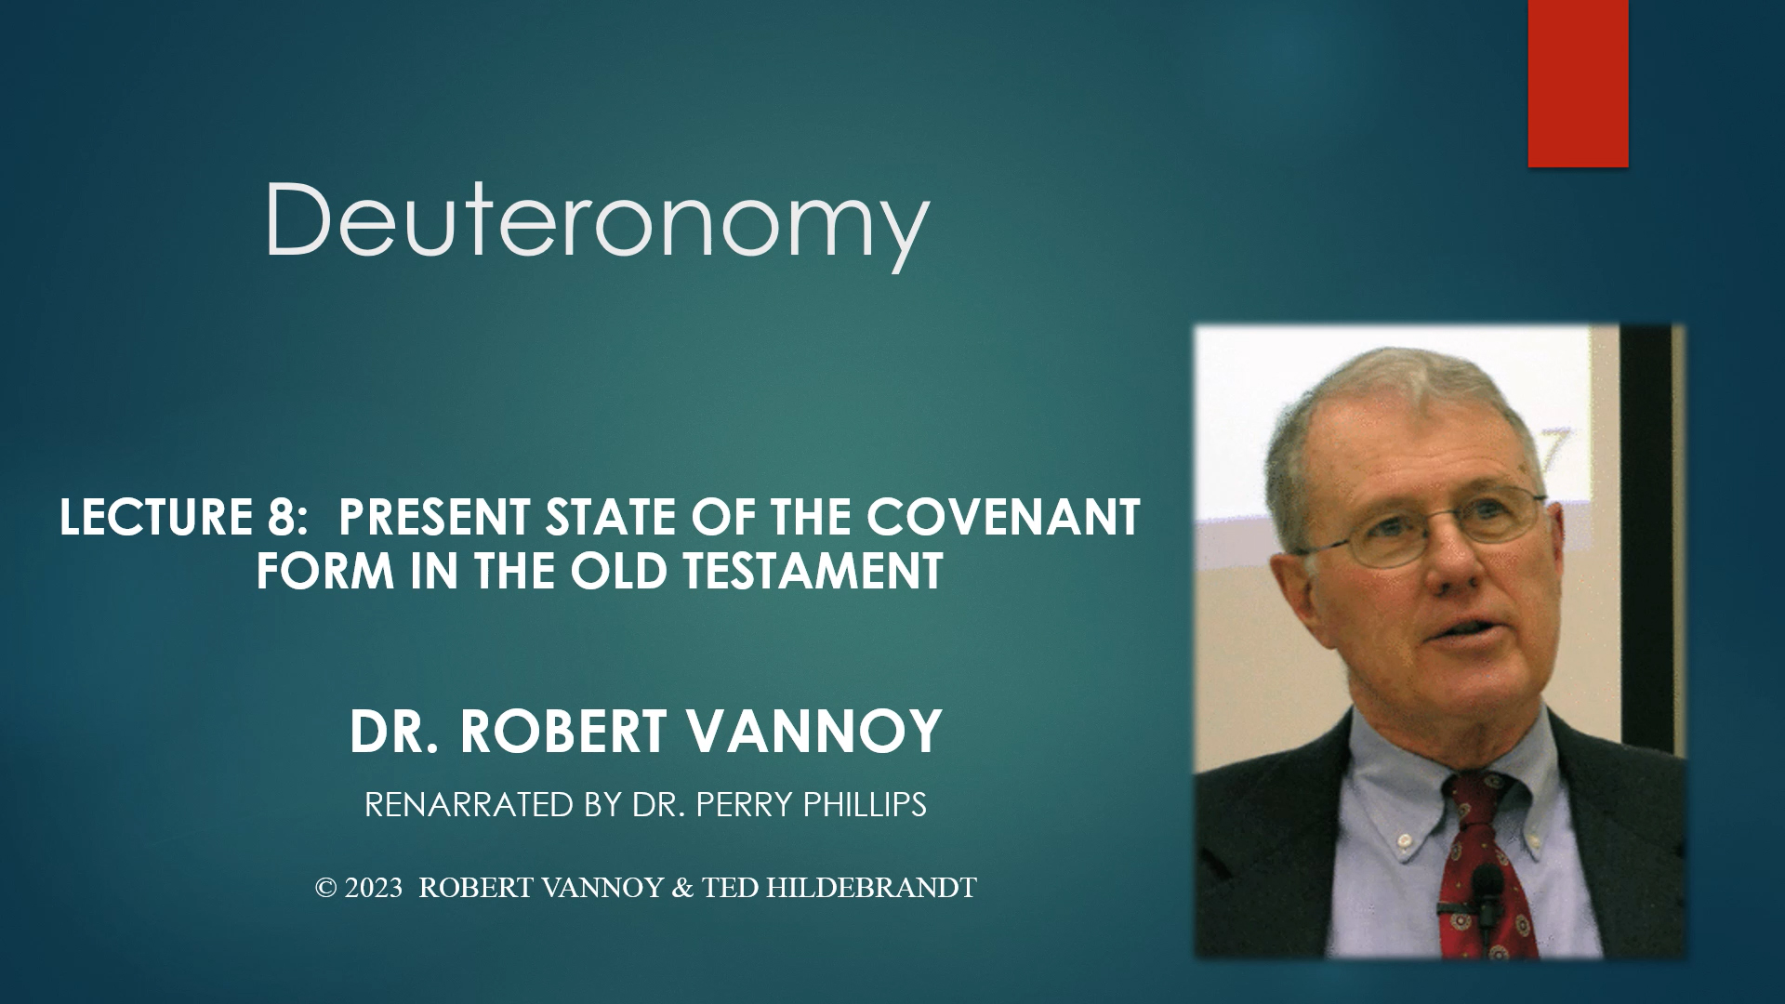


Deuteronomy: Specialized Studies
Lecture 9: Differences Between the Hittite, Assyrian and Sefire Treaty Forms and Deuteronomy
Dr. Robert Vannoy
ReNarrated by Dr. Perry Phillips
© 2023 Robert Vannoy & Ted Hildebrandt

Slide 2
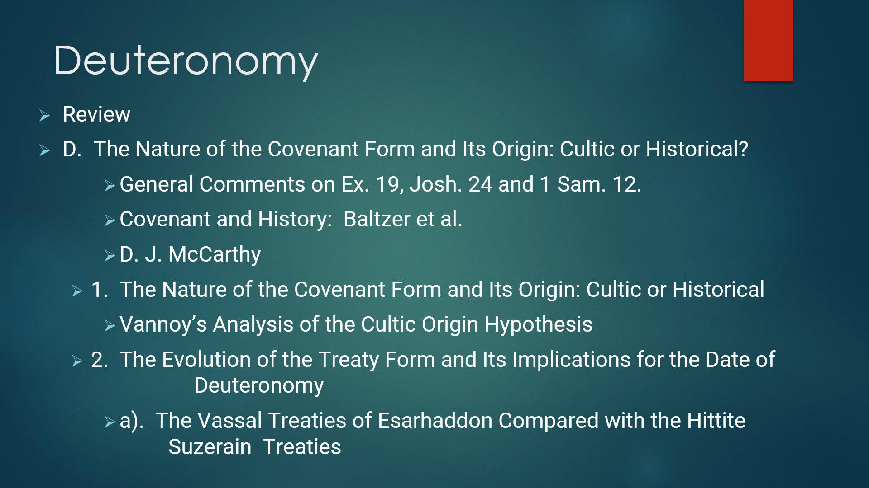
Deuteronomy
4. Absence of a Basic Stipulation
5. Absence of Blessings
6. The Stipulations of the Assyrian Treaties Are One Sided
7. The Assyrian Treaties Are Strictly Succession Treaties
8. Conclusion
9. Objectors to the Differences in Hittite and Assyrian Treaties

Slide 3
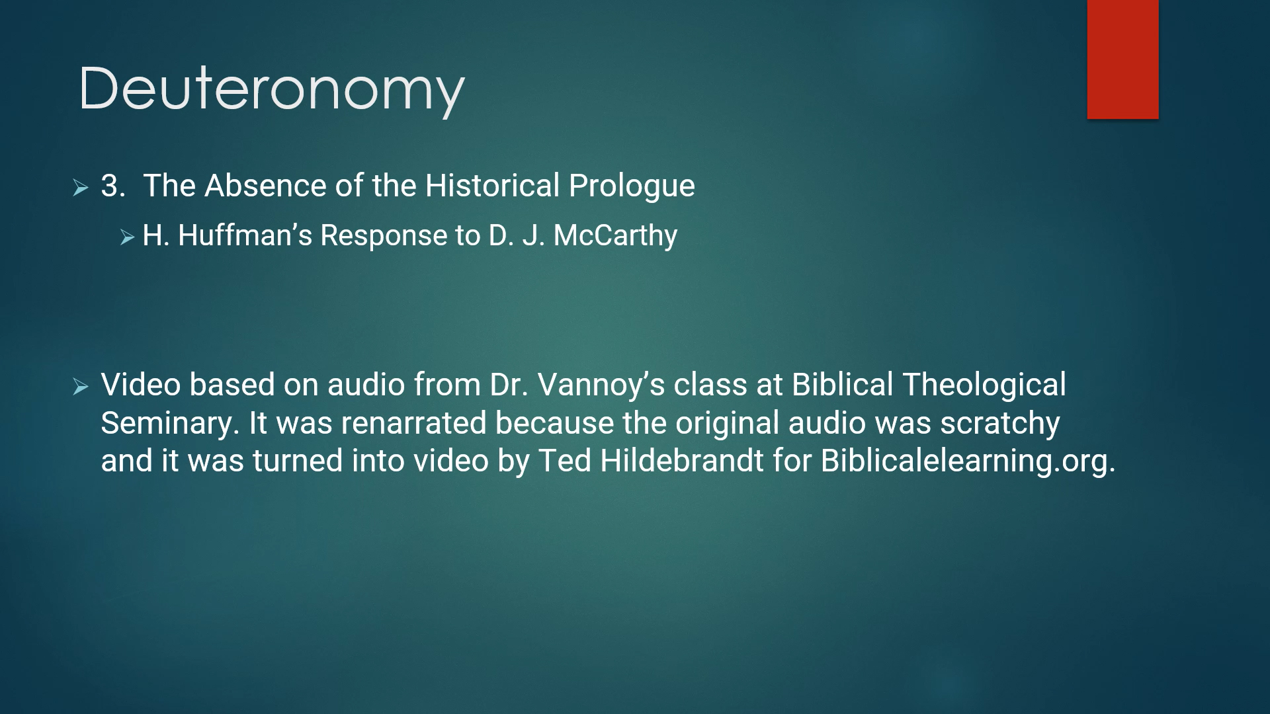
Deuteronomy
  D. The Aramaic Treaties from Sefire Compared with the Vassal Treaties
  of Esarhaddon and with the Hittite Suzerainty Treaties
    1. Introduction Remarks
    2. A Brief Survey of the Form
    3. Similarities of the Sefire Treaties of the Assyrian Treaties
    4. Basic Stipulation Missing
    5. The Conclusion on the Comparison with the Aramaic Sefire Treaties

