Slide 1
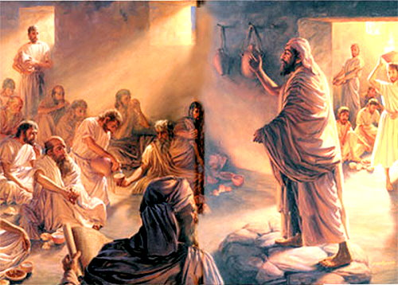
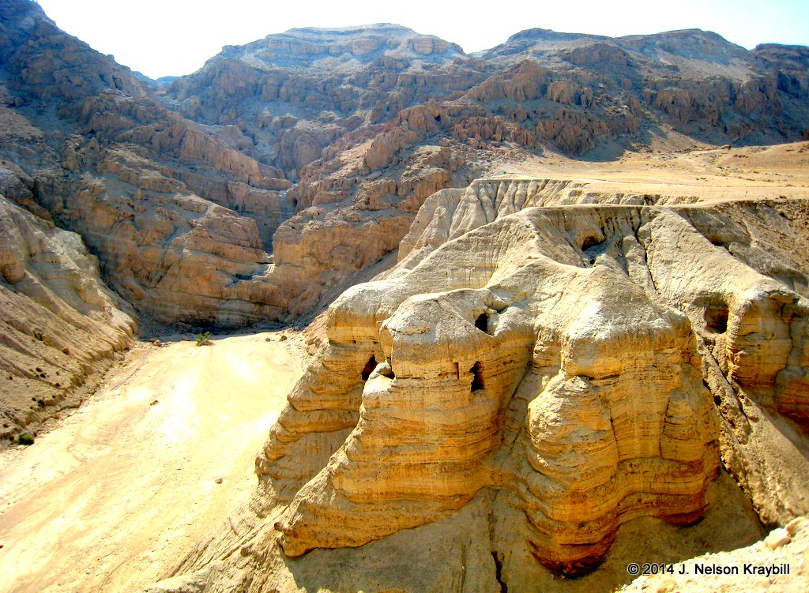
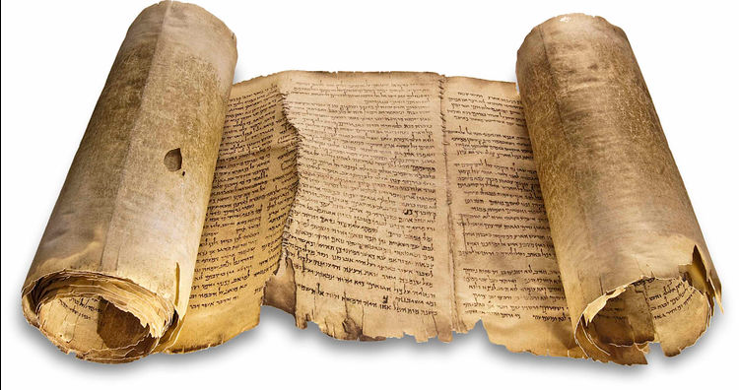
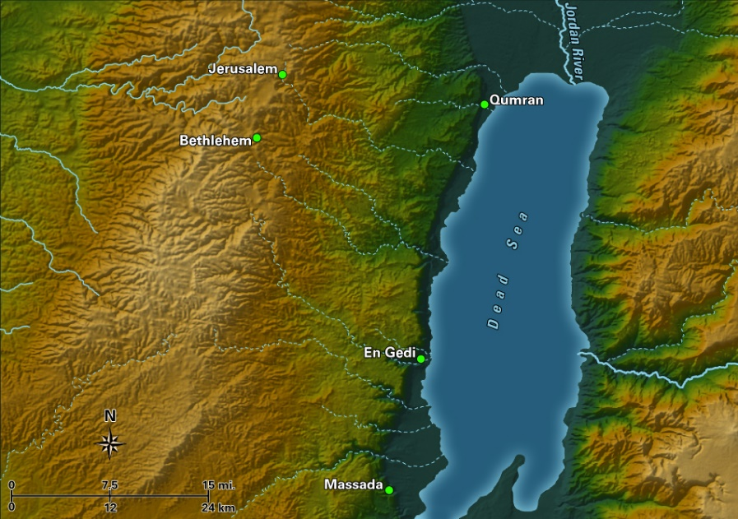
Archaeology and the Dead Sea Scrolls

Slide 2
The Dead Sea Scrolls: Some Facts
The Dead Sea Scrolls are the most important and exciting archaeological find relating to the Bible
The first DSS were probably discovered in late 1946 or early 1947 by Bedouin of the Ta’amira tribe, but medieval accounts mention scrolls found near Jericho.
The DSS scrolls originally numbered over 800 different manuscripts. Only a dozen of these were basically intact scrolls. About 200 of the corpus were biblical books, others were commentaries (pesherim), Aramaic translations (targums) and sectarian literature.
The scrolls were inscribed on goat or sheepskin, a few were papyrus and one was copper.
Despite valiant efforts by archaeologists, most of the scrolls and fragments were found by Bedouin.

Slide 3
The Importance of the Dead Sea Scrolls
The DSS provide copies of biblical books over 1000 years older than the most ancient extant copies to date (as early as 250 B.C.)
The DSS provide a window into first century B.C.-A.D. Judaism and its beliefs
The DSS show the importance of the Septuagint in biblical textual research and reveal early Jewish interpretation of Old Testament books
The DSS overwhelmingly show the amazing preservation of God’s word and disprove attempts to date some OT books (Isaiah and Daniel) late.

Slide 4
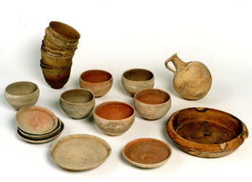
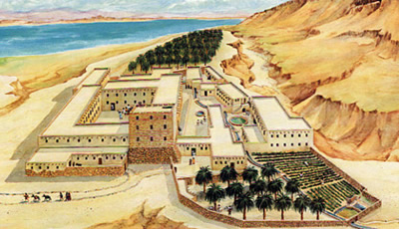
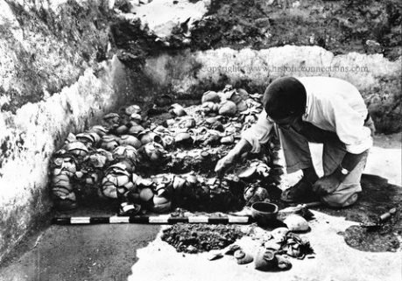
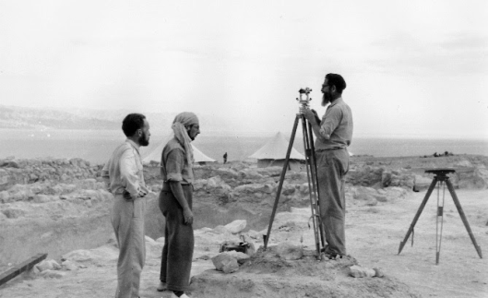
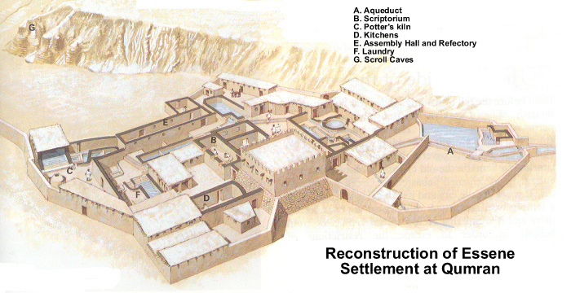
Khirbet Qumran

Slide 5
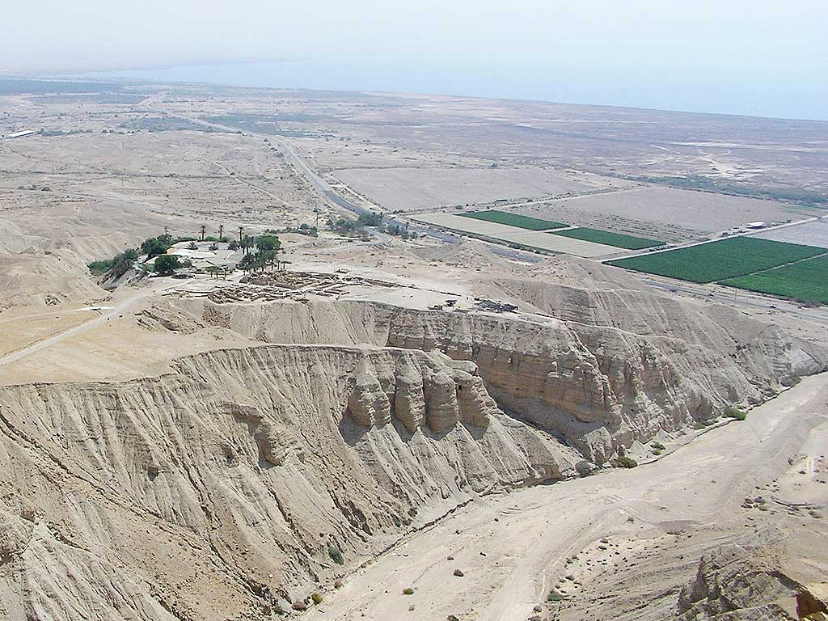
Qumran and the Dead Sea from the West

Slide 6
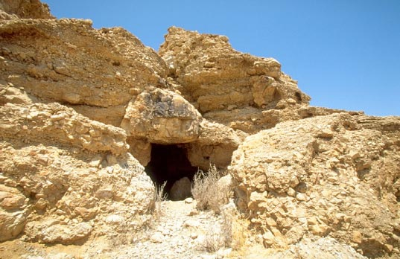
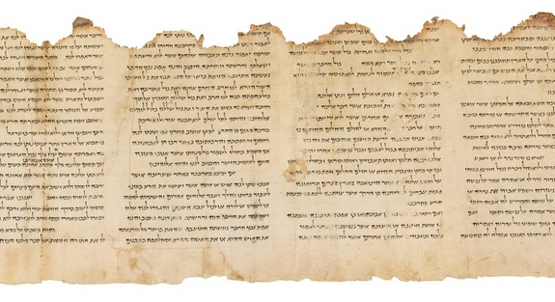
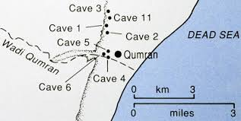
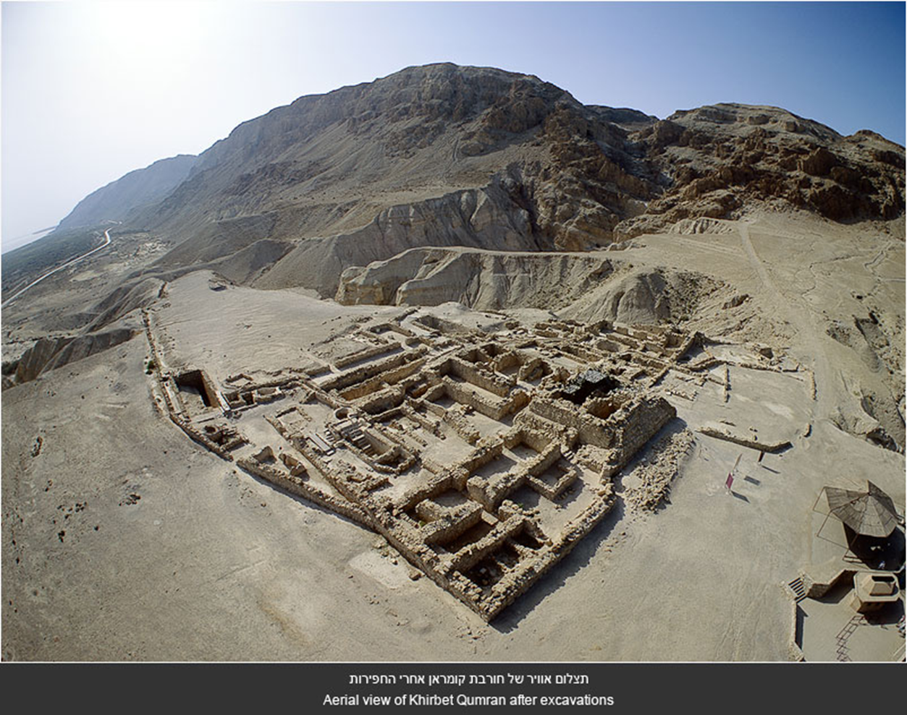
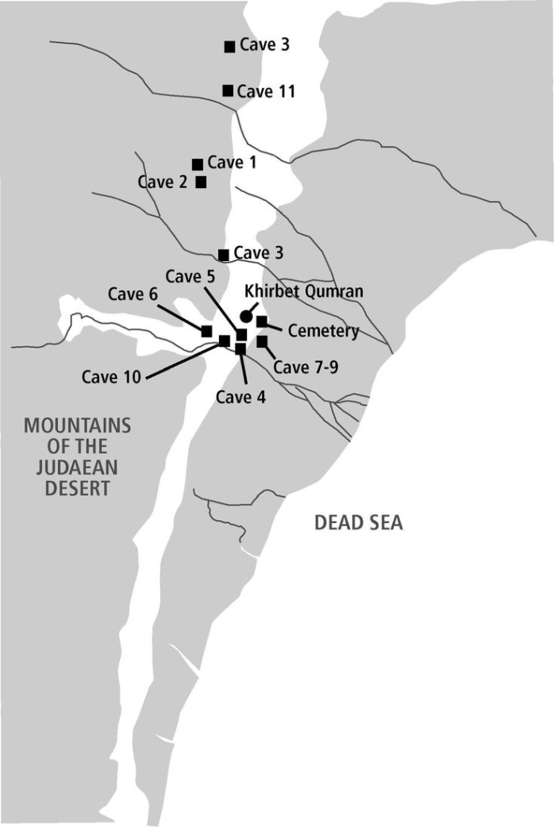
The Site of Qumran

Slide 7
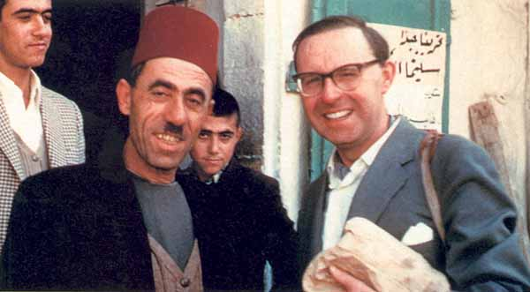
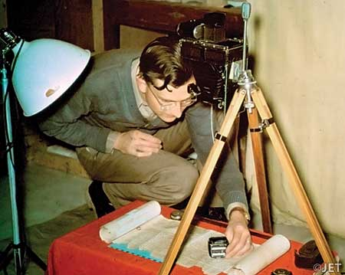
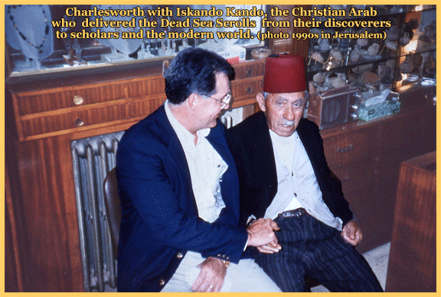
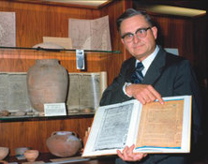
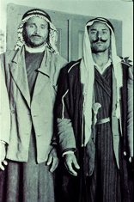
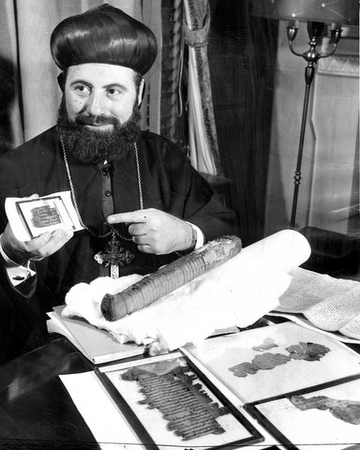
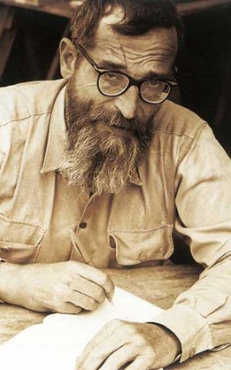
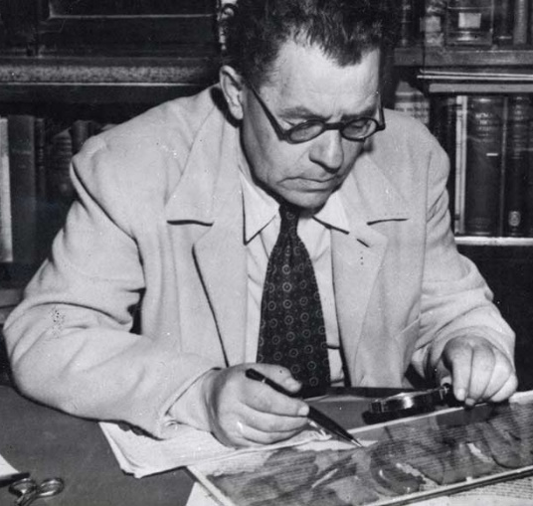
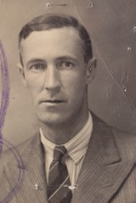
The Cast of Characters in the Dead Sea Scroll Saga
Muhammad Ahmed al-Hamed; edh-Dhib (born 1931?)
Khalil Eskander Shahin; Kando ( c. 1910-1993)
Athanasius Yeshu` Samuel (1909-1995)
John C. Trever (1915-2006)
Eliezer L. Sukenik (1889-1953)
Roland de Vaux (1903-1971)
G. Lankester Harding (1901-1979)

Slide 8
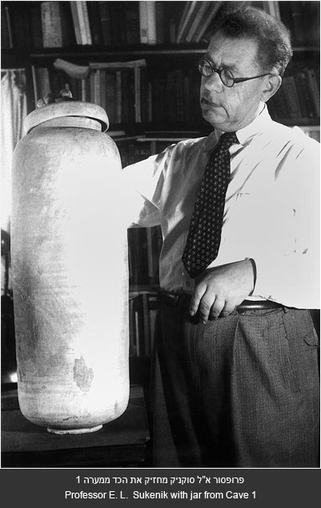
The Amazing Historical Significance of the Scrolls
“My hands shook as I started to unwrap one of them. I read a few sentences. It was written in beautiful biblical Hebrew. The language was like that of the Psalms, but the text was unknown to me. I looked and looked, and I suddenly had the feeling that I was privileged by destiny to gaze upon a Hebrew Scroll which had not been read for more than 2,000 years.”
-Eliezer Sukenik

Slide 9
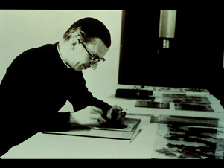
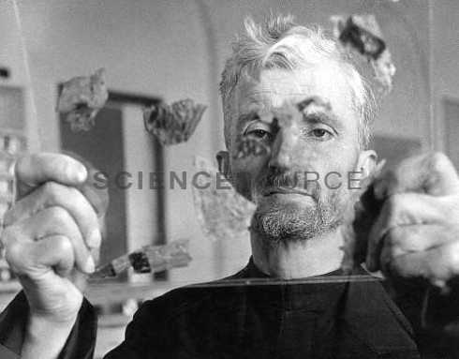
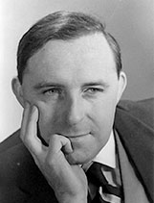
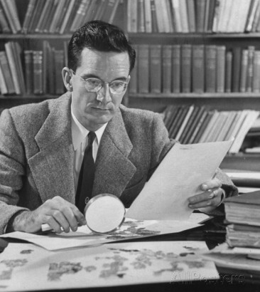
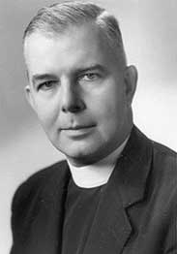
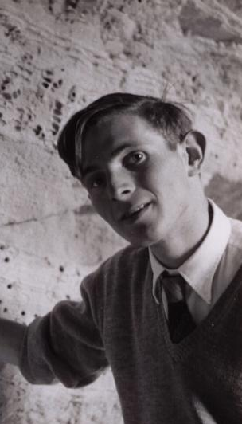
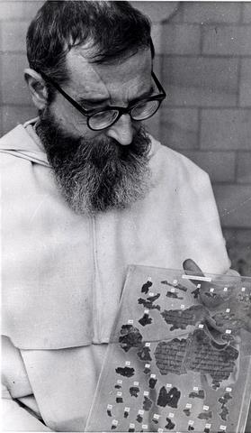
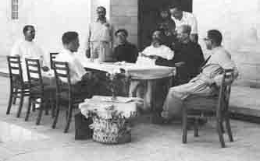
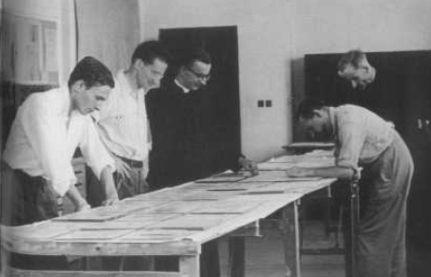
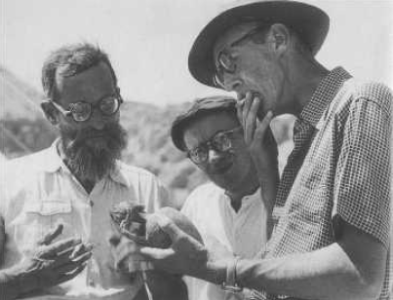
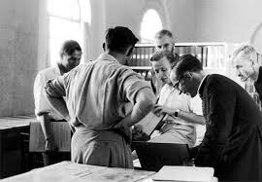
The Original DSS Publication Team
John Marco Allegro (1923-1988; England; Atheist)
Frank Moore Cross (1921-2012; United States; Protestant)
Jozef Milik (1922-2006; Poland; Catholic)
Patrick Skehan (1909-1980; United States; Catholic)
Jean Starcky (1909-1988; France; Catholic)
John Strugnell (1930-2007; England; Protestant, later Catholic)
Roland de Vaux (1903-1971; France; Catholic)

Slide 10
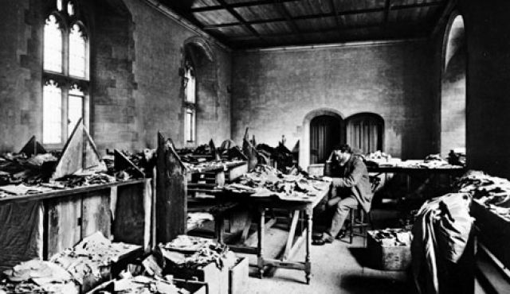
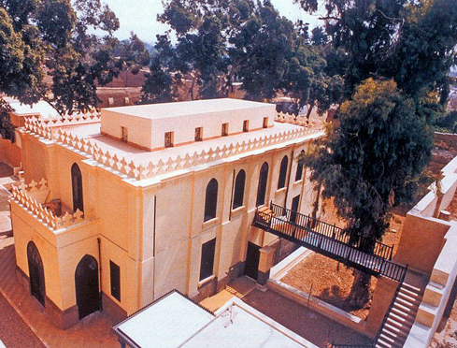
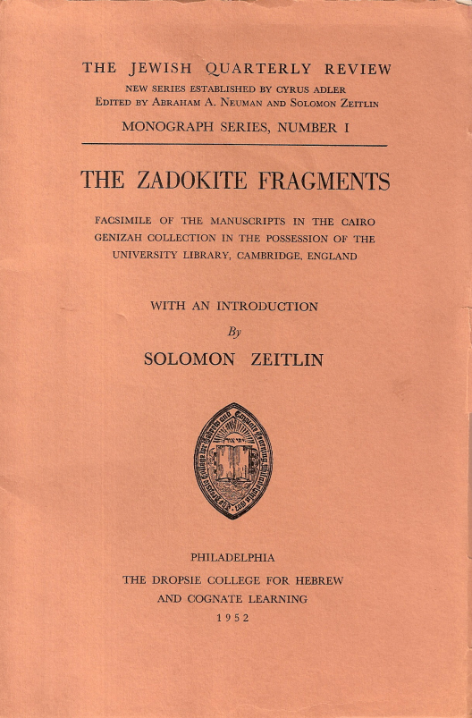
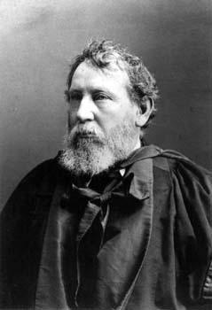
Solomon Schechter (1847-1915)
The “Damascus Document”: A DSS found in 1897 in Cairo’s 1,000 year old Ben Ezra Synagogue’s Genizah, along with 140,000 other scrolls. Called an unknown Zadokite work by Solomon Schechter, a reader in Talmud at Cambridge, fragments of two copies were recovered.
Schechter recognized that the texts were copies of a much earlier work dating to the NT period written in biblical Hebrew by a group of Jews that separated themselves from Judaism and saw themselves as the true Israel, led by priests called the Sons of Zadok. The fragments quoted other unknown works that Schechter surmised included a “manual of rules or discipline.” Ten copies of this Zadokite work were found among the DSS and copies of the lost work that Schechter envisioned were also found.

Slide 11
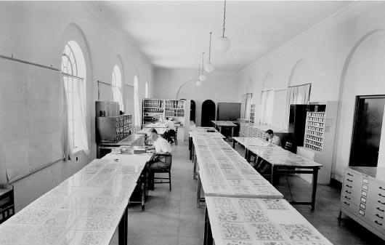
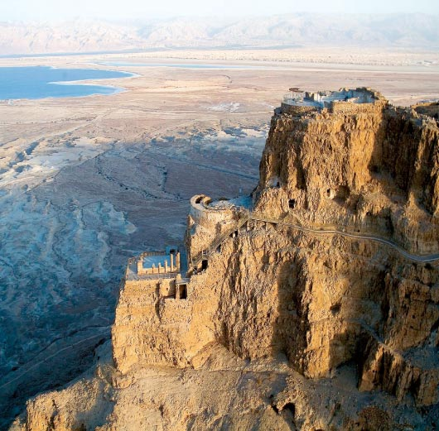
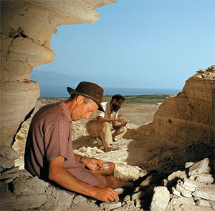
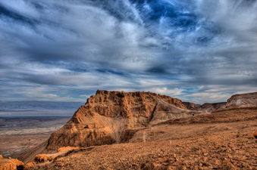
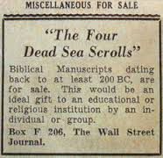
Acquiring the Scrolls

Slide 12
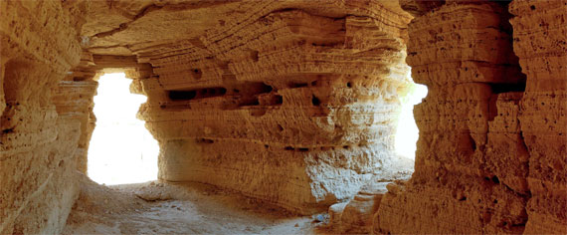
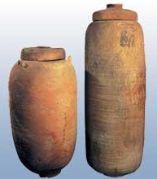
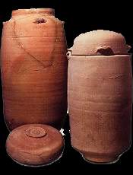
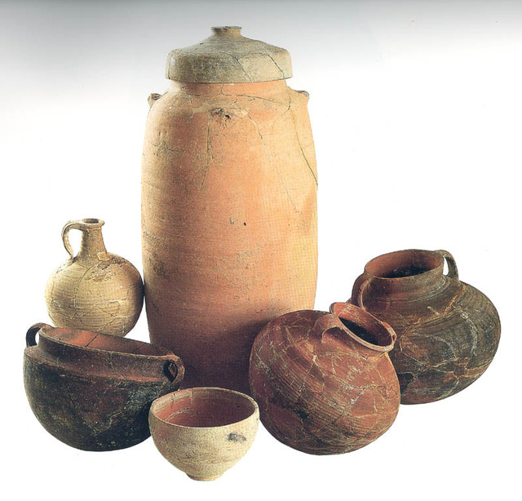
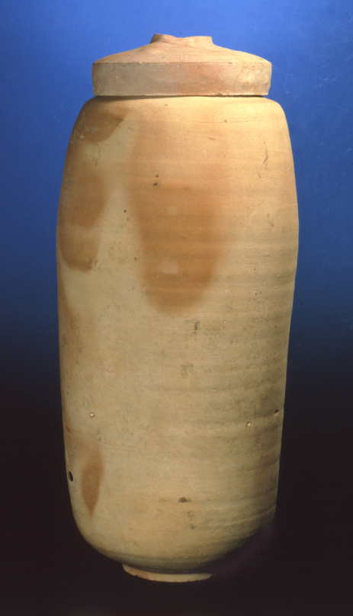

The Scroll Jars and Pottery

Slide 13
Questions about the Dead Sea Scrolls
Which Jewish sect wrote / copied and assembled such an immense library of scrolls and from where did it originate?
Who is the Teacher of Righteousness (moreh zedek) and the Wicked Priest in the scrolls?
What, if any, connections are there between the DSS community and early Christianity?
What was the purpose of Khirbet Qumran and its relationship to the scrolls?
Why were the scrolls hidden in the caves?
Are there more scrolls to be found, both near Qumran and in private collections?

Slide 14


The Essenes
A devout Jewish sect that lived a communal life, asceticism, daily immersion in water and poverty. Their faith included mysticism and eschatological beliefs with a messianic fervor. Noted by Josephus and Pliny the Elder, who noted that the Essenes did not marry and had no money. New members were admitted to the community or yahad only after completing a 3 year probationary period.

Slide 15




Christian Connections?
André Dupont-Sommer (1900-1983): A French orientalist, Dupont-Sommer was the first to suggest a connection between “primitive” Christianity and the scrolls.
The Galilean Master . . . appears in many respects as an astonishing reincarnation of [the Teacher of Righteousness in the scrolls]. Like the latter, He preached penitence, poverty, humility, love of one's neighbor, chastity. Like him, He prescribed the observance of the law of Moses, the whole Law, but the Law finished and perfected, thanks to His own revelations. Like him, He was the Elect and Messiah of God, the Messiah redeemer of the world. Like him, He was the object of the hostility of the priests.... Like him He was condemned and put to death. Like him He pronounced judgment on Jerusalem, which was taken and destroyed by the Romans for having put Him to death. Like him, at the end of time, He will be the supreme judge. Like him, He founded a Church whose adherents fervently awaited his glorious return.
Edmund Wilson (1895-1972): Wrote a series of articles on the scrolls from 1951-1954 as installments in the New Yorker magazine.
The monastery [at Qumran], this structure of stone that endures, between the waters and precipitous cliffs, with its oven and its inkwells, its mill and its cesspool, its constellations of sacred fonts and the unadorned graves of its dead, is perhaps, more than Bethlehem or Nazareth, the cradle of Christianity.

Slide 16












Interpreting Khirbet Qumran
An Essene monastery with five ritual pools (miqva’ot), a scriptorium, ink wells, refectory, an over 1,200 person cemetery with mostly male burials and the testimony of Pliny the Elder.
A “Villa Rustica” with luxury goods, a tricliniuim and ornate column bases
A Hasmonean fortress with a tower and glacis and later a Herodian administrative center with over 1,200 coins

Slide 17

The Qumran Tower
Robert Cargill: UCLA

Slide 18






The Scrolls
Biblical books: All Old Testament books are attested except for Esther (some of them only in a fragment or two)
Commentaries, and translations: Habakkuk scroll, Genesis Apocryphon
Sectarian literature: Rule of the Community 4QMMT, War Scroll
The Copper Scroll: An inventory of treasure from 63-64 locations around Jerusalem and the Judean Desert. The treasure weighs in the tons. The date and purpose of this scroll is widely debated.
The Temple Scroll: Longest DSS and the last one recovered: It describes an idealized Temple that was never built and is written in the form of a revelation from God to Moses reworking biblical texts from Exodus 34 and Deuteronomy 23. It gives detailed instructions and regulations about sacrifices and practices. It implies that these instructions of Moses were either lost or overlooked when Solomon built the Temple.

