Slide 1
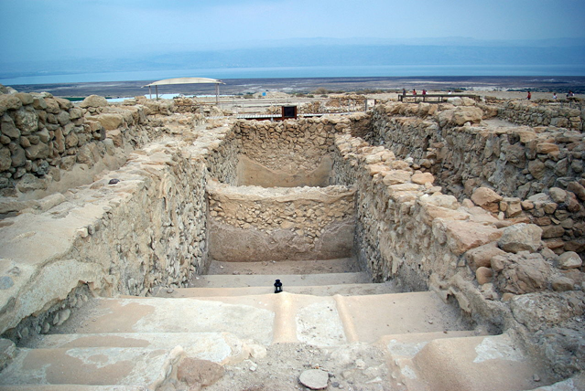

Slide 2
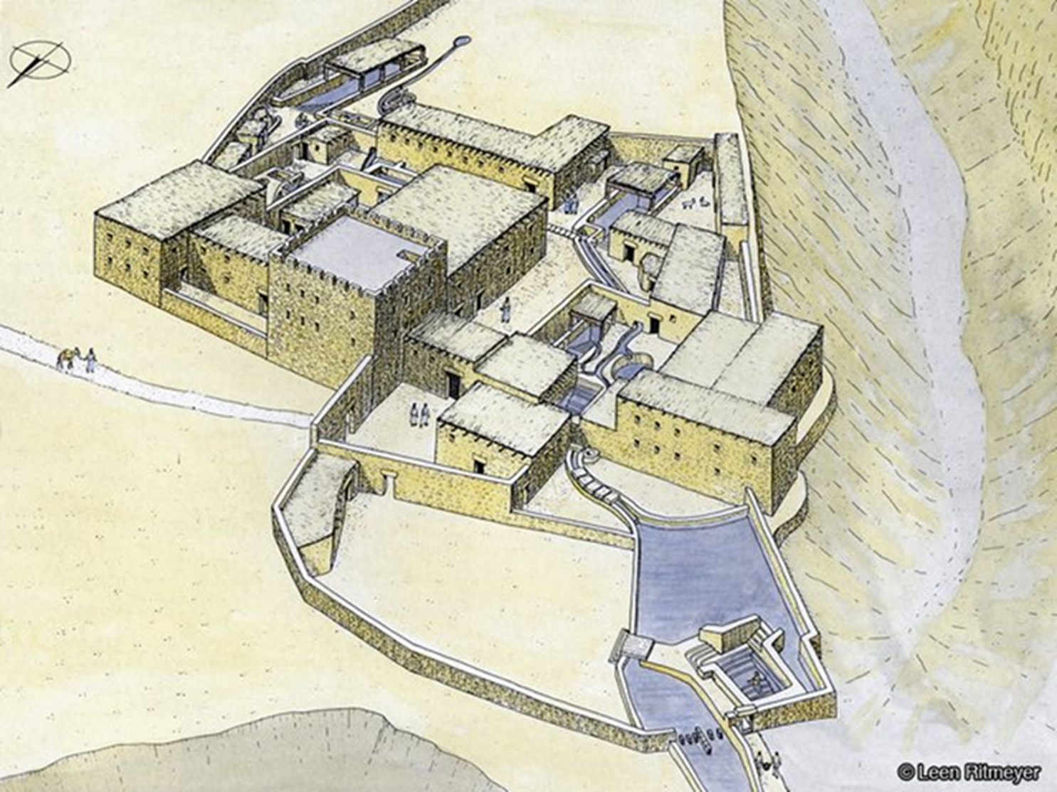
Qumran in Context: Isolated Religious Settlement, Patrician Villa or fortified border outpost?
Is Khirbet Qumran related or linked to the scrolls found in nearby caves?
The common sense response would be YES!
Both the caves and Qumran were occupied at the same time
Many of the caves bearing manuscripts are adjacent to the Qumran
The same distinctive pottery jars recovered from Cave 1 were also found at Qumran
Evidence of scribal activity, pottery producton and religious-communal living exist at Qumran, including 10 miqvaot.
The Testimony of Pliny the Elder in his Natural History, writes that the Essenes (a conservative Jewish sect) lived on the west side of the Dead Sea and that below them “infra hos” was En Gedi
The sectarian literature among the scrolls admirably fits what we know about the Essenes

Slide 3
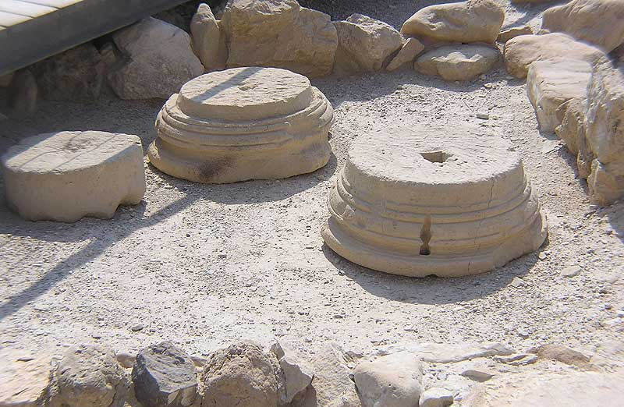
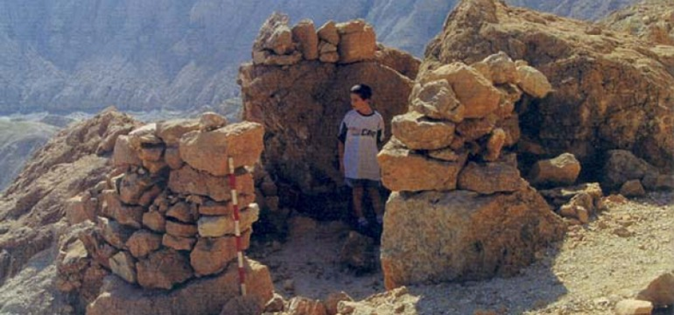
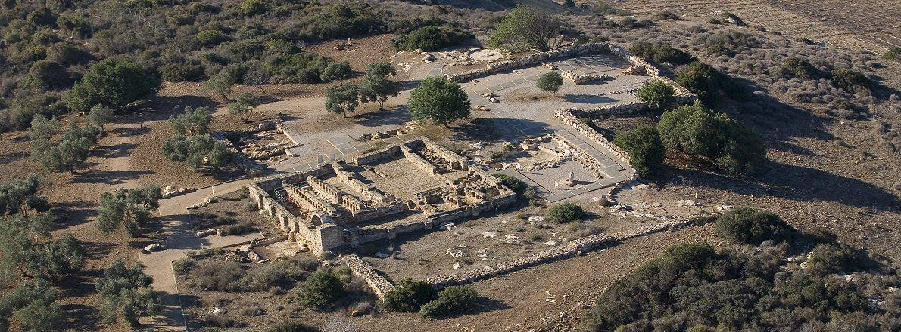
Qumran as a A Villa Rustica
Proposed by Robert Donceel and Pauline Donceel-Voûte, this view suffers from many drawbacks
An almost complete absence of interior decoration on plaster or other surfaces, aside from two column bases
A proposed cenacle (triclinium) for the Scriptorium cannot be sustained
No prospects for agriculture exist at the site, nor a reliable source of water
Nearby Palm groves do not need maintenance
Floor plan of rooms do not fit villas found elsewhere in Judea

Slide 4
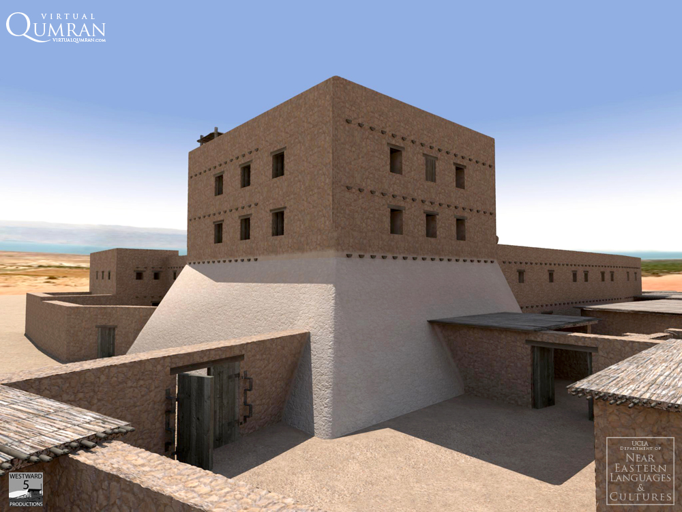
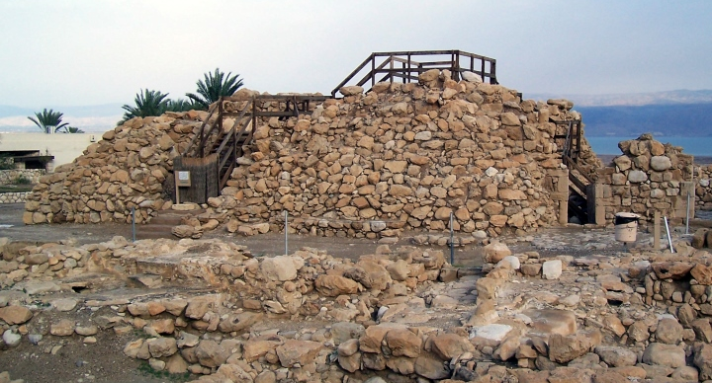
Qumran as a Fortress or Caravanserai
Proposed by Norman Golb, this theory also has shortcomings:
Aside from the tower, the walls of Qumran are rather flimsy and their width (60-70 cm) show them as clearly not military in nature
No fortified gateway was discovered, just entrance openings in the wall
During the NT period, Qumran did not occupy a strategically important position or guard an important road
The lack of scrolls and scroll fragments at the compound is expected. However several ink wells attest to scribal activity beyond that of a garrisoned military post
The cemetery’s 1200 graves were not casualties of war against Rome
Topographical problems for both a fort and caravanserai
No evidence of stables or fireplaces

Slide 5
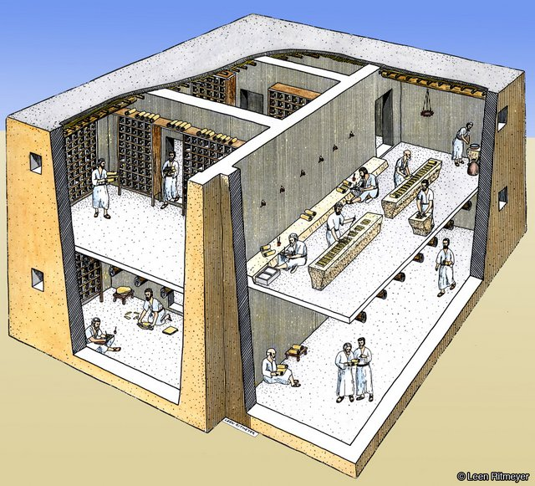
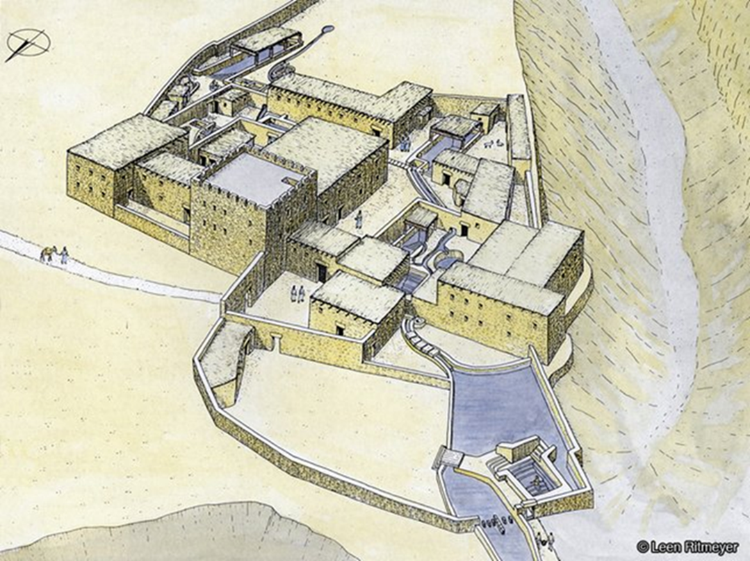
The “Scriptorium” or Manuscript Production Center at Qumran
A two story structure at the east edge of the compound may have served as the library and scribal center of Qumran

Slide 6
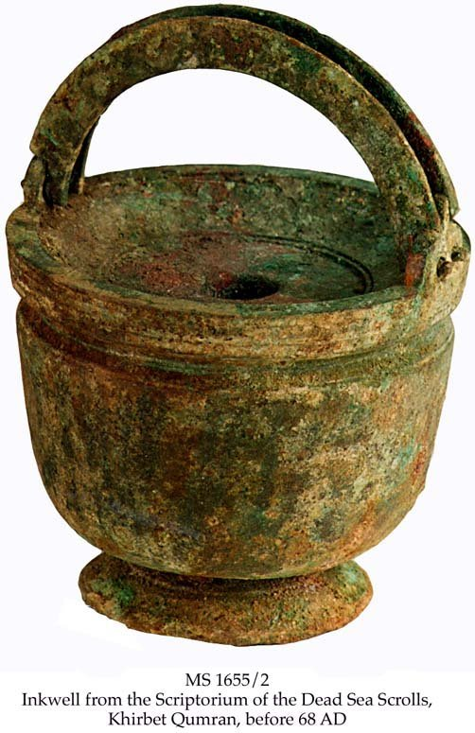
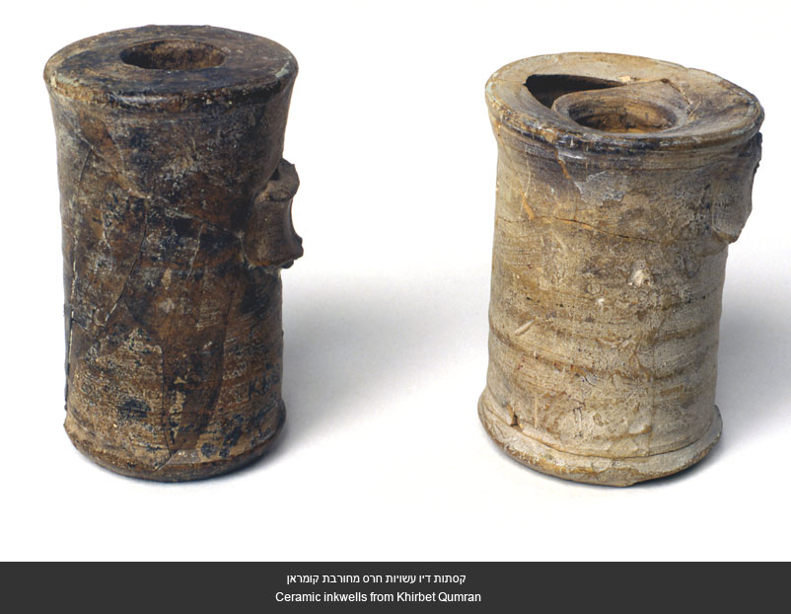
The Finds from the Scriptorium
Several inkwells (terracotta and bronze) were recovered from the debris of this building. Dried ink was still present inside.
Also, remnants of long, narrow plastered tables were found. Both low and high versions, these tables that may have been used for the production and copying of scrolls. It is quite probable that this was the scribal and studying area of the community at Qumran.

Slide 7
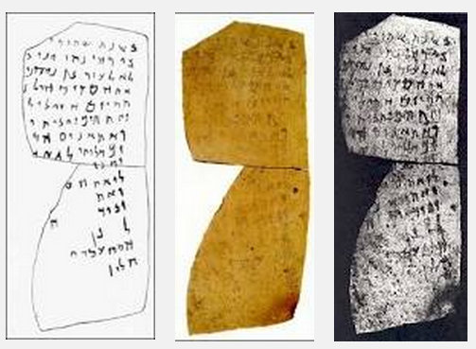
The Qumran Ostracon: A Key to the Solution?
Discovered in 1996 by James Strange along the limestone terrace at the edge of the settlement along a boundary wall
Dated to 50-68 by FMC and Esther Eshel
Perhaps a note relating to an individual joining the community or “Yahad”
Disputed by Ada Yardeni, who has a different reading for the crucial line 8 “and every other tree…”
The script doesn’t seem to match the skilled scribal hands that copied the Dead Sea Scrolls
Has this ostracon, one of only two found thus far at the site, been overinterpreted?
“In year two of… in Jericho, Honi, son of … gave to ‘Eleazar son of Nahamani… Hisday from Holon… from this day to perpetui[ty] and the boundaries of the house and… the fig trees, the o[live trees, and] when he completes (his oath) to the Community…(fragmentary additions).”

Slide 8
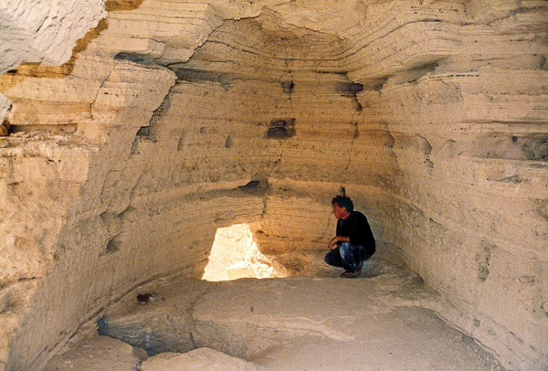
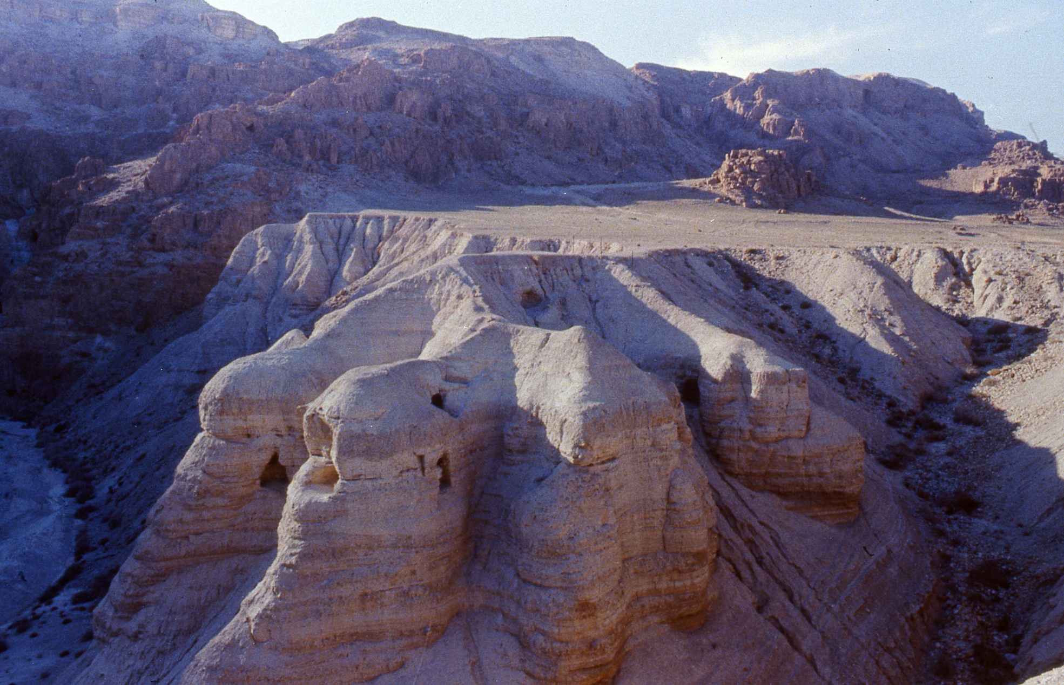
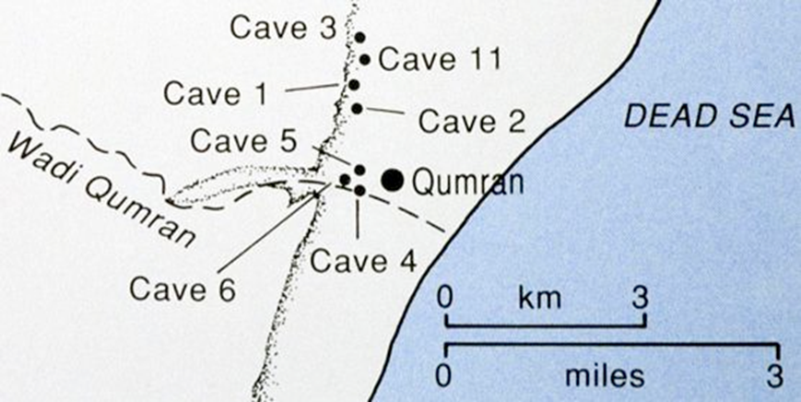
The “Discovery” of Cave 4: The Mother Lode
Discovered by Bedouin in late summer 1952, who excavated 80-90% of the contents before detection.
Harding and de Vaux began excavating the cave in September, recovering fragments of hundreds of scrolls, phylacteries and bits of LXX and paleo Hebrew documents.
Cave 4 was clearly a emergency Geniza for the Qumran library and the hundreds of scrolls were probably thrown into the cave in haste, without jars to protect them.
Cave 4 was a tomb during the occupation of Qumran in the eighth-sixth centuries BC!

Slide 9
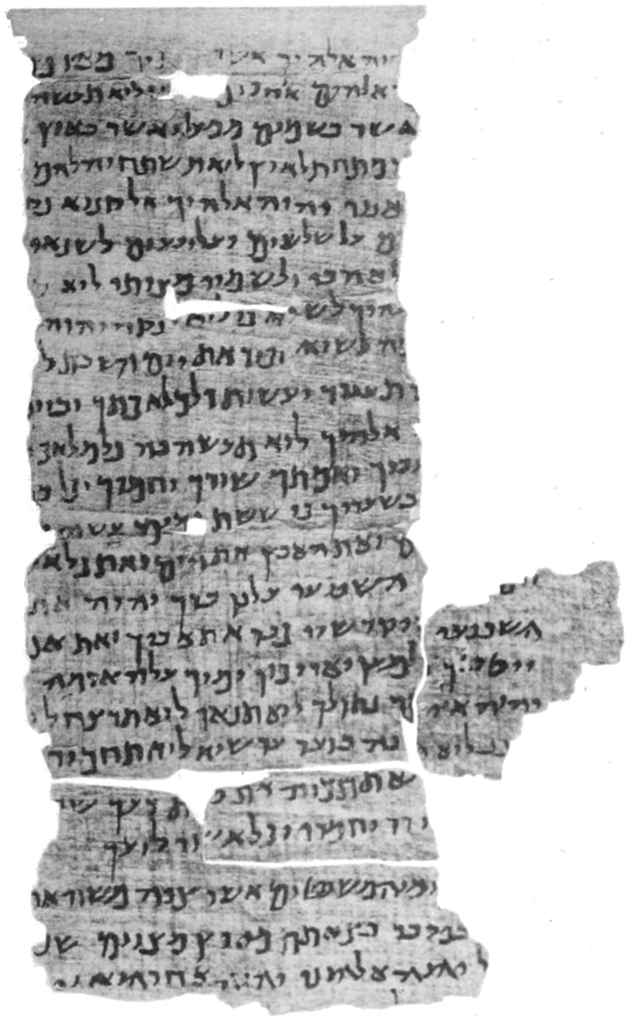
The Significance of the DSS and the Nash Papyrus
A piece of papyrus originating in the Fayyum area of Egypt came to light in 1893 and was sent to Cambridge University
The writing is a slightly abbreviated form of the Ten Commandments and the Shema (Exodus 20, Deuteronomy 5 and 6:4) that omits a phrase.
The dating of this document was fixed at 150-100 BC and was the oldest text of Scripture known until the DSS.
W. F. Albright: "A Biblical Fragment from the Maccabean Age: The Nash Papyrus." Journal of Biblical Literature 56 (1937): 145-176.

Slide 11
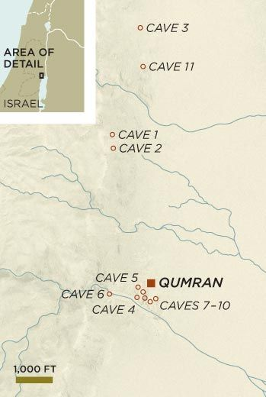
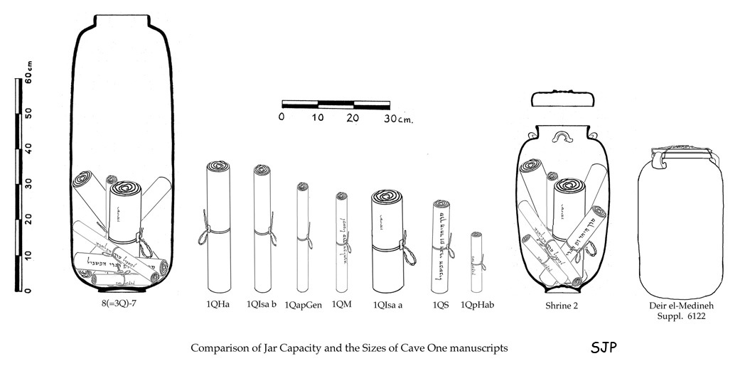
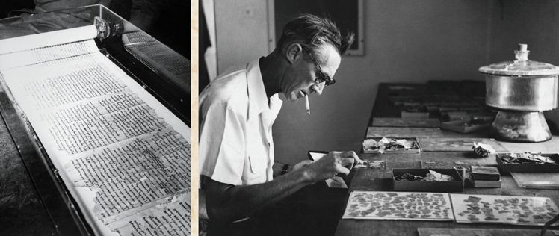

Slide 12
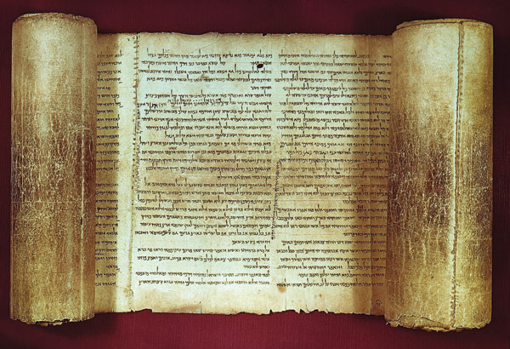
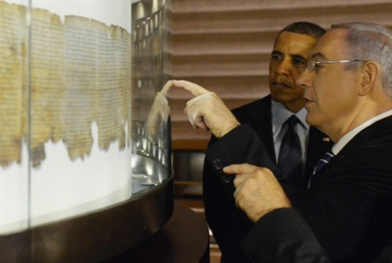
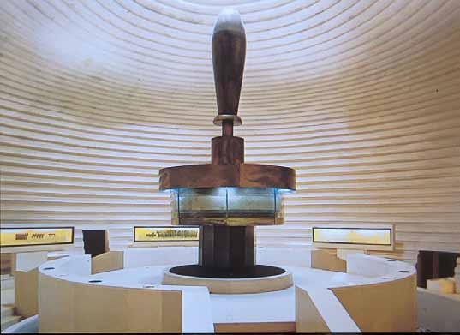
The Great Isaiah Scroll (1QIsaª

