Slide 1
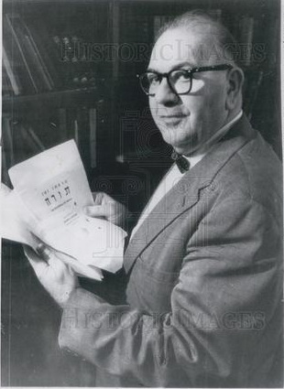
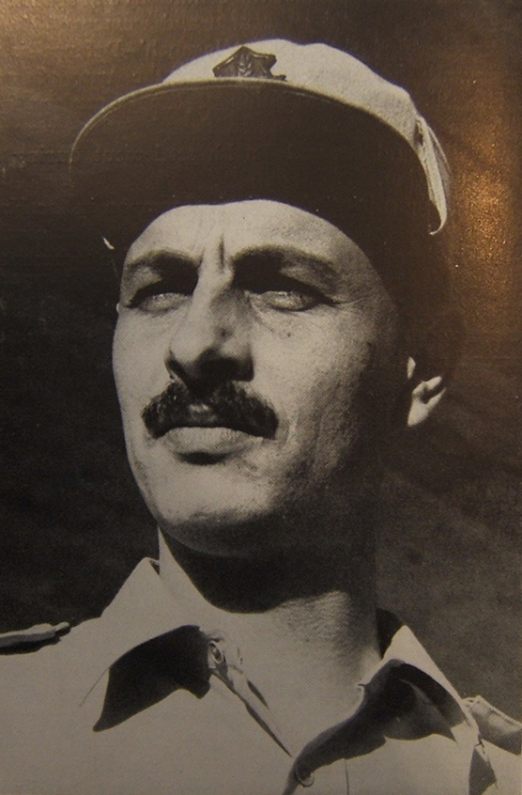
The Sale of the other Four Cave 1 Scrolls to Israel via the Wall Street Journal

Slide 2
The Israeli Expeditions to the Dead Sea
Difficulties related to the new border (1948-1967) for Israel
Reports of Bedouin looting contents of caves in Jordan and Israel
Discoveries in the Wadi Murabba’at (11 miles south of Qumran) from two caves. The name of Shimon Bar Kosiba (Bar Kokhba) was first found.
Occupied during the Chalcolithic, Middle Bronze, and Iron Ages, as well as the Roman period (first-second centuries, AD) by refugees or brigands hiding from authorities.
A survey of Nahal Hever showed Bedouin activity at even the remotest of caves (1953-1955), but materials from the Chalcolithic and Roman periods were found.
The recent testimony of a member of this team
New document appear on the antiquities market in 1959 from the Israeli side of the border! A full expedition is organized and launched.

Slide 3
The Israeli Team and their Discoveries
David Ben-Gurion and General Haim Laskov urge a comprehensive archaeological “offensive” to discover caves yet untouched by the Bedouin.
Joseph Aviram (IES) organized the expedition
Nahal ‘Arugot: (Yigael Yadin)
Nahal Hever: (Yadin and Pesach Bar Adon); Bar Kokhba archive and finds
Nahal Mishmar: (Bar Adon and Yohanan Aharoni); Cache of Chalcolithic finds
Hahal Se’elim: Near Masada. Caves had produced arrowheads and documents (Aharoni and Nahman Avigad)
Helicopter surveys utilized
Access and logistics are extremely difficult

Slide 4
The Race for more Scrolls
Captain Akkash Al Zeben of the Jordanian Arab Legion led an expedition to the area of the discovery and located the cave (Qumran Cave 1).
G. Lancaster Harding of the Jordanian Department of Antiquities organized an archaeological expedition to search for more caves and to excavate the nearby ruins of Khirbet Qumran, led by the Dominican Father Roland de Vaux of the Ecole Biblique et Archéologique in Jerusalem.
The Israelis organized a large expedition under the leadership of Joseph Aviram of four major wadi systems on the Israeli side of the border (Nahal Arugot, Nahal Hever, Nahal Mishmar and the Nahal Seelim led by Yigael Yadin, Pesach Bar Adon, Yohanan Aharoni and Nahman Avigad.
The Bedouin, realizing the financial rewards additional scrolls could bring them, also began a systematic search throughout the region. They were far more successful than the archaeologists.

Slide 5
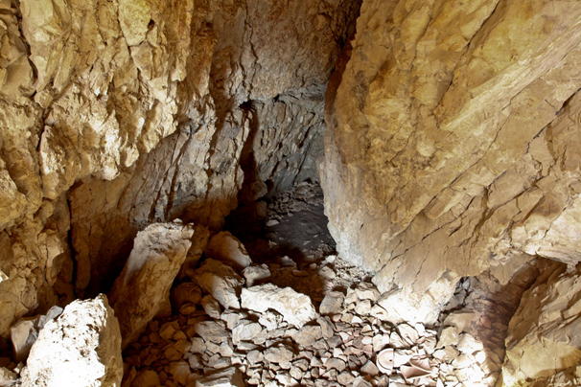
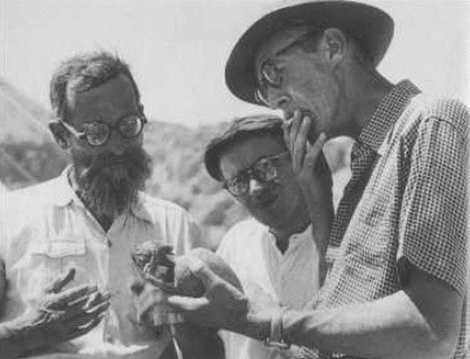
The Excavation of Khirbet Qumran
After Cave 1 was identified, excavations of the cave floor (carried out in February-March 1949) revealed fragments from approximately 70 documents and two of the seven original scrolls.
A joint effort to explore all of the caves in the cliffs west of the Dead Sea was carried out in March, 1952. Soundings were made in over 200 caves. 25 produced pottery similar to Cave 1 and Khirbet Qumran.
G. Lankester Harding and Roland de Vaux decided to make soundings at the ruins of Qumran (.6 mile south of Cave 1) in November-December 1951 to find connections with the manuscript finds. In all, five seasons of excavations at the site were carried out through 1956. Later excavations were done in the 1990’s and 2000’s.

Slide 6
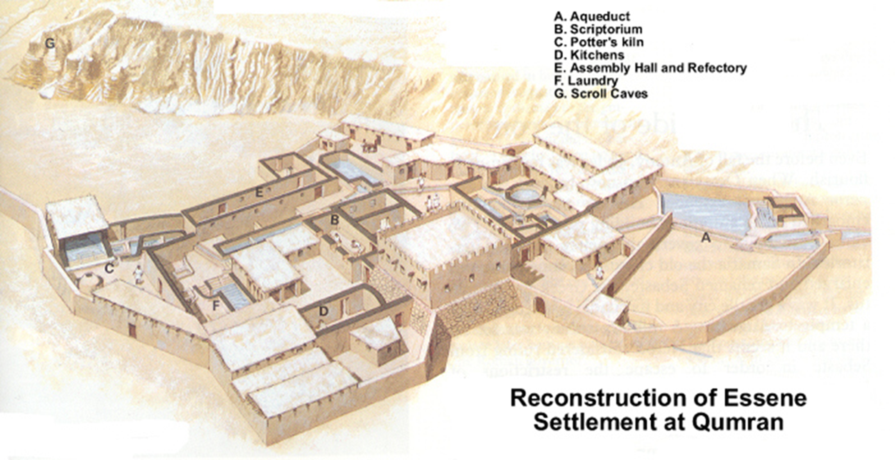
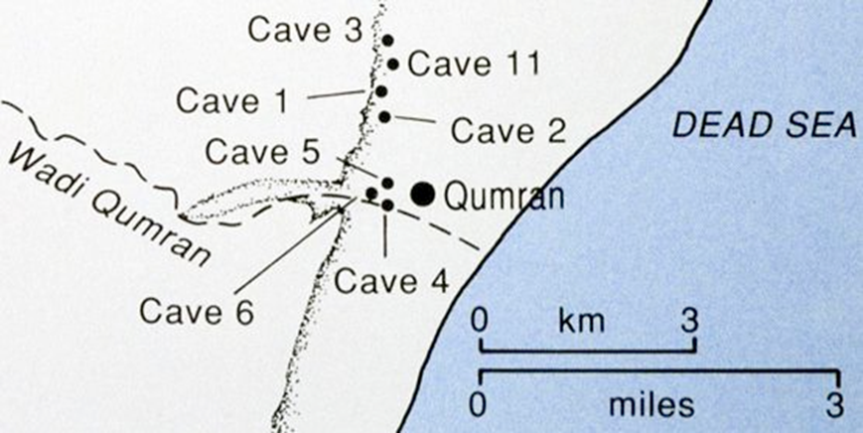
The Site and Interpretation of Khirbet Qumran
The physical and topographical setting of Qumran atop a marl terrace overlooking the Dead Sea
The Road System around the site in antiquity
Early Explorers:
Loius de Saulcy (1850-51) erroneously called the site “Goumran” and mistakenly identified Qumran with Gomorrah
Henry Tristram (1850’s) missed the site, but visited Ein Feshka
Charles Clermont-Ganneau (1874) explored a vast cemetery of over 1000 graves next to the ruins at the site.
Gustaf Dalman (1914) noted water channels and thought the site was a fortress (burg).
The site has been identified with one of the towns listed in Joshua 15:61-62, most probably Secacah

Slide 7
The History of Khirbet Qumran and Its Features
Ca. 900-586 BC: A Fortified Border Post and village is established at Qumran by the Kingdom of Judah (Joshua 15:61; 2 Chronicles 26:9-10)
Ca. 125 BC: A Jewish religious sect or dissidents reoccupy, rebuild and expand Qumran upon the ruins of the earlier compound-village
Members of the sect construct halls, workshops and meeting rooms as well as an elaborate system of water channels, cisterns and ritual baths (miqvaot) and the population expands significantly during the reign of Alexander Jannaeus (103-76 BC)
A massive earthquake in 31 BC heavily damaged the Qumran compound and forced its abandonment until the turn of the era
Ca. 4 B.C.-AD 68: Qumran is reoccupied by the same sect until the Roman army approaches. The site is abandoned

Slide 8
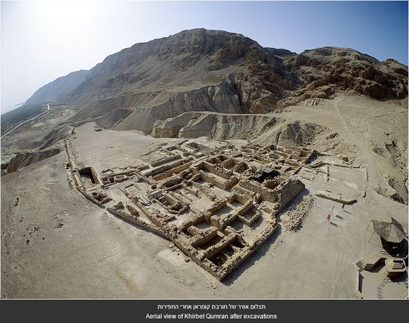
Aerial Views, Photos and Archaeological Reconstructions of the site of Khirbet Qumran

Slide 10
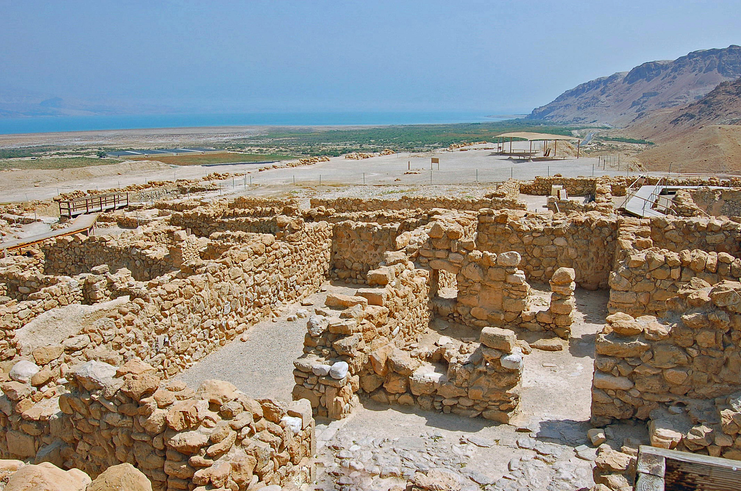

Slide 11
