Slide 1
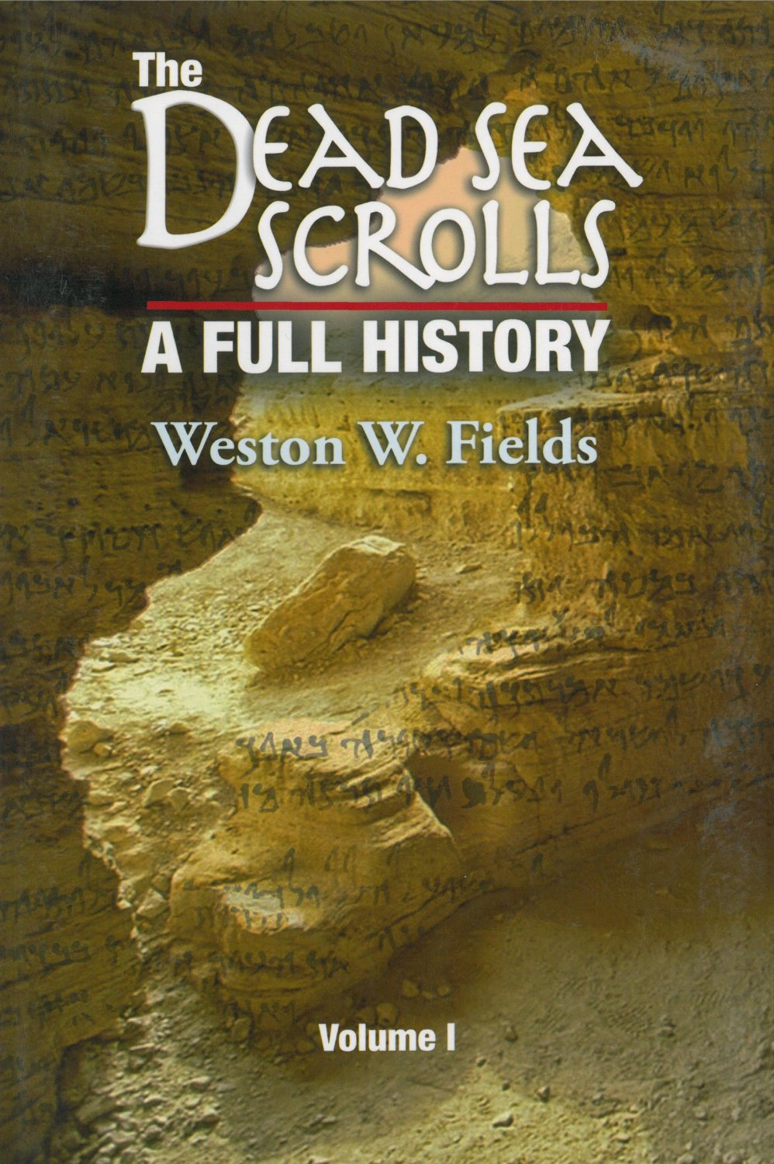
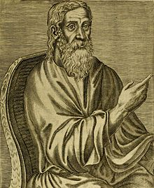
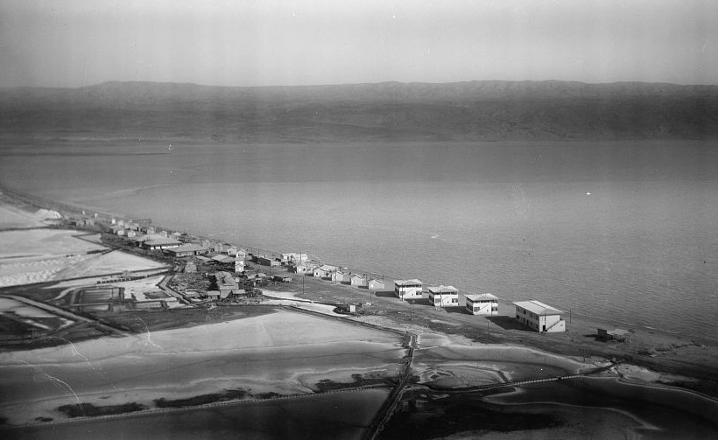
Possible (very) Early Dead Sea Scrolls Discoveries?
Origen (ca. 185-254) reported the discovery of an ancient manuscript “together with other Hebrew and Greek books in a jar near Jericho.”
Timotheus, Patriarch of Seleucia (780-823): learned from trustworthy Jews that some books were found some years ago in a rock dwelling near Jericho after a hunter followed his dog into a cave and found a chamber containing many books. Jews from Jerusalem investigated and found book of the Old Testament and others in Hebrew script.
Yakub al-Qirqasani (ca. 950) was a historian of the Jewish sect of the Karaites, described the doctrines of a Jewish group called the maghariyah “Cave People” that he claimed were contained in books hidden in a cave
Dead Sea Potash Works (1930’s view): Local Bedouin (the Ta’amireh) sold antiquities (coins and pottery) to the workers at this settlement on the northern shore of the Dead Sea and offered to take them to see caves that contained “books from the time of your kings” for a few piasters more.

Slide 2
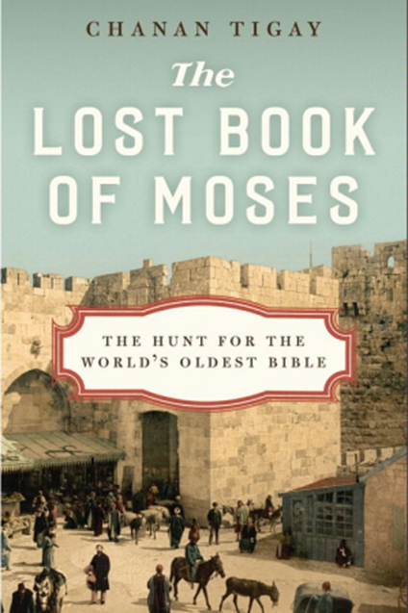
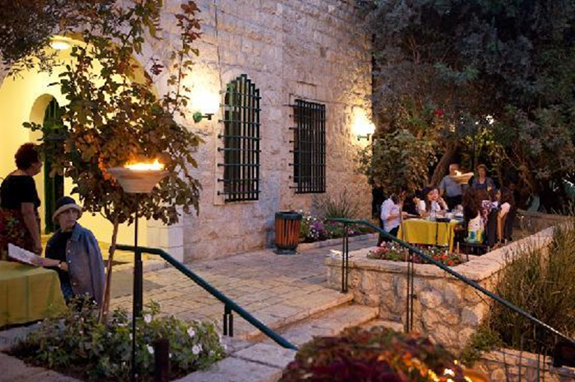
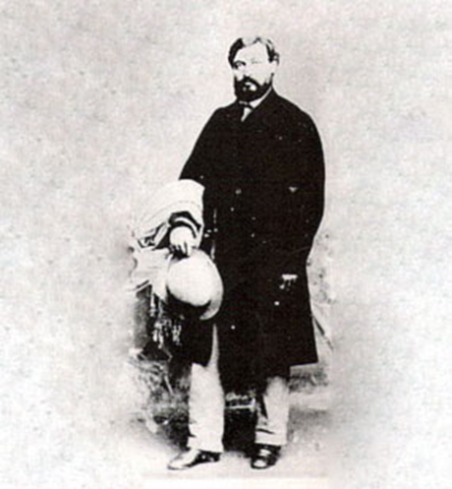
The Saga of Moses Wilhelm Shapira (1830-1884)
A successful Jewish antiquities dealer in Jerusalem with many clients, including museums in Europe. Purchased a lovely stone house along Jaffa Road in Jerusalem, known today as the Ticoh House.
Claimed to have found leather strips containing part of the book of the biblical book of Deuteronomy found near the eastern shore of the Dead Sea
Offered his leather strips to the British Museum for one million pounds sterling as the oldest copy of Deuteronomy dating to ca. 850 BC.
After their exhibition in London, the leather strips were claimed as a forgery by two biblical scholars and Shapira later commits suicide in Rotterdam in 1884.
The leather strips are documented until the 1890’s then they disappear.

Slide 3
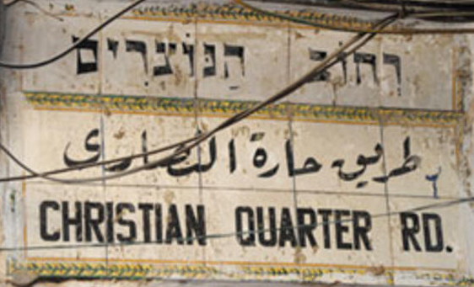
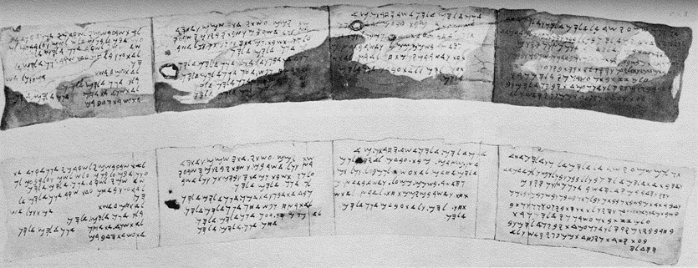
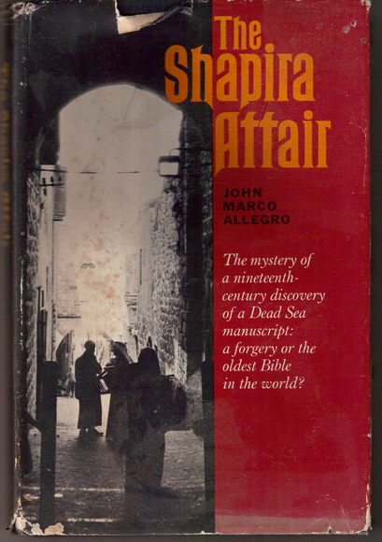
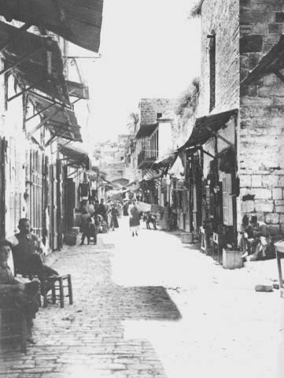
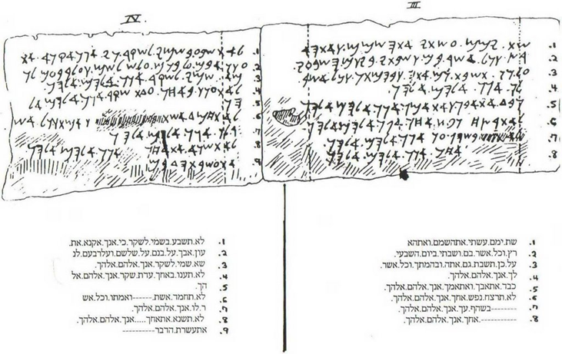
Authentic Dead Sea Scrolls Discoveries?
Hand drawn “facsimiles” of the Deuteronomy strips (ca. 1883), extant photos merely show dark, worn leather and no letters.

Slide 4
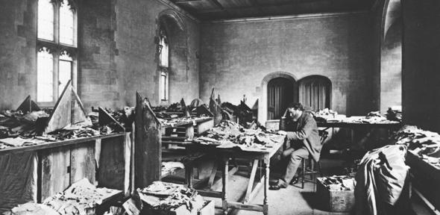
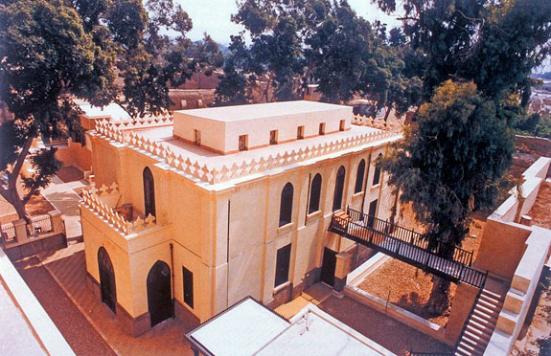
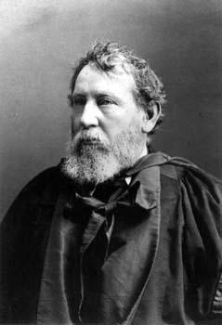
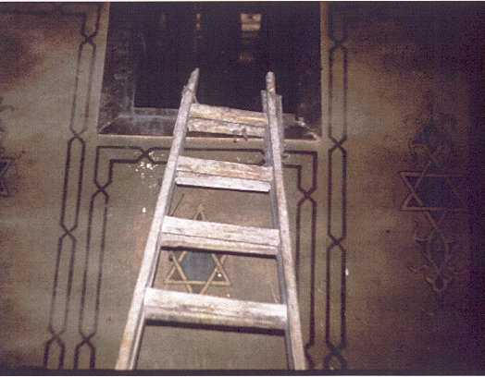
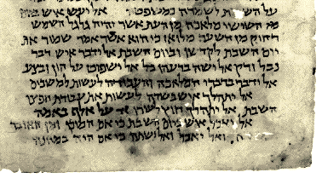
The Geniza at the Ibn Ezra Synagogue in Cairo and Solomon Schechter (1847-1915) “Fragments of a Zadokite Work”
Medieval Jewish scrolls appearing in Cairo’s suq were traced to a geniza at the Ibn Ezra synagogue.
1896, Solomon Schechter is allowed to examine this geniza and removes 30 bags of manuscripts to Cambridge for study
Schechter focuses on two fragments of a work copied from a much more ancient source that contained the teachings of an extinct Jewish sect called the Sons of Zadok that existed around the first century BC and led by a figure known as the Teacher of Righteousness. Another copy of this work was later found with the first group of the Dead Sea Scrolls in 1947-48 and called the Damascus Document.

Slide 5
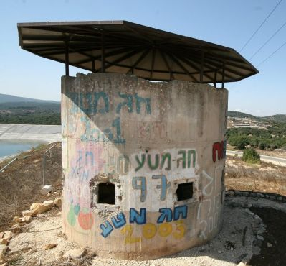
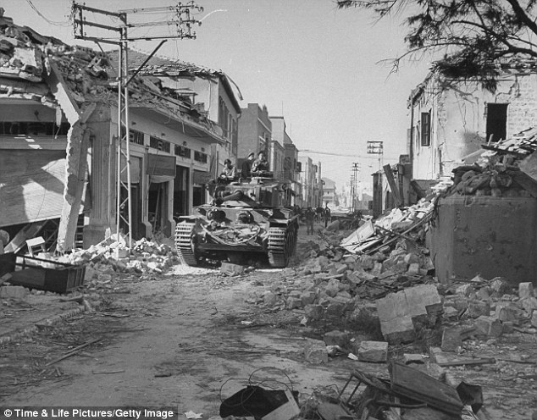
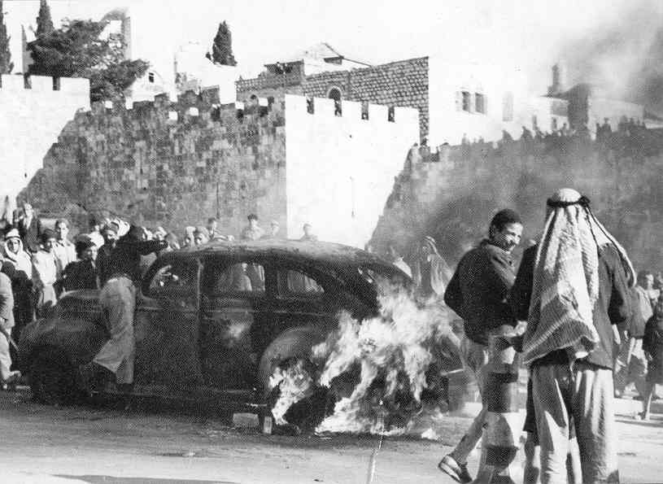
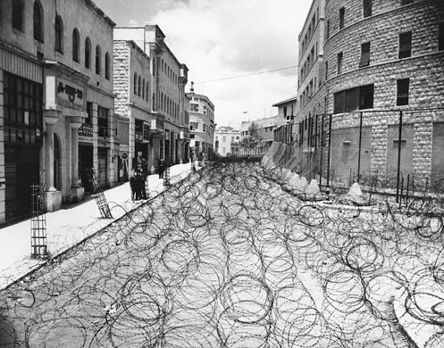
How Were the Dead Sea Scrolls Found? The Historical Context
Images of Violence during the Waning Years of the British Mandate in Palestine (1946-1948)

Slide 6
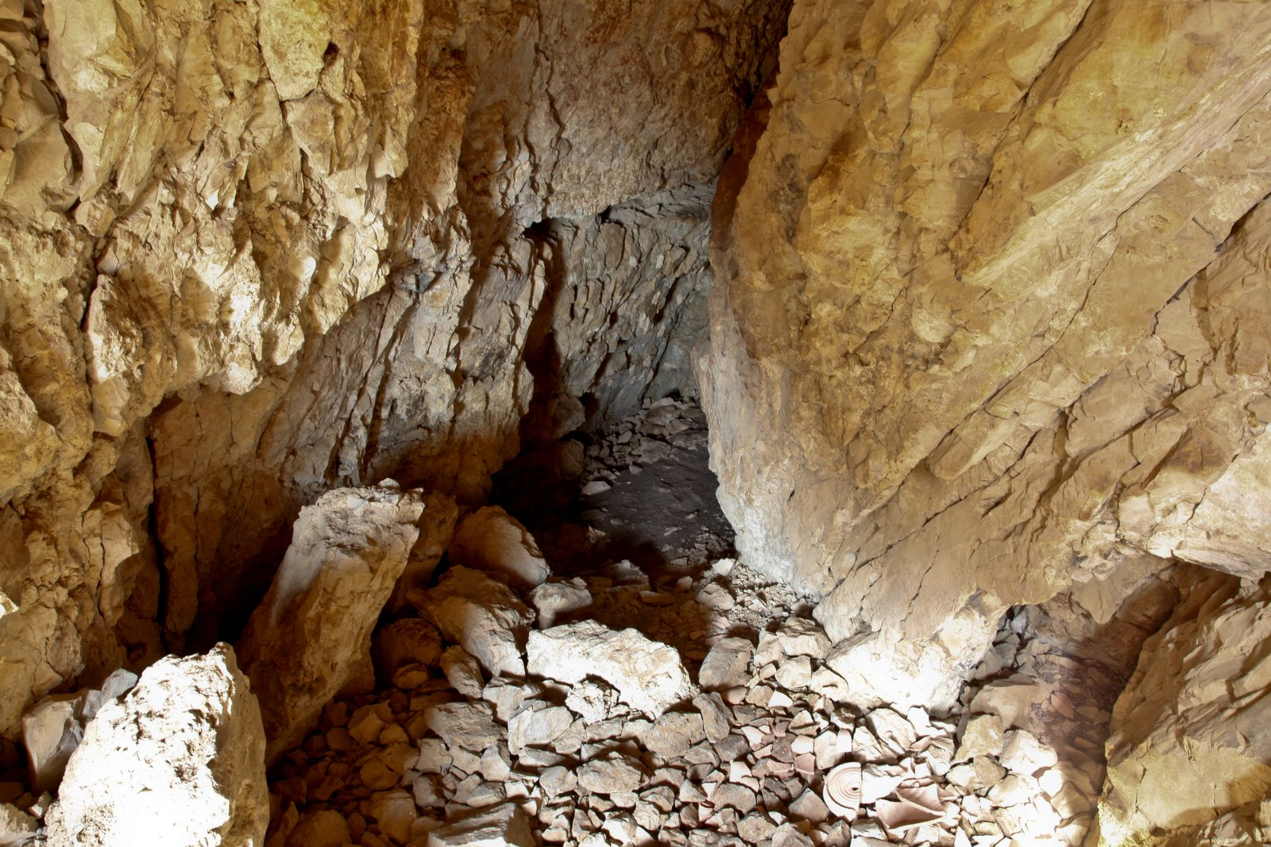
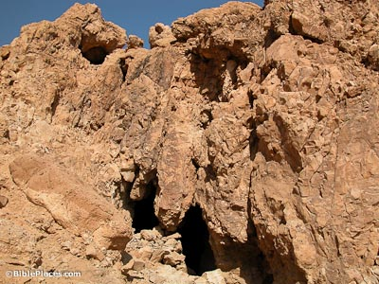
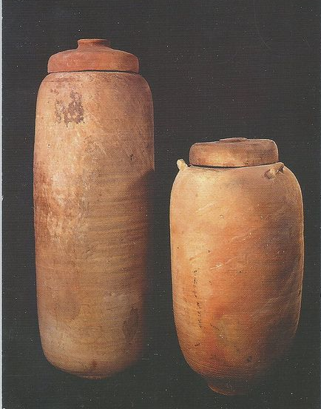
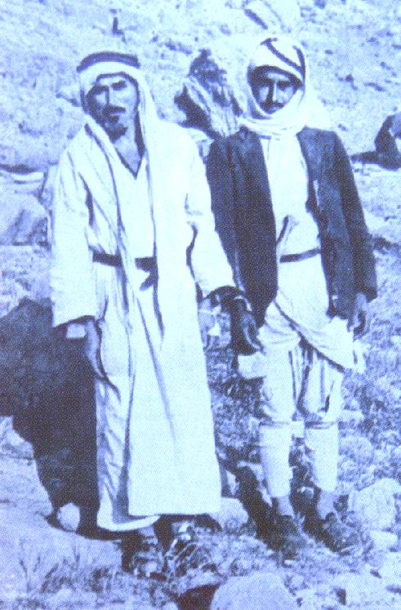
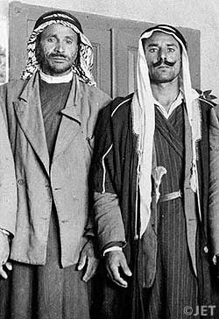
The Initial Discovery by the Ta’amireh Bedouin
The dates and location: the winter of 1946-1947 (or perhaps earlier) along the cliffs overlooking the north western coast of the Dead Sea near the ancient ruins of Qumran.
Muhammad Ahmad el-Hamed (edh-Dhib) discovered ancient scrolls in jars inside a cave while searching for a lost sheep
The identity of the actual person(s) is disputed, as is every detail of the story, that has been told often

Slide 7
Chronology of Discovery
Initial discovery of three scrolls by two or three Ta’amirah Bedouin in winter 1946-1947 and possibly even earlier, due to seasonal grazing patterns of their flocks. The scrolls were hung in a sack from a tent pole for several weeks.
The Bedouin brought the scrolls to Bethlehem where they were shown to shopkeepers that dealt in antiquities to ascertain their value. They were then recognized as Hebrew manuscripts.
George Isaiah (Shaya), a shopkeeper, was convinced the scrolls were genuine and referred the Bedouin to Khalil Iskandar Shahin (Kando). Kando took the scrolls, gave a five pound advance and brought them to Mar Athanasius Yeshue Samuel of the Syrian Orthodox Church and an amateur manuscript enthusiast, at Saint Mark’s Church in the Armenian Quarter of Jerusalem. He bought them on the spot for 24 pounds ($100) and the deal was made in late summer, 1947.
Samuel attempted to get expert opinions about his scrolls. No one took him or the scrolls, seriously!

Slide 8
Chronology of Discovery II
Samuel even traveled with the scrolls to Homs, Syria, where his ecclesiastical patriarch dismissed them as well.
Kando dispatched Shaya to find more scrolls and, with the Bedouin as guides, four more scrolls were retrieved from the cave. Three of these were sold to another dealer in Bethlehem for $30 and two of the jars they were found in went for 75 cents apiece.
Nasri Ohan, a shopkeeper in Jerusalem, acted as the selling agent for these three scrolls and contacted Eliezer Sukenik of Hebrew University. He traveled on a bus to Bethlehem on the very day the UN voted for the partition of Palestine.
Sukenik was able to buy the three scrolls offered by Ohan for Hebrew University, consisting of a poorly preserved scroll of Isaiah and two sectarian scrolls: The War of the Sons of Darkness against the Sons of Light and the Thanksgiving Scroll.

Slide 9
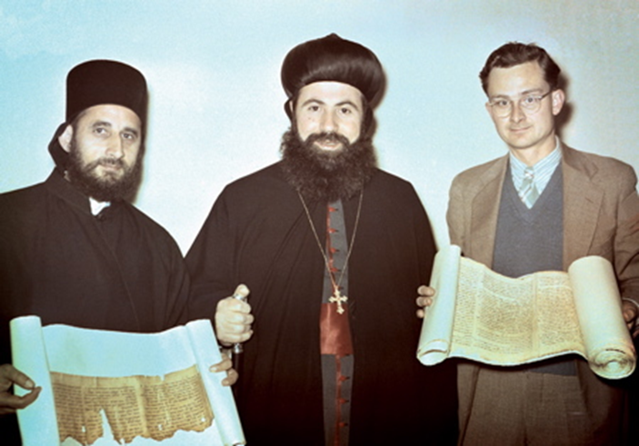
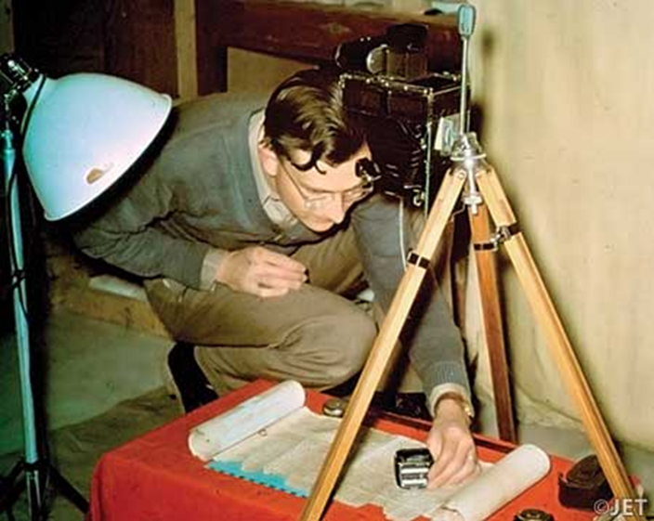
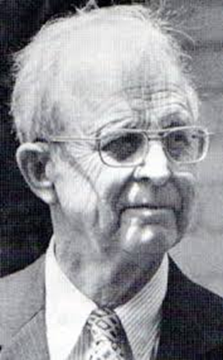
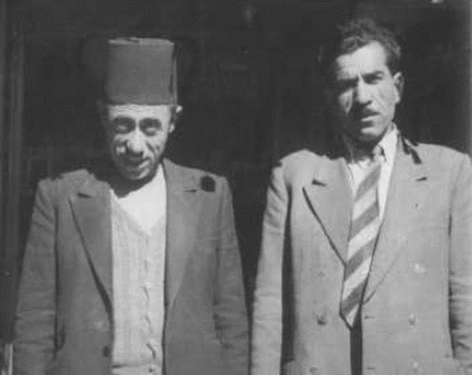
The Players in the Dead Sea Scrolls Account
William H. Brownlee (1917-1983)
Athanasius Yeshue Samuel (1909-1995)
Khalil Iskandar Shahin (ca. 1910-1993)
George Isaiah
John C. Trever (1915-2006): Trever is photographing a Dead Sea Scroll in the basement of the American School in Jerusalem in 1948 . This photo captures one of the greatest moments in modern biblical scholarship

Slide 10
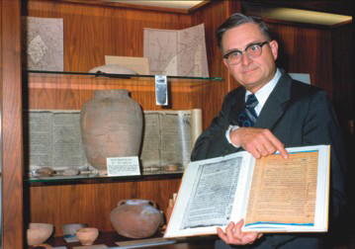
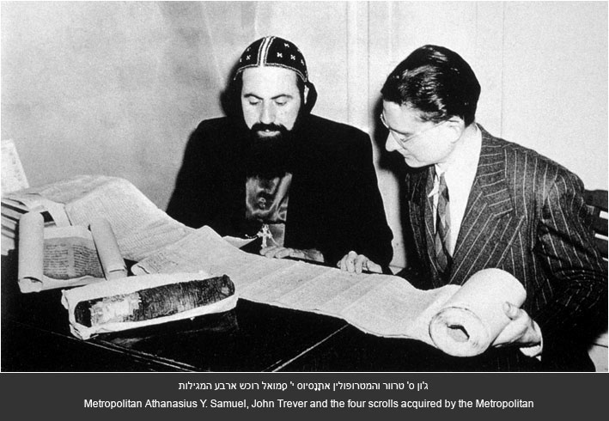
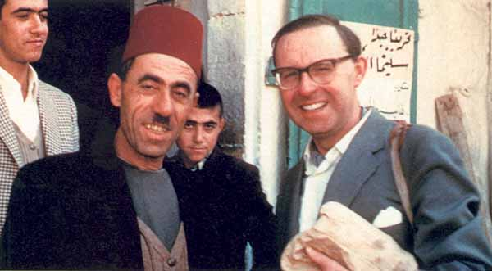
More Images of the People and Events from 1948: John C. Trever at Claremont Graduate School with his famous book of DSS photos, “Kando” with John Allegro outside of his Bethlehem shop, and the Metropolitan Samuel with John Trever: The scroll they are handling is the great Isaiah scroll. The Genesis Apocryphon and the Habakkuk commentary are to the side.

Slide 11
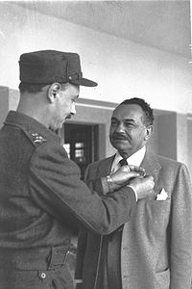
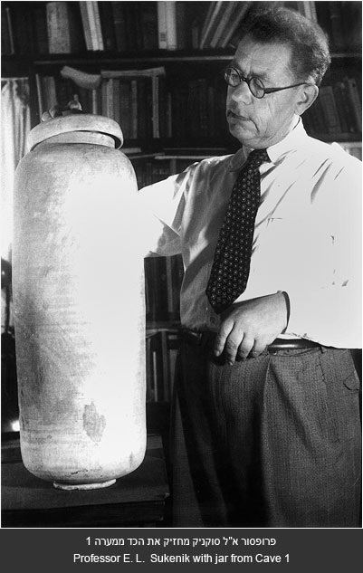
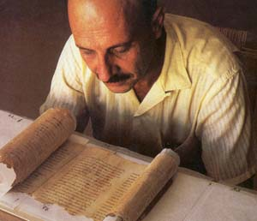
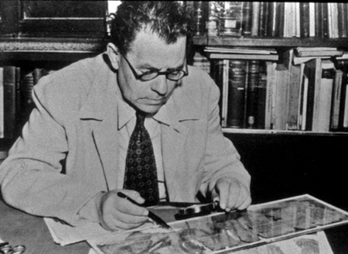
The Israelis and the three other Scrolls: Yigael Yadin (1917-1984) and his father Eliezer Sukenik (1889-1953)

