Slide 1
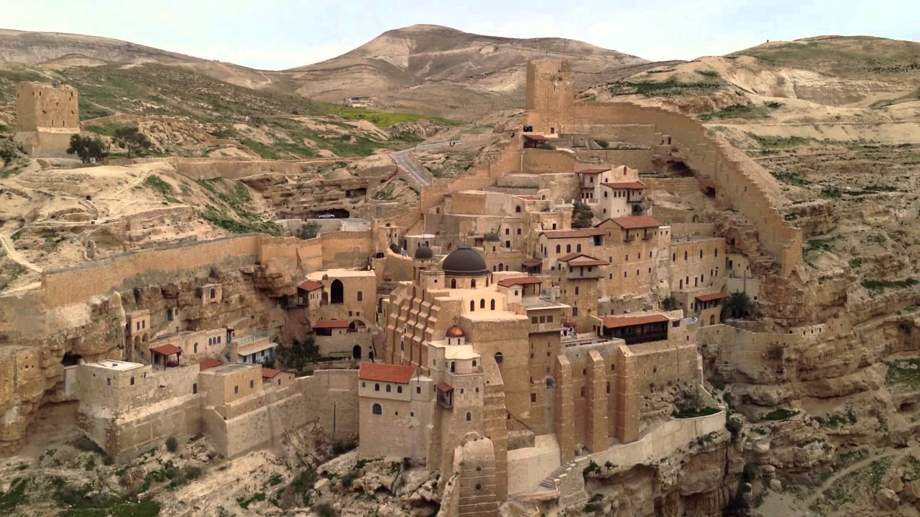
The Byzantine Period (A.D. 325-650): “The Desert A City”

Slide 2
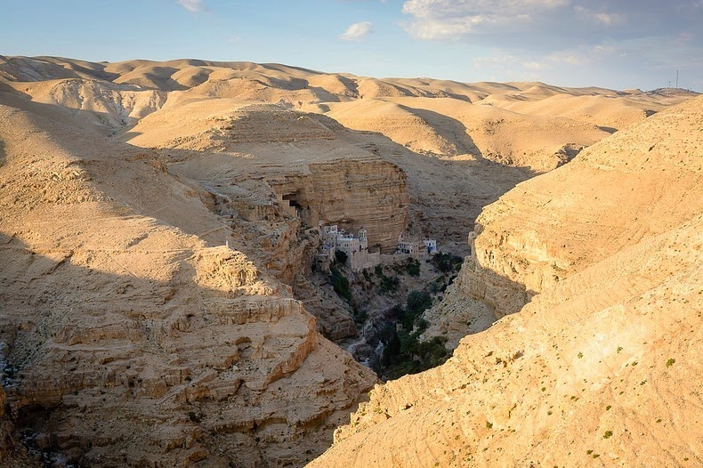
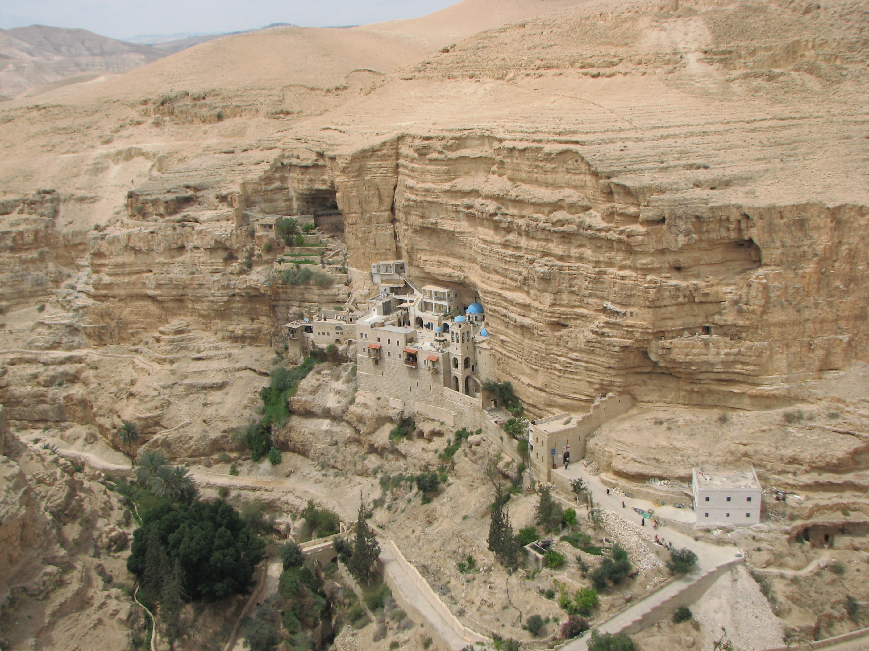
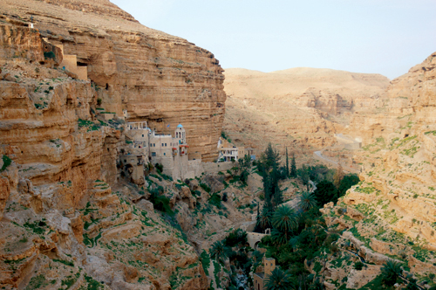
Saint George Monastery (ca. AD 480)

Slide 3
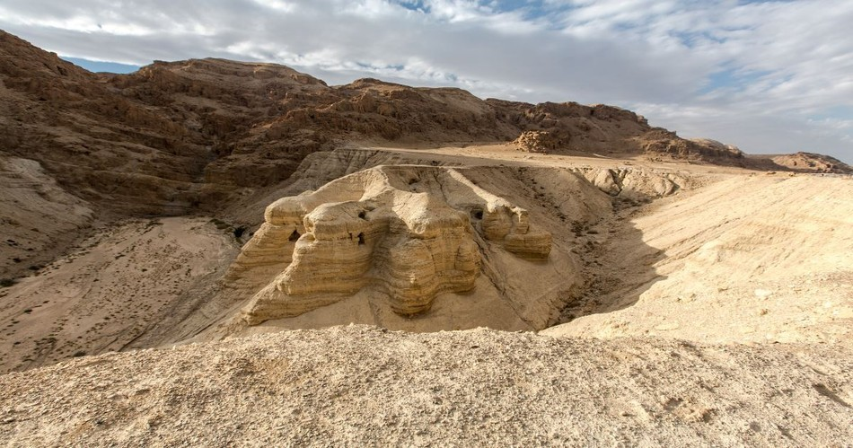
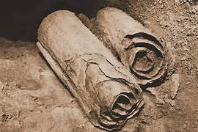
Archaeology and the Dead Sea Scrolls
Dr. Jeffrey P. Hudon
Biblicalelearning.org

Slide 4
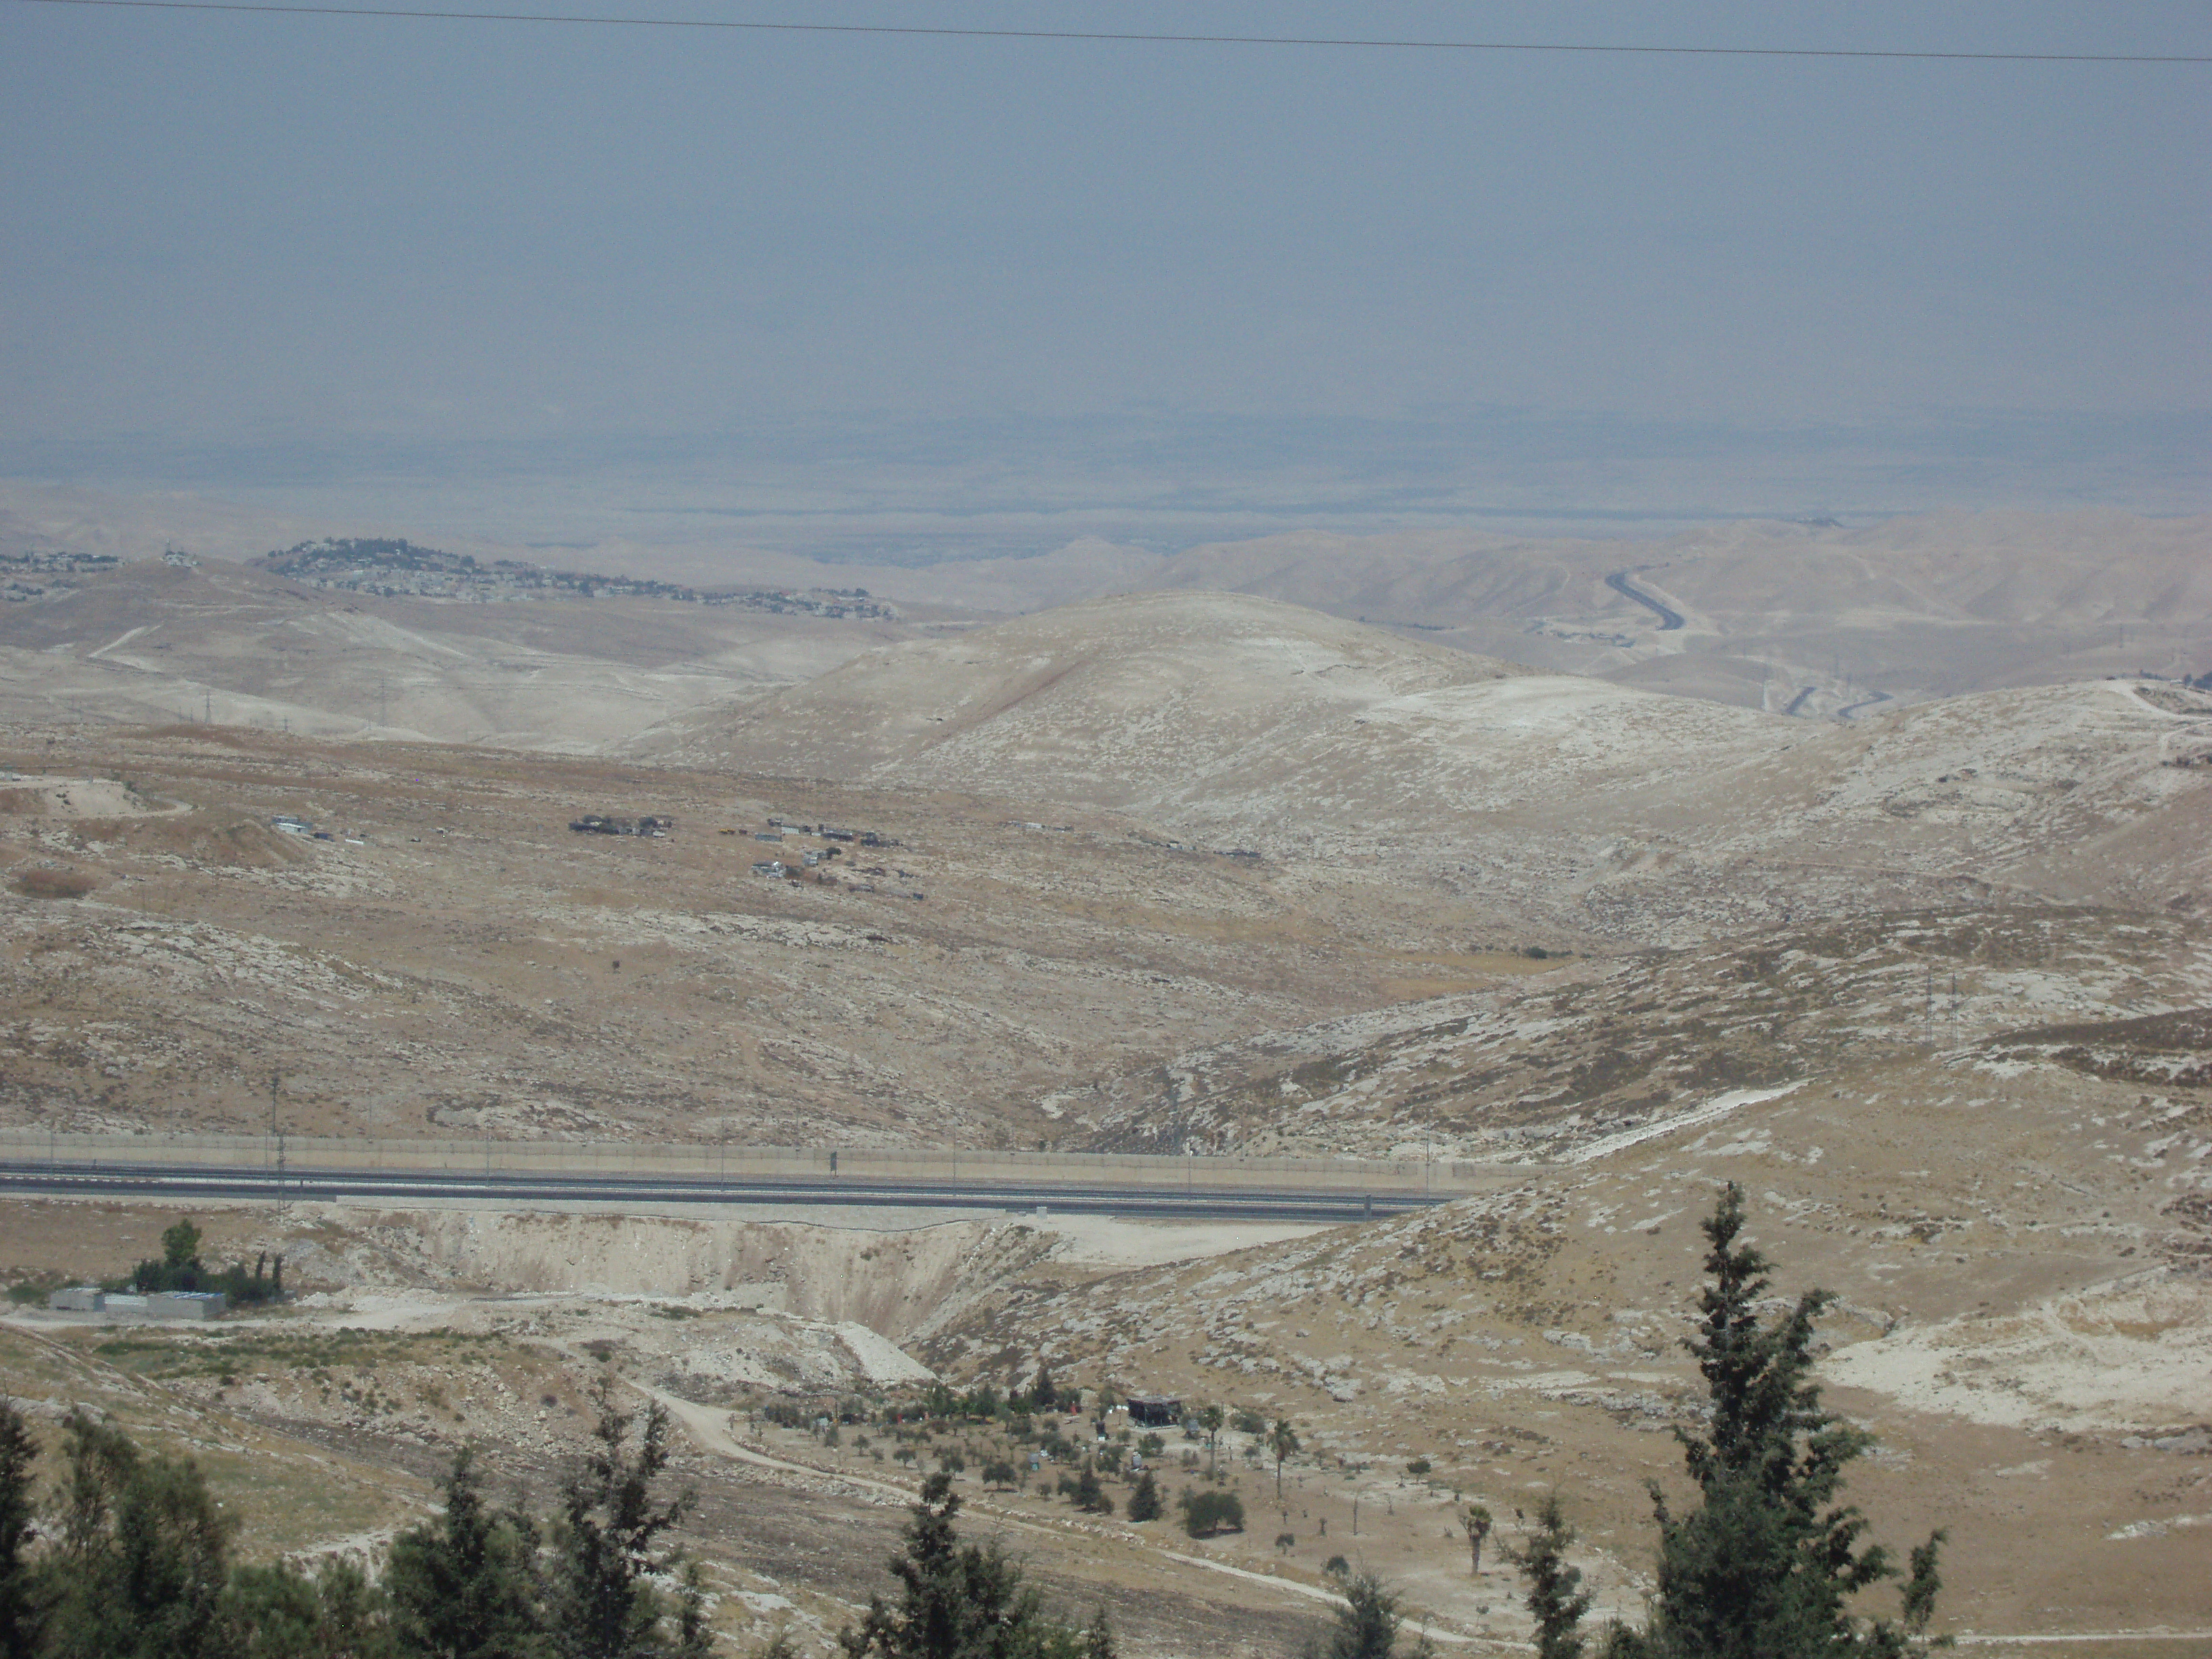
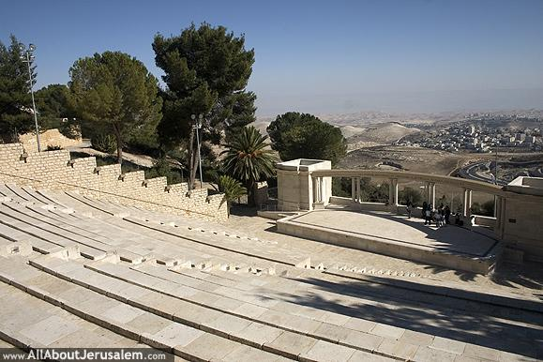
The Wilderness of Judah: Brief Facts Periods of Settlement: Chalcolithic (ca. 3100 B.C.), Iron Age (1000-550 B.C.) Roman Period (63 B.C. to A.D. 135); Byzantine Period (A.D. ca. 325-650) Elevation change: ca. 2500 feet above sea level to ca. 1400 feet below sea level in 15 miles Average Annual Rainfall is 20” at the watershed (Jerusalem) dropping to less than 2” in the Arava Views to the east from the Amphitheater at Hebrew University, Mt. Scopus

Slide 5
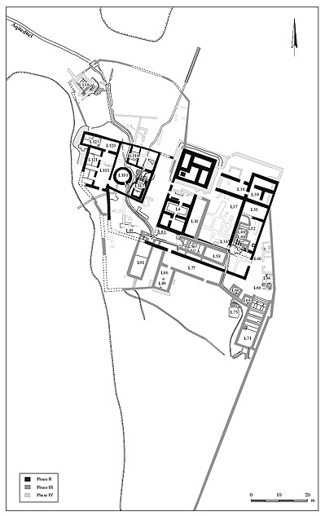
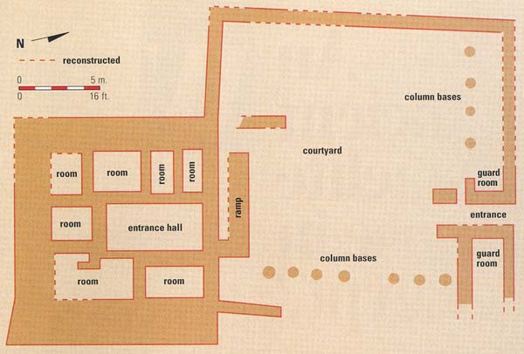
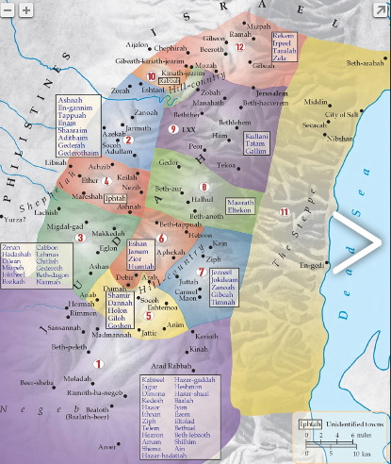
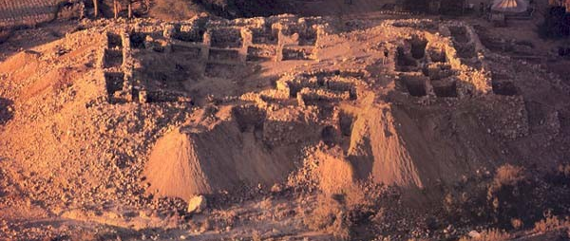
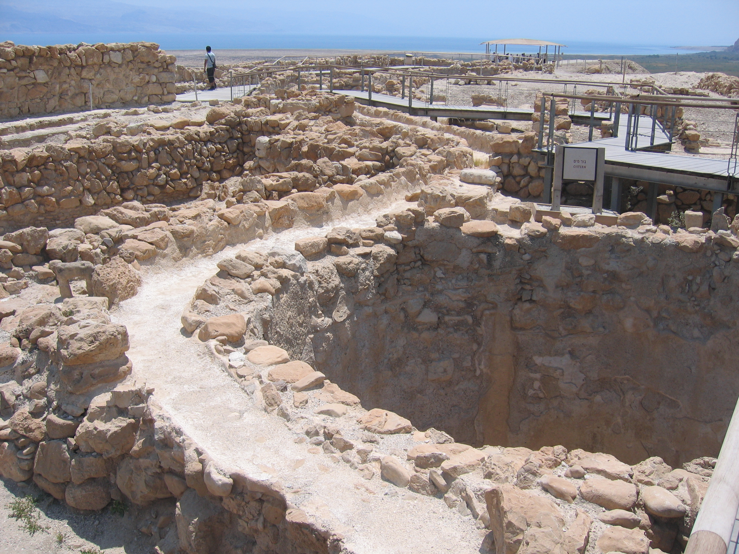
Joshua 15:61-62 In the wilderness: Beth Arabah, Middin, Sekakah, Nibshan, the City of Salt and En Gedi—six towns and their villages.

