Slide 1
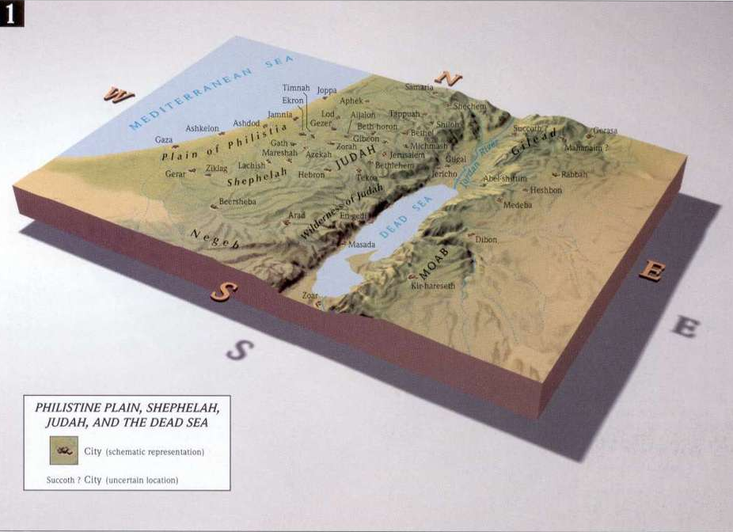
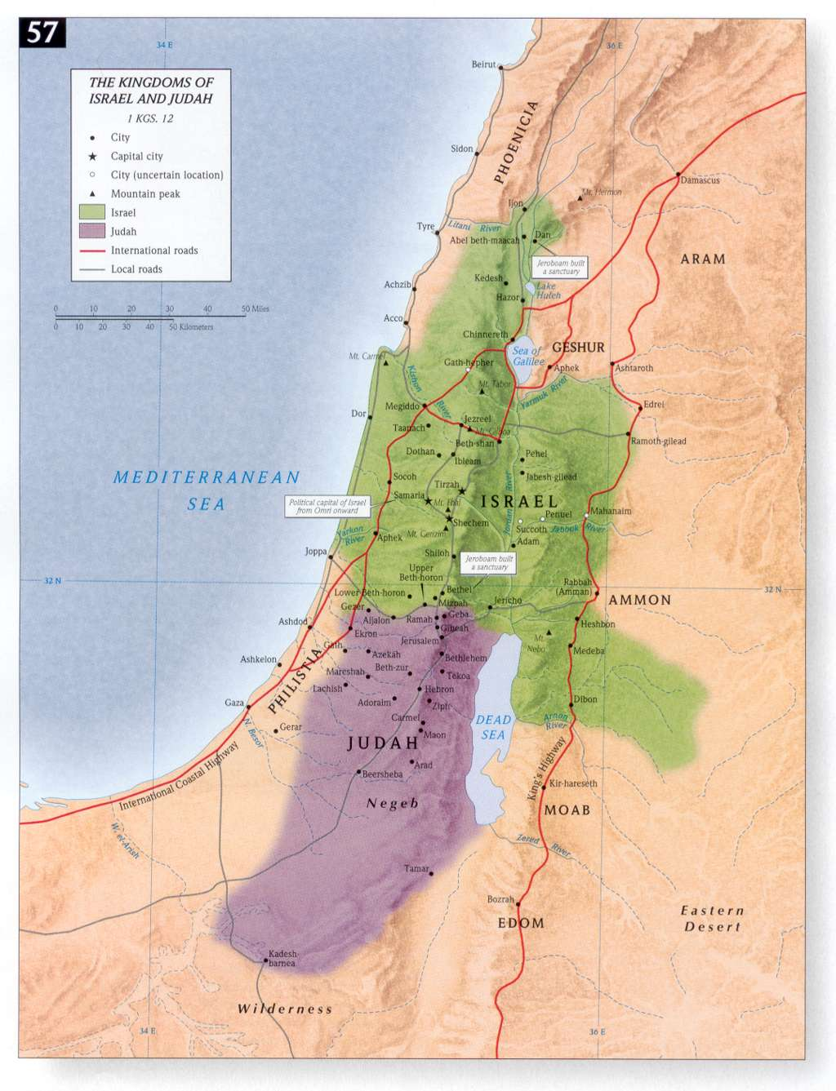
The Wilderness of Judah:
Hiding Place for the Dead Sea Scrolls

Slide 2
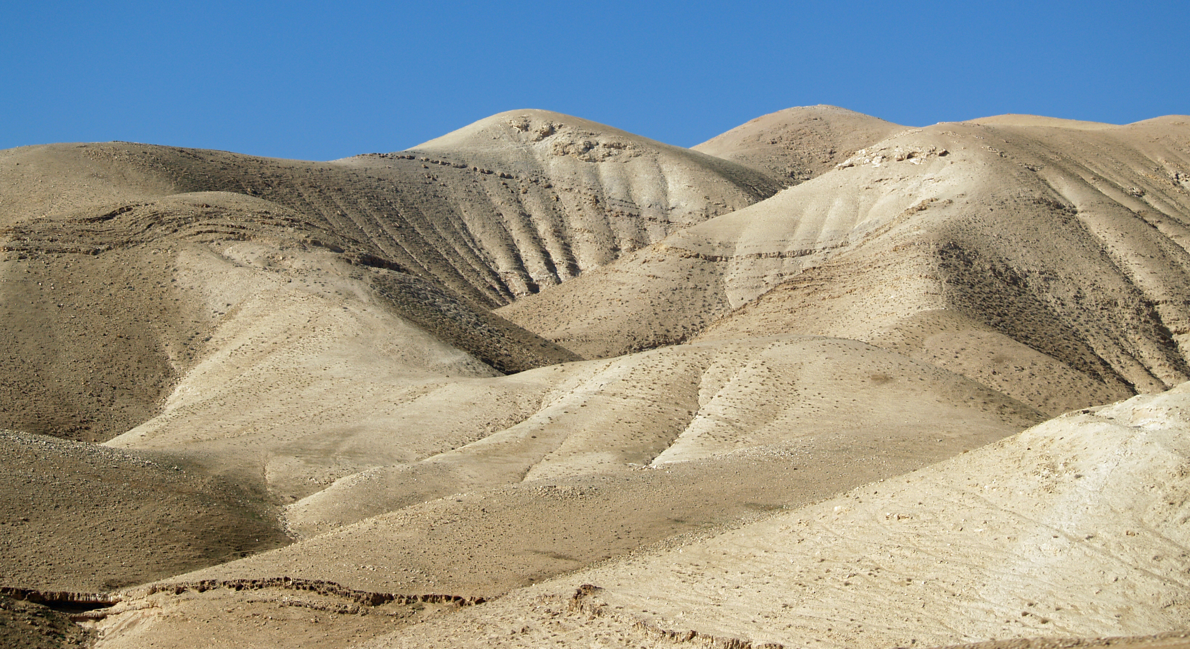
A Steppe Land between Jerusalem and the Arava

Slide 3
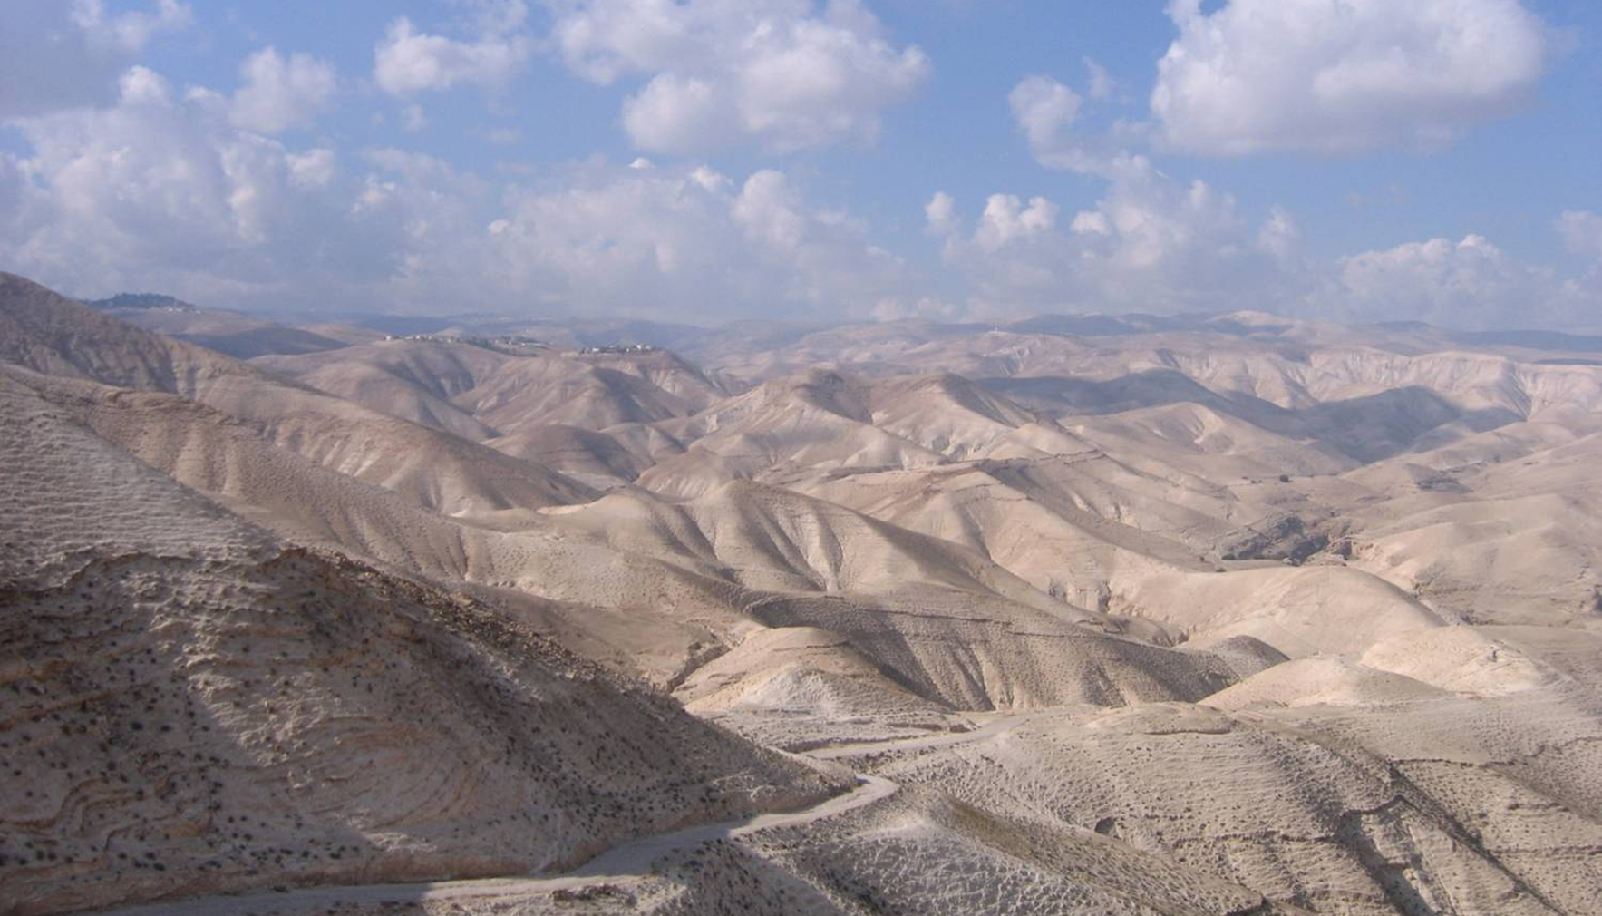

Slide 4
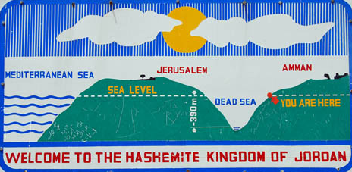
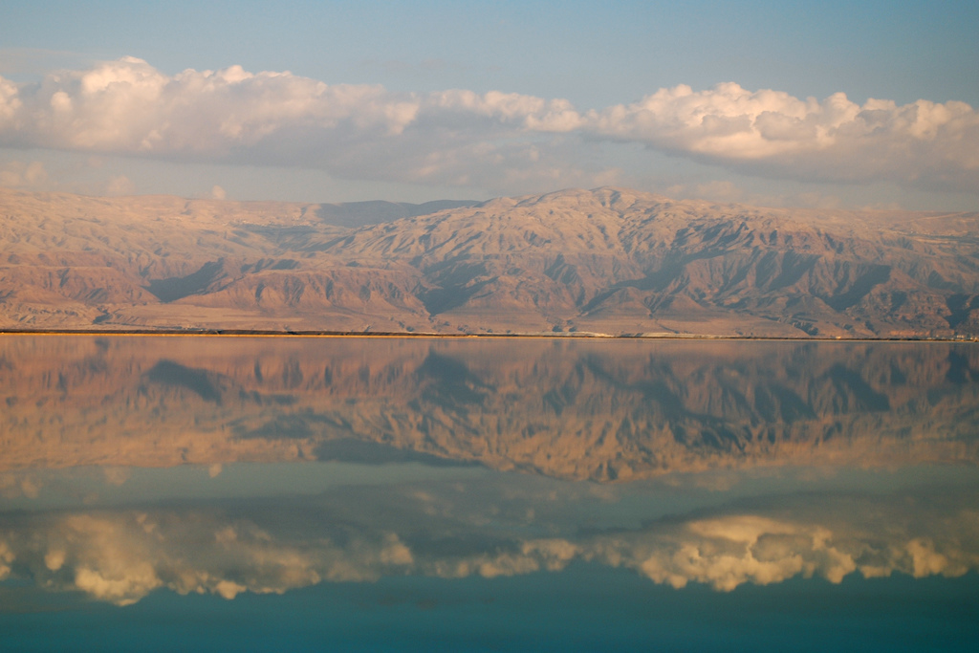
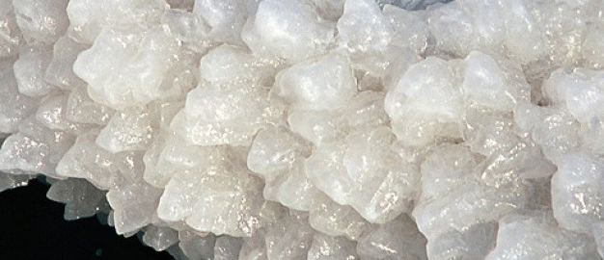
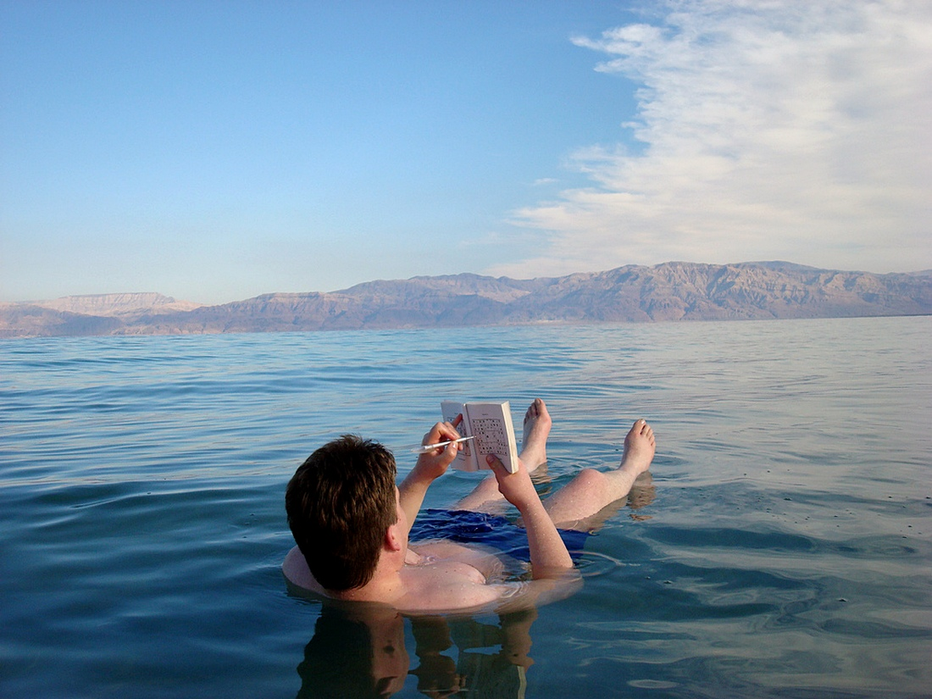
The Dead Sea (Sea of Salt)

Slide 5
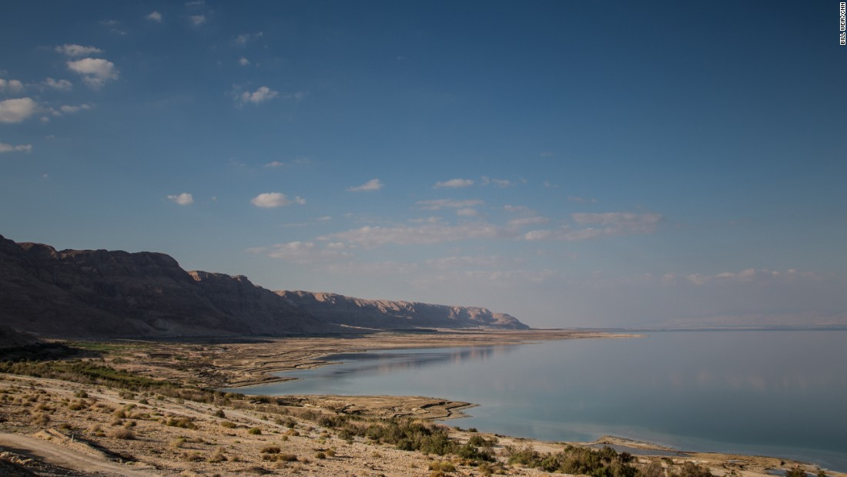

Slide 6
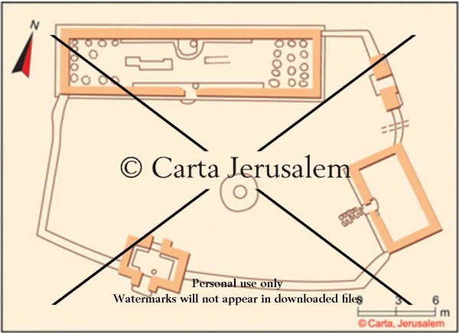
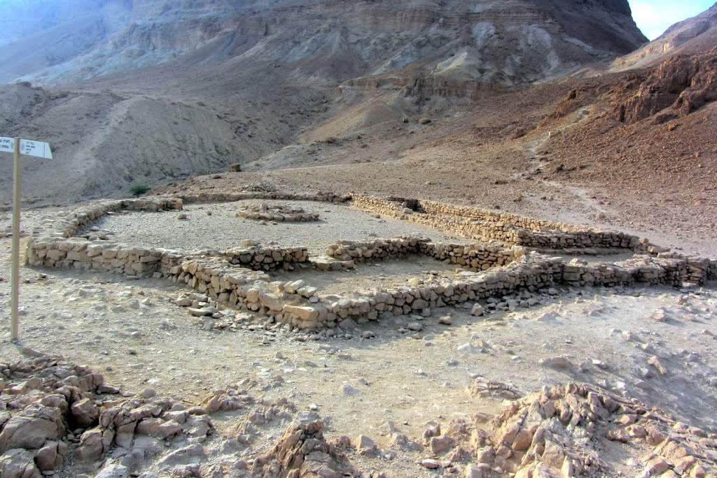
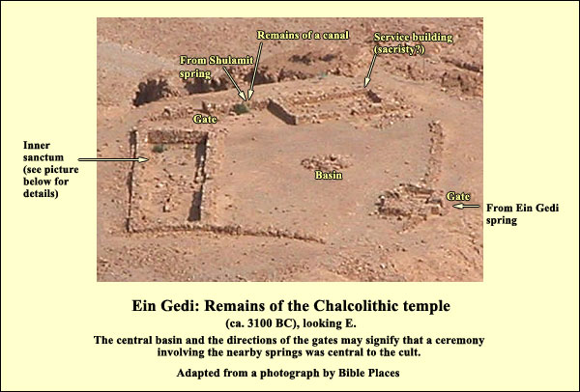
The Chalcolithic Temple above En Gedi

Slide 7
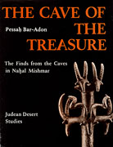
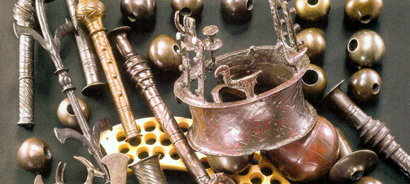
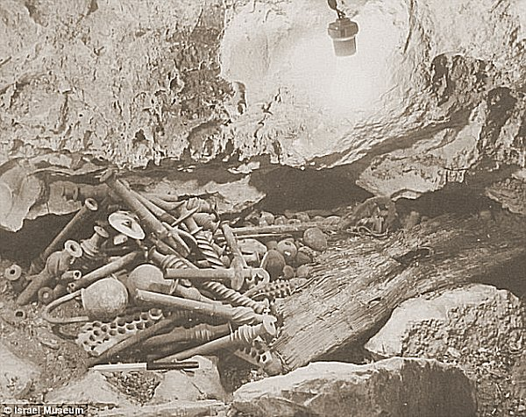
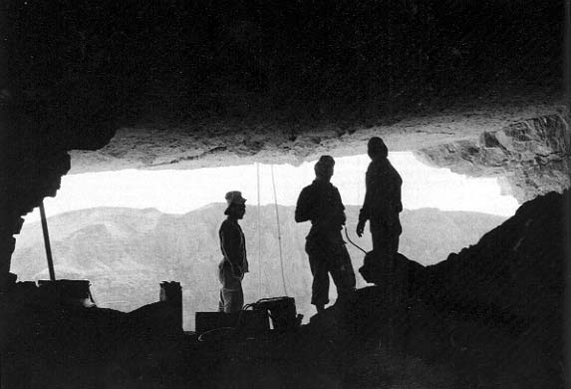
The Cave of Treasure discovered in the Nahal Mishmar

Slide 8
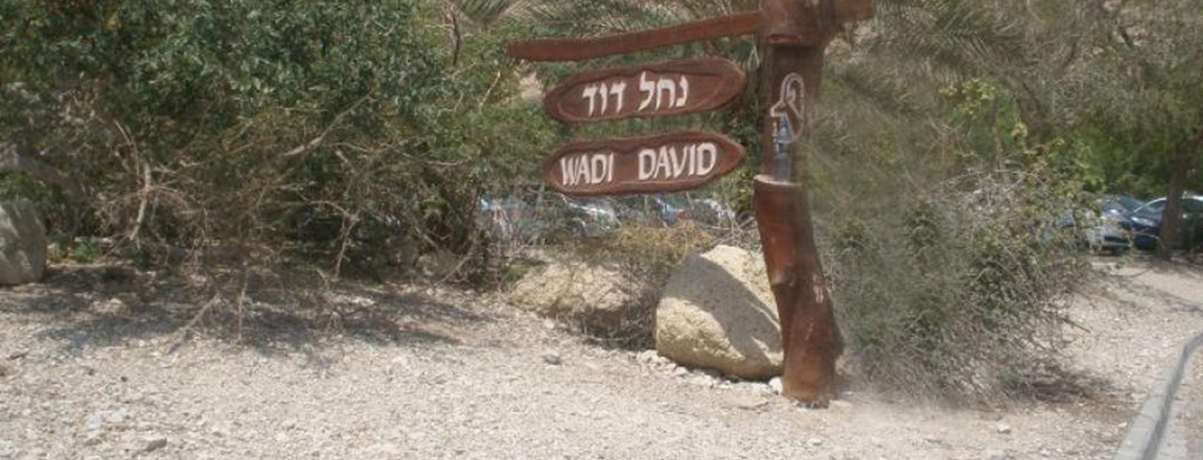
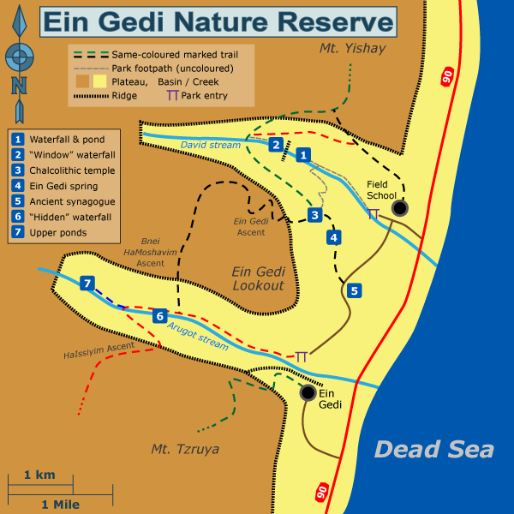
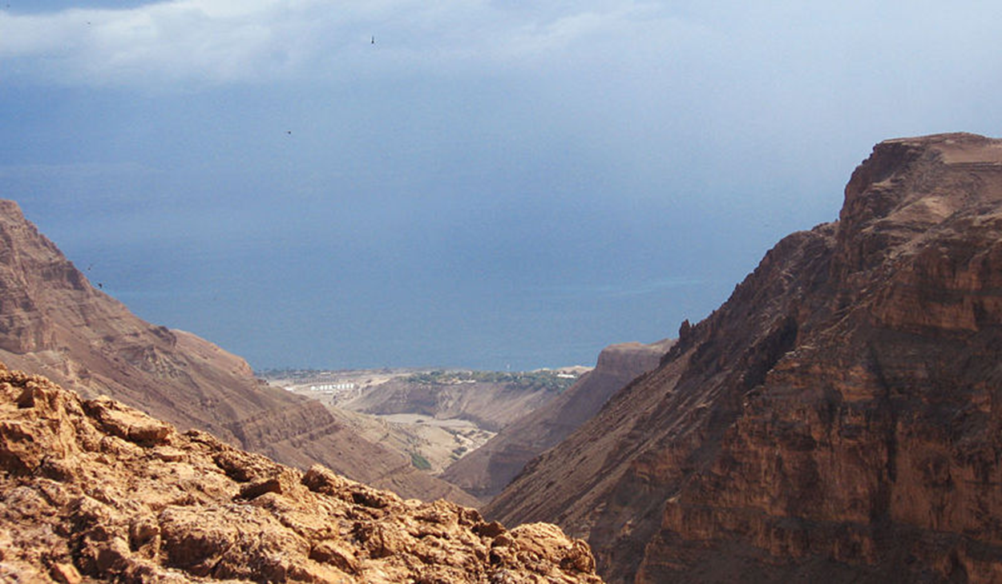
En Gedi (Goat Spring) Called Hazazon Tamar
(2 Chr 20:2); Genesis 14:7; Joshua 15:62; 1 Samuel 24:1; Song of Songs 1:14.
NT era boasted a beautiful synagogue and date palm plantations
View to the east over the Dead Sea.
Chedorlaomer; Joshua, David; Solomon; Jehoshaphat; Uzziah; and Herod are important figures in its history

Slide 9
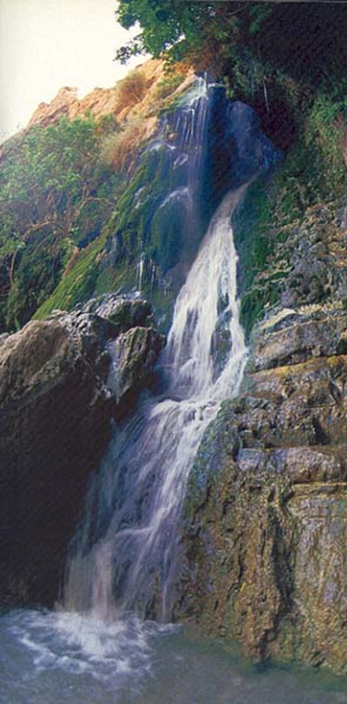
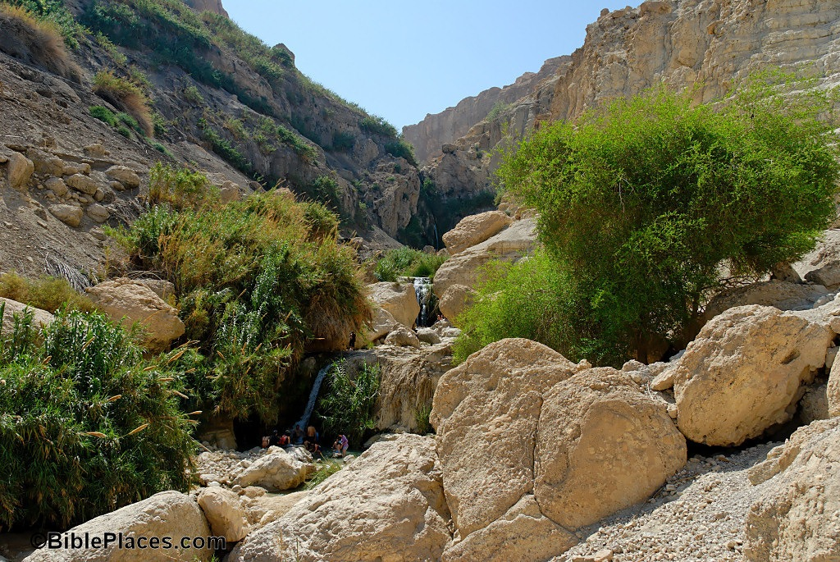
The Nahal David Spring and Pool

Slide 10
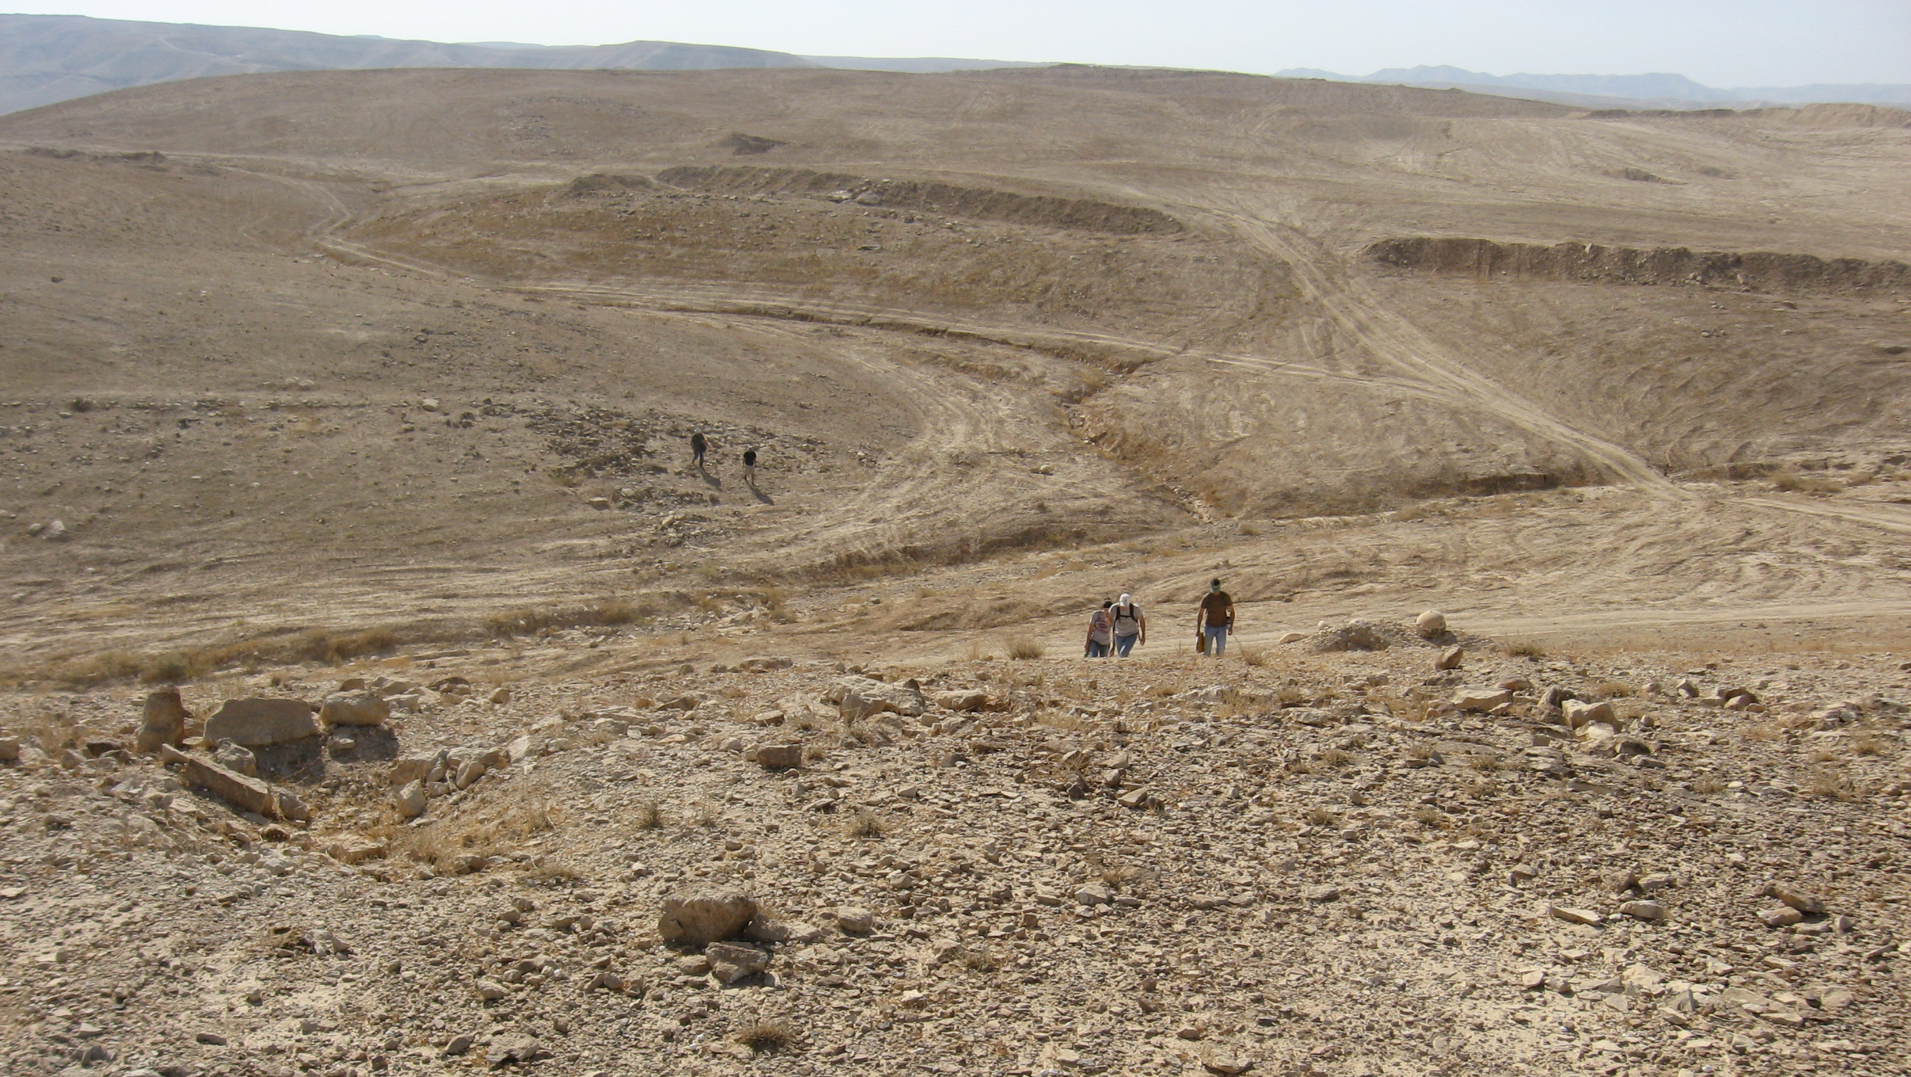
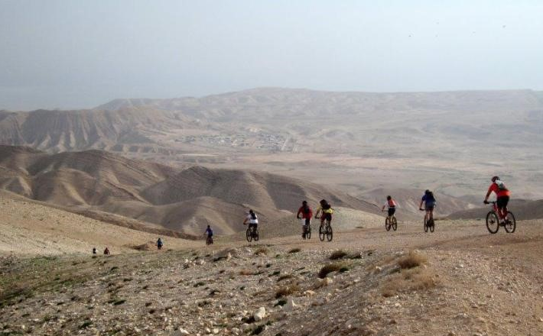
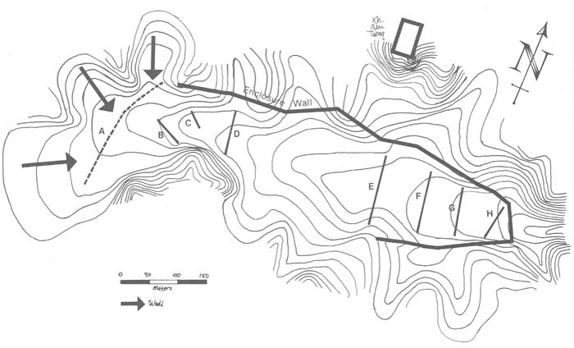
The Valley of Achor (Buqe’ah Valley)
There I will give her back her vineyards, and will make the Valley of Achor a door of hope. There she will respond as in the days of her youth, as in the day she came up out of Egypt (Hosea 2:15).

Slide 11
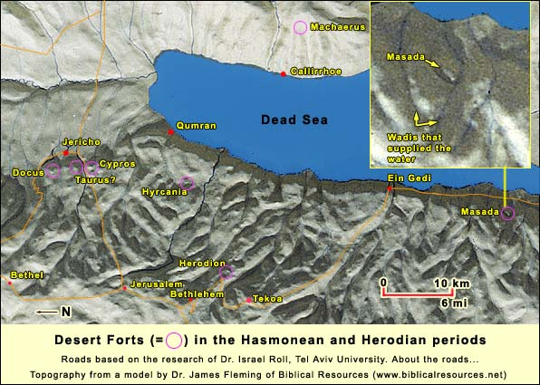
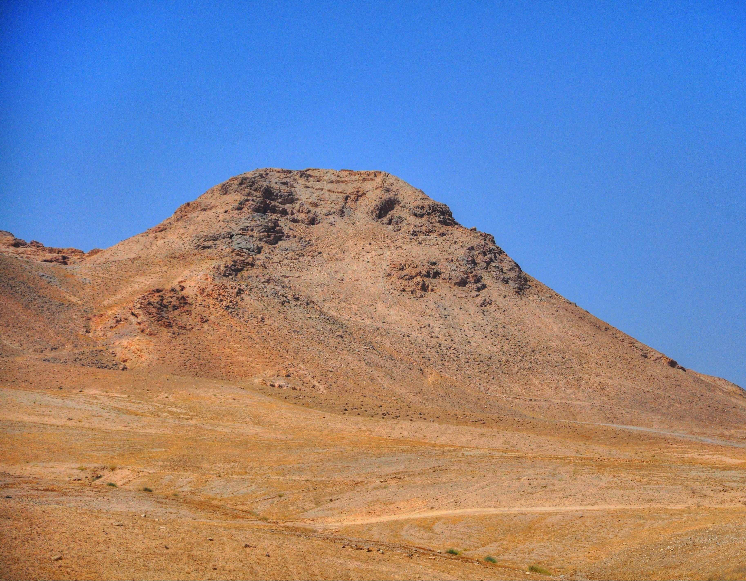
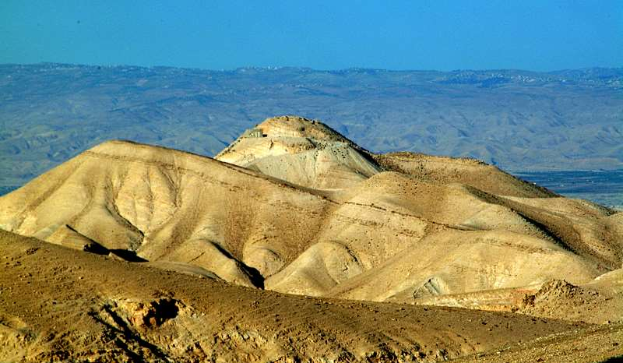
Herodian Fortresses in the Wilderness of Judah
Hyrcania (Khirbet Mird) and Cypros

