Slide 1
The Babylonian Exile (586-539 BC)

Slide 2
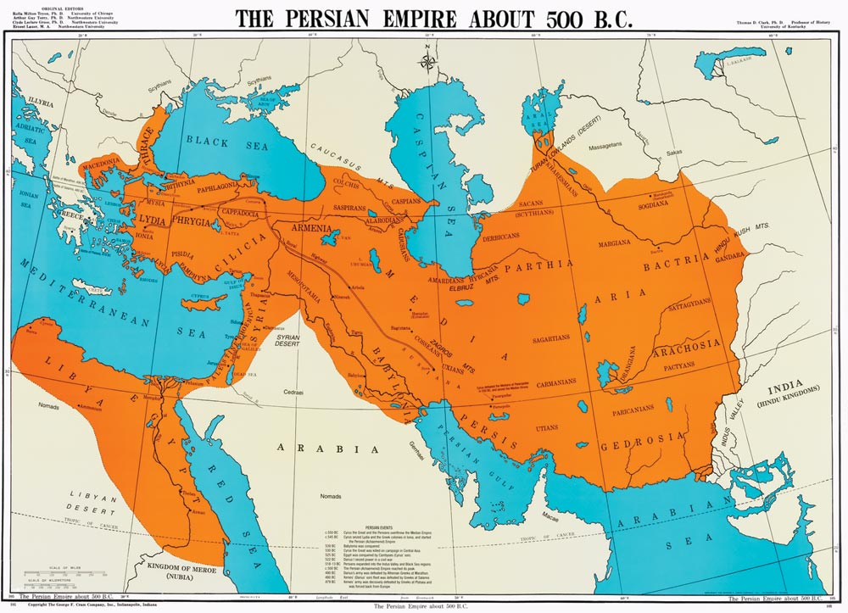

Slide 3
The Birth of Judaism and the Origin of the Synagogue
The exiles from Judah had to quickly implement some rather ingenious and resourceful changes to worship after the Temple was destroyed. Those living in Judah likely worshiped at the ruined site, but those in Babylon turned to the synagogue as a cultural and religious center of worship. It is not an overstatement to say that the synagogue saved Judaism.
beth ha’am: “The House of the People” (Jeremiah 39:8) hints at activity during the reign of Josiah or earlier, during the brutal reign of Manasseh (2 Kings 21:16)
beth midrash: “House of (Bible) Study or Learning” (literally “to seek”)
Synagogues were certainly in use during the Exile as a beth haknesset or “House of Assembly” (a Jewish Community Center)
The Synagogue is a Jewish prototype for the Christian Church and provided a pre existing public platform and aid in Jewish (and Gentile) evangelism for Paul and the other Apostles

Slide 4
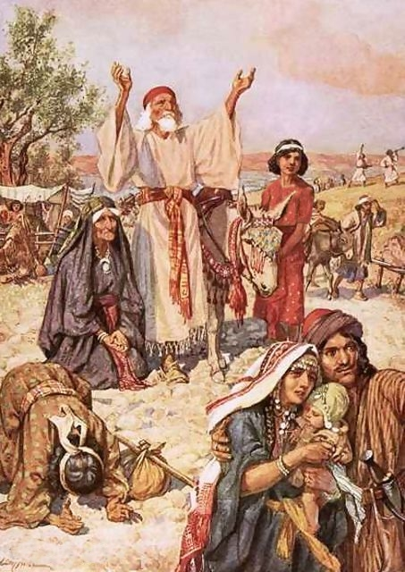
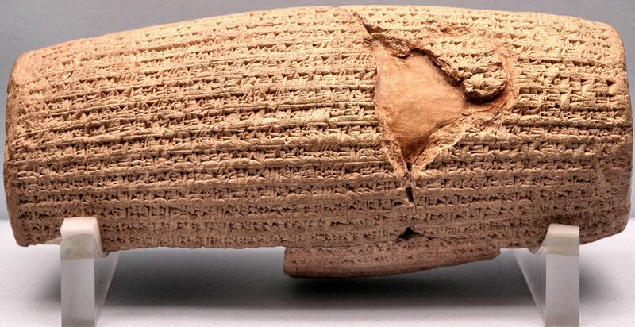
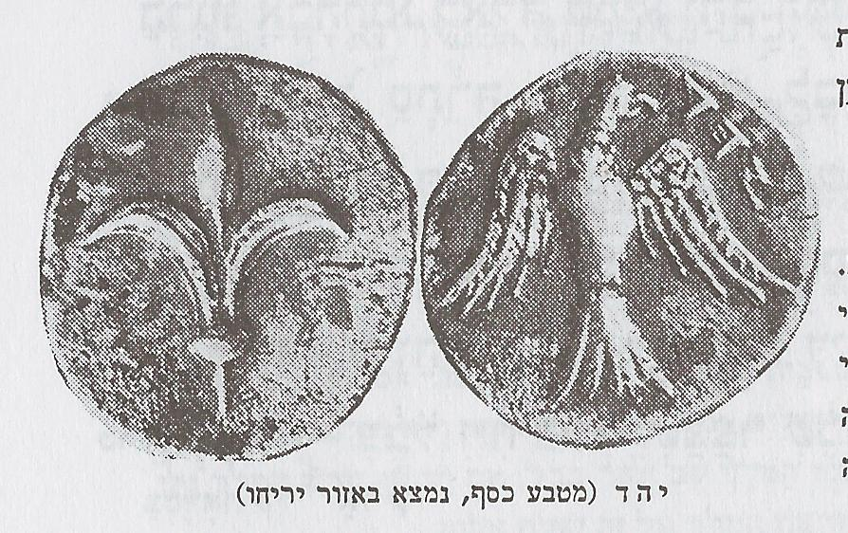
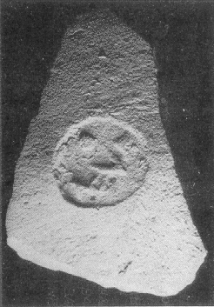
The Persians and the Edict of Cyrus

Slide 5
The Mysterious Fate of Zerubbabel The leader of the first group of returnees was Zerubbabel, a man from the Davidic line and certainly a leading candidate for a political leader of Jerusalem. However, the Old Testament is silent regarding his fate. The Jews would have to wait for a later Davidic family member to be their Messiah

Slide 6
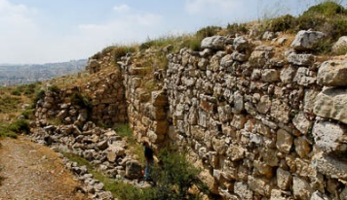
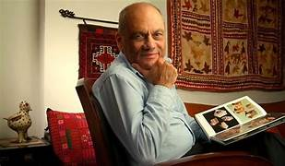
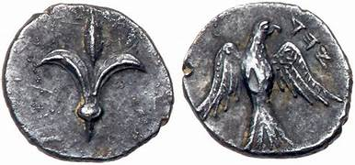
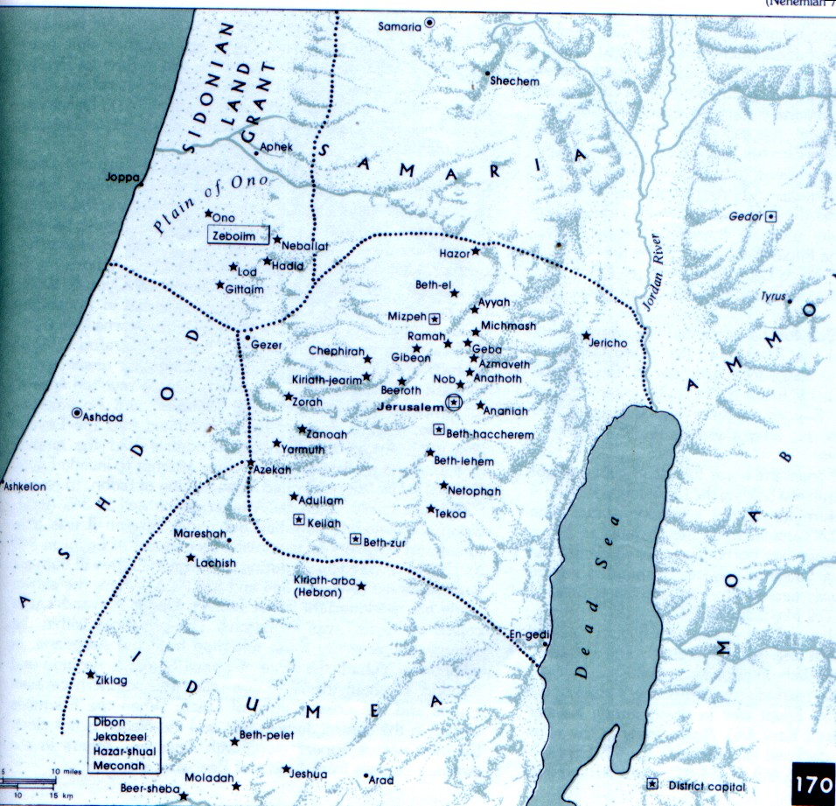
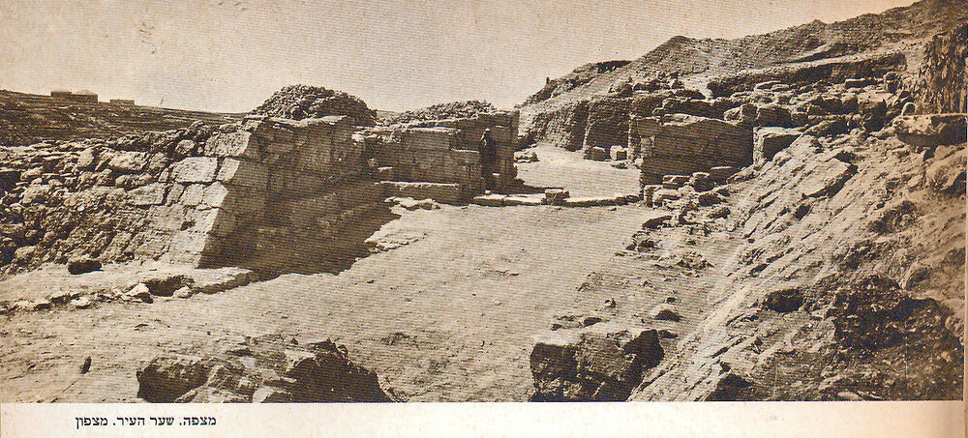
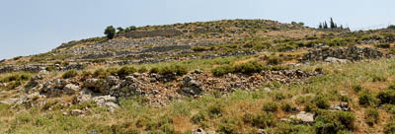
The Province of Yehud

Slide 7
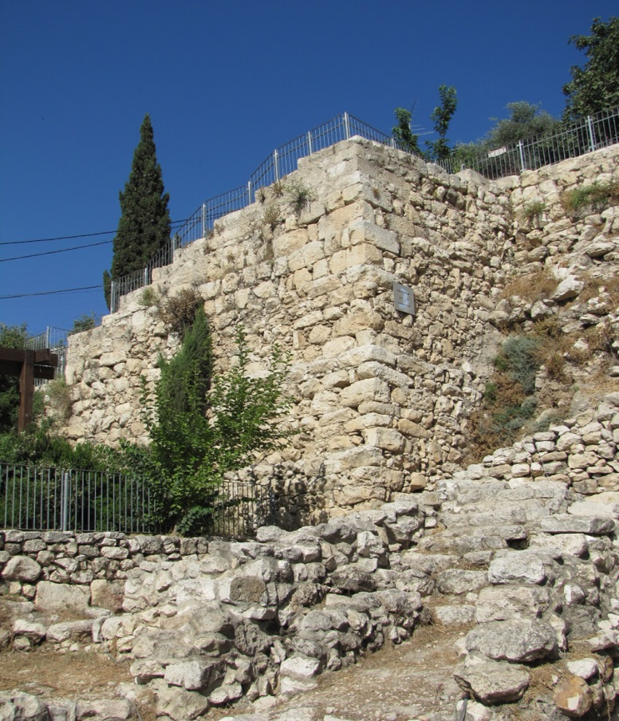
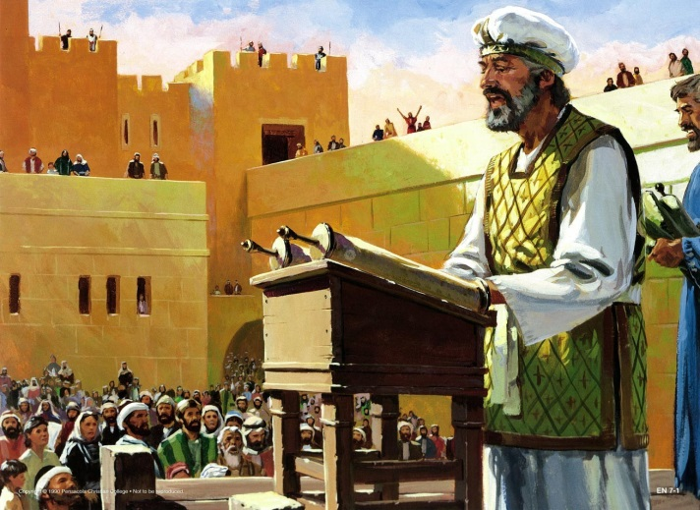
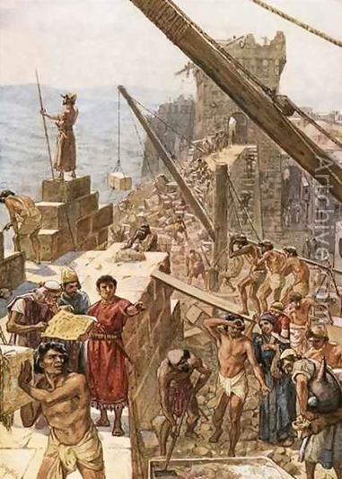
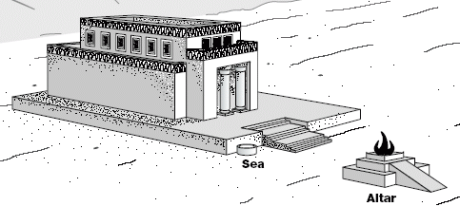
The Restoration Jewish Community and Its Leaders
Leaders like Zerubbabel, Ezra and Nehemiah carefully led the Jewish people that returned to Jerusalem to rebuild their nation

Slide 8
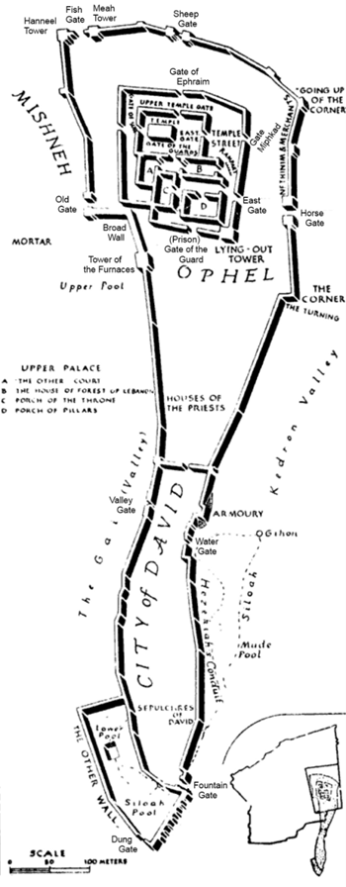
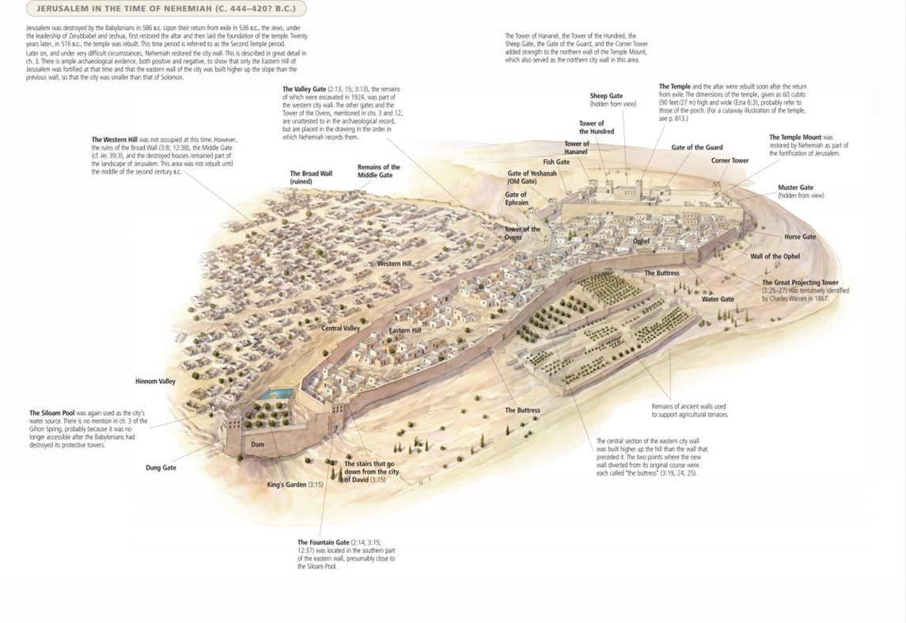
The Book of Nehemiah
In Nehemiah 2-4, Nehemiah, who arrived from Persia, inspects the ruined and broken walls of Jerusalem and organizes the families and clans of Judah to rebuild them, despite harsh opposition from Geshem, Sanballat and Tobiah, leaders and rulers over peoples of the region. The course of the walls Nehemiah inspected and rebuilt are reconstructed below.

Slide 9
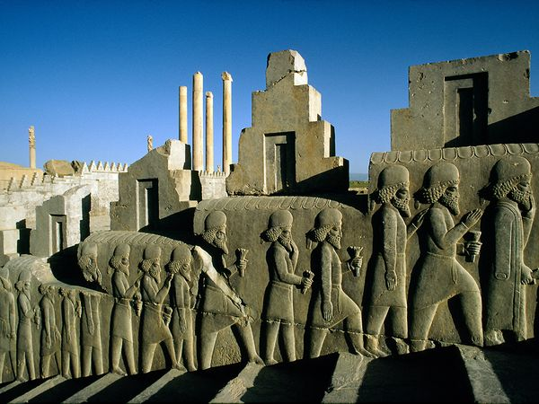
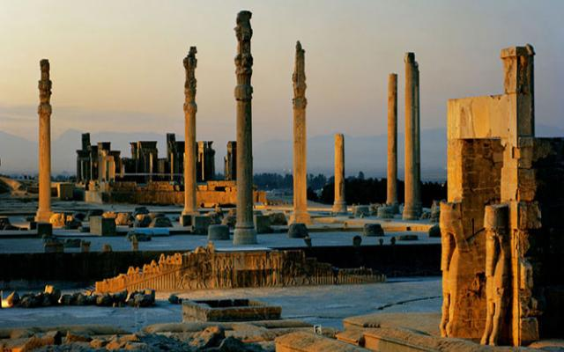
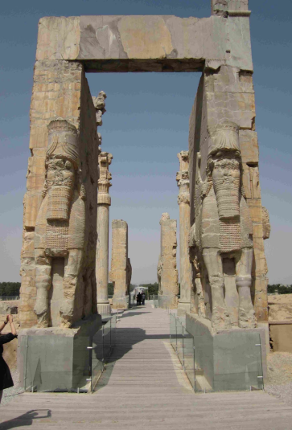
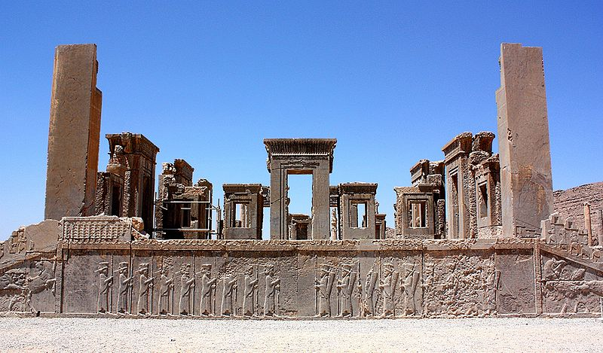
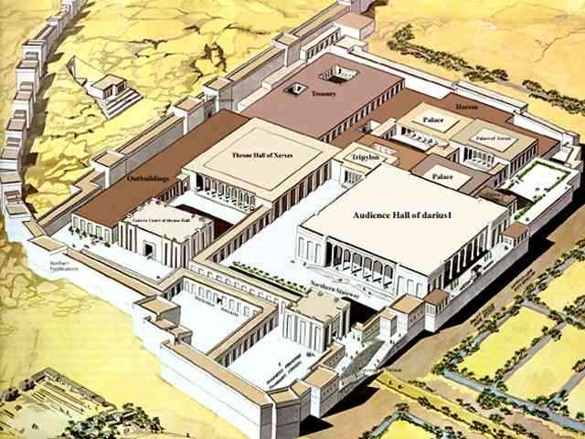
The Great City of Persepolis

Slide 10
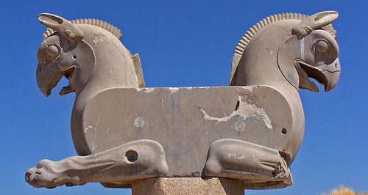
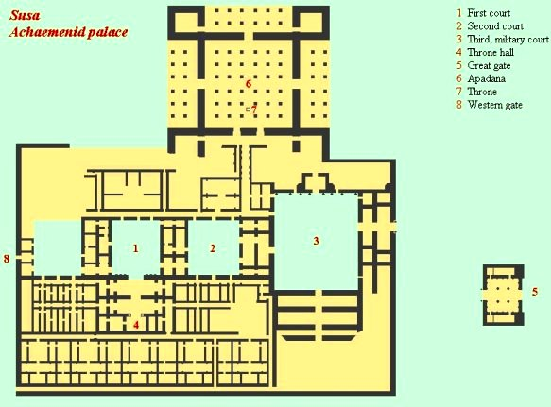
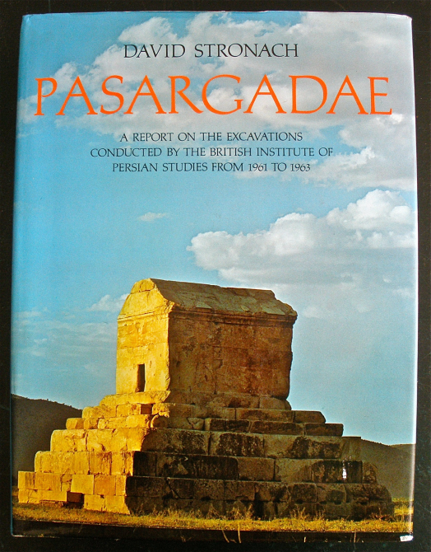
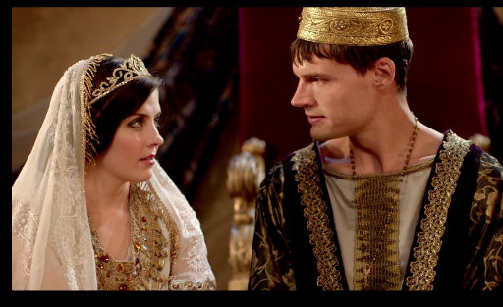
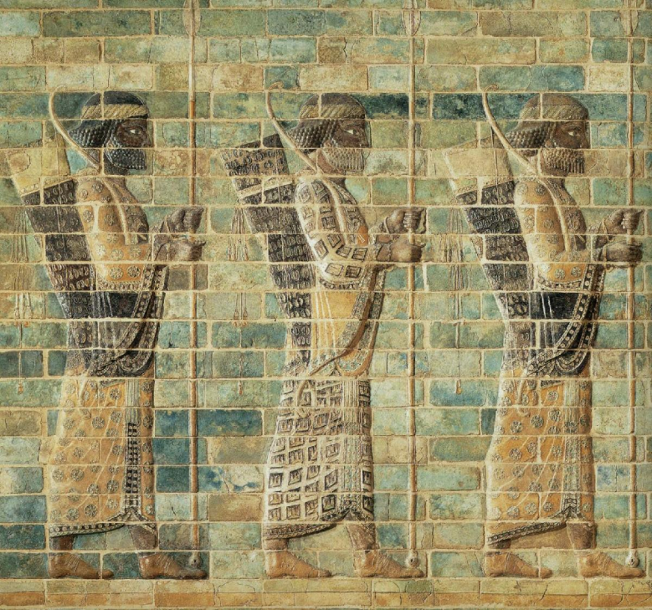
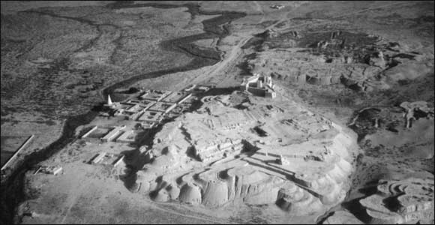
Susa, the Second Capital of Persia

