Slide 1
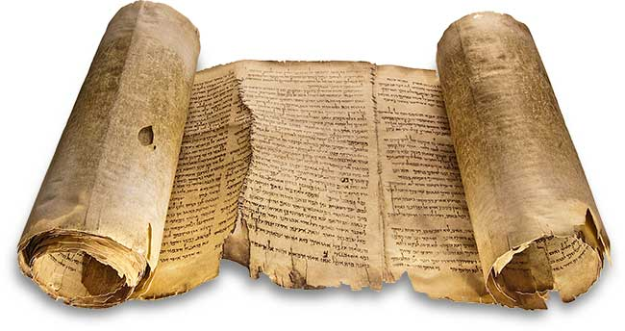
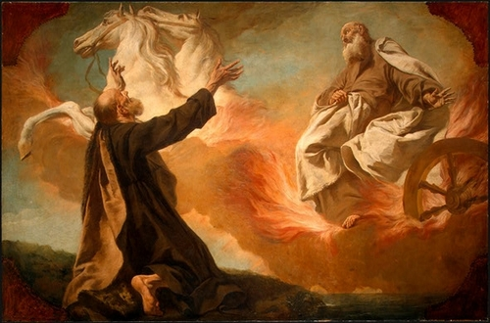
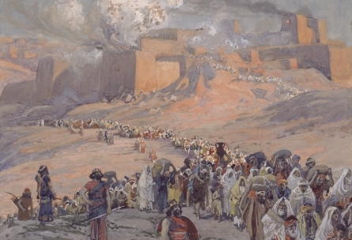
The Archaeology of the Divided Monarchies of Israel and Judah

Slide 2
Introduction to the Books of Kings and Chronicles
The biblical account of Israel's and Judah's kings is recorded in two parallel histories: The Book of 1-2 Kings and the Book of 1-2 Chronicles. These great works of history were written at different times to different initial audiences and each one written from a different theological perspective. Both books are not strictly political annals or records, although they use and actually cite these for their sources. Rather, Kings and Chronicles are theological histories that utilize events to illustrate the acts of God in Israel’s history.
The Book of Kings was written for the Jewish people while they enduring the exile in Babylon in order to answer their question: "Why are we here!" and “What went wrong.” The writer of Kings then recounts their history; a history of one sinful generation after another. Israel and Judah had a few godly kings and revivals, but sadly failed to keep the covenant given them by God through Moses and Joshua. Their sinful actions eventually sealed their collective fate. The Book of Kings depicts a theology of delayed or cumulative retribution as a consequence for sin and wickedness over time.
The Book of Chronicles was written after the exile and speaks to the Jewish people after they returned to Israel and begin rebuilding their nation and lives. While they repair the Temple and farm the land, they are acutely aware of their lack of and need for a ruler from the Davidic line; a Messiah to completely restore their nation and renew their covenant with the LORD. Ironically, Chronicles, not Malachi, is the last book in the Hebrew Old Testament. Thus, the Old Testament ends with this recognized need for a Messiah, a Savior to arrive! It is no coincidence that the Gospel of Matthew, which opens the New Testament, begins with a genealogy showing the direct Messianic lineage of Jesus Christ!
The Book of Chronicles relates a theology of immediate retribution for sinfulness. In other words, the consequences of the sin is carried by the person who sinned.

Slide 3
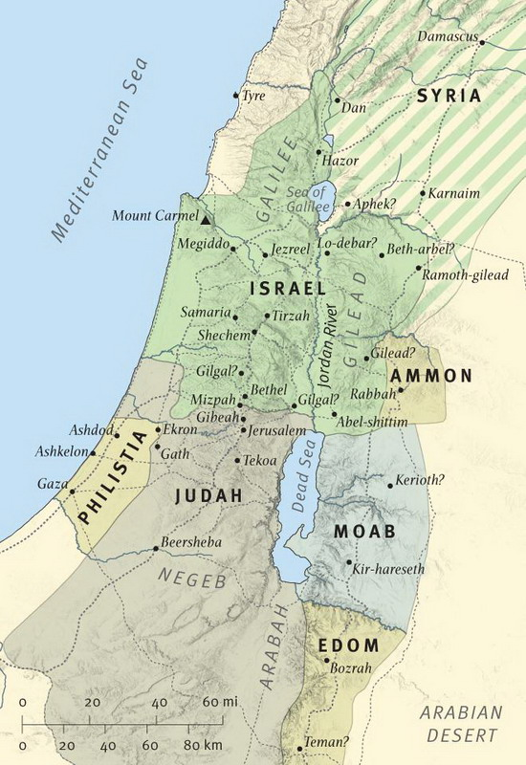
The Divided Monarchy of Israel and Judah
The Great Schism: (1 Kings 12; 2 Chronicles 10)
Israel Rebels Against Rehoboam
12 Rehoboam went to Shechem, for all Israel had gone there to make him king. ² When Jeroboam son of Nebat heard this (he was still in Egypt, where he had fled from King Solomon), he returned from^{[a]} Egypt. ³ So they sent for Jeroboam, and he and the whole assembly of Israel went to Rehoboam and said to him: ⁴ “Your father put a heavy yoke on us, but now lighten the harsh labor and the heavy yoke he put on us, and we will serve you.”
⁵ Rehoboam answered, “Go away for three days and then come back to me.” So the people went away.
⁶ Then King Rehoboam consulted the elders who had served his father Solomon during his lifetime. “How would you advise me to answer these people?” he asked.
⁷ They replied, “If today you will be a servant to these people and serve them and give them a favorable answer, they will always be your servants.”
⁸ But Rehoboam rejected the advice the elders gave him and consulted the young men who had grown up with him and were serving him. ⁹ He asked them, “What is your advice? How should we answer these people who say to me, ‘Lighten the yoke your father put on us’?”
¹⁰ The young men who had grown up with him replied, “These people have said to you, ‘Your father put a heavy yoke on us, but make our yoke lighter.’ Now tell them, ‘My little finger is thicker than my father’s waist. ¹¹ My father laid on you a heavy yoke; I will make it even heavier. My father scourged you with whips; I will scourge you with scorpions.’”
¹² Three days later Jeroboam and all the people returned to Rehoboam, as the king had said, “Come back to me in three days.” ¹³ The king answered the people harshly. Rejecting the advice given him by the elders, ¹⁴ he followed the advice of the young men and said, “My father made your yoke heavy; I will make it even heavier. My father scourged you with whips; I will scourge you with scorpions.” ¹⁵ So the king did not listen to the people, for this turn of events was from the Lord, to fulfill the word the Lord had spoken to Jeroboam son of Nebat through Ahijah the Shilonite.
¹⁶ When all Israel saw that the king refused to listen to them, they answered the king:
“What share do we have in David, what part in Jesse’s son? To your tents, Israel! Look after your own house, David!”
So the Israelites went home. ¹⁷ But as for the Israelites who were living in the towns of Judah, Rehoboam still ruled over them.

Slide 4
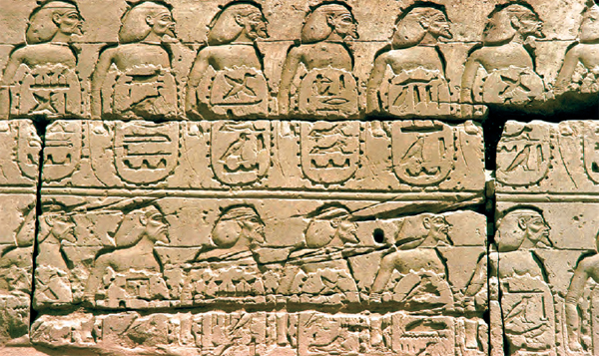
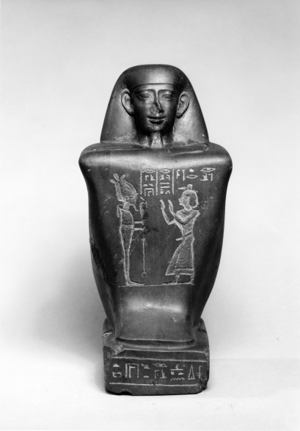
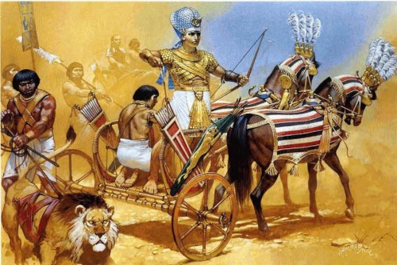
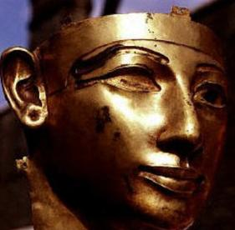
The Raid of Shishak
https://www.youtube.com/watch?v=KwewfO4Ijxw
In ca. 924 B.C., the fifth year of Rehoboam, Shishak “King of Egypt” embarked on a military “expedition” to Israel and Judah
Shishak was the first pharaoh of the 22nd Libyan dynasty and saw the split and breakup of Solomon’s kingdom as a golden opportunity to acquire a vast amount of plunder for Egypt and himself
He commemorated his raid on the Bubastite portal of a wall of the great Karnak Temple, displaying a topographical list of abut 180 of the cities and forts he captured (symbolized by a bound Asiatic captive with a cartouche naming the site).
Shishak and subsequent kings of his dynasty had richly ornamented tombs and burial objects that seem to demonstrate that he did possess a great amount of gold. Where did he get such wealth.

Slide 5
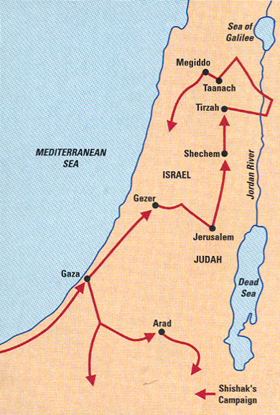
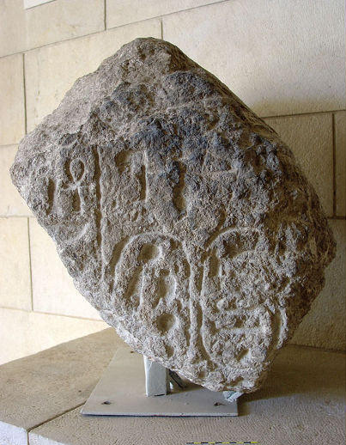
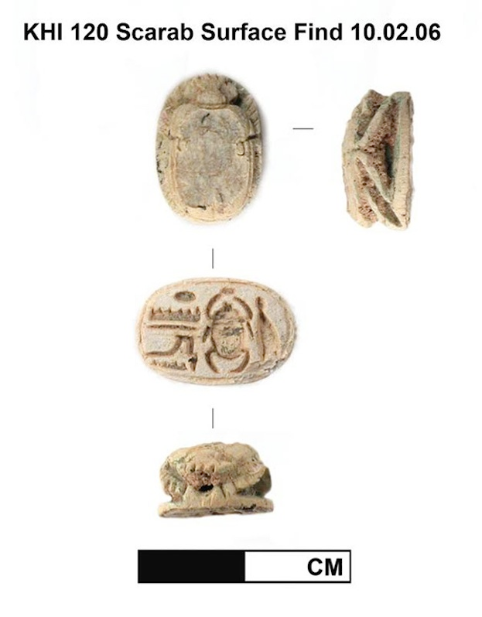
The Route of Shishak’s Raid
The Bible focuses solely upon Judah (2 Chronicles 12:1-4, 9-10)
12 After Rehoboam’s position as king was established and he had become strong, he and all Israel with him abandoned the law of the Lord. ² Because they had been unfaithful to the Lord, Shishak king of Egypt attacked Jerusalem in the fifth year of King Rehoboam. ³ With twelve hundred chariots and sixty thousand horsemen and the innumerable troops of Libyans, Sukkites and Cushites that came with him from Egypt, ⁴ he captured the fortified cities of Judah and came as far as Jerusalem…
⁹ When Shishak king of Egypt attacked Jerusalem, he carried off the treasures of the temple of the Lord and the treasures of the royal palace. He took everything, including the gold shields Solomon had made. ¹⁰ So King Rehoboam made bronze shields to replace them and assigned these to the commanders of the guard on duty at the entrance to the royal palace.
From his damaged topographical list, we know that Shishak also campaigned extensively through Israel, Transjordan and launched an expedition to the south, capturing about 70 hagarim (fortified outposts) in the Negeb and farther south in the Negeb Highlands. A fragment of a stele of Shishak was found at Megiddo (below left) and a scarab of Shishak recently came to light at Khirbat en Nahas, the site of one of Solomon’s copper mines SE of the Dead Sea.

Slide 6
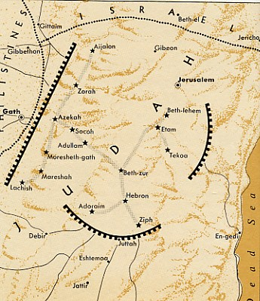
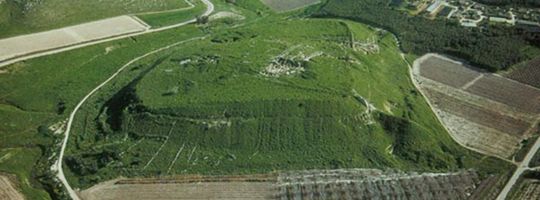
Rehoboam’s Fortified Cities
Rehoboam Fortifies Judah
⁵ Rehoboam lived in Jerusalem and built up towns for defense in Judah:⁶ Bethlehem, Etam, Tekoa, ⁷ Beth Zur, Soko, Adullam, ⁸ Gath, Mareshah, Ziph,⁹ Adoraim, Lachish, Azekah, ¹⁰ Zorah, Aijalon and Hebron. These were fortified cities in Judah and Benjamin. ¹¹ He strengthened their defenses and put commanders in them, with supplies of food, olive oil and wine. ¹² He put shields and spears in all the cities, and made them very strong. So Judah and Benjamin were his.
This rather dry (!) sounding list of cities has drawn the attention of many scholars. At issue is what were their expressed purpose? The arrangement of these fortifications do not make a lot of logistical sense. The northern approach is left completely undefended as are other important routes that enter Judah. Either earlier fortifications were integrated into this network or these cities had a different purpose. One scholar suggests that “cities of defense” would better be translated as “cities of restraint!” This implies Rehoboam was defending his kingdom from internal revolt, not external threats. In other words, his control over Judah was not very strong, nor was his popularity.
Archaeologists have found evidence for Rehoboam’s construction at some of these sites, but not at others and some have yet to be excavated. Excavations at Lachish (to the right) have revealed fortifications and a palace from the time of Rehoboam.

Slide 7
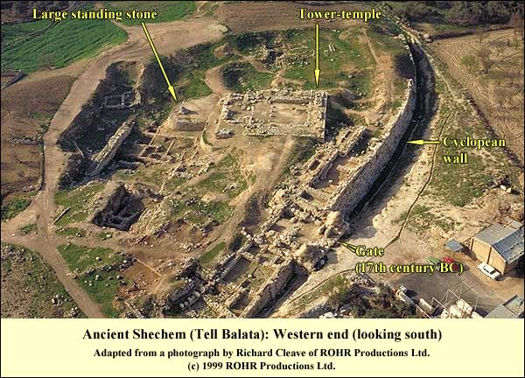
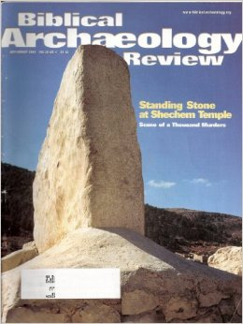
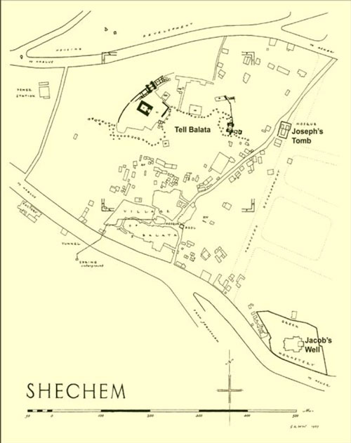
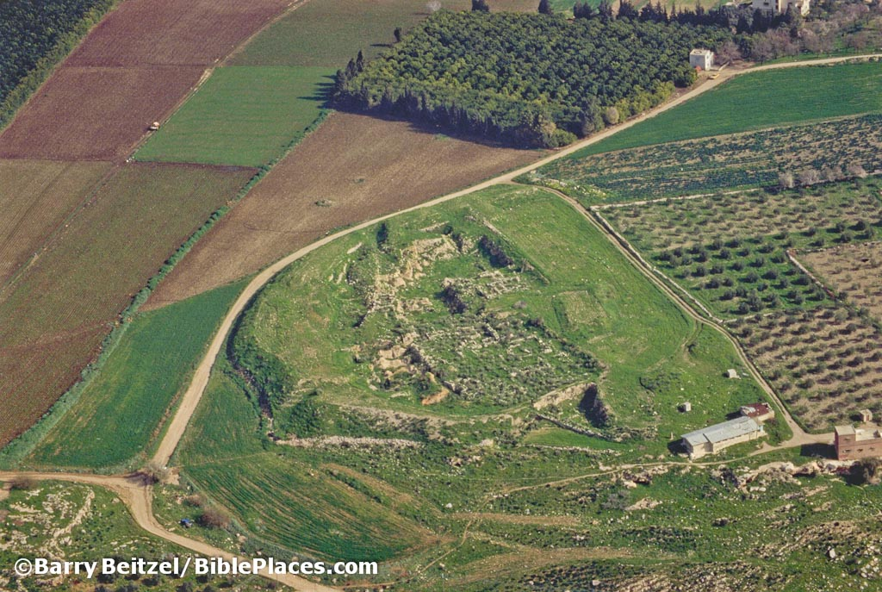
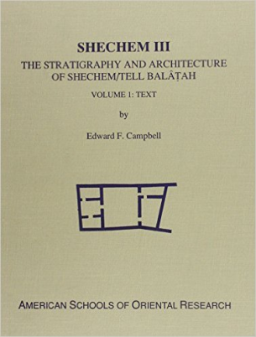
The Northern Kingdom
Jeroboam ruled his new kingdom first from the ancient city of Shechem for its central location and for its national and religious history relating to Abraham and Joshua. The site is known today as Tell Balatah near Nablus. The site was extensively excavated by German and American expeditions.
Tirzah, a city at the western end of the Wadi Far’ia, became the capital during the reigns of Baasha, Elah, Zimri and Omri. The site is known today as Tell el-Farah (North). Roland de Vaux excavated Tirzah from 1946-1960 for the French School of Biblical Archaeology in Jerusalem.
Both cities were strategically located and in a much better defensive position than Jerusalem. Omri later moved his capital from Tirzah to Samaria (discussed later).

Slide 8
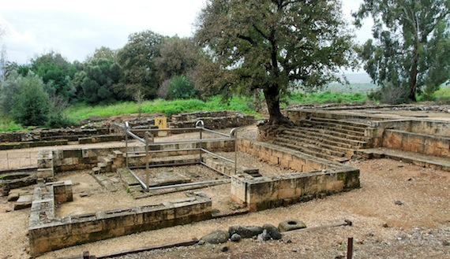
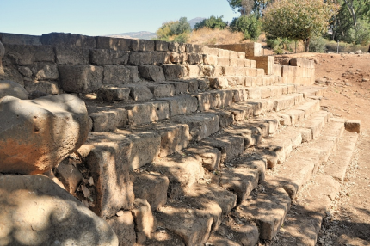
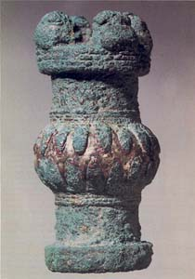
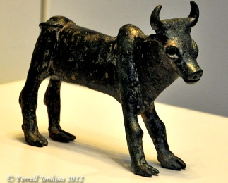
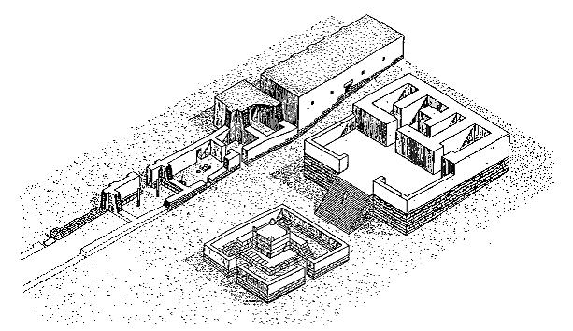
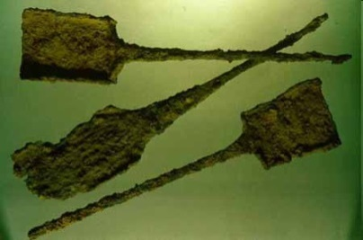
The Sanctuaries at Bethel and Dan
The Golden Calves at Bethel and Dan
²⁵ Then Jeroboam fortified Shechem in the hill country of Ephraim and lived there. From there he went out and built up Peniel.
²⁶ Jeroboam thought to himself, “The kingdom will now likely revert to the house of David. ²⁷ If these people go up to offer sacrifices at the temple of the Lord in Jerusalem, they will again give their allegiance to their lord, Rehoboam king of Judah. They will kill me and return to King Rehoboam.”
²⁸ After seeking advice, the king made two golden calves. He said to the people, “It is too much for you to go up to Jerusalem. Here are your gods, Israel, who brought you up out of Egypt.” ²⁹ One he set up in Bethel, and the other in Dan.³⁰ And this thing became a sin; the people came to worship the one at Bethel and went as far as Dan to worship the other.
At Dan, the sacred precinct built by Jeroboam, including the high place and altar platform for the Golden Calf have been discovered and partially restored. Also Found was a scepter head for a priest and incense shovels

Slide 9
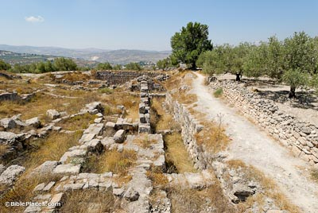
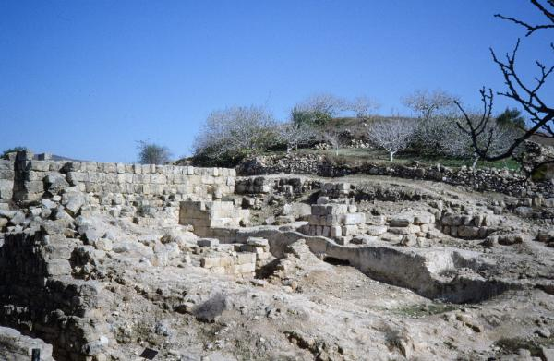
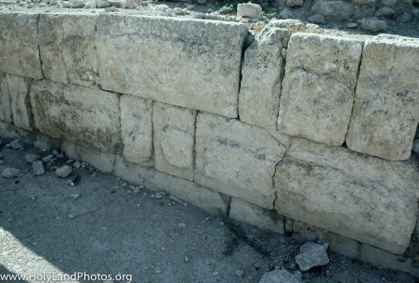
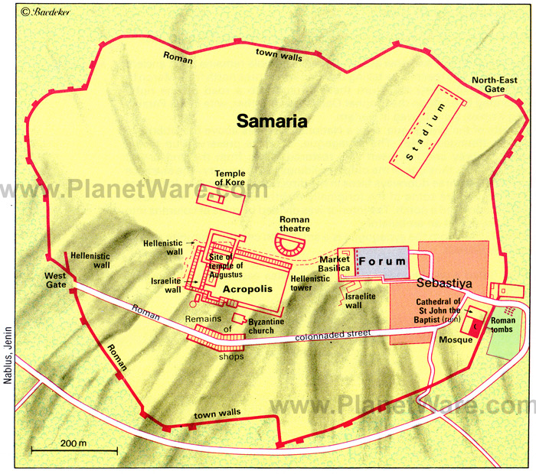
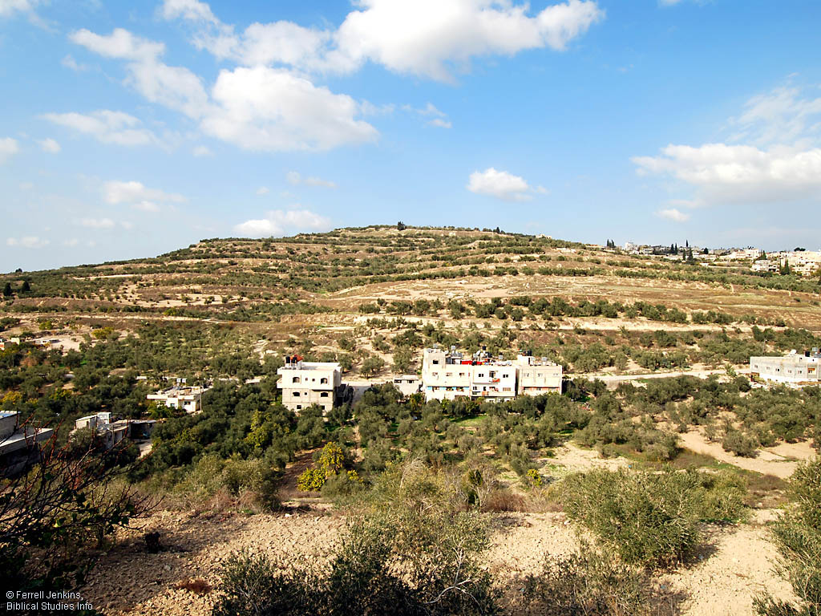
Samaria: Capital of the Northern Kingdom
King Omri purchased the hill of Samaria from Shemer and built a lavish and extensive city, including a rectangular acropolis, with palaces and a pool. A century later, Jeroboam II extended this acropolis. The lower city of Samaria was very large, as befitting a royal capital. A recent study has suggested a wall course around the city, based upon surveys and aerial photos. Later (first century AD) construction by the Romans obliterated much of the earlier remains, save for foundational levels.

Slide 10
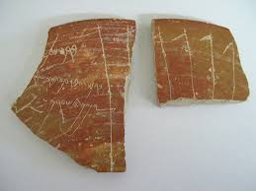
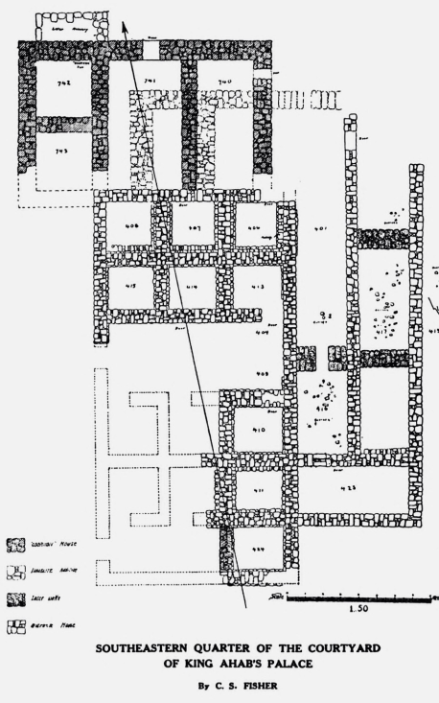
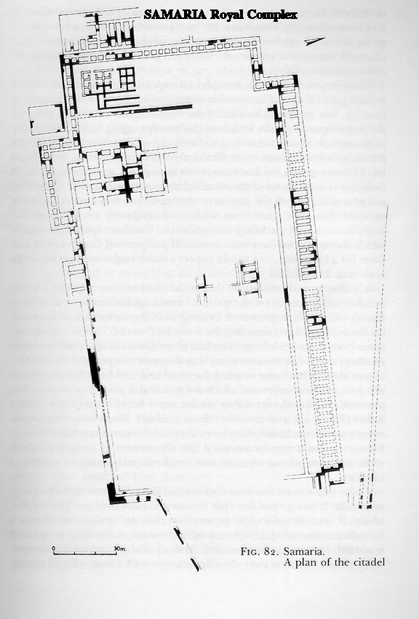
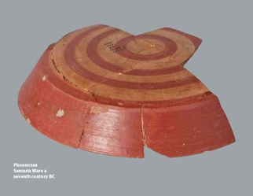
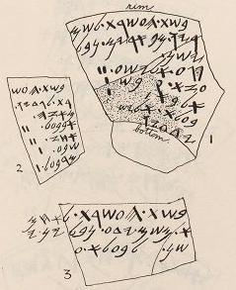
The Samaria Ostraca and Pottery
In 1910, George Reisner found 102 ostraca in the palace at Samaria. Less than 70 are legible and the corpus seem to date to around 800 BC. They are legers and receipts for goods arriving at the palace from farms of tribal clans of Manasseh as well as surrounding royal estates.
Samaria Ware (below) is found at Israelite sites. It is among the most highly and beautifully crafted pottery of the Iron Age and dates to the eighth century BC. Examples are uncommon, which means this probably served only the royal household and Israel’s elite.

Slide 11
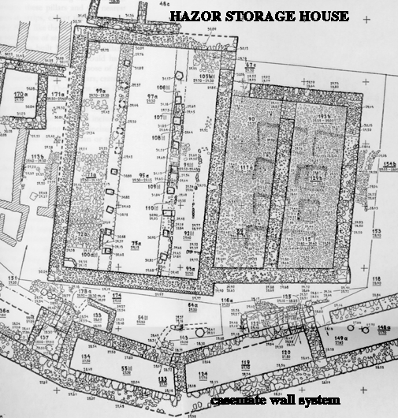
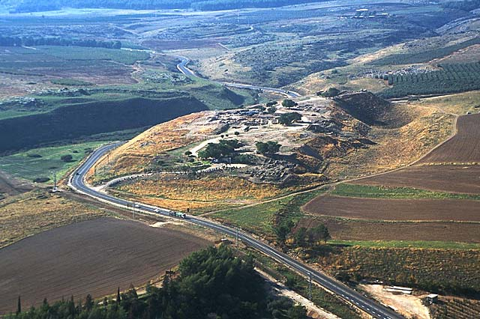
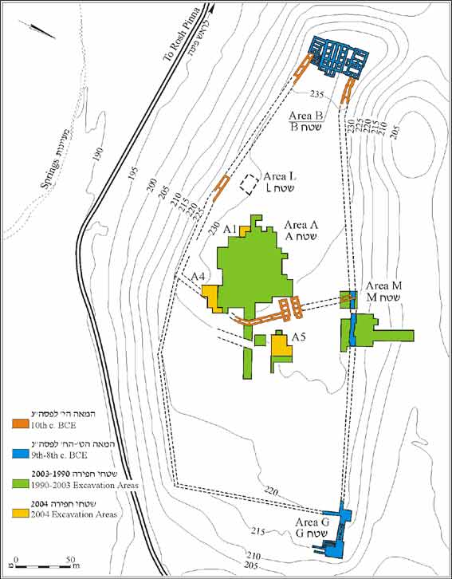
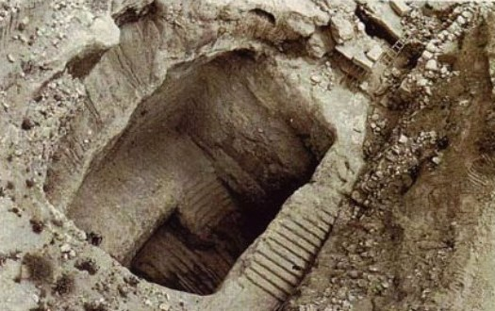
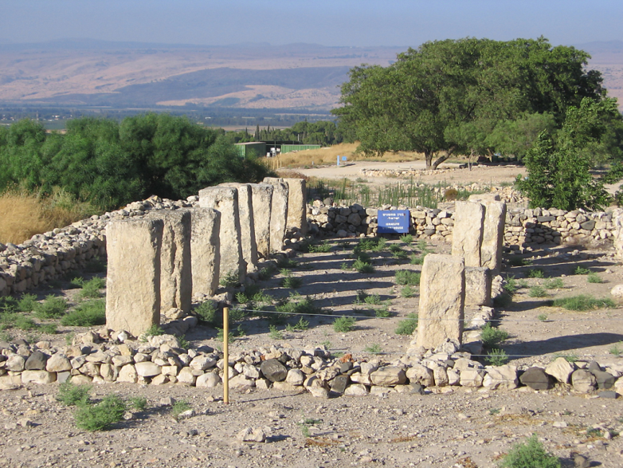
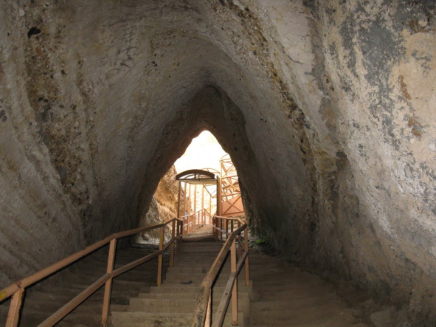
Royal Cities of Israel: Hazor
2 Kings 15:29 (NIV)
In the time of Pekah king of Israel, Tiglath-Pileser king of Assyria came and took Ijon, Abel Beth Maakah, Janoah, Kedesh and Hazor. He took Gilead and Galilee, including all the land of Naphtali, and deported the people to Assyria.

Slide 12
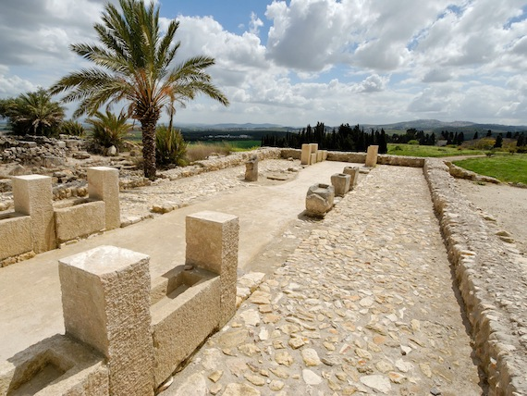
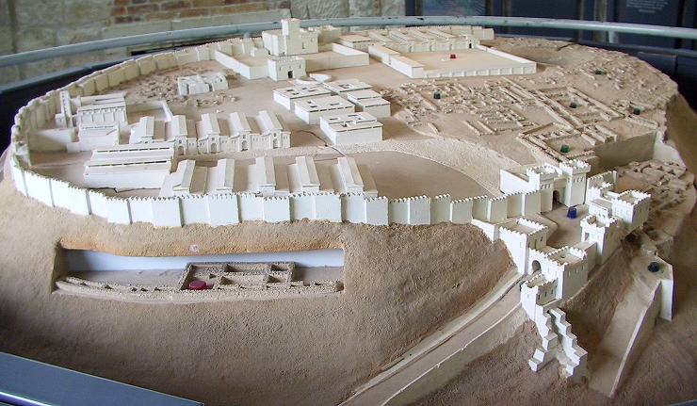
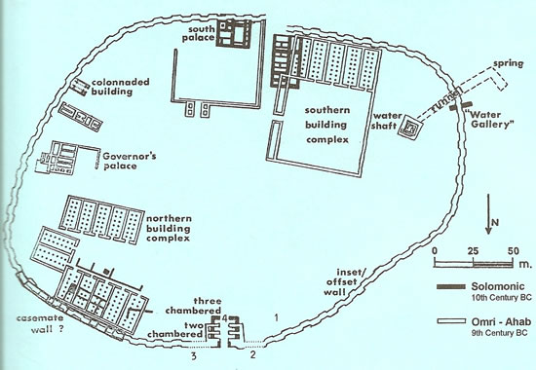
Royal Cities of Israel: Megiddo
Megiddo was a strategic city throughout its long history. David conquered and Solomon fortified and made it an administrative center (1 Kings 9:15). Later Ahab developed it as a major chariot and store city. Its stratigraphy and architecture is still debated, especially the Iron Age IIA-B levels (VA-IVB and IVA).

Slide 13
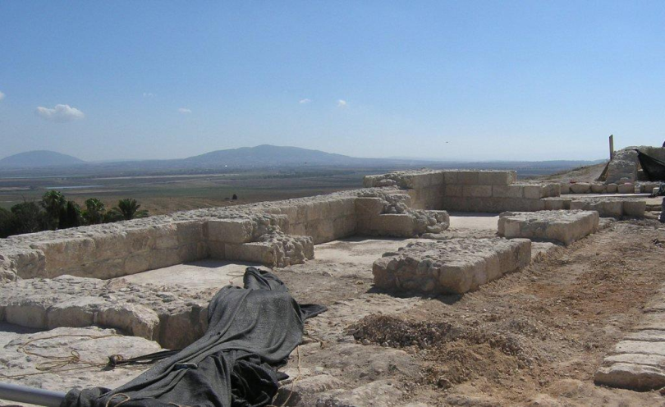
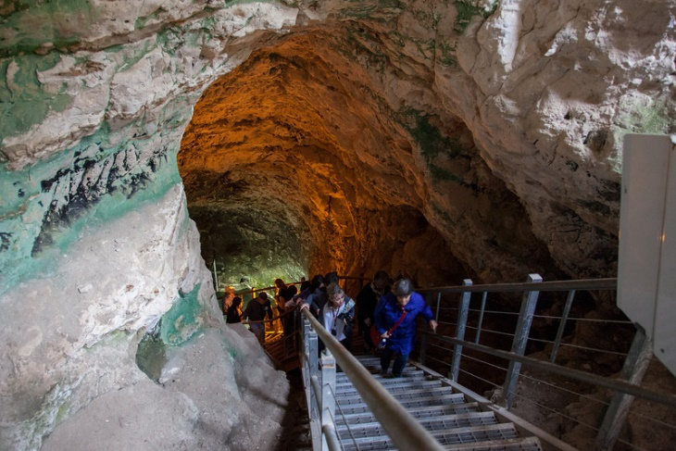
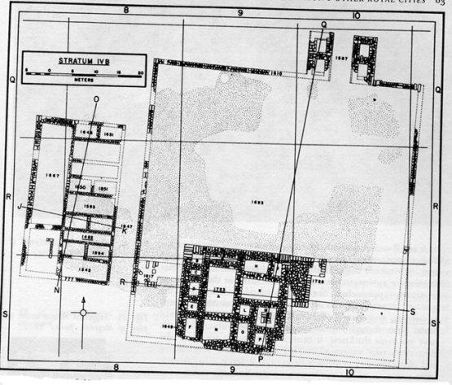
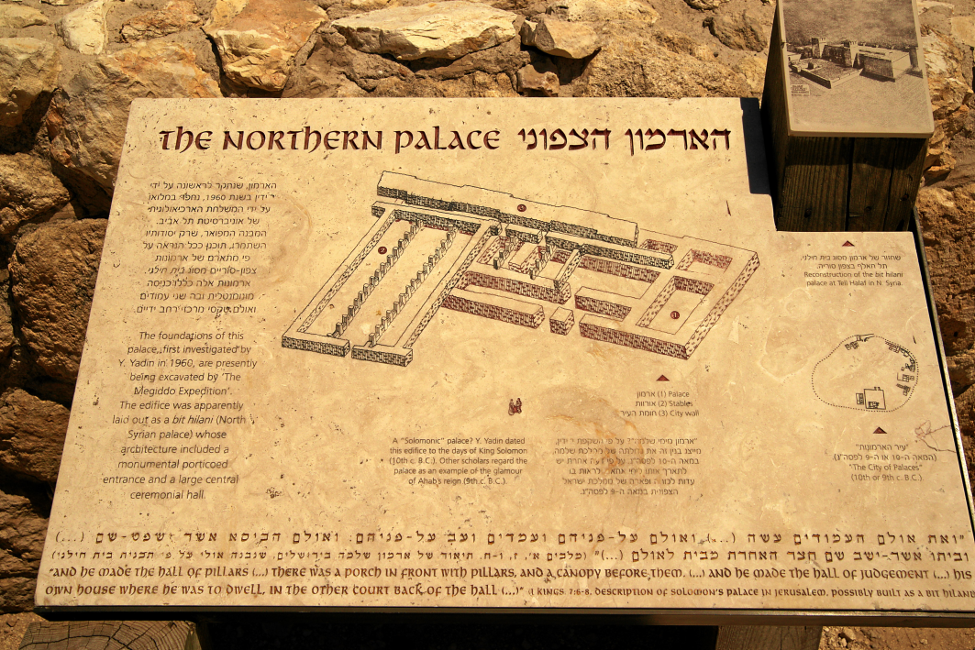
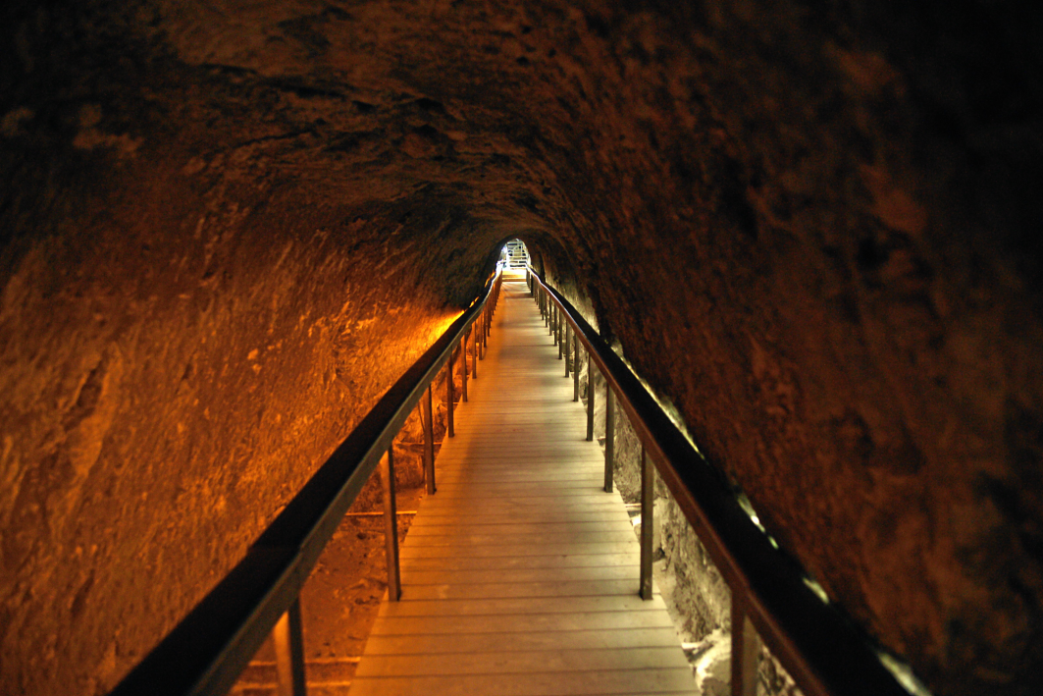
Megiddo: Additional Features
Megiddo also boasted a northern palace from the reign of Solomon (6000), a later palace (1723) and a monumental water shaft and tunnel that allowed its population to retrieve water from the spring at the foot of the mound without going outside the city. Megiddo was a “state of the art” city during the Old Testament.

Slide 14
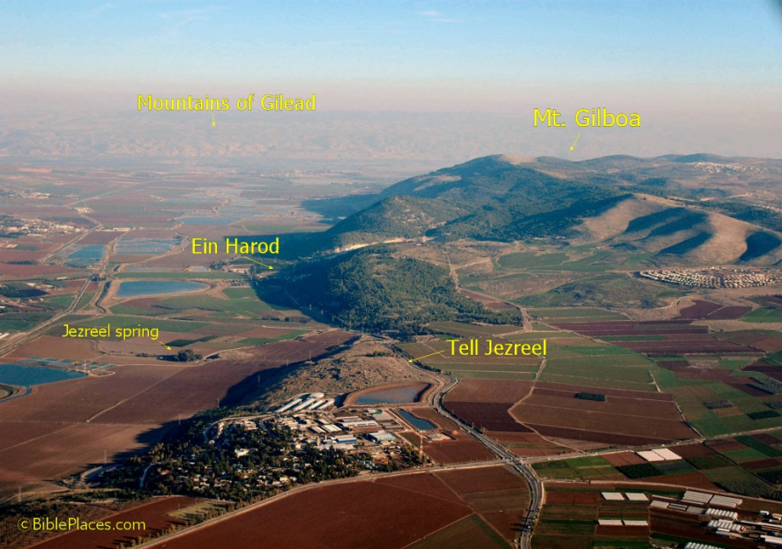
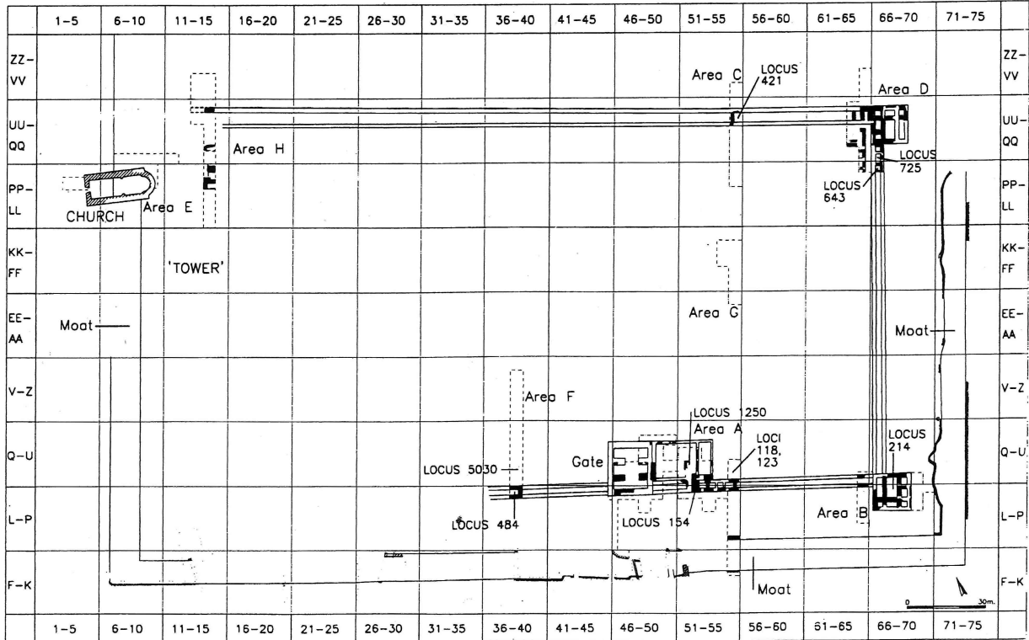
Royal Cities of Israel: Jezreel
Jezreel was a “second capital” for the Omride Dynasty of Israel (ca. 880-840 BC) for two reasons, its strategic location and its warm climate, ideal for a winter retreat from cold Samaria. Famous for the story of Naboth’s Vineyard (1 Kings 21), Jezreel was also a military center for chariotry and cavalry. In 2 Kings 9, Ahab has died and Jehoram, his son is king. A war with Aram brings dissatisfaction to the army and Jehu, a career soldier, leads a coup and takes power, killing Jehoram, king Ahaziah of Judah and Jezebel when he arrives at Jezreel. Jehu later murders all of the remaining Omride family members (2 Kings 10) at the temple of Ba’al in Samaria. Recent excavations revealed that the royal compound was poorly preserved, but boasted a four chamber gate, two corner towers and a monumental moat.

Slide 15
Monumental Art: The Volute Capital
Volute style column capitals, a variation of similar capitals known from Phoenicia and Cyprus, began to appear during the reign of Solomon. Artistic development of these continued at major Israelite and Judahite sites until the end of the monarchy.

Slide 16
Monumental Art: Window Balustrades
Window Balustrades from Ramat Rahel and a close Assyrian parallel on an Ivory plaque from Nimrud

Slide 17
The Pillar Figurines of Judah
Variants of these interesting terracotta figurines have been found at sites throughout Judah, but rare elsewhere. Are they fertility figurines or images of Asherah, the Canaanite goddess or both? What can they tell us about the political borders and religious life of Judah?

Slide 18
Religious Art: Cultic Bulls
The worship of Bulls was popular in Egypt (Apis Bulls) and among the Canaanites. The Bible deliberately names these pagan idols as calves as an implication to their religious impotence. The illustrations reflect various historical periods

Slide 19
Ancient Ivories from Samaria
The Prophet Amos ridiculed Israel and the wealthy of Samaria for their decadent lifestyle:
You lie on beds adorned with ivory and lounge on your couches. You dine on choice lambs and fattened calves (Amos 6:4).

Slide 20
The Woman at the Window
Judges 5:28:
Through the window peered Sisera’s mother; behind the lattice she cried out, ‘Why is his chariot so long in coming? Why is the clatter of his chariots delayed?’
2 Kings 9:30:
Then Jehu went to Jezreel. When Jezebel heard about it, she put on eye makeup, arranged her hair and looked out of a window.
Proverbs 7:6-13

Slide 21
Israelite Iconography
Seal of Jotham (son of Uzziah); “The Governor of the City" Seal; Seal of Ja’azaniah, Servant of the king (Zedekiah; Ezekiel 8:11, Tell en Nasbeh); Seal of Ma’adanah, daughter of the King (Jerusalem, 7th century BC); Seal of Jezebel; Seal of Manasseh, son of the king; Seal of Shema, Servant of Jeroboam (II); Seal of Hagab (Jerusalem, 7th century BC); Royal seals of Judah: Two and Four winged “lmlk” seal impressions (8th century BC) and a rosette seal impression (7th century BC)

Slide 22
The Ta’anach Cult Stand
This elaborate cultic stand was discovered at the ancient city of Ta’anach by Paul Lapp in 1968 in a 10th century BC context, during the reign of Solomon. The iconography of the stand is probably syncretistic in nature and seems to blend worship of YHWH with Canaanite motifs. Cult stands have been found at other sites, most recently Yavneh, but this is the largest, most ornate and detailed.

Slide 23
Battle of Qarqar in 853 BC
1 Kings 22:1: Three years of peace between Aram and Israel, ca. 853 BC (due to Assyrian threat). The OT makes no mention of this epic battle!
Kurkh Stele of Shalmaneser III describes a great battle between a Levantine coalition of kings and Assyria. King Ahab of Israel mentioned with 2000 chariots and 10,000 soldiers!
Perhaps this very large number includes client kingdoms of Judah, Moab and Edom (Kelle)
Claimed as a victory, but no further Assyrian campaigns in the west for a decade
Found in Turkey with another stele in 1861 and donated to the British Museum

Slide 24
The Death of Ahab at Ramoth Gilead
Ahab was a powerful king of Israel, but followed after his Phoenician wife Jezebel and worshipped pagan gods. A somewhat comical, but ultimately poignant account (1 Kings 22) relates to a joint military campaign against Aram by Israel and Judah. As was the custom, both Ahab of Israel and Jehoshaphat of Judah called forth prophets of Samaria to inquire what the LORD had told them concerning the upcoming battle. Then we pick up the narrative…
(read the account copied on the following slide).
Despite the ominous warning of Micaiah, Ahab and Jehoshaphat nevertheless led their armies across the Jordan River and climbed up to the Gilead plateau, where they fought a disastrous battle against Aram. Despite being dressed in disguise, Ahab was mortally wounded by an arrow and died at sunset. Micaiah’s prophecy was true. The photo below shows the site of Tell er-Rumeith, ancient Ramoth Gilead and the scene of Ahab’s death. The ruins are of a fortress from the time of Ahab and the archaeological report on the lower right.

Slide 25
Elijah and Elisha: Prophets of God
The photos and art here represent the dramatic events taken from the lives of Elijah and Elisha. Clockwise from right: The view from Mount Carmel looking east over the Jezreel Valley from near the scene of Elijah’s contest with the prophets of Ba’al (1 Kings 18); Elisha and the Shunamite woman (1 Kings 4:8-37); A statue of Elijah on Mount Carmel; A wine press at Jezreel, the remnants of Naboth’s vineyard (1 Kings 21).

Slide 26
Rise and Fall of the Northern Kingdom
The Northern Kingdom reached its height of power during the Jehu dynasty and especially under the rule of Jeroboam II (786-746 BC), but a series of coups after his death, coupled with the rise of Assyria, led to the fall of the kingdom in 722 BC. The Assyrian relief below depicts King Jehu of Israel bowing before Shalmaneser III of Assyria (ca. 840 BC). It is the only known image of an Israelite king yet known.

Slide 27
Judah and her Neighbors during the Reign of Jehoshaphat
After the defeat at Ramoth Gilead, where he barely escaped with his life, Jehoshaphat faced another threat, this time from Transjordan. He recognized that the odds were greatly stacked against him and Judah’s survival was in doubt. Jehoshaphat turned to God for divine deliverance. The account that follows in 2 Chronicles 20 describes an episode of Holy War, where the LORD fights on behalf of His people. The geo-political realities were as follows:
Israel (often Judah’s enemy, but now her unlikely ally) was directly to the North
Philistia (the Land of the Philistines) was to the South West
The Ammonites (the Land of Bene Ammon or Ammon) were across the Jordan to the East
The Moabites (the Land of Moab) were across the Dead Sea to the East
The Edomites (the Land or Edom: aka Mount Seir or the Meunites) were south and across the Dead Sea to the East
Jehoshaphat led a praise band, not an army, into battle and God faithfully delivered Judah that day.

Slide 28
The Mesha Stele
Dates to ca. 840 BC and is the longest Levantine inscription from the period of the Old Testament
Monumental stele erected by Mesha, king of Moab
Found at Dhiban in 1868.
Describes a war with Israel and Judah that is recorded in 2 Kings 3 as well as various building activities of Mesha.
Omri king of Israel and House of David are mentioned in this inscription

Slide 29
The En Gedi Region
En Gedi (Goat’s Spring) is an ancient biblical town along the Dead Sea shore. To the west, the rugged steppe of the Wilderness of Judah looms. Only a steep path, called the Ascent of Ziz, climbs up into Judah and Jerusalem.

Slide 30
Views from the Biblical “Ascent of Ziz”: The Climb from the Dead Sea, through the Judean Desert to the Hill Country and Tekoa

Slide 31
The Ascent of Ziz at the Desert of Tekoa: View to the Southeast from near Tekoa

Slide 32
The Valley of Berakah

Slide 33
The Joash Stele
A monumental Hebrew inscriptions supposedly found in a Muslim cemetery near the Temple Mount in Jerusalem.
Describes repairs made to the Temple by Joash, king of Judah in ca. 835-792 BC) as recorded in 2 Kings 12
Most scholars view this unprovenanced object as a forgery, but others argue for its genuiness.

Slide 35
The Reign of Uzziah of Judah (792-740 BC)
Uzziah reigned 52 years, built and fortified Jerusalem, and the cities of Judah; towers, cisterns and isolated posts such as Tamar and Ezion Geber
Successful wars with Philistines and Arabs (2 Chr 26:6-7)
Agricultural activities: Royal Estates, Desert farming and herding in Transjordan and control over the Negeb trade routes (2 Chr 26:8-10)
All of Judah’s citie show a flourishing, vigorous economy and strong military (2 Chr 26:11-15)
The palace at Ramat Rahel, a site 3 miles south of Jerusalem (biblical Beth Hakerem), was probably built during Uzziah’s reign to oversee the royal estate in the Rephaim Valley

Slide 36
Hezekiah and the Assyrian Crisis
Judah’s King Hezekiah revolted against Assyria in 705 BC and hurriedly prepared the nation for war. A long tunnel was hewn out of bedrock to bring water from the Gihon Spring into Jerusalem (2 Chronicles 32:30; upper right). A massive new wall surrounded the western part of Jerusalem (lower right) and thousands of storage jars with special royal stamps (below center) were distributed to all the fortified cities of Judah. A seal impression belonging to Hezekiah himself was also found (below left). A huge Assyrian army finally arrived in 701 BC and destroyed 46 of Judah’s largest cities. Jerusalem was miraculously saved, but the kingdom was devastated and rebuilding was slow. The experience led to a false belief, called Royal Zion Theology, which held that God would never allow Jerusalem to fall. Just over a century later Jerusalem was destroyed.

Slide 37
The Babylonian Exile

Slide 39
1 Kings 22:6-18
⁶ So the king of Israel brought together the prophets—about four hundred men—and asked them, “Shall I go to war against Ramoth Gilead, or shall I refrain?” “Go,” they answered, “for the Lord will give it into the king’s hand.” ⁷ But Jehoshaphat asked, “Is there no longer a prophet of the Lord here whom we can inquire of?” ⁸ The king of Israel answered Jehoshaphat, “There is still one prophet through whom we can inquire of the Lord, but I hate him because he never prophesies anything good about me, but always bad. He is Micaiah son of Imlah.” “The king should not say such a thing,” Jehoshaphat replied. ⁹ So the king of Israel called one of his officials and said, “Bring Micaiah son of Imlah at once.” ¹⁰ Dressed in their royal robes, the king of Israel and Jehoshaphat king of Judah were sitting on their thrones at the threshing floor by the entrance of the gate of Samaria, with all the prophets prophesying before them. ¹¹ Now Zedekiah son of Kenaanah had made iron horns and he declared, “This is what the Lord says: ‘With these you will gore the Arameans until they are destroyed.’”
¹² All the other prophets were prophesying the same thing. “Attack Ramoth Gilead and be victorious,” they said, “for the Lord will give it into the king’s hand.” ¹³ The messenger who had gone to summon Micaiah said to him, “Look, the other prophets without exception are predicting success for the king. Let your word agree with theirs, and speak favorably.” ¹⁴ But Micaiah said, “As surely as the Lord lives, I can tell him only what the Lord tells me.” ¹⁵ When he arrived, the king asked him, “Micaiah, shall we go to war against Ramoth Gilead, or not?” “Attack and be victorious,” he answered, “for the Lord will give it into the king’s hand.” ¹⁶ The king said to him, “How many times must I make you swear to tell me nothing but the truth in the name of the Lord?” ¹⁷ Then Micaiah answered, “I saw all Israel scattered on the hills like sheep without a shepherd, and the Lord said, ‘These people have no master. Let each one go home in peace.’”
¹⁸ The king of Israel said to Jehoshaphat, “Didn’t I tell you that he never prophesies anything good about me, but only bad?”

Slide 40
Jehoshaphat’s Holy War (2 Chronicles 20:1-30)
Jehoshaphat Defeats Moab and Ammon
20 After this, the Moabites and Ammonites with some of the Meunites came to wage war against Jehoshaphat. ² Some people came and told Jehoshaphat, “A vast army is coming against you from Edom, from the other side of the Dead Sea. It is already in Hazezon Tamar” (that is, En Gedi). ³ Alarmed, Jehoshaphat resolved to inquire of the Lord, and he proclaimed a fast for all Judah. ⁴ The people of Judah came together to seek help from the Lord; indeed, they came from every town in Judah to seek him. ⁵ Then Jehoshaphat stood up in the assembly of Judah and Jerusalem at the temple of the Lord in the front of the new courtyard ⁶ and said: “Lord, the God of our ancestors, are you not the God who is in heaven? You rule over all the kingdoms of the nations. Power and might are in your hand, and no one can withstand you. ⁷ Our God, did you not drive out the inhabitants of this land before your people Israel and give it forever to the descendants of Abraham your friend? ⁸ They have lived in it and have built in it a sanctuary for your Name, saying, ⁹ ‘If calamity comes upon us, whether the sword of judgment, or plague or famine, we will stand in your presence before this temple that bears your Name and will cry out to you in our distress, and you will hear us and save us.’ ¹⁰ “But now here are men from Ammon, Moab and Mount Seir, whose territory you would not allow Israel to invade when they came from Egypt; so they turned away from them and did not destroy them. ¹¹ See how they are repaying us by coming to drive us out of the possession you gave us as an inheritance. ¹² Our God, will you not judge them? For we have no power to face this vast army that is attacking us. We do not know what to do, but our eyes are on you.” ¹³ All the men of Judah, with their wives and children and little ones, stood there before the Lord. ¹⁴ Then the Spirit of the Lord came on Jahaziel son of Zechariah, the son of Benaiah, the son of Jeiel, the son of Mattaniah, a Levite and descendant of Asaph, as he stood in the assembly. ¹⁵ He said: “Listen, King Jehoshaphat and all who live in Judah and Jerusalem! This is what the Lord says to you: ‘Do not be afraid or discouraged because of this vast army. For the battle is not yours, but God’s. ¹⁶ Tomorrow march down against them. They will be climbing up by the Pass of Ziz, and you will find them at the end of the gorge in the Desert of Jeruel. ¹⁷ You will not have to fight this battle. Take up your positions; stand firm and see the deliverance the Lord will give you, Judah and Jerusalem. Do not be afraid; do not be discouraged. Go out to face them tomorrow, and the Lord will be with you.’” ¹⁸ Jehoshaphat bowed down with his face to the ground, and all the people of Judah and Jerusalem fell down in worship before the Lord. ¹⁹ Then some Levites from the Kohathites and Korahites stood up and praised the Lord, the God of Israel, with a very loud voice. ²⁰ Early in the morning they left for the Desert of Tekoa. As they set out, Jehoshaphat stood and said, “Listen to me, Judah and people of Jerusalem! Have faith in the Lord your God and you will be upheld; have faith in his prophets and you will be successful.” ²¹ After consulting the people, Jehoshaphat appointed men to sing to the Lord and to praise him for the splendor of his holiness as they went out at the head of the army, saying: “Give thanks to the Lord, for his love endures forever.” ²² As they began to sing and praise, the Lord set ambushes against the men of Ammon and Moab and Mount Seir who were invading Judah, and they were defeated. ²³ The Ammonites and Moabites rose up against the men from Mount Seir to destroy and annihilate them. After they finished slaughtering the men from Seir, they helped to destroy one another. ²⁴ When the men of Judah came to the place that overlooks the desert and looked toward the vast army, they saw only dead bodies lying on the ground; no one had escaped. ²⁵ So Jehoshaphat and his men went to carry off their plunder, and they found among them a great amount of equipment and clothing and also articles of value—more than they could take away. There was so much plunder that it took three days to collect it. ²⁶ On the fourth day they assembled in the Valley of Berakah, where they praised the Lord. This is why it is called the Valley of Berakah to this day. ²⁷ Then, led by Jehoshaphat, all the men of Judah and Jerusalem returned joyfully to Jerusalem, for the Lord had given them cause to rejoice over their enemies. ²⁸ They entered Jerusalem and went to the temple of the Lord with harps and lyres and trumpets. ²⁹ The fear of God came on all the surrounding kingdoms when they heard how the Lord had fought against the enemies of Israel. ³⁰ And the kingdom of Jehoshaphat was at peace, for his God had given him rest on every side.

