Slide 1
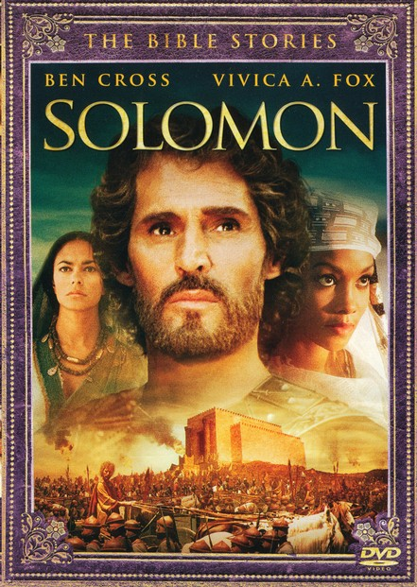
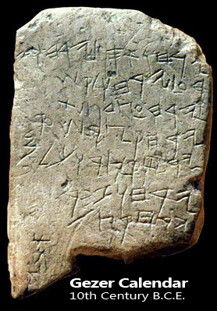
1 Kings: The Reign of Solomon
The Gezer Calendar was a school writing exercise describing the agricultural months of the year from the time of Solomon. It was found over 100 years ago at Gezer, a city Solomon built (1 Kings 9:17).

Slide 2
1 Kings: The Background of the Book
Kings is part of the Deuteronomistic History: A Selective Historical Narrative with a dominant Theological Message and assessment of each king.
Archival Information, which is cited in the text, is taken from Israelite Records, such as the Chronicles of the Kings of Israel and Judah, which has been lost.
The Royal Formula dates each reign by synchronizing it with the corresponding king in either Israel or Judah; names the mother, gives a (usually) brief account of the reign, a theological assessment; and death and burial details
Why was Kings Written?: Kings was written to answer the questions regarding the reasons for the Babylonian Exile (586-539 BC)
The Theology of Kings is Cumulative Retribution: The sins of the fathers are atoned for by their descendants

Slide 3
Solomon’s Reign

Slide 4
Solomon versus Adonijah: The Succession Conflict 1 Kings 1
Entrance to the
Gihon Spring
En Rogel (Job’s Well): Jerusalem in the Background

Slide 5
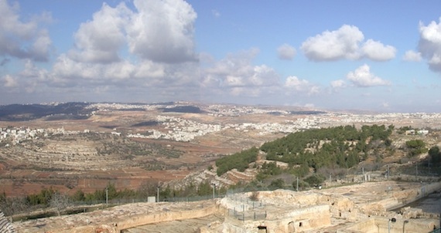
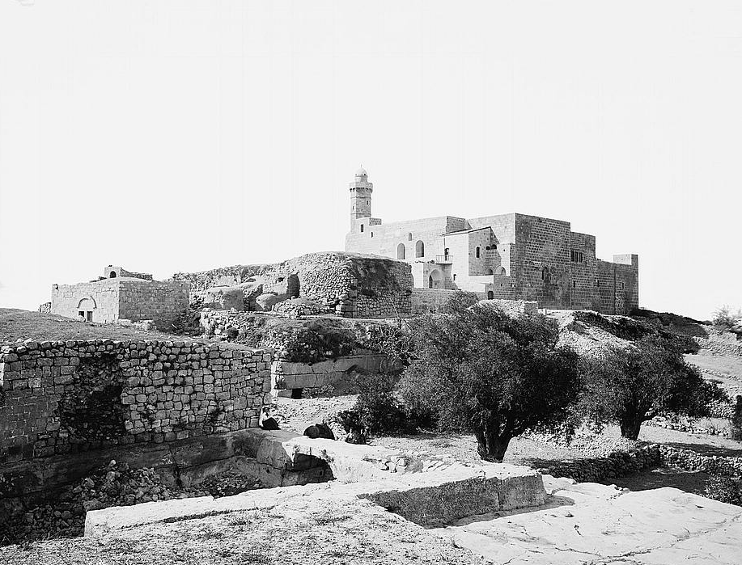
Solomon asks the Lord for Wisdom: at the High Place of Gibeon 1 Kings 3: This site is identified today with Nabi Samwil, a high hill north of Jerusalem with a prominent mosque and minaret (lower two slides).
Notes:
God granted riches, long life and victory over enemies

Slide 6
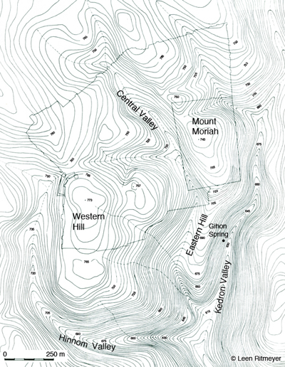
Jerusalem in the Old Testament Jerusalem grew under Solomon from 8 to 12 acres, incorporating the Temple Mount (Mount Zion / Mount Moriah). Later during the ninth and eighth century BC, the city grew to the west and north, reaching 150 acres by the early sixth century BC.

Slide 7
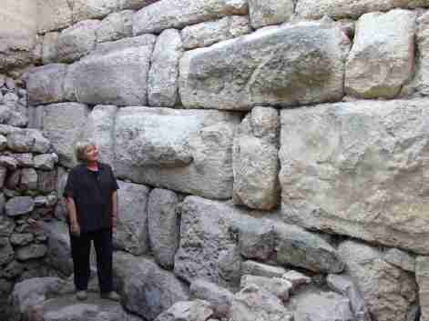
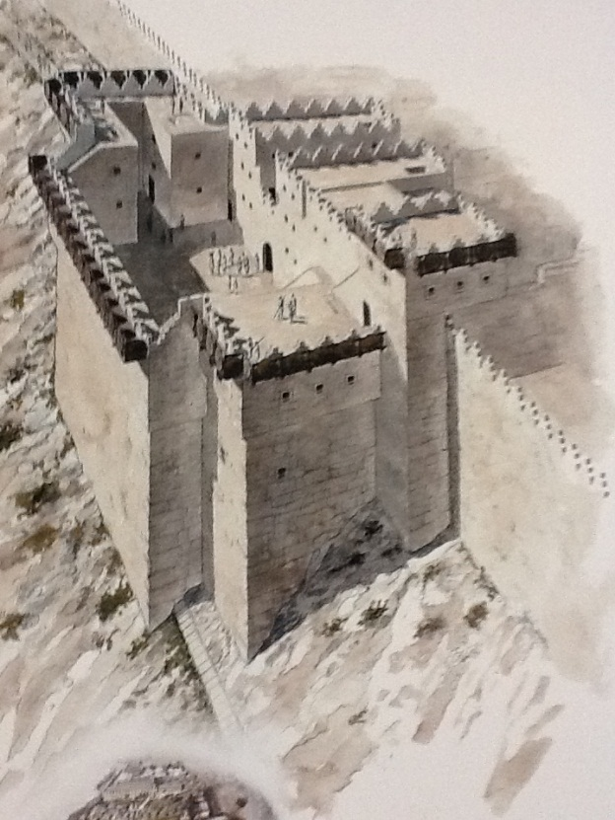
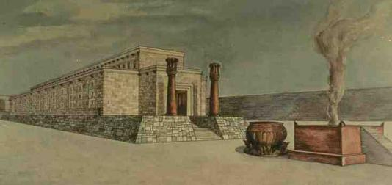
Jerusalem at the time of Solomon

Slide 8
Solomon’s Royal Gardens: Solomon created beautiful terraced gardens along both slopes of the Kidron (or King’s) Valley pictured below

Slide 9
The Solomonic Empire
Solomon inherited David’s empire, but ceded land to the Phoenicians in return for their assistance in construction and shipping trade (the Land of Cabel, see a slide below). Unlike David, Solomon’s reign was relatively free from conflicts with foreign powers and Solomon had a great economic and trading empire that included the ports of Joppa and Ezion Geber on the Mediterranean and Red Seas. From these ports expeditions were launched to Africa, Arabia and exotic destinations in the Western part of the Mediterranean Sea. Solomon married the daughter of an Egyptian pharaoh, probably Siamun of the 21 dynasty and was given the city of Gezer as a dowry.

Slide 10
Solomon’s Administrative Districts: 1 Kings 4
Solomon’s Twelve Administrative Districts
Adapted from Map 113 in The Carta Bible Atlas, 4th edition
Solomon divided Israel into twelve districts , each with its own capital, that roughly followed the twelve tribal boundaries. Each district was responsible for supplying the royal household for one month a year. Absent from this list is the tribe of Judah, from which comes the Davidic line. Scholars are divided on how to interpret this omission. Was Judah exempt from taxes? Perhaps this contributed to the split of the kingdom after Solomon’s death.
District Twelve (1 Kings 4:19) is located in Transjordan and identified with Heshbon on the basis of the Hebrew text behind the Greek translation of the Old Testament (LXX)
Geber son of Uri—in Gilead (the country of Sihon king of the Amorites and the country of Og king of Bashan). He was the only governor over the district (NIV)
Gaber son of Adai in the land of Gad, [the land] of Sihon{gr.Seon} king of Heshbon {gr. Esebon}, and of Og king of Bashan {gr. Basan}, and one officer in the land of Judah (LXX)
The organization of District 12 possibly derives from the tribal roster of Reuben (Josh 13:15-23)
Notes:
G. Ernest Wright, The Provinces of Solomon, Eretz Israel 8 (E. L. Sukenik Memorial Volume): 67*-68*
Ernst Axel Knauf, King Solomon's Copper Supply: E. Lipinski ed., Phoenicia and the Bible: Studia Phoenicia XI. Leuven:
Peeters, 1991, 167-186.
Alt, Noth, Wright, Aharoni emend the LXX reading
Albright (corrupt, emends to Judah), Oded, Na’aman (emends to Judah), Kallai (follows MT but locates district around Heshbon).
Rainey (Rainey and Notley 2006: 177) restores Heshbon to the list, but rejects Gad as Gilead referred to the entire Israelite settlement in Transjordan.

Slide 11
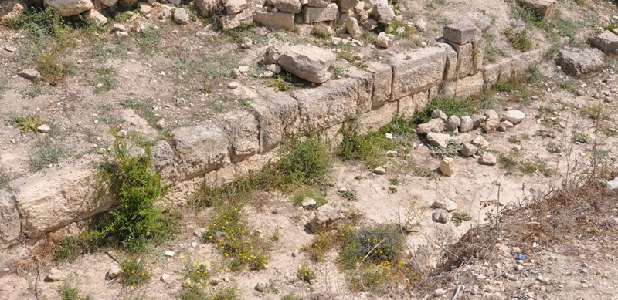
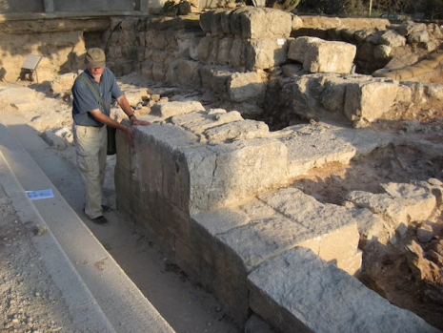
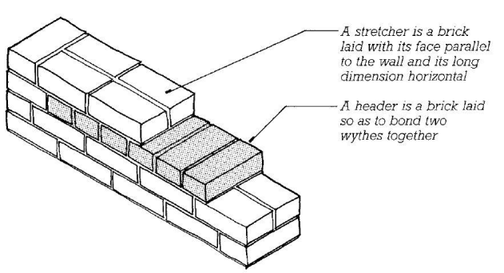
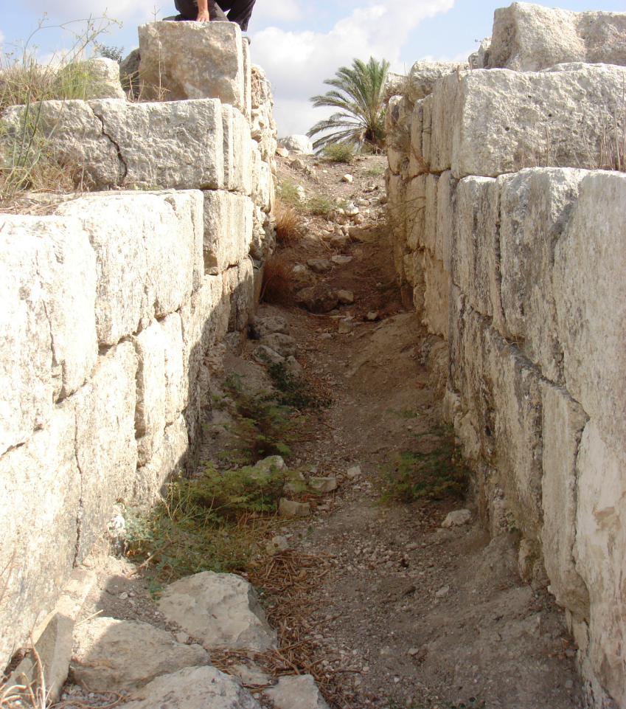
Solomonic Header-Stretcher Ashlar Walls from Heshbon (Reservoir Wall) and Megiddo (Gallery 629)

Slide 12
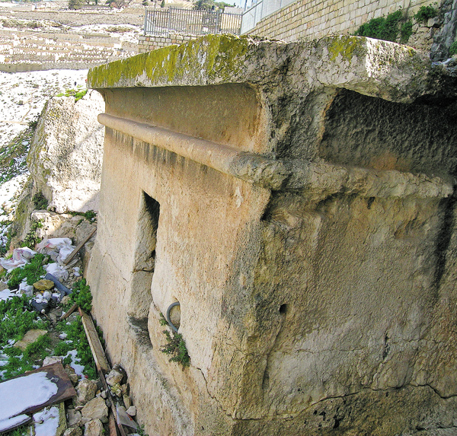
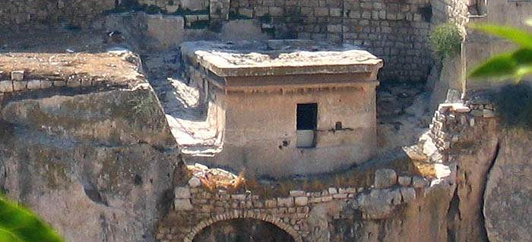
Solomon’s Wives: The Tomb of Pharaoh’s Daughter in Jerusalem 1 Kings 3

Slide 13
Shunem: Home of the Shulamite Girl (Solomon’s first wife) with the Hill of Moreh in the back

Slide 14
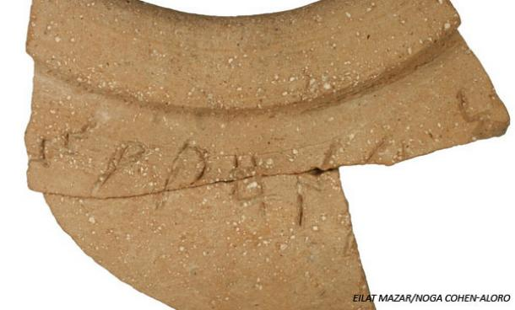
The Floruit of Israelite Culture
Red Burnished Pottery from the Temple Mount, Jerusalem, dating to the time of Solomon
A Cultural, Artistic, Economic and Literary Renaissance
The material culture of Israel flourished during Solomon’s reign
The Age of Solomon produced a wealth of wisdom literature such as these books:
Proverbs
Ecclesiastes
Song of Songs
This recently discovered ostracon (to the right) may read “cheap wine” and was part of a storage jar rim from the time of Solomon. The wine was probably issued to workers on royal projects in Jerusalem, including the Temple and palace complex.

Slide 15
Façade of Solomon’s Temple 1 Kings 8:22-61

Slide 16
Solomon’s Temple According to 1 Kings 6-7

Slide 17
The Ain Dara Temple: A Temple remarkably similar to Solomon’s Temple was found in northern Syria

Slide 18
Comparative Temple Floor plans
A Comparison with the Solomonic Temple
The Ain Dara Temple

Slide 19
Sphinx or Cherub Figure at Ain Dara

Slide 20
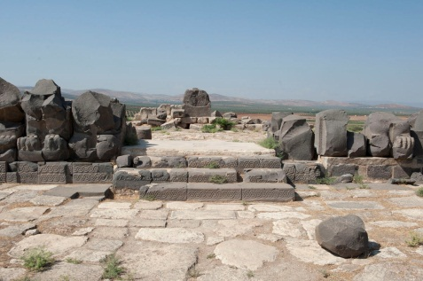
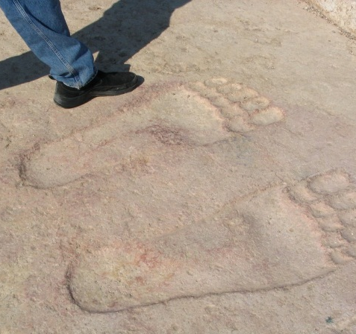
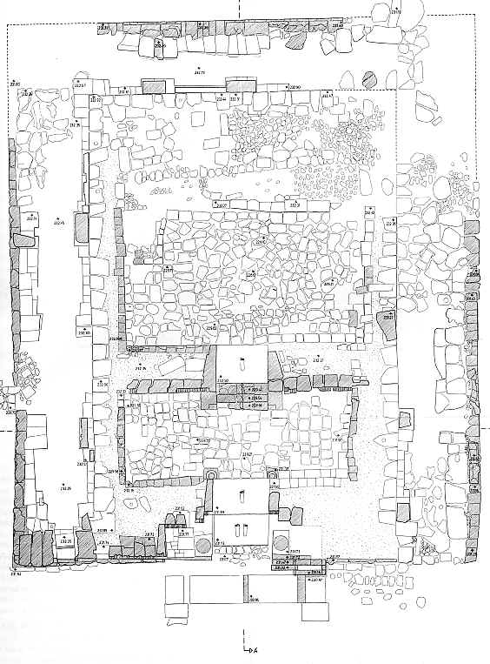
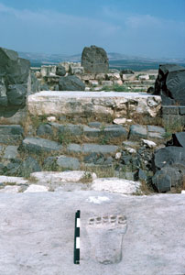
“The Footsteps of God” at Ain Dara

Slide 21
Latticed Windows and Ornamental Design at Ain Dara:
Similar windows with lattices were installed in Solomon’s Temple
(1 Kings 6)

Slide 22
Solomon’s Palace and Temple Later construction on the Temple Mount has eradicated any evidence (thus far) of Solomonic structures, but similar temples and palaces have been excavated elsewhere, such as Tell Tayinat in Turkey
Recreation of Solomon’s Palace and Temple
The Palace and Temple at Tell Tayinat, Turkey

Slide 23
The Growth of the Temple Mount

Slide 24
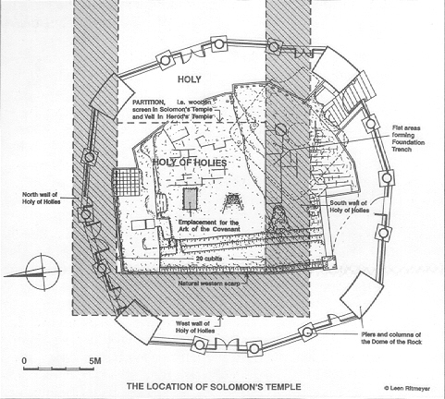
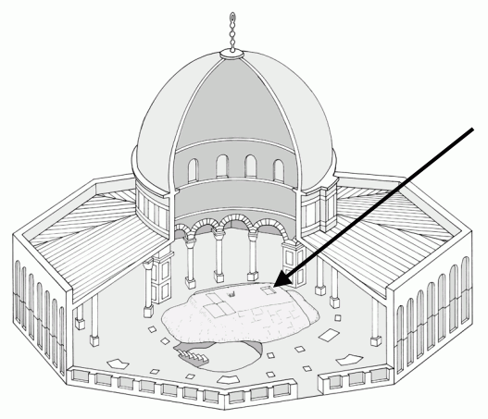
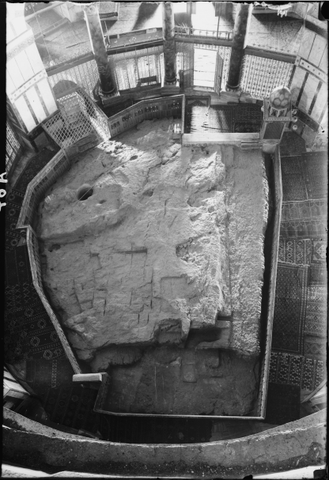
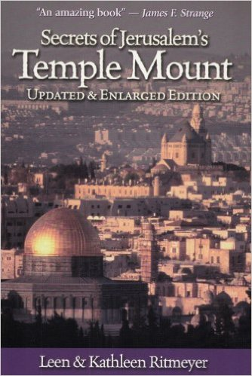
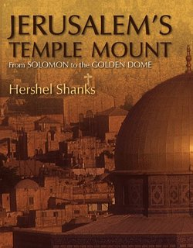
Have the Foundations of Solomon’s Temple been Found?
Inside the rotunda of the Muslim shrine called the Dome of the Rock is a large exposed area of bedrock called Al Sakhra. Archaeologist Leen Ritmeyer has carefully studied this sacred area and determined that foundation cuts for two of the walls of Solomon’s Temple exist on this bedrock, as well as a shallow, rectangular depression for the Ark of the Covenant itself! The building is now off limits for non Muslims, in part to Ritmeyer’s findings.

Slide 25
An Underground Reservoir near the Temple from the Time of Solomon Uncovered in 2012

Slide 26
Biblical Archaeology and 1 Kings 9:10-28
Solomon’s Other Activities
¹⁰ At the end of twenty years, during which Solomon built these two buildings—the temple of the Lord and the royal palace— ¹¹ King Solomon gave twenty towns in Galilee to Hiram king of Tyre, because Hiram had supplied him with all the cedar and juniper and gold he wanted. ¹² But when Hiram went from Tyre to see the towns that Solomon had given him, he was not pleased with them.¹³ “What kind of towns are these you have given me, my brother?” he asked. And he called them the Land of Cabul, a name they have to this day. ¹⁴ Now Hiram had sent to the king 120 talents of gold.
¹⁵ Here is the account of the forced labor King Solomon conscripted to build the Lord’s temple, his own palace, the terraces, the wall of Jerusalem, and Hazor, Megiddo and Gezer. ¹⁶ (Pharaoh king of Egypt had attacked and captured Gezer. He had set it on fire. He killed its Canaanite inhabitants and then gave it as a wedding gift to his daughter, Solomon’s wife. ¹⁷ And Solomon rebuilt Gezer.) He built up Lower Beth Horon, ¹⁸ Baalath, and Tadmor in the desert, within his land, ¹⁹ as well as all his store cities and the towns for his chariotsand for his horses—whatever he desired to build in Jerusalem, in Lebanon and throughout all the territory he ruled.
²⁰ There were still people left from the Amorites, Hittites, Perizzites, Hivites and Jebusites (these peoples were not Israelites). ²¹ Solomon conscripted the descendants of all these peoples remaining in the land—whom the Israelites could not exterminate—to serve as slave labor, as it is to this day. ²² But Solomon did not make slaves of any of the Israelites; they were his fighting men, his government officials, his officers, his captains, and the commanders of his chariots and charioteers. ²³ They were also the chief officials in charge of Solomon’s projects—550 officials supervising those who did the work.
²⁴ After Pharaoh’s daughter had come up from the City of David to the palace Solomon had built for her, he constructed the terraces.
²⁵ Three times a year Solomon sacrificed burnt offerings and fellowship offerings on the altar he had built for the Lord, burning incense before the Lord along with them, and so fulfilled the temple obligations.
²⁶ King Solomon also built ships at Ezion Geber, which is near Elath in Edom, on the shore of the Red Sea. ²⁷ And Hiram sent his men—sailors who knew the sea—to serve in the fleet with Solomon’s men. ²⁸ They sailed to Ophir and brought back 420 talents of gold, which they delivered to King Solomon.

Slide 27
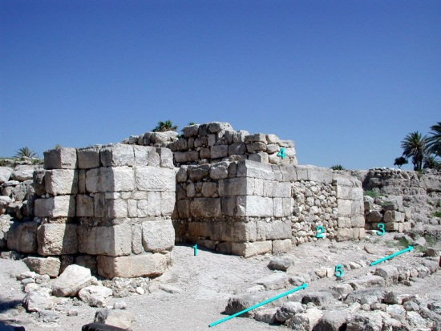
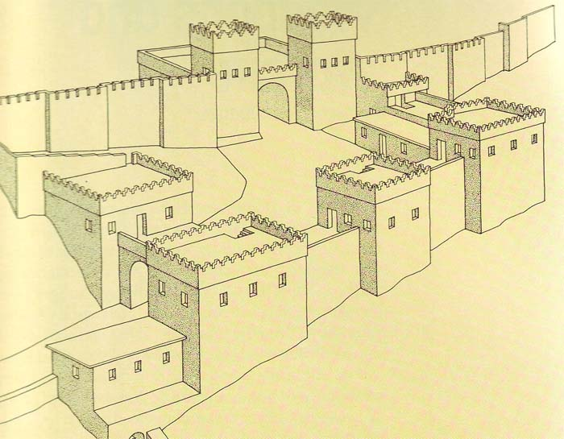
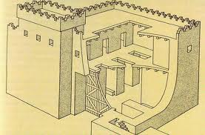
Solomon’s “Chariot Cities” 1 Kings 9:15
Gezer: Given as a dowry by Pharaoh Siamun
Hazor: Conquered from the Canaanites and rebuilt

Slide 28
The Gate “Blueprint” of Solomon’s Chariot Cities

Slide 29
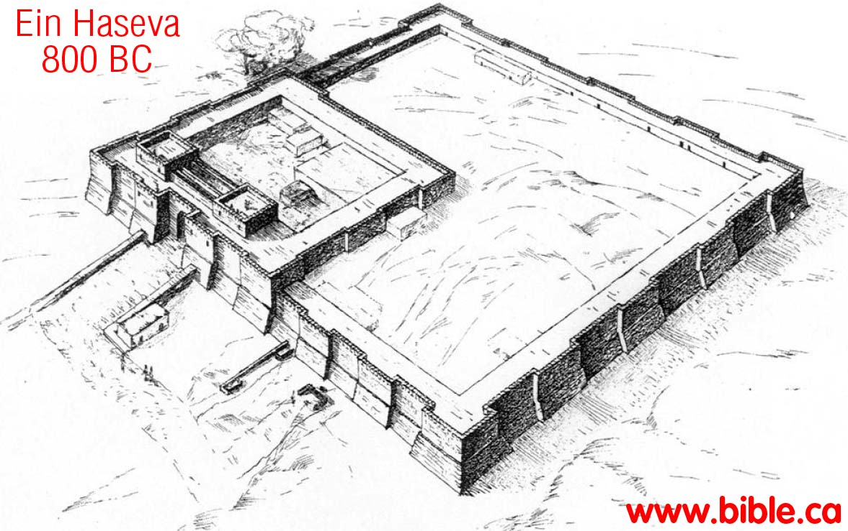
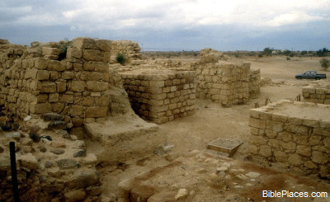
Solomon’s Outposts: Tamar or Tadmor So Solomon rebuilt Gezer and the lower Beth-horon and Baalath and Tamar in the wilderness, in the land of Judah (1 Kings 9:17-18)

Slide 30
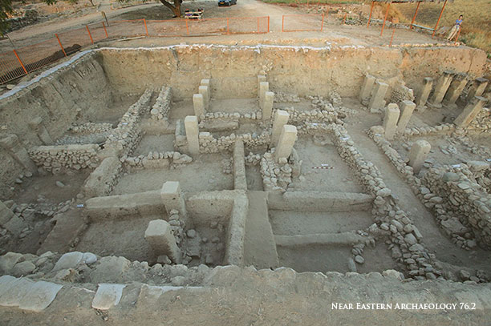
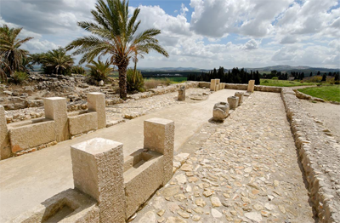
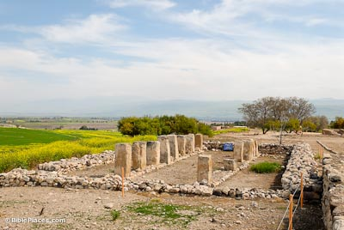
Solomon’s Storehouses and Stables
Stables at Megiddo
Storehouses at Beer Sheba
Notes:
Bottom two photos are the new tripartite building and the old tripartite building at Hazor

Slide 31
The Queen of Sheba 1 Kings 10:1-13

Slide 32
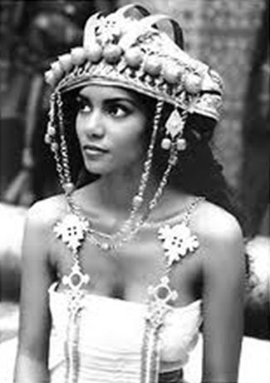
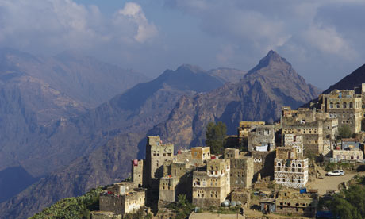
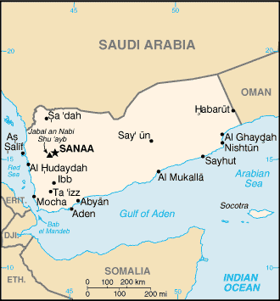
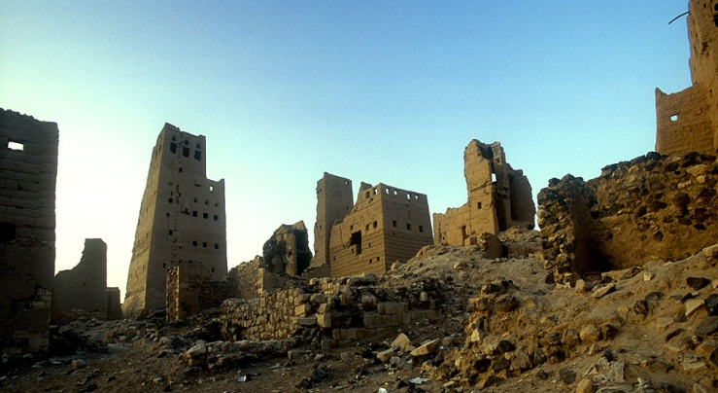
The Biblical Land of Sheba Located in Modern Yemen, a recently discovered inscription in Sabaen mentions trade with Judah
Modern Views of Yemen
Trade with “towns of Judah”
Notes:
Ancient Marib, Capital of the Sabaeans

Slide 33
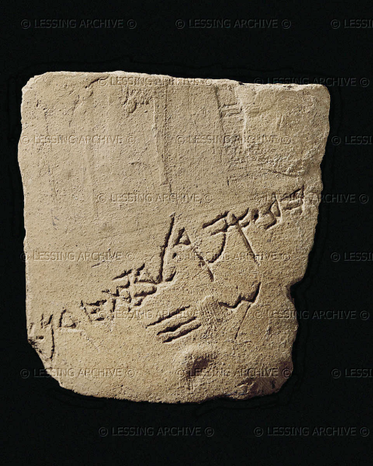
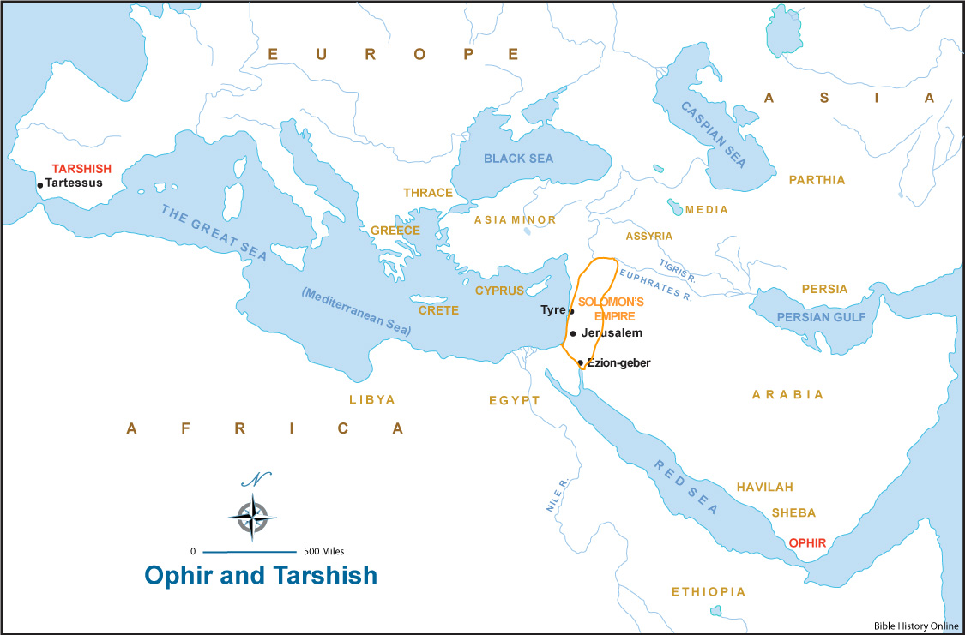
The Fabled Sites of Ophir and Tarshish
An ostracon found at Tell Qasile read "Gold of Ophir to Beth-Horon...30 shekels"
"Moreover, in my delight in the house of my God, the treasure I have of gold and silver, I give to the house of my God, over and above all that I have already provided for the holy temple, namely, 3,000 talents of gold, of the gold of Ophir, and 7,000 talents of refined silver, to overlay the walls of the buildings.” ( I Chronicles 29:3-4)
Where is biblical Ophir and Tarshish? Nobody knows for certain! Locations as far away as Spain, India and Mozambique have been suggested!
“For the king had at sea the ships of Tarshish with the ships of Hiram; once every three years the ships of Tarshish came bringing gold and silver, ivory and apes and peacocks.”
(1 Kings 10:22)

Slide 34
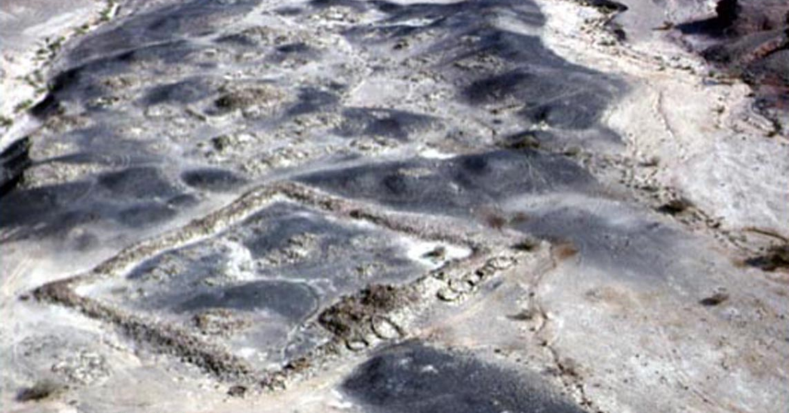
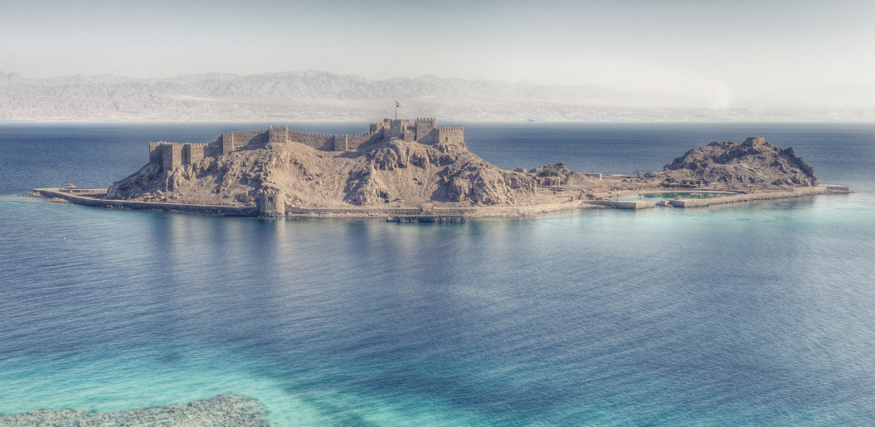
Solomon’s Activities
Huge Copper Mines in the Arava; Khirbet al Nahas in Jordan
Maritime ventures with Hiram, King of Tyre; Ezion Geber on the Red Sea

Slide 35
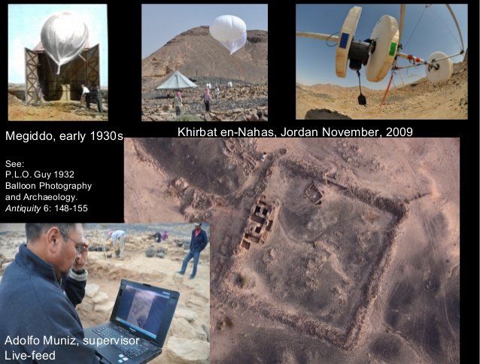
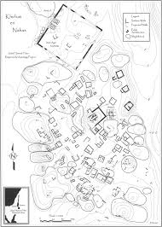
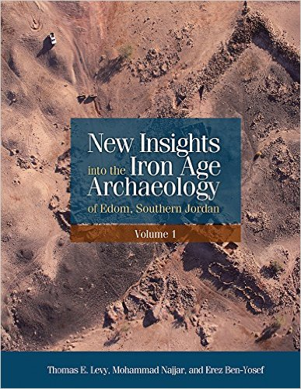
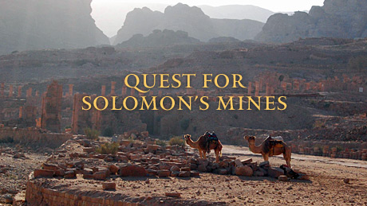
The Edom Lowland Project
A high tech UCSD project led by Thomas Levy recently uncovered a huge mining operation in Edom dating to the tenth century B.C. and clearly associated with King Solomon. Levy’s findings have revolutionized our understanding of biblical Edom and provide strong evidence for the historicity of the biblical narrative

Slide 36
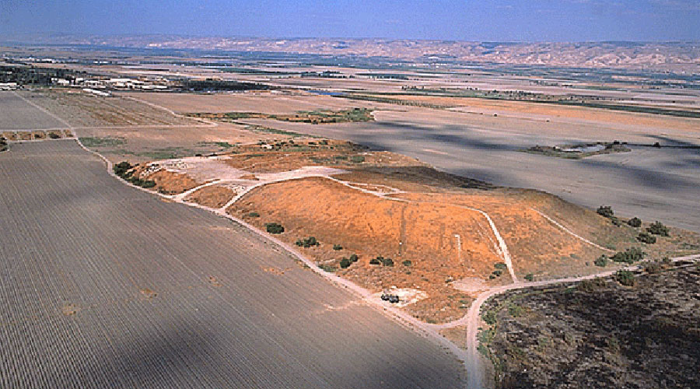
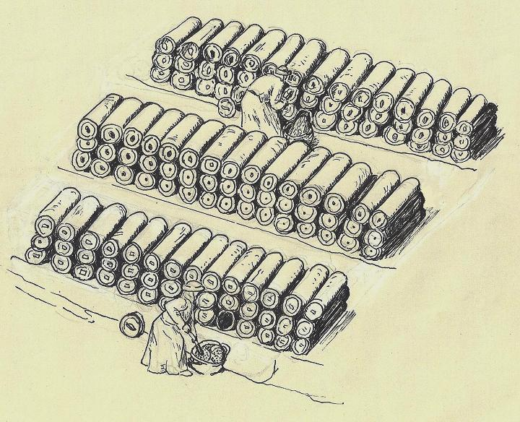
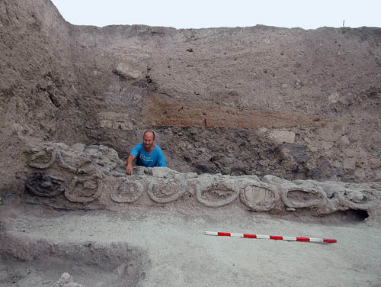
1 Kings 7:45b-47 and the Tel Rehov Beehives
All these objects that Hiram made for King Solomon for the temple of the Lord were of burnished bronze. ⁴⁶ The king had them cast in clay molds in the plain of the Jordan between Sukkoth and Zarethan. ⁴⁷ Solomon left all these things unweighted, because there were so many; the weight of the bronze was not determined.

Slide 37
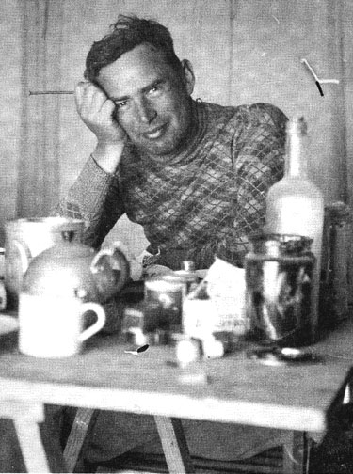
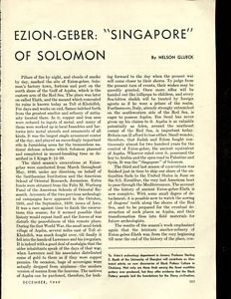
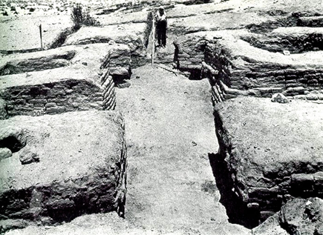
Nelson Glueck and Tell el-Kheleifeh: An Archaeological Romance that ended
Glueck excavated a large Iron Age II fortress near Elath and the Read Sea coast and identified it as biblical Ezion Geber and also interpreted the site as a copper smelter. He was later proved wrong, but acknowledged his error before he died

Slide 38
Gary Pratico’s Reassessment of the Site
Pratico published Glueck’s data and found some methodological problems with the data, largely due to poor recording and an incomplete collection of pottery. Pratico’s conclusions are intriguing in that he sees at least two superimposed fortresses, an early casemate fortress and a later solid wall fortress with a four chamber gateway.

Slide 39
Ezion Geber and Elath: 1 Kings 9:26-28
The mysterious Coral Island or Pharaoh’s Island, currently under Egyptian control, is just south of Elath on the Read Sea and demonstrates use as a seaport in antiquity. Was this Solomon’s Ezion Geber. The answer is probably yes.

Slide 40
Agricultural Paramilitary Settlements in the Negeb Highlands
During his reign, Solomon built an extensive network of fortified settlements in the Negev Highlands along the southern borders of his kingdom. Were these agricultural test stations, caravansaries or para military outposts? The four scholars below invested much of their careers in studying this fascinating question.

Slide 41
The Land of Cabul A fortress on the border with Phoenicia (Horvat Rosh Zayit), ceded to Hiram of Tyre (1 Kings 9:10-14)
Notes:
Horvat Rosh Zayit: It came about at the end of twenty years in which Solomon had built the two houses, the house of the LORD and the king's house 11(Hiram king of Tyre had supplied Solomon with cedar and cypress timber and gold according to all his desire), then King Solomon gave Hiram twenty cities in the land of Galilee. So Hiram came out from Tyre to see the cities which Solomon had given him, and they did not please him. 13He said, "What are these cities which you have given me, my brother?" So they were called the land of Cabul to this day. 14And Hiram sent to the king 120 talents of gold.

Slide 43
1 Kings: An Outline
I. The United Kingdom under Solomon (1:1-11:43)
The Beginning of Solomon’s Reign (1:1-2:46)
Glory of Solomon’s Reign (3:1-10:29)
Tragic End of Solomon’s Reign (11:1-43)
II. The Divided Kingdom (12:1-22:53)
Enmity between Israel and Judah (12:1-16:28)
Peace and Friendship between Israel and Judah (16:29-22:53)

Slide 44
Solomon’s Wisdom
1 Kings 3:16-28: A Wise Ruling
¹⁶ Now two prostitutes came to the king and stood before him. ¹⁷ One of them said, “Pardon me, my lord. This woman and I live in the same house, and I had a baby while she was there with me. ¹⁸ The third day after my child was born, this woman also had a baby. We were alone; there was no one in the house but the two of us.
¹⁹ “During the night this woman’s son died because she lay on him. ²⁰ So she got up in the middle of the night and took my son from my side while I your servant was asleep. She put him by her breast and put her dead son by my breast. ²¹ The next morning, I got up to nurse my son—and he was dead! But when I looked at him closely in the morning light, I saw that it wasn’t the son I had borne.”
²² The other woman said, “No! The living one is my son; the dead one is yours.”
But the first one insisted, “No! The dead one is yours; the living one is mine.” And so they argued before the king.
²³ The king said, “This one says, ‘My son is alive and your son is dead,’ while that one says, ‘No! Your son is dead and mine is alive.’”
²⁴ Then the king said, “Bring me a sword.” So they brought a sword for the king. ²⁵ He then gave an order: “Cut the living child in two and give half to one and half to the other.”
²⁶ The woman whose son was alive was deeply moved out of love for her son and said to the king, “Please, my lord, give her the living baby! Don’t kill him!”
But the other said, “Neither I nor you shall have him. Cut him in two!”
²⁷ Then the king gave his ruling: “Give the living baby to the first woman. Do not kill him; she is his mother.”
²⁸ When all Israel heard the verdict the king had given, they held the king in awe, because they saw that he had wisdom from God to administer justice.

Slide 45
The Dark Side of Solomon’s Reign 1 Kings 11
Greed: Compulsorily Labor Gangs and Slavery of non-Israelites coupled with high taxes to fund his royal administration, building projects and decadent lifestyle
Moral Failures: Political marriages to many foreign wives and large numbers of concubines
Religious Failures: Allowance of foreign pagan shrines and worship in and around Jerusalem
Foreign Adversaries: Hadad the Edomite (11:14-22), Rezon of Damascus (11:23-25) and Jeroboam the Ephraimite (11:26-40)
The Division of the Kingdom after his death

