Slide 1
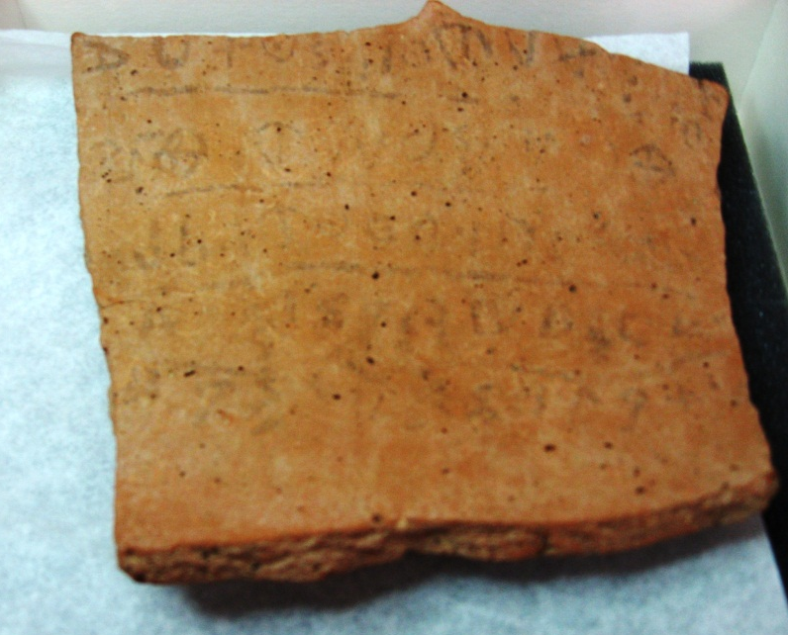
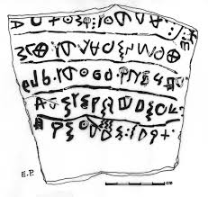
Second Samuel: The Reign of David A Man after God’s own Heart
Notes:
1 Do not oppress, and serve God … despoiled him/her2 The judge and the widow wept; he had the power3 over the resident alien and the child, he eliminated them together4 The men and the chiefs/officers have established a king5 He marked 60 [?] servants among the communities/habitations/generations

Slide 2
Outline of Second Samuel
I. David’s Rise to Power in Judah (1-4)
David Laments over Saul (1)
David Struggles against Ishbosheth (2-4)
David’s Reign over all Israel (5-24)
David Secures his Borders (5, 8, 10)
David Captures Jerusalem (5-6)
God Makes a Covenant with David (7)
David sins with Bathsheba (11-12)
David Experiences discontent within his kingdom (13-20)
The Last years of David’s reign and his death (21-24)

Slide 3
Themes of Second Samuel
David’s Rise to Kingship in Israel: Chosen by God
David’s Choice of Jerusalem as Capital
God’s Covenant with David: A Promise of Descendants; His throne established forever; God’s plan of redemption and salvation flows through David
David’s Sin and Consequences

Slide 4
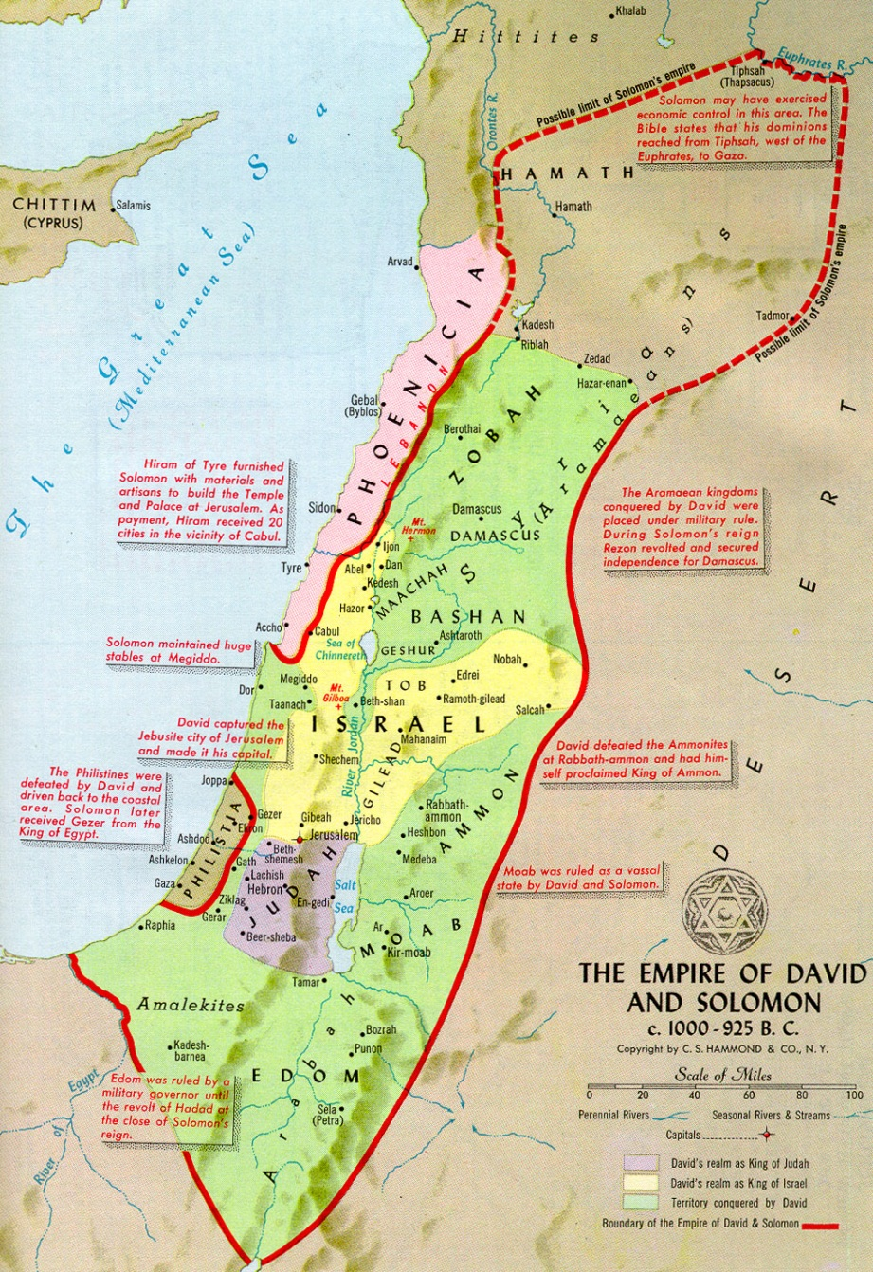
The Achievements of King David
Unified the loosely confederated tribes of Israel into a nation, then an empire
Established a political dynasty that lasted for over 400 years.
Conquered Jerusalem and made this neutrally located city his capital with a sophisticated governmental bureaucracy
Subdued the Philistines and Amalekites
Defeated Aram, Ammon, Moab and Edom
Forged a treaty with Hiram of Tyre and Phoenicia
Exercised limited political and economic control as far as northern Syria and the Euphrates River
Built palaces and amassed material for the Temple, purchasing the threshing floor of Araunah the Jebusite for the site of the Temple

Slide 5
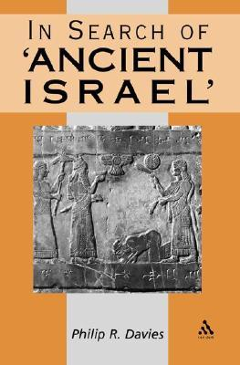
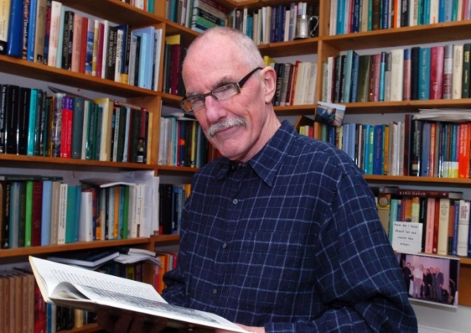
The Minimalist Challenge
Philip R. Davies (Sheffield): "King David is about as historical as King Arthur."

Slide 6
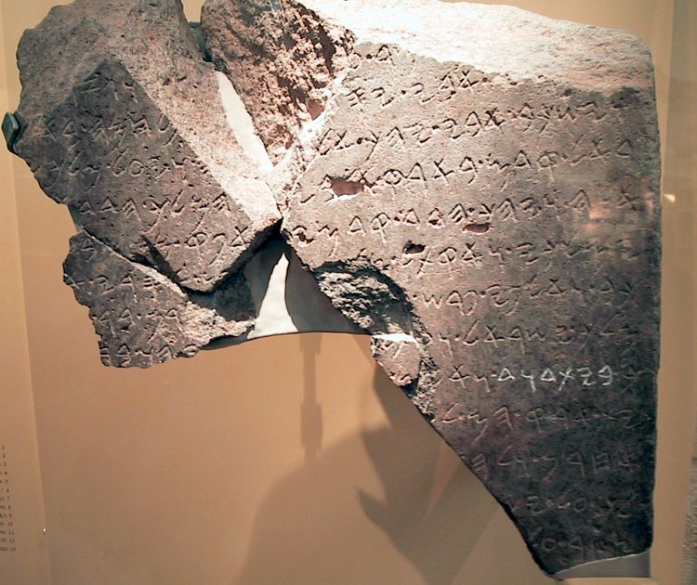
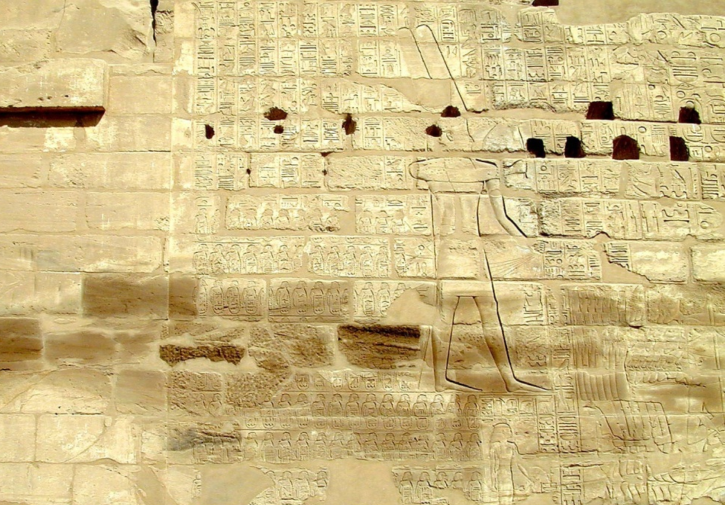
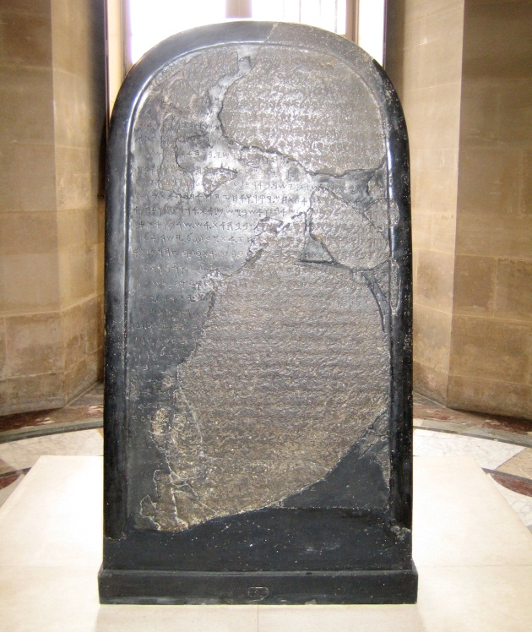
The Historical David
The Tel Dan Stela was discovered at Tel Dan in July 1993 (Biran and Naveh 1993). Then, in June 1994, two additional joining fragments were found (Biran and Naveh 1995). Together these pieces represent only a fraction of a much longer inscription. The language is Aramaic and it celebrates the victory of a king of Aram over Israel and Judah. It is the first royal inscription to be found in Israel. The most stunning aspect of the document is the reference to Judah as the “House of David.” For the first time, it was thought, the name David appeared in an extra-Biblical document. At about the same time, however, two French scholars, André Lemaire (1994) and Émile Puech (1994), independently recognized the same phrase in the Mesha Inscription [848 BC], which has been around for well over 100 years. It now likely that the name David is in a third inscription. Egyptologist K.A. Kitchen believes that the phrase “highland of David” appears in the Shishak inscription on the Bubastite portal in the Temple of Amun at Karnak, Egypt (1997: 39–41). All this at a time when a number of scholars were challenging the existence of the United Monarchy and a king name David!

Slide 7
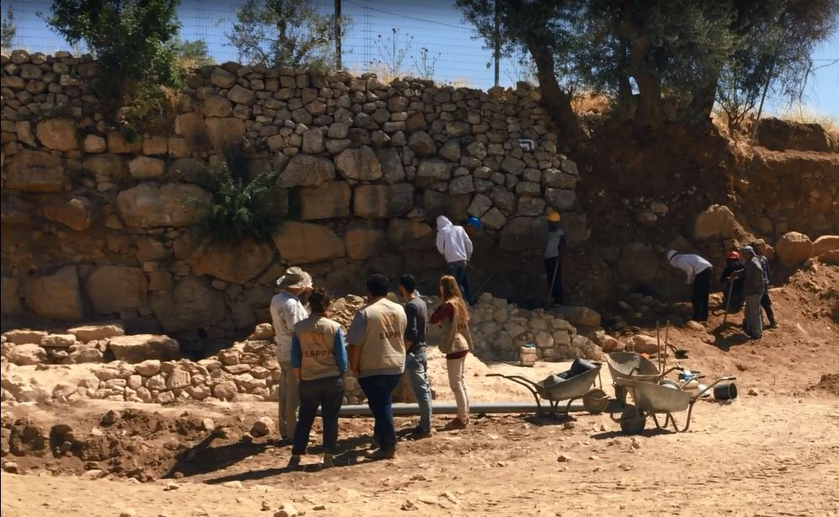
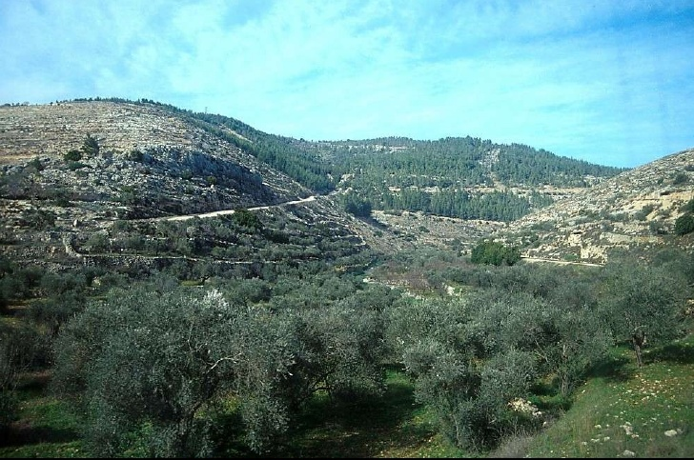
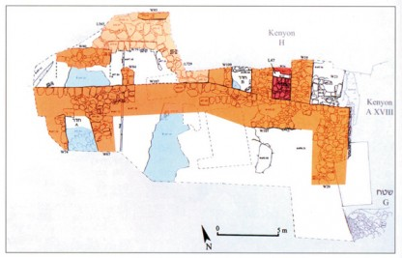
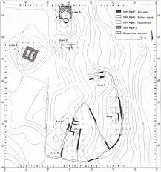
David’s First Years as King
David ruled over Judah for 7 years at Hebron. The site of Old Testament Hebron is covered by an Islamic khan and houses, making efforts to unearth finds from David’s time impossible.
David was offered the kingship over all twelve tribes and wisely chose Jerusalem as his capital

Slide 8
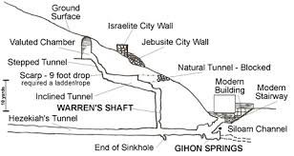
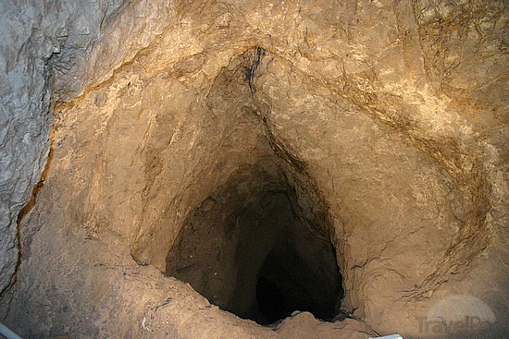
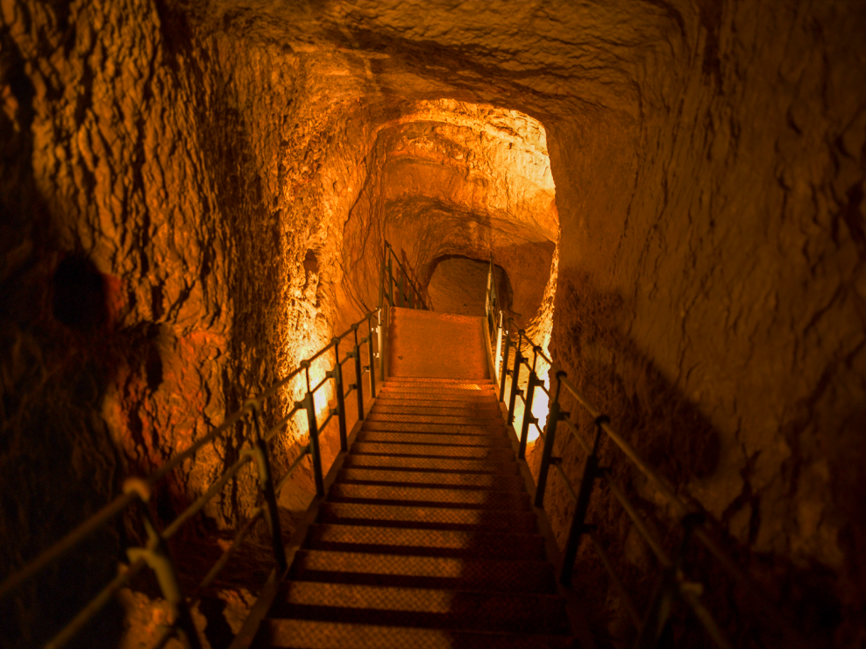
The sinnor, Joab and David’s Conquest of Jerusalem
Innovative strategy used to capture Jerusalem. Joab climbed up a vertical shaft (the sinnor) and let the Israelite army into the gate. The Water supply for Jerusalem was the Gihon Spring, which was heavily fortified by the Jebusites, who mocked David and his army before Joab’s daring act (2 Samuel 5:6-8)
Renamed the Fortress or Citadel of Zion (Jerusalem) as the “City of David” making it a royal precinct (much like Washington DC)
Defeated the Philistines twice in the Rephaim Valley (2 Samuel 5:17-25), once attacking them from Ba’al Perezim, probably a stronghold overlooking the valley. An Iron Age I Israelite tower at Tel Giloh fits this criteria very well.

Slide 9
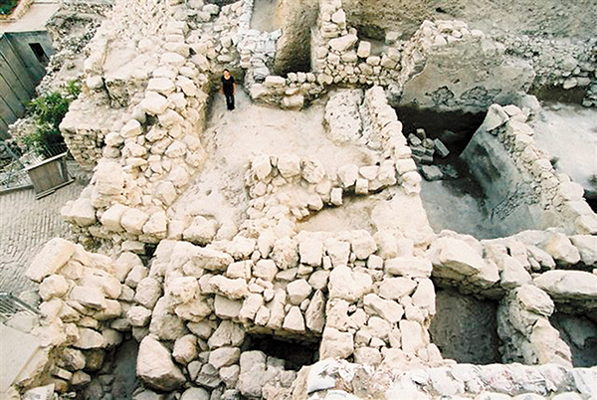
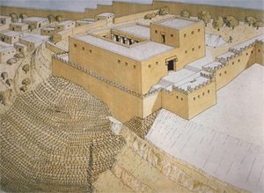
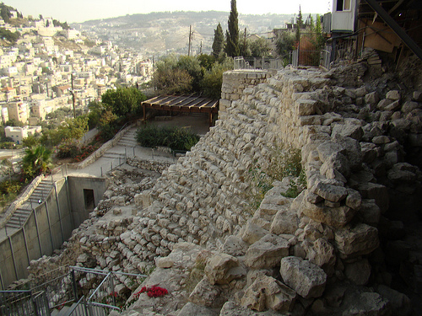
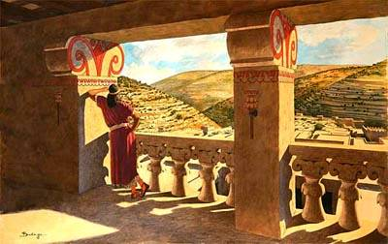
King David’s Jerusalem
David built a palace in Jerusalem with the assistance of King Hiram of Tyre (2 Samuel 5:11)
Wall fragments and at least one capital from a column of this palace has been discovered

Slide 10
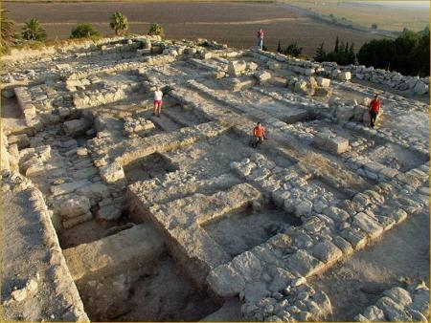
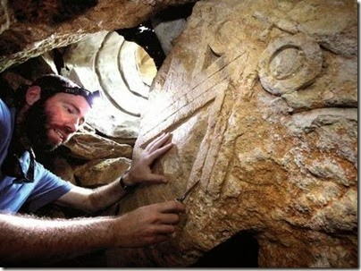
Other Works of King David
Megiddo: Palace 6000 may be attributed to David
Davidic Royal Estates were managed by the Royal Steward (who is over the house). A recent discovery of a royal column in a Rephaim Valley cave confirms theories of at least one royal estate near Jerusalem

Slide 11
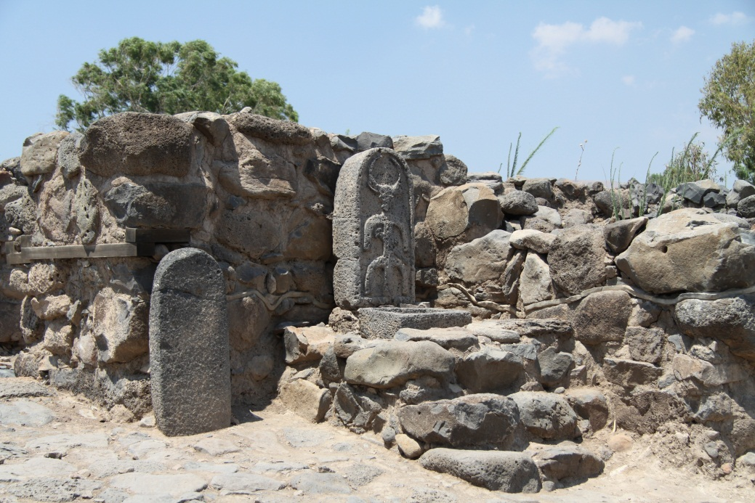
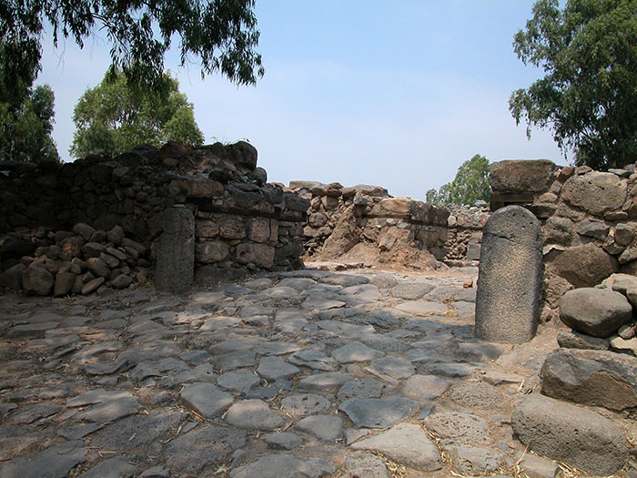
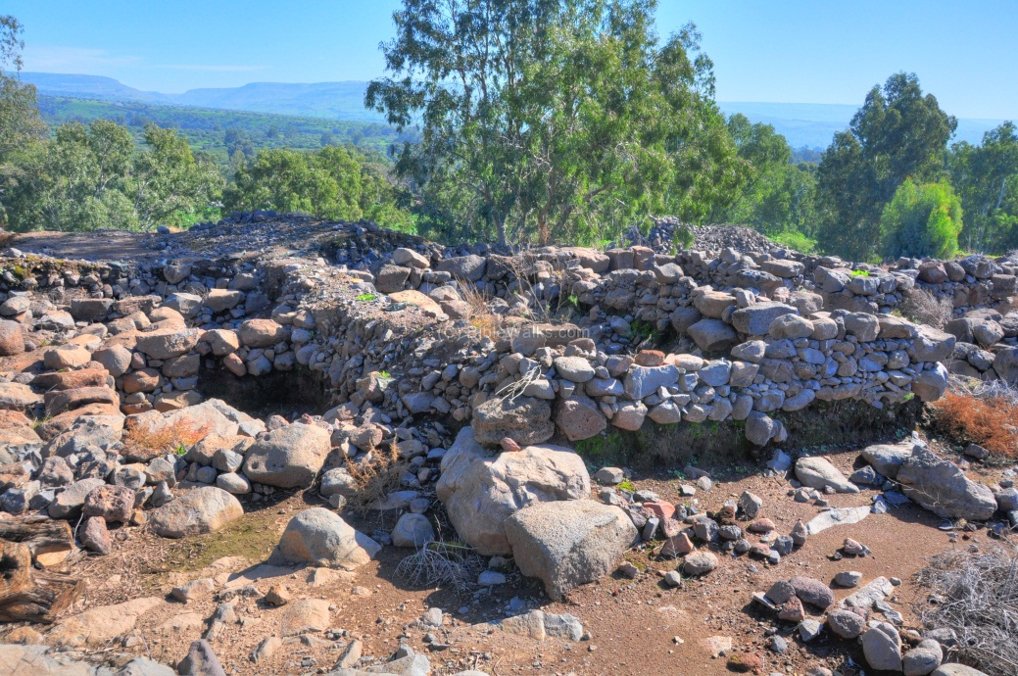
King David and the Kingdom of Geshur
King David married Maachah, daughter of Talmai, king of Geshur (2 Samuel 3:3; 1 Chronicles 3:2)
The Geshurite was found (north of the Sea of Galilee), including Talmai’s palace
David’s son Absalom fled here after killing Amnon for raping his sister Tamar
The site is also New Testament Bethsaida

Slide 12
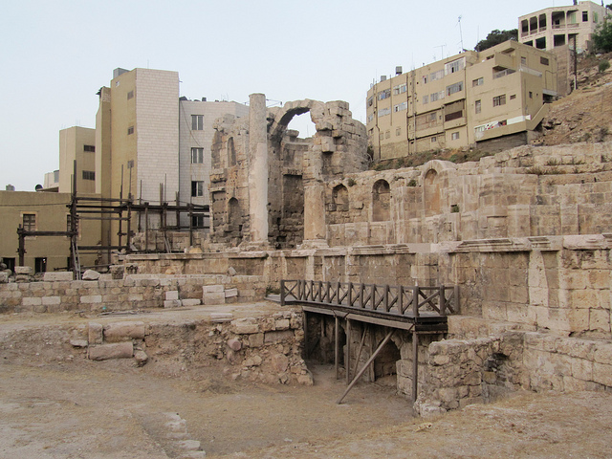
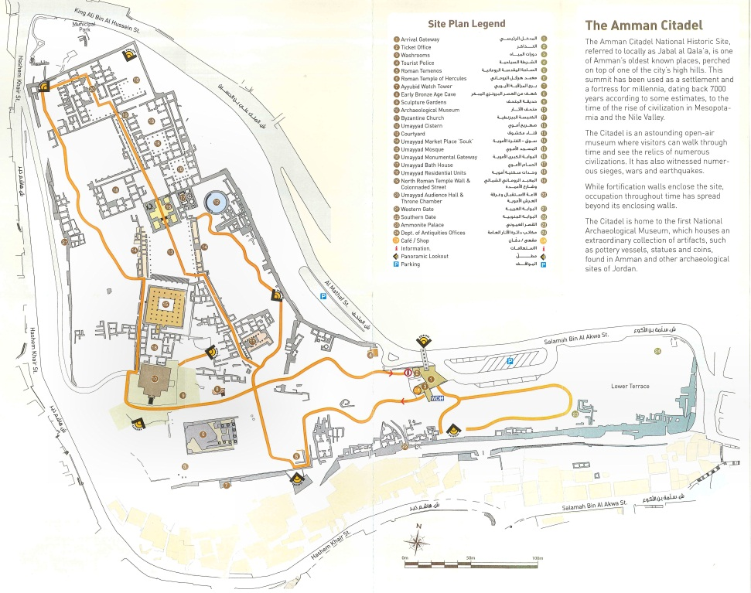
David’s War against the Ammonites 2 Samuel 10, 12:26-31
Notes:
Nymphaeum in Amman (2nd Century AD): 2 Samuel 12:26-31
²⁶ Meanwhile Joab fought against Rabbah of the Ammonites and captured the royal citadel.²⁷ Joab then sent messengers to David, saying, “I have fought against Rabbah and taken its water supply. ²⁸ Now muster the rest of the troops and besiege the city and capture it. Otherwise I will take the city, and it will be named after me.”
²⁹ So David mustered the entire army and went to Rabbah, and attacked and captured it.³⁰ David took the crown from their king’s^{[a]} head, and it was placed on his own head. It weighed a talent^{[b]} of gold, and it was set with precious stones. David took a great quantity of plunder from the city ³¹ and brought out the people who were there, consigning them to labor with saws and with iron picks and axes, and he made them work at brickmaking.^{[c]}David did this to all the Ammonite towns. Then he and his entire army returned to Jerusalem.

Slide 13
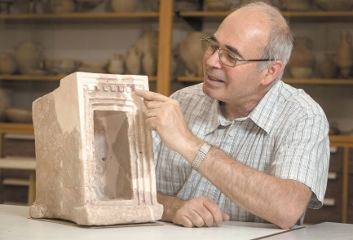
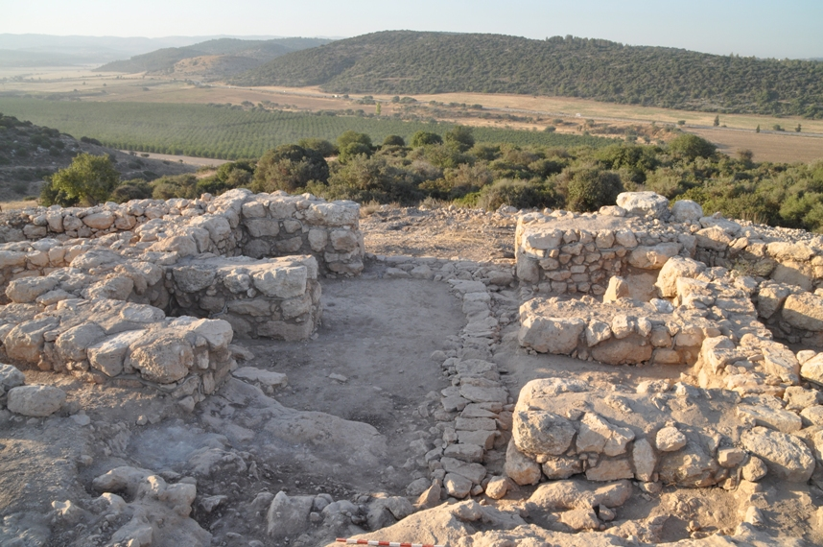
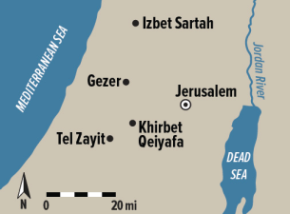
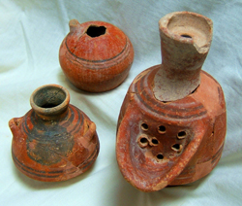
King David’s Palace at Sha’arim
Sha’arim (Two Gates) appears twice in the Old Testament:
1 Samuel 17:52: When the Philistines saw that their hero was dead, they turned and ran. Then the men of Israel and Judah surged forward with a shout and pursued the Philistines to the entrance of Gath and to the gates of Ekron. Their dead were strewn along the Shaaraim road to Gath and Ekron. When the Israelites returned from chasing the Philistines, they plundered their camp. 1 Chronicles 4:31 (a town list of Simeon) mentions Sha’arim.
The site of Khirbet Qayafa overlooks the Elah Valley at the exact location of the duel between David and Goliath.
It was excavated from 2007-2013 by Yosef Garfinkel. Two four chamber gates, a massive casemate wall and a palace were found, along with an important ostracon, a large amount of pottery, including storage jars with thumb impressed handles.
The massive construction of Khirbet Qeiyafa and its urban planning clearly indicate central authority in Judah in the early 10th century BC, the time of King David.

Slide 14
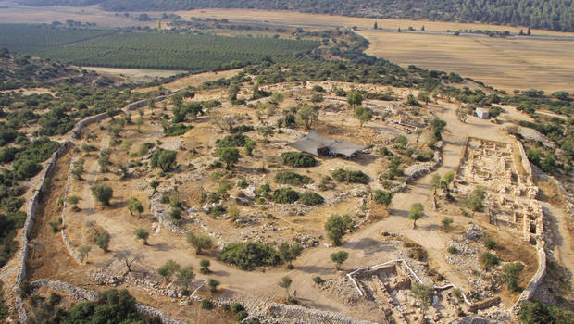
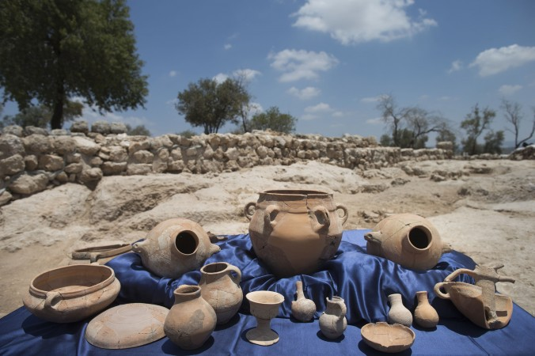
Sha’arim: An Israelite Border Town from the Time of King David

Slide 15
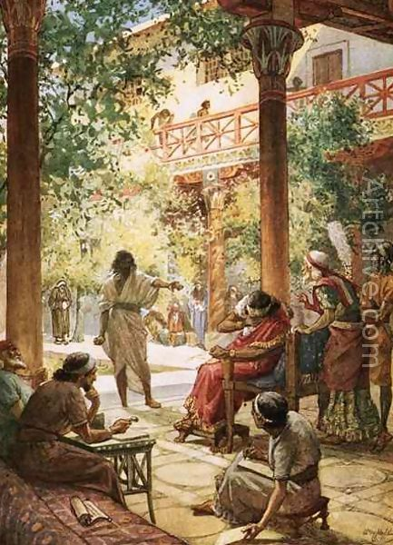
David’s Domestic Failures
Adultery with Bathsheba
Murder of Uriah the Hittite
Rebellion of Absalom
Census of Israel
Revolt of Shebna
Notes:
Sin can be forgiven, but consequences remain

Slide 16
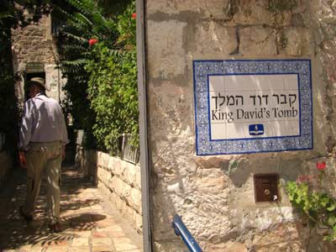
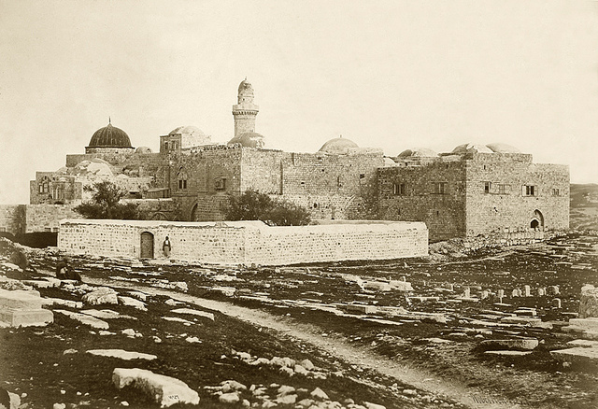
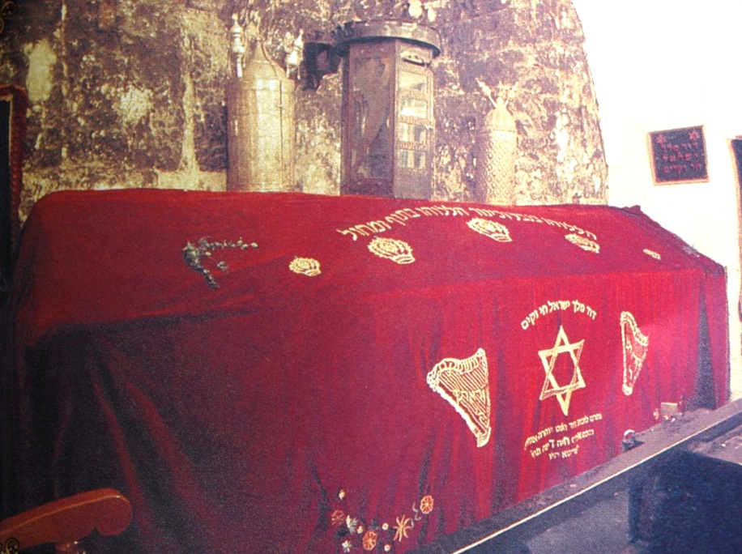
King David’s Tomb

Slide 17
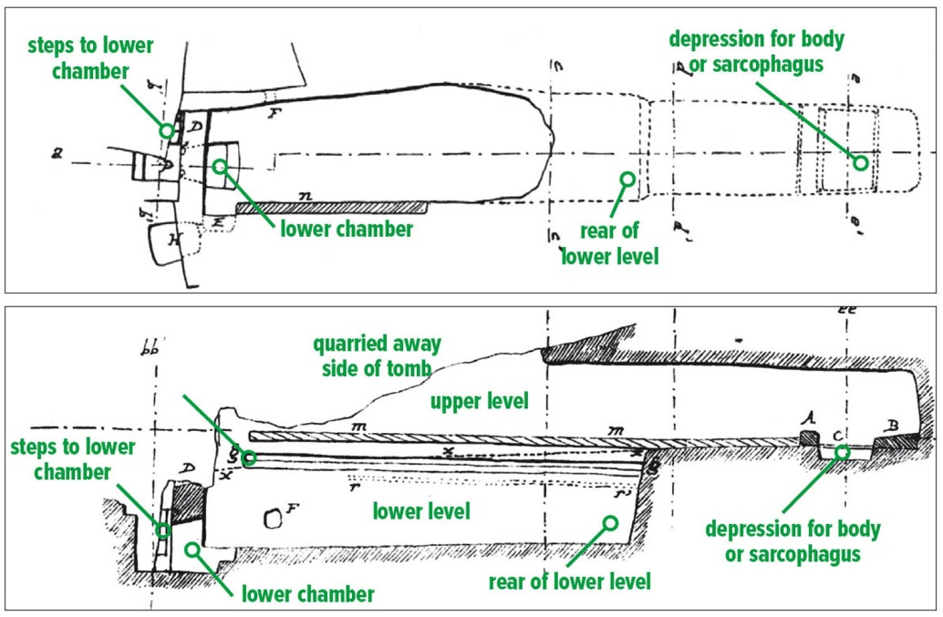
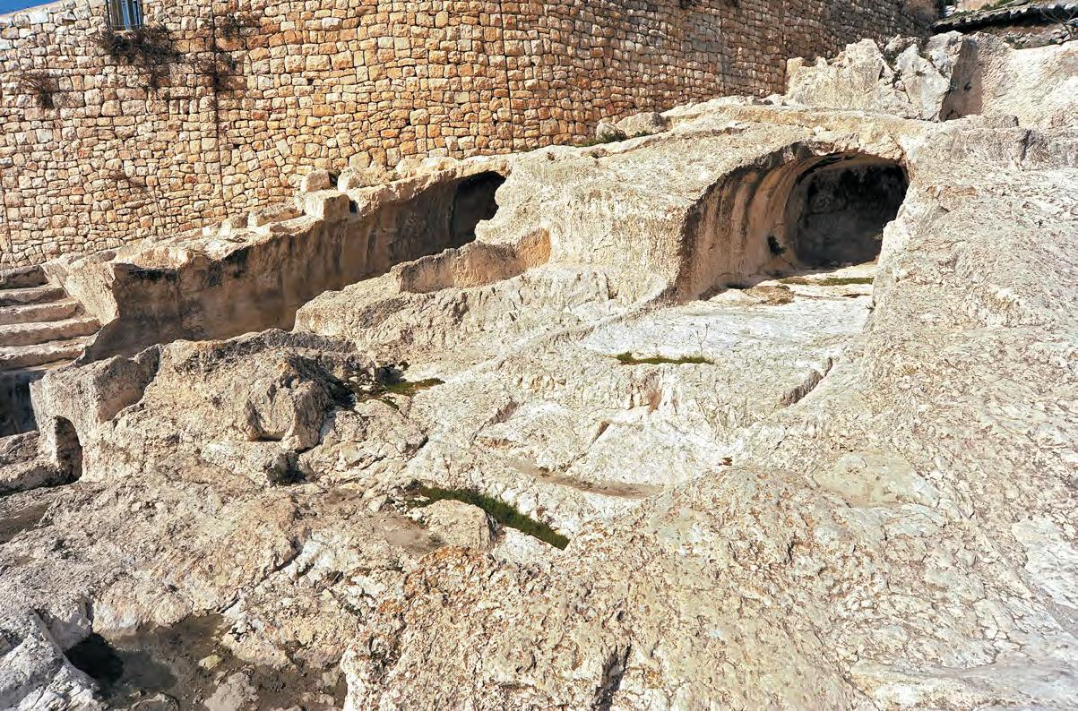
The Royal Tombs of the Davidic Dynasty

Slide 18
David as Psalmist: Psalm 22

