Slide 1
Archaeology and the Exodus from Egypt Painting by Edward Poynter (1867)

Slide 2
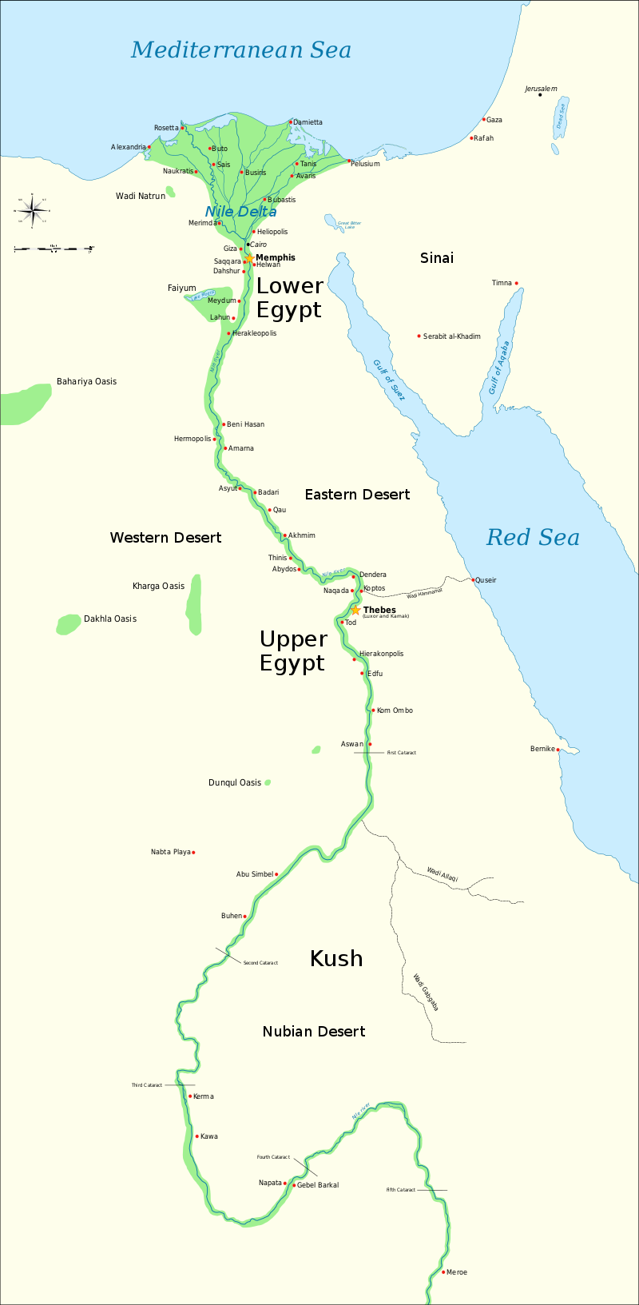
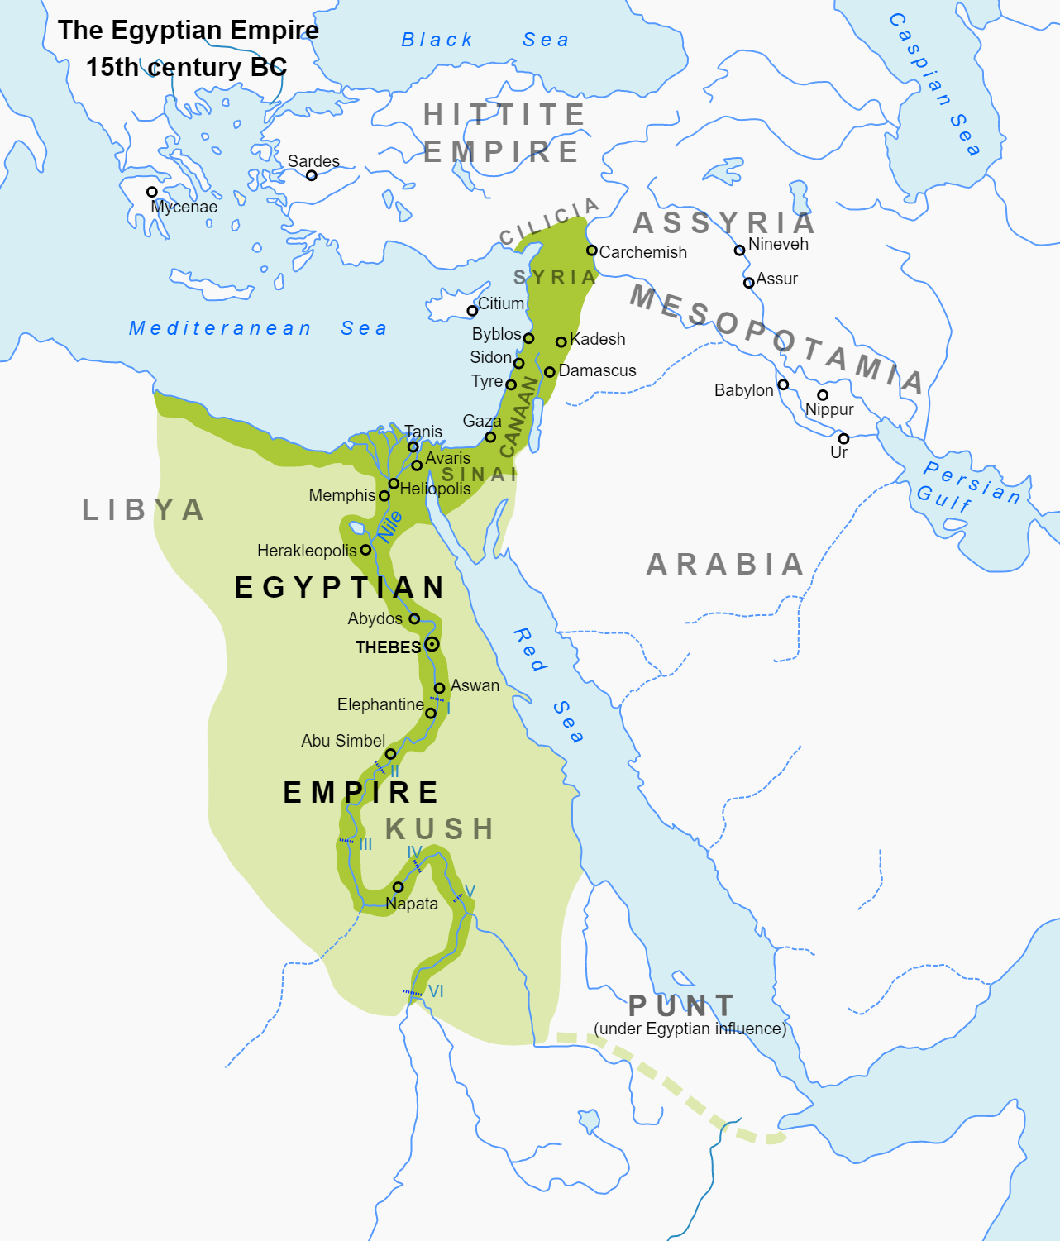

Slide 3
The Deliverance of Moses (מֹשֶׁה)

Slide 4
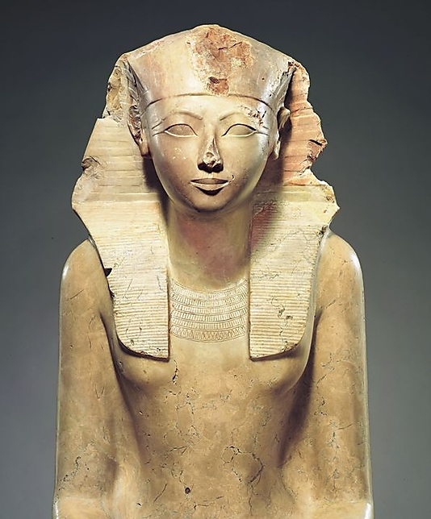
Hatshepsut as the stepmother of Moses?
The title “Pharaoh’s daughter” is a title reserved for very few women and this dramatically narrows the number of persons to whom the Bible could refer, and one of these would be Hatshepsut.

Slide 5
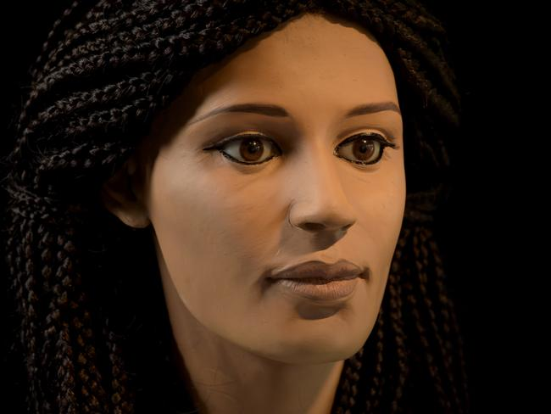
What an Ancient Egyptian Woman looked like (ca. turn of the era)
Dramatic facial reconstruction by the University of Melbourne of the mummified head of a woman named Meritamun (‘beloved of the god Amun’)

Slide 6
Archaeology and the Exodus
Two Main Questions: IF and WHEN
IF: Did the Exodus take Place? Opinions are divided!
Many critical biblical scholars say NO! They admit that a small group or groups of slaves may have “escaped” from Egypt, but not on such a large scale as recorded in the Bible.
Conservative biblical scholars and most Egyptologists say YES! There is an amazing amount of circumstantial evidence to support the biblical account even though Egyptian records are silent and for good reason. Egyptian pharaohs would never admit to such a humiliating and devastating event!
WHEN: Most scholars support one of two dates for the Exodus.
The “Early Date” for the Exodus falls during the 18th dynasty reign of Pharaoh Thutmoses III and took place ca. 1445 BC
The “Late Date” for the Exodus fall during the 19th dynasty reign of Pharaoh Rameses II and took place ca. 1290 BC

Slide 7
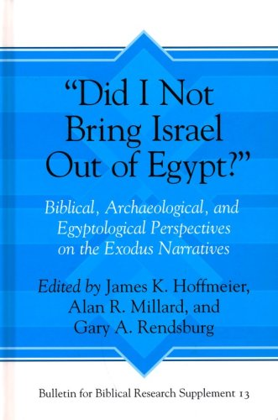
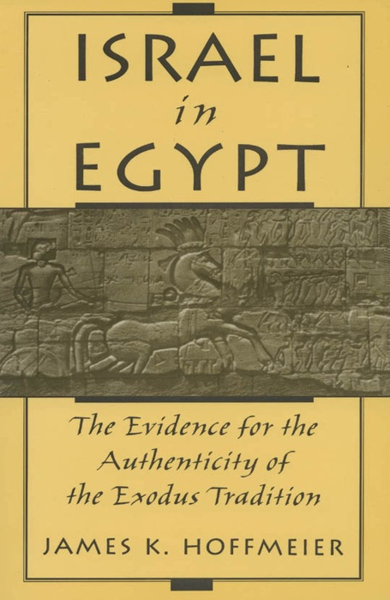
Recent Studies on Egyptian Sources for the Exodus

Slide 8
How Do We Know the Exodus actually Took Place?
The Exodus is the central historical event of the Jewish People and Passover was celebrated, honored, remembered and recalled very early in their history. Thus, many scholars recognize that some great event stands at the core of this deeply ingrained ancient account and religious festival. The Exodus is to Judaism what the Resurrection is to Christianity.
The fact that the Jewish nation was born out of slavery is important for its historicity since no ancient Near Eastern culture would ever invent a story of their origins in slavery.
The biblical account itself provides many hints of an Egyptian sojourn. Names such as Moses, Hophni and Phineas are clearly Egyptian and place names in Exodus, Pithom and Rameses are known cities in Egypt.
Most of the ten plagues against pharaoh are actually polemics against the Egyptian pantheon of gods, demonstrating their impotence against YHWH (Exodus 12:12). See the following slide
The silence of Egyptian texts is completely understandable as no kingdom, let alone a world empire such as Egypt would record such an embarrassing and devastating event in their annals.
Akhenaten, an 18th dynasty pharaoh promoted a new monotheistic religion, worshipping Aten, the son and built an entirely new capital. Was his new religion actually an adaptation of the Hebrew religion? At the least, the timing is incredibly coincidental!

Slide 9
The Plagues of Egypt
Life and vitality in Egypt was provided by two natural elements; the Nile River and the sun.
Water to Blood (7:14-25): A son of Rameses II claimed to his mother that drinking water will become the color of blood. A much earlier tale mentions the Nile River was blood during a period of chaos in the land. Hapi, god of the Nile and Osiris (god over the inundation) are challenged.
Swarms of frogs (8:1-15): The Egyptian god Heqt is mocked.
Gnats (or lice) (8:16-19)
Swarms of Flies (Hebrews are spared; 8:20-32)
Plague upon Cattle (Hebrews are spared; 9:1-8)
Boils on man and beast (9:8-12)
Hail, thunder and lightning (Hebrews are spared; 9:13-35)
Plague of Locusts (10:1-20)
Three Days of thick Darkness (10:21-29): Re, and Amon-Re, Egyptian gods associated with the sun, are humiliated.
The Death of the First Born (People and Cattle; 11:1-12:36): Pharaoh is mocked.
Two other accounts of these plagues are preserved in the OT (Psalm 78:42-51; 105:27-36) in poetic form.

Slide 10
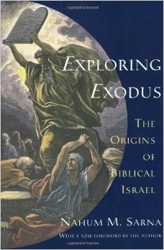
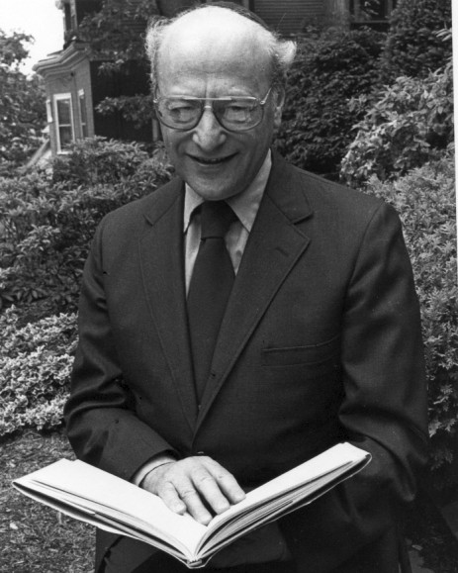
Nahum Sarna’s Exposition on the Ten Plagues
Water to Blood (7:14-25): Heavy rainfall in Ethiopia (along the Blue Nile) caused catastrophic flooding, rather than the usual inundation of the Nile and swept huge amounts of tropical red earth into the river, causing it to turn red and the excessive amount of flagellates and bacteria killed fish and destroyed much of the river ecosystem (September)
Swarms of frogs (8:1-15) resulted from their moving away from the polluted Nile, but died from insect born disease from the rotting fish (September-October).
Gnats (or lice; 8:16-19): Gnats may be the mosquitos infest the Nile Valley after flooding (October-November)
Swarms of Flies (Hebrews are spared; 8:20-32): These are blood sucking flies that live in tropical, not Mediterranean climates and appear and vanish with no warning.
Plague upon Cattle (Hebrews are spared; 9:1-8): The bacteria responsible for the death of the frogs killed livestock that were now able to graze in the flood plain (early January)
Boils on man and beast (9:8-12): Possibly an outbreak of anthrax.
Hail, thunder and lightning (Hebrews are spared; 9:13-35): Probably occurred in early February.
Plague of Locusts (10:1-20): A rather common occurrence. Locusts were blown by the east (sea) winds into Egypt from the north in March.
Three Days of thick Darkness (10:21-29): This was possibly the first khamsin of the year; a wind from the desert, dense with sand and dust in the aftermath of the previous plagues, that dramatically blocked sunlight, probably in early March.
The Death of the First Born (People and Cattle; 11:1-12:36) is clearly only a supernatural event!

Slide 11
When did the Exodus Occur?
Evidence for an Early Date for the Exodus (ca. 1445 BC):
The date fits much better with biblical chronology, which notes a 430 year (Exodus 12:40-41) sojourn in Egypt before the Exodus
Moses has an 18th dynastic name, which is a logical choice for a boy raised in the court of a pharaoh such as Ahmose or Thutmoses, but highly unlikely during the 19th dynasty.
Thutmoses III, the leading candidate for the early date pharaoh of the Exodus, was NOT succeeded by his oldest son!
Uncertainty in Egyptian Chronology allows for either Thutmoses III or Amenhotep II to be the pharaoh of the Exodus. Both Thutmoses III and Amenhotep II launched multiple military campaigns into Canaan and farther north. Thutmoses III was the most powerful Egyptian pharaoh in history and during his reign, the Egyptian empire enjoyed its greatest extent of rule.

Slide 12
Pharaohs of the Eighteenth Dynasty ca. 1550–1295 B.C. https://www.metmuseum.org/toah/hd/phar/hd_phar.htm
Ahmose: ca. 1550–1525 B.C.
Amenhotep I: ca. 1525–1504 B.C.
Thutmose I: ca. 1504–1492 B.C.
Thutmose II: ca. 1492–1479 B.C.
Thutmose III: ca. 1479–1425 B.C.
Hatshepsut (as regent): ca. 1479–1473 B.C.
Hatshepsut: ca. 1473–1458 B.C.
Amenhotep II: ca. 1427–1400 B.C.
Thutmose IV: ca. 1400–1390 B.C.
Amenhotep III: ca. 1390–1352 B.C.
Amenhotep IV: ca. 1353–1349 B.C.
Akhenaten: ca. 1349–1336 B.C.
Neferneferuaton: ca. 1338–1336 B.C.
Smenkhkare: ca. 1336 B.C.
Tutankhamun: ca. 1336–1327 B.C.
Aya: ca. 1327–1323 B.C.
Haremhab: ca. 1323–1295 B.C.

Slide 13
Thutmose III (18th Dynasty) (1479-1425 BC) His mother, Hatshepsut, may have rescued Moses from the Nile

Slide 14
When did the Exodus Occur?
Evidence for a Late Date for the Exodus (ca. 1290 BC)
The account of Joseph seems to fit best during the Hyksos rule in Egypt (Exodus 1:8), when “a new king arose over Egypt, who did not know Joseph.” This king would then be Ahmose.
The cities Pithom and Rameses (Exodus 1:11) are the names of 19th dynasty cities in the Nile Delta.
The 19th dynasty pharaohs ruled from Memphis in the north, which seems to correlate with the various meetings between pharaoh and Moses.

Slide 15
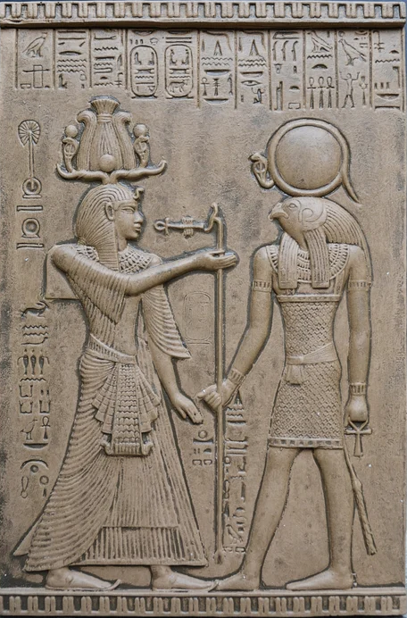
Pharaohs of the Nineteenth Dynasty (ca. 1295–1186 B.C.) https://www.metmuseum.org/toah/hd/phar/hd_phar.htm
Ramesses I: ca. 1295–1294 B.C.
Seti I: ca. 1294–1279 B.C.
Ramesses II: ca. 1279–1213 B.C.
Merneptah: ca. 1213–1203 B.C.
Amenmesse: ca. 1203–1200 B.C.
Seti II: ca. 1200–1194 B.C.
Siptah: ca. 1194–1188 B.C.
Tawosret: ca. 1188–1186 B.C.

Slide 16
Ramses II (19th Dynasty) (1279-1213 BC; 66 year reign!)

Slide 17
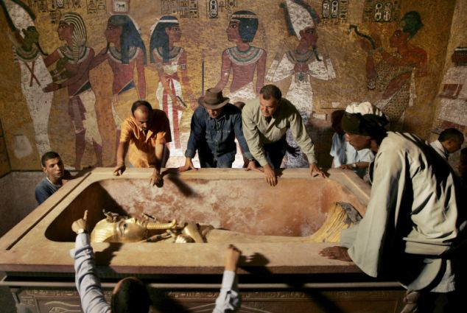
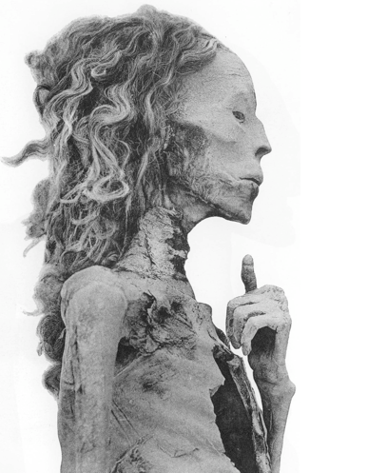
Queen Tye, wife of Amenhotep III and mother of Akhenaten
The mummification process was a sacred duty of the Egyptians. Preparations included removal of all major organs, including the brain and heart. Queen Tye, shown below, lived ca. 1360 BC, yet her body is remarkably well preserved, including her long hair.

Slide 18
The “Store Cities” of Pithom and Rameses (Exodus 1:11) The two cities built by Hebrew Slaves during their oppression by the Egyptians before the Exodus

Slide 19
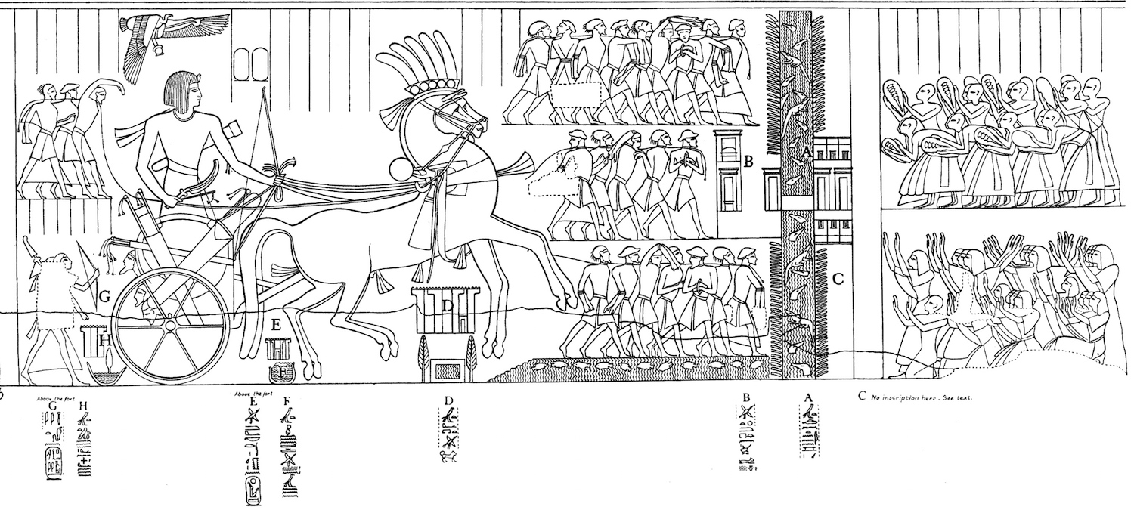
The Wall of the Ruler (Shur) of Egypt
On the mural below, Seti I (19th dynasty) returns from a campaign into Canaan and approaches the Wall (Shur) of Egypt with captives and his army. Note the crocodiles in the moat, as well as the forts guarding the bridge. The wall was built to keep Bedouin (Shasu) out of Egypt more than keeping slaves in Egypt. It is quite likely that the Hebrews would have been recognized, not only as Asiatics, but as Shasu bedouin once they left Egypt.

Slide 20
The Route(s) of the Exodus

Slide 21
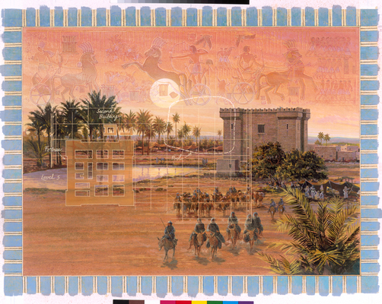
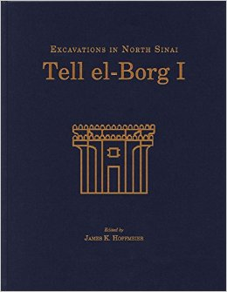
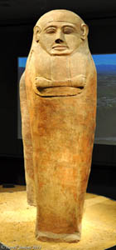
Egyptian Forts and Outposts
Itinerary of Thutmoses III’s Asiatic Campaigns demonstrates the existence of a string of Egyptian forts along the coast of Sinai and Canaan to at least Gaza.
Egyptian Forts along the Way of the Land of the Philistines (the main coastal road leading up into Canaan) were strategically placed at intervals of a day’s march and at water sources.
The Bible clearly states that the LORD told the Hebrews NOT to go the “Way of the Land of the Philistines” (Exodus 13:17-18), which was the shortest route to Canaan that followed the coast. This string of fortified Egyptian outposts were probably part of the reason Moses led his people towards the Red Sea.
The Place Names in the Exodus Route cannot be matched with Arabic place names today due to the lack of consistent settled populations in the region.

Slide 22
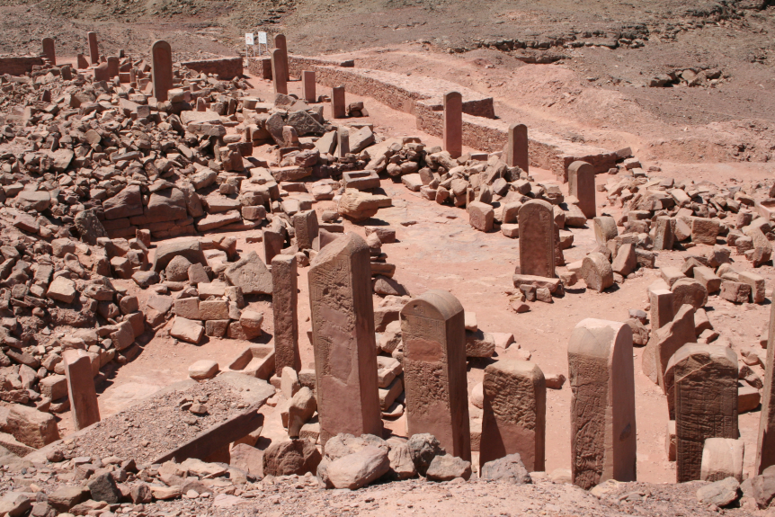
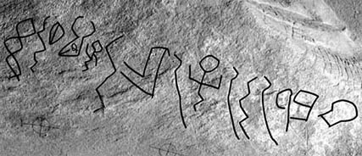
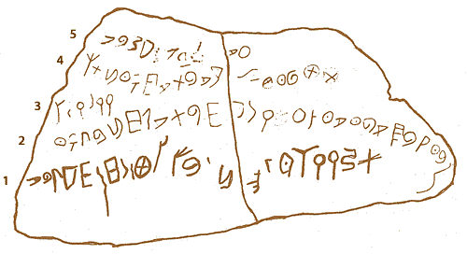
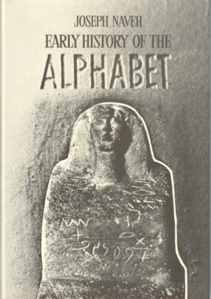
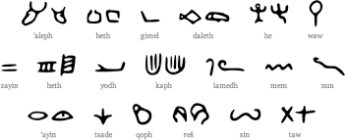
The Origin of the Alphabet
Canaanite scribes working at Avaris (the Hyksos capital of lower Egypt) before and during the Hyksos period devised a much simpler way to write using symbols representing only sounds not objects and did it with 24 symbols (or letters) rather than tens of thousands of hieroglyphic or cuneiform symbols. Their invention changed the world as we know it.
This was a long process, starting around 1900 BC and not an overnight adoption and the famous proto-Sinaitic script, found at Serabit el-Khadim, the great Egyptian mines of Sinai show a stage of its development.
Very early Hebrew script from the period of the Judges still preserves some pictographic letters and was often written left to right (below left).

Slide 23
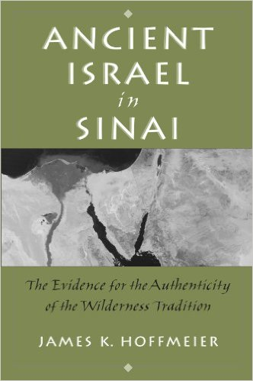
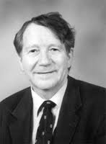
Archaeology and the Desert Sojourn
Can we recover archaeological evidence of Israel during their 40 year desert sojourn?
Several Obstacles: Toponymic Problems: the place names in the Exodus and Numbers Itineraries have nearly all been forgotten.
A nomadic group or nation leaves very little archaeological evidence
Extensive Israeli surveys in Sinai have concluded that the Late Bronze Period is an archaeological blank for the region.
Hoffmeier’s treatment of this period of biblical history is exhaustive, but more than a little guesswork is used to recreate the route.

Slide 24
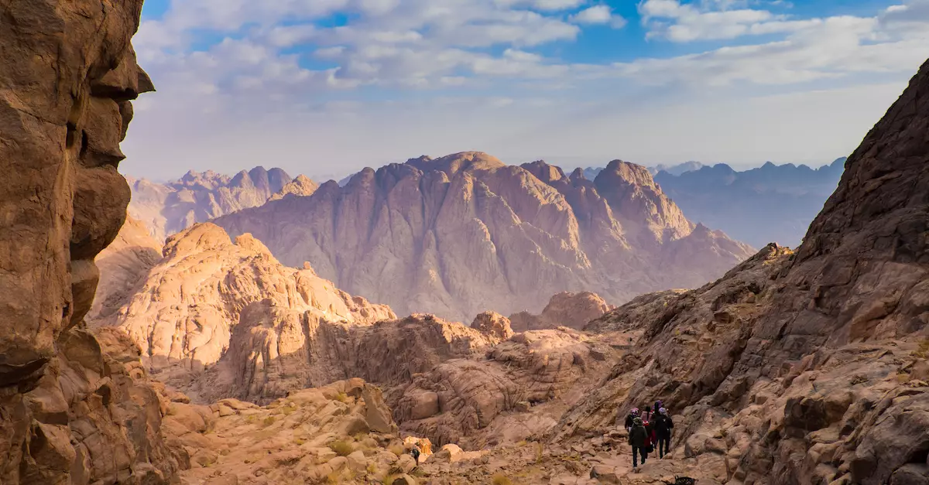
The Location of Mount Sinai and Horeb
Horeb and Sinai are used various times in the OT and apparently refer to the same region/site. However, the true location of the biblical Mount Sinai/Horeb is still debated, and various scholars have offered numerous sites in Israel, Sinai and Saudi Arabia as viable candidates…

Slide 25
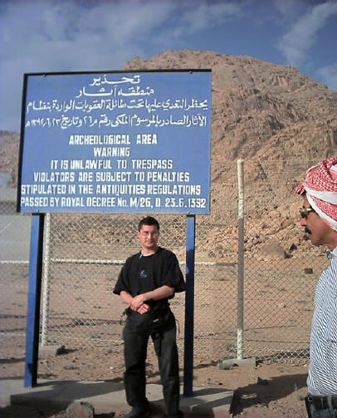
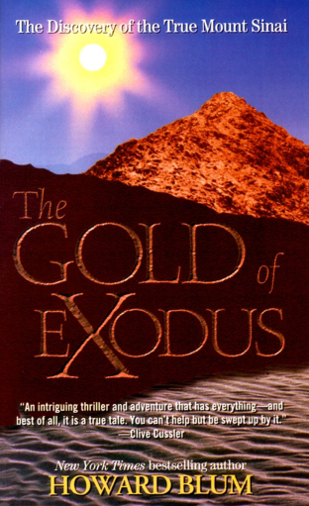
Mount Sinai in Midian? Mount Horeb (Sinai) is located in Midian and scholars recognize the validity of biblical and archaeological arguments that place Mount Sinai in Northern Saudi Arabia (Jebel el Lawz), in the region known as the Hejaz, where Moses’ father in law Jethro lived. Needless to say, the Saudi government is not impressed and guards the area. For an exciting account to two Americans that sneaked in and out of this area and lived to tell about it, check out the book The Gold of the Exodus, which is a sensational account, but has some credibility. It also contains errors (e.g.: the Israelites did not cross the Gulf of Aqaba) and a seven day itinerary from Egypt to Sinai limits the site to the Sinai peninsula as well so beware!

Slide 26
Mount Sinai (Jebel Musa) The traditional Mount Sinai (Jebel Musa, which means Mountain of Moses in Arabic) lies near the southern tip of Sinai and has been a place of pilgrimage since the fourth century AD. The ancient fortified monastery of Saint Catherine’s sits at its base (below left). A steep trail leads to the summit with incredible sweeping views and a prayer chapel (below right). Sadly, tourism has virtually ceased since this area now has ISIS elements roaming around. Jebel Safsafeh (Widow Peak) and Jebel Serbal are nearby and very viable candidates as well as Jebel Musa.

Slide 27
The Tabernacle (משכן) mishkan The Tabernacle (Exodus 35-40) allowed Yahweh to live amongst His People and the tent was placed in the center of the camp. A Holy God living in the midst of a sinful people demanded that God’s instructions had to be strictly followed. The Tabernacle was portable and remained with the Israelite tribes until Solomon built the Temple in Jerusalem. The parallels between the Tabernacle and Jesus Christ are rich with symbolism, but perhaps the best is the statement in John 1:14, which states that the Word (Jesus Christ) became flesh and tabernacled (made His dwelling) among us.

Slide 28
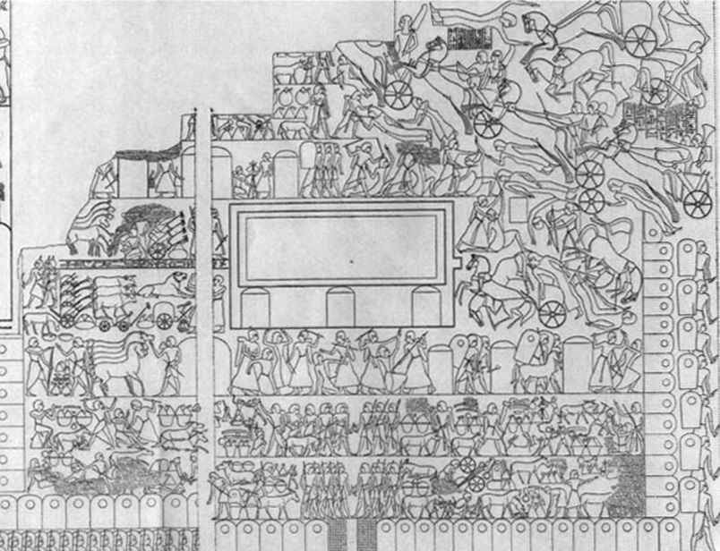
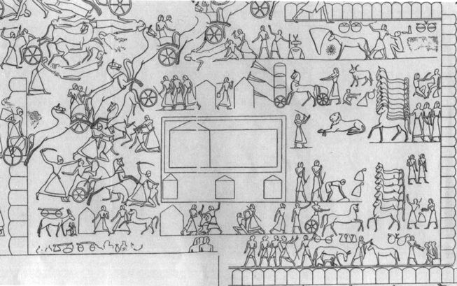
Archaeological Parallels to the Tabernacle
The “Tabernacle” of Rameses II
The closest parallel to the form and function of the Tabernacle stems from pictorial evidence of a military tent camp that Rameses II used to fight the Hittites in the Battle of Qedesh. This battle was so important to Ramesses II that it is described in hieroglyphics in 10 different places throughout ancient Egypt, and scenes of the battle were depicted artistically in five locations. The Egyptian camp of Ramesses II, which parallels the Tabernacle, is portrayed at Abu Simbel, Luxor, and twice at the Ramesseum.
Both structures have rectilinear courtyards orientated to the East, and they are twice as long as they are wide, with the entrance in the center of the eastern short wall. In the camp’s middle is the entrance to a 3:1 long-room tent, composed of a 2:1 reception tent leading to a square throne tent, alternatively labeled Pharaoh’s Chamber or the Holy of Holies for the Tabernacle.
The wall relief of Rameses II’s camp at Qedesh, as carved in southern Egypt at Abu Simbel, also shows a 2:1 rectilinear courtyard with the entrance to the pharaoh’s tent in the center. Subjects are shown kneeling and paying homage to the Pharaoh Rameses II, represented by a cartouche, with the wings of twin Horus figures covering the pharaoh. This is reminiscent of the wings of two cherubim that are described as having covered the Ark of the Covenant’s Mercy Seat in the Tabernacle’s Holy of Holies (Exod 25:18-20).
Other features of the Tabernacle share Late Bronze Age Egyptian parallels. This includes the form and function of the Ark of the Covenant. Similarly, the Tabernacle Menorah, based on terminology, artistic parallels, and craftsmanship, shares similarities with Egyptian lampstands during the Late Bronze period.
Courtesy of Michael Holman:
https://www.thetorah.com/article/the-tabernacle-in-its-ancient-near-eastern-context

Slide 29
Pagan Altars and High Places
Early Bronze Age Altar: Megiddo
Nabataean High Place and Altar: Petra

Slide 30
Kadesh Barnea (Deuteronomy 1:46) From this oasis in the Wilderness of Zin, Israel was encamped during much of its forty year sojourn. Moses sent the 12 men to reconnoiter Canaan (Numbers 13:1-33) from here. The fortress shown below dates to the eighth century BC (the time of King Uzziah), but recently, Midianite pottery from the time of the Exodus was identified at the site, which shows it was occupied during the period of the Wilderness sojourn.

Slide 31
Mount Hor (Jebel Haroun or Mountain of Aaron in Arabic) In 2010, I made the arduous six hour hike (in 110 degree heat) from the Petra Park to the top of Mount Hor, where Aaron is buried (Numbers 20:22-29). The mountain is located on the Border of Edom (Numbers 33:37). A Muslim shrine with a white dome crowns the summit. For our group, the overall experience and view from the shrine was utterly breathtaking and surreal.

Slide 32
The Ruins of Heshbon (Tall Hisban) Numbers 21:21-31 describes the defeat of Sihon, king of the Amorites and the fall of his city, Heshbon, to Moses and the Israelites. Your professor serves as administrative director of the excavations at this site and several Bethel students accompanied us in 2013-2014, all receiving four Bethel credits for their efforts. If you’d like to join our Andrews University / University of Bonn group this next year and dig up some biblical history, let me know!

Slide 33
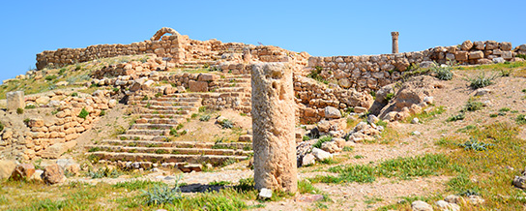
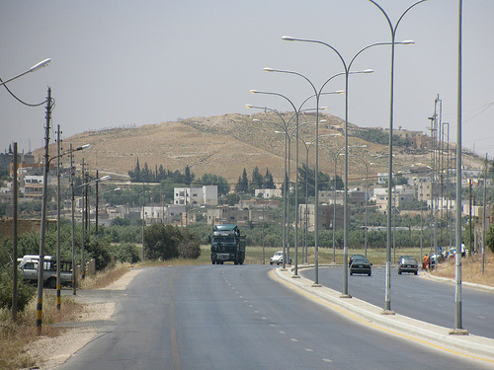
The Site of Tall Hisban (Heshbon)
The site has 21 compacted and complex strata or “layers” of occupation dating from ca. 1225 BC to the present.
The site is strategically located at the junction of three geographical regions, the Madaba Plains (Mishor or Balqa) to the east and south, the Ammonite Hill Country to the north, and the steppe land (Abarim) descending to the Plains of Moab and the Dead Sea to the west. The North-South King’s Highway passes by the foot of the site.
The commanding position of Hisban makes it a place of power. Except to the north, one enjoys superb views in all directions including the Judean Desert, the Hill Country of Judah and all the way to the the vicinity of Jerusalem.
Tall Hisban is technically not a traditional “tell”, but rather a prominent hill that has been used as a palimpsest, that is, the builders of each stratum have generally scraped off earlier remains. This makes excavation and identification of earlier layers very difficult. One has to search for “pockets” in the bedrock where early remains are preserved.

Slide 34
The History of Tall Hisban (Heshbon)
The City of Sihon, King of the Amorites that was conquered by Israel: (Numbers 21:21-31, Deuteronomy 1:3-4; 2:24; 3:2, 6; 29:7; Joshua 9:10; 12:2, 5; 13:10, 21, 27; Nehemiah 9:22).
In the fifteenth century B.C., Sihon was thus a conqueror who soon lost his lands to another invader (cf. Num. 21:25–30). Situated on the "King's Highway“ and surrounded by fertile fields and vineyards, Heshbon was eminently suited as a central settlement.
As the city was assigned to the tribes of both Reuben and Gad (Num. 32:37; Joshua 13:10-28), its proximity to the borders of these tribes is probable. Heshbon is listed as a Levitical city in the Gad's territory (Josh. 21:39; I Chron. 6:66). Its fate in the conflict between Israel and Moab in the time of the Judges (Ehud) is uncertain (cf. Judg. 3:12ff.; I Sam. 12:9–11); the Ammonites also appear to have claimed it at that time (Judg. 11:26).
A small unfortified village existed at the site during the 12th–11th centuries B.C.E. The territory remained Israelite until after the death of Ahab (c. 853 B.C.) when Mesha, king of Moab, possibly reconquered it during his rebellion against his Israelite overlord. Remains of a settlement at the site were uncovered dating from the 7th–6th centuries B.C.E. Several inscribed sherds were found.
During the eighth to early sixth centuries B.C., Isaiah (15:4) and Jeremiah (48:2, 34) mention Heshbon as a Moabite city although Jeremiah also speaks of it as belonging to Ammon (49:3). The fertile area around Heshbon is mentioned in Isaiah 16:8–9 and the memory of the pools of Heshbon lingers on in Song of Songs 7:5 where the eyes of the beloved are compared with them.
It was an important site during the Hellenistic to Roman periods (c. 200 B.C. to A.D. 130). In Hasmonean times it was apparently conquered by John Hyrcanus early in his reign (135–104 B.C.) although the sources record only the conquest of Samaga, a village in its territory (Jos., Ant. 13:255; Wars 1:63). Although the city was apparently held by Alexander Yannai (Ant. 13:397), Hyrcanus II ceded it to the Nabatean king Aretas III (as may be concluded from Ant. 14:18). Herod recovered it from the Nabateans and established a colony of veterans there (ibid., 15:294). At the outbreak of the Jewish War in A.D. 66, it was attacked by Jews (Wars 2:458). In A.D. 106 Heshbon became part of the new Provincia Arabia (Eusebius, Onom. 84:4). From the 2nd-4th centuries A.D. the site has the remains of a temple and inn on the acropolis, the former destroyed in the earthquake of A.D. 365. In the third century it was renamed Aurelia Esbus and Jerome mentions it by this name and describes it as "a notable city of Arabia in the mountains in front of Jericho, 20 Roman miles from the Jordan" (Onom. 85:4–5). Its coins, struck under Elagabalus, show Zeus and Esculapius as well as the Arabian deities Dushara-Dionysus and Astargatis-Astarte. In the fourth and fifth centuries Heshbon was the seat of a bishop (two churches are known from the site).
After the Arab conquest it was the capital of the Belka district up to Mamluk times. An impressive Medieval Islamic and Ottoman settlement covered the site.

Slide 35
The Conquest of Heshbon and the Song of Heshbon (Numbers 21:21-31)
The Defeat of Sihon and Og
²¹ Israel sent messengers to say to Sihon king of the Amorites:
²² “Let us pass through your country. We will not turn aside into any field or vineyard, or drink water from any well. We will travel along the King’s Highway until we have passed through your territory.”
²³ But Sihon would not let Israel pass through his territory. He mustered his entire army and marched out into the wilderness against Israel. When he reached Jahaz, he fought with Israel. ²⁴ Israel, however, put him to the swordand took over his land from the Arnon to the Jabbok, but only as far as the Ammonites, because their border was fortified. ²⁵ Israel captured all the cities of the Amorites and occupied them, including Heshbon and all its surrounding settlements. ²⁶ Heshbon was the city of Sihon king of the Amorites, who had fought against the former king of Moab and had taken from him all his land as far as the Arnon.
²⁷ That is why the poets say: “Come to Heshbon and let it be rebuilt; let Sihon’s city be restored.
²⁸ “Fire went out from Heshbon, a blaze from the city of Sihon. It consumed Ar of Moab, the citizens of Arnon’s heights. ²⁹ Woe to you, Moab! You are destroyed, people of Chemosh! He has given up his sons as fugitives and his daughters as captives to Sihon king of the Amorites.
³⁰ “But we have overthrown them; Heshbon’s dominion has been destroyed all the way to Dibon. We have demolished them as far as Nophah, which extends to Medeba.”
³¹ So Israel settled in the land of the Amorites.
(See also Deuteronomy 1, 2, 3, 29)

Slide 36
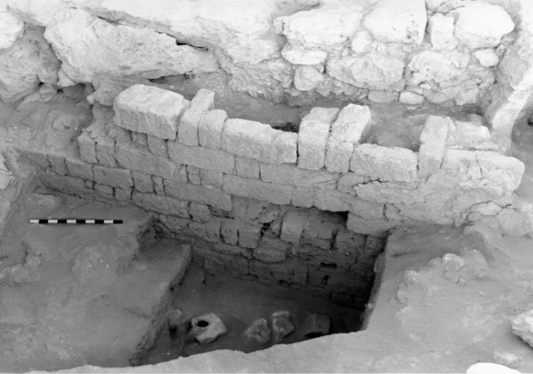
The Biblical Evidence for Heshbon 1 Kings 4
Solomon’s Twelve
Administrative Districts
Adapted from Map 113 in The Carta Bible Atlas, 4th edition
District Twelve (1 Kings 4:19)
Geber son of Uri—in Gilead (the country of Sihon king of the Amorites and the country of Og king of Bashan). He was the only governor over the district (NIV)
Gaber son of Adai in the land of Gad, [the land] of Sihon{gr.Seon} king of Heshbon {gr. Esebon}, and of Og king of Bashan {gr. Basan}, and one officer in the land of Judah (LXX)
The organization of District 12 possibly derives from the tribal roster of Reuben (Josh 13:15-23)

Slide 37
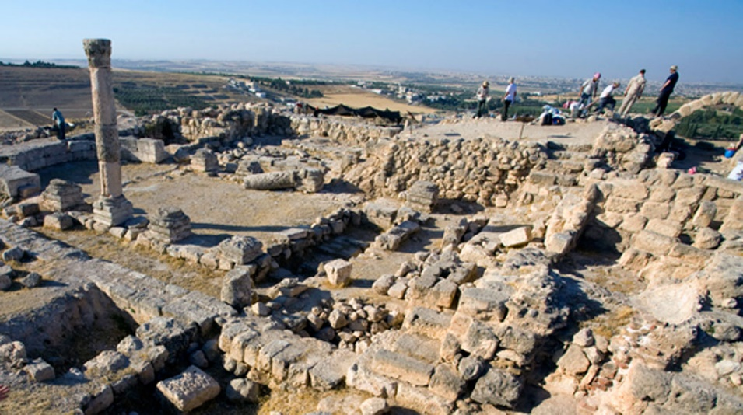
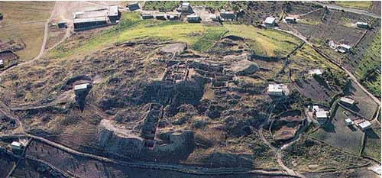
The Problem of Heshbon
Class Exercise
Heshbon is mentioned in relation to the settlement of the Israelite tribes of Gad and Reuben, the reign of Solomon and with regards to Moab and Ammon in the eighth and seventh centuries BC. Remains and objects from all of these periods have been found at Heshbon, but not from the time of Moses and the conquest of Sihon in Numbers 21! What do we do and what are our options? Has archaeology disproved the Bible? Read Numbers 21: 21-31; Joshua 13:10-28; 21:39; I Chron. 6:66; Isaiah 15-16; Jeremiah 48-49)
Now read Ecclesiastes 2:4-6 and Song of Sons 7:4

Slide 38
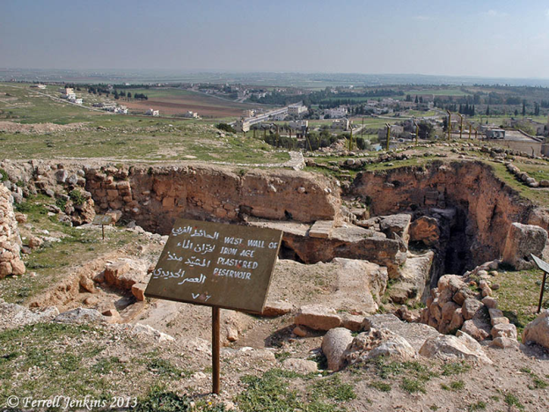
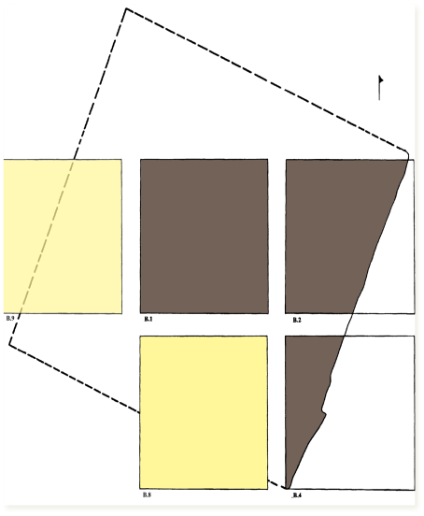
The Monumental Pool (Reservoir) of Heshbon (בְּרֵכוֹת בְּחֶשְׁבּוֹן) Today
Song of Songs 7:4 (NIV)
Your neck is like an ivory tower. Your eyes are the pools of Heshbon by the gate of Bath Rabbim. Your nose is like the tower of Lebanon looking toward Damascus.

Slide 39
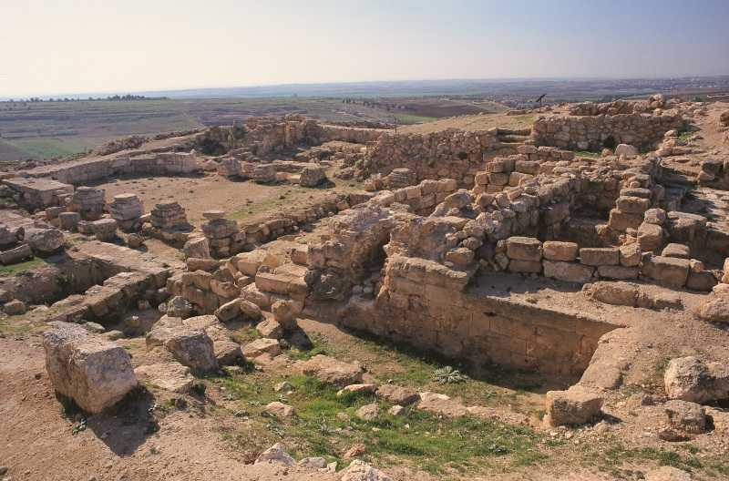
Was Hisban a Royal Estate during Solomon’s Reign?
The geographical location of Hisban offers commanding views (Madaba Plains, Jordan Valley, Judean Hill Country, including the vicinity of Jerusalem. Hisban overlooks the King’s Highway and is strategically located at the confluence of both political borders and geographical transition zones (Younker 1994). Later polities also recognized Hisban’s strategic location and chose to establish administrative and religious centers there.
The dating of the reservoir fits the Iron IIA period (Stratum 18) and has been dated to the tenth century by Sauer (1994: 241-44). The discovery of an ashlar header and stretcher wall with close similarities to gallery 629 at Megiddo (Ray 2001: 107) seems to suggest a close architectural link to the reign of Solomon.
The paucity of domestic dwellings and the lack of any city wall seems to imply a royal residence and compound of a powerful king rather than a town or city.
The immense size and location of the reservoir strongly suggests the existence of extensive gardens פרדסים along the slopes of Hisban (Ecclesiastes 2:4-6) watered by gravity flow via a series of channels; hence the need for such a large amount of water.
The Pools of Heshbon (Song of Songs 7:4) were probably extra mural pools along the slopes to the west. The Gate of Bath Rabbim may have been a ceremonial gateway as part of the Royal Estate.

Slide 40
Kir Haresheth (Kerak) Capital of the Moabite king Balak

Slide 41
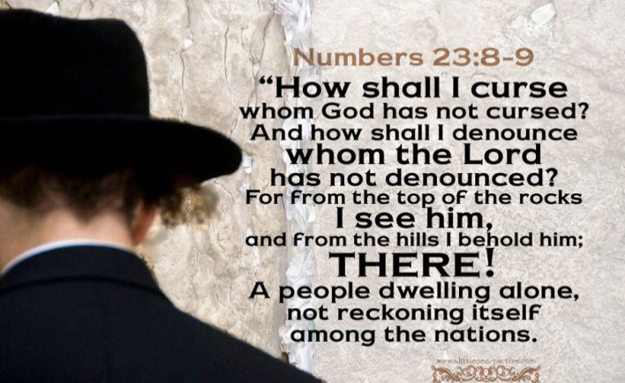
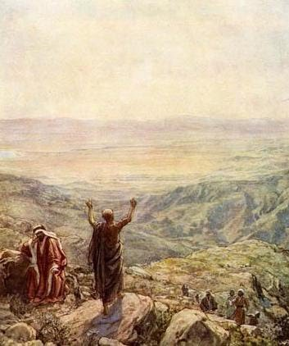
Balaam the Seer
Balak, king of Moab, had a problem. A huge number of foreigners, calling themselves Israelites, were camped on the edge of his kingdom. They had destroyed the Amorites and their mere presence was a threat to his kingdom. Everyone in Moab was terrified. Yet Balak could not hope to defeat them in battle. He decided to turn instead to the dark side and hired a seer named Balaam to curse these people. Perhaps then the threat to his sovereignty and life would be removed. Balaam came well recommended, possibly all the way from Mesopotamia. Yet the Lord spoke to Balaam and, ultimately, amidst much drama, including lavish sacrifices and the erection of seven altars at different locations, Balaam spoke four beautiful oracles of blessing to Israel (and judgement upon Moab) to the Israelites (see the quote above) camped below in the Plains of Moab. Balak was absolutely furious, but Balaam returned home. Yet Numbers 31:16 implies that Balaam made an ominous suggestion to Balak of offering the Israelites food offered to pagan gods and young women as prostitutes. This action seduced many Israelite men (Numbers 25) and led to many deaths. While Balaam was evil (Revelation 2:14), God took control over him for Israel’s benefit and protection. Yet when Israelites subsequently faced a choice, when offered the opportunity to engage in immoral acts and worship pagan gods, sadly, many fell away.

Slide 42
The Balaam Inscription from Deir ‘Allah (Biblical Succoth)
This inscription, written in an early form of Aramaic, was written on a plaster wall of a temple. Recovered in 1967 during excavations at the ancient city of Succoth, it dates to the ninth-eighth century BC. Amazingly, the inscription mentions Balaam as a seer, thus providing very dramatic historical evidence to support the historicity of the biblical account in Numbers 22-24.

Slide 44
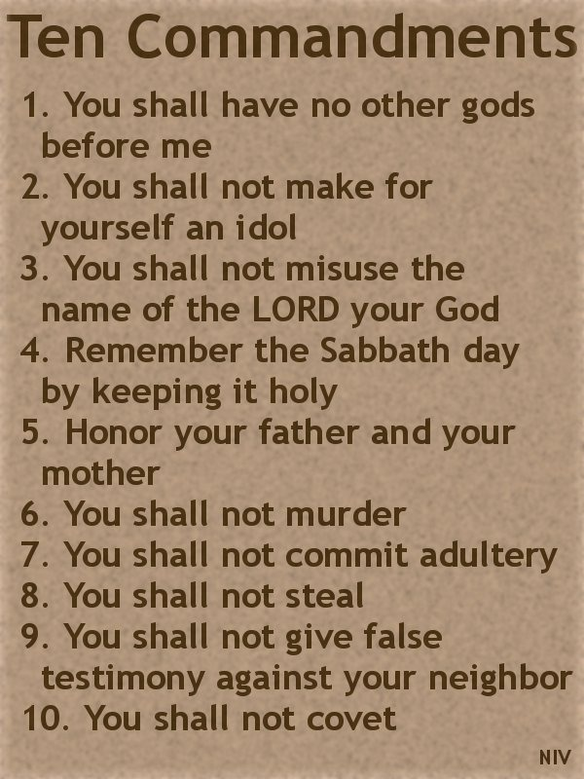
The Ten Commandments (Exodus 20:1-17 and Deuteronomy 5:4-21)

Slide 45
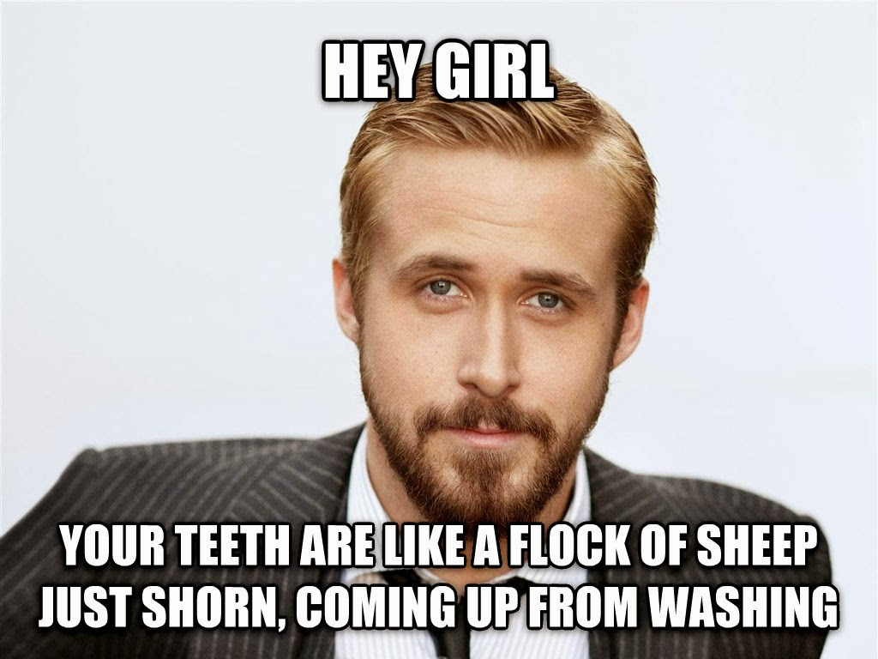

Slide 46
Leviticus

Slide 47
Acceptable Sacrifices

Slide 48
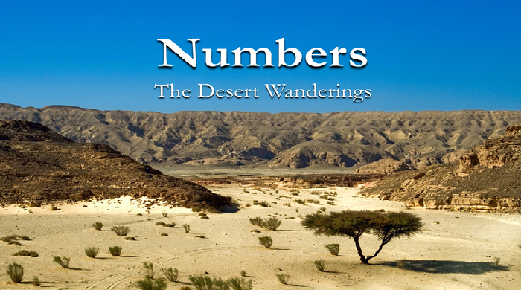
The Book of Numbers

Slide 49
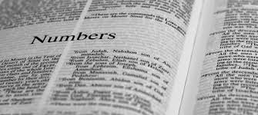
The Book of Numbers Hebrew Title (bamidbar; in the desert)
Theological Aspects
The Presence of the LORD (9:15; 12:6-8)
The Providence of the LORD: Manna and quails (Numbers 11) and water from the rock
The Patience of the LORD: Against grumbling and faithlessness (14)
The LORD and the Nations: Sovereignty over all other gods and peoples (21-24)

Slide 50
The End of the World That’s the name the local Jordanians give for this panoramic view of biblical history. Looking over the Arabah and Wilderness of Zin from Aaron’s Tomb atop Mount Hor allowed us to view nearly the entire 40 year Wilderness sojourn of the Israelites under Moses. The photos below are looking to the west, across the biblical Arabah into the Wilderness of Zin. It’s an experience every Bethel student should have! Just bring lots of water with you!

