Slide 1
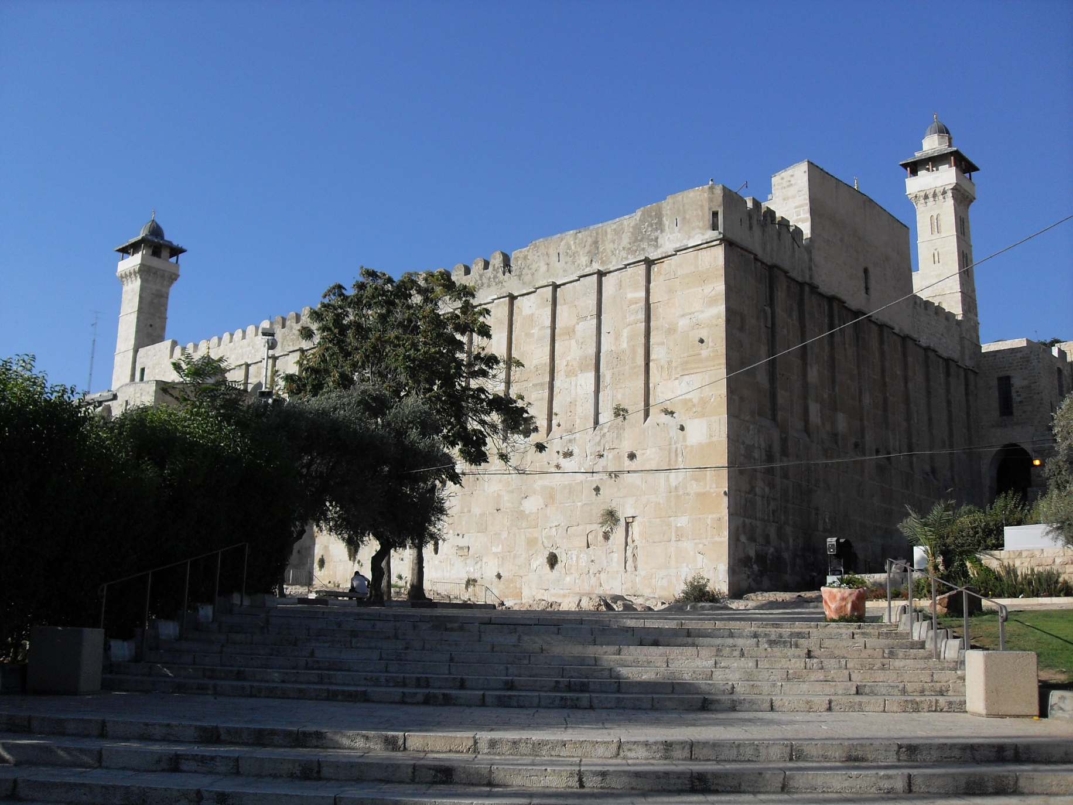
The Patriarchs and Archaeology
The burial cave of the Patriarchs at Hebron (Genesis 23-25) beneath a shrine built by Herod the Great

Slide 2
The World of the Patriarchs

Slide 3
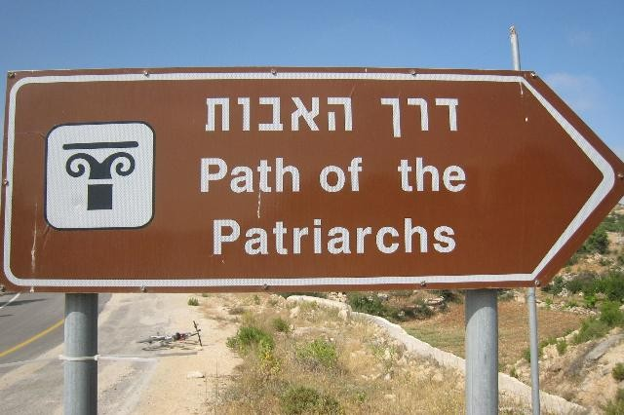
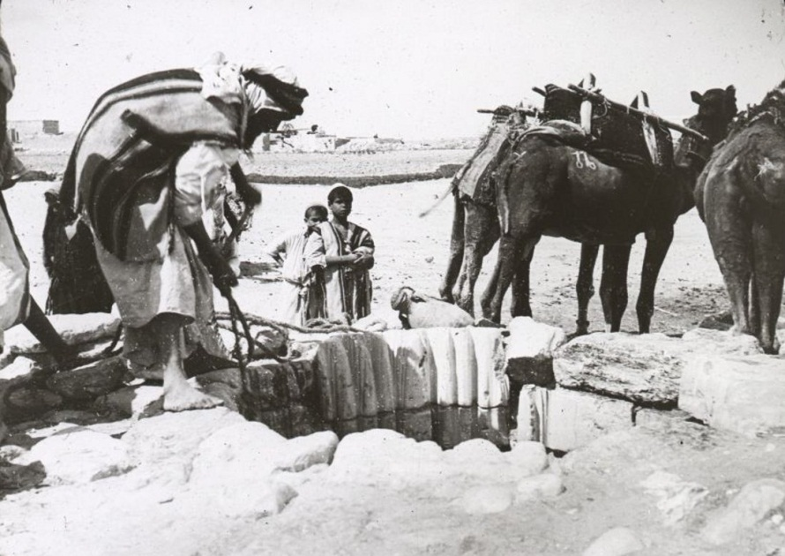
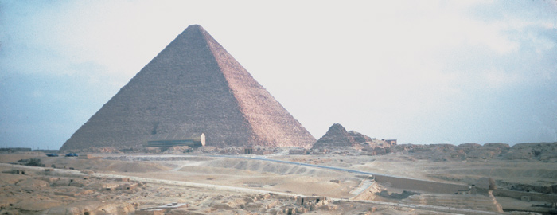
Abraham’s Journey From Ur to the Land of Canaan and Egypt (Genesis 12)

Slide 4
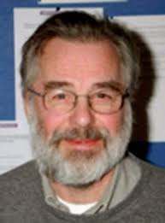
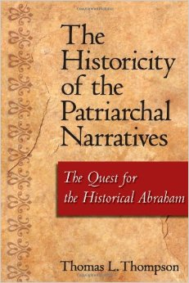
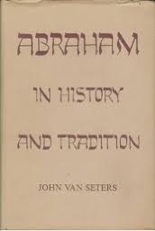
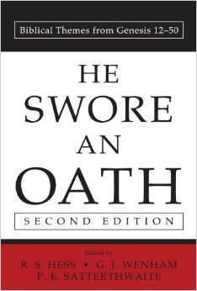
Debate on the Historicity of the Patriarchs John J. Bimson and K. A. Kitchen

Slide 5
The Patriarchs and their Historical Context
God spoke to Abraham in Ur, a city located in what is now southern Iraq, telling him to leave his family, his occupation, his friends and go! -Go to a land God would show him in order to become a great nation there with descendants more numerous than he could count. Why? Well, from his seed (think back to Genesis 3), God promised to bless all of the families of the Earth. You see, Abraham’s family, the Jewish people, were chosen to carry the seed of the Messiah, from Whom would come forth salvation and deliverance from sin and reconciliation with God, which was lost in the Garden of Eden. Abraham obeyed God and, despite some setbacks, remained faithful and God kept His promise as well.
Genesis 12-50 presents an action packed narrative depicting the history of Abraham, his family and his descendants, but does outside evidence confirm their existence? Yes and No!
Scholars debate whether the Patriarchs fit into the final century of the Early Bronze Age (2100-2000 BC) or some part of the following period, the Middle Bronze Age (2000-1550 BC). That’s an incredibly long period of time!
Surprisingly little specific information is presented in Genesis to help us. Cities, towns and sites are mentioned, the four kings from the east that attacked the five cities of the plain are named (Genesis 14:1-9), but are unattested in other sources. Semites are mentioned in Egyptian records, but not specifically Jacob and his family (see below). There are tantalizing clues from various sources, such as seals bearing the name Jacob (see slide below) and an Israelite fort named after Abram that is mentioned in Egyptian records and a Philistine king with a Semitic name, Abimelech.
The lack of outside information is not at all surprising. We are reading the history of a single family, not a dynasty of kings (not yet anyway!). Yet what we know of the cultural and historical setting of the first half of the second millennium BC seems to fit the Genesis account quite well.

Slide 6
Placing the Patriarchs in Their Proper Historical Context
Hints from the Biblical Texts:
The Canaan that Abraham knew
The Cities of the Plain and the names of the kings at war (Genesis 14) from Elam, Mesopotamia and southern Anatolia
In the days of Amraphel king of Shinar, Arioch king of Ellasar, Chedorlaomer king of Elam, and Tidal king of Goiim, ² these kings made war with Bera king of Sodom, Birsha king of Gomorrah, Shinab king of Admah, Shemeber king of Zeboiim, and the king of Bela (that is, Zoar). ³ And all these joined forces in the Valley of Siddim (that is, the Salt Sea). ⁴ Twelve years they had served Chedorlaomer, but in the thirteenth year they rebelled. ⁵ In the fourteenth year Chedorlaomer and the kings who were with him came and defeated the Rephaim in Ashteroth-karnaim, the Zuzim in Ham, the Emim in Shaveh-kiriathaim, ⁶ and the Horites in their hill country of Seir as far as El-paran on the border of the wilderness. ⁷ Then they turned back and came to En-mishpat (that is, Kadesh) and defeated all the country of the Amalekites, and also the Amorites who were dwelling in Hazazon-tamar.
Equating place names with known sites (Salem, Dan, Damascus, Moriah, Shaveh, Beer Sheba, etc)
Identifying Ethnic Groups (Amorites, Canaanites, Philistines, Hittites, etc)
Patriarchal customs (Sarah as a “sister”, Hagar’s role as surrogate mother, etc)
Identifying kings (pharaoh, Abimelech, Edomite king list in Genesis 36:31, etc)
Slave prices (Genesis 37:28): 20 silver shekels is consistent with the early second millennium BC.
Treaties and Covenants
Epigraphic material (Fort Abram, Jacob seal)

Slide 7
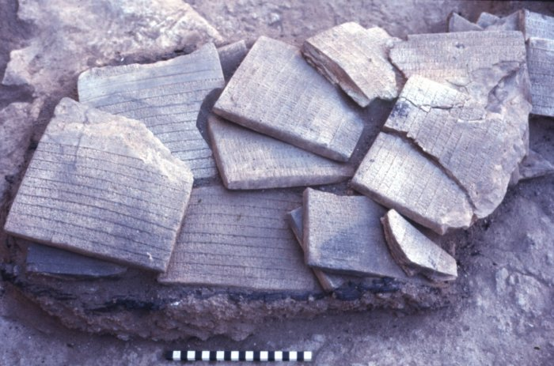
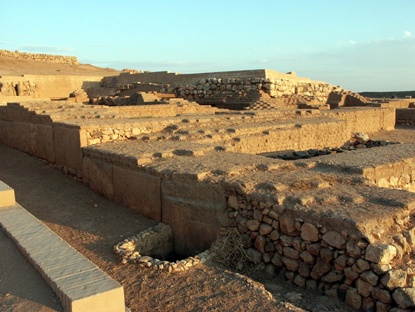
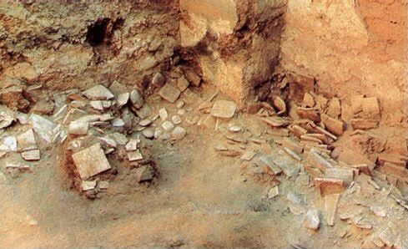
Ebla and Biblical History: Hopes and Disappointments
Tell Mardikh near Aleppo revealed a trading empire lasting from ca. 3100-1600 B.C. and a palace archive containing 20,000 tablets. Giovanni Pettinato and others claimed that these tablets, written in Eblaite cuneiform, contained references to YHWH, Jerusalem, Sodom, Gomorrah, Zoar and the Patriarchs. The director of the excavation, Paolo Matthiae and others disputed the claims. The Syrian government got involved as well. The claims were found to be unsubstantiated. However, interest in re-dating the Patriarchs to the Early Bronze Age was seriously considered.

Slide 8
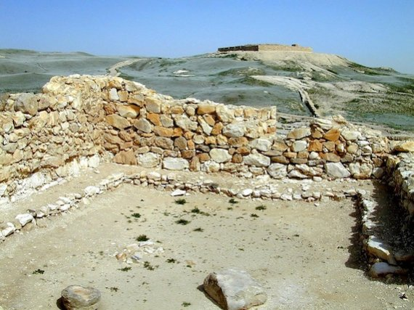
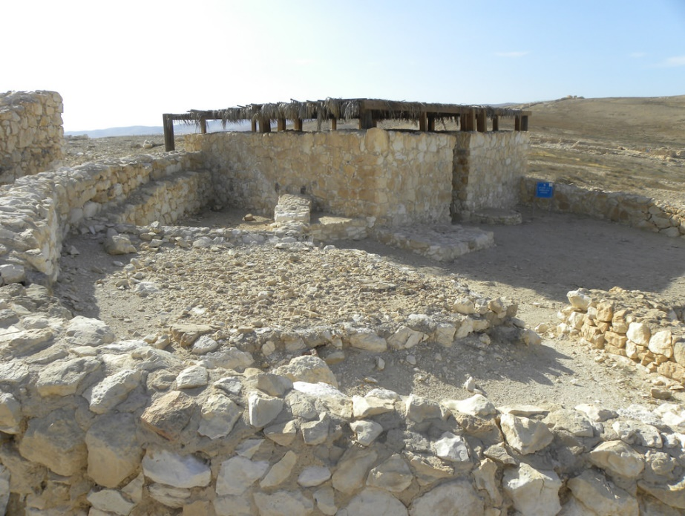
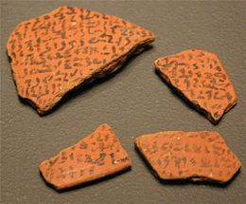
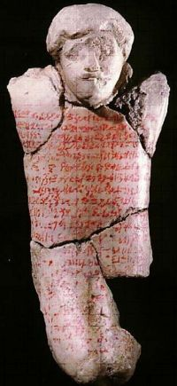
Salem, Moriah and the Vale of Shaveh: Early References to Jerusalem
Excavations in the Rephaim Valley and the City of David have uncovered settlements from both the Early and Middle Bronze Ages. The upper Rephaim Valley (the modern Bekaa Neighborhood of west Jerusalem) or the Kidron Valley may be synonymous with the Vale of Shaveh in Genesis 14. Adoni Zedek, a Jebusite king of Jerusalem in Joshua 10:1-3, may also preserve a dynastic name “Zedek” going back to Melchizedek. The houses at the right are from this period at Arad, in the Negeb. Note the bench that lines the outer wall. The earliest known reference to Jerusalem outside of the Bible is from The Execration Texts, which have the names of cities and rulers, including “rushalimum” deemed enemies of Egypt written on bowls and figurines, then smashed during a ritual.

Slide 9
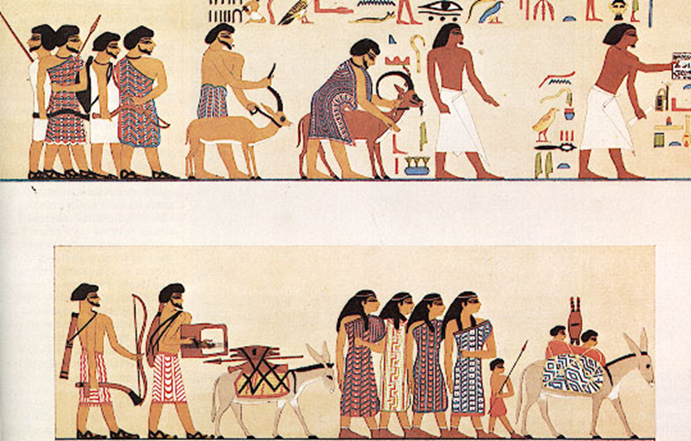
Abraham and Sarah in Egypt
A famine in Canaan forced Abraham to journey to Egypt to trade for food (Genesis 12). A beautifully preserved wall mural discovered in a tomb of an Egyptian official at Beni Hasan depicts a group of lighter skinned Semites arriving in Egypt to trade. Notice the different hair styles, beards and colorful coats! Dating roughly from the time of Abraham (the Egyptian Middle Kingdom, which dates from 21st -17th century BC), the Beni Hasan mural is our best contemporary portrait of what the Patriarchs looked like.

Slide 10
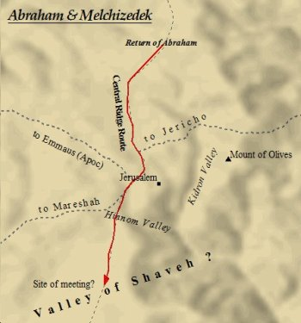
Abraham and Melchizedek Genesis 14:17-24 mentions a somewhat strange meeting between Abraham, the king of Sodom and Melchizedek, king of Salem (Jerusalem) and priest of “God Most High.” The Hebrew meaning of Melchizedek is “king-priest” so a play on words is evident here. Melchizedek blesses Abraham, who in turn gave a tithe. Who was Melchizedek? Many scholars believe him to be an appearance of the pre-incarnate Christ on the basis of other references to him in the Bible. The Valley of Shaveh, which denotes a smooth plain, is believed to be just outside the city of Jerusalem, possibly in the Rephaim Valley shown below or the King’s Valley, where Solomon had his Royal Gardens. This brief meeting between God and Abraham in a well watered and lush plain both reflects Eden before the fall and looks forward to the birth of Christ, His atonement for our sins and our reconciliation with God.

Slide 11
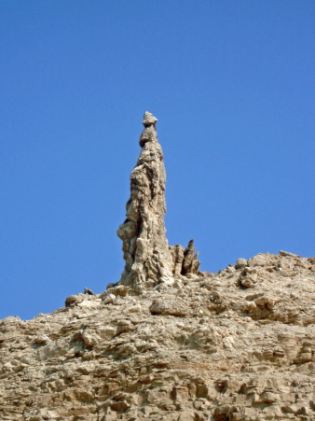
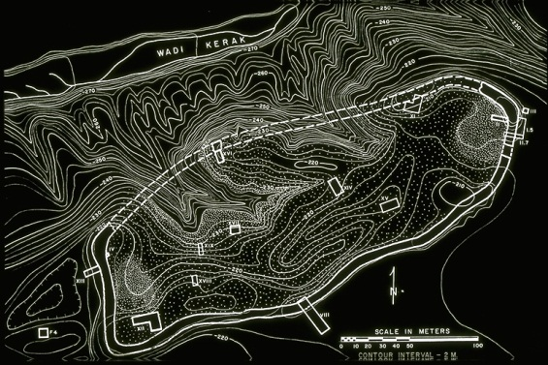
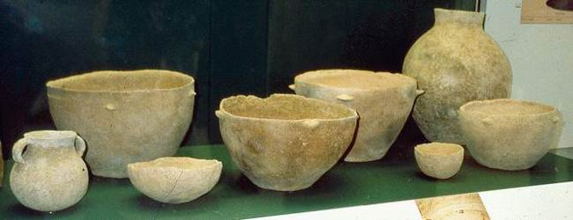
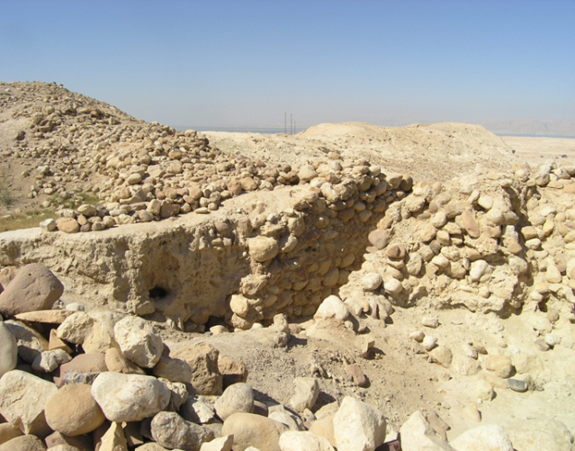
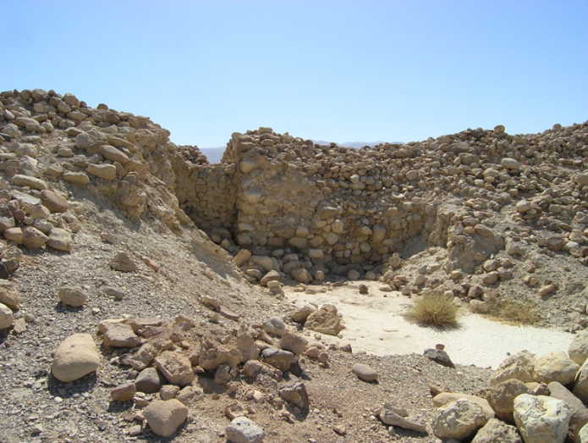
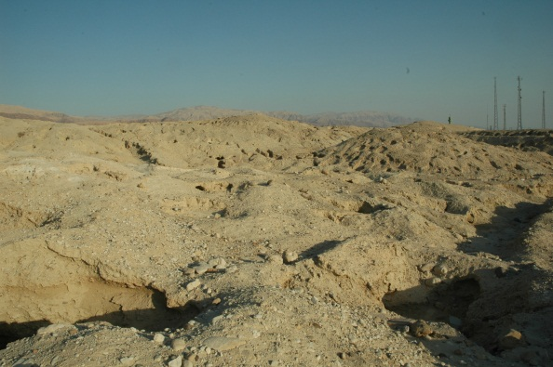
Sodom and Gomorrah
Sodom and Gomorrah were the two most prominent of five “cities of the plain” located near the Dead Sea. The area is extremely hot and arid now, but had a much wetter climate 4000 years ago, as shown by core samples taken in the vicinity. Thus, Lot chose this region to live. The ancient site of Bab edh Dhra, shown below, is one of the leading candidates for Sodom. It was destroyed by a fierce fire around the time of Abraham. Near the site is one of the largest cemeteries on the Near East. The pottery below has been recovered from tombs in this cemetery. Four other sites south of Bab edh Dhra also date to approximately the same time and may be the other four cities: Sodom, Gomorrah, Admah, Zeboiim and Bela (Zoar; Genesis 14:8). Another site farther north, Tell Hammam, is another candidate for Sodom.

Slide 12
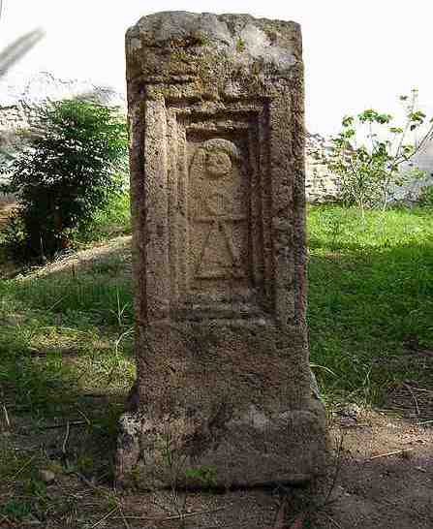
The Akedah The binding of Isaac (Genesis 22) The monument to the left is for the Canaanite god Molech at Carthage, to whom children were regularly sacrificed by being thrown into a fire alive at a place called Tophet. Was Abraham’s God demanding the same thing?

Slide 13
The Place: The Land of Moriah (calledYahweh Yireh; in spoken English, the name is Jehovah Jirah)
The Place of Sacrifice on Mount Moriah, where Abraham bound his son Isaac, is the location of the Golden Dome in the distance (right center of the picture), which is also the location of Solomon’s Temple. This photograph is taken along the Haas Promenade near the Hill of Evil Council south of Jerusalem and very close to where Abraham “lifted up his eyes and saw the place afar off” (Genesis 22:4)

Slide 14
The Sons of Jacob: The Twelve Tribes of Israel The twelve tribes of Israel, depicted on stained glass windows (on the left), by Marc Chagall, are on display at the Hadassah Medical Center, En Karem, Jersusalem

Slide 15
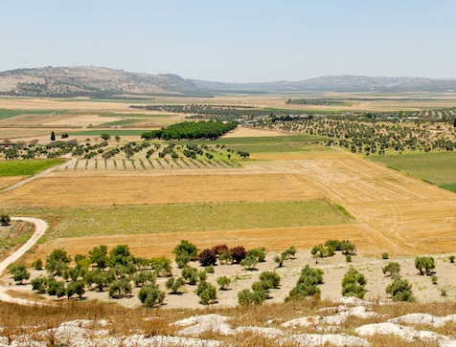
The Biblical Narrative of Joseph Genesis 37-50
Semites from Canaan, such as Jacob’s family (called Asiatics by Egyptians) appear in various Egyptian records from the Second Intermediate Period and the Middle Kingdom (1963-1600 BC) and bear Hebrew names such as Menahem, Shipra (Exodus 1:15), Tawti (David), Epir (Ephron), Asher, and Aqob (Jacob). Brought to Egypt as prisoners of war, slaves (like Joseph), or as tribute from vassal kingdoms. They were especially numerous in the northern Nile Delta region at the city of Avaris (Tell el-Dab’a). They worked in a variety of positions at various social levels.
A view of the Dothan Valley, where Joseph was sold by his brothers to Midianite traders for 20 pieces of silver (Genesis 37:28), which is the average price for a male slave during Joseph’s day (the first half of the second millennium BC)!

Slide 16
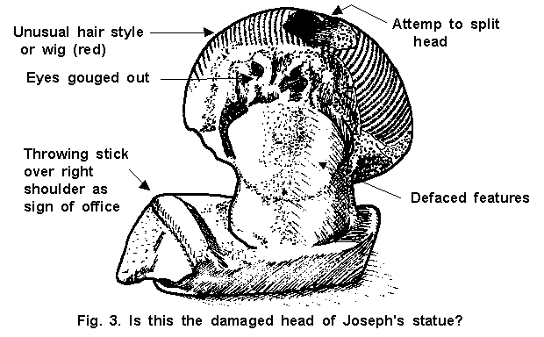
Evidence of Joseph in Egypt?
Reconstructed Statue of an Asiatic Official recovered from the Tomb, possibly Joseph himself
A reconstruction of an Egyptian Official’s Tomb at Tell el-Daba. Is this the original tomb of Joseph?

Slide 17
Judah and Tamar (Genesis 38) An interesting interlude to the account of Joseph is the story of Judah and Tamar, which documents the failure of Judah in fulfilling his duty as a father in law and Tamar’s ingenious way of procuring this obligation from him, including taking his identity and revealing his immorality and hypocrisy. To his credit, Judah accepts all blame and repents.
Seals of Jacob
A Veiled Woman from Tunisia

Slide 18
Biblical Avaris (Tell el-Daba) Excavations at the Egyptian Hyksos Capital in the rich Delta region of Egypt, possibly from the time of Joseph

Slide 19
The Land of Goshen in Egypt The Nile Delta, known as the Land of Goshen was the Breadbasket of Egypt and Pharaoh gave this rich land to Jacob and his family. Here the nation of Israel was born. The satellite photo on the right depicts Goshen’s fertility and abundant water. The men on the left are sitting on the feet of Rameses II, who made his capital here and may have been the pharaoh of the Exodus.

