Slide 1
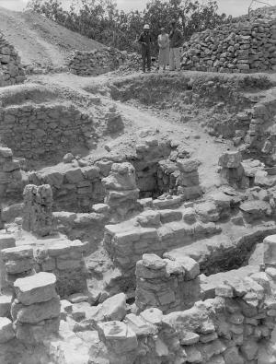
Kelso’s Excavation Results from Bethel
Chalcolithic (4300-3300 BC) and Early Bronze Periods (3300-2000 BC): Mixed sherds but apparently no clear stratigraphic levels
Middle Bronze (2000-1550 BC): Two occupational phases; A temple oriented to the east with flagstone pavement; building near spring; massive 3.5 m wall; gates and streets
Late Bronze (1550-1200 BC): Two occupational phases; houses with flagstone pavements; drainage and sewer systems; olive oil press.
Iron I (1200-1000 BC): Poorly built homes “huts”
Iron II (1000-586 BC): The Royal Religious Shrine and Temenos; destroyed by Josiah
Persian (539-333 BC): Small village
Hellenistic (333-63 BC): Prominent village (two phases)
Roman-Byzantine (63 BC-AD 634): A large, flourishing town with churches
Islamic (AD 634-1517): Early Islamic and Mamluk remains

Slide 2
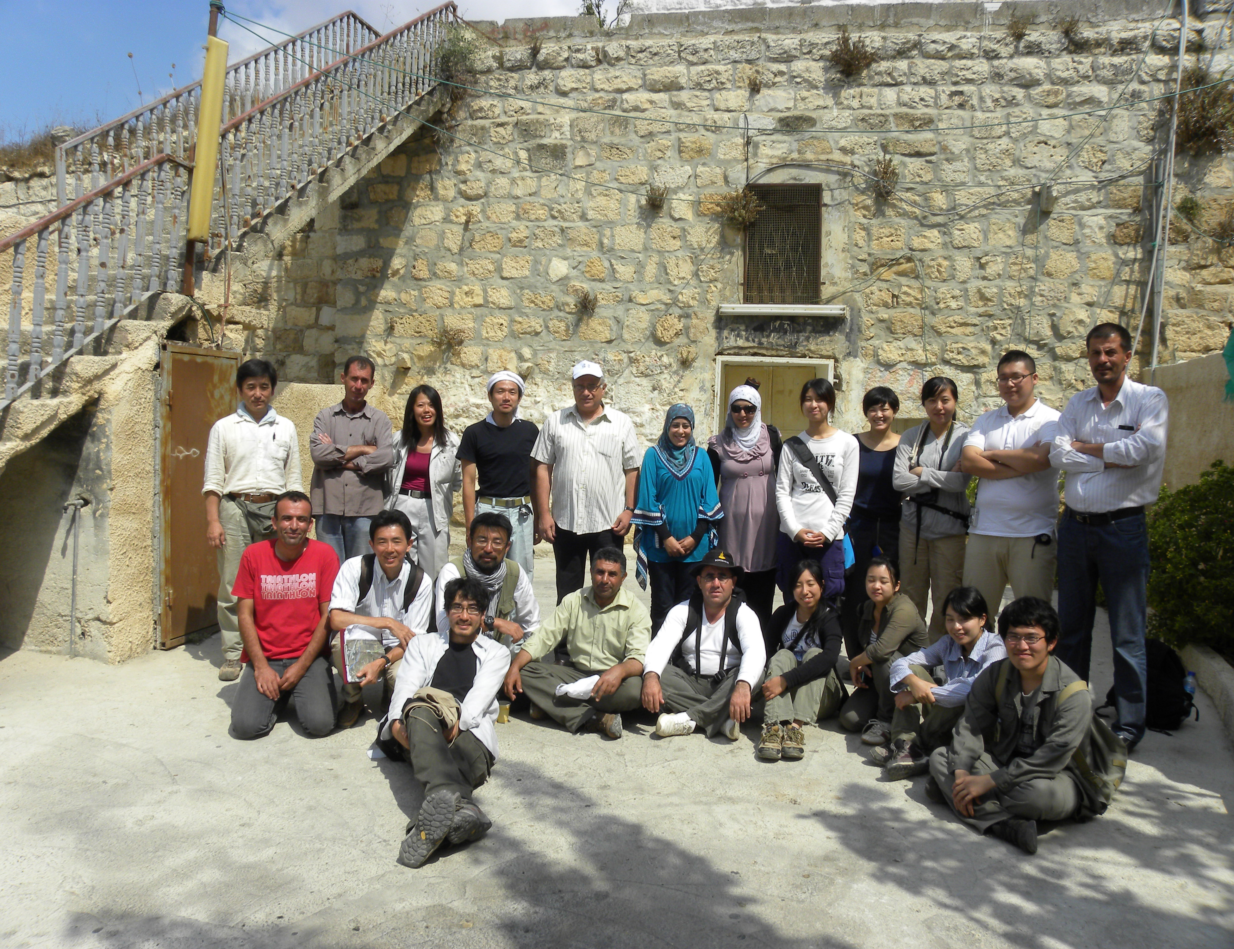
The Joint Palestinian-Japanese Expedition to Beitin (2011-2013)
The Archaeological Excavations and Development of Resources for Tourism at Beitin (Bethel) is a Palestinian-Japanese cultural heritage project to promote tourism at the site. Jointly led by Hamdan Taha and David Sugimoto (from Keio University), the project included a survey and excavations at the Burj Beitin, a Byzantine monastery east of the modern village (note my title page) as well as several MB and Roman tombs to the south.
https://www.jcic-heritage.jp/en/project/middle_east_palestine_201312/

Slide 3
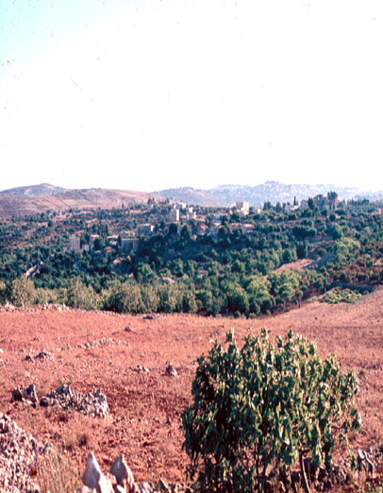
Recent Scholarly (and unscholarly) Debates over Beitin vs. el-Bireh as the Site of Bethel
For several generations, equating the site of biblical Bethel with the Arab village of Beitin seemed secure as the site appeared to fulfill all of the requirements forwarded by Historical Geographical research, such as place name preservation, location matching data from historical sources and archaeological confirmation of the periods in which it was occupied.
Yet, in 1970 a rift in the consensus developed and a minority of scholars looked to el Bireh to the south as the site of Bethel
https://www.pitts.emory.edu/dia/bridge.cfm?ID=100236

Slide 4
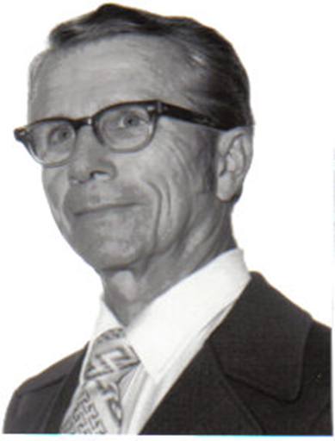
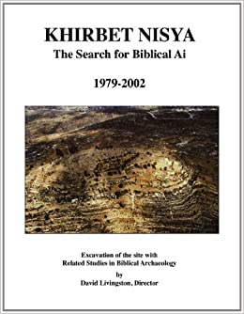
David Livingston (1925-2013)
David founded ABR in 1969, primarily in response to the scholarly assertions that the Biblical city of Ai showed no evidence that Joshua conquered and burned it. Through careful investigation, he ascertained that scholars had wrongly identified the location of Ai, and he worked vigorously to correct the error and identify the Lost City of Ai in Israel. Part of this work included correcting another scholarly blunder: the misidentification of Bethel. Properly identifying Bethel was the key to finding Ai. David determined that Ai was at Khirbet Nisya, directing 15 seasons of excavations there.
David’s educational background was extensive. He graduated from Wheaton College with a B.A. in General Science, Pittsburgh Xenia Seminary with an M. Div., Trinity Evangelical Divinity School with an M.A. in OT Studies, took graduate studies at Dropsie University and received his Ph.D. in Archaeology from Andrews University in 1988. His doctoral dissertation topic consisted of six years of his excavation reports from Khirbet Nisya.
David served with Campus Crusade for Christ from 1972-1975. He has also participated in excavations at Jericho, Jerusalem, Jezreel, Bourgata, and Gezer. He has conducted more than 25 tours in Israel, Jordan and Egypt. David served six years as editor of Bible and Spade, and 20 years as the editor of the ABR Newsletter.
Argued that Beitin was NOT Bethel due to the lack of LB material at et Tell (Ai) and preferred el Bireh, beginning a sharp debate with Israeli scholar Anson Rainey.
https://biblearchaeology.org/staffabr/4281-in-honor-of-dr-david-livingston
https://biblearchaeology.org/about/founders-corner
https://www.amazon.com/Khirbet-Nisya-Search-Biblical-1979-2002/dp/0974140503

Slide 5
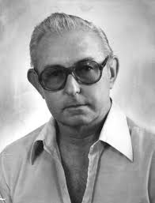
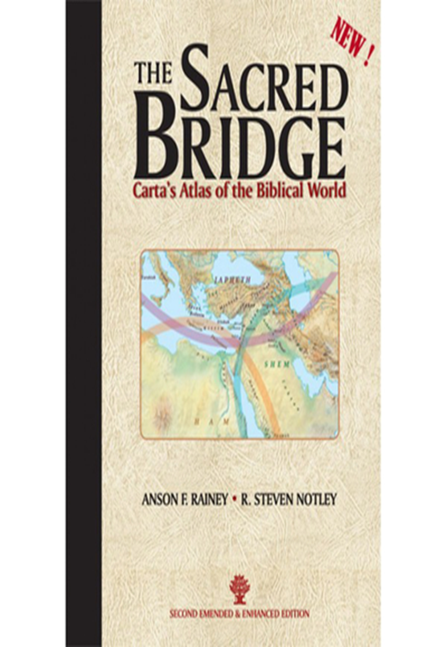
Anson F. Rainey (1930-2011)
The foremost Historical Geographer of the previous generation. Rainey was a disciple of Yohanan Aharoni and wrote extensively on the topography of the Holy Land always reading sources in the original language.
Livingston took Rainey’s course in Historical Geography while a student at Jerusalem’s American Institute of Holy Land Studies (JUC) in the 1960’s, but published his own views on Bethel in 1970.
Rainey responded with a scathing rebuttal in 1971. Both followed up with additional arguments, with Rainey returning to the topic for the last time in 2006.
Most biblical scholars and archaeologists agree with Rainey, with a minority following Livingston.
https://brill.com/view/book/edcoll/9789004281547/B9789004281547_001.xml
https://www.thriftbooks.com/w/the-sacred-bridge-cartas-atlas-of-the-biblical-world_anson-f-rainey_r-steven-notley/1391074/item/19781551/?gclid=Cj0KCQjw0PWRBhDKARIsAPKHFGikm4p30oVvJhdQxaAmBlSpusZZFMWsVcYuJkoSe6WbPPfW1gAEQiMaAoIZEALw_wcB#idiq=19781551&edition=14575870

Slide 6
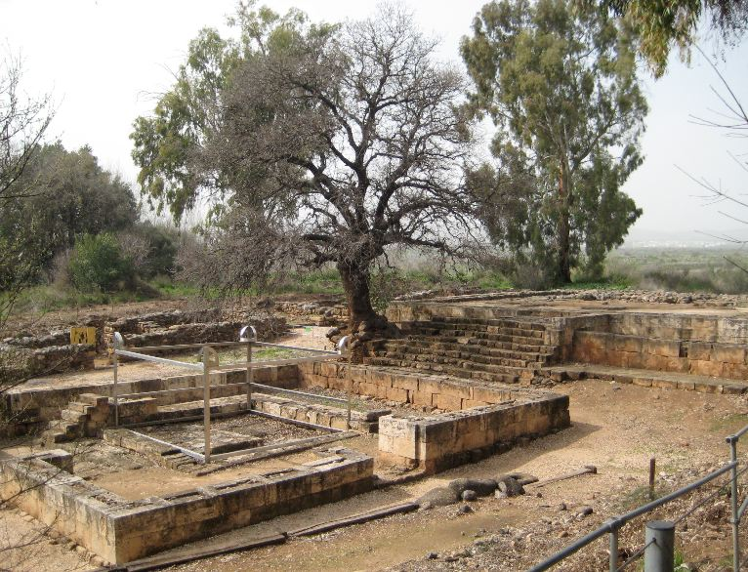
The Sacred Precinct- Temenos at Dan
While excavations at Bethel did NOT expose remains of a shrine or high place, excavations at Dan by Avraham Biran (1966-) DID uncover the Iron Age II High Place,Temenos or Shrine of Jeroboam I, which likely offers a more modest parallel of the shrine that once existed at Bethel
http://holyland-sites.blogspot.com/2013/08/tel-dan-sacred-precinct.html

Slide 7
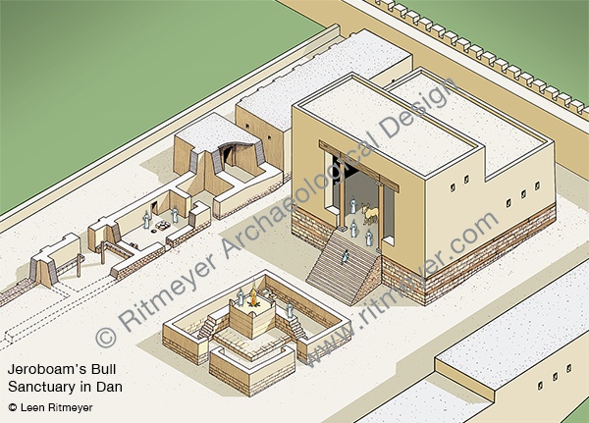
What did the Bethel Shrine Look Like?
The Bethel Shrine or Cultic Precinct (Temenos) probably closely paralleled the shrine at Dan, which combined elements of Solomon’s Temple with earlier Canaanite temples, such as the Temple of Baal Berith (Judges 8-9): the Migdal Temple at Shechem
However, the Bethel Shrine was undoubtedly larger and much more elaborate than the one Jeroboam built at Dan.
https://www.ritmeyer.com/product/image-library/buildings/temples/king-jeroboams-temple-2/

Slide 8
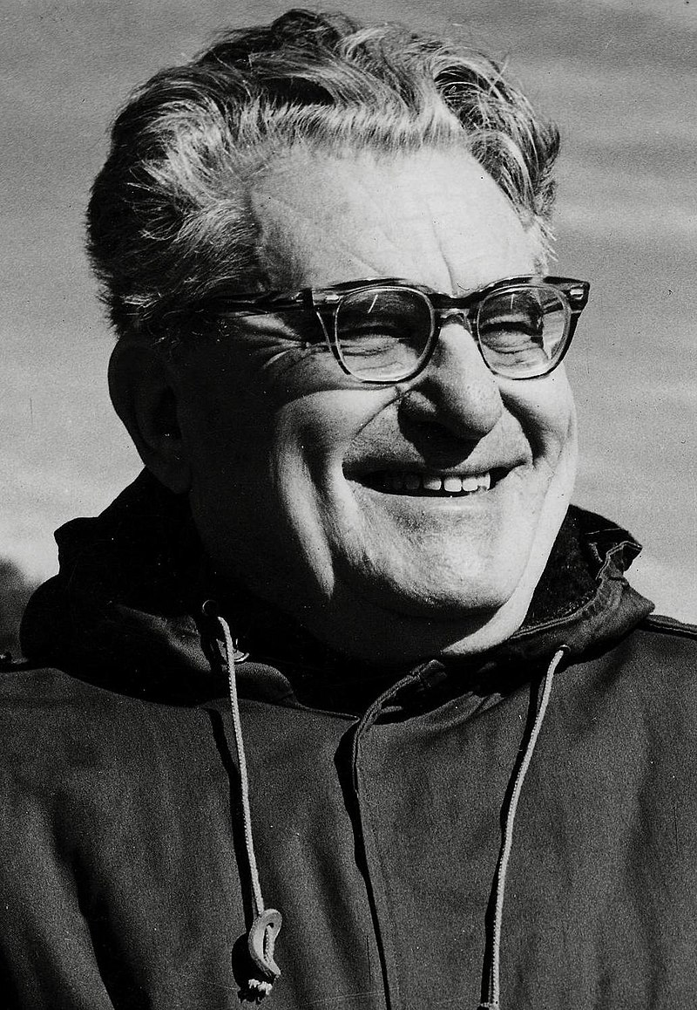
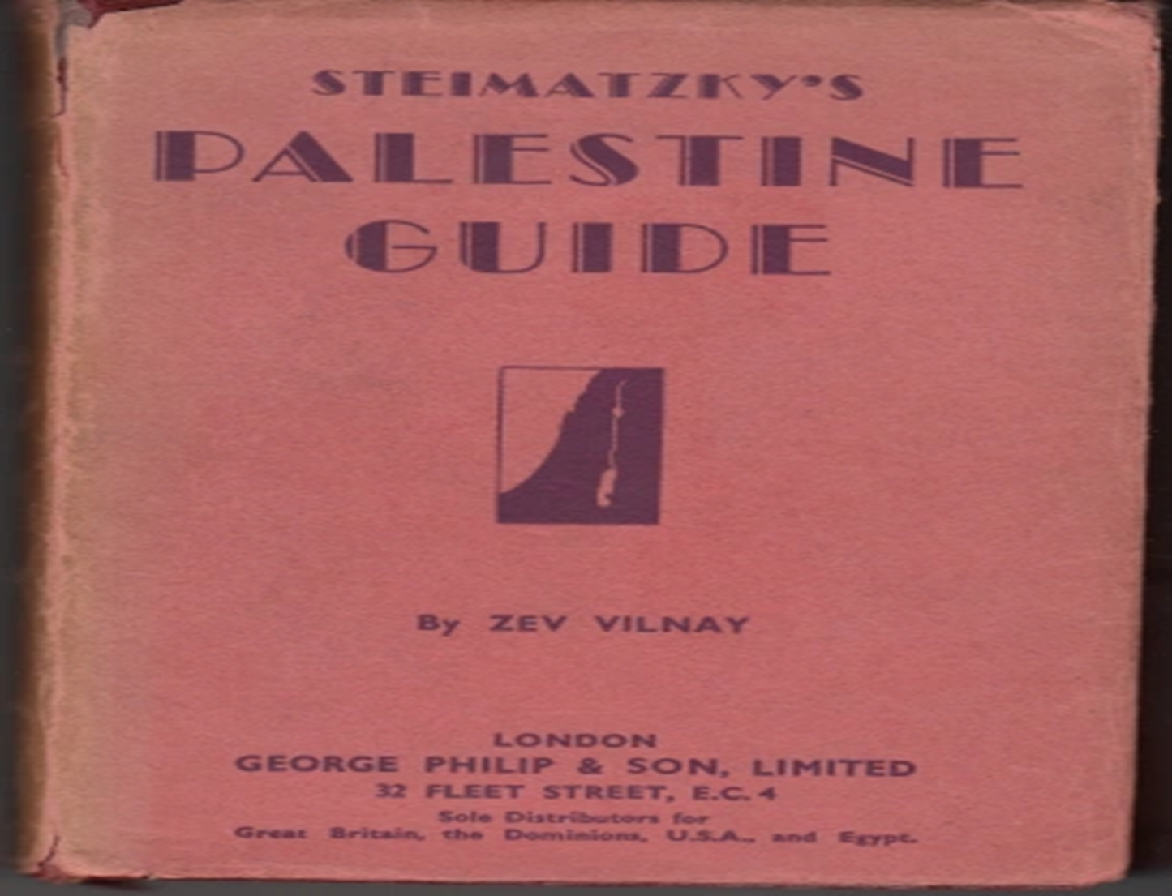
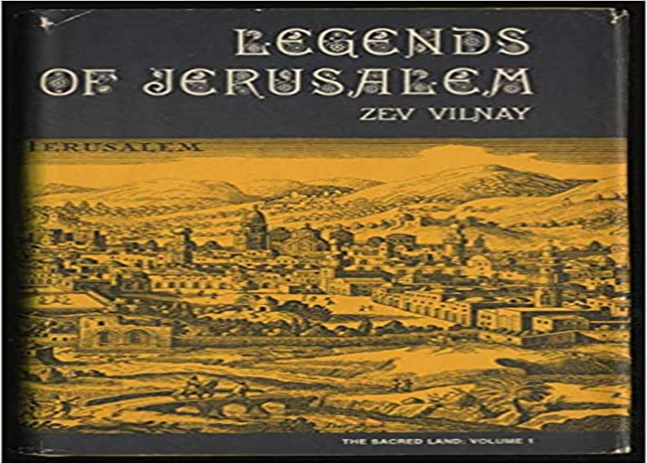
Zev Vilnay (1900-1988)
Zev Vilnay was born in 1900 in Kishinev, Russia (now Moldova). His family immigrated to Israel when he was six years old, and he grew up in Haifa. In high school Vilnay studied at the Hebrew Reali School and then in the Teachers’ Seminary in Jerusalem. Continuing his studies, he went to the University of London, as well as the Dropsie University in Philadelphia where he completed his Ph.D. in 1938. Vilnay grew up during the years of the Second Aliyah when connecting to nature and the landscape was a key component of Zionist education. He was greatly influenced by the activities of touring the country and courses of knowing the land (‘Yediath Ha’Aretz’), which became very popular during the 1920’s. From then and onwards, for sixty years Vilnay devoted his life to spreading knowledge of the land and love of the country through tours, lectures, and publications. He believed that the right way of bequeathing these values was by walking in the various areas of the country, and the motto that had guided him was “by the sweat of your feet you will know the land.” He attracted thousands of travelers and formed the courses of the knowledge of land of Israel. In his many publications he had addressed a variety of issues related to knowing the land. He collected hundreds of stories and folklore stories and compiled them in the book: ‘Legends of the Sacred Land’. He also documented settlements and regions in the ‘Israel Guide’ and ‘Ariel Encyclopedia’. Vilnay was a member of the naming committee of Israel in which he contributed his vast knowledge to the creation of dozens of names of new settlements.
Even if there were those who preceded Vilnay in the engagement of knowledge of the land, there is no doubt that he can be viewed as the pioneer who had paved the way for dealing with this subject over the years. His preoccupation in knowing the land was popular to a great extent, but the tours he had led and the books he had written formed the basis for the scientific engagement in the field. Vilnay won the Israel Prize for his contribution to imparting knowledge of the land and the love of the country in 1982. To his dying day in 1988, Vilnay continued leading and promoting the study of knowing the land.
In 1980, Vilnay visited the Israeli settlement of Beth El and suggested that Jebel Aratas was the site of Jacob’s dream and Jeroboam’s religious shrine. Why didn’t someone think of this possibility and suggest it before?
The Zev Vilnay Chair for the Study of the Knowledge of Land of Israel (‘Yediath Ha’Aretz’) and its Archaeology at Kinneret Academic College
https://en.wikipedia.org/wiki/Zev_Vilnay
https://jewishmiscellanies.com/2020/04/11/steimatzkys-palestine-guide-by-zev-vilnay-published-in-london-and-printed-in-palestine-1935-first-english-edition/
https://www.amazon.com/Legends-Jerusalem-Zev-VILNAY/dp/B002BRYMGI
https://vilnay.kinneret.ac.il/

Slide 9
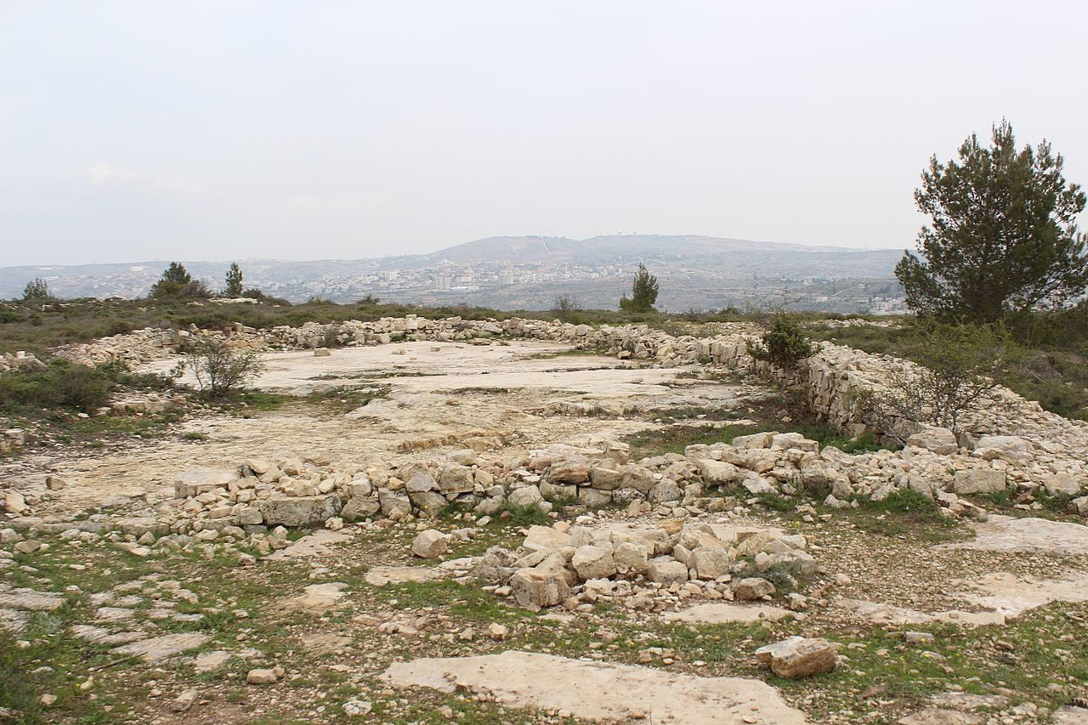
Where is the High Place of Jeroboam?
Vilnay’s suggested site; the summit of Mount Aratas, 1 mile north of Beitin,does provide a very strong candidate, if not a probable answer for the lack of evidence at Beitin. Facing north is a big stone platform framed by a stone wall forming a rectangular shape. By local tradition this was the place of Jeroboam’s temple. The site also provides one of the best panoramic views in all of Israel. The coastline, the Jordan valley, the mountains of Moab and even the Mount Hermon are visible from here.
https://dannythedigger.com/bethel/
https://en.wikipedia.org/wiki/Bethel

Slide 10
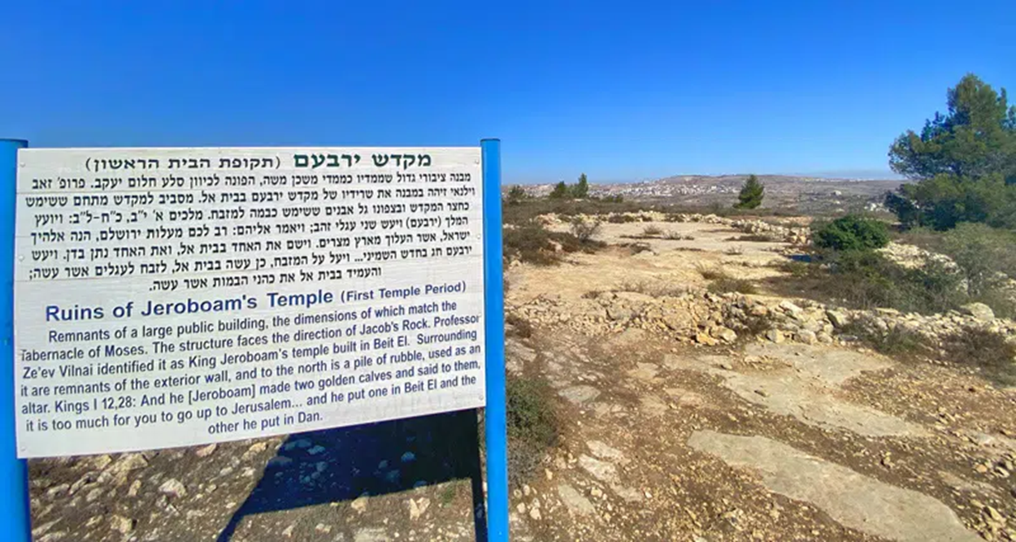
The Probable Site of Jeroboam’s Temple/High Place and to YHWH on Jebel Aratas https://dannythedigger.com/bethel/
Next to the site of the probable Israelite temple/high place, a Muslim prayer shrine (Maqam Sheikh Abdallah) was built over and next to an arched chapel dating from Crusader times. According to local tradition, the chapel marks the site of Jacob’s dream.

Slide 11
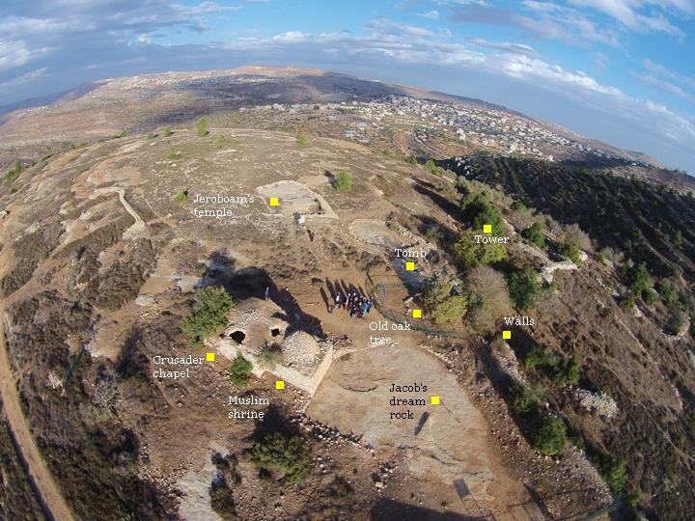
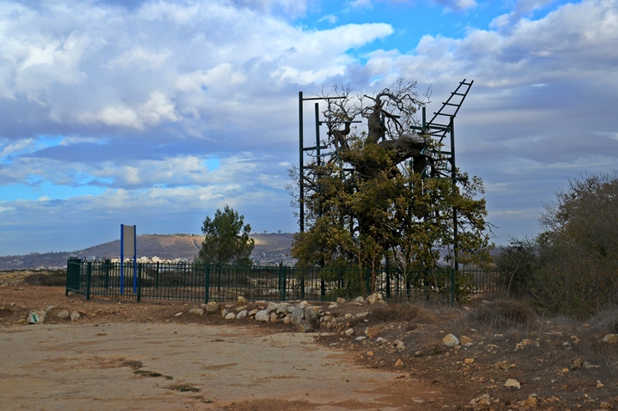
An Ancient (ca. 1000-year-old) Oak Tree still standing at the Jebel Aratas Site
Aerial View showing the features of the summit of Jebel Aratas

Slide 12
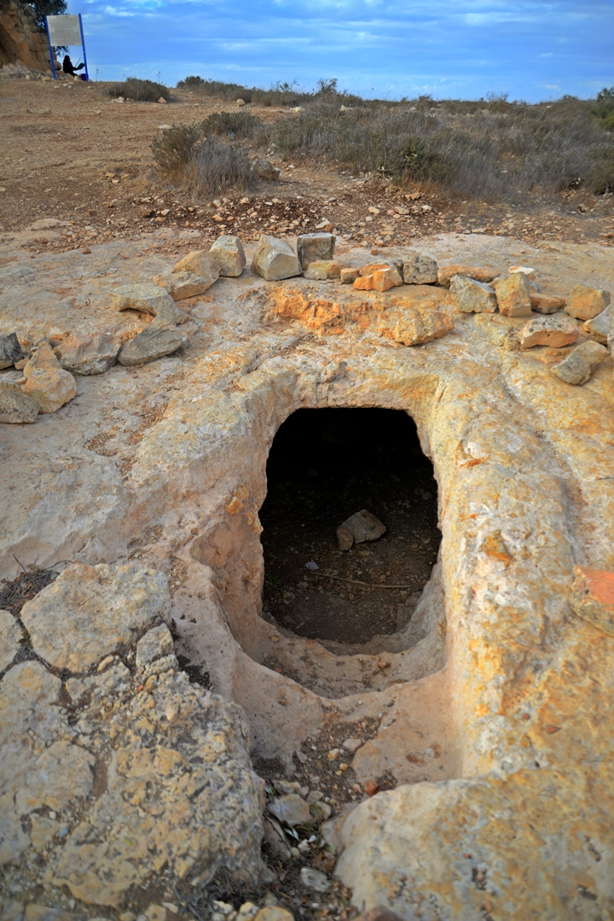
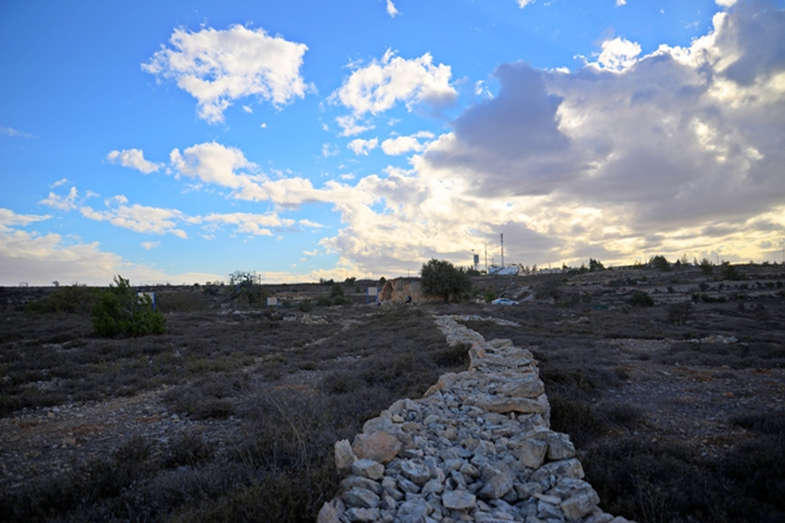
A New Testmament Era Jewish Tomb and part of a 200 x 100 m Wall surrounding the Site

Slide 13
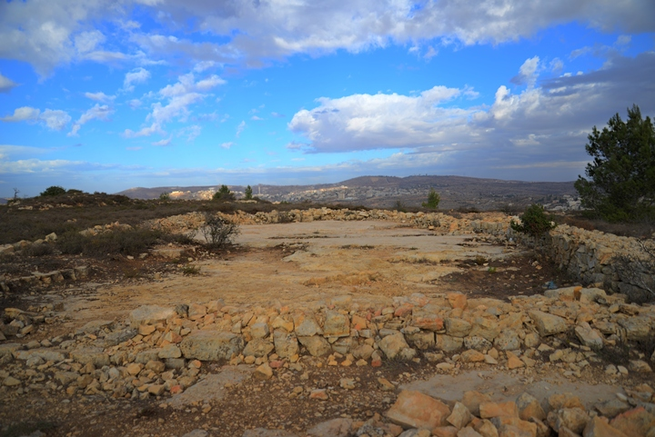
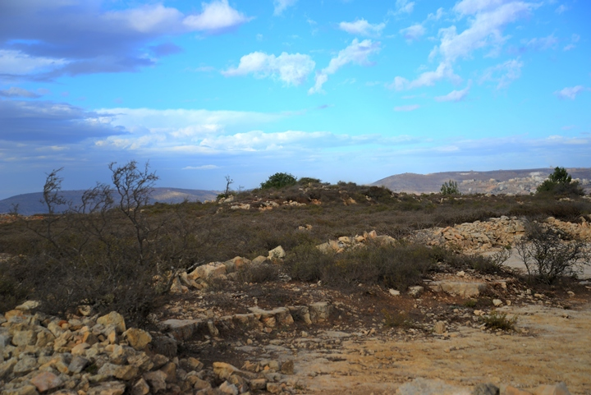
Two Views of an Ancient Mound north from the cleared limestone of the Temenos or Cultic Precinct
Could this be the altar or ruins of Jeroboam’s Temple? A tower and perimeter wall to the east (right side) of this photo contains Iron II sherds. Excavations are necessary to clarify these conjectural views

Slide 14
Arguments supporting Jebel Aratas as the Site of Jacob’s Dream and Jeroboam’s Shrine and High Place
Religious Significance: A holy site that displays elements from all three monotheistic religions: The site of Jebel Aratas includes the Muslim makam and the Crusader Chapel, but also Jewish rock cut tombs from the Second Temple (New Testament) period. Significantly, an ancient Oak tree (over a millennium old) still stands on the summit, which harkens the Oak tree at Bethel where Deborah (Rebekah’s nurse) was buried.
Elevation: The summit of Jebel Aras is ca. 886 m and has commanding views, not only of the surrounding region, but as far as the Mediterranean to the west and Transjordan to the east. Throughout antiquity, places of worship were located upon high hills or mountains.
Identity: The sites of Bethel and Luz are indistinguishable in Genesis and in Joshua 18:13, but appear to be two distinct sites in Joshua 16:2, which describes the southern boundary between Ephraim and Manasseh; “going out from Bethel to Luz.” This distinction may indicate a sacred precinct that is adjacent to, but separate from, the town of Bethel.
וְיָצָא מִבֵּית-אֵל, לוּזָה
Remains: Measurements show the area to be roughly 200 x 100m, with an unexcavated ruined mound and perimeter walls and tower.
https://www.biblewalks.com/beitel#Background

Slide 15
Bibliography
Dever, William G.
1971 Archaeological Methods and Results: A Review of Two Recent Publications. Orientalia n.s. 40/4: 459-471.
1992 Beitin, Tell. Pp. 651-652 in Volume 1 of The Anchor Bible Dictionary, edited by David Noel Freedman. New York: Doubleday.
Finkelstein, Israel, and Singer-Avitz, Lily
2009 Reevaluating Bethel. Zeitschrift des Deutschen Palastina-Vereins 125: 33-48.
Kelso, James L.
1968 The Excavation of Bethel (1934-1960). Annual of the American Schools of Oriental Research 39. Cambridge: American Schools of Oriental Research.
1993 Bethel. Pp. 192-194 in Volume 1 of The New Encyclopedia of Archeological Excavations in the Holy Land, edited by Ephraim Stern. Jerusalem: Israel Exploration Society.
Knauf, Ernst Axel
2006 Bethel: The Israelite Impact on Judean Language and Literature. Pp. 291-349 in Judah and the Judeans in the Persian Period, edited by Oded Lipschits and Manfred Oeming. Winona Lake: Eisenbrauns.
Livingston, David P.
1970
1971
1994 Further Considerations on the Location of Bethel at el-Bireh. Palestine Exploration Quarterly 126: 154-159.
Rainey, Anson F.
Bethel is Still Beitin. Westminster Theological Journal 33: 175-88.
1988 Rainey on the Location of Bethel and Ai. Biblical Archaeology Review 14/5: 67-68.
2006 Looking for Bethel: An Exercise in Historical Geography. Pp. 269-73 in Confronting the Past: Archaeological and Historical Essays on Ancient Israel in Honor of William G. Dever, edited by Seymour Gitin; J. Edward Wright; and J. P. Dessel. Winona Lake: Eisenbrauns.
Wood, Bryant G.
2008 “The Search for Joshua’s Ai.” Pp. 205-40 in Critical Issues in Early Israelite History, edited by Richard S. Hess; Gerald A. Klingbeil; and Paul J. Ray. Bulletin for Biblical Research Supplement 3. Winona Lake: Eisenbrauns.

