Slide 1
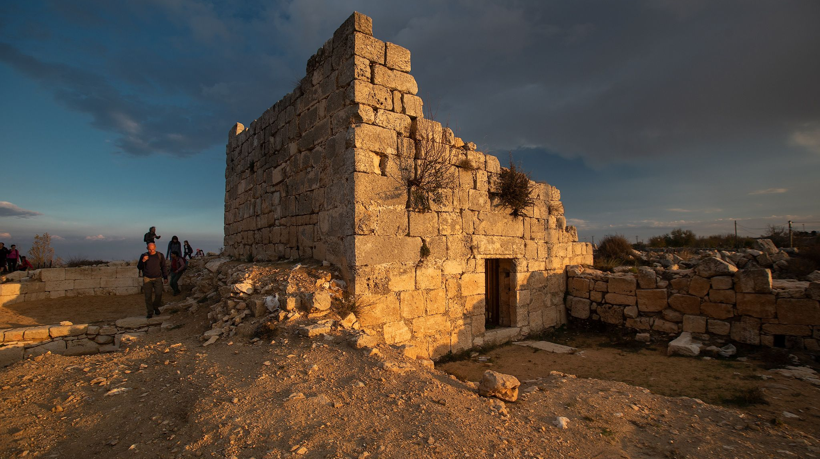
Bethel: A Bronze and Iron Age Town with a nearby Religious Shrine on Israel’s Border with Judah
Jeffrey P. Hudon, PhD
Biblicalelearning.org

Slide 2
West Bank and Vicinity Map https://maps.lib.utexas.edu/maps/midd le_east_and_asia/westbank_central92.jpg

Slide 3
The Site of Bethel in the Biblical Texts
Apart from Jerusalem with ca. 669 references, Bethel is the most frequently mentioned place in the Old Testament. Most scholars place Bethel at Beitin, an Arab village 10.5 miles north of Jerusalem at a strategic crossroads and with a copious spring.
Abram built an altar to the LORD on the hills east of Bethel and west of Ai (Genesis 12:8) and returned there after his Egyptian sojourn (Genesis 13:3)
Jacob camped at Bethel and dreamt of a ladder to heaven with ascending and descending angels and erected an altar and pillar, naming the site Beth El (Genesis 28:10-22). The Angel of the LORD later appears to Jacob in a dream as the God of Bethel (Genesis 31:13). Jacob returns, builds another altar and erects a pillar and calls the place Bethel (Genesis 35:1-15).
Bethel/Luz was a royal Canaanite city with a king (Joshua 12:16) that the Israelites apparently captured (Joshua 8:3-9)
Originally assigned to Benjamin (Joshua 18:22), Bethel apparently passed into the control of Ephraim (Judges 1:22; 1 Chr 7:28)
Bethel served as a sanctuary during the Settlement (Judges) period (Judges 2:1; 4:5; 20:18; 1 Sam 7:16 and had a prophetic guild (2 Kings 2:3; Amos 4:4; 5:5)
Jeroboam establishes Bethel as a major Religious Center for the Northern Kingdom in ca. 930 BC (1 Kings 12)
Abijah and Asa occupied Bethel during the border clashes between Judah and Israel (2 Chr 13:19; 14:8)
The prophet Amos gives his oracles, including a devastating judgement against Israel, at the Bethel shrine in ca. 750 BC (Amos 7:12-13)
King Josiah’s reform included the utter destruction and desecration of Bethel’s sanctuary and High Place and slaying of its priests (2 Kings 23:15-20)

Slide 4
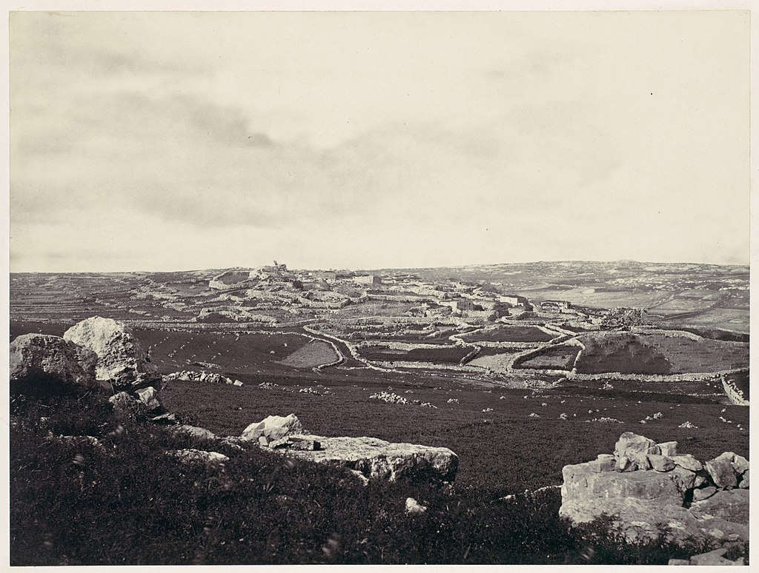
Bethel and Luz: Two Names for a Biblical Town
Photo of Beitin during the nineteenth century
Luz is best defined as an almond tree.
Luz was a Canaanite city renamed Bethel by Jacob (Genesis 28:19). Updates to site/city names are not uncommon in the Old Testament (e.g.; Laish=Leshem = Dan; Hazazon Tamar = En Gedi; Jebus = Jerusalem; Kiriath Sepher = Debir; Kiriath Arba = Hebron), but the possibility always remains that two separate sites are referenced.
Luz is also mentioned in Genesis 35:6; Joshua 18:13; Judges 1:23; Jubilees 27:19, 26.
In Joshua 16:2 (MT and LXX), Luz is mentioned in a border description of Ephraim and Benjamin and seems to indicate that Luz is distinct and separate from Bethel. More on this later….
https://www.wikiwand.com/en/Bethel

Slide 5
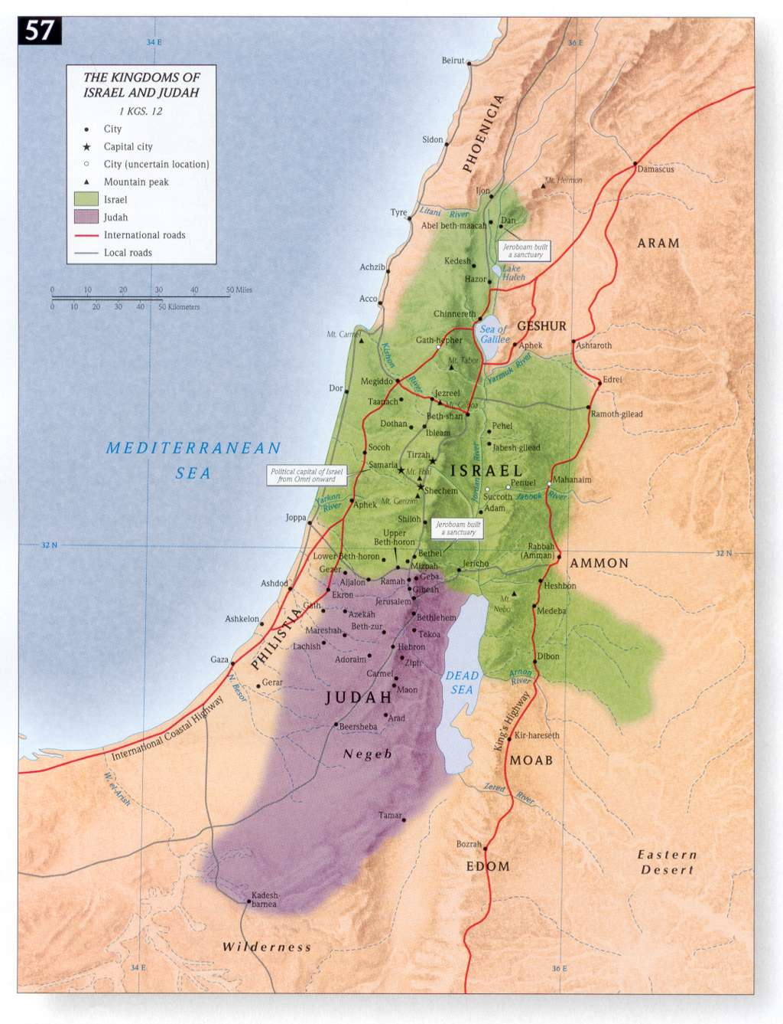
Realpolitik in the Aftermath of the Intertribal Schism between Israel and Judah (ca. 930 BC)
1 Kings 12:1-24: In the wake of leading a rebellion against the House of David and Rehoboam, Jeroboam is faced with the pressing need to consolidate his power over the ten northern tribes.
Shechem, the “uncrowned queen of the hill country” is wisely chosen as his capital due in part to its cultic history during Patriarchal and pre monarchic (conquest and settlement) times.
The House of YHWH in Jerusalem remains as a unifying religious site and symbol for the 12 tribes and Jeroboam recognizes the need to sever, if not eradicate that deep connection by establishing two alternative religious centers for Israelites to make pilgrimage to as well as places for worship and sacrifice.
The sites are well chosen; Dan at the northern border and Bethel at the southern border. Bethel again offers a rich religious tradition and history back to Patriarchal times.
Two golden calves are fashioned to be displayed at these sites.
The biblical writers rightly recognized these shrines as religious counterfeits to the Jerusalem Temple and Cult. Chr does not even acknowledge their existence (2 Kings 23:15).
http://rectorscorner.blogspot.com/2010/04/divided-kingdom-of-israel-judah.html

Slide 6
Bethel in the Hebrew Bible: A Cult Center established by Jeroboam I
Jeroboam's Golden Calves
²⁵ Then Jeroboam built Shechem in the hill country of Ephraim and lived there. And he went out from there and built Penuel. ²⁶ And Jeroboam said in his heart, “Now the kingdom will turn back to the house of David. ²⁷ If this people go up to offer sacrifices in the temple of the Lord at Jerusalem, then the heart of this people will turn again to their lord, to Rehoboam king of Judah, and they will kill me and return to Rehoboam king of Judah.” ²⁸ So the king took counsel and made two calves of gold. And he said to the people, “You have gone up to Jerusalem long enough. Behold your gods, O Israel, who brought you up out of the land of Egypt.” ²⁹ And he set one in Bethel, and the other he put in Dan. ³⁰ Then this thing became a sin, for the people went as far as Dan to be before one. ³¹ He also made temples on high places and appointed priests from among all the people, who were not of the Levites. ³² And Jeroboam appointed a feast on the fifteenth day of the eighth month like the feast that was in Judah, and he offered sacrifices on the altar. So he did in Bethel, sacrificing to the calves that he made. And he placed in Bethel the priests of the high places that he had made. ³³ He went up to the altar that he had made in Bethel on the fifteenth day in the eighth month, in the month that he had devised from his own heart. And he instituted a feast for the people of Israel and went up to the altar to make offerings (1 Kings 12:25-33 ESV)
https://slideplayer.com/slide/14123688/

Slide 7
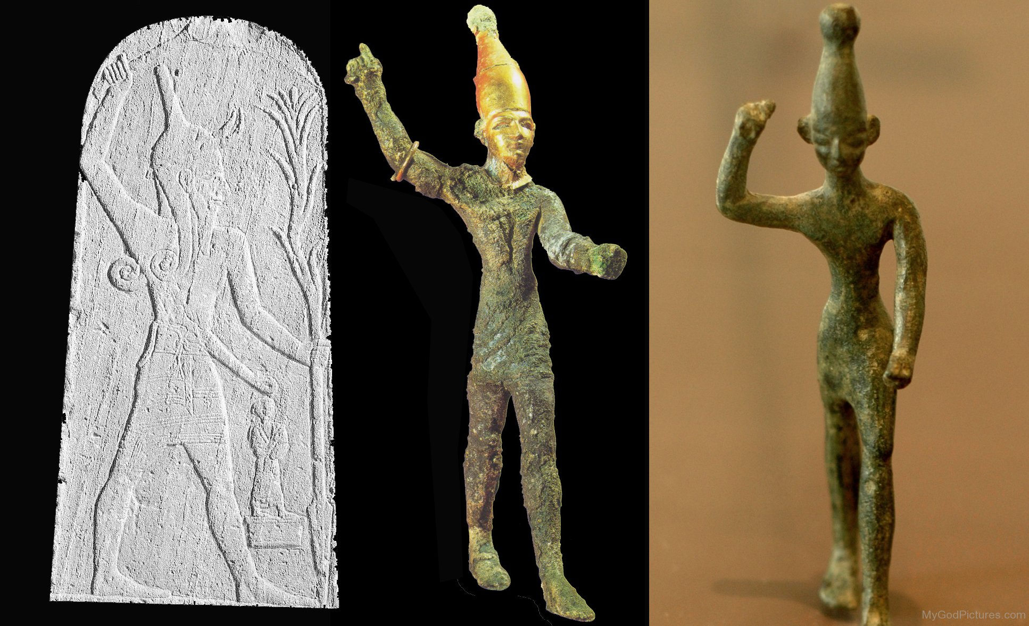
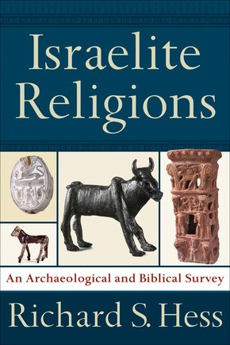
The Golden Calves at Bethel and Dan: A Syncretistic Blending of the Worship of YHWH with the Canaanite (Ba’al) Religious Cult (see Psalm 68 as a polemic)
32 O kingdoms of the earth, sing to God; sing praises to the Lord, Selah
33 to him who rides in the heavens, the ancient heavens; behold, he sends out his voice, his mighty voice.
34 Ascribe power to God, whose majesty is over Israel, and whose power is in the skies.
https://www.abebooks.com/Israelite-Religions-Archaeological-Biblical-Survey-Hess/30960919118/bd?cm_mmc=ggl-_-US_Shopp_Trade_20to50-_-product_id=COM9781540960245NEW-_-keyword=&gclid=Cj0KCQjw8_qRBhCXARIsAE2AtRb73OARhutrtv4alvsVAa-faNLsDkJcpvwO_OgV0F7KWSyX_yE2ISMaAiNbEALw_wcB#&gid=1&pid=1
https://www.mygodpictures.com/wp-content/uploads/2015/09/Baal-God-ghy201.jpg

Slide 8
The Bethel Shrine during the Eighth Century BC
Significant changes in the Geo-political landscape. Israel and Judah are strong allies and work together “recreate” the Solomonic empire.
Bethel is clearly recognized as the most important religious site in the Kingdom of Israel and the prophet Amos pronounces his devastating oracles there with a predictable response:
And Amaziah (a priest at Bethel) said to Amos, “Go away, you seer! Flee to the land of Judah; earn your bread there and do your prophesying there. But never prophesy at Bethel again, because it is the sanctuary of the king and the temple of the kingdom.” (Amos 7:12-13 ESV)
Note that Amaziah identifies Bethel as the Royal Sanctuary and Temple for the kingdom, clearly displacing Dan for that role.

Slide 9
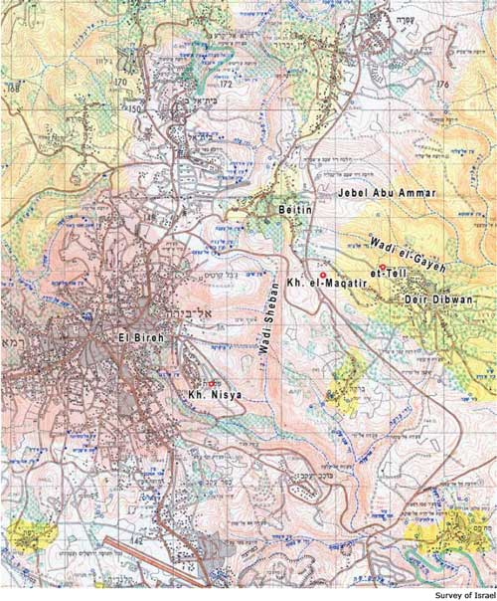
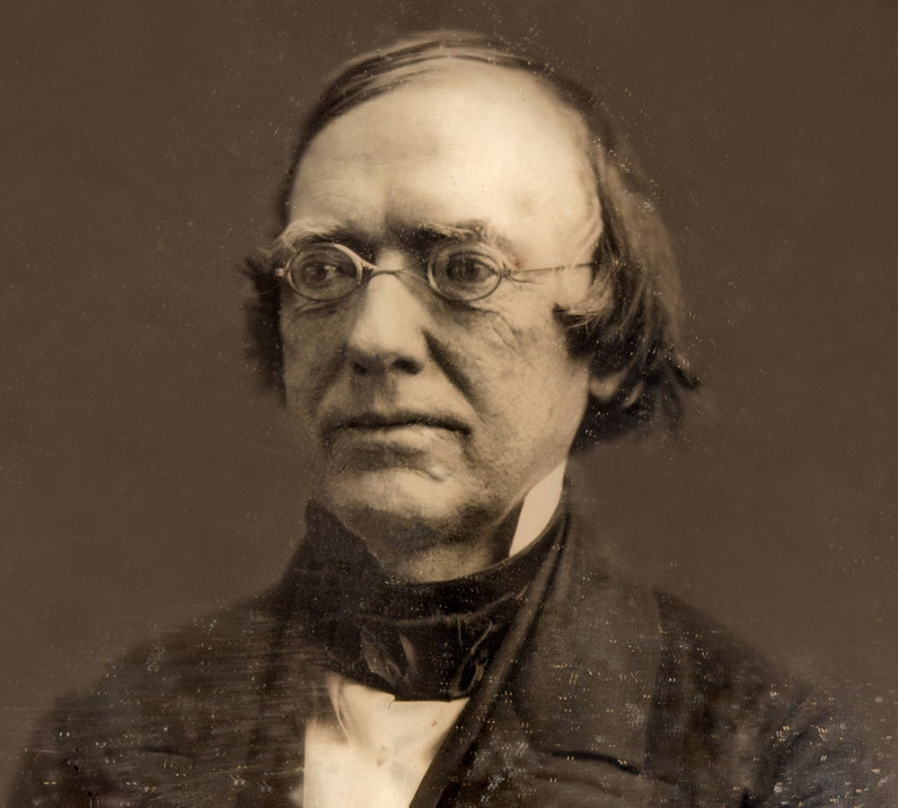
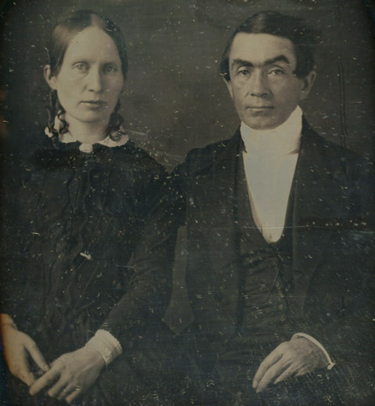
Rediscovering Bethel: Edward Robinson (1794-1863) and Eli Smith (1801-1857)
These two American biblical scholars and linguists introduced the discipline of Historical Geography as a scientific disciple. Two lengthy trips to the Holy Land during the years 1838 and 1852 resulted in their identification of scores of biblical sites based upon biblical sources with Arabic place names or toponyms still remembered by the local population.
They made excellent use of the Onomasticon of Eusebius
One of their key contributions was the area north of Jerusalem; the central Benjamin Plateau and the land of Ephraim. And they recognized the link between the Arabic name Beitin and biblical Bethel.
Published the three volume Biblical Researches in Palestine, Mount Sinai and Arabia Petraea
In 1939, Albrecht Alt wrote that “In Robinson's footnotes are forever buried the errors of many generations"
https://biblearchaeology.org/research/conquest-of-canaan/3908-researching-ai?highlight=WyJhaSIsIidhaSIsImFpJ3MiLCInYWknIiwiYWknIl0=
https://ancientneareast.tripod.com/Ai_Tell.html
https://vilnay.kinneret.ac.il/edward-robinson/
https://www.bu.edu/missiology/missionary-biography/r-s/smith-eli-1801-1857/

Slide 10
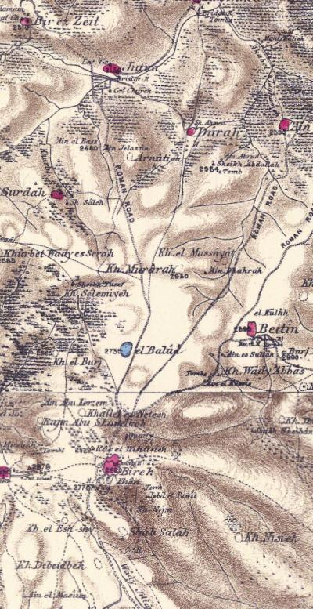
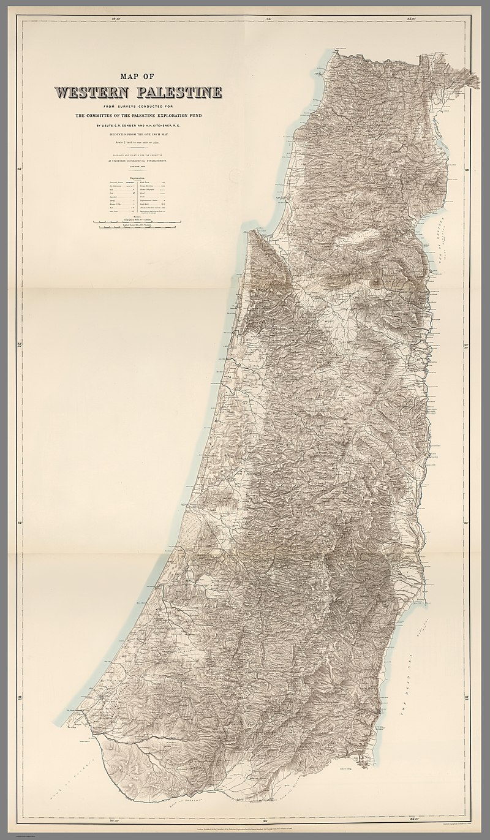
Mapping Bethel: Claude R. Conder, Herbert H. Kitchener and the magisterial Survey of Western Palestine
Between 1872-1877, the Palestine Exploration Fund in London conducted a monumental topographical survey of Cisjordan on a scale of 1 inch to 1 mile. Every topographical feature and toponym was recorded and mapped. To this day, the seven volume Survey of Western Palestine is an indispensable resource for biblical scholars.
https://www.biblewalks.com/beitel#Background
https://en.wikipedia.org/wiki/PEF_Survey_of_Palestine#/media/File:PEF_Survey_of_Western_Palestine_composite.jpg

Slide 11
Major Claude Reignier Conder, R.E. (1848-1910)
Conder was a British army officer in the Royal Engineers that carried out the monumental Survey of Western Palestine for the PEF with H. H. Kitchener from 1872-1874 and, in 1881-1882 he began the Survey of Eastern Palestine, which had to be aborted due to conflicts with the Ottoman officials and other political events. Conder was fluent in Arabic and served in a military capacity in Egypt later until sickness forced him to return to England. He was a prodigious writer and authored many articles and books about his work in the Holy Land.

Slide 12
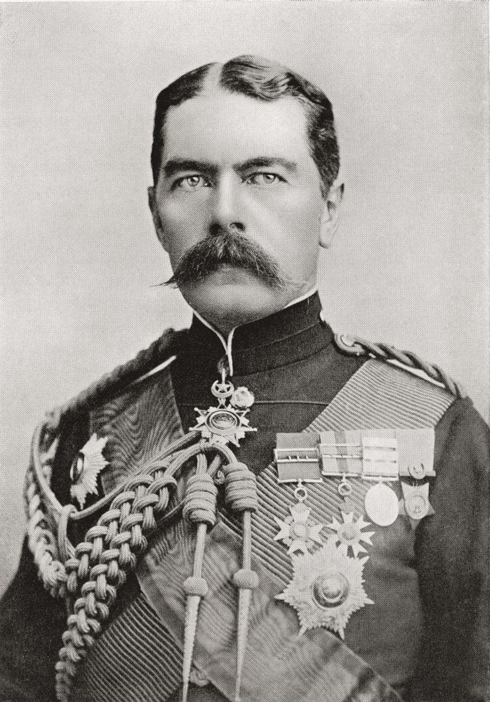
Lord Herbert H. Kitchener, R.E. (1850-1916)
Trained as a military engineer, Kitchener served in posts in the Middle East and Sudan before being appointed commander in chief of the Egyptian army in 1892. In 1898 he crushed the rebellious Mahdist movement in the Battle of Omdurman and forced concessions from France in the Fashoda Incident. He entered the South African War as chief of staff in 1899, becoming commander in chief a year later. In the last 18 months of the war, he resorted to brutal methods, burning Boer farms and herding Boer women and children into concentration camps. He was later sent to India to reorganize the army there. A clash with Lord Curzon over control of the army resulted in Curzon’s resignation in 1905. In 1911 Kitchener returned to Khartoum as proconsul of Egypt and the Sudan. As secretary of state for war during World War I, he organized armies on a scale unprecedented in British history and became a symbol of the national will to victory. He died on a mission to Russia when his ship was sunk by a German mine.
https://www.posterazzi.com/lord-kitchener-in-1896-when-as-brigadier-general-sir-hh-kitchener-he-held-the-position-of-sirdar-of-the-egyptian-army-field-marshal-horatio-herbert-kitchener-1st-earl-kitchener-1850-posterprint-item-vardpi2429977/
https://www.britannica.com/summary/Horatio-Herbert-Kitchener-1st-Earl-Kitchener

Slide 13
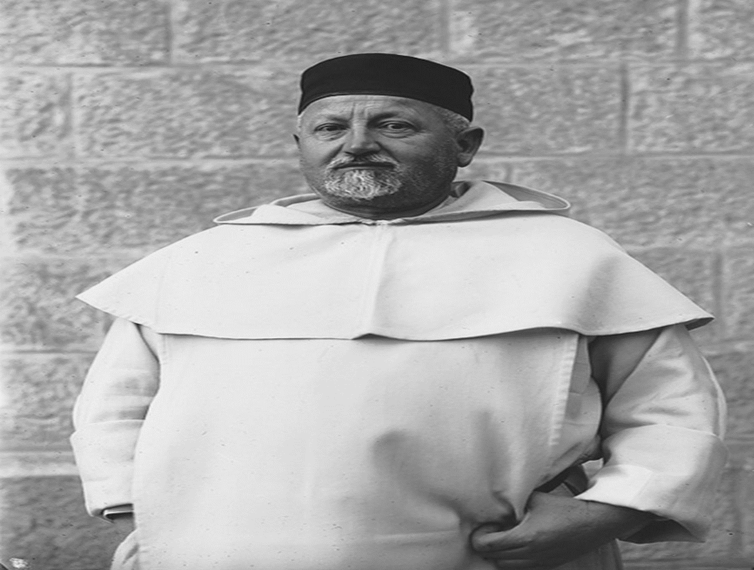
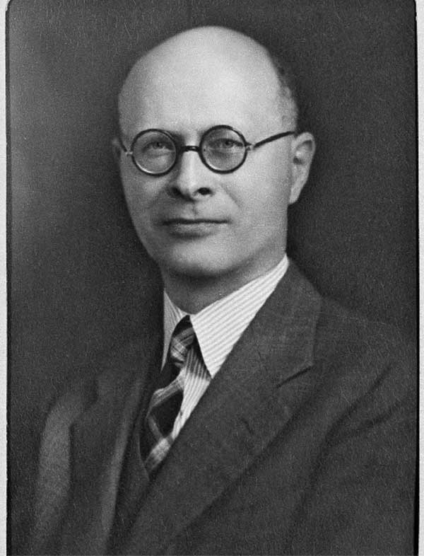
Confirming the site of Bethel with Beitin: F. Felix Marie Abel (1878-1953) and William F. Albright (1891-1971)
In the first decades of the twentieth century, two leading biblical scholars and geographers unquestionably confirmed the identification of Beitin with Bethel. Felix M. Abel, a Dominican priest from the French Biblical School in Jerusalem and author of an important work on biblical geography, as well as Johns Hopkins professor William F. Albright, the doyen of biblical archaeologists and textual experts concurred with the conclusions reached by Robinson and the SWP: Beitin = Bethel
https://vilnay.kinneret.ac.il/f-felix-marie-abel/
https://johnchristy.com/william-foxwell-albright-the-dean-of-biblical-archaeology/

Slide 14
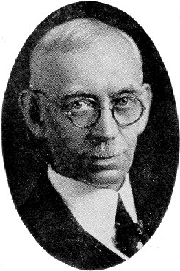
Excavating Bethel: Melvin Grove Kyle (1858-1933)
Dr. Melvin Grove Kyle, eminent educator, archaeologist and publicist, died May 25 after a brief illness at his home in Pittsburgh. He had passed the seventy-fifth anniversary of his birth, and although not in rugged health he planned to carry on his research work. The loss to the Christian world is great, but for him his entrance to the presence of the Lord he loved is gain.
Many will be the encomiums for his accomplishments as a seminary administrator and educator, archaeologist, editor and writer. He held a rare position in theological education as one who combined a broad and accurate scientific knowledge with entire loyalty to the Scriptures as the inerrant Word of God. As president, and professor of Biblical Theology, at Xenia Seminary, archaeologist in Bible lands, editor of Bibliotheca Sacra and the Archaeology Department of the Sunday School Times, and author of scholarly works in defense of the Bible, he gained a host o friends both amongst Christian scholars and in the church at large.
Dr. Kyle was always ready to defend his convictions and the faith he lived and died by, but he gave no occasion to be classesd [sic] with those whose principal occupation is the criticizing of their fellow-members in the Body of Christ. With him Christian fellowship in the present world was a foretaste of the heavenly experience. We thank God upon every remembrance of him and his spirit of helpfulness.
Recognizing Dr. Kyle’s intensive interest in apologetics and archaeology and the site of Bethel, his successor at Xenia (Pittsburg Theological Seminary), James Kelso, partnered with the American Archaeological School (ASOR) in Jerusalem to excavate Bethel, calling it the Kyle Memorial Excavation…..
https://www.logcollegepress-annex.com/melvin-grove-kyle-18581933/
https://www.journals.uchicago.edu/doi/abs/10.1086/BASOR1355420?journalCode=basor
https://mla.bethelks.edu/mediawiki/index.php/Kyle,_Melvin_Grove_(1858-1933)

Slide 15
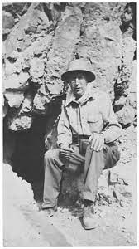
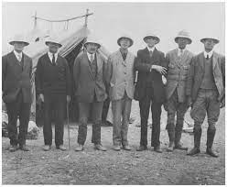
Excavating Bethel: W.F. Albright and James L. Kelso (1892-1978)
The Kyle Memorial Excavations
An expedition from Pittsburgh-Xenia Theological Seminary (now Pittsburg Theological Seminary) led by James L. Kelso excavated the site in 1934 (under the leadership of Albright). Kelso returned in 1954, 1957 and 1960. As it is today, Beitin was a Palestinian town built over the ancient mound or “tel” particularly in the southeast part of the tel, so the excavators only had access to selected areas of the site, most notably a 4 acre plot in the northwest sector.
https://www.journals.uchicago.edu/doi/abs/10.1086/BIBLARCH3209548?journalCode=biblarch
https://en.wikiquote.org/wiki/William_F._Albright

