Slide 1
The Geo-Political Arena

Slide 2
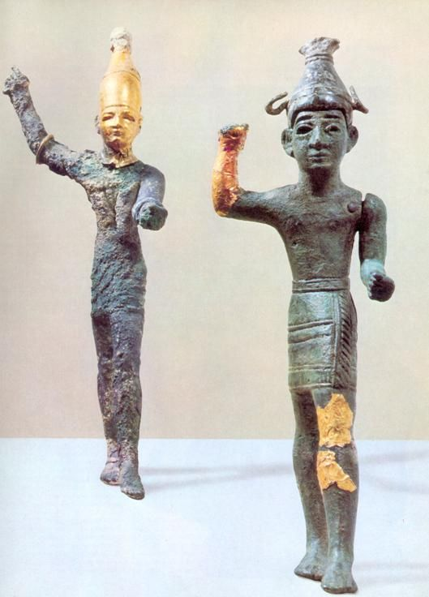
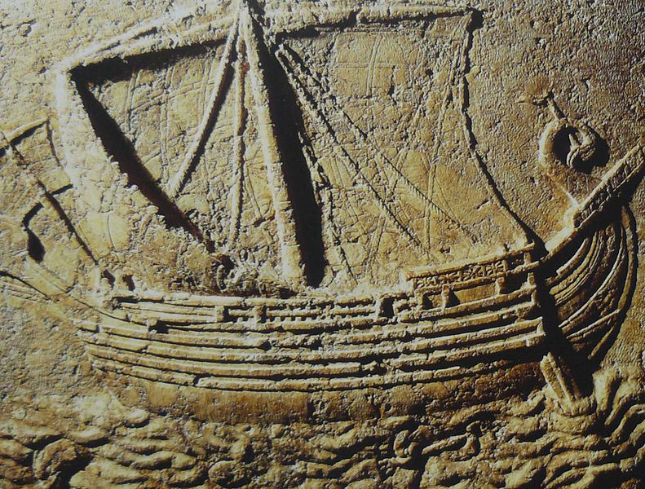
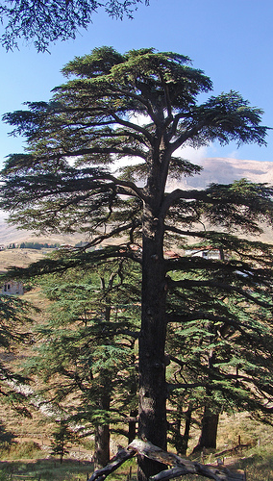
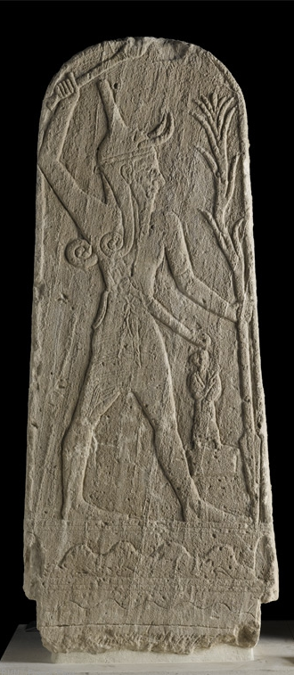
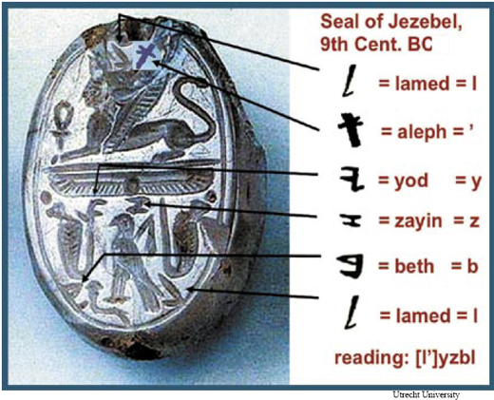
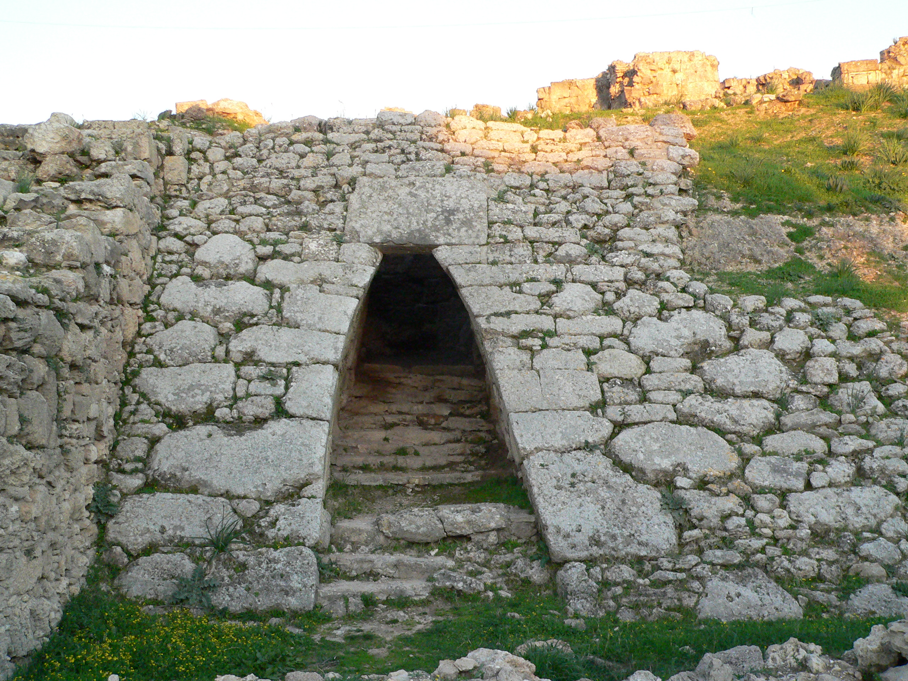
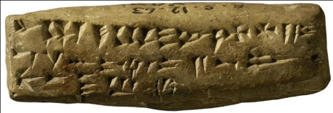
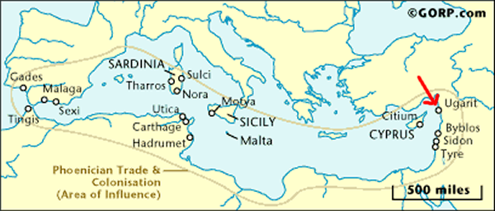
The Canaanites and Phoenicians

Slide 3
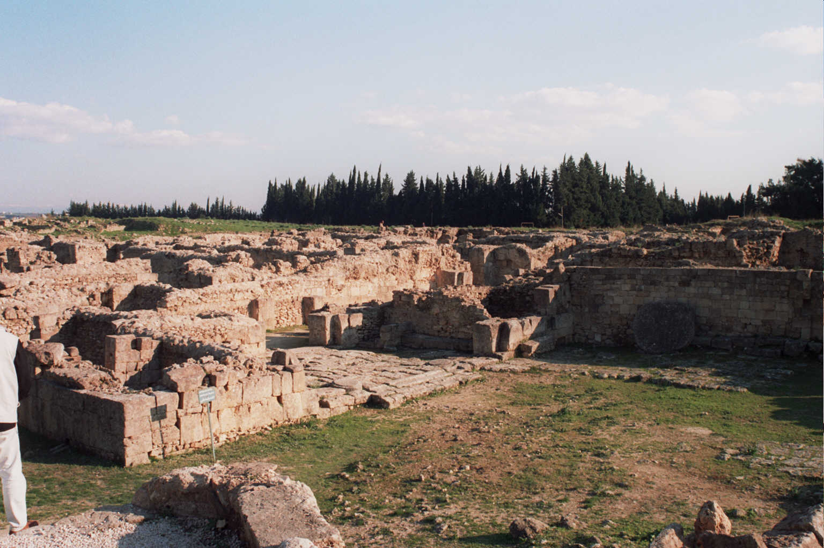
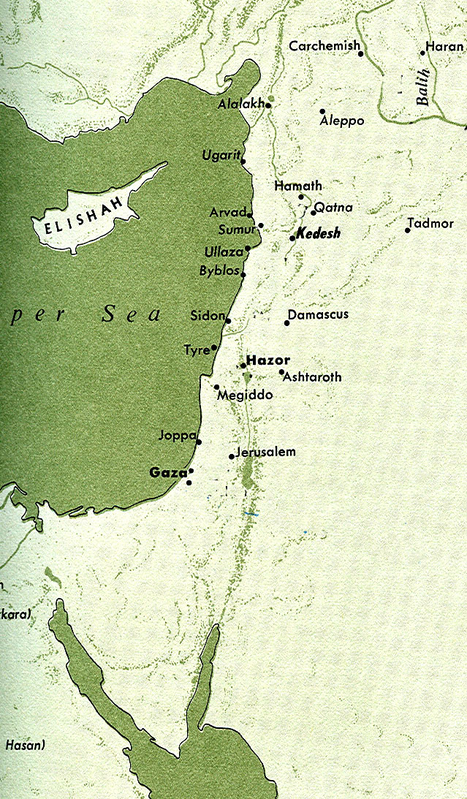
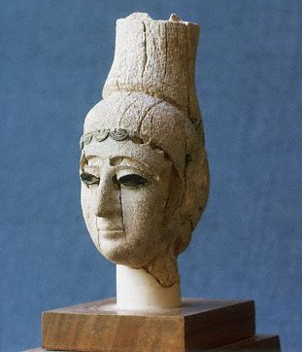
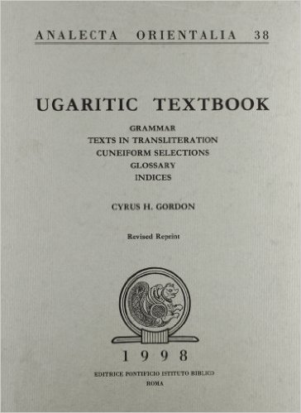
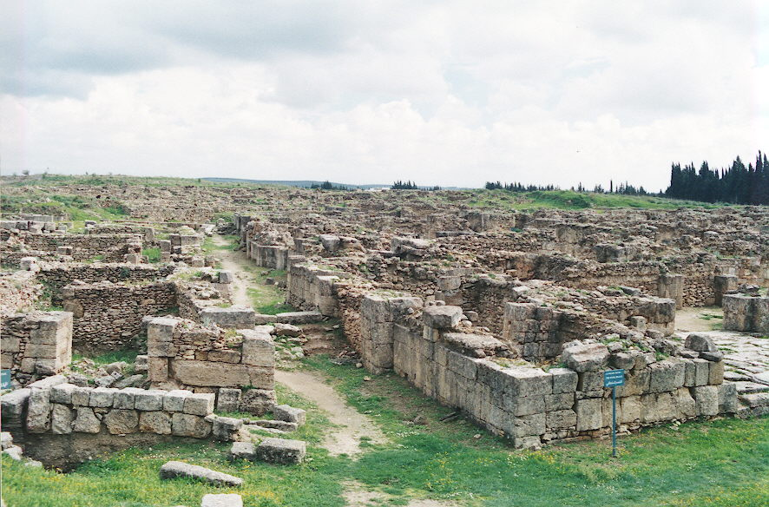
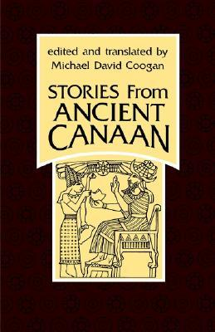
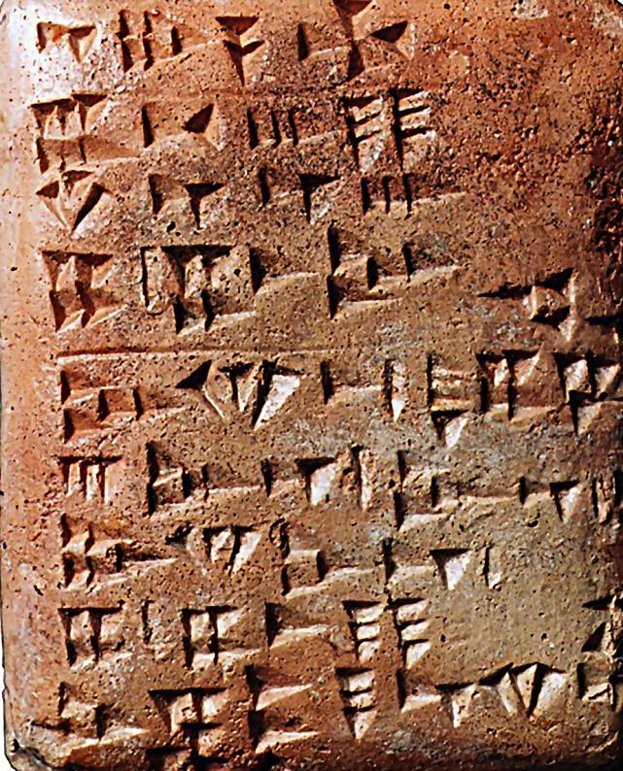
Ugarit and Ugaritic

Slide 4
Egypt: Land of the Pharaohs

Slide 5
The Black Land: Ancient Egypt
The Egyptians called their land “The Black Land” due to the fertility of the soil on the banks of the Nile River. Vast deserts surrounded Egypt to the west and east, which isolated her from enemies and cultural influences. This desert was called “The Red Land.” The Nile River is the life blood of Egypt that helps explain why the first plague turned the Nile into blood (Exodus 7:14-24). Each year the river flooded its banks and fertilized the soil, allowing the Egyptian to grow a variety of crops along a less than 12 mile wide strip. The Nile is one of the few major rivers that flows north and Egypt is divided into two parts: Upper Egypt to the south (think upriver) and Lower Egypt to the north (think down river). Separate kingdoms ruled these two regions until Menes or Narmer united the two together. Hence the pharaohs wore the “double crown” signifying control over both Lower and Upper Egypt.

Slide 6
Egyptian Chronology
The Old Kingdom (2624-2135 BC): Upper and Lower Egypt united; The Age of the Pyramids
The First Intermediate Period (2135-2040 BC)
The Middle Kingdom (2040-1640 BC): The Age of the Patriarchs
The Second Intermediate Period (1640-1550 BC): Joseph; The Hyksos
The New Kingdom (1550-1069 BC): Israelite Sojourn and Exodus; Period of the Judges; The Valley of the Kings
The Third Intermediate Period (1069-664 BC): The United Monarchy; The Kingdoms of Israel and Judah
The Saite Period (664-525 BC): The Last years of Judah through the Persian Period
Egyptian Interactions with Israel: Genesis 12:10-20 (Abraham in Egypt), 37-50 (Joseph); Exodus, 1-2 Kings, 1-2 Chronicles and Isaiah 37:9: Siamun, Shishak, Zerah, Tirhaqa, Necho, Jeremiah 44:30 (Apries or Hophra)

Slide 7
The Dynasties of Ancient Egypt

Slide 8
Egypt in the Old Testament
Egyptian history that parallels the OT narrative is divided by Egyptologists into the Old Kingdom (2686 -2180 BC); First Intermediate Period (2180-2030 BC); the Middle Kingdom (2030-1786 BC); the Second Intermediate Period (1786-1633 BC); the New Kingdom (1551-1070 BC); the Third Intermediate Period (1085-664 BC); The Late Period (664-525 BC)
Egypt plays important roles in both the OT and the NT (remember Joseph, Mary and Jesus fleeing Herod’s soldiers and living in Egypt until his death). Abraham and Sarah (actually Abram and Sarai) travel to Egypt (Gen. 12:10-20), probably during the Middle Kingdom. Joseph settles his father Jacob and his brothers in the Land of Goshen in Lower Egypt, where they flourish and become a threat to a new dynasty of pharaohs simply due to their vast numbers. This occurred during the Second Intermediate Period. After 400 years of slavery, YHWH delivers Israel out of Egypt during the New Kingdom, but Egypt appears later in Israel’s history as well, during the Third Intermediate Period. Pharaoh Merneptah mentions Israel in 1205 BC as living in the land of Canaan. Pharaoh Siamun offers his daughter in marriage to Solomon. After Solomon’s death, Pharaoh Shishak invades Israel and Judah and plunders the Temple. Later pharaohs offer aid to Israel and Judah against Assyria. Pharaoh Necho kills King Josiah of Judah at Megiddo in 609 BC. Finally, Pharaoh Hophra promises help to Zedekiah against the Babylonians, but this fails to materialize. Egypt is, by this time, “a broken reed” and impotent to stop the Babylonian onslaught.
Egyptian influence in the OT can be seen in various aspects. For example, several people have Egyptian names (Moses, Hophni, Phineas), and a number of Proverbs have close Egyptian parallels as well.

Slide 9
Semites (Hebrews) arriving in Egypt from a tomb painting at Beni Hasan dating to the reign of the Twelfth Dynasty Pharaoh Sesostris II (ca. 1892 BC)

Slide 10
Avaris, the Hyksos Capital of Egypt The Hyksos were powerful Canaanites living in northern Egypt that overthrew the Egyptian ruler and controlled Egypt for over a century, from ca. 1648-1540 BC. It is believed by many scholars that Joseph (Gen. 37-50) lived during this time. Note Exodus 1:8: “Now there arose a new king over Egypt, who did not know Joseph” implies a new (Egyptian) dynasty.

Slide 11
The Asiatic Tomb at Avaris
Detail of the vandalized statue
The Tomb of a High Official (Joseph?) at Avaris

Slide 12
The Reconstructed Statue from the Nobles Tomb at Avaris: Is this Joseph?
Genesis 50:26: “So Joseph died at the age of a hundred and ten. And after they embalmed him, he was placed in a coffin in Egypt.”
Exodus 1:6-8: “Now Joseph and all his brothers and all that generation died, but the Israelites were exceedingly fruitful; they multiplied greatly, increased in numbers and became so numerous that the land was filled with them. Then a new king, to whom Joseph meant nothing, came to power in Egypt.”
Exodus 13:19: Moses took the bones of Joseph with him because Joseph had made the Israelites swear an oath. He had said, “God will surely come to your aid, and then you must carry my bones up with you from this place.”
Left: Reconstructed statue of an Egyptian Vizier with Semitic features, found smashed in a desecrated tomb at Avaris, possibly Joseph himself

Slide 13
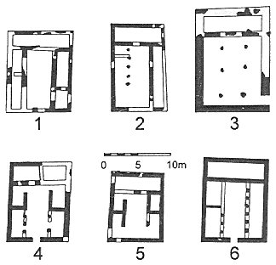
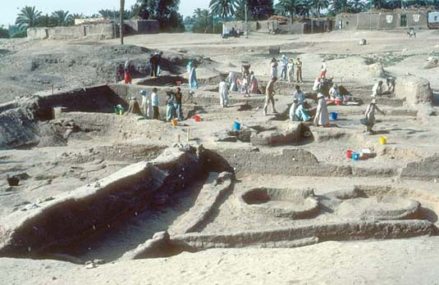
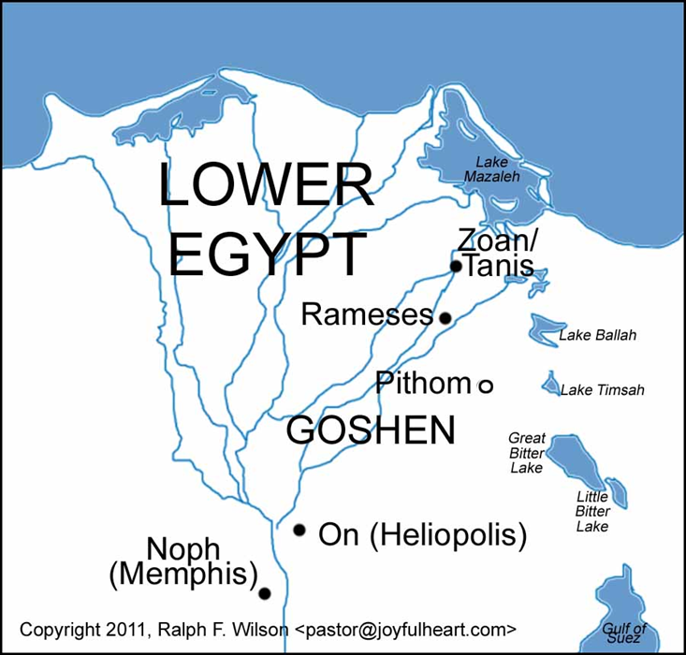
Pitom and Rameses: Cities built by Israelite Slaves
Excavations at Biblical Pithom: Store city of Rameses II
So they put slave masters over them to oppress them with forced labor, and they built Pithom and Rameses as store cities for Pharaoh (Exodus 1:11)

Slide 14
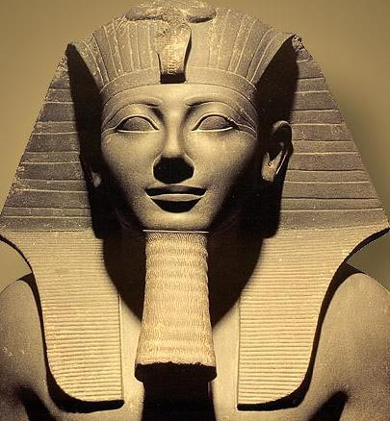
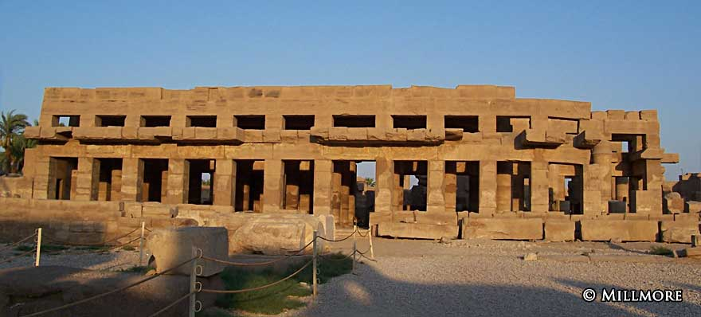
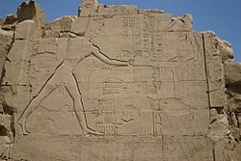
The Eighteenth Dynasty ca. 1550-1292 BC
Mummified skull of Thutmose III (1479-1425 BC): Possible Pharaoh of the Exodus
Thebes: Karnak Temple Processional Way

Slide 15
The Egyptian Empire
Egypt experienced the apex of its power and influence during the 18th Dynasty reign of Thutmoses III (1490-1436 BC), who controlled an empire stretching from Kush (Sudan and Ethiopia) to the banks of the Euphrates River in northern Mesopotamia. It is precisely this pharaoh who is one of the leading candidates for the pharaoh of the Exodus, along with 19th dynasty pharaoh Rameses II. Chronological factors support Thutmoses, while other information in the OT seems to support Rameses.

Slide 16
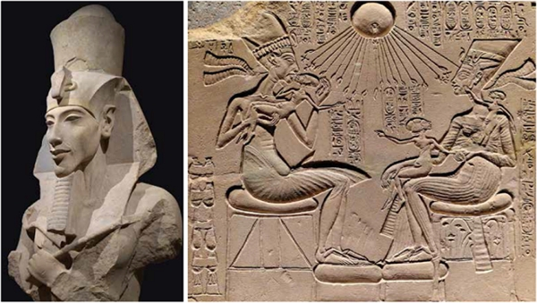
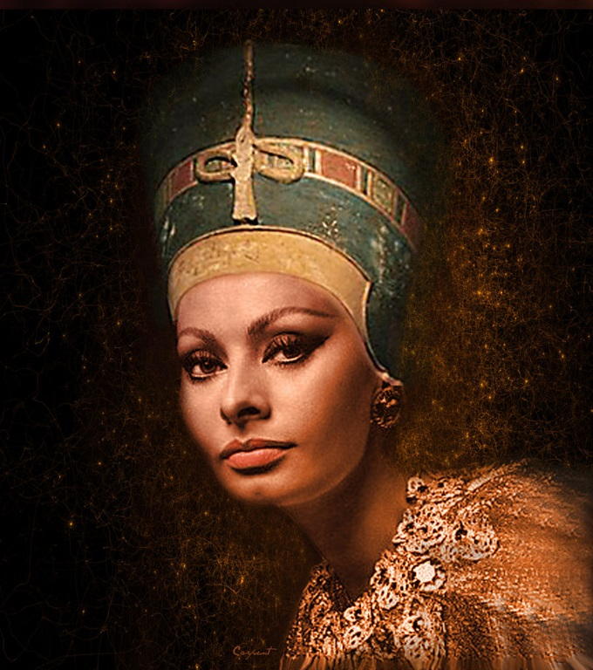
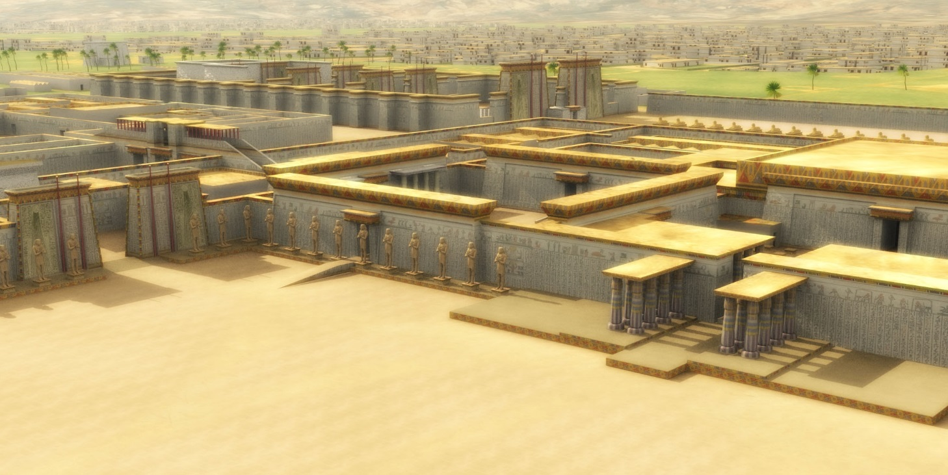
Akhenaten: The Heretic Pharaoh (1353-1336 BC)

Slide 17
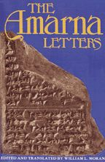
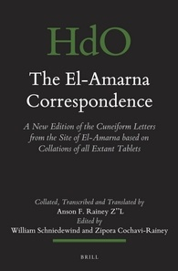
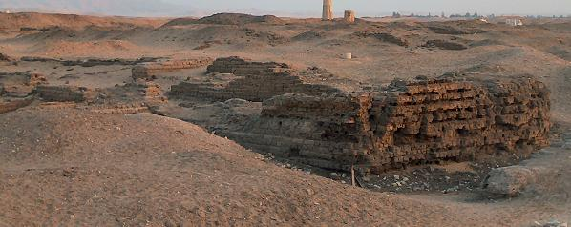
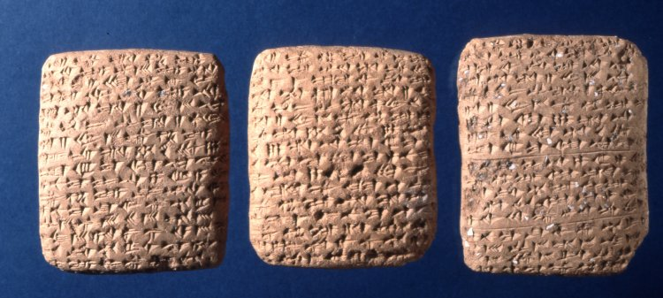
The Amarna Letters

Slide 18
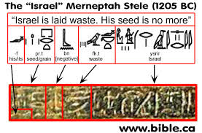
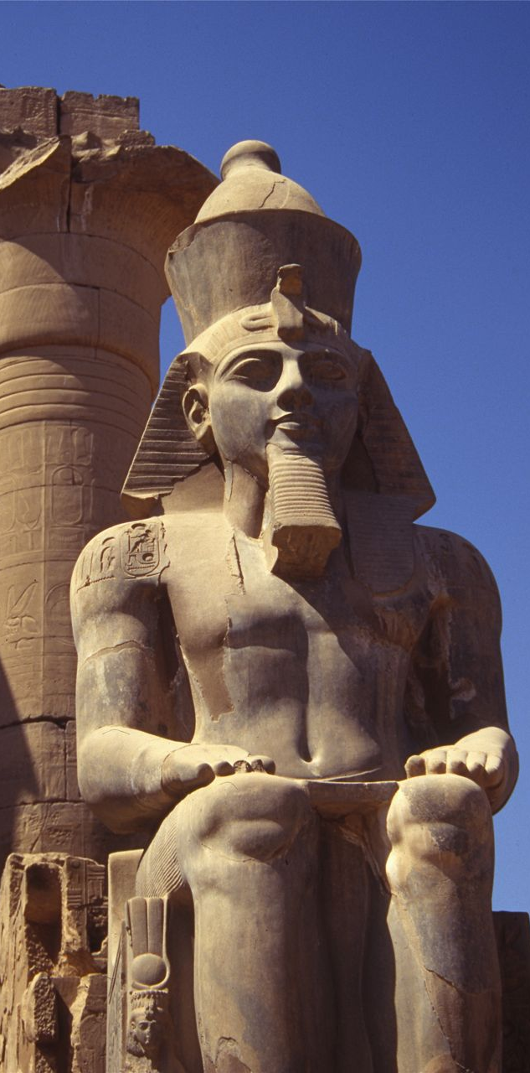
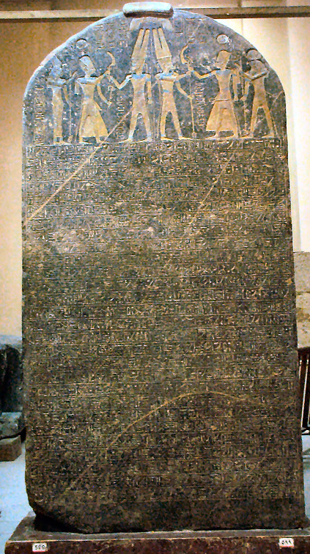
The Nineteenth Dynasty ca. 1292-1189 BC
Rameses II: 1279-1212 BC

Slide 19
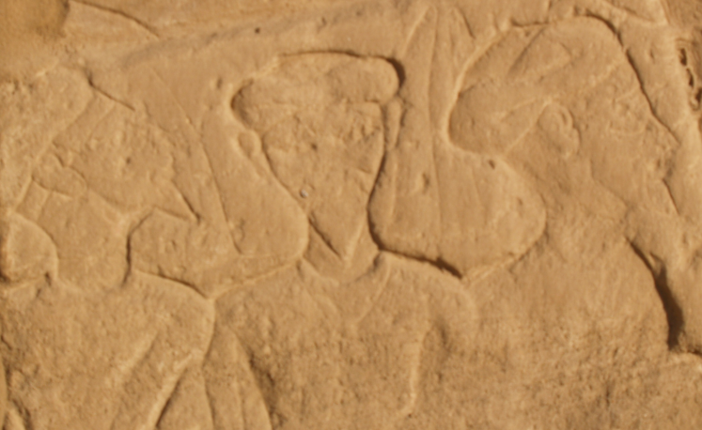
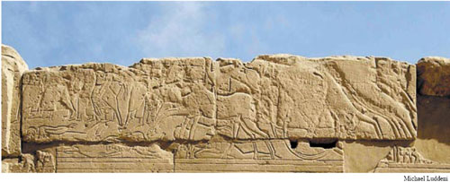
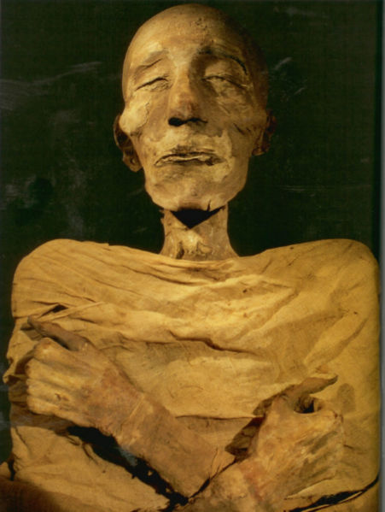
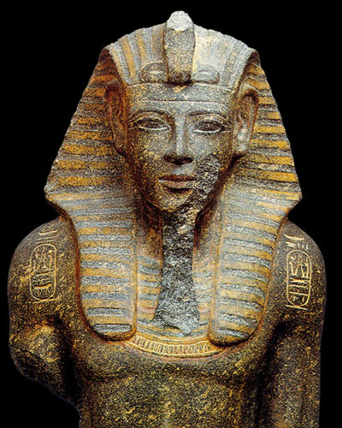
Pharaoh Merneptah (1213-1203 BC)
This 19th dynasty Pharaoh was not the vigorous ruler like his father, Rameses II, but he made history when he erected a monument and temple relief that mentioned Israel for the first time outside of the Bible.

Slide 21
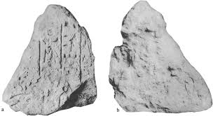
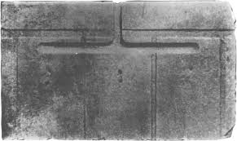
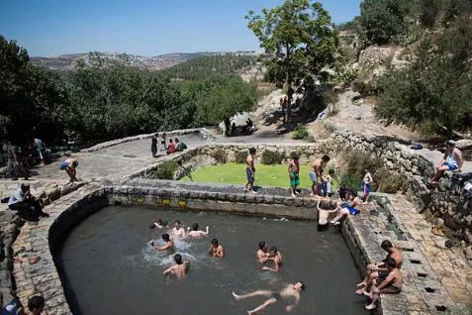
The Waters of Nephtoah
Joshua 15:9: From the hilltop the boundary headed toward the spring of the waters of Nephtoah, came out at the towns of Mount Ephron and went down toward Baalah (that is, Kiriath Jearim).

Slide 22
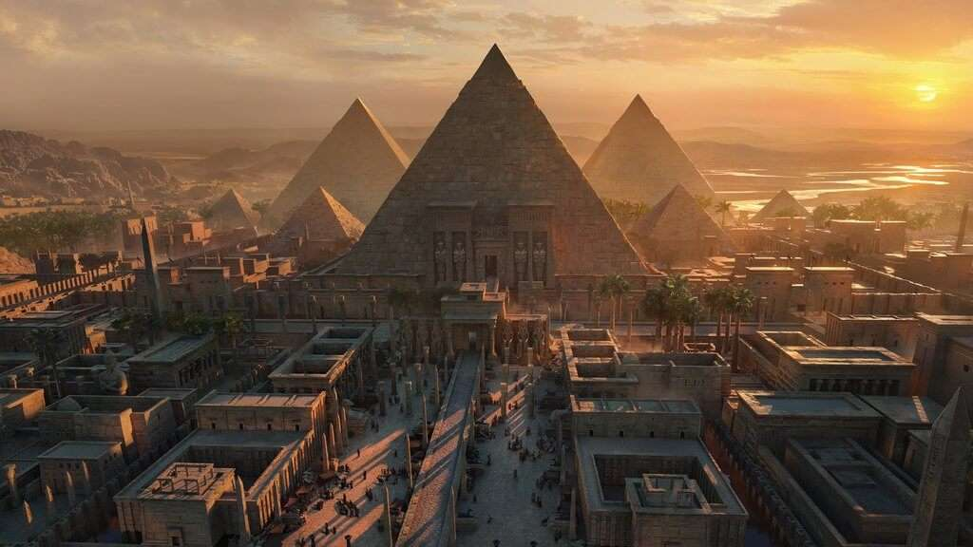
The Legacy of Egypt
“Behold, you are trusting now in Egypt, that broken reed of a staff, which will pierce the hand of any man who leans on it. Such is Pharaoh king of Egypt to all who trust in him.” (2 Kings 18:21)
“When Israel was a child, I loved him, and out of Egypt I called my son.” (Hosea 11:1)

Slide 23
The Neo-Assyrian Empire

Slide 24
The Neo-Assyrians
Assyria was a great empire largely based in its later years at Nineveh, a huge metropolis on the Tigris River in Mesopotamia (modern Iraq). Expansion into the Levant began in earnest with Shalmaneser III (859-824 BC), who fought a horrific battle against a coalition of states, led by Ahab of Israel in 853 BC at Qarqar in Syria. Israel was later made a vassal client state in 841 BC. Assyria went into decline (Jonah was active during this period) until the reign of Tiglath-pileser III (745-727 BC; 2 Kgs 15:29; 16:7-10), who annexed much of Israel and made Judah a vassal. Assyrian kings Shalmaneser V (727-722 BC) and Sargon II (722-705 BC) both claim to have conquered Samaria in 722 BC, which ended the northern kingdom of Israel. At the death of Sargon II, Hezekiah of Judah revolted against Assyria and Sennacherib (705-681 BC) responded by a full scale invasion of Judah, destroying 46 cities and towns and laying siege to Jerusalem itself. He claimed of shutting up Hezekiah “like a bird in a cage” (2 Kgs 18:17-19:9) but never stated that he conquered Jerusalem. The OT accounts tell us that his entire army was wiped out and Jerusalem miraculously saved (2 Kgs 19:35). Reading between the lines from Assyrian annals support the biblical accounts, as retreating from an ongoing siege was unprecedented in Assyrian history. Judah did later become an Assyrian vassal under later rulers Esarhaddon (680-669 BC) and Ashurbanipal (669-627 BC). Assyria weakened after Ashurbanipal’s death and was finally crushed by Babylonian and other external enemies. The great city of Nineveh fell in 612 BC. Nobody lamented this event (see the book of Nahum), because Assyria was one of most brutal empires in history.

Slide 25
Nineveh on the Tigris River: The great capital of the Neo-Assyrian Empire until its fall in 612 BC

Slide 26
Assyrians in the Bible
Shalman (Shalmaneser III): Hosea 10:14 “the roar of battle will rise against your people, so that all your fortresses will be devastated—as Shalman devastated Beth Arbel on the day of battle, when mothers were dashed to the ground with their children.”
Pul (Tiglath pileser III) 2 Kings 15:29: “In the time of Pekah king of Israel, Tiglath-Pileser king of Assyria came and took Ijon,Abel Beth Maakah, Janoah, Kedesh and Hazor. He took Gilead and Galilee, including all the land of Naphtali, and deported the people to Assyria.”
Shalmaneser V: Conquered the Northern Kingdom of Israel and destroyed Samaria.
Sargon II: 2 Kings 17:24; Isaiah 20:1-2 Deported the population of Israel to Assyria and imported foreigners.
Sennacherib: 2 Kings 18:13-37: Sennacherib invaded Judah and destroyed all of her cities except Jerusalem. While besieging Jerusalem, his entire army of 185,000 men died and Sennacherib returned to Nineveh.
Esarhaddon: 2 Kings 19:37; Isaiah 38:38 and Ezra 4:2 “they came to Zerubbabel and to the heads of the families and said, "Let us help you build because, like you, we seek your God and have been sacrificing to him since the time of Esarhaddon king of Assyria, who brought us here.“
Ashurbanipal: Ezra 4:10 “…and the other people whom the great and honorable Osnapper (Ashurbanipal) deported and settled in the city of Samaria and elsewhere in Trans-Euphrates.”
Assyrian Interactions with Israel: 1 Kings 22:1 refers to the Battle of Qarqar; 2 Kings; 2 Chronicles; Jonah; Isaiah; Hosea; Micah and Nahum

Slide 27
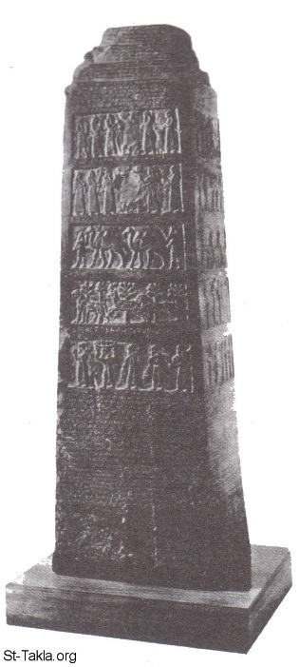
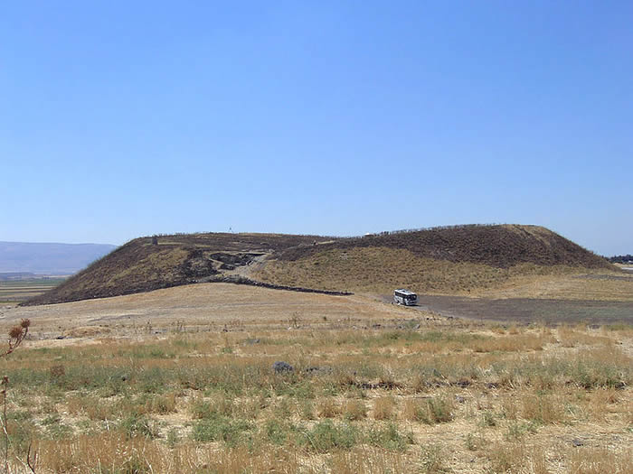
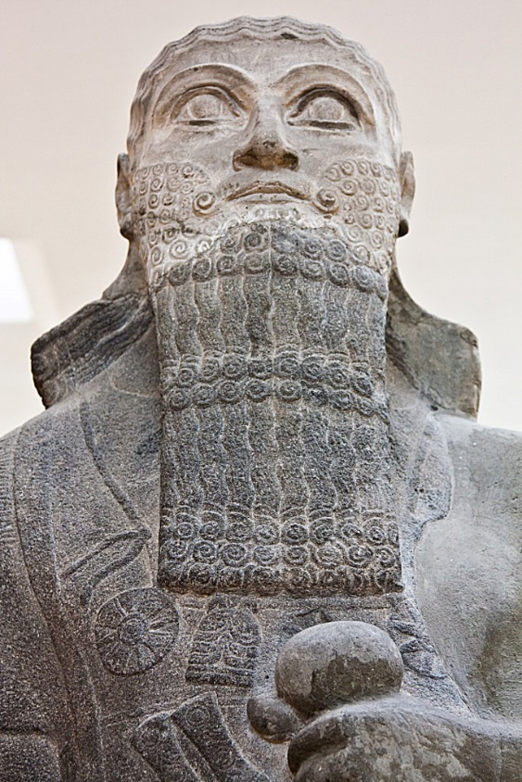
Shalmaneser III in the Levant
The Kurkh Stele (853 BC)
“For three years there was no war between Israel and Aram” (1 Kings 22:1)
The Black Obelisk (841 BC)

Slide 28
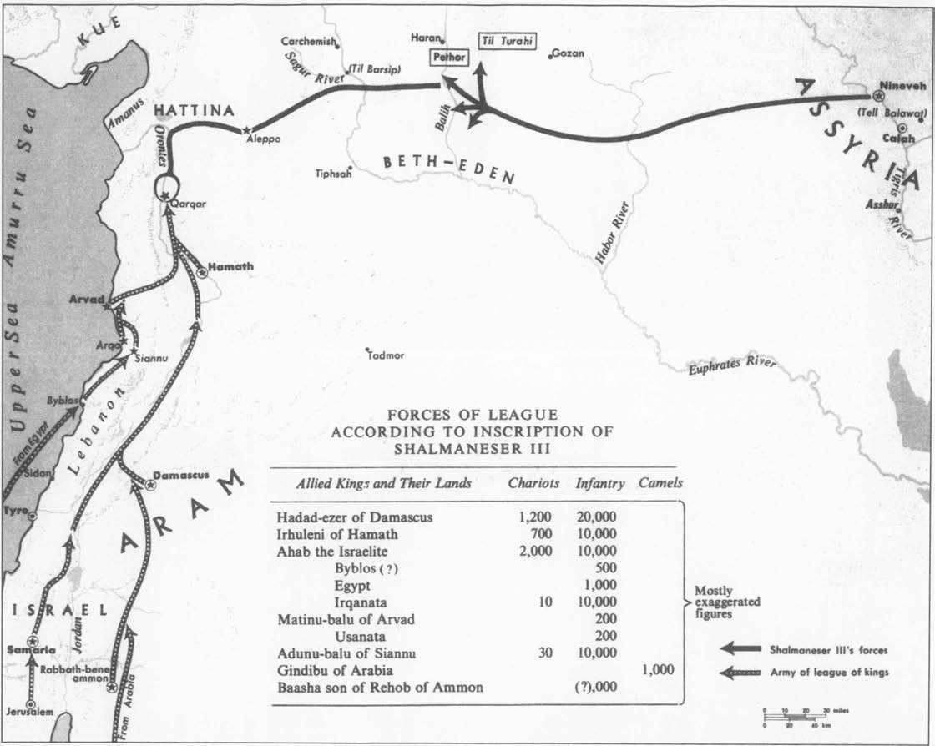

Slide 29
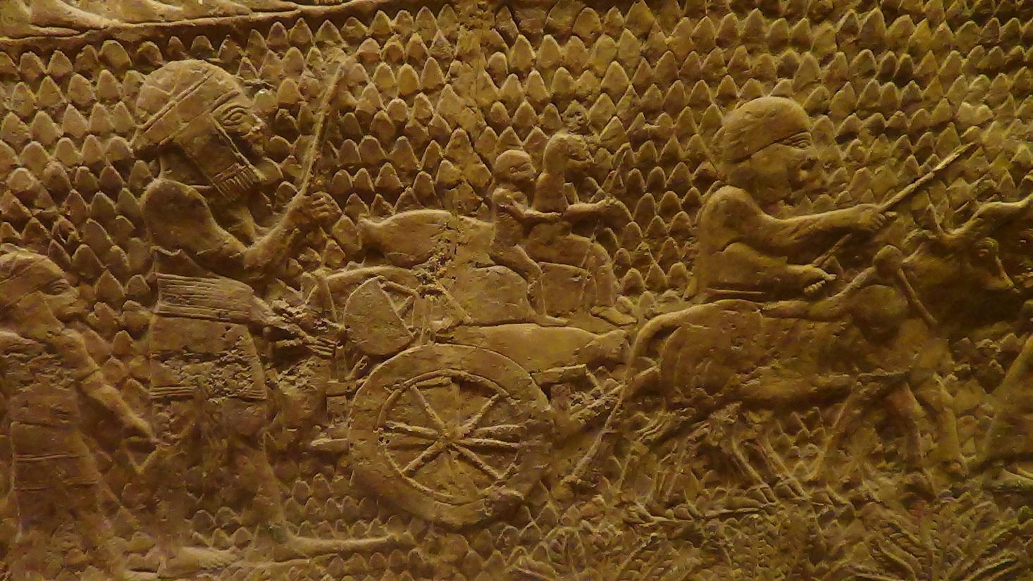
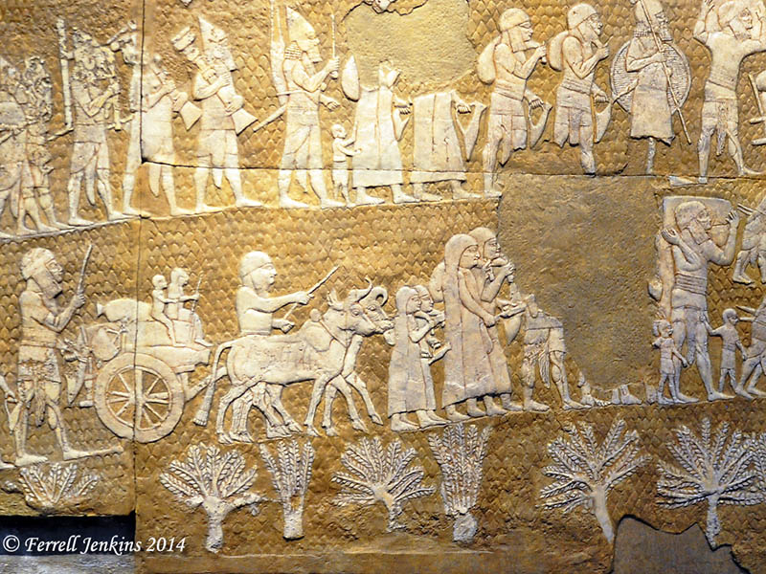
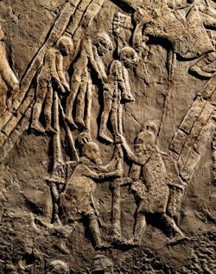
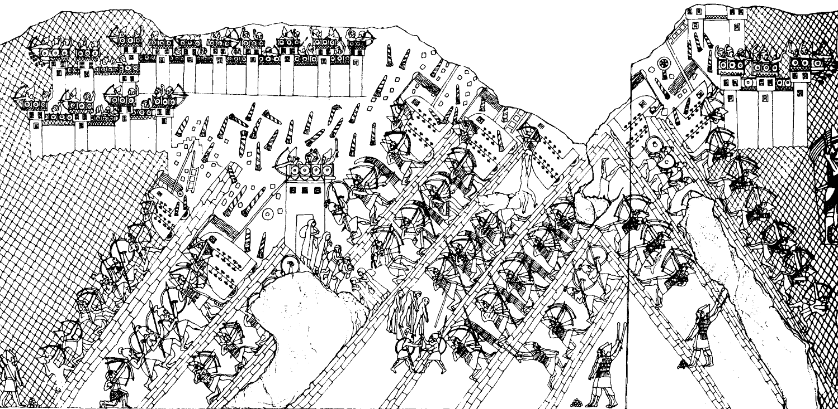
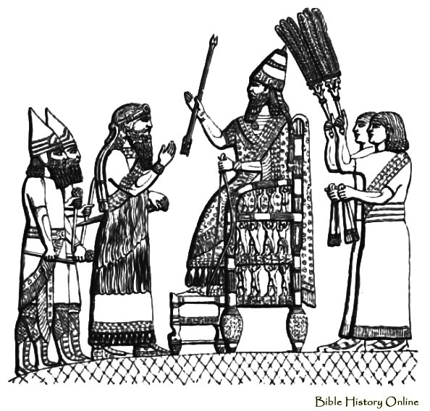

Slide 30
The Assyrian Throne Room of Sennacherib at Nineveh

Slide 31
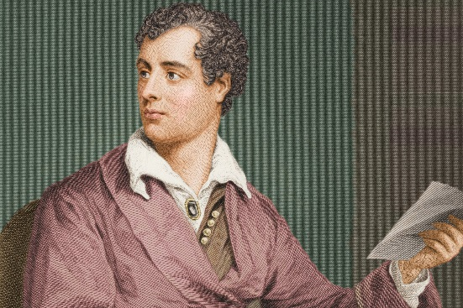
The Destruction of Sennacherib Lord Byron (1788-1824)
The Assyrian came down like the wolf on the fold, And his cohorts were gleaming in purple and gold; And the sheen of their spears was like stars on the sea, When the blue wave rolls nightly on deep Galilee. Like the leaves of the forest when Summer is green, That host with their banners at sunset were seen: Like the leaves of the forest when Autumn hath blown, That host on the morrow lay withered and strown.
For the Angel of Death spread his wings on the blast, And breathed in the face of the foe as he passed; And the eyes of the sleepers waxed deadly and chill,
And their hearts but once heaved, and for ever grew still! And there lay the steed with his nostril all wide, But through it there rolled not the breath of his pride; And the foam of his gasping lay white on the turf, And cold as the spray of the rock-beating surf.
And there lay the rider distorted and pale, With the dew on his brow, and the rust on his mail: And the tents were all silent, the banners alone, The lances unlifted, the trumpet unblown. And the widows of Ashur are loud in their wail, And the idols are broke in the temple of Baal; And the might of the Gentile, unsmote by the sword, Hath melted like snow in the glance of the Lord!

Slide 32
Ashurbanipal’s Palace without Rival

Slide 33
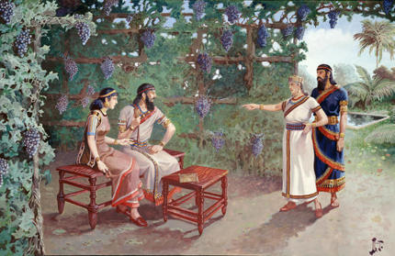
Ashurbanipal’s “Garden Party”

Slide 34
A Wedding Procession of modern day “Assyrians” The Assyrian Christian Church in Iraq has no direct link to the ancient Assyrians, but this is quite an interesting photo. Many of these Christians fell under the control of ISIS and have been martyred.

Slide 35
The Legacy of Assyria
"Woe to the Assyrian, the rod of my anger, in whose hand is the club of my wrath! (Isaiah 10:5)
He will stretch out his hand against the north and destroy Assyria, leaving Nineveh utterly desolate and dry as the desert. Flocks and herds will lie down there, creatures of every kind. The desert owl and the screech owl will roost on her columns. Their hooting will echo through the windows, rubble will fill the doorways, the beams of cedar will be exposed. This is the city of revelry that lived in safety. She said to herself, “I am the one! And there is none besides me.” What a ruin she has become, a lair for wild beasts! All who pass by her scoff and shake their fists. (Zephaniah 2:13-15)
Assyria exemplified a culture that both lived and died by the sword.
The Prophecy of Nahum: Delight and rejoicing over Nineveh’s destruction.

Slide 36
The Neo-Babylonian Empire

Slide 37
The Neo-Babylonian Empire
Babylon is first mentioned in Gen. 10:10 as founded by Nimrod. Merodach-Baladan, king of Babylon (Isaiah 39:1) sent emissaries to visit Hezekiah when Judah revolted against Assyria in 705-4 BC.
Babylonian king Nabopolassar resisted then attacked Assyria and conquered Asshur (614 BC) then Nineveh in 612 BC. His son, Nebuchadnezzar took his place in 605 BC and expanded his empire to include the Levant and Egypt. Rebellious vassals such as Judah were punished by deporting part of their population (one of these deportees was Daniel). Further rebellious acts of Judah led to a brief campaign in 597 BC, where king Jehoiachin was exiled and Zedekiah made Judah’s king. Finally, Judah revolted again, against the warnings of the prophet Jeremiah, and Nebuchadnezzar returned with a large army and destroyed all of Judah’s cities, besieged and conquered Jerusalem, destroyed the Temple of YHWH and deported most of the population to Babylonia in 586 BC. Another rebellion was put down in 582 BC. The empire declined after Nebuchadnezzar’s death. The last king, Nabonidus, ruled from a desert oasis. His son, Belshazzar, was the de facto ruler in Babylon itself when the city fell to the Medes and Persians in 539 BC (Dan. 5:30).

Slide 38
The Ishtar Gate of Babylon

Slide 39
The Ishtar Gate

Slide 40
Was this the Hanging Gardens of Babylon?

Slide 41
Nabonidus and His Queen Touring Babylon

Slide 42
The Persian Empire

Slide 43
The Persian Empire
Unlike the Assyrians and Babylonians, who used terror and deportations to maintain control of their vassals and subjects, the Persians were (relatively speaking) much more lenient. After conquering Babylon, where he was treated like a hero, Cyrus the Great allowed deported peoples to return to their homelands. This was known as The Edict of Cyrus (see the following slides). Among the returnees were groups of exiled Judahites (now called Jews), who returned to Jerusalem and began to rebuild the Temple under the leadership of Zerubbabel. Later groups or “waves” followed. Judah was made a semi-autonomous province named Yehud overseen by Jewish governors. Coins began to be widely used during this time, as well as a reliable mail (pony express) service.
Later Persian kings repeatedly attempted to invade Greece, but were ultimately unsuccessful. One of these, Xerxes (Ahasuerus) plays a prominent role in the book of Esther.
Persia and its kings became increasingly corrupt and when unable to stop a relatively small Greek army led by Alexander at the Granicus River in 334 BC. Decisive victories at Issus (333 BC) and Arbela in 331 BC crushed the Persian Empire and Hellenism took over the Near East. The great Persian capitals at Persepolis, Susa and Pasargadae were sacked and burned (see the painting in a following slide).

Slide 44
Persepolis: The Capital of the Persian Empire The Story of Esther takes place at Susa, a subsidiary Persian capital

Slide 45
Cyrus the Great Cyrus was proclaimed YHWH’s Anointed One (Messiah) in Isaiah 44:28; 45:1 as he delivered the Jews from their Babylonian Captivity and allowed them the freedom to return to the Land of Israel and rebuild the Temple in Jerusalem
Tomb of Cyrus at Pasargadae
Cyrus triumphantly entering Babylon after its capture

Slide 46
The Monuments of Cyrus
Statue in Relief of Cyrus
The tomb of Cyrus located at Pasargadae: His capital with an extensive garden complex (built ca. 540-530 BC)

Slide 47
The Cyrus Cylinder (ca. 539 BC)
Found as a foundational deposit in Babylon in 1879, the Cyrus Cylinder contains a royal decree allowing deported peoples to return to their native lands. This corroborates the account in Ezra.

Slide 48
The Great Persian Epicenters
Persepolis: The Showcase Capital of Persia
Palace of Xerxes
Frieze from Susa

Slide 49
Judah under Persian Control
Jewish “YEHUD” Coins
“YEHUD” Seal Impressions

Slide 50
The Sack of Persepolis by Alexander the Great (331 BC)

Slide 51
The Roman Empire

Slide 52
Hellenism versus Judaism
A clash of two conflicting cultures and worldviews
Antiochus IV and the Maccabean Revolt
The Hellenization (secularization) of many Jews
Judaism: One God, humanity is made in God’s image, a balance of body and soul, Calendar based on the New Moon, observance of the Sabbath, and the practice of Circumcision. Jews lived by a covenant code and held to personal moral ethics and behaviors
Hellenism: Many gods (Plato: the active involvement of gods in human affairs and even the existence of deities were not seriously recognized), god is in the image of humanity and has human characteristics, physical beauty is ideal and should be displayed and enjoyed with little or no inhibitions, leading to gross immorality, self-indulgence and debauchery

Slide 53
The Roman Contribution to the Spread of Christianity
Highly developed network of trade and roads
Stable, well-organized rule with a relatively safe countryside for travel.
The nearly universal use of the Greek language
Roman culture was outwardly polytheistic, but essentially atheistic; exemplified in its extreme decadence.

