Slide 1
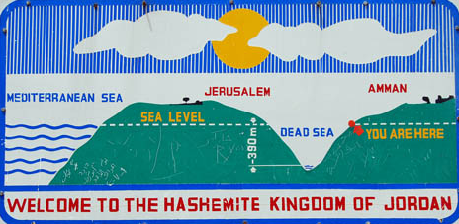
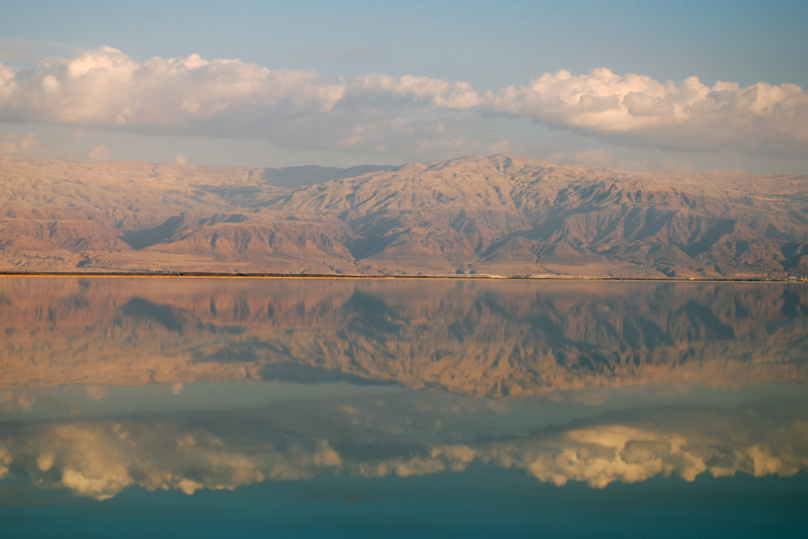
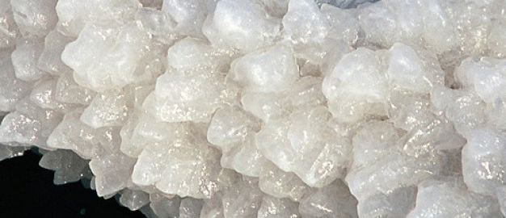
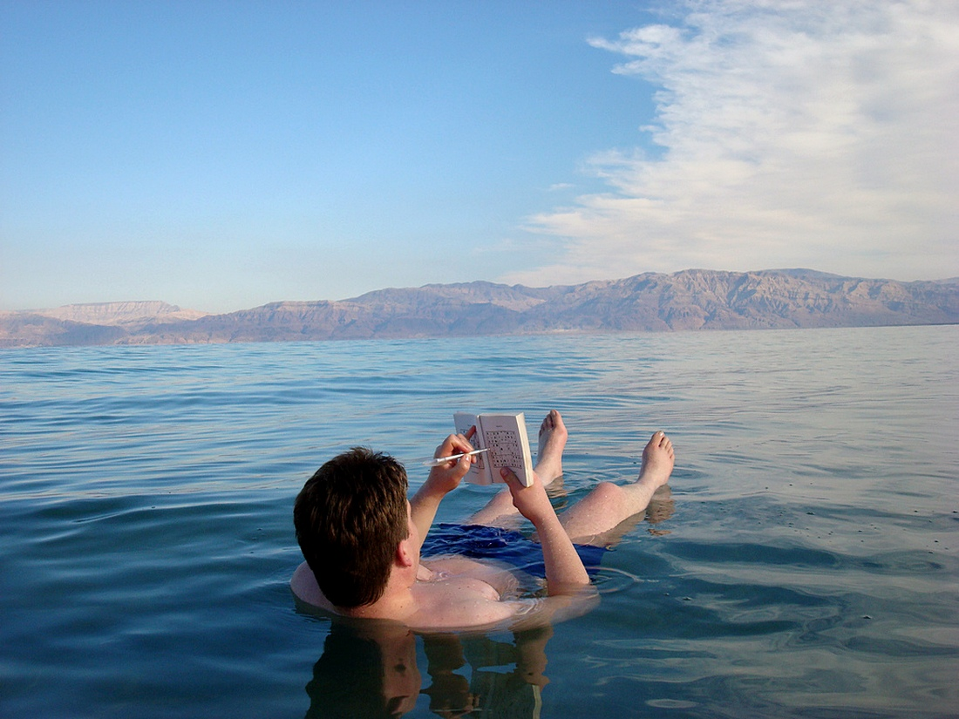
The Dead Sea (Sea of Salt)

Slide 2
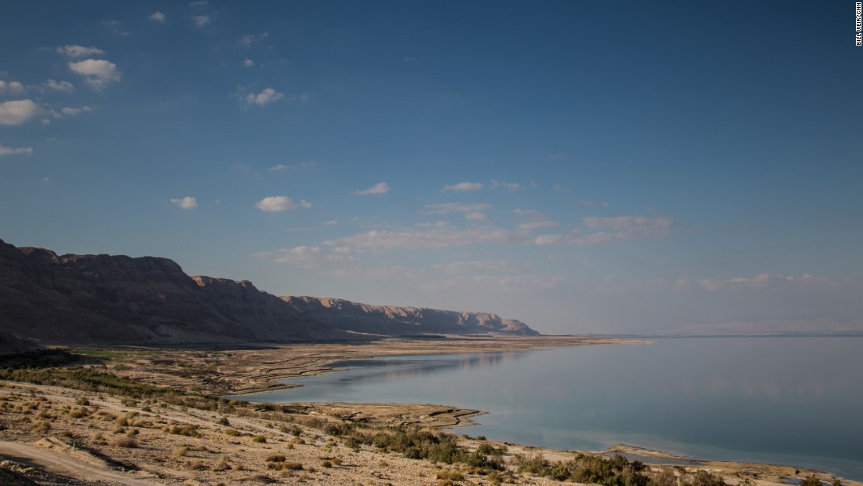

Slide 3
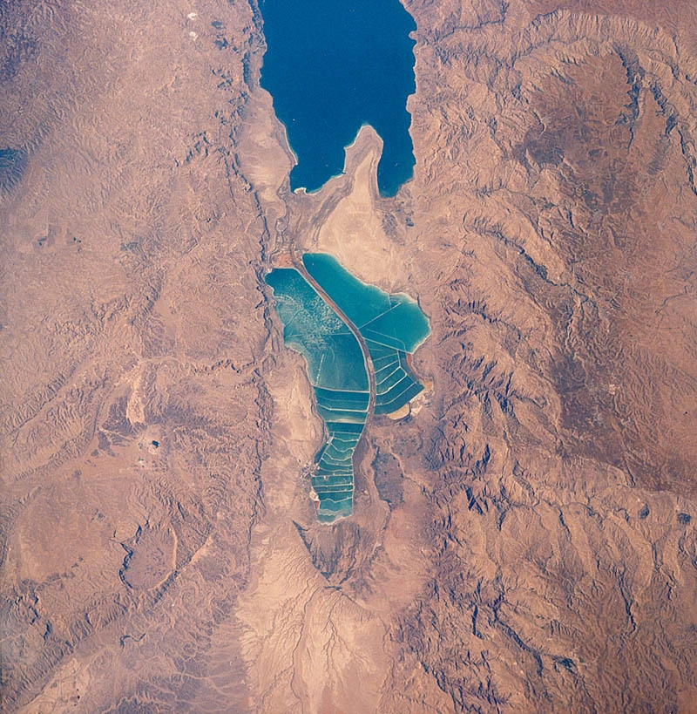
Dead Sea Facts
The surface and shores of the Dead Sea are 423 metres (1,388 ft) below sea level, making it Earth’s lowest elevation on land
The Dead Sea is 67 kilometres (42 mi) long and 18 kilometres (11 mi) wide at its widest point. It lies in the Jordan Rift Valley and its main tributary is the Jordan River.
Biblically, the Dead Sea was a place of refuge for King David. It was one of the world’s first health resorts (for Herod the Great), and it has been the supplier of a wide variety of products, from balms for Egyptian mummification to potash for fertilizers
The Dead Sea area has become a major center for health research and treatment for several reasons. The mineral content of the water, the very low content of pollens and other allergens in the atmosphere, the reduced ultraviolet component of solar radiation, and the higher atmospheric pressure at this great depth each have specific health effects
The Dead Sea is roughly 8.6 times saltier than the ocean. This salinity makes for a harsh environment in which animals cannot flourish (hence its name). The high salinity prevents macroscopic aquatic organisms such as fish and aquatic plants from living in it, though minuscule quantities of bacteria and microbial fungi are present
The Dead Sea’s unusually high salt concentration means that people can easily float in the Dead Sea due to natural buoyancy. In this respect the Dead Sea is similar to the Great Salt Lake in Utah in the United States
With 33.7% salinity, the Dead Sea is one of the world’s saltiest bodies of water. Although Lake Assal (Djibouti), Garabogazköl and some hypersaline lakes of the McMurdo Dry Valleys in Antarctica (such as Don Juan Pond) have reported higher salinities
The Dead Sea is 377 m (1,237 ft) deep, making it the deepest hypersaline lake in the world. A hypersaline lake is a landlocked body of water that contains significant concentrations of sodium chloride or other mineral salts, with saline levels surpassing that of ocean water
An unusual feature of the Dead Sea is its discharge of asphalt. From deep seeps, the Dead Sea constantly spits up small pebbles and blocks of the black substance. Asphalt coated figurines and bitumen coated Neolithic skulls from archaeological sites have been found. Egyptian mummification processes used asphalt imported from the Dead Sea region
The world’s lowest road, Highway 90, runs along the Israeli and West Bank shores of the Dead Sea at 393 m (1,289 ft) below sea level

Slide 4
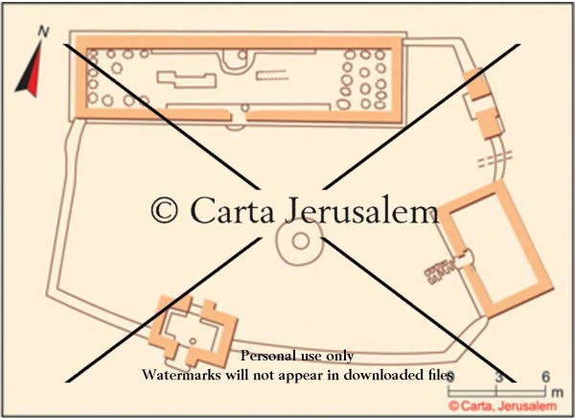
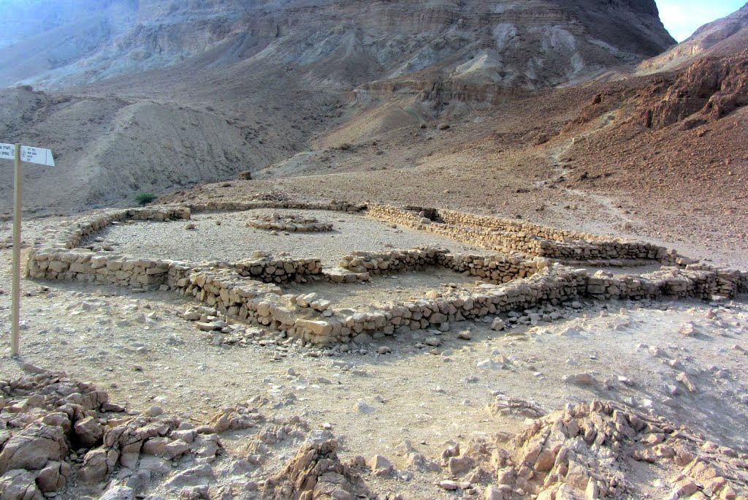
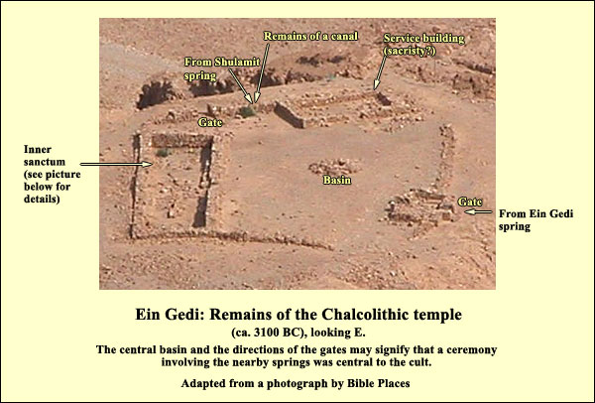
The Chalcolithic Temple above En Gedi

Slide 5
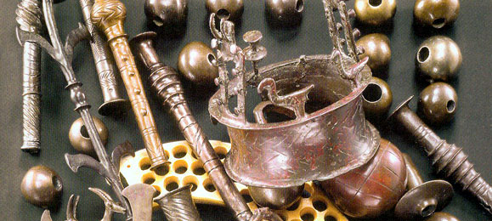
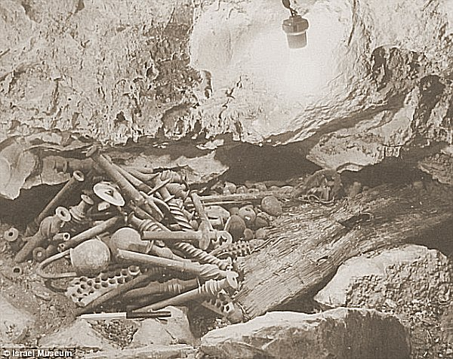
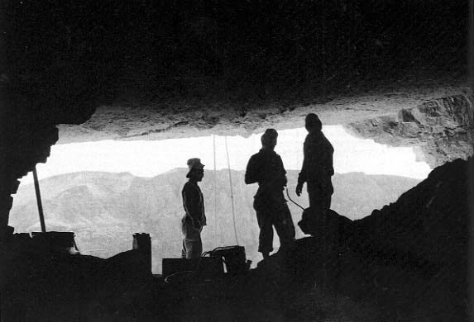
The Cave of Treasure discovered in the Nahal Mishmar

Slide 6
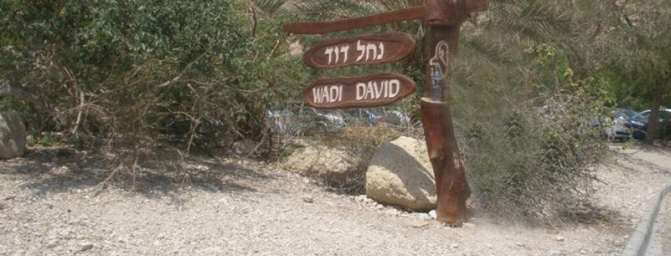
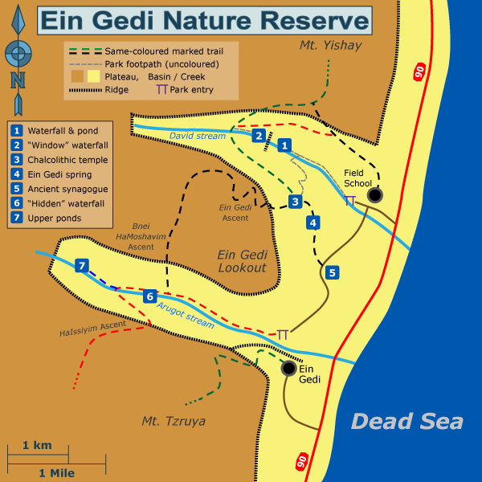
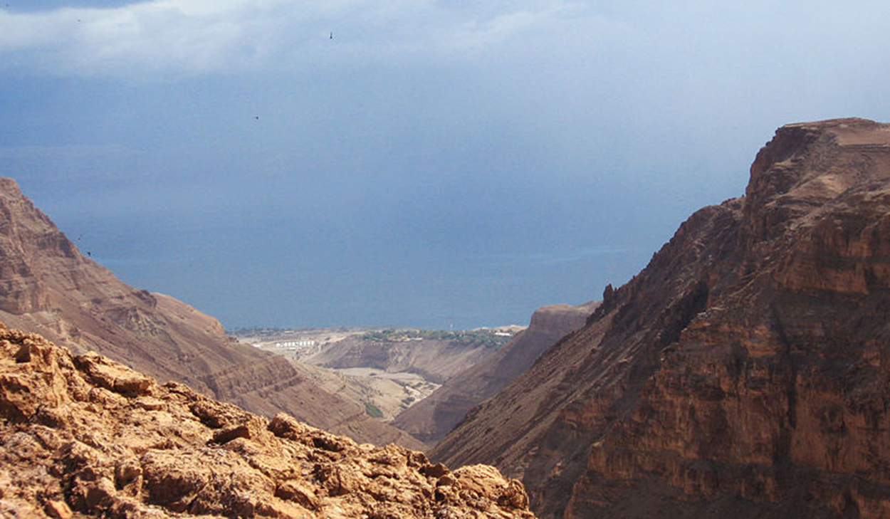
En Gedi (Goat Spring) Called Hazazon Tamar (2 Chr 20:2); Genesis 14:7; Joshua 15:62; 1 Samuel 24:1; Song of Songs 1:14. NT era boasted a beautiful synagogue and date palm plantations View to the east over the Dead Sea. Chedorlaomer; Joshua, David; Solomon; Jehoshaphat; Uzziah; and Herod are important figures in its history

Slide 7
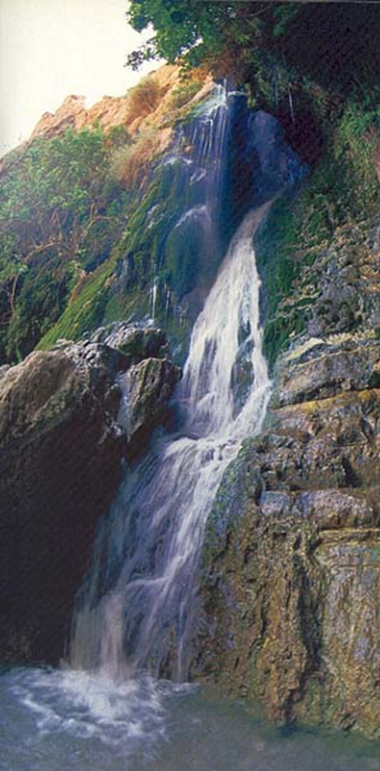
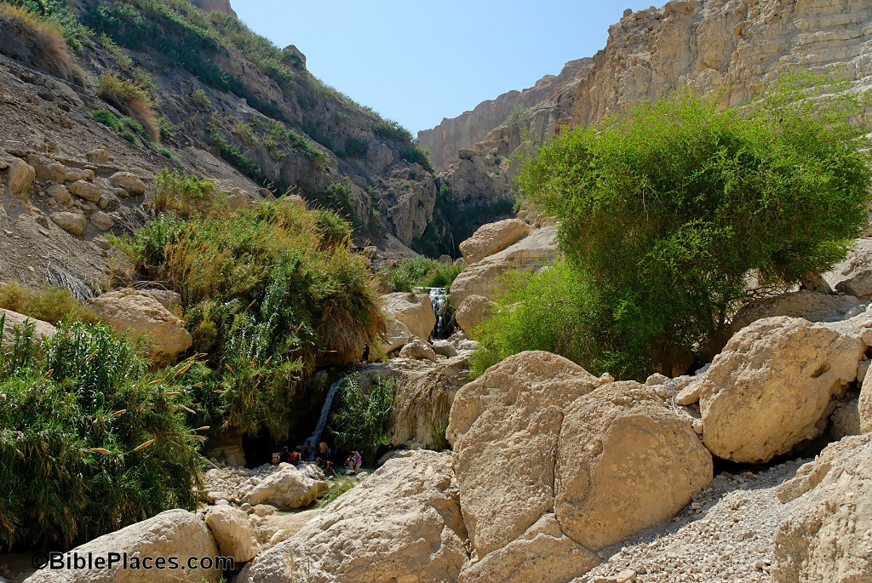
The Nahal David Spring and Pool

Slide 8
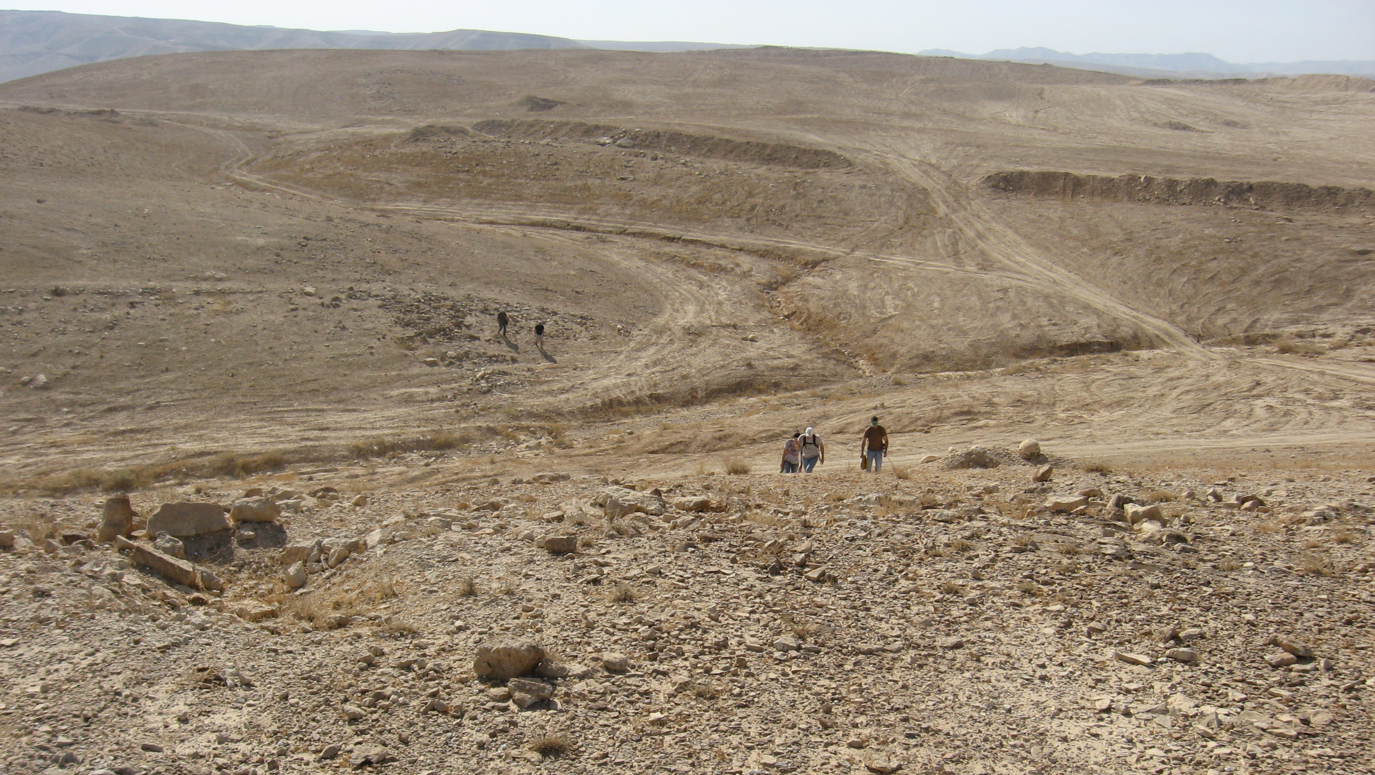
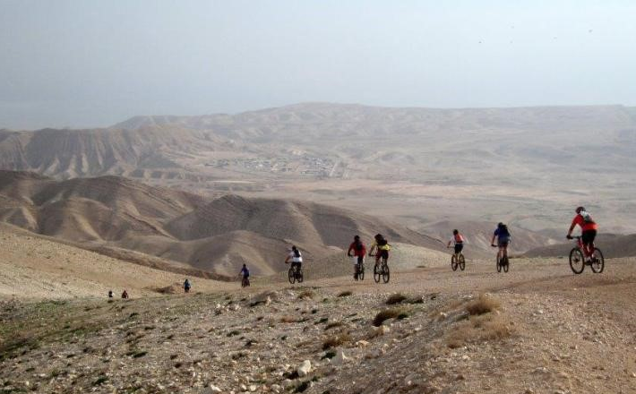
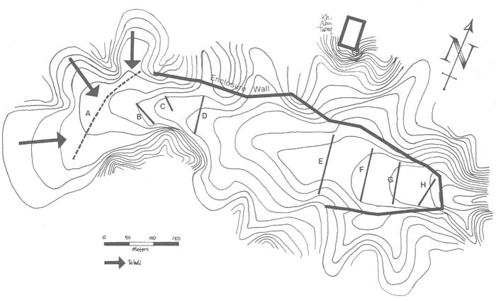
The Valley of Achor (Buqe’ah Valley) There I will give her back her vineyards, and will make the Valley of Achor a door of hope. There she will respond as in the days of her youth, as in the day she came up out of Egypt (Hosea 2:15).

Slide 9
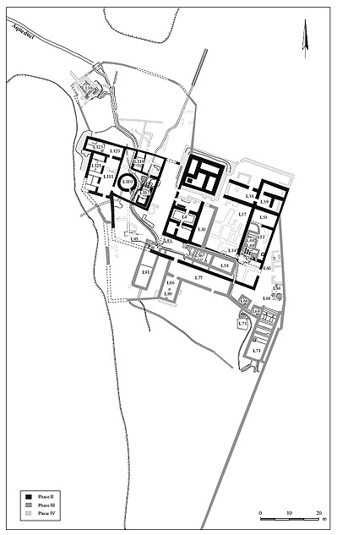
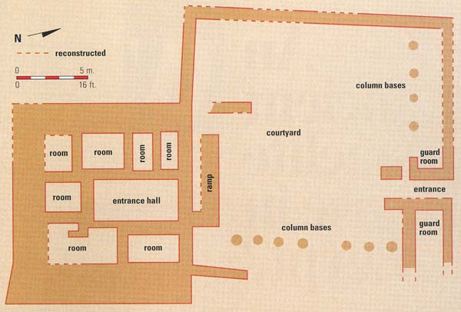
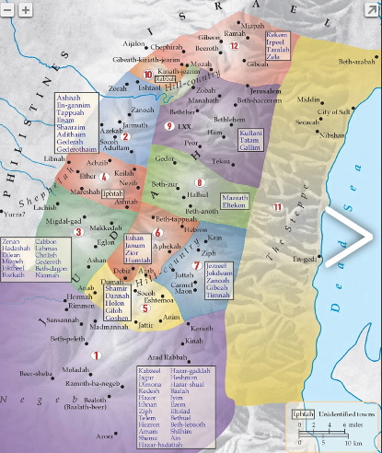
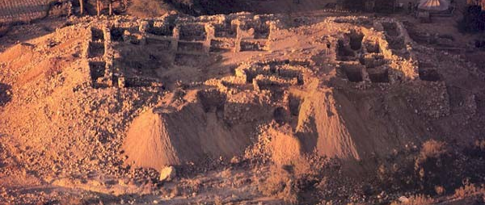
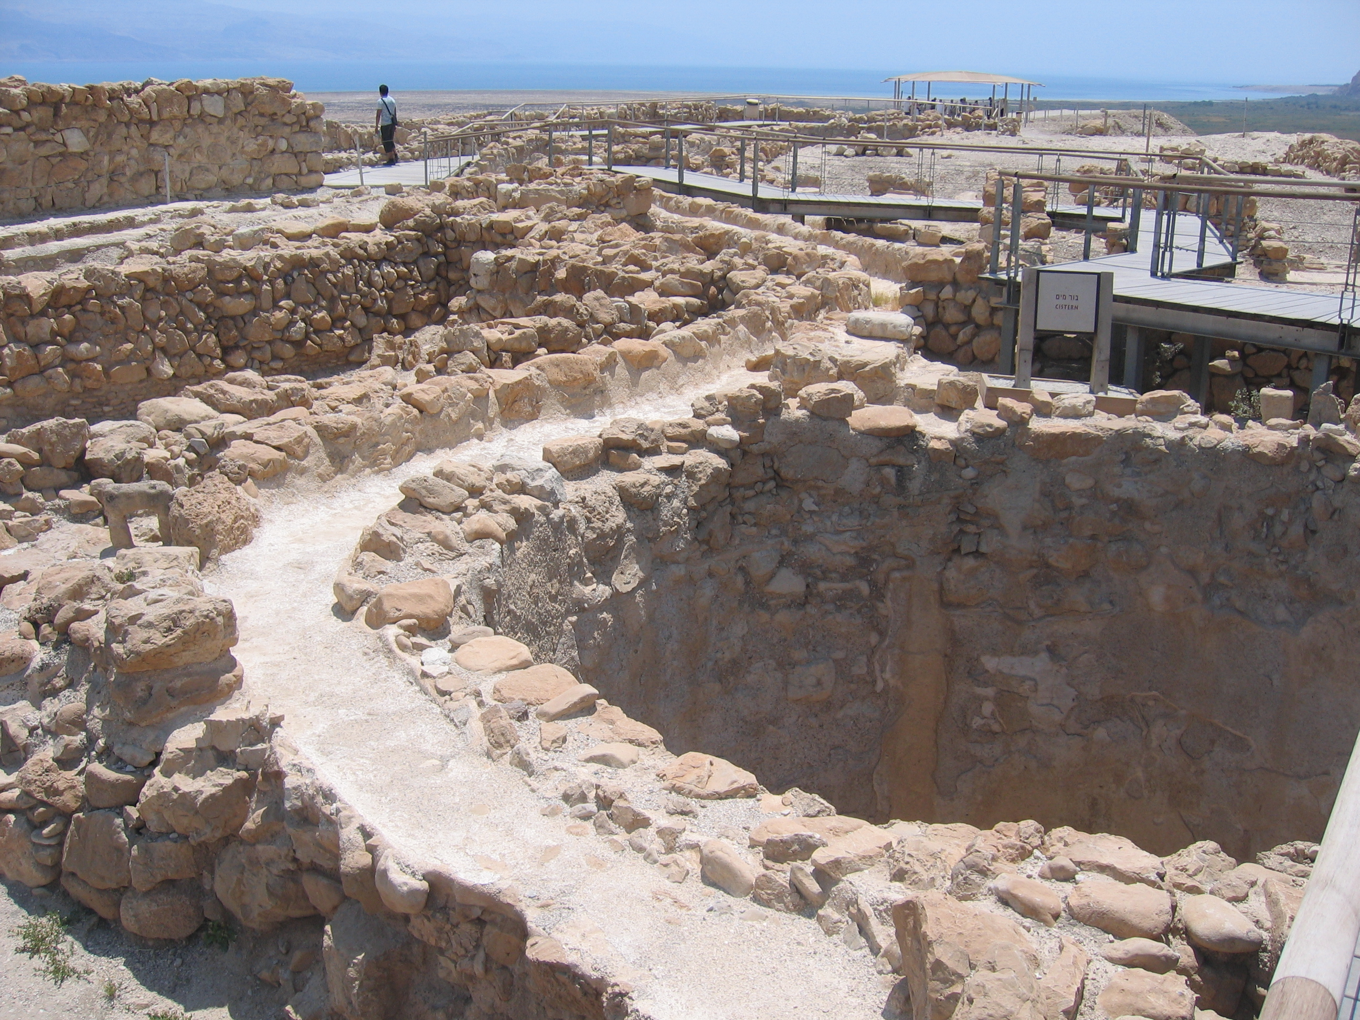
Joshua 15:61-62 In the wilderness: Beth Arabah, Middin, Sekakah, Nibshan, the City of Salt and En Gedi—six towns and their villages.

Slide 10
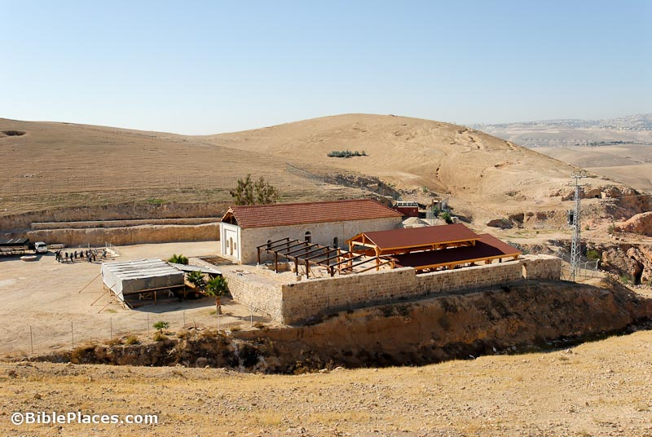
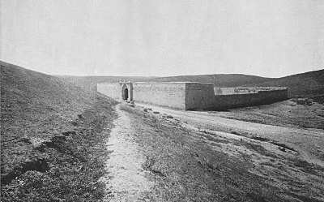
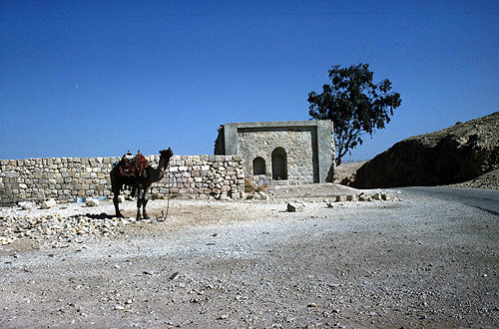
The Good Samaritan Inn on the Road to Jericho

Slide 11
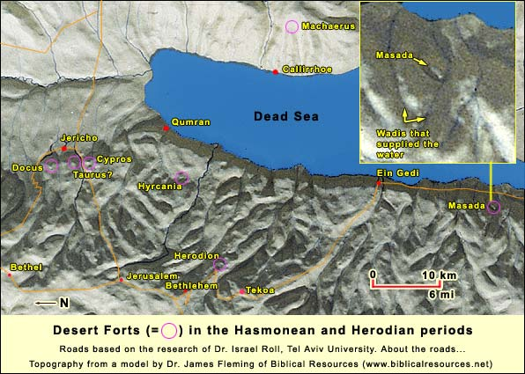
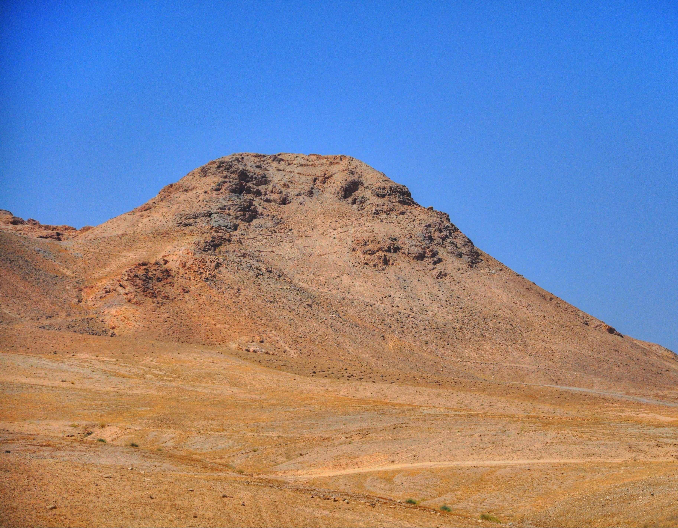
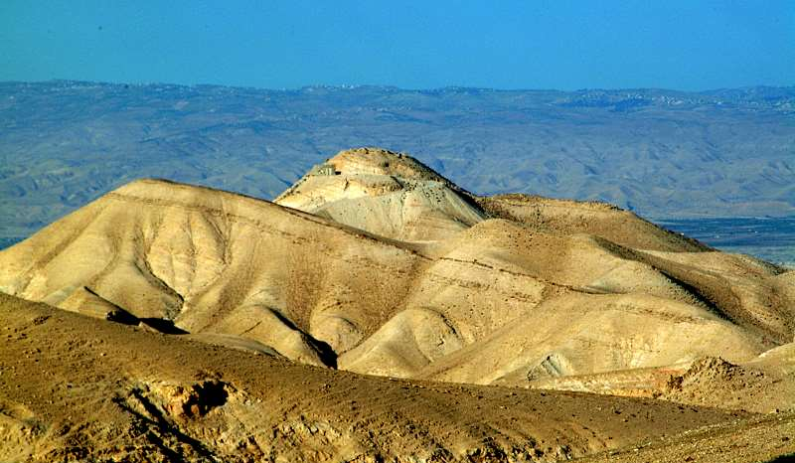
Herodian Fortresses in the Wilderness of Judah Hyrcania (Khirbet Mird) and Cypros

