Slide 1
Archaeology: A Closer Look
Archaeology and the Old Testament versus Archaeology and the New Testament: There is a big difference…. What is it? In Biblical Studies, Archaeology is the Fifth Gospel. It provides additional information, insight into daily life and material evidence that can substantiate the Biblical account.
Archaeology is especially relevant for the Old Testament. Why?: We have only scanty written sources for the OT, mostly Egyptian, Assyrian and Babylonian records. We have many more outside sources that describe the daily life and culture during the NT period. Also, the archaeology of the NT is much different; the NT (early Christians) did not leave archaeological evidence behind. Christianity was a movement, not a culture or a distinct political kingdom. Its events are not archaeologically verifiable for the most part.
Definition: Near Eastern Archaeology is a blend of physical science and history that attempts to find evidence of humanity’s past, both prehistoric and historic from material remains.
Methodology: What is left for us to discover? Very little, like a puzzle with 90% of the pieces missing. Material remains (relating to the OT) include pottery (used for everything: storage, cooking, eating, drinking and writing as well as ornamentation such as cult stands and small statues); metal (nails, weapons and tools as well as coins in later periods); stone (tools for grinding, rolling, sling stones and building materials). Perishable materials, such as wood, parchment, leather and cloth rarely survived. An appropriate term is “residue” for the low percentage of extant artifacts.

Slide 2
Archaeology: A Closer Look
Inscriptions are the most valuable finds. Here the ancient writer speaks directly to us and much is learned. Most are on discarded pottery called ostraca. Examples of important inscriptions are those from Mesad Hashavyahu (the Judicial Letter), Arad (The Eliashib archive) and Lachish corpus: And may (my lord) be apprised that we are watching for the fire signals of Lachish according to all the signs which my lord has given, because we cannot see Azeqah.(Jeremiah 34:7 “When the king of Babylon’s army fought against Jerusalem and all the cities of Judah that were left, against Lachish and Azekah; for only these fortified cities remained of the cities of Judah”).
How to Date Remains? Pottery, coins, architectural and artistic styles, Carbon 14 dating of organic materials and historical sources (Amarna correspondence).
Archaeology is a destructive science. You get one chance to dig an area, so careful records must be kept. Digging is done by excavating 5 x 5 squares (plus balks) or by excavating a trench, cutting through the tell.

Slide 3
The Use and Abuse of Archaeology
Abuses of Archaeology
Looting and plunder: Carting off monuments and artifacts to display in foreign museums or private collections or to sell for profit on the antiquities markets, such as ISIS is currently doing.
Nationalistic purposes: Military and /or Political Intelligence, national prestige, to support or contest contemporary nationalistic aims such a legal historical claim to territory or for territorial acquisition. (Moshe Dothan and PA archaeologists)
Religious Purposes relating to the Bible: Many of the early societies had statements of purpose that included “for biblical illustration” or for a “scientific aid to theology” while others specifically strive to excavate for apologetic purposes. (Archaeological Eisegesis)
Ideological Purposes that counter the Bible: One of the best examples are the “Minimalists” and followers of their blogs. Another is for Self Promotion, either in supporting a new theory or model and even taking unsavory measures to exalt oneself and his or her research. The field of Archaeology has a lot of large egos.
The Proper Use of Archaeology
To Satisfy the Quest for Knowledge about the Ancient Past and a deep desire to make a contribution to our understanding of it.
To Commit oneself to objectivity throughout the process of digging, processing and publishing the data.
To fully collect, assess and study the data before making biblical correlations with it.
To Get professional assistance rather than attempt to interpret finds outside of your expertise.
To Be exceptionally organized in the field with recording, collecting and storing data and finds.
To Recognize the limitations of Archaeology as a tool to prove the Bible, but rather to help us understand the Biblical World, its peoples and to correlate evidence when appropriate.
Can Archaeology prove the Bible? Usually, archaeology can only support or affirm what the Bible states. Examples: Camels used by Abraham, Patriarchs in Egypt, Israel mentioned in ancient inscriptions, etc.

Slide 4
Excavation Methodology: Preparation OK, I want to excavate a biblical site! What do I do?
Choose a specific site to excavate: Careful consideration of which site suits your interests, budget and abilities and provides promising evidence. Moreover, one must select a particular area of a site: slopes, depressions, high point(s), exposed architecture, a saddle along the slope or anything that indicates ancient remains lay below the surface. Other concerns include accessibility, the local population and other “intangible” factors.
Where to dig? Two options are Surveys and Excavations. Most people during the OT lived in walled cities or towns. These can usually be identified as mounds or tells.
Research Design: Prepare a detailed plan of action and list questions you wish to answer. Include detailed budgets, specialists, publication plans and site preservation. Sounds logical, but planning is critical for a successful project.
Permits: The Israel Antiquities Authority, the Palestinian Department of Antiquities or the Jordanian Department of Antiquities need to issue a permit for every dig, every year, plus a sizable fee. Foreign teams digging in Israel require an Israeli co-director. Most digs affiliate with ASOR or the AIA to show legitimacy and respectability, as well as to get access to grants. DOA representatives oversee the project.
Finances: Raising money is a substantial part of organizing a dig. Grants from large foundations, USAID, the UN or wealthy benefactors and / or supporters are vital in order to launch a dig. Money must also be set aside for processing, publication and site preservation.
Volunteers: Recruiting lay people, experienced excavators and students require planning and promotion. Field schools are a great way to encourage volunteers as college credit is provided plus lots of adventurous trips on the weekends. Most digs supplement volunteers with paid local laborers.
Staff: Professional staff should be recruited from a pool of colleagues and specialists. Some require a fee, others require travel and lodging.
Equipment: Excavations require a considerable amount of equipment: vehicles, hand tools, wheelbarrows, photography equipment, survey equipment, tent(s) , potable water, etc. Some of these can be rented or borrowed from institutes or the respective DOA in country.
Local and Regional Surveys: Your site must be seen in its context and a survey of the surrounding “hinterland” is vital for understanding its history. Even if the area has been previously surveyed, this task must be carried out at the start of the project.
Notes:
Mention Siegfried Horn’s method of selecting a site.

Slide 5
What Things We Search for when Excavating In Archaeology, the questions remain the same, only the answers change!
Answers: regarding site identification, periods of settlement, reasons why the settlement was abandoned, the ethnicity of the inhabitants, any destruction evidence and the identities of the responsible parties.
Inscriptions: Epigraphic material written on stone, ivory or ceramic, rarely on plaster, parchment or leather fragments
Material Cultural Objects: Anything made, altered, shaped and / or deposited by humans
The Stones do cry out. We just need to listen very carefully!

Slide 6
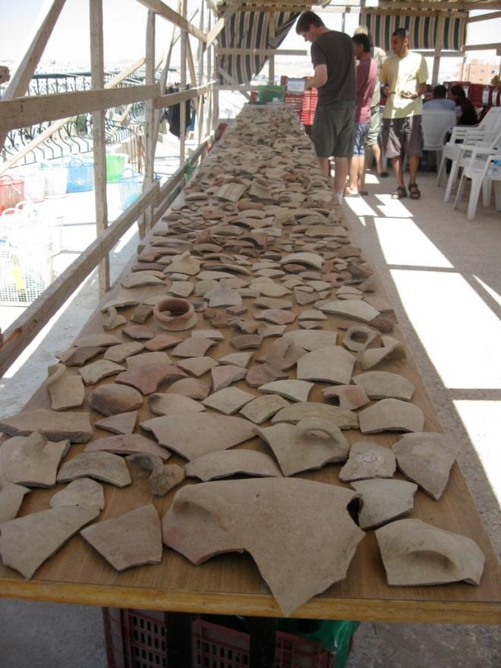
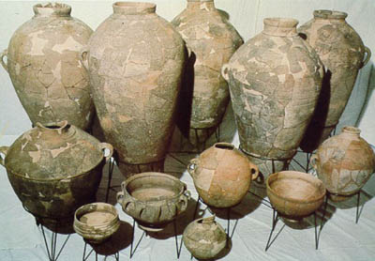
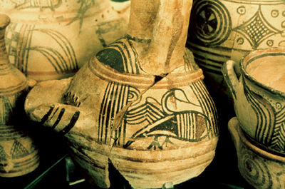
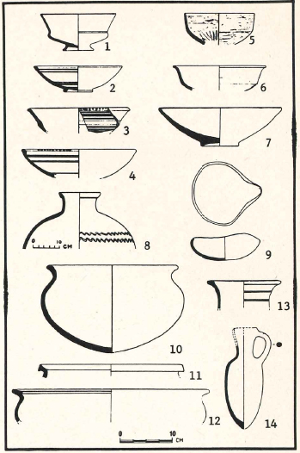
The Importance of Pottery
Pottery forms and ware constantly changed and evolved through the years. Pot sherds (broken pottery) is EVERYWHERE at an ancient site. It is indestructible. Thus, it can be used to provide a relative chronology for a site. Pottery can tell us the date, ethnicity (pots and people), level of prosperity, economic structure, what activities were carried out in sites and even buildings, trading relationships with neighboring or distant kingdoms or polities and where the pottery was produced. Pottery from different kingdoms is similar yet often distinctive in critical areas.

Slide 7
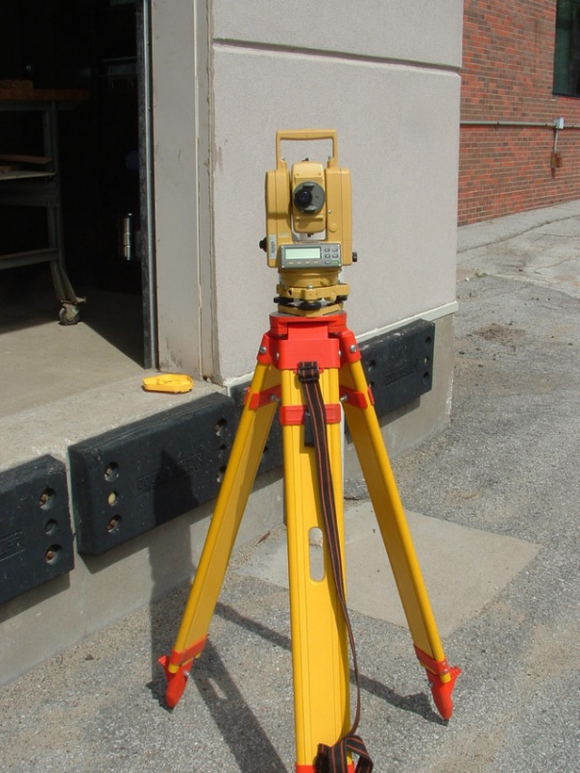
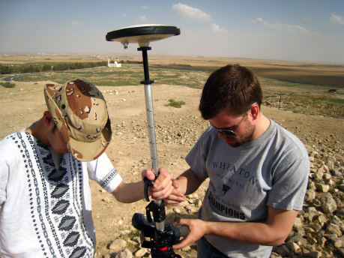
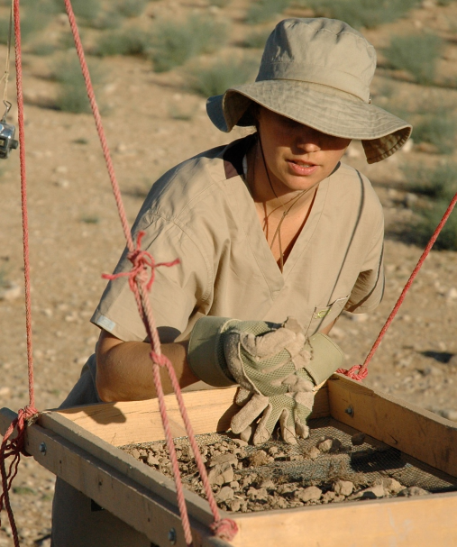
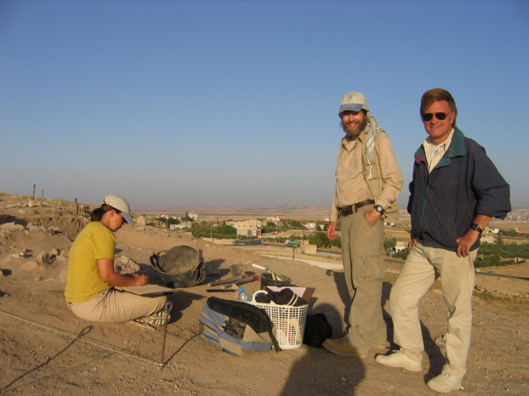
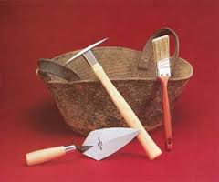
Methodology: Tools of the Trade
A transit level or theodolite to take elevations from a known benchmark
GPS provides an easier and more accurate alternative using satellites
Sifting screens are an important tool in collecting artifacts
Guffahs (rubber buckets made of old tires), trowels, hand picks and brushes are used in every excavation
Larger tools such as picks and hoes are also used.
Small tools such as dentil picks are only used when unearthing small, delicate objects.
Tall Jalul director and co-director oversee their excavations

Slide 8
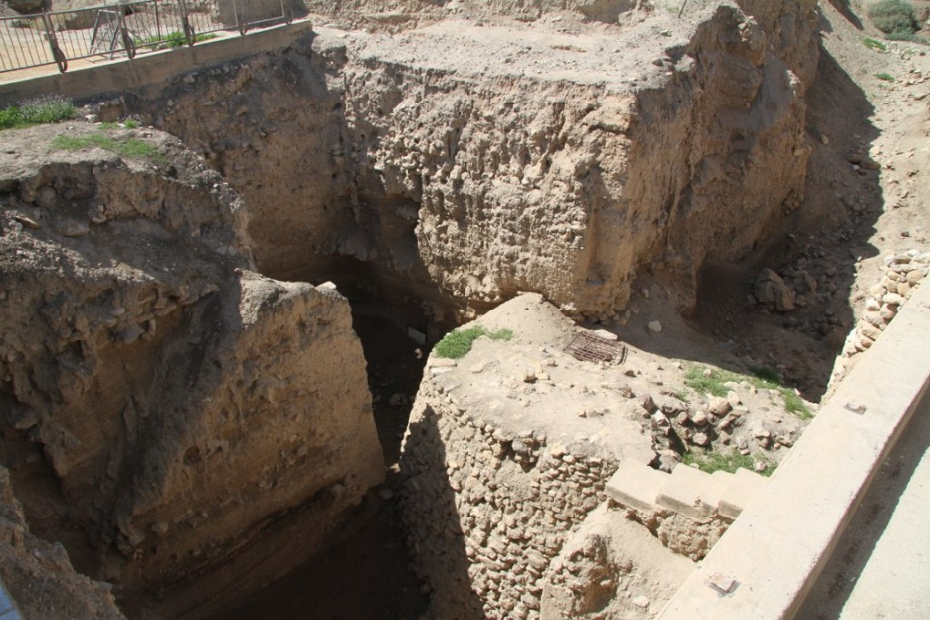
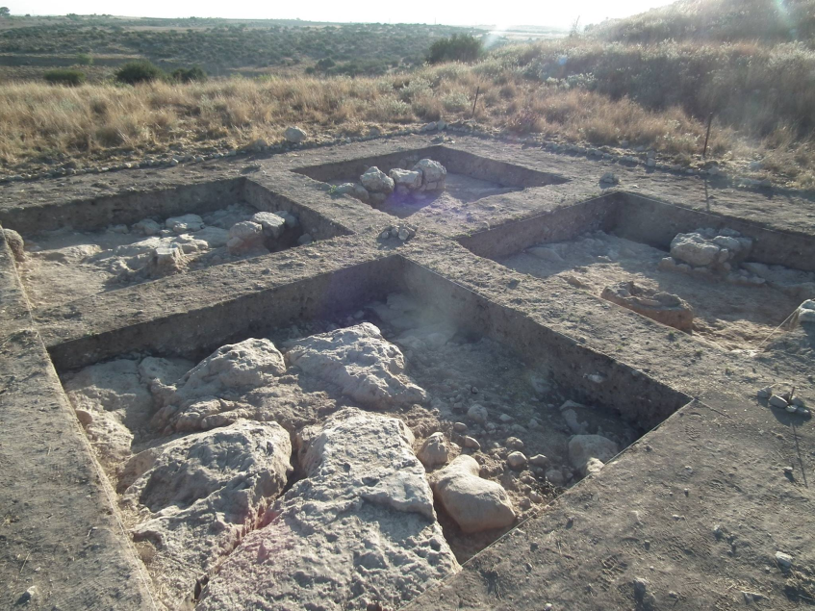
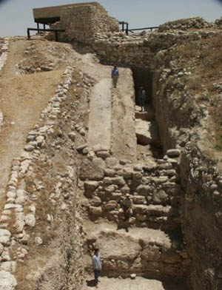
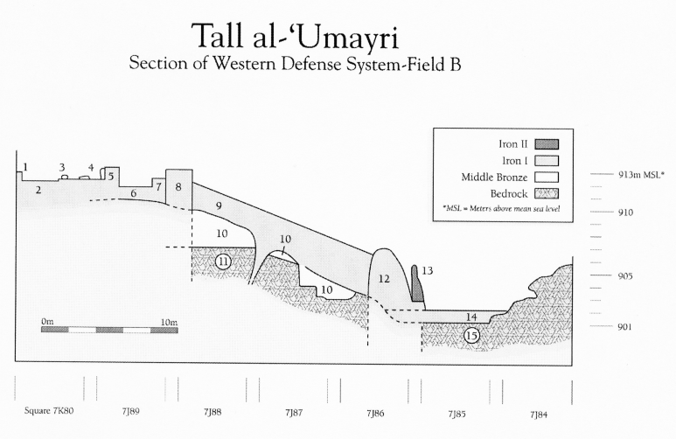
Excavating a Biblical Site
The Architectural (Israeli) method offers broad exposure and total retrieval of pottery and artifacts.
Debris Layers (Wheeler-Kenyon) method provides more control over distinguishing strata or occupational layers.
The use of 6 x 6 meter squares with balk strips provide the ability to view vertical accumulations while you dig.
Trenching: Allows an excavator to cut a slice out of a tell to get a complete history of the site.
Most material encountered on tells is fill, which are haphazard deposits over occupational layers or strata.
Archaeologists love destruction layers and people’s misfortune. They are usually sealed time capsules capturing a dramatic tragic moment in the history of a site, including ash and skeletons.
Naturally, sites mentioned in conquest or building accounts are the logical choices for testing and comparing the archaeological data with the biblical accounts. The conquest accounts of Joshua; the settlement of the Israelite tribes in Canaan; the reigns of David and Solomon; destructions from recorded and unrecorded warfare are all important.

Slide 9
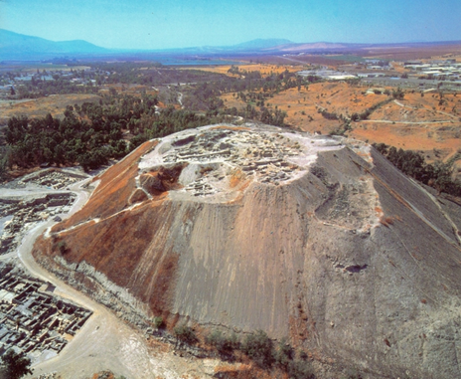
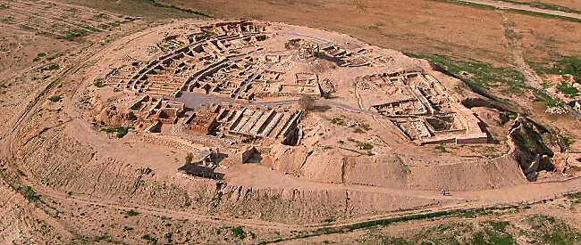
Tells: Mounds of Ruins
Tells or Talls (Arabic) or Tels (Hebrew) are the mounds of built up debris of ancient cities. Beth Shan, where the bodies of King Saul and his sons were hung by the Philistines (top photo) comprises over 30 superimposed ancient cities from well before Abraham to the Roman and early church periods.
Tells are like layered cakes with many occupational levels; latest at the top and the earliest at the bottom. Tells are formed over centuries of occupation (example contrasting modern construction). Sites of cities, such as Jerusalem were intentionally chosen based on Water, defensibility, access to roads, agricultural hinterland.
Beer Sheba (lower photo) is a less impressive tell, but still shows occupational evidence stretching over one thousand years, from the period of the Judges to a Roman fortress.

Slide 10
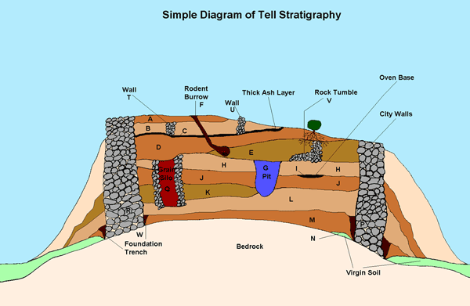
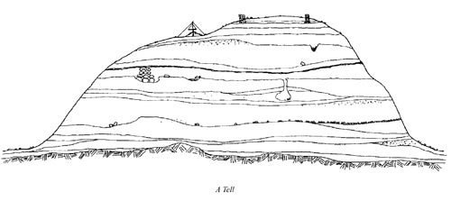
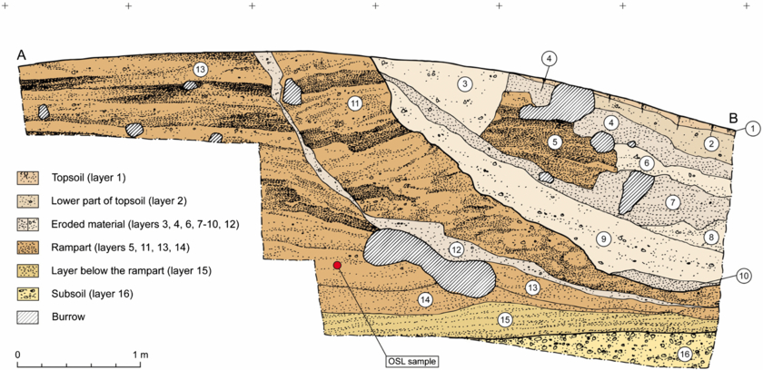
Tells tell Tales: Schematic Examples

Slide 11
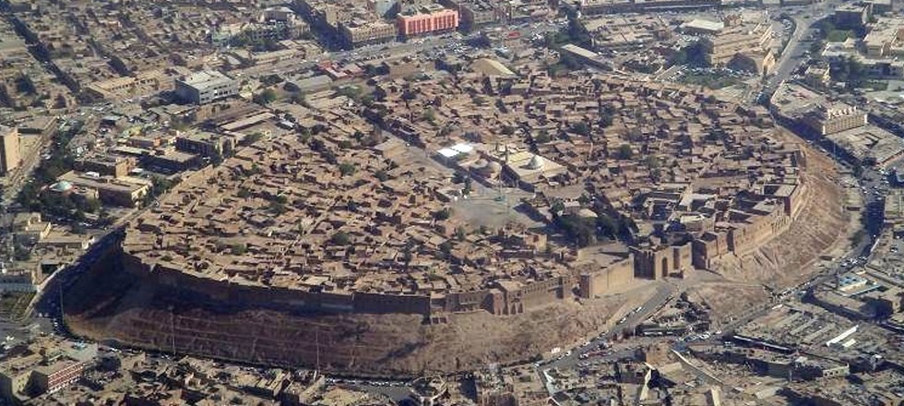
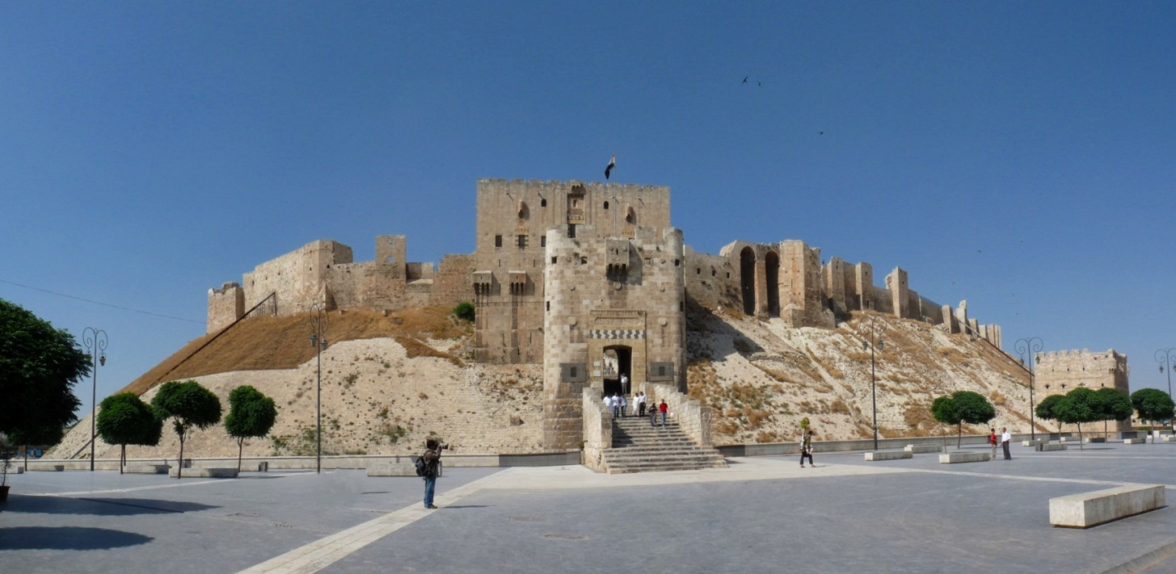
Arbil, Iraq and Aleppo, Syria
Arbil in Iraq provides a fantastic example of what an ancient Old Testament city looked like. Note the sloped glacis of the tell.
The Aleppo “Citadel” was occupied as early as the third millennium BC (before Abraham) and remains a “tell” city today!
Two Modern Day Tells

Slide 12
A Khirbeh or Surface Ruins
Unlike a tel, a khirbeh is a largely surface ruin with shallow deposits and only a few occupational phases.
Below is an aerial view and top plan of Khirbet Safra, near Madaba, Jordan; an Iron I-IIA town site with accumulated deposits of approximately 1 meter.

Slide 13
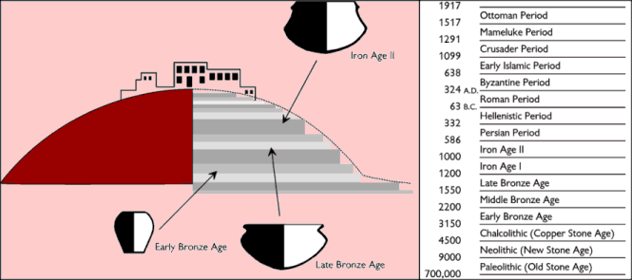
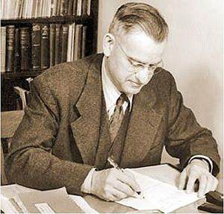
Chronology: The Backbone of History
Edwin R. Thiele (1895-1986) wrote an important book: The Mysterious Numbers of the Hebrew Kings, which used co-regencies and accession dates to harmonize the biblical chronology.

Slide 14
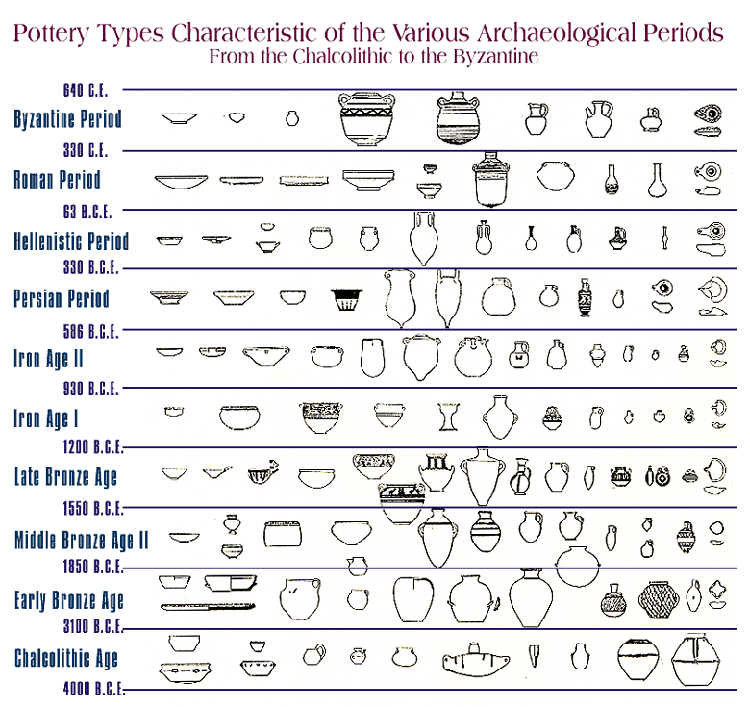
Chronological Table for the Archaeology of the Holy Land
Genesis uses the Hebrew term tōledōt (histories, offspring, genealogies or generations), including the Table of Nations (Genesis 10) to condense and highlight eras or lengthy periods of time from Adam to the Flood and from the Flood to Abraham (Genesis 1-11).

Slide 15
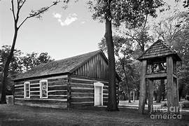
Taylor Memorial Chapel: Through the Eyes of an Archaeologist
Primary and Secondary Source Documents: Gather all historical information available.
Contextual Observations: A comparison of architecture and features with the surrounding buildings. What was the function of the structure (floor plan, objects).
Why was it preserved in this location: An important historical structure with religious significance.
Comparative Age (construction style, artifacts)
Evidence for being remodeled and moved (cement floor, artifacts under the floor, updated materials, electricity, windows, roof)
When was the building occupied (later than latest datable object under the floor, latest object found on the floor).
Taylor Memorial chapel was erected in the late nineteenth century in Union, Michigan and is considered an important part of the early history of the Missionary Church
The chapel was carefully disassembled and moved to its current location on the campus of Bethel University in Mishawaka, Indiana, where it was rebuilt and restored.

Slide 16
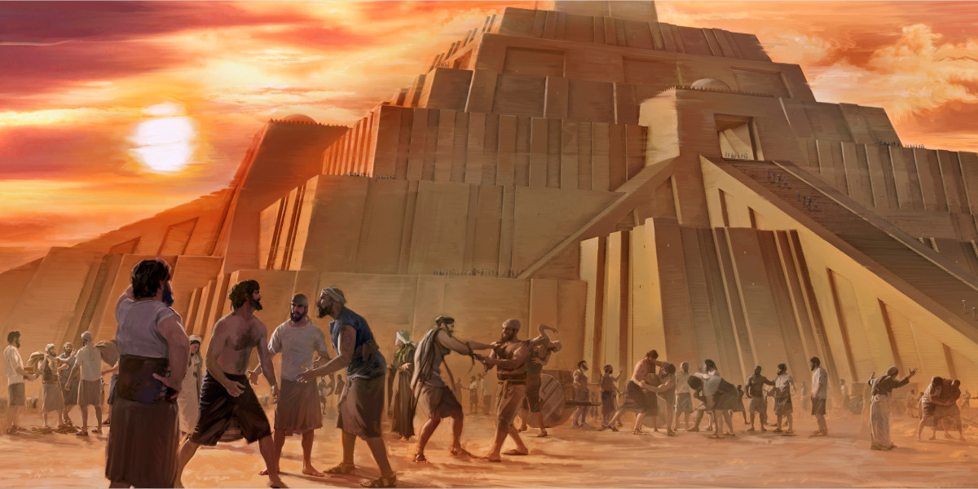
Archaeology and Primeval History (Genesis 1-11)
Several Isolated Finds shed light on the World of Genesis 1-11

Slide 17
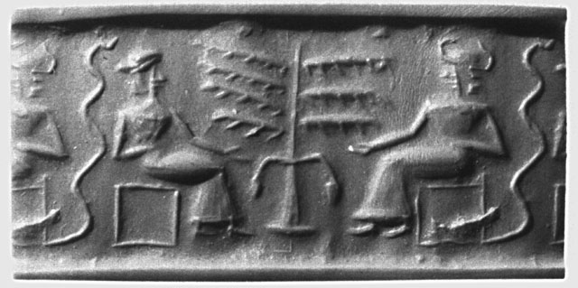
An Early Sumerian Cylinder Seal
What does this cylinder seal, found in ancient Sumer and displayed in the British Museum, represent? It dates to the third millennium BC (ca. 2200 BC)

Slide 18
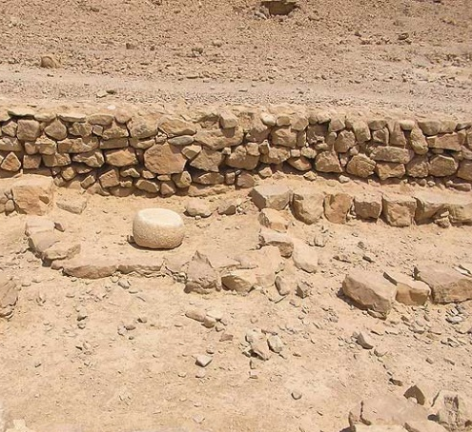
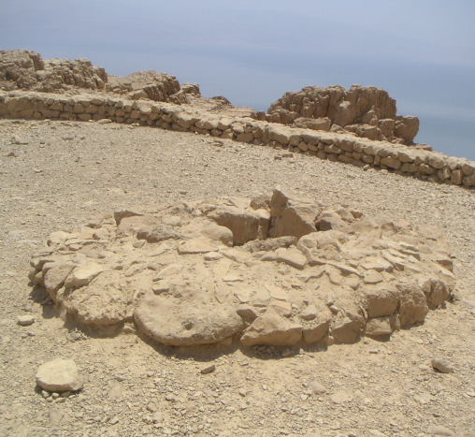
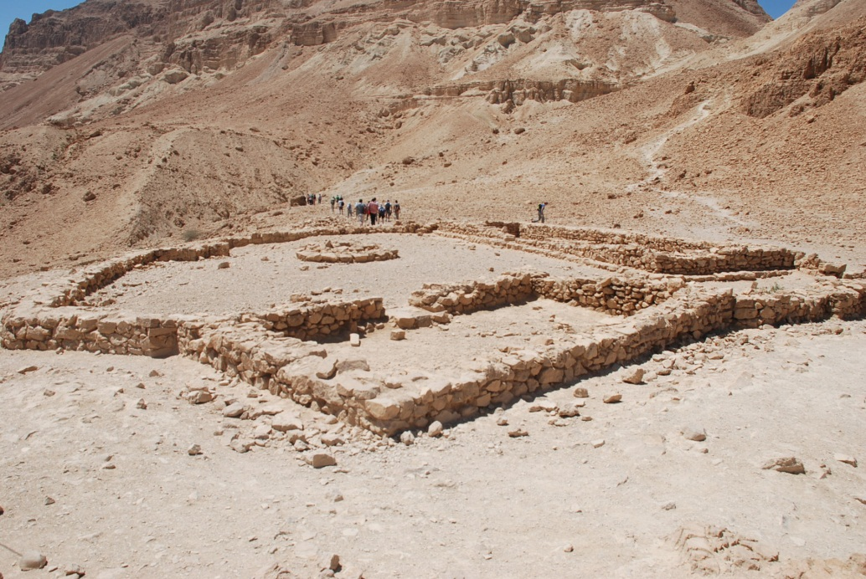
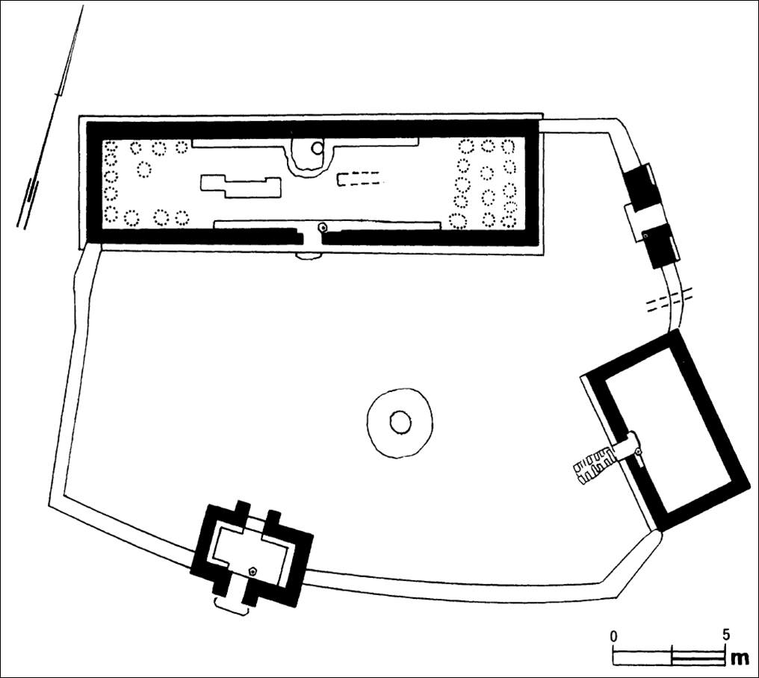
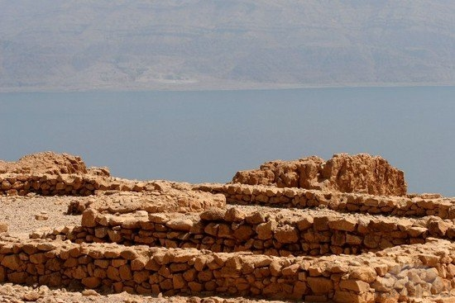
The En Gedi Chalcolithic Temple

Slide 19
Eden as a Biblical Place Name
Can we locate the Garden of Eden? The following two slides illustrate some of the locations scholars have suggested for Eden. For many biblical questions, the answer lies in the name: Eden and the three rivers associated with it: the Pishon, which flows around Havilah, the Gihon, which flows around Cush, the Tigris and the Euphrates (Gen 2:10-14). The location of the last two are known. The Gihon probably refers to the Nile, as it flows through biblical Cush (modern day Ethiopia), but the location of the Pishon was unknown… until relatively recently.
Archaeological surveys of Northern Iraq and Western Iran have documented place names that seem to preserve the name Eden (which means plain or steppe in Akkadian; luxury, abundance, lushness in Sumerian) and may have an ancient association with the biblical Eden. The term “to the east” (Gen. 2:8) seems to support this hypothesis. However, the current political climate in this region has made further research prohibitive.
Archaeologist James Sauer wrote an important article in 1994, reporting that satellite photos of the Saudi desert (taken before and during the first Gulf War), demonstrated the existence of a large and lengthy river that ran across Saudi Arabia in ancient times, from the Hejaz Mountains (biblical Midian) to the Persian Gulf coast at Kuwait. Called the Kuwait River (for lack of a better term) by geologists, this ancient river must have made northern Saudi Arabia a tropical paradise! Genesis 10:29; 25:18 seem to connect Havilah with Arabia, so the Kuwait River may indeed be the biblical Pishon.

Slide 20
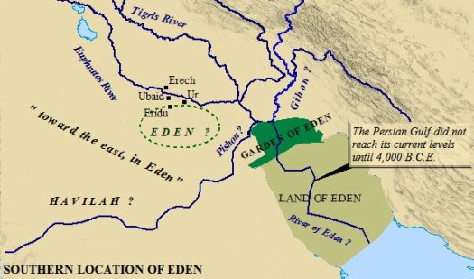
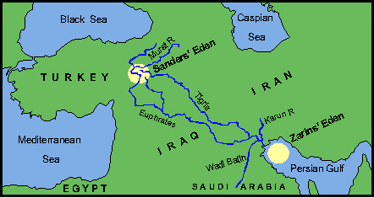
The Location(s) of the Garden of Eden

Slide 21
The Ancient Pishon River… in Saudi Arabia!

Slide 22
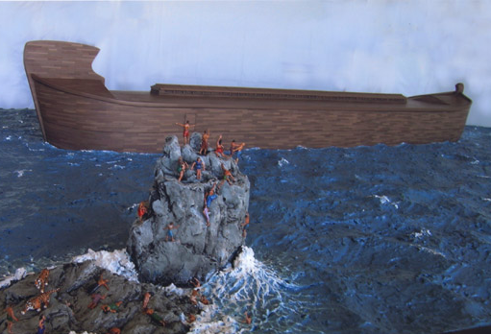
Noah’s Ark and the Flood Account
Genesis 6-9 presents an amazing account of a worldwide flood, survived by only one family and two of every kind of living thing, animal and reptile. While the account is historical, there is theological symbolism as well. The Ark that God commanded Noah to build contained only one door. Entering that door meant life (salvation), while remaining outside meant certain death. For us, Jesus Christ is that one door to life and salvation.

Slide 23
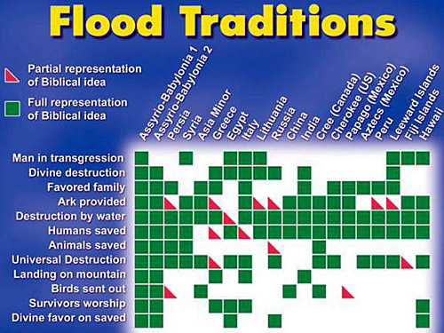
The Global Flood: Genesis 6-7
The Gilgamesh Epic is a Babylonian mythical tale that contains a flood Account on its 11th Tablet: the Story of Utnapishtim and his boat. Certain parallels between the two accounts demonstrate that the biblical flood account was used by the author of the Gilgamesh Epic, which is heavily embellished with pagan mythology
Flood accounts are found in various world cultural traditions and legends, which is not surprising since the memory of such a catastrophic event would have made an indelible impression on all of humanity

Slide 24
Mount Ararat

Slide 25
The Ark on Mt. Ararat (an artistic depiction)

Slide 26
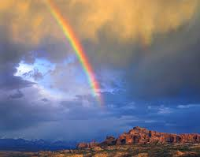
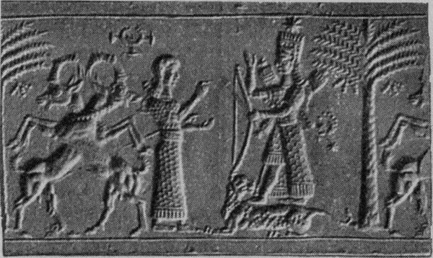
The Symbolism of the Rainbow
In Mesopotamian Iconography, when a covenant is made between a greater party, usually the king, and a lesser party (a subject), the king or greater party is depicted holding an arched bow with the arched side pointed toward him, not the subject. The Rainbow is a beautiful example of a similar covenant between God, the greater party, and Humanity, the lesser party, with the arched rainbow facing towards heaven. This ancient custom of holding a bow in this fashion likely goes back to a time shortly after the flood.

Slide 27
When did The Flood Occur?
Human Culture (walled cities, farming, pottery, limited chiefdoms) began in the Neolithic Period (before 4300 BC)
The Chalcolithic Period (ca. 4300-3300 BC) may represent a pre-flood or Antediluvian Culture. Teleilat Ghassul is a 50 acre site NE of the Dead Sea and occupied the entire period. Clusters of sites in the Beer Sheba Valley, coastal plain, Golan Heights and in the Rift Valley; the peripheral zones. Olive trees grown. Broad Houses and temples were rectangular and long with benches against the walls. Entry along the long side. Pottery shapes included milk churns and cornets and featured rope designs. Copper smelting and artistry was sophisticated as discovered with the Nahal Mishmar hoard, which included mace heads and crown-like objects. Ivory and geometric art was highly developed. Burial customs used pottery ossuaries.
The collapse of the Chalcolithic Culture is a mystery. The sites were abandoned, not destroyed. What happened?
Sir Leonard Wooley’s excavations at Ur uncovered a thick layer of silt that covered the city about 3800 BC.

Slide 28
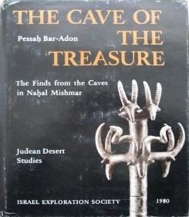
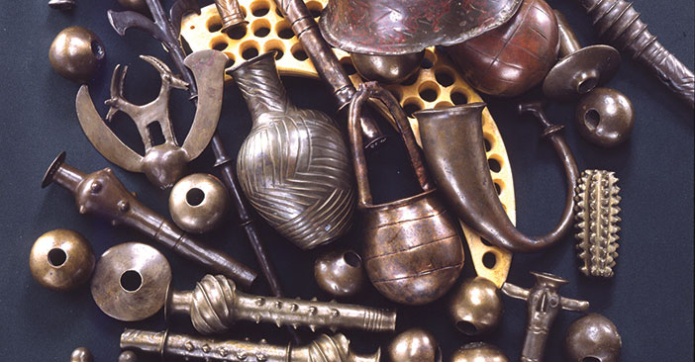
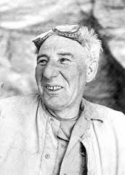
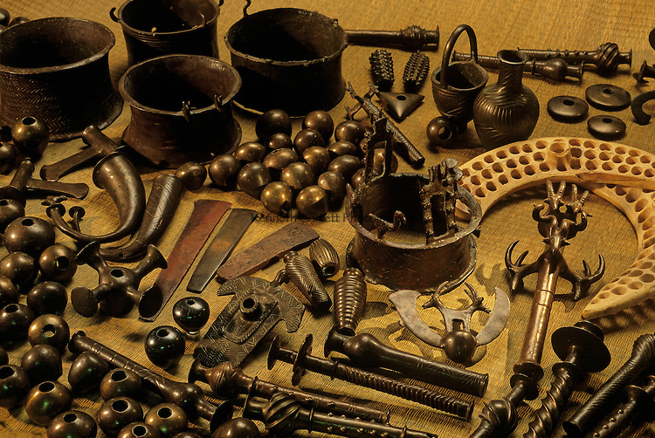
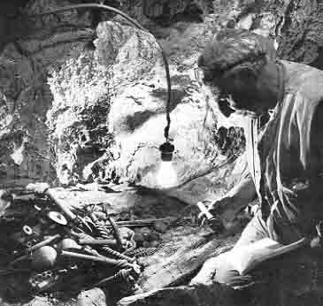
The Cave of Treasure (Nahal Mishmar) and Pesach Bar-Adon

Slide 29
Babbling at Babel! Genesis 11:1-9 as an Anthropological Crux

Slide 30
The Tower of Babel
The Tower of Babel account in Genesis (11:1-9) provides a very entertaining demonstration of God’s complete dominance and sovereignty over Humanity. The entire account is a polemic against Mesopotamian gods and human attempts to get to heaven on their own works and merits (sound familiar?).
The Location is Babylon (babel means the Gate of God or the Gate to God), and the sun dried bricks are characteristic building materials used in the region. The late dictator of Iraq, Sadaam Hussein copied early Babylonian kings, such as Nebuchadnezzar, by stamping bricks with his name. The Tower of Babel clearly refers to an early (perhaps the earliest) Ziggurat, which are artificial stepped mountains of clay similar to the Egyptian pyramids, but usually with a temple at the top (see the following slides).
The play on words here is hilarious. Babel (Gate to God) becomes balal or bavel (confusion in Hebrew).
It is important to note that anthropologists have expressed difficulty in explaining how humans developed languages or how infants and toddlers learn to speak. This account helps us realize that humans are unique creations of God, not simply a species of animal.

Slide 31
The Ziggurat at Ur

Slide 32
An Early Ziggurat in Mesopotamia

Slide 33
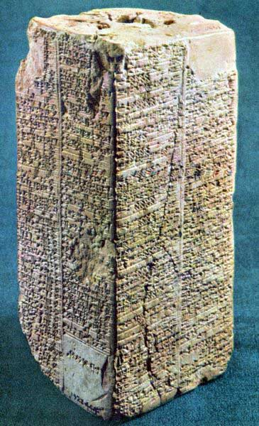
The Sumerian King Lists
The Sumerian culture in southern Mesopotamia flourished between the fourth to early second millennium BC.
Tablets were discovered containing lists of Sumerian kings that had incredibly long reigns (lasting thousands of years) with king lists dating before and after “the flood.”
The long life spans (lasting hundreds of years) recorded in the toledoth (early biblical genealogical lists, notably Genesis 5) seem to parallel the Sumerian records.

Slide 34
Test Page
Class Question: If you were an archaeologist, which biblical Joshua’s conquest of Canaan: The Israelites enter the Promised Land and defeat the Canaanites and destroy at least three cities (Jericho, Ai and Hazor) by burning them. Evidence for this is mixed, causing scholars to suggest other theories (longer period of conquest, peaceful immigration, peasant revolt).
Class Question: The Historical David. The OT portrays David as a mighty warrior and ruler over a large kingdom or regional empire. This has been seriously questioned over the last 20 years. Why? Very little archaeological evidence of his reign. He was not mentioned in other ancient sources.
Spears: Inscribed with names of professional (mercenary) soldiers from David’s time found near Bethlehem, but none of them matched the names of David’s mighty men.
Philip R. Davies:He wrote “In Search of Ancient Israel” in 1992. David is no more historical than King Arthur! If he existed, he was likely a tribal chief, not a king and his “House of David” was more likely a tent.
Tel Dan Stele: In 1993 a fragment of an Aramean stone monument (stele) was found that mentions Aram Damascus defeating the king of Israel and the king of the House of David. This dated about 100 years after David! If his enemies acknowledged him, he existed and was a legitimate threat. Other mentions of David found in Moabite and Egyptian inscriptions. PIC
David’s Palace: In 1995, after carefully reading 1 Samuel (5:9-10, 17), EilatMazar thought she knew where David’s palace was located in Jerusalem. She got the necessary funding and began digging. She uncovered part of a huge building (large stone structure) that she dates to the reign of David. It is poorly preserved and other archaeologists are not all convinced of her findings.PICS
Khirbet Qayafa: A border fortress dating to David’s reign with a Hebrew inscription, pottery and two gates, proving Israelite hegemony over the Shephelah during his reign. Clear assumption that a significant capital city and bureaucracy existed in Jerusalem to organize, build and garrison this border fortress.
Solomon: The site of Solomon’s Temple is (Mount Moriah or Zion) covered by an Islamic shrine built in 690 AD. Digging is forbidden on the Temple Mount (Gaby’s sifting and the Montague Parker story). I Kings 6 gives almost blueprint quality dimensions and construction details of this temple that include architectural terms not fully understood. What do archaeologists do? Look for parallels. Hittite Temples in Turkey and Syria have almost exactly the same floor plan as Solomon’s temple. PICS
1 Kings 9:17-19: Solomon built several cities including chariot cities (Gezer, Megiddo, Hazor, Lower Beth Horon, Baalath and Tadmor [Tamar] in the desert). Large buildings with basins and troughs have been found at several of these sites leading to their being identified as stables.
Elath, Ezion Geber: Solomon’s port on the Red Sea (1 Kings 9:26). Glueck thought it was a small ruined fortress set back from the shore, which he excavated. More likely it is Pharaoh’s (or Coral) Island down the Red Sea coast.PICS

