Slide 1

Using AI in Proverbs Instruction By Ted Hildebrandt biblicalelearning.org

Slide 2
Agenda
Introduction
AI Transcriptions – TurboScribe, Google Translate → MS Word, MS Word Immersive Reader
NotebookLM by Google - Study guide, audio podcasts, video overviews
Gemini Storybook by Google + Chatgot Proverbial stories
Wisdom’s Song – Making music with Suno AI
Avatar short videos – HeyGen
Discussion

Slide 3

Introduction

Slide 4
Helpful Christian Voices on AI
John Lennox [Oxford Math] 2084 and the AI Revolution
Rosalind W. Picard [MIT Media Lab]
Drew Dickens – AI & Spirituality Podcast on Spotify

Slide 5
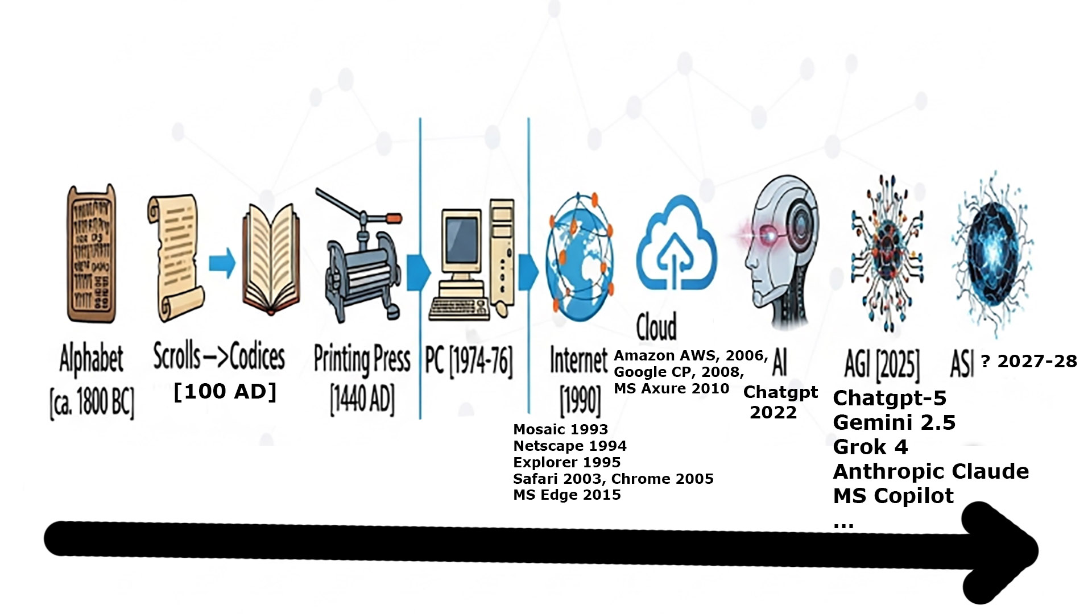
Major Technological Advances

Slide 6
Youtube Learning AI Resources – sources to help keep you up-to-date on AI and Teaching
Futurepedia Channel
Russell Stannard Teacher Training
Kevin Stratvert Channel – former MS engineer
Teacher’s Tech Channel
Boon Ai
Edcafe.ai

Slide 7
Proverbs Case Study – Introducing Biblicalelearning.org [BeL] on Proverbs
https://biblicalelearning.org
OT → Pss & Wisdom → Proverbs

Slide 8
Survey of BeL Proverbs Page Non-AI trad resources
Author Videos Series:
Fred Putnam – 4 lectures
Knut Heim – 20 lectures
Gus Konkel – 22 lectures
Daniel Treier – 4 on Christian Living and Proverbs
Kyle Dunham – 2 on Structure and Theology of Proverbs
Ted Hildebrandt – 7 on how Proverbs is Different than Tanak, Genre, Prov. 26:4-5, Fear of the Lord, et al.

Slide 9
Survey of BeL Proverbs Page Non-AI trad resources
Hebrew Bible Speaker – Abraham Shmuelof & …
Quizlet – over 240 pages of MC quiz questions on Proverbs
Sermon Series by Gordon Hugenberger, Tim Keller
Resource scanned books & articles (TB, JETS)
Internet sources & Videos

Slide 10
Trad research sources often overlooked
R. C. Trench: Proverbs and Their Lessons (1861) – excellent and available on Youtube and full text BeL
Wolfgang Mieder: The Wisdom of Many: Essays on the Proverb, Proverbs: A Handbook, Twisted Wisdom: Modern Anti-Proverbs
Recent Excellent Paremiological sources:
1) Proverbs Within Cognitive Linguistics: State of the Art (2024) 2) Introduction to Paremiology: A Comprehensive Guide to Proverb Studies (2015) – free download

Slide 11
5 AI Tools and How to Use them
TurboScribe AI + Google Translate →MS Word + MS Word Immersive Reader – Why?
NotebookLM [making study guides, podcast summaries- 15 min., video overview 5-7 mins. ] – Why?
Google’s Gemini Storybook + Chatgpt [making proverbial stories] – Why?
Suno AI [making music – Wisdom’s Song] – Why?
HeyGen – Making Youtube Video Shorts via Avatars and lip-synching – Why?

Slide 12
5 AI Tools and How to Use them
Presentation Structure for each AI tool set:
1) Example: shown in BeL of how AI was actually used
2) Tools: Name and URL
3) Process for Developing Demonstrated
Notes provided have all the details, so you can relax and enjoy
This PowerPoint is also posted on BeL opening “Welcome” page

Slide 13

Video Transcriptions using AI
BeL Example: Daniel Treier’s 12 language Section Proverbs – Heim, Putnam, Treier, Dunham, Konkel, Hildebrandt - rationale
3 Tools: 1) https://www.turboscribe.ai/dashboard
2) https://translate.google.com → MS Word Review → Translate → Translate Document → Pick Language
3) Microsoft MS Word → View → Immersive Reader → Read Aloud

Slide 14
Transcription/translation Process
TurboScribe AI: STT [Speech To Text] https://www.turboscribe.ai/dashboard
Video/audio input → output transcription [*.docx]
Click on Blue Button: “Transcribe Your First File” – input many
Click on “+” sign → search for mp3 audio or video file OR import a link [paper clip upper right]
Select “Whale” – Most Accurate
Click “Transcribe” button

Slide 15
Transcription/translation Process
TurboScribe AI:
Click three ellipsis dots “…” on right to “Export”
Pick “Export as DOCX” and click the Download button
Should download to your Download folder in Windows
Spent 30-40 minutes running transcription through Grammarly making corrections

Slide 16
Transcription to 12 languages Process
Google’s Translate: https://translate.google.com - limits MS Word → Review → Translate → Translate Document → Pick Language -- free/unlimited/easy
Select “Documents”
Select File (*.docx) from English: Input → Browse to your English version you just transcribed
Select Language to go to: Chinese, German, French, Spanish…
Click the “Translate” button → then “Download translation”

Slide 17
Text to Speech [TTS] in 12 languages Process
Go to Microsoft Windows Settings → Open “Time & Language”→ “Language and Region” → “Add a Language” → Enable Text to Speech for the language you want.
Open Now Smart Audio Recorder – split screen with MS Word
Word: Open Spanish Document: MS Word → View → Immersive Reader (2x) → Read Aloud (after recorder started)
Now Smart Audio click record button
Word click the Read Aloud and let it go for 1 hour recording.
Stop the recording and save it on your computer

Slide 18
NotebookLM: Study Guides, Podcasts, Video Overviews
BeL Example: Knut Heim Proverbs – study guides, podcast summary, Video Overview Proverbs – Heim, Putnam, Treier, Dunham, Konkel, Hildebrandt
Tool: Google’s NotebookLM – Amazing tool! 1) https://notebookLM.google.com

Slide 19
Process of working with NotebookLM
https://notebookLM.google.com
“Create New” button to make a new Notebook
Dashboard: 3 columns:
Left Input Sources Column [can load 50 multi-modal sources, and it will give you an abstract, study guides, podcast summary, Video overview] I just input 1 source – transcription of the video
Middle Chat Column: – abstract made automatically, ask questions like “Produce 5 FAQs with answers,” “Make 10 MC questions with answers and sources. “ copy/paste results into MS Word.

Slide 20
Process of working with NotebookLM
Left Studio Column: Reports – Briefing Document, Study Guide, can also do Core Concepts, Explanatory Notes, Scholarly Review, Mind Maps, Quiz-Interactive with Instant feedback, Flashcards.
I use it for Briefing Document, Study Guide, FAQs (from Chat), Podcast summary (15 mins.) and Video Overview (5-7 mins.)
NB: Settings pencil → can output in many languages – Kyle Dunham outputted the podcasts in 12 languages. Proverbs – Heim, Putnam, Treier, Dunham, Konkel, Hildebrandt

Slide 21
Google’s Gemini Storybook: Making Proverbial Stories
Example: 3 examples Prov. 27:1 – One proverb in many situations Proverbs – Heim, Putnam, Treier, Dunham, Konkel, Hildebrandt
Tool: Chatgpt https://chatgpt.com [for making the storyline text] and Gemini’s Storybook for illustrations https://gemini.google.com/ - When you get to Gemini, click the hamburger menu [upper left]→ Storybook [readkidz and videoexpress, other options]

Slide 22
Process for Building a Proverbial Story
Chatgpt – to write the storyline plot and characters https://chatgpt.com
Prompt: “Write a 500-word creative story built on Proverbs 27:1 “Don’t brag about tomorrow, since you don’t know what the day will bring.” Cite the proverb itself in the story.” [optional: put it in a family, business, or school context for teenagers, young adults]
Chatgpt https://chatgpt.com
I’ll often do that prompt 3x using different contexts and pick the best story.
Cut / Paste into Word for editing. Save as pdf.

Slide 23
Process for Building a Proverbial Story
Open Gemini 2.5 → : https://gemini.google.com/ Click hamburger menu [upper left] → Storybook to develop storybook with illustrations
Storybook prompt: “Develop a storybook exactly word-for-word based on the text from the attached pdf document. Use Anime Art Style for the illustrations. Give it the Title “The Last Boast of Eli Brighton – Proverbs 27:1”. Make it 17 pages long. Make sure the last two pages follow exactly word-for-word the text of the attached pdf document.”
Click “+” button to attached the pdf document → click the arrow head on the right to “Submit” and wait 5-10 minutes.

Slide 24
Process for Building a Proverbial Story
Make corrections that are needed by prompting corrections and running it again.
Correction Prompt: “Keep the storybook exactly the same except for these three changes: 1) Split page 16 into two pages”, 2) on page 16 change the text “Proverbs 10:12” to Proverbs 10:11”, and 3) on page 10 have the illustration of Zoe have only two arms instead of three.”
Often have to do corrections 2-4 times to get it “right”
Click “Listen” to listen to it and flip through pages

Slide 25
Process for Building a Proverbial Story
Recording the storybook using Prt Scr [Print Screen function button] → Select Video Camera icon
Then select the area you want to record – drag + sign around
Hit the “Start” button to record, wait until countdown is over and then click the “Listen” button in the Storybook program
Wait 3-4 minutes to record → then hit the Stop to stop recording It saves it automatically onto your computer → videos folder → Screen Recording Folder → move to the folder where you want it
Edit it in a video editing program (e.g. Adobe Premiere trimming beginning and end) → Post on Youtube.

Slide 26
Making Music with Suno AI
Example: Wisdom’s Song – based on Proverbs 1:20-22; 2:4-5; 9:1-6, 10 https://biblicalelearning.org/elementor-97330/#Wisdoms_Song or on Youtube: https://youtu.be/E0NphVcdE5A
Tools: Suno AI [ https://suno.com ] makes the music + Chatgpt help refining lyrics

Slide 27
Process for Making Music using Suno Ai
I made initial lyrics using first listing verses [ESV/NLT]: Prov. 1:20-22, 2:4-5; 9:1-6, 10 Madame Wisdom Speeches → Organize it into Verse 1, Verse 2, Verse 3, Verse 4, Chorus
Put it into Chatgpt and told it to enhance it into a song – it added rhyming et al.
Spent a week or so messaging, editing, and enhancing the lyrics
Drop the lyrics into Suno AI -- https://suno.com
Set the style: “Country-influenced Soft Rock, Acoustic guitar, light drums, Advance settings: male voice – exclude fiddle

Slide 28
Process for Making Music
Made AI music in several different styles: rhythm and blues, acapella, orchestra choir, Motown (for my kids)
Ellipsis […] to left of song to Title it and Download the mp3 music file
Developed images in Photoshop (Edit → Generate) by telling it what I wanted [Gemini was a better option – Nano Banana] Google Gemini https://gemini.google.com/app
Imported the mp3 music file into Adobe Premiere video editing and added pictures → rendered the video and uploaded video to Youtube.
Posted mp3 file and Youtube video link on BeL

Slide 29
Making Talking Avatars for making 60 second Youtube shorts
Example: Be, 3 hrs. → 60 seconds https://biblicalelearning.org/elementor-97330/#TedHildebrandt
Tool: https://HeyGen.com
Process: Login
Dashboard: Have script ready from NotebookLM Abstract – copy it
“Create” button → Quick Avatar Video
Pick an Avatar Person → Pick Look
Click Next → Add Script from NotebookLM
Select a Voice (lower right)
Preview – to hear voice
Give it a title, Submit → Generate Video
Download video → post on Youtube

Slide 30
Discussion
What are your thoughts and questions?
How are you using AI currently? What tools have been useful?
What can you envision for the future possibilities?
What issues are you having with it currently?
What problems do you anticipate? How will you deal with those problems?

Slide 31

Thank you
Ted Hildebrandt
ted.hildebrandt@gordon.edu
https://biblicalelearning.org

Slide 32
Invitation to Lecture for BeL
Most of the biblical book surveys are covered. Need specialized studies in … Biblical Books and Topics
I travel to your place – so no travel time lost for you
Pay: ca. $150/hr. – shoot 4-5 lectures/day ($600-750)
Post on Youtube and Biblicalelearning.org add 12 languages and all this AI stuff.

