Slide 1
Galatians

Slide 2
Galatian Churches
Visited them when he was sick
Harsh rebuke -- tone
Autobiographical – he is an apostle
Reception – enthusiasm but
Composition – Handwritten
Audience – Uncircumcised

Slide 3
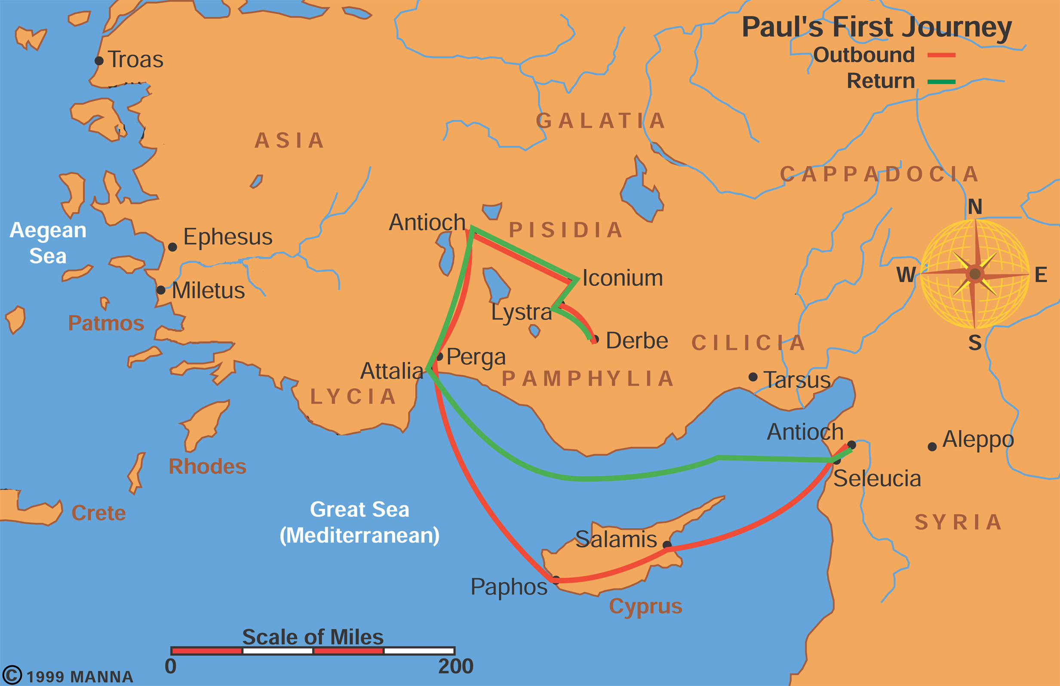
Paul’s First Missionary Journey

Slide 4
N/S Galatian theory
North Galatia
South Galatia

Slide 5
Themes of Galatians
CLLL WWWRF
Law
Circumcision
Liberty -- Christian Liberty
Love neighbor –5:14
Women – Gal. 3:28
Weary in well doing – 6:9
Weaker brother – 6:1
Reap what you sow – 6:7
Fruit of Spirit

