Slide 1
1 Corinthians

Slide 2
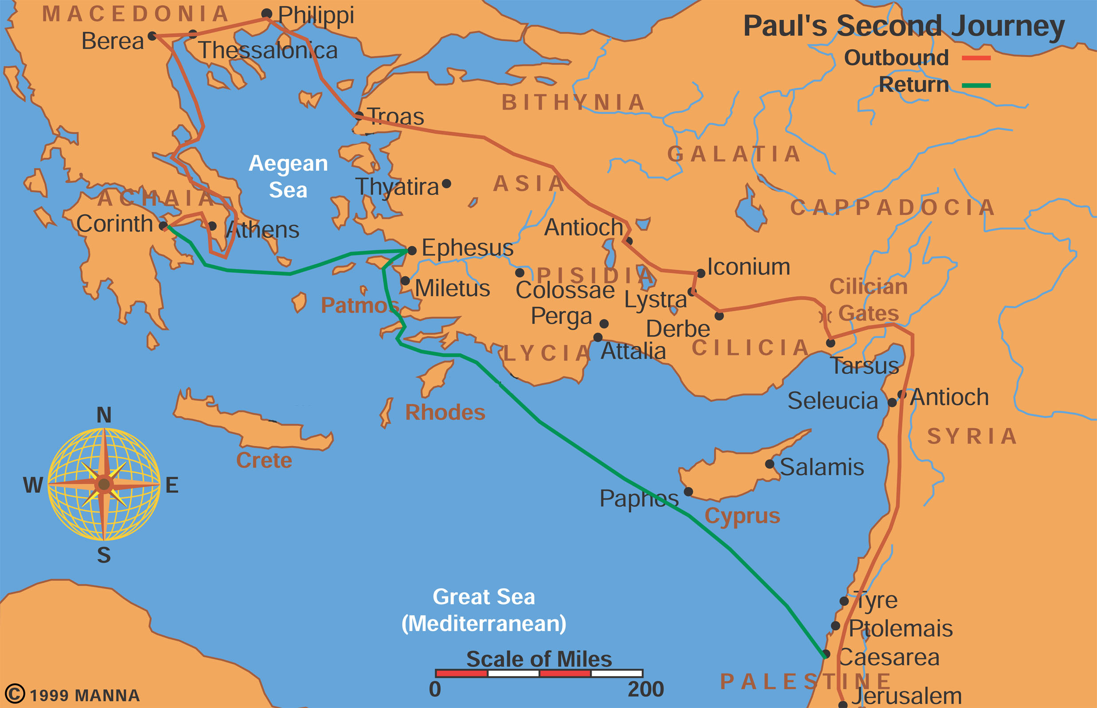
Paul’s Second Missionary Journey

Slide 3
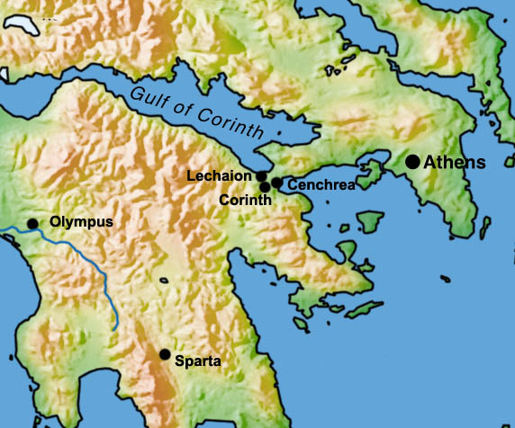
Corinth-Athens map

Slide 4
City of Corinth:
Does Location impact a church?
Does History impact a church?
Does commerce impact a church?
Does the origin of its inhabitants impact a church?
Does culture impact a church?--Roman
Do local morals and religion impact a church?

Slide 5
Church at Corinth
Paul as Founder—2MJ
3 Archaeological finds: bema, Erastus, inscription, Jewish Lintel inscription
Occasion of letter writing:
  Previous letter (1 Cor 5:9);
  Oral 1 Cor. 1:11
  Written 1 Cor 7:1

Slide 6
What were the Church Problems?
Deep sin in past—ch. 6
Lord’s supper—ch. 11
Remiss in Disciplining—ch.5
Factions—ch. 1, 3, 4
Idol-Meat—ch. 8
Lawsuits—ch. 6

Slide 7
Key Issues in Corinthians
Marriage or Celibacy?—ch. 7
I say not the Lord: 7:12
Head Coverings—ch. 11
Woman speaking in Church—ch. 14
4 Principles for handling cultural issues
  Is it a moral principle or cultural practice?
  Are there contextual indicators?
  Is Scripture diverse on the subject?
  What is the deeper principle?

Slide 8
Key Issues in Corinthians
Delivering to Satan—ch. 5
Baptism for the Dead—ch. 15:29
  Vicarious baptism; Mormons
  In place of the dead—replacement
  Heretical view: What will “they” do
  Because of the dead:
  Stephen’s death → Paul’s baptism
  Baptized in anticipation of the dead in hope of resurrection

Slide 9
Other Important Points
What is the chief end of humans?—10:31
One Step principle—10:12f
Love chapter—ch. 13
Resurrection chapter—ch. 15
  Connection of story and history:
  Modernism: history=facts; story=fiction
  Post-modernism: It’s my story, facts irrelevant
Body as temple 1 Cor 3:16; 6:13

Slide 10
2 Corinthians– Major issues
Lost Letter? (I Cor. or Tear letter, or 2 Cor 10-13)
Forgiveness of Sinner—2:7
Old Glory – New Glory – Weight of Glory -3:17f
Glory in jars of clay (already/not yet tension)
Transparency
Separation from Evil
Requests for money – cheerful giver
Satan as an angel of light
Paul’s “Boasting”—Paul’s thorn in flesh

