Slide 1
Acts
– The Church Goes Forth

Slide 2
Canonical Importance of Acts

Slide 3
Plan of the Book: Acts 1:8
But you will receive power when the Holy Spirit comes on you; and you will be my witnesses in Jerusalem, and in all Judea and Samaria, and to the ends of the earth.”
Jerusalem – Judea 1-7
Judea – Samaria 8-12
Uttermost Part 13-28

Slide 4
Missionary Mission Field Base Chs.
Peter – Stephen Judea Jerusalem 1-7
Barnabas –Philip Judea-Samaria Judea 8-12
Paul Uttermost Antioch 13-28

Slide 5
Selection of Materials - How do you write history?
Omissions:
  1) Paul’s 3 yrs. in Arabia-Gal. 1:17;
  2) Mark/Barnabas to Cyprus,
  3) other 12 apostles—e.g. Thomas → India, Mark to Egypt
Summaries key transition points and opposition highlights: 2:42; 6:7; 9:31; 13:46-50, 17:1ff, 22:23
Jews trouble –13:46, 50; 14:1-2; 22:23

Slide 6
What was the early church like? -POPU
Prayer – when do people pray? 2:42
Organization – simple – ADEP
  Apostles -- Acts 1: 12 (Matthias)
  Deacons -- Acts 6: Stephen
  Elders/Overseers/Pastors: Acts 20:17, 28
  Prophets/prophetesses: Acts 11:27f; 21:8f
Providing for physical needs: 2:45; 4:32ff.
Annanias and Saphira (Acts 5) Today?
Unity: Acts 2:44

Slide 7
What sources did Luke use?
Not present for Acts 1-15 personally
With Paul during Caesarean imprisonment
Travel diary during some of the Missionary journeys
Stephen’s speech from Paul (Acts 7)
Peter’s speeches and I Peter:
  set purpose and foreknowledge, Acts 2:23 // 1 Pet 1:2
  silver or gold, Acts 3:6 // 1 Pet 1:18
  judge of the living and the dead. Acts 10:42 // 1 Pet 4:5

Slide 8
Details
Peter and Paul paralleled (Witherington)
Peter Paul
2:22ff 13:26ff both preach resurrection
3:1ff 14:8ff both heal cripple person
8:17 19:6 both lay hands on & H.S.
5:15 19:12 special healing, crowds
12:6ff 16:25ff both angel freed from jail
Emphasis in the Book: 3 conversions of Paul, 3 stories of Cornelius’ conversion, 3 stories of Paul’s trial…
Contradiction: Judas field/death (Acts 1:18//Mat 27:5ff)

Slide 9
Did Luke really write this book?
“3 We” passages:
  2MJ Troas to Philippi,
  3MJ Philippi to Jerusalem (2 yrs. In Israel while Paul in Prison)
Journeyed to Rome with Paul: Acts 27
2 Tim 4:11 Luke with Paul during Roman imprisonment
Vocab and Style=Luke
Theophilus Lk 1:1-4; Acts 1:1

Slide 10
Why did Luke write it? CHAMPSS
Catechetical Instruction for Theophilus
History: Not a complete history of church
Apologetic –meet charges of Jews:
  Why were Christians persecuted? Atheists, incest, cannibals
Missionary concern—gospel fulfillment “to all peoples”
Paul’s Defense –help from Theophilus?
24 speeches: 9 Peter; 9 Paul, Stephen ch. 7
Spirit coming 4x on different groups

Slide 11
When did he write it?
63 AD—Why? 2 silences
  No outcome of Paul’s trial in Rome (63 AD) or mention of his death (ca. 68 AD)
  No mention of the destruction of the temple (70 AD)
View of Rome favorable—Nero (54-68 AD; Rome fire 64) not yet bad

Slide 12
Is Acts normative for modern church?
Acts as an historical document: What is the difference between historical and normative material? Indicative versus Imperative? A record of what happened versus what should happen (“is” versus “ought”)?
Descriptive versus prescriptive
Examples of non-normative material:

Slide 13
How do you tell what is historical or what is a universal principle?
4 Approaches
Then = now (miracles and all)
Then =/= now: Dispensational Approach – Acts transition (cessationists)
Epistles versus Acts/Gospels:
epistles normative; Acts—particular history;
canon in a canon idea
Acts as a historical document – Distill principles

Slide 14
Pentecost—Acts 2
Background discussion
On what basis do I judge whether something is from God?
Is experience always the best guide for making decisions?
Bible as sole judge of spiritual experiences
Is Acts 2 normative?
3 Pilgrimage feasts

Slide 15
Acts
3 Signs of Spirit’s coming 2:2: wind, fire, tongues
What is the baptism of the Spirit? 1 Cor 12:13
Second level of holiness? Judas did miracles Mt 10
Purpose of tongues in Acts 2: foreign language, charge of drunkenness?
Careful -- No NT yet
  Second Blessing idea –got Christ but not got it all
  Instant spirituality
  External sign dependence
  Not taught to seek it
Who never spoke in tongues: Christ, Wesley, Spurgeon, Luther ...
Purposes of tongues in Acts 2—2:38

Slide 16
Other groups in Acts & Holy Spirit
8:17 Samaritans receive the Holy Spirit
10:44 Cornelius (Gentile receives H.S.)
19:2-6 Jn Bapt. disciples receive Holy Spirit

Slide 17
What about the Corinthians passages?
1 Cor 14:2 sitz im leben
1 Cor 14:22f: prophecy and tongues
3 Guidelines: I Cor 14:27-28
  One at a time
  2 or at most 3
  Interpretation must be given

Slide 18
God’s use of Language
God speaks the language of the people
[Hebrew, Aramaic, Greek]
Linguistic analysis of “tongues”
Respect with Differences

Slide 19
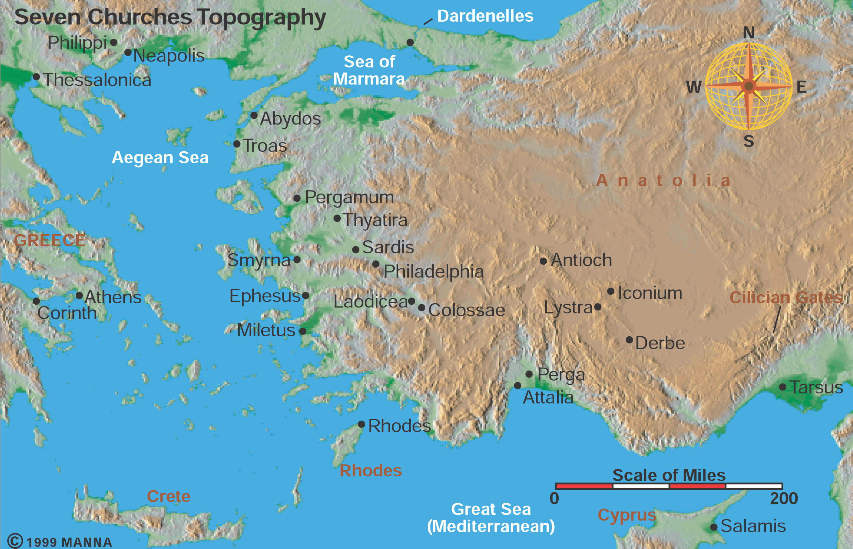
Revelations-Seven Churches topo

Slide 20
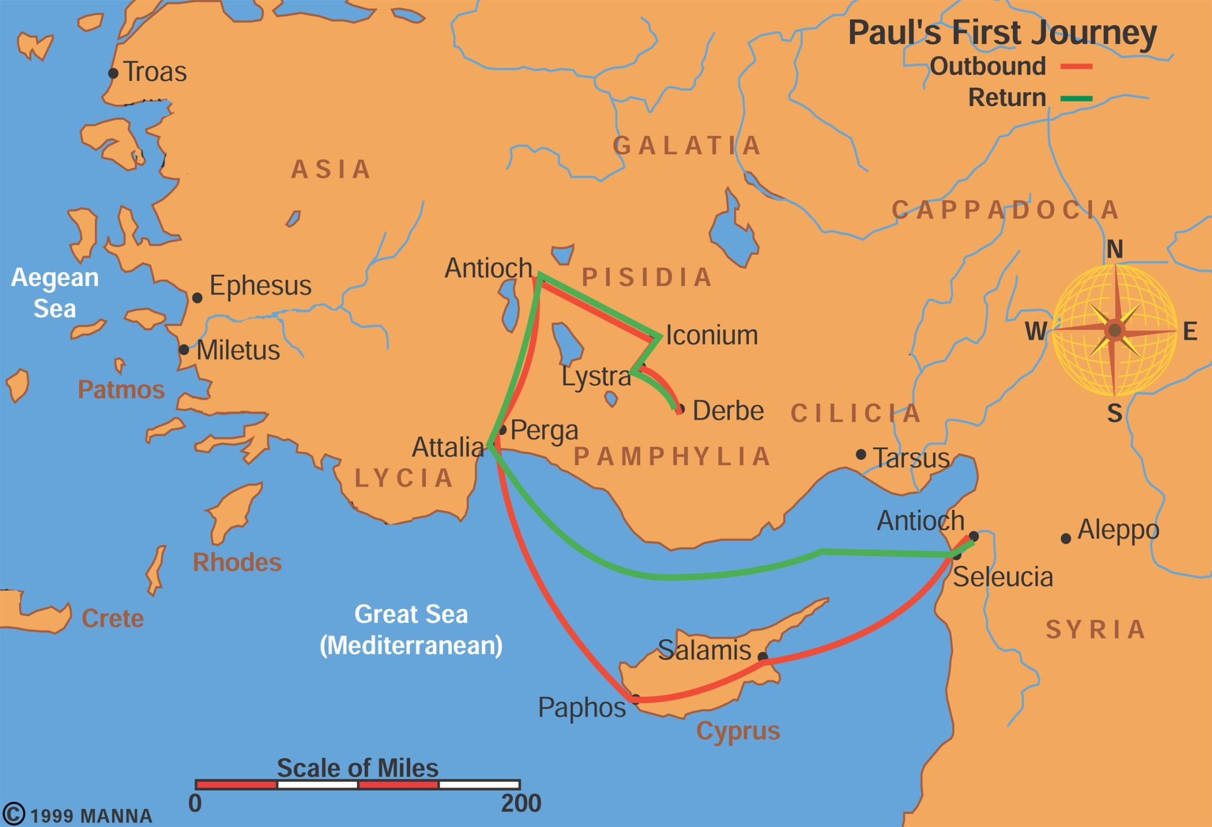
Paul’s First Missionary Journey

Slide 21
Missionary Journeys
1MJ 48-49 AD Cyprus – central Asia Minor
What 3 levels are there to the Christian call? (Acts 13:2f)
Antioch to Cyprus-Bar Jesus (Acts 13:6ff)
  What convinced Sergius Paulus to believe?
  Do God’s miracles always heal?
Perga—John Mark quits (Acts 13:13)
  Why did John Mark quit?
  How have you reacted to betrayal?
  Why is trust hard to rebuild?
Antioch in Psidia-synagogue, Jews jealousy (13:44ff), turns to Gentiles,
  How does jealousy creep into a church?
  What does 13:48 mean--as many as appointed?

Slide 22
1 MJ: 48-49 AD
Iconium: Acts 14:1ff: Proclamation, believe/unbelief, plot, fled
  Is there ever a time to flee a situation?
Lystra: Acts 14:8ff
  Heals cripple
  Made gods? –Zeus, Hermes
  Stoned and left for dead
  Timothy
  What does this show us about fickleness of public opinion?

Slide 23
1 MJ: 48-49 AD
Derbe: concluding summary—Acts 14:22—many hardships to enter kingdom
Why does the kingdom grow through hardships?
What does that suggest about marketing Christianity by selling success, peace, etc.?

Slide 24
Paul’s First Missionary Journey

Slide 25
Jerusalem Council (50 AD)
Gentiles → Jews (circumcision)→Christians?
or Gentiles → Christians
What are the basics for one becoming a Christian? You must do _______ (Acts 16:9)
Why?–no blood, sexual immorality, idol meat.
Paul writes Galatians most likely back to 1MJ churches in Galatia

Slide 26
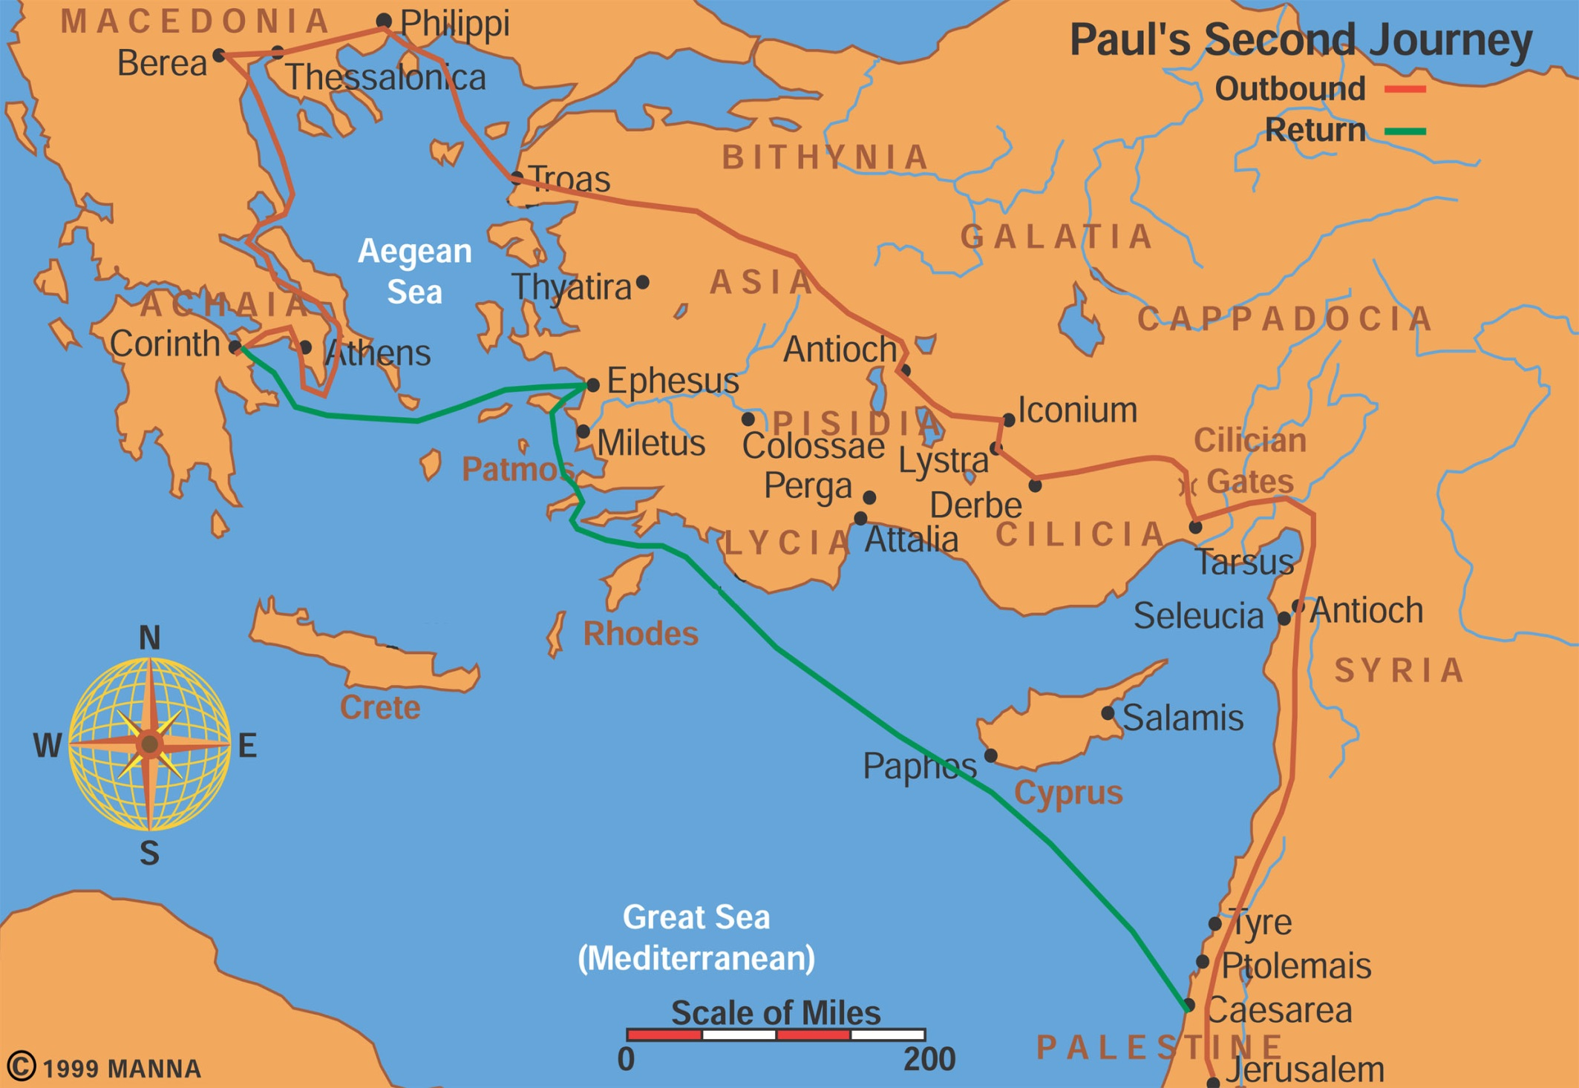
Paul’s Second Missionary Journey

Slide 27
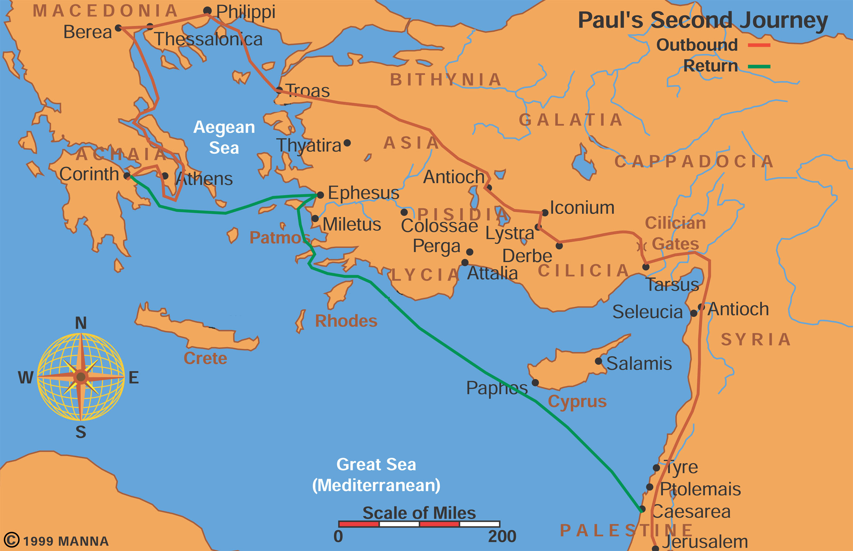

Slide 28
2 MJ Paul and Silas (AD 50-52)
Dispute over John Mark (Barnabas); Paul/Silas
Lystra: stoned →Timothy (Acts 16:1)
Question: After the Jerusalem council why did Paul circumcise Timothy?
Troas: refused into Asia,…Macedonian call
Following God’s leading contrary to our plans
When did Luke join? “we’s” start at Troas→Philippi

Slide 29
2MJ – Macedonia → Philippi
Philippi: Lydia, seller of purple from Thyatira
No synagogue, --Jews?
Slave girl→ jailed and singing
Philippian Jailor’s question—What must I do to be saved? (Acts 16:30, cf. 2:38)
Question: What does it mean to believe?

Slide 30
2 MJ: 50-52 AD
Thessalonica: synagogue custom,
Why so much negative on Jewish jealousy reaction?
Jason’s house
Berea: noble, searched the Scriptures
Athens:
Idols→ unknown God,
Paul quotes Epimenides/Aretas: knowing Philosophy and other disciplines
Must we believe before we can know (presuppositional) or can our knowing lead us to belief (evidences)?
How do we use post-modern culture to proclaim Christ?

Slide 31
2 MJ: 50-52 AD
Corinth:
  Priscilla/Aquilla—Claudius kicked Jews out of Rome; tentmaking
  Crispus synagogue leader believes
  Sosthenes the accuser of Paul--beaten
  Gallio proconsul favorable—dismisses charges
  Stays 1.5 years, Apollos
  writes 1 & 2 Thess. (after Timothy/Silas brought down support)

Slide 32
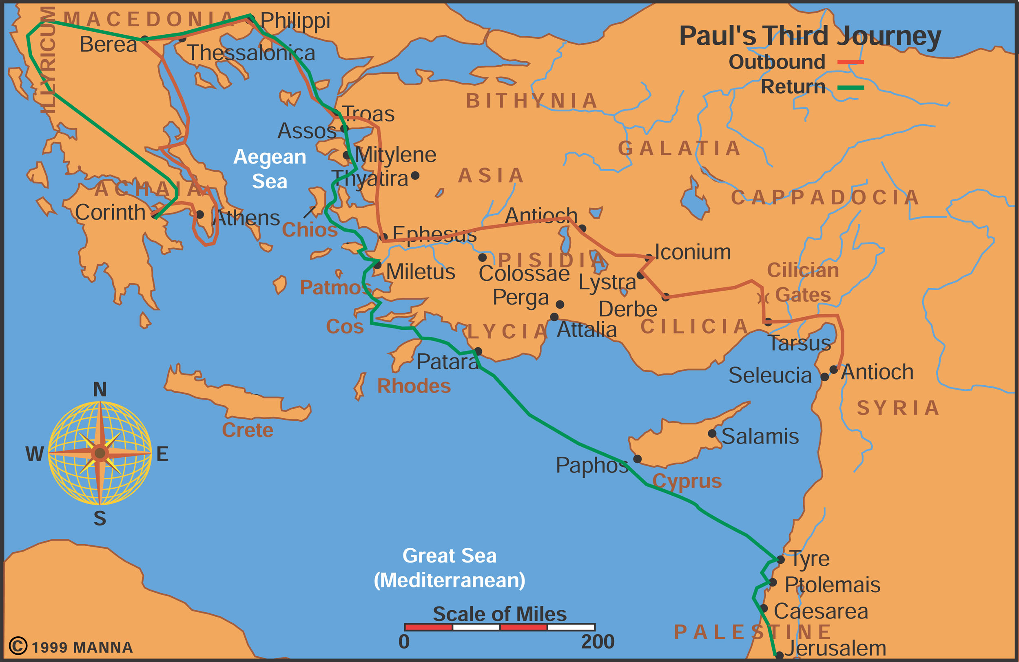
Paul’s Third Missionary Journey

Slide 33
3 MJ – AD 53-57
Ephesus 3 years: 1 Corinthians written (Acts 19)
  John Bapt. Disciples receive Holy Spirit,
  magical books burned,
  Demetrius’ riot; money and religion;
  how does religion fares in the public square?
Revisits Macedonia—2 Corinthians written
Corinth—Romans written west –going east
Revisits Macedonia and Asia, Eutychus
Heads back to Jerusalem—gift for poor in famine

Slide 34
Trials
Jerusalem riot: Agabus, citizenship
Felix: procrastinator, 2 yrs., bribe
Festus: please Jews, trap, appeal to Caesar
Agrippa: knowledgeable, almost
Ship wreck on Island of Malta, snake
1st Roman Imprisonment (AD 60-62)
Freedom
2nd Roman Imprisonment (AD 67-68)

Slide 35
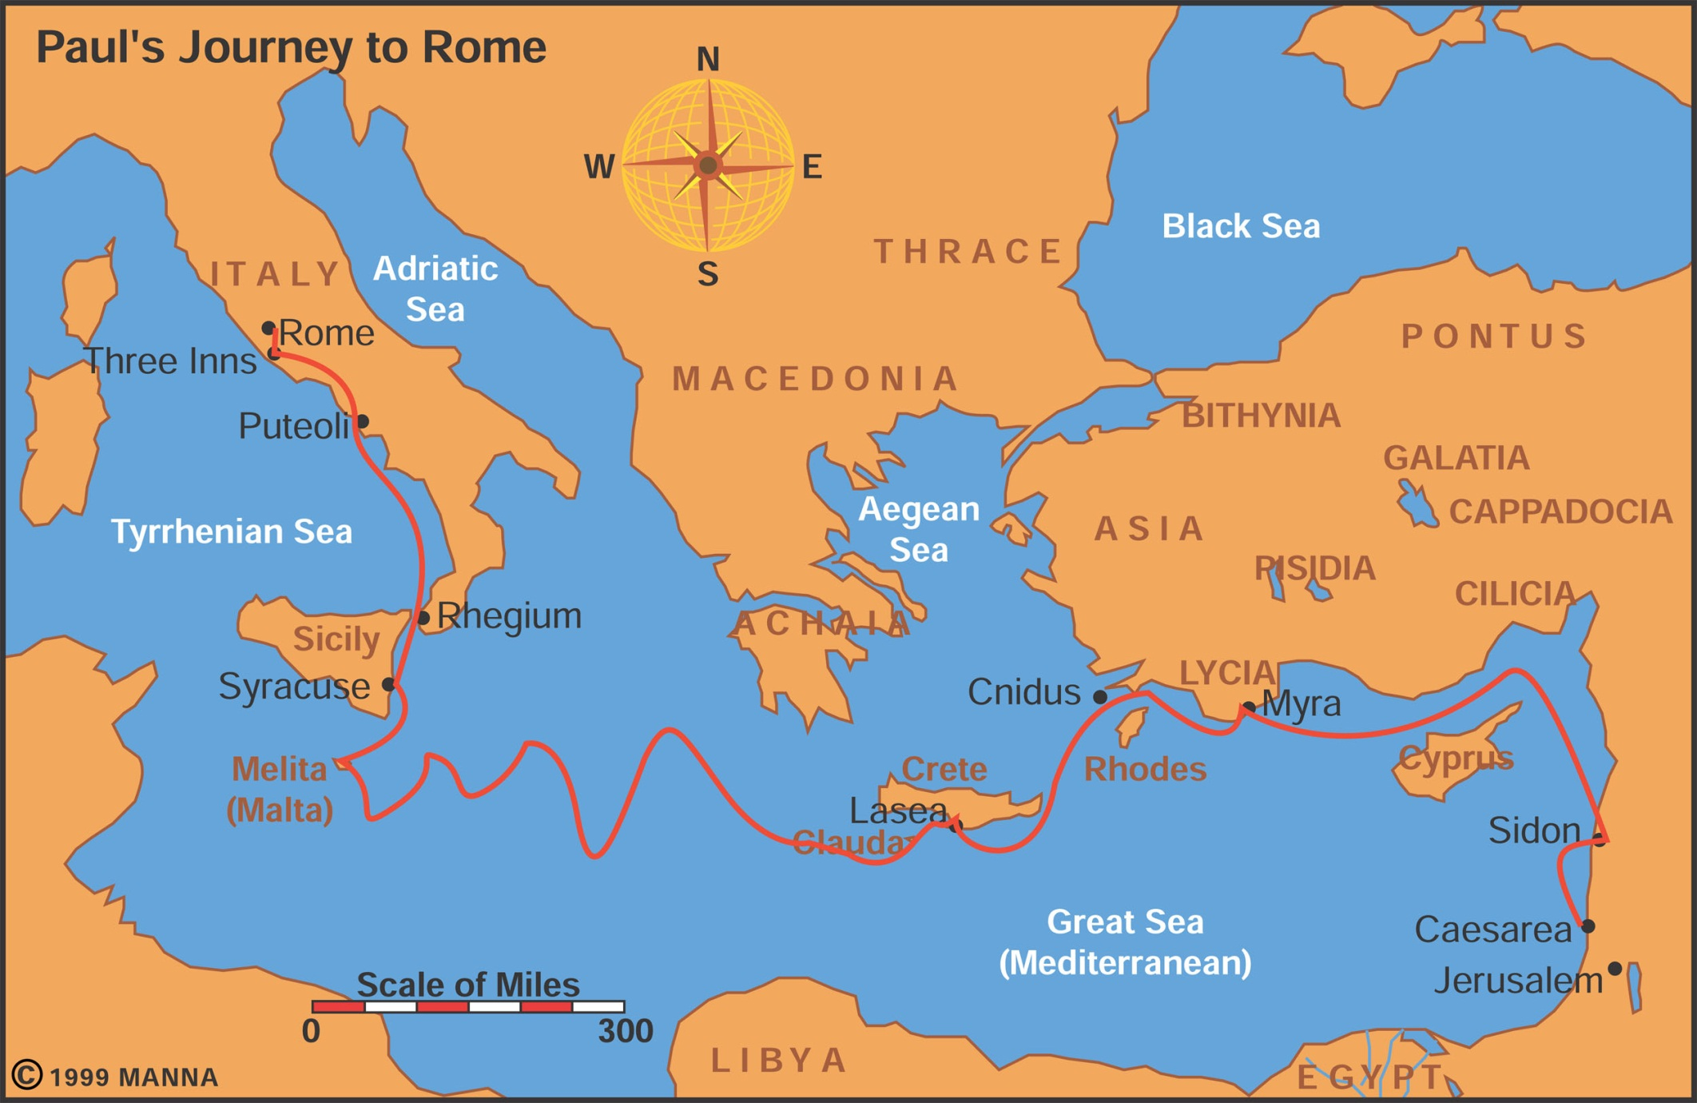
Paul’s Journey To Rome

Slide 36
Final Acts Theme
Malta (Acts 28) Snake and on the interpretation of history? Providence and secularism
Acts as history: how do you see God in your own personal history? Purpose driven life
Writing history: including God→ secular, is history moving to an end by design or random?
God’s design moving history in Acts: 2:23
History: foreknowledge fixed, some fixed/some open, totally open
God did this because…

Slide 37
Paul’s Epistle Chronologically
After 1 MJ: Galatians
Jerusalem Council: 50 AD - circumcision
During 2 MJ: 1 & 2 Thess. from Corinth
During 3 MJ: 1 Cor. (from Ephesus);
2 Cor. (from Macedonia);
Romans from Corinth
1st Roman Imprisonment: Prison Epistles:
PPEC: Eph. Col., Philippians, Philemon
Freedom: 1 Tim., Titus (Pastoral Epistles)
2nd Roman Imprisonment: 2 Tim.

Slide 38
Epistles of Paul: Topically
Eschatological
  1 & 2 Thess
Soteriological
    Galatians, 1 & 2 Cor, Romans
Christological
  Col., Eph., Philp., Philemon
Ecclesiological
  1 & 2 Tim, Titus

