Slide 1
Luke – Christ the Perfect Man

Slide 2
Intro. To Luke
How does Luke portray Christ?
How do we know Luke wrote it?

Slide 3
How do we know Luke wrote it?
“We” passages in Acts:
  Picks him up 2MJ -51 AD at Troas to Philippi
  Acts 16:10, (leaves him at Philippi)
  On 3MJ picks him up at Philippi as Paul is returning to Jerusalem Acts 20:5, --2 years in Israel while Paul in prison in Caesarea
  Goes with Paul on the voyage to Rome/Shipwreck Acts 27:2
Elimination procedure = Luke (Col. 4:12; 2 Tim 4:11)

Slide 4
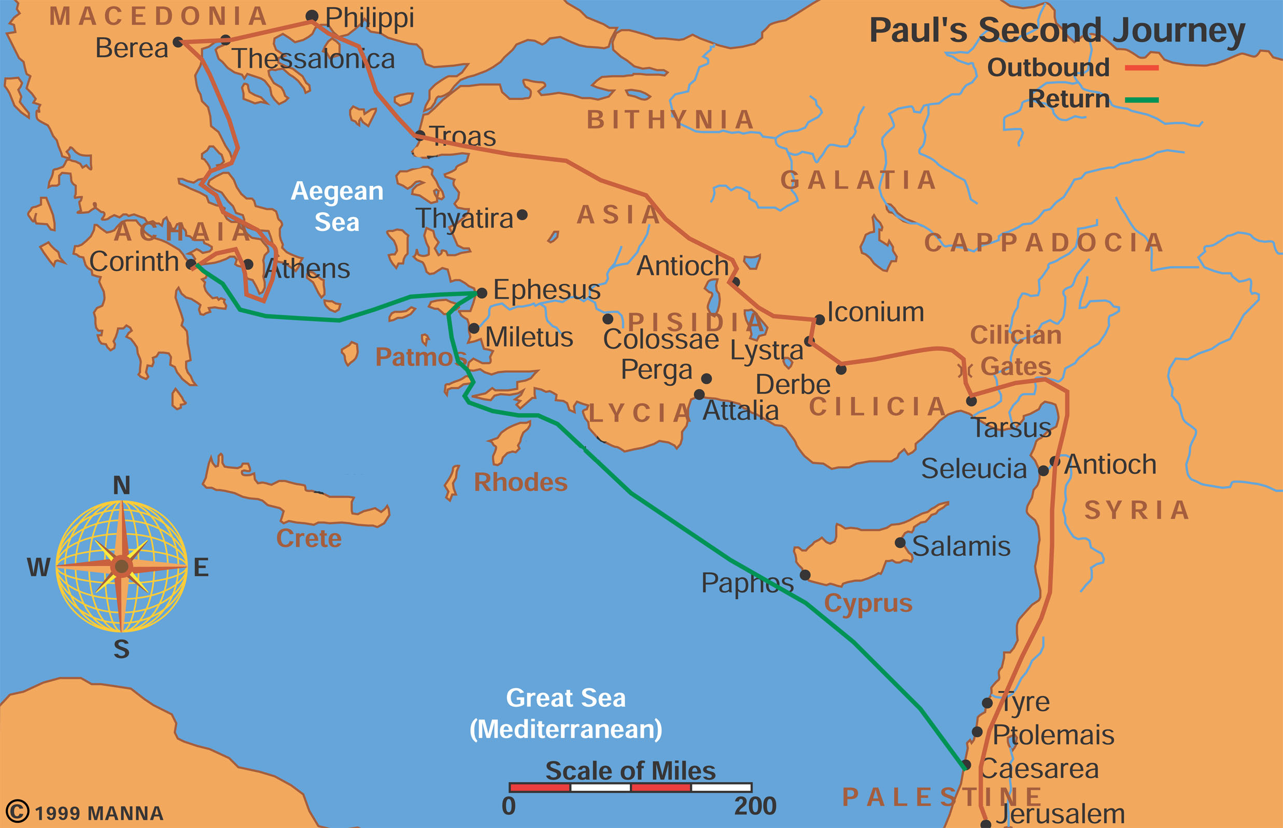
Paul’s Second Missionary Journey

Slide 5
Luke’s Background
Question: Was Luke a Doctor?
Medical language? 4:38; 5:12
Josephus too;
Col 4:14—Paul calls him “beloved physician”

Slide 6
Luke Gentile or Jewish?
Gentile descent –
  Jesus never speaks Aramaic
  Hebrew names avoided (no Satan, Gethsemane or Golgotha), no hosannas,
  Grouped with Gentiles in Col. 4:10-14;
  Acts 1:19—Aceldama, in their language,
  Explains locations 1:26
  OT quotes—mostly only in mouth of Jesus

Slide 7
Are Acts and Luke related?
Acts & Luke both to Theophilus (28% of NT)
Luke 1:1-4: Many have undertaken to draw up an account of the things that have been fulfilled among us,
² just as they were handed down to us by those who from
the first were eyewitnesses and servants of the word.
³ Therefore, since I myself have carefully investigated
everything from the beginning, it seemed good also to me to write an orderly account for you, most excellent Theophilus,
⁴ so that you may know the certainty of the things you
have been taught. (Luke 1:1-4)
Acts 1:1: In my former book, Theophilus, I wrote about all that Jesus began to do and to teach (Act 1:1 NIV)

Slide 8
Luke and Acts related
Former book: Acts 1:1 referring back to Lk.
Not anonymous – Luke 1:3
Picks up story where Luke left off
Vocabulary (800 hapax legomena) and style similar

Slide 9
Luke 1:1-4 and Inspiration process
Question: If Luke was not Jewish, not a disciple or not an eyewitness who saw Jesus how does he get to write a gospel?
What is the relation of inspiration and historical research? [FRASES] Lk. 1:1-4
Not FIRST hand information
Does RESEARCH
Many ACCOUNTS available
SYSTEMATIC orderly account his goal
EYEWITNESSES –keenly aware of
SOURCES used by Luke

Slide 10
Where did Luke get his info.?
Where did Luke’s get his information from?
  Paul, Silas –2MJ
  2 Years in Israel while Paul in prison in Caesarea
  Peter and Mark at Rome (2 Tim. 4:11f)
  Mary [1:29; 2:19,33, 51], in Israel while Paul was in jail at Caesarea 2 yrs.

Slide 11
Date
Before Acts (65 AD) Paul still living awaiting first trial in Rome
After 70 AD prophecy after the fact
  Vaticinium post eventum Lk. 21:20f
Set in Roman time frame: Lk. 2:1; 3:1
Most excellent Theophilus—community or help in Paul’s case pre-65 AD

Slide 12
Luke Characteristics (HH CD SSPPP)
Holy Spirit (vid. John Bapt 1:15, Zacharias 1:67, Mary 1:35, Simeon 2:25f., Jesus 4:1; Acts 2)
Humanity of Christ: 2:52 grew, 4:16
Distinct—6 miracles, birth stories (Shepherds, Simeon, Anna), 19 parables (chs. 9-18), unique stories-e.g. Zacchaeus, Road to Emmaus
19 Parables unique: Good Samaritan, Rich fool’s barns, Prodigal son, persistent widow/judge, Lazarus/Dives, Pharisee and tax collector praying

Slide 13
Parables
Why did Jesus use parables? Mk. 4:12
What is a parable: 4 types
  Simile: kingdom like mustard seed
  Example story: Good Samaritan
  Parable story: Banquet
  Allegory: Sower
  Hyperbole in some to make a point
  Apocalyptic nature of some (sheep/goats; 10 bridesmaids)

Slide 14
How do you interpret parables?
Jewish parables—Nathan to David (2 Sam. 12)
Allegorically: early church—Good Samaritan
One point: 19th century critical
Apocalyptic versus realized eschatology
Jesus seminar, ipssissima verba// ipsissma vox--red, pink, grey and black words
Re-reading the Good Samaritan (Lk 10:25ff)

Slide 15
Parables
Rereading the Parable of the Good Samaritan
Why a lawyer? What’s initial question?
Geography?
Sociology?
Jesus shifting question?
Questions on the Parable of the sower

Slide 16
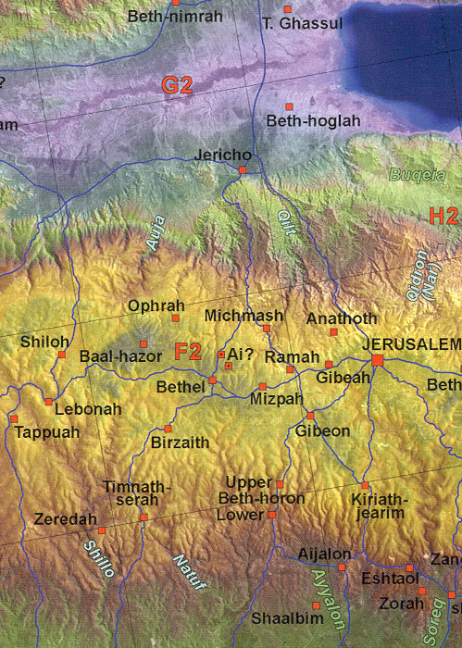

Slide 17
Luke—Jesus--Savior of all
Question: How does the story about Zacchaeus play off Rich Young Ruler (RYR) story? Lk. 19
What’s obstacle for Zach and RYR (Lk 18)?
Zach and RYR both wealthy
RYR keeps commandments // Zach violates them
RYR counseled to sell all give // Zach volunteers to give
Conclusion: RYR can wealthy be saved? Zach salvation is come to your house today-play, Abraham
Seeking inclusio: who’s seeking whom?

Slide 18
Zachaeus’ seeking to salvation
Crowds
Repents/repays/gives
Mumurs, rejects
Overcomes obstacle
Zach
Jesus
seeking
seeking/salvation

Slide 19
Savior of All
3:6 [a voice calling in the wilderness…] all have quote only Luke adds “all flesh shall see the salvation of God.”
Universal setting: Birth—Caesar Augustus census (2:1); 15th year of Tiberius Caesar,… (3:1)
Date problem: 2:1-7 1) no census? Quirinius census not till AD 6 [Josephus]; 2) no travel to Bethlehem ordered??

Slide 20
Luke Characteristics
Songs
  Magnificat 1:46ff
  Benedictus 1:68ff
  Gloria in Excelsis 2:14
  Nunc Dimittis 2:29ff
People interest
  Prodigal son
  Emmaus road –Cleopas
  Women & children

Slide 21
Luke Characteristics
Poor focused on
  Mary’s song—Magnificat
  Evangel to poor: 4:16-19
  Sell everything 3x—12:31; 14:33; 18:22(RYR)
  Parables: rich fools barns (Lk 12),
  Lazarus+Dives -- on heaven/hell reversal of this life (Lk 16)
  Riches for good ends (Lk 8:1-3)

Slide 22
Prayer in Luke
Prayer—8x Jesus (7 only in this gospel)
Vending machine prayer: ask and you will receive (Mat 7:7)
The Jesus prayer (of tax collector)—18:13—humility in prayer
Woman and unjust judge 18:1-8-persistence in prayer
Jesus in Gethsemane—3 times asks…remove the cup (Mat 26:36) –Paul thorn in flesh 2 Cor 12:7f
Praying when it matters and when feel helpless: son in Afghanistan (Twig, Canal, that mission).
Jim Kinney’s Bryan with Leukemia
Rebekah’s prayer and coming to Gordon

Slide 23
Heaven and Hell
Lk 16:19ff: Lazarus and the rich man
Contrasting descriptions in this life and the next: reversals, who is named in the story?
  Place of suffering, chasm (no escape), remembers brothers—Lazarus absent?
They have Moses and the prophets…
Foreshadowing Jesus—one who came back from the dead
Is heaven/hell the point? Does now matter

Slide 24
NT Hell
Three words: Sheol (OT), gehenna, hades
Jesus more on hell than on heaven: contra modern culture (2nd chances, love, sin no big; always forgiveness therefore no problem)
Sheep/goats (Mat. 25)
Mk 9:47ff—eye offends you; --worm dieth not, fire
Mt. 7:22 Lord, Lord--depart from me,
Mt. 23:23; better for Sodom than for X
Rev. 20 lake of fire

Slide 25
Emmaus Road
Luke 24:13ff
Their understanding of Jesus: prophet, redemption of Israel
Jesus: prophets suffering → Isa. 53 et al.
Moses, all the prophets, Psalms = OT
Breaking of bread → eyes opened
Their response and ours: 24:32

