Slide 1
Mark:
Jesus as Amazing Servant of the Lord

Slide 2
Amazing Servant
Mk. 1:22, 27 People amazed at Jesus
Mk. 6:6 Jesus amazed at people’s lack of faith

Slide 3
Authorship
What kind of person was Mark?
Since he is inspired does it make any difference who he was?
What kind of personal trail does the writer leave in the text he/she writes?
Name—John Mark (Acts 12:12) disambiguation (John)

Slide 4
Authorship
Apostolic meeting place in his house—Acts 12:12
Pitcher bearer?-- 14:13—upper room, last supper
Personal touch—14:51f.
Peter’s secretary?—Papias, 1 Pet. 5:13
Barnabas’ younger cousin Col. 4:10
1 MJ Paul/Barnabas—Acts 12:25; 13:5
Quits at Perga – why? Acts 13:13;
Paul’s rejection of John Mark: Acts 15:36ff.
Why suggestions: Homesick, Paul, Gentiles?

Slide 5
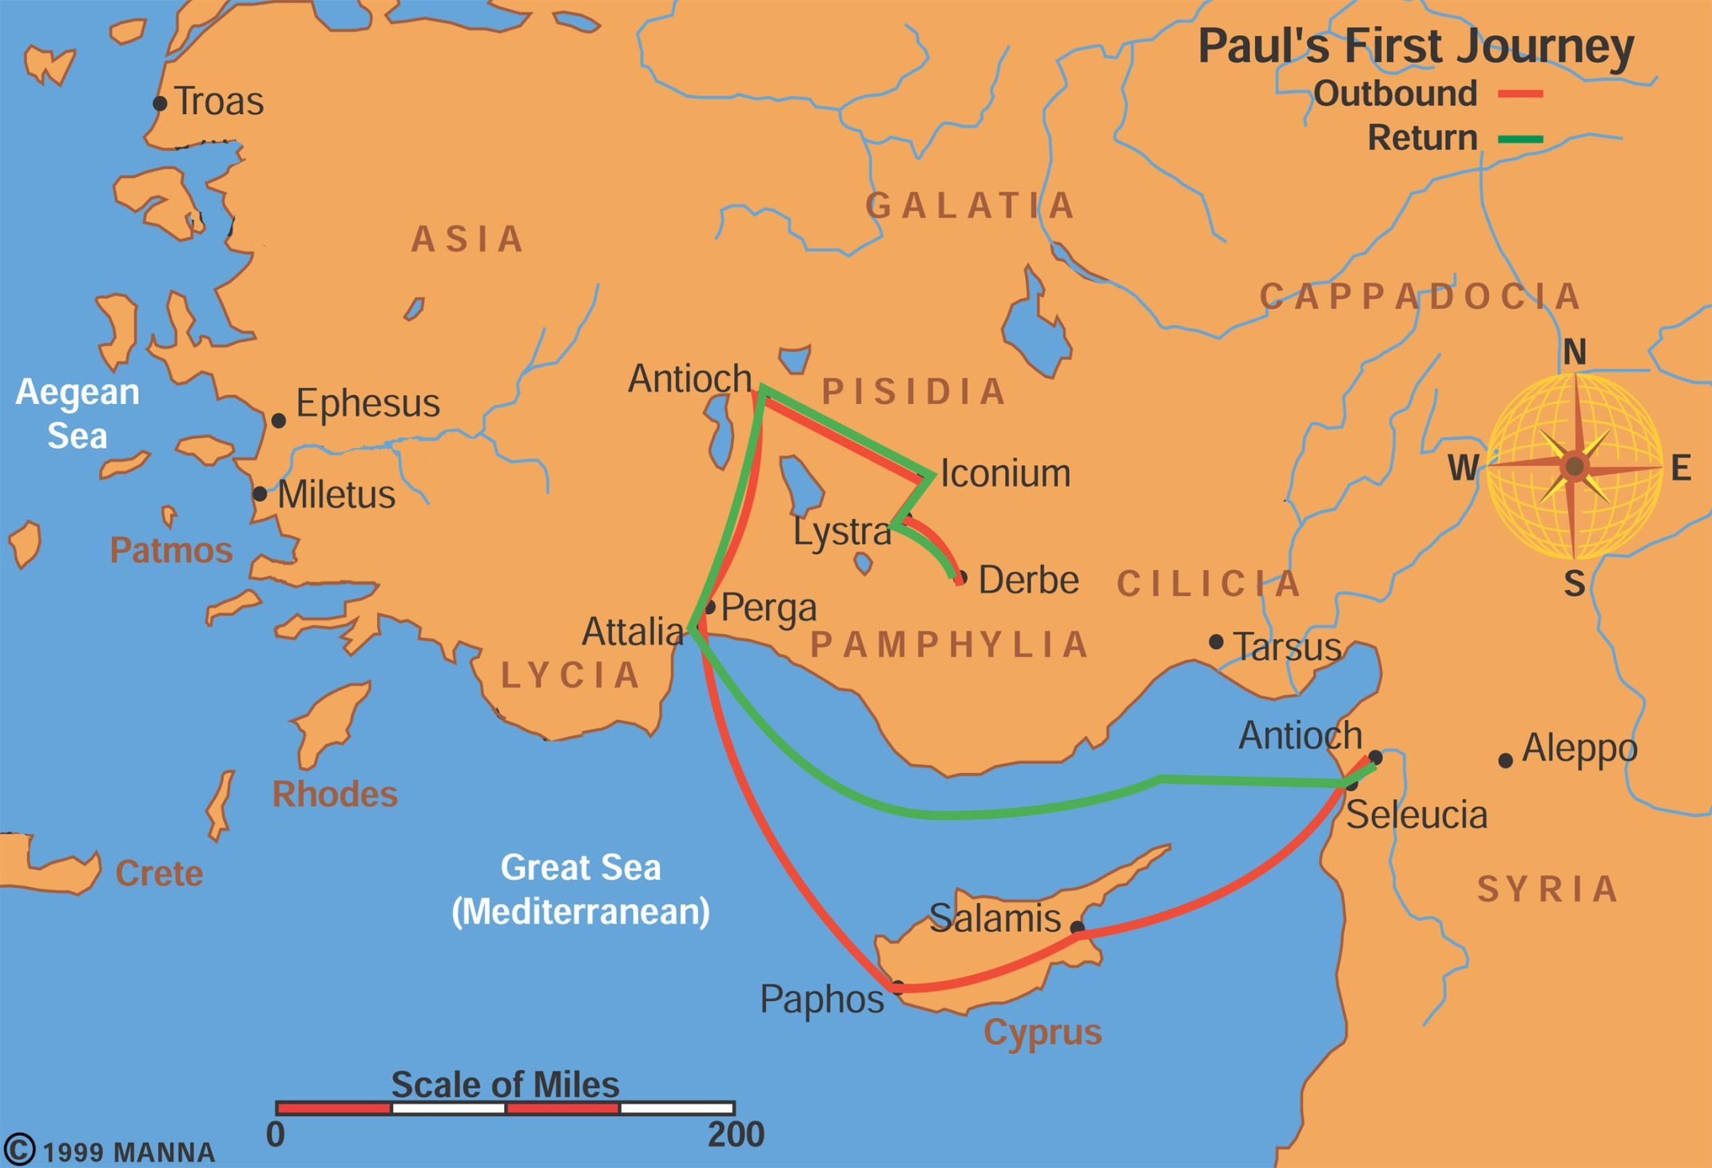

Slide 6
Authorship
Can godly folks disagree so strongly they split? Paul/Barnabas
Peter’s affirmation 1 Pet 5:13
Do people change over time? Do young people make bad choices they regret later?
Paul finally values him 2 Tim 4:11—
For Demas, because he loved this world, has deserted me and has gone to Thessalonica. Crescens has gone to Galatia, and Titus to Dalmatia. Only Luke is with me. Get Mark and bring him with you, because he is helpful to me in my ministry.
Nature of reconciliation: the struggle

Slide 7
Authorship: Internal evidence
Omits Peter as hero 3x (walks on water, keys of kingdom, temple tax)
Peter’s 3 bungles elaborates on (get behind me Satan, transfiguration, 3 denials of X)
Peter’s comment: 7:19 –(In saying this, Jesus declared all foods “clean.”) cf. Acts 10-11
Scriptural honesty: apostles have problems, realism, not legend, flawed heroes

Slide 8
When was Mark written?
Early Church - Peter connection – Papias, Peter dead by 65 AD so before that so Peter could ratify it
Synoptic ordering –first “gospel” 40-65 AD
Date: pre – 65 AD –Mk 13:2 temple destruction prediction (temple destroyed 70)
Liberal aversion to predictive prophecy and miracles: Vaticinium post eventu—13:2

Slide 9
To whom was Mark written? Audience?
Church History says: Rome (Eusebius, Papias)
Presence in Rome (1 Pet. 5:13; Col. 4:10)
Non-Jewish audience examples
  Translates Hebrew expressions: talitha cum 5:41, Boanerges 3:17
  Explains Jewish customs 14:12-Passover lamb, 7:2ff Unwashed hands explanation
  No mention of the law (Cf. Mat 5:17f;);
  No sending of 12 order not to go to Gentiles (Mt 10)
  Explains geography (13:3) Mount Olives–temple)

Slide 10
Latin Audience
Rome: puts Greek into Latin
au]lh?j aules→ palace→ praetorium (Mk 15:16)
Roman folks mentioned: Rufus, Alexander (Mk 15:21) cf. Romans 16:13. Simon Cyrene’s kids
Roman conceptual framework:
power 1:7, demons 1:33,
crowds 1:45, banquets 6:21
Importance of understanding who the audience is and who the author is (today many drop the author in favor of the audience; both/and)

Slide 11
Portrayal of Christ
First “Gospel” –cf. Acts 10:34-43
Eu-aggelion (angelion): eu=good, message
Mk 1:1f.—deity of Christ (OT quotes)
Mk 1:2: → messenger prepares way before you (=Jesus)
Mal. 3:1f → messenger prepares way before me (=YHWH)…comes into his temple
Mk 1:3 “voice crying in the desert prepare the way of the YHWH (Is. 40:3)

Slide 12
Gospel
Why is it called “good news”?
Life/death; sin/pardon, emptiness/love, breathiness/significance, God/human, kingdom near--hope
Christ as human: eats, drinks, hungry, touches, gets angry
Key Verse: 10:45: For even the Son of Man did not come to be served, but to serve, and to give his life a ransom for many.

Slide 13
Christ as divine in Mark 1 (OT)
So John came baptizing preparing way before Jesus
Jesus Bapt. Mk. 1:11: “You are my Son,” → Ps. 2:7 (son of God=Messiah).
“Whom I am well pleased”=Is. 42:1 (of the suffering servant on whom God will put his Spirit and he will bring deliverance and justice to the earth.

Slide 14
Who is the Son of Man?
What does “son of ”____ mean? 3 options
Jesus Self-identification—what he calls himself (Mat 16:13; Mark 2:10)
5 Nuances of the Son of Man [AI SED]
  Identification with humans Mt 8:20—foxes have holes
  Authority Mk 2:10—SM ability to forgive sin/heal
  Suffering: Messiah ben David//Messiah ben Joseph
  Mk 8:31 (suffering); 9:31 (kill); 10:33 (betrayal)
  Eschatological coming judgment: Mk 14:61f
  Christ as divine—”Son of Man” Dan. 7:13
  Divine: Mk. 14:61ff; cf. Mat 26:63f

Slide 15
Messianic secret
Question: Why did Jesus tell people not to tell what he did?
Messianic secret—Why?
  Healed ones —settings/reason: crowds/magician Mk. 1:44f, arrest, reverse psych.
  Demons —settings/reason: bad PR; Mk. 1:33; 3:11
  Disciples —settings/reason: understand; Mk 9:9f

Slide 16
Mark’s Characteristics
Brevity – actions not words—too busy to eat (3:20; 6:31)
Miracles: faith → miracles
  Faith character contrasts [suppliants]
  suppliants + faith 2:5; 5:34, 36
  opponents 2:7 disciples-little faith 4:40
  contra John: faith comes after miracles--Jn 2:11

Slide 17
Mark’s Characteristics
Vividness graphic details 1:13, 26, 27, 31
Euthus=immediately – 42x 1:12, 5:42...
Present tense used

Slide 18
Mark’s characteristics
Realism – disciples not understanding
Only here the Jesus = “carpenter” 6:3
Suffering emphasized: 8:31; 9:31; 10:33ff
Minor characters//disciples
  3 boat scenes [boat [rebuke] + miracle]
  1. Stills storm —why afraid + 3 miracle stories of folks who overcame fear: Gerasene demoniac, Jairus daughter, hemorrhaging woman; 4:40ff
  2. Walks on water;--don’t be afraid + Canaanite woman overcomes obstacle → daughter healed; 6:45ff
  3. No bread/yeast: rebuke of disciples 8:14, + deaf man healed before and blind man after 7:34 & 8:22ff
  Centurion at the cross: gets it—Mk 15:39
  End of book: women afraid 16:7f → personal fear

Slide 19
Question: Forgives sin – Mk 2
Is there ever a connection between sin and sickness?—give examples, 4 levels of sin/suffering
Question of Jesus “authority” and growing opposition: healing –yes; forgiving sin—woe, thoughts of opponents 2:6f;
Context of the story:
Why did Jesus switch from healing to forgiveness? 4
How is it true that forgiving sins is easier than healing? –a fortiori argument –theological positions
Sin – Sickness connection is there a connection? Yes/no, careful (balance) --Randy
Purposes of sickness: punishment, repentance, wisdom, obedience, humility, glory of God

Slide 20
Healing today?
Jesus acknowledges need for doctors (Mk. 2:17)
Paul acknowledges need for medicine 1 Tim 5:23
Not all sickness from sin: Jn. 9:2; Lk. 13:4f
Paul sick: 2 Cor 12:7—thorn in flesh
Job sick→ means of attaining knowledge
Keener’s arguments for miracles today
Already: see Jesus healing folks; inauguration of the kingdom
Not yet: perfect state where sickness banished Rev. 21:4

Slide 21
Geographical Questions:
2 Geographical contradictions?—
1) Mark--Mk. 7:31 Tyre, cf. 2 Sam 24:6;
2) Gerasa--Mk. 5:1

Slide 22
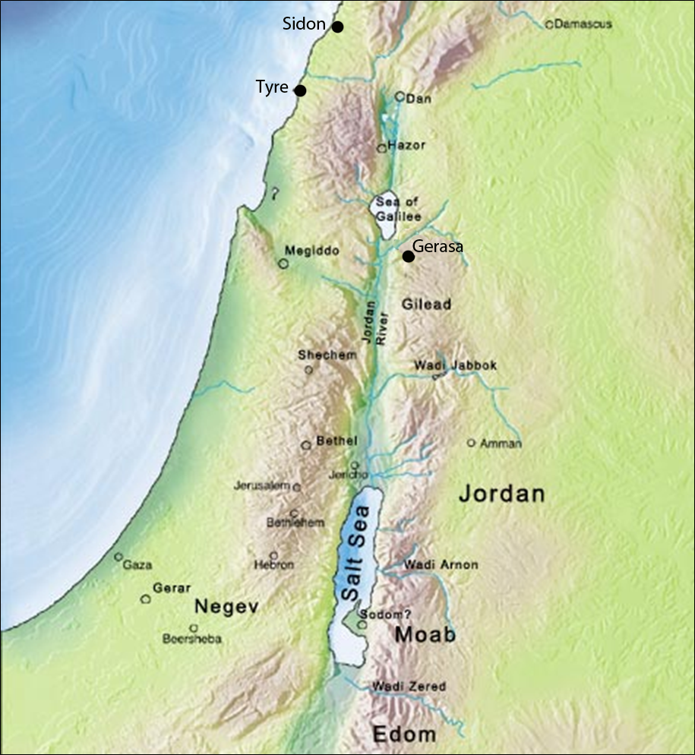

Slide 23
Question: end of Mark 16
Endings of Mark: short, medium, long
Purpose of short ending finishes with fear of minor characters (women) 16:8
John Mark’s personal history; disciples flee too (14:50f)
Church at Roman –fear and flight (audience)
The theological significance of the long ending? Be careful; Mat 28 possibility

