Slide 1
From God to Us:
Inspiration to translations

Slide 2
Where did my NIV come from?
Inspiration [God spoke to prophet]
Canonicity [Books collected]
Copied by Scribes: Text Criticism
Translation into English
KJV [NKJV], NASB, NIV, NRSV, NLT, ESV, DASV

Slide 3
Inspiration
2 Tim 3:16
All Scripture is God-breathed and is useful for teaching, rebuking, correcting and training in righteousness
2 Pet 1:21
For prophecy never had its origin in the will of man, but men spoke from God as they were carried along by the Holy Spirit.

Slide 4
Advantages of Written records
Orality of Jesus
Preservation
Precision
Propagation

Slide 5
Why the Formation of the NT Canon?
Death of the apostles as eyewitnesses
Geographical spread of Christianity (unity/diversity/preservation)
Heresy Pressures: Motanism, Gnosticism, Marcion (deletes OT)
Pastoral concerns: which documents are from God to help people in Xn life
Persecution: which books do you die for?
Summary, Significance, Questions

Slide 6
Basis of Books collected: Key Questions
Is it inspired? Some inspired documents (Clement of Rome, considered inspired by many, not canon)—Does it claim authority?
Rev. 22:18f. 1 Cor. 14:37
Does it agree with previous revelation?—Hermes and Polycarp orthodox yet not canon; James questioned at various points (salvation by works)

Slide 7
Basis of Books collected:
Is it prophetic/apostolic? note spurious works using names of apostles (even Gospel of Judas, Gospel of Thomas to up status, Hebrews questioned)
Was it received by the people of God?—by apostles, church—
2 Pet. 3:15f; Peter on Paul
1 Tim. 5:18f (Deut. 25:4/Luke 10:7)
Is it dynamic? Does it come with the power of God to change lives?—Pastoral concern

Slide 8
Circulation and Collection problems
None of the NT writers had a New Testament—circulation Rev. 1-3
Circulation problems: Ephesus had it, Jerusalem didn’t, sub-collections forming
Collection processes taking time. Authentication needed.

Slide 9
Early Church process of recognizing canon
Muratorian Canon: all but 1/2 Peter, James and Hebrews; adds Wisdom of Solomon, dispute over Apocalypse of Peter, Shepherd of Hermes (helpful but not canon)—170 AD to 3rd century
Eusebius (ca. 325 AD)
  Homolegomena: Gospels, Acts, Pauline Epistles, 1 Peter, 1 John, + Revelation (with questions)
  Antilegomena: James, Jude, 2 Peter, 2/3 John,
  Rejected: Epistle of Barnabas, Shepherd of Hermes, Apocalypse of Peter…
Summary, Significance, Questions

Slide 10
Manuscripts:
Sinaiticus: Has all NT (Hebrews grouped with Paul’s epistles)+ Shepherd, Epistle of Baranabas; Alexandrinus adds 2 Epistles of Clement of Rome
Partially NT distributed: Gospels, Paul’s letters, Catholic epistles, Rev. –few would have seen a complete NT
Councils: East versus west (some variation) Carthage Council 397 AD=NT
Church fathers: Athansius 367 AD = NT

Slide 11
Text Criticism: Copies
Copying the Bible –Christian scribes not= Jewish scribes?—OT commands to copy: Deut. 17:18; read at feasts (Deut 31:9ff)
Written records versus oral:
  Did Jesus write anything? Told stories and sermons on the Mount, Olivet discourse …orally remembered by followers… later written down by them

Slide 12
External Evidence
Copies: types
# 96 299 2,812
TR/
Majority text
Papyri
AD 120-300
Uncials
AD 300-500
Miniscules
AD 500-
P52, P46
A, B, x, D
1059, 1087

Slide 13
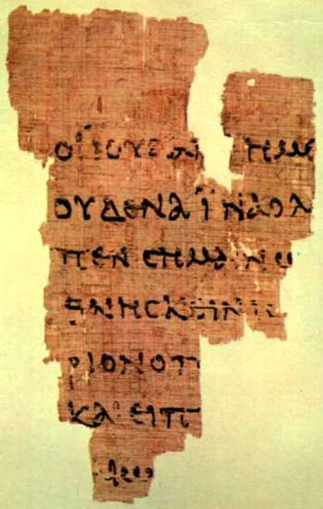
P52–John 18:31-33 (ca. 125 AD)

Slide 14
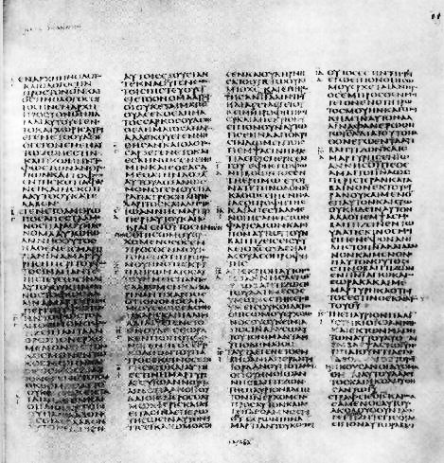
Codex Sinaiticus -4th century AD

Slide 15
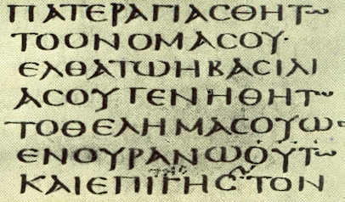
Sinaiticus 4th century AD

Slide 16
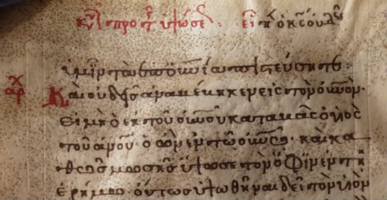
Miniscules--later

Slide 17
External Evidence Amounts
5,700 Greek Manuscripts – some as early as 125 AD within 30 years of apostles,
Wallace just announce fragment from Mark from 1st century AD ????
10,000 Latin Vulgate (ca. 400 AD→ )
1,000 early versions (Coptic, Syriac…)
Million quotes from church father quotes
Lectionaries (church readings texts)
Compare Plato = 7 manuscripts (900 AD)
Aristotle = 5 (1100 AD) *** SSQ

Slide 18
4 Manuscript Families
Alexandrian Family: Uncials
  Codex Vaticanus B (4th century: 300’s AD)
  Codex Sinaiticus א (4th century; 300’s AD)
  Codex Alexandrinus A (5th century; 400’s AD)
Caesarean Family
Western Family
Byzantine (Textus Receptus TR) or Majority Text—9th century AD; miniscule, KJV

Slide 19
Rules of Evaluating manuscripts
Earlier the better
Wider geographical spread better
Family type: Alexandrian best, Byzantine the worst

Slide 20
Types of Copyist Errors
Errors of Sight
  Similar letters: s / o
  Homoeoteleuton: same endings so skipped
  Haplography: written 1x should be 2x
  Dittography: written 2x should be 1x
  Metathesis: thier elabon// ebalon
  Fusion: CHRISTISNOWHERE
  Fission: Am 6:12 with oxen NIV//with oxen the sea GNB BBQRYM // BBQR YM
Errors of sound: lite/light; αὐτῶν =αὐτόν

Slide 21
Types of Copyist Errors
Errors of mind
  Substituting a synonym
  Harmonizing corruptions
  Conflation: Title of Revelation

Slide 22
Rules for evaluating variants
More difficult reading is preferred
Shorter reading preferred
Reading best fits style of writer preferred
Summary, Significance, Questions

Slide 23
3 Big NT Examples
Mk 16:8ff—gone in some mss.
Jn 8—floating → Luke 21:38ff
1 Jn 5:7—added later
No major doctrine effected

Slide 24
Translations
OT
NT
MT
(Hebrew)
Papyri
120-300 AD
Uncials
300-500 AD
LXX
Gk
250 BC
Miniscules
500AD→
DSS
Qumran
100 BC
Vulgate (Latin)
Jerome AD 400
Wycliffe (1380) / Tyndale (1536), KJV 1611

Slide 25
English Bible
John Wycliffe (1330-1384 ) bones burned
Gutenberg Printing press (1450)
William Tyndale (1494-1536) martyr
Great Bible (1539) chained in churches
Geneva Bible (1560)
King James Bible (1611) Textus Receptus
Reasons for change: Manuscripts, archaic language, translation theories, publishers ($)

Slide 26
Modern English Versions
NASB (1970; updated 1991)-literal
NIV (1973) → TNIV (gender neutral; 2001)
New version came out 2011, Wilson
NRSV (1989) based on the RSV (1952)
NLT (1996)--Living Bible [Tyndale House]
ESV (2002)—RSV based
The Message (2002) E. Peterson
DASV 2011 (free online text/audio),
NET Bible

Slide 27
6 Guides for Selecting a Version
To what audience is it addressed? Old/young, American/British etc.
Purpose: study, reading, carrying
Underlying Gk/Heb Text
English Style: dynamic / more literal
Accuracy: word for word or meaning
What does your community use?
Summary, Significance, Questions

