Slide 1
New Testament Backgrounds

Slide 2
OT Foundations
“Look, the lamb of God which takes away the sin of the world” John 1:29
Climax of Institutions of Israel:
  Prophet: Deut 18, Mal. 4:5f
  King: greater son of David; temple builder
  Priest: Aaronic → Melchizedek

Slide 3
Initial Questions
What happens between Malachi (435 BC) and Matthew (AD 50-70)?
What shifts in culture took place between the Semitic OT and the Greek/Roman NT? What difference does it make?
Where did the synagogue come from?
Who are the Samaritans? Why do they hate Jews and vice versa?
Who are the Pharisees and Sadducees?
Why is the NT in Greek instead of Hebrew?
Why was that time the “right time” for God’s son to come?

Slide 4
Galatians 4:4
But when the set time had fully come, God sent his Son, born of a woman, born under the law.

Slide 5
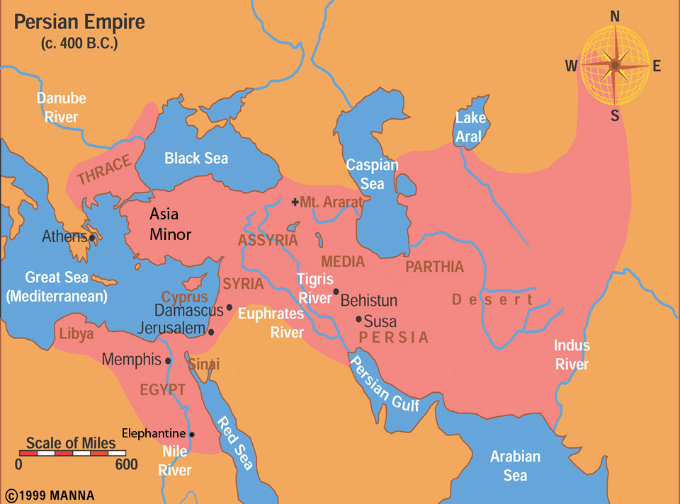
Persian Empire

Slide 6
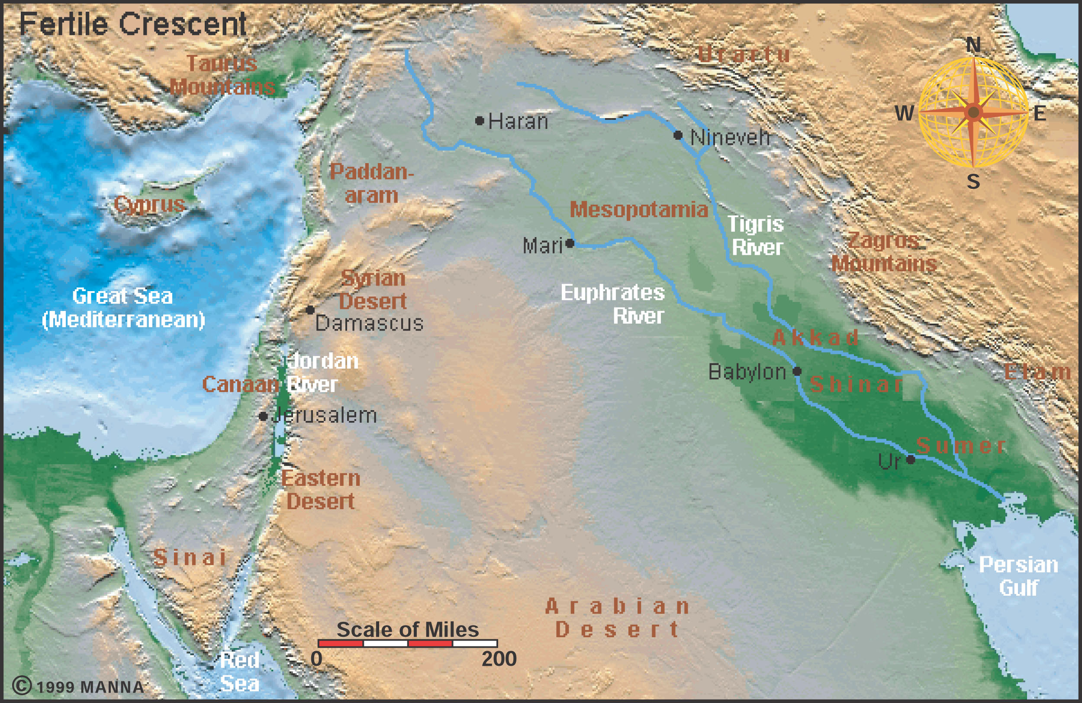

Slide 7
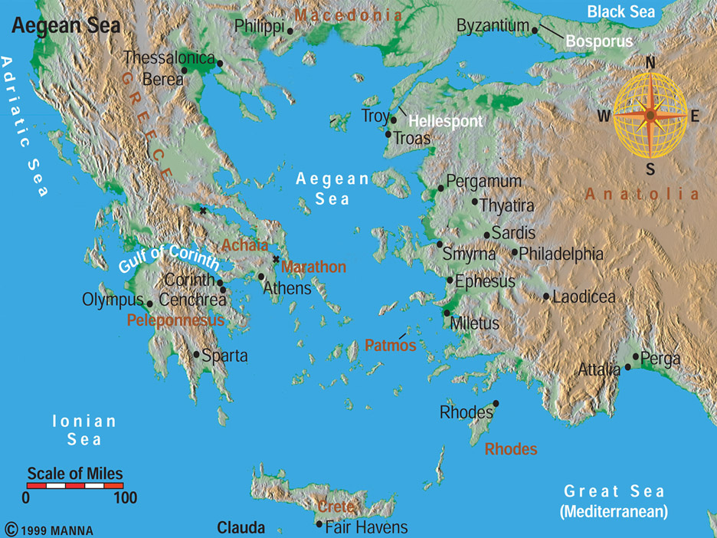
Aegean Sea

Slide 8
Conquering Empires
Assyria
Babylon
Persia
Greeks
Rome
612 BC
539 BC
333 BC
63 BC
Dates of Empire
Defeats
586 BC Jerusalem falls – people deported to Babylon (Nebuchadnezzar)-1st temple gone
70 AD 2nd Temple destroyed by Rome –
Summarize, Significance, Questions (SSQ)

Slide 9
Persians (539-333 BC) BB(i)BLED
559 Cyrus become king
Cyrus in Bible Isa 45:1; 44:28; Ezra 1:2-4 (Edict); Ezra 6:3-8-reiterated by Darius
Benevolent policies—respect local customs, reverses exiles
3 Empires to conquer: Babylon, Lydia, Egypt
  Babylon - Nabonidas
  Lydia – Croesus-Delphi Oracle
  Egypt—left to son Cambyses—disaster, Amasis, Siwa
Death / body 1000 miles / respect from Alexander

Slide 10
Darius (522-486 BC) Empire organizer BBSSS GT
Behistun Inscription-Elamite, Old Persian, Akkadian—usurper?
Benevolent (Apis bull) + Firm (Ezra 6:11)
Satrapy—governor organization
Street system-Postal system-Herodotus
Suez Canal?
Greece – Lost at Marathon
2nd Temple completed (515 BC)

Slide 11
Xerxes I (486-465 BC) BEG-300
Son of Darius
Babylon rebels: Bel-Marduk statue melted down in Babylon
Greece – torches Athens, Loss at Salamis
300 Spartans stand up against Persia
Esther’s husband (Ezr 4:6)

Slide 12
Artaxerxes: (464-424 BC) NEE
Nehemiah was his cupbearer—wall builder
Egypt revolts
Ezra returns—scribe/priest

Slide 13
Later Persians: Disintegration
Darius II – Peloponnesian wars (Athens/Sparta (431-404 BC)) – time of Socrates/Plato in Greece
Darius III – lost battle of Issus 333 BC to Alexander—End of Persian Empire
***Summarize, significance, questions
Picture Scripture – Matthew 1-5

Slide 14
Hellenism / Alexander 333 BC
How did Alexander conquer the world in 10 years?
What happened to Alexander’s empire?
Why is the NT written in Greek instead of Hebrew?
How did the Jews get from Alexander to Roman rule?
Who were the Maccabees?

Slide 15
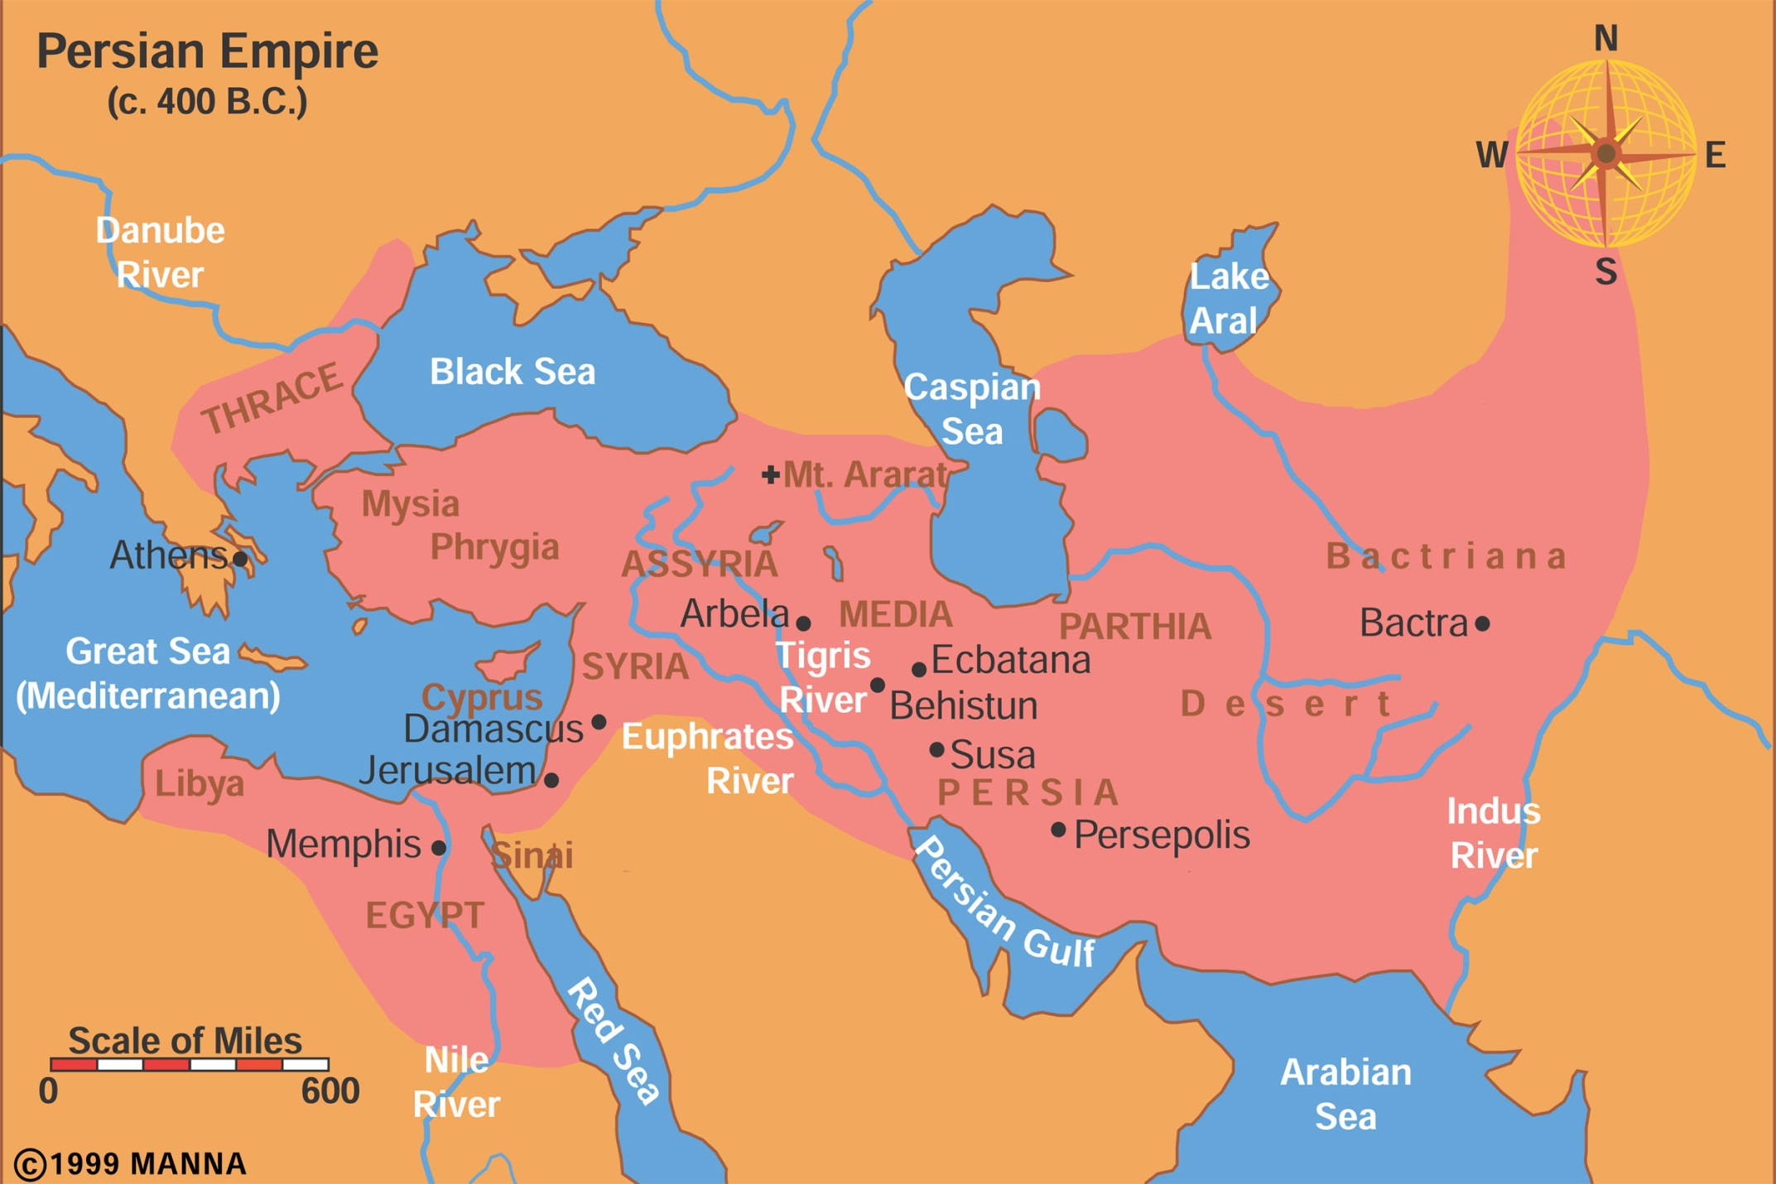
Persian Empire

Slide 16
Aegean Sea

Slide 17
Alexander III (333 BC)
Philip II of Macedon –army fighting machine, son’s teacher Aristotle, 336 assassinated
Alexander’s background-Aristotle
Granicus River victory over Persians-334 BC
Issus victory over Persians (333 BC)
Tyre (Ezek 26:1-6) -7 months, + on Jews (Josephus)
Siwa in Egypt
Babylon – Roxanne, Opis banquet, intermarriage, drunk a lot…
Hindu Kush mountains

Slide 18
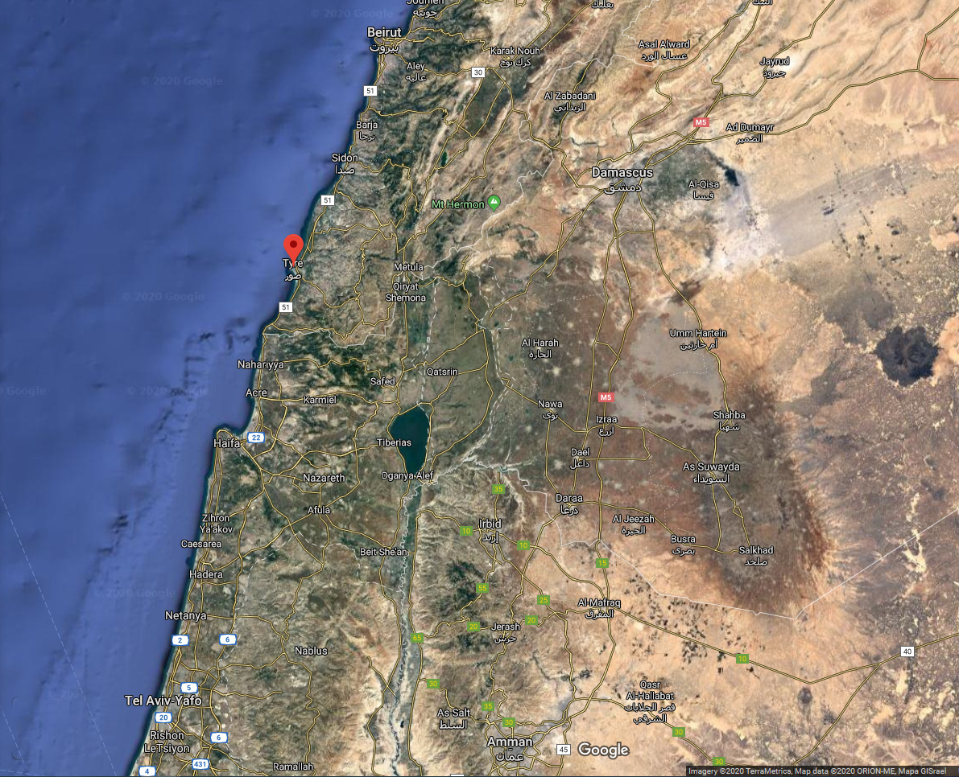

Slide 19
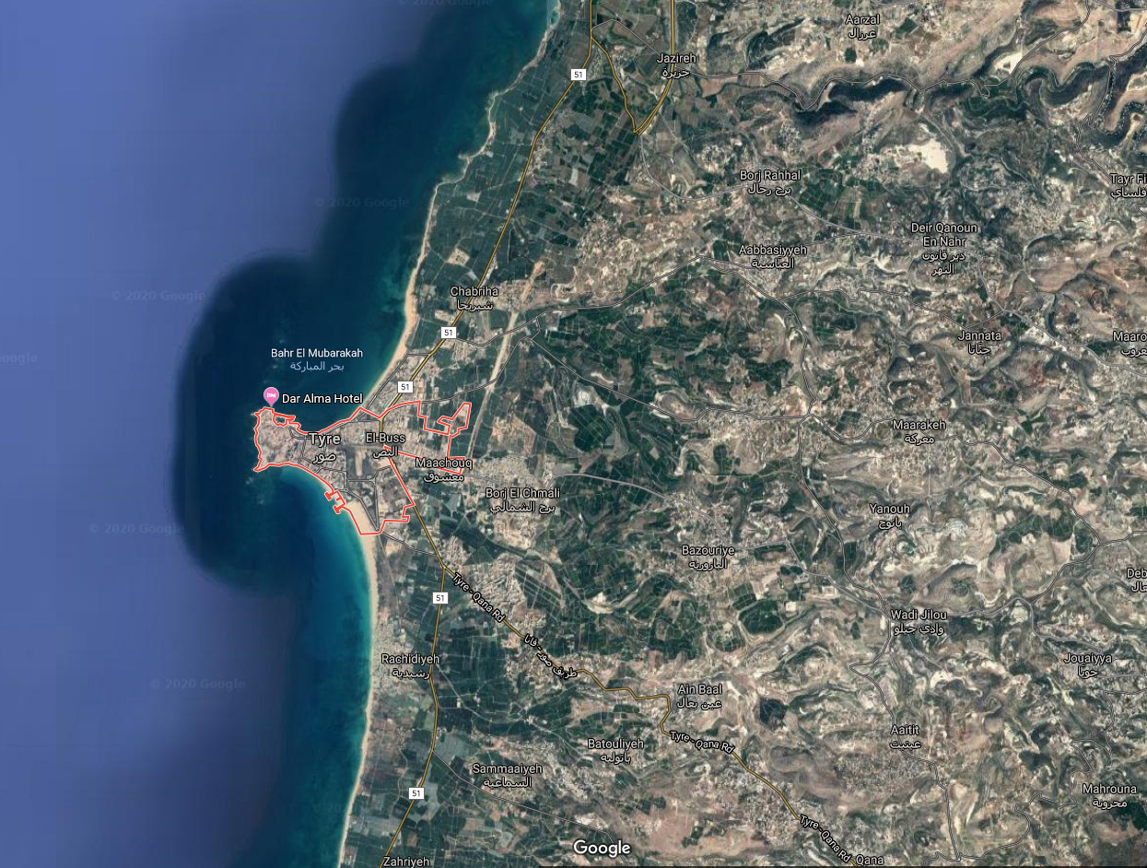

Slide 20
Alexander (333 BC)
Cultural amalgamations –transcending the polis (city) → globalization; Polis to oikoumene (whole civilized world)
Importance for NT: language, worldview: east [Semitic]→ west [Hellenistic]
*** Summarize, significance, Questions

Slide 21
Diadochi [successors]– 4 Generals CLAPS
Cassander – Macedonia/Greece
Lysimachus - Thrace
Antigonus - Turkey/Syria
Ptolemy son of Lagi – Egypt
Seleucus– Iraq/Babylon to India

Slide 22
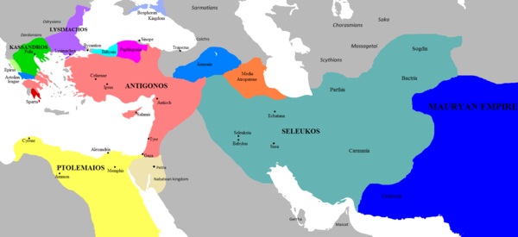
Persian Empire

Slide 23
Tolerant Ptolemies (323-198 BC)
Over Egypt, rule Palestine (300-200 BC)
Ptolemy takes title of King (304 BC)
Alexandria built by 200 BC--Library

Slide 24
Ptolemaic Hellenism
Alexandrian allegorism—hermeneutics, anthropomorphisms of gods offensive → Zeus=logos/word
Unified language—Koine Greek
Septuagint (Hebrew→LXX – 250-150 BC) Greek translation of OT

Slide 25
Hellenism—Factions in Israel
Areas of cultural interface: REAP
Religion: Jewish // Greek // priests
Economic: taxes, merchants
Army: generals & army
Political: king, governors & courts
Responses to Hellenism: TAWA; diaspora:
  Tradition (Pharisees, separation ideology),
  Assimilate (Sadducees),
  Withdraw (Essenes, apocalyptic),
  Attack (zealots) *** SSQ

Slide 26
Seleucids (198-167 BC)
Antiochus III (the Great) – victory Panion 198 BC gets Palestine away from Ptolemy
Romans begin taxing
Antiochus IV (175-163 BC) Epiphanes
  Hellenize the Jews: Grk. Deities, no circumcision,
  eat pigs, Scriptures burned
  Three high priests: OJM
    Onias—money-bought High priesthood
    Jason — gym, Hellenism
    Menelaus—Benjamin (not Levite), temple treasure
  Abomination of Desolation

Slide 27
The Big Maccabees
Mattathias (167 BC)-- Father
Judas Maccabee (166-160 BC)—hammerer, Hanukkah
Poor Eleazar—Elephant man
Jonathan the diplomat, made high priest
Simon the dynasty builder (Hasmoneans) (142-135 BC)

Slide 28
Hasmoneans - Questions
Who are the Hasmoneans?
Where did the Pharisees and Sadducees come from?
What was Herod the Great like? Why did everybody hate him?
How does Rome get into the picture?
Was Jesus an Essene from Qumran?

Slide 29
Hasmoneans
John Hyrcanus (135-104 BC) PECC
  Religious Parties – Pharisees [Hasidim] /Sadducees [Hellenists]
  Expansion of territory
  Circumcision Idumeans (Edomites)
  Children trained Greek
Aristobulus (103 BC)

Slide 30
Alexander Jannaeus (102-76 BC)
F CAPE
Feast of Tabernacles
Crucifies Pharisees
Assimilation of all groups
Pharisees ask for Syrian help
Expansion of territory

Slide 31
Salome Alexandra (75-67 BC) HA MEPS
Hyrcanus = high priesthood;
Aristobulus = army
Married: Aristobolus→ Alexander Jannaeus
Education
Pharisee link
Sadducees abused

Slide 32
Hyrcanus II (66-63 BC)
Takes High priesthood
Aristobulus and Sadducees march on Jerusalem

Slide 33
Aristobulus (66-63 BC)
Hyrcanus goes to Aretas (Nabatean) for help
Enter Rome to break up the fight (63 BC)

Slide 34
Rome takes over (63 BC)
Pompey
Antipater’s boys (Idumean)
Roman Government structure
  Senatorial provinces
  Imperial provinces—legions, answerable to the emperor;
  Client state under Rome

Slide 35
Herod the Great (37-4 BC) JK MCBS
Julius Caesar –First Triumvirate end 46 BC with Julius Caesar as supreme leader (assassinated 44 BC, Brutus).
Herod as “King of the Jews”
Mariamne (Hasmonean)
Cleopatra—Marc Antony, Second Triumvirate and Augustus (31 BC-14AD) as savior and good news (Luke)
Herod the Builder: Caesarea, Masada, Temple
Sons & Wife

Slide 36
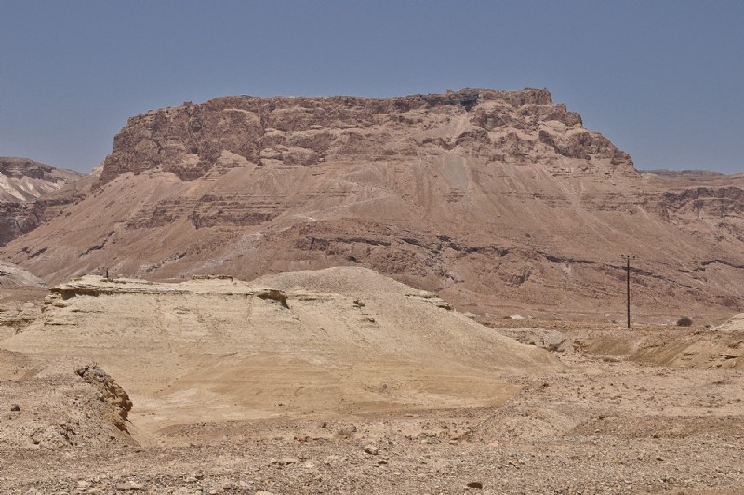

Slide 37
Tetrarchs after Herod
Archelaus: gets Judea, Idumea & Samaria [huge], kills 3,000 pilgrims to Jerusalem—exiled to Gaul (6 AD)
Herod Antipas: gets Galilee & Perea: Kills John Bapt. At trial of Jesus, exiled France
Herod Philip: Golan Heights, wife goes to Antipas
Supposed to be 4 but only 3 listed; Archelaus may have 2 sections

Slide 38
Jewish Sects -- Pharisees
Pharisees
  History
  Sources—oral tradition big
    Two types: Expository // Logical deductions
  Expository
    Midrash (ca. 200 AD) expository on Scripture
      Halakhah: legal—ca 200 AD
      Haggadah: stories—Rabbis
    Targums: Hebrew → Aramaic translations

Slide 39
Jewish Oral Traditions
  Logical extractions/deductions
    Mishna (200 AD)…oral tradition at Sinai; reflects beliefs around the time of Christ
    Tosefta 250 AD –supplement comments on Mishnah
    Talmud (elaboration on Mishnah): Babylonian (400 AD); Jerusalem (600 AD)

Slide 40
Extra biblical sources
  Apocrypha: 1 & 2 Mac., Ben Sirach, Wisdom of Solomon—not accepted by the Jews, 16th century AD first time in church council
  NT Pseudepigrapha:
  Gospels of [Judas, Peter, Thomas. Phillip…];
  Apocalypses of [Peter; Paul, Thomas]
  Acts of [Peter, Paul, Andrew, John, Thomas]

Slide 41
New Testament Rabbinic Examples
Matt 23:25-26: “Woe to you, scribes and Pharisees, hypocrites! For you cleanse the outside of the cup and plate but inside they are full of extortion; cf. Mishnah; Shammai (outside clean important), Hillel (inside is what matters)
Lord’s prayer; Lk. 11:1
Mat 7:4: You hypocrite, first cast the beam out of your own eye; and then shall you see clearly to cast out the mote out of your brother’s eye—Rabbi Tarfon similar
Parables not found in DSS or pseudepigrapha
but prolific in the Midrashim

Slide 42
Jewish Sects
  Saul/Paul; Gamaliel, Nicodemus—Pharisee Phil. 3:6f; respected by most!
Sadducees--Hellenists
  History—upper class, high priests; unpopular with masses
  Beliefs: no resurrection, angels, oral tradition
Essenes – Qumran-DSS
  History—Hasmonean/Zadokite temple split
  Beliefs—torah over temple scribes, monastic

Slide 43
Jewish Sects (cont.)
Zealots –Kingdom political/military
Samaritans—tale of two temples;
  Origins
  John Hrycanus destroys Samaritan temple
Diaspora: Jews scattered around the world still, synagogues

Slide 44
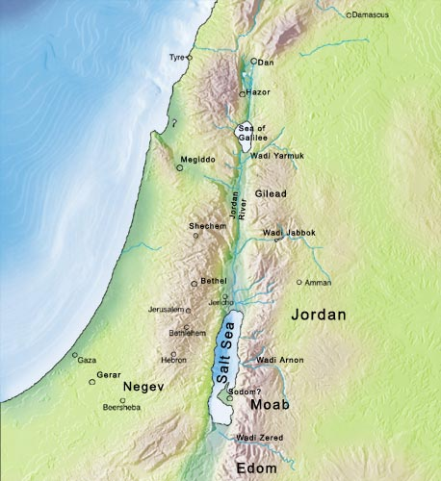
Galilee
Nazareth
Caesarea
Samaria
Perea
Joppa
Judea

Slide 45
Institutions
Sanhedrin: High Priest run, Sadducees+ scribes+elders
  Arrest and trial, no capital punishment; this court was disbanded after 70 AD
Synagogue—background, diaspora
  Structure: 10 heads
  4 Functions: school, worship, court, social (marrying/burying) among diaspora
  Worship: Shema, prayer, Scripture, sermon, blessing

Slide 46
NT –Jewish backgrounds
Josephus (37-100) –Jewish historian using Greek historiographic methods
Philo (20 BC-50 AD)—Alexandrian Jew, merging of Greek philosophy and Judaism
Later Judaism would see the LXX/Septuagint as a second golden calf (product of Hellenism; used by Christians)

