Slide 1
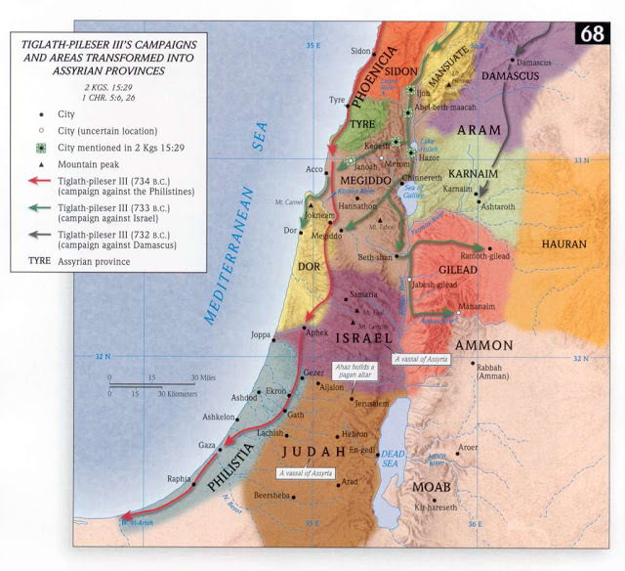
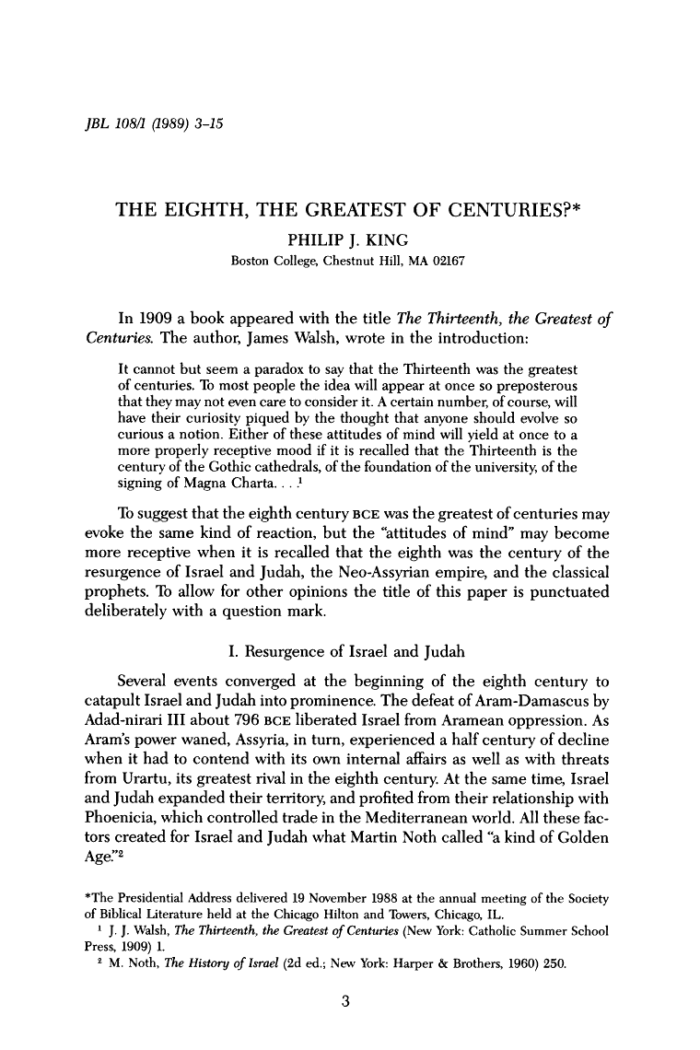

The Iron Age IIB (ca. 792-701 BC):
The Great Eighth Century Biblicalelearning.org
The Resurgence of Israel and Judah (ca. 790-740 BC) in the absence of imperial powers; a second golden age of Israelite culture and society (noted in Hosea, Amos and Isaiah 5).
The rise of Assyria dominated the final decades of the century, with regional kingdoms struggling against the might of this imperial power, resulting in great destructions and loss of life

Slide 2
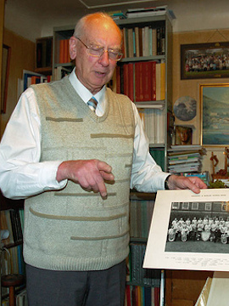
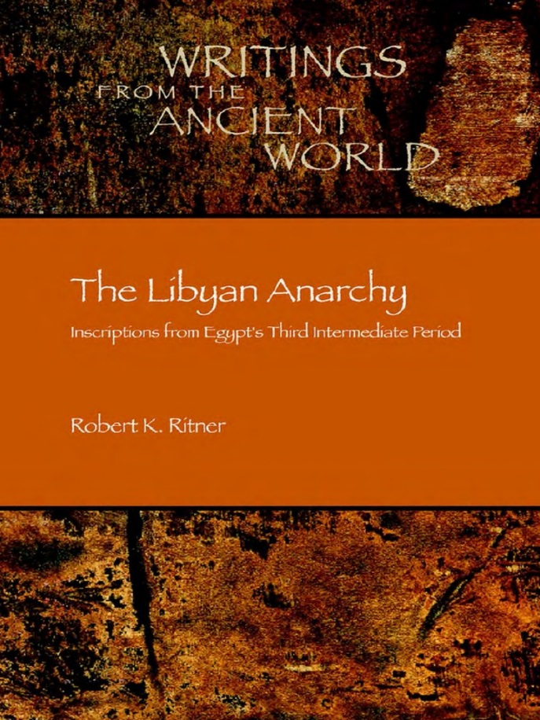
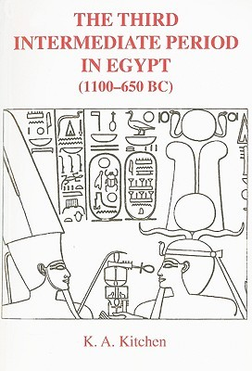
The Eighth Century in Geo-Political Context
Egypt: Egypt is fragmented and weak under the control of pharaohs of the 23-25th dynasties. Egyptologists, such as K.A. Kitchen, label this era as the Third Intermediate Period due to the chaotic turmoil and conflicting rule in the land. As such, Egypt did not play a major role in international affairs until the late seventh century BC (the 26th dynasty).

Slide 3
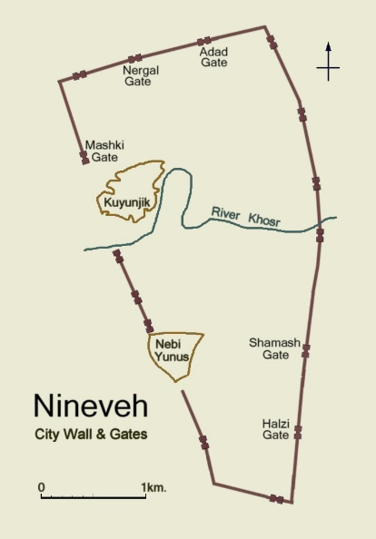
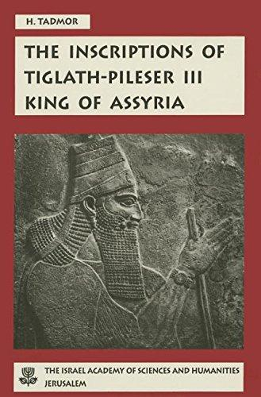
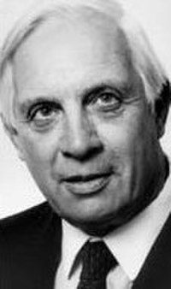
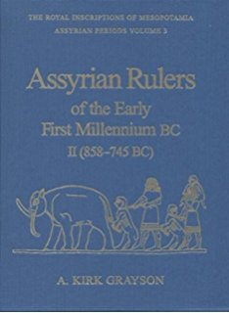
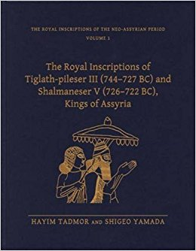
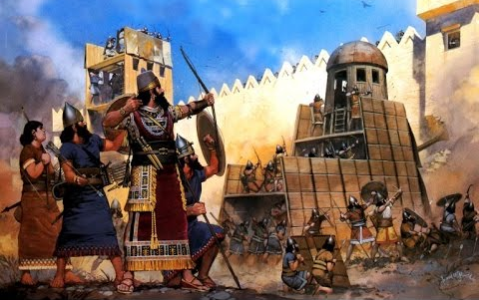
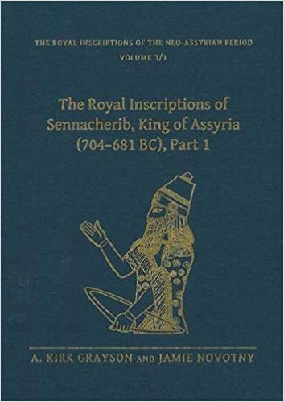
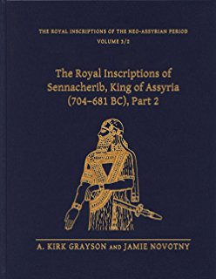
The Eighth Century in Geo-Political Context
Assyria: An Imperial superpower in Mesopotamia
Embroiled in regional conflicts and suffering from weak leadership during the first half of the century.
The reign of Tiglath-Pileser III revitalized Assyria and expanded her control into the Levant, which she controlled for over a century.
Donald J. Wiseman (1918-2010)

Slide 4
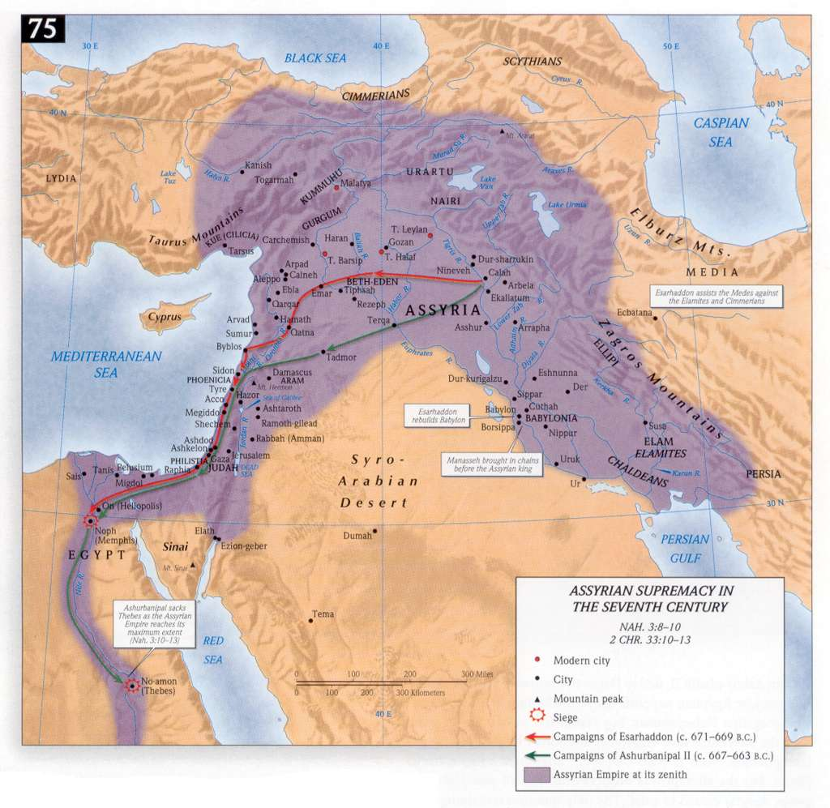
The Eighth Century Assyrian Kings
Adad-Nirari III (811-783 BC)
Shalmaneser IV (783-773 BC)
Ashur-Dan III (773-755 BC)
Ashur-Nirari V (755-745 BC)
Tiglath-Pileser III (743-727 BC)
Shalmanezer V (727-722 BC)
Sargon II (722-705 BC)
Sennacherib (705-681 BC)

Slide 5
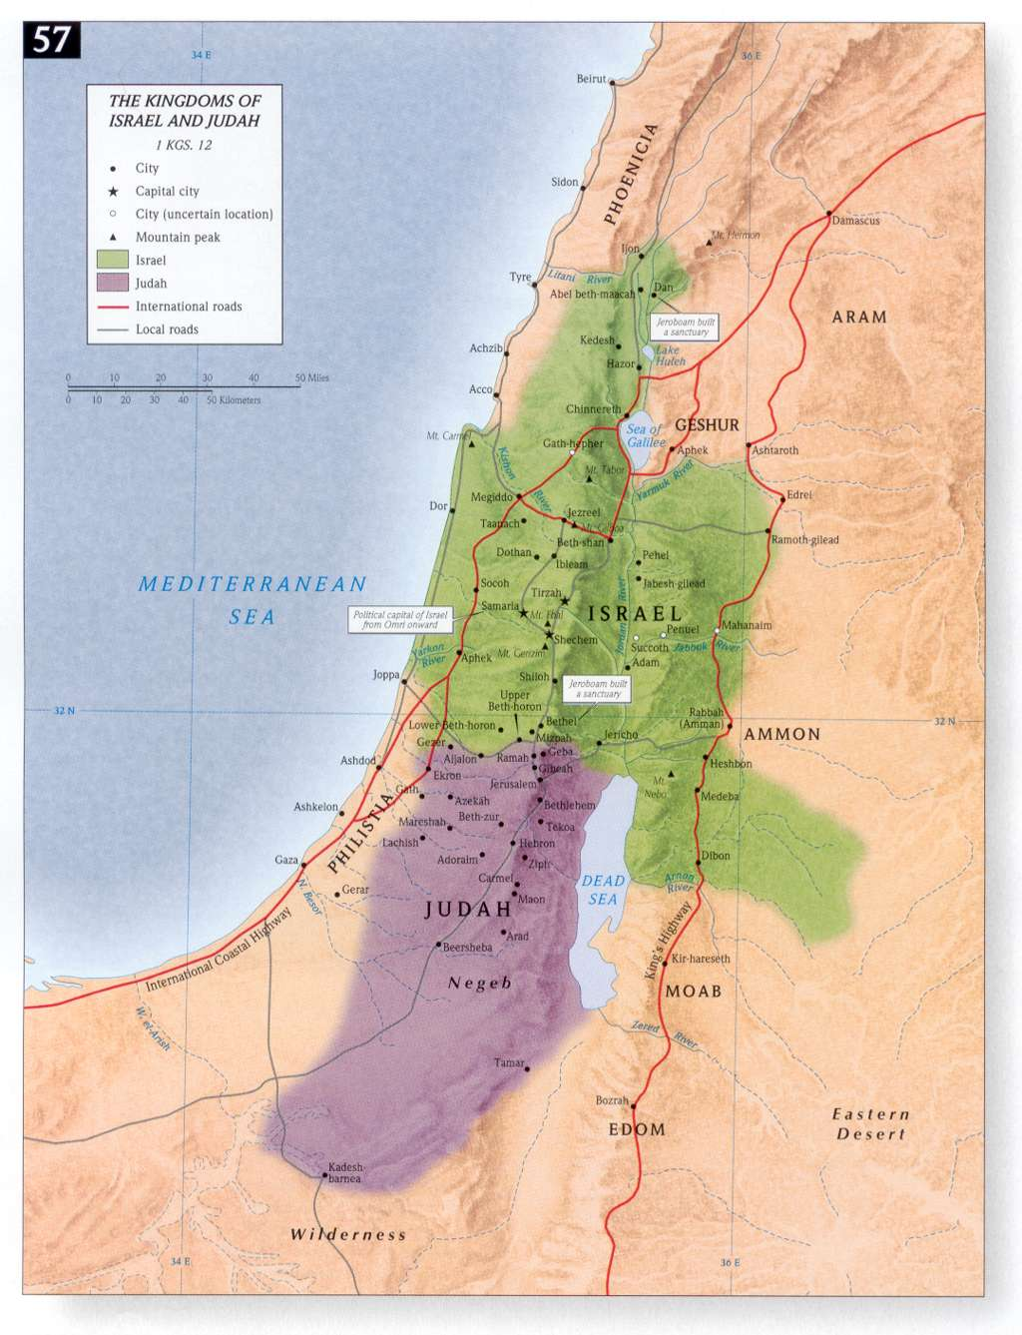
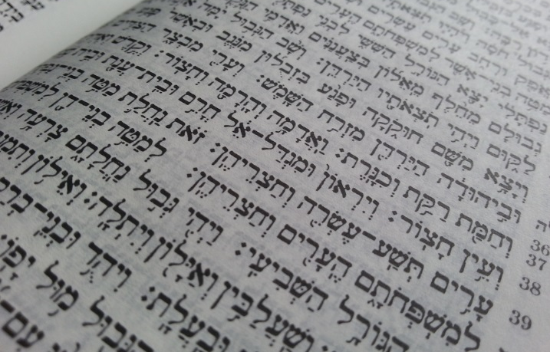
The Biblical Context of the Eighth Century
2 Kings 13-20
2 Chronicles 25-32
Jonah, the Prophet
Amos, the Prophet
Hosea, the Prophet
Isaiah the Prophet (1-39)
Micah, the Prophet
The dates of Joel and Obadiah are uncertain, but probably later

Slide 6
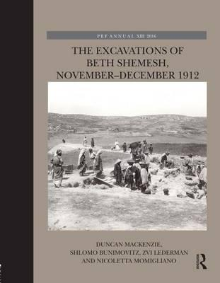
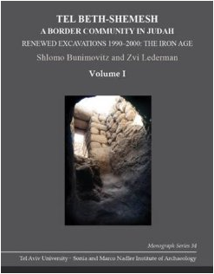
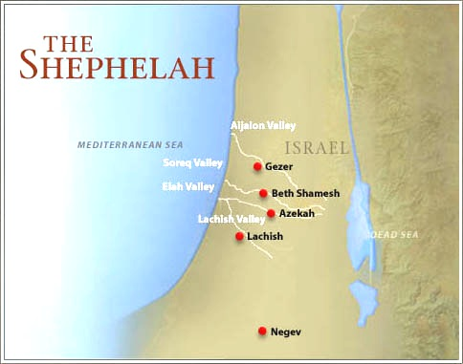
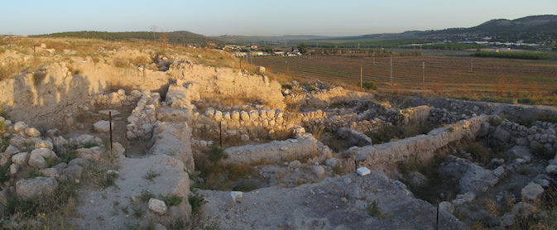
The Debacle at Beth Shemesh: The Victory of Jehoash over Amaziah (792 BC)
A minor dispute over Israelite mercenaries in Judah’s war against Edom erupts in a war of words, then violence, then warfare between Amaziah and Jehoash (2 Kgs 14; 2 Chr 25)
Beth Shemesh, a city on Judah’s NW border is destroyed (Level 3) and Amaziah is captured

Slide 7
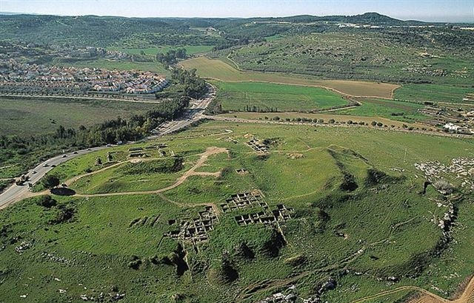
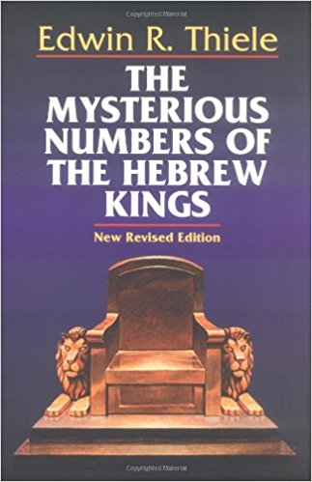
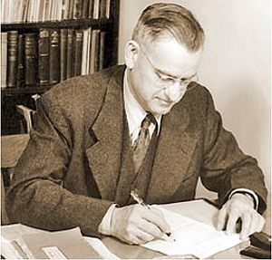
Jehoash’s Retaliatory Actions against Judah and the Ascension of Uzziah: A Chronological Bonanza
Jehoash sacks Jerusalem and the Temple, but the text hints that other cities suffered
Lachish, Judah’s second largest city was also partially destroyed at this time (Level IV) and this should also be related to Jehoash
These events and destructions should mark the transition of two archaeological eras (Iron Age IIA-IIB)
Edwin Thiele dated the co-regency of Amaziah and Uzziah to 792 BC

Slide 8
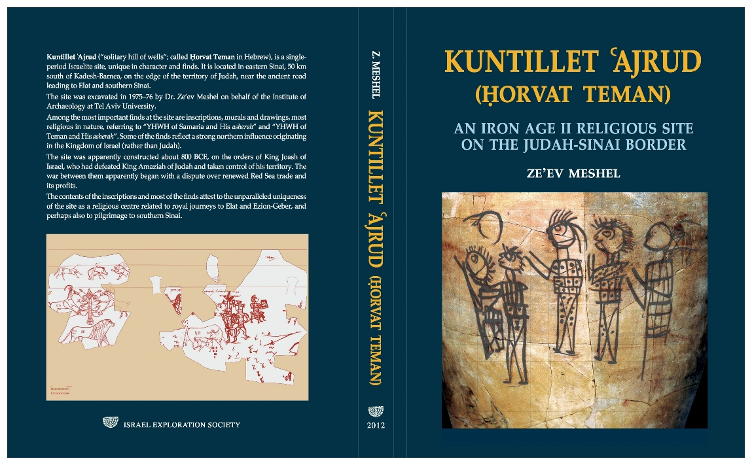
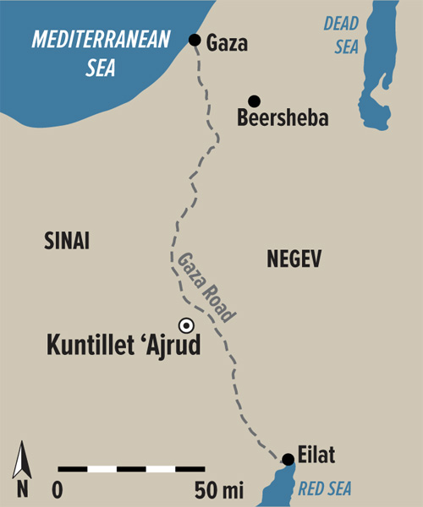
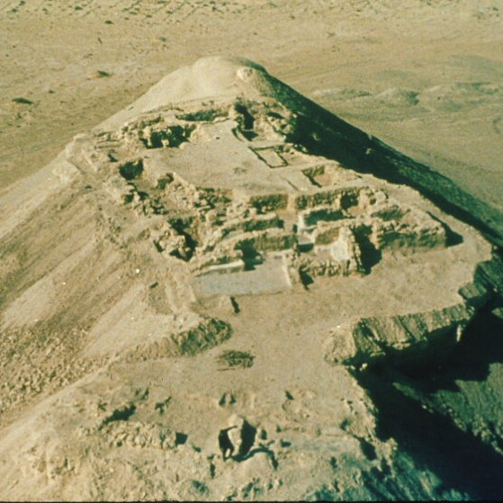
The Enigmatic Site of Kuntillet ‘Ajrud (Horvat Teman) in the Sinai
Excavated in 1975-76 by Ze’ev Meshel (Tel Aviv University) and published in 2012
Superb preservation of artifacts and buildings, including wood due to climate and isolation
Questions remain regarding its purpose, date, the polity with hegemony, iconography and inscriptions, including the famous: "I have blessed you by Yahweh of Samaria and [his] Asherah“
The site is important, but most of the sensational literature is overreaction and misplaced focus, as well as purely wishful thinking

Slide 9
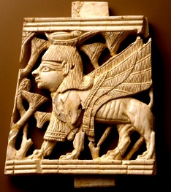
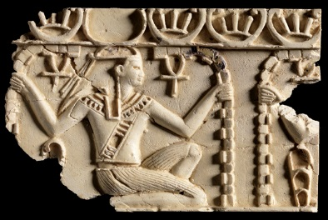
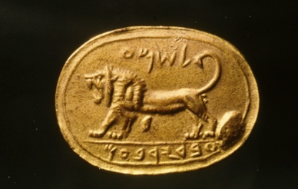
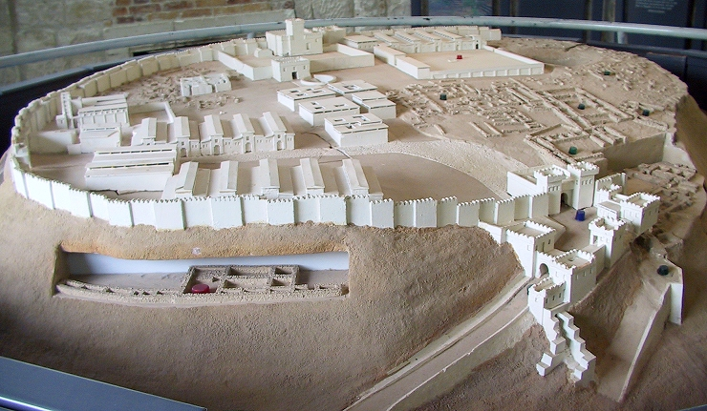
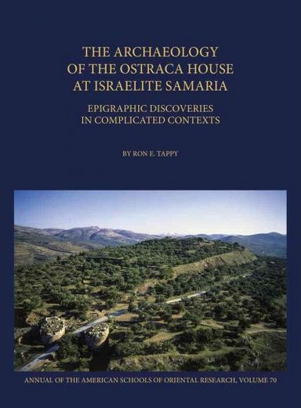
The Reign of Jeroboam II of Israel (793-753 BC)
Jeroboam II was a powerful Israelite king that reigned at the same time with Uzziah of Judah. The Bible only hints at his successes (2 Kgs 14:23-29)
He controlled an area stretching north to Lebo Hamath and covering parts of Transjordan to the Dead Sea, including making the kingdom of Aram-Damascus a vassal
About 80 ostraca and various ivory inlays were found inside the palace at Samaria (Amos 3:15)

Slide 10
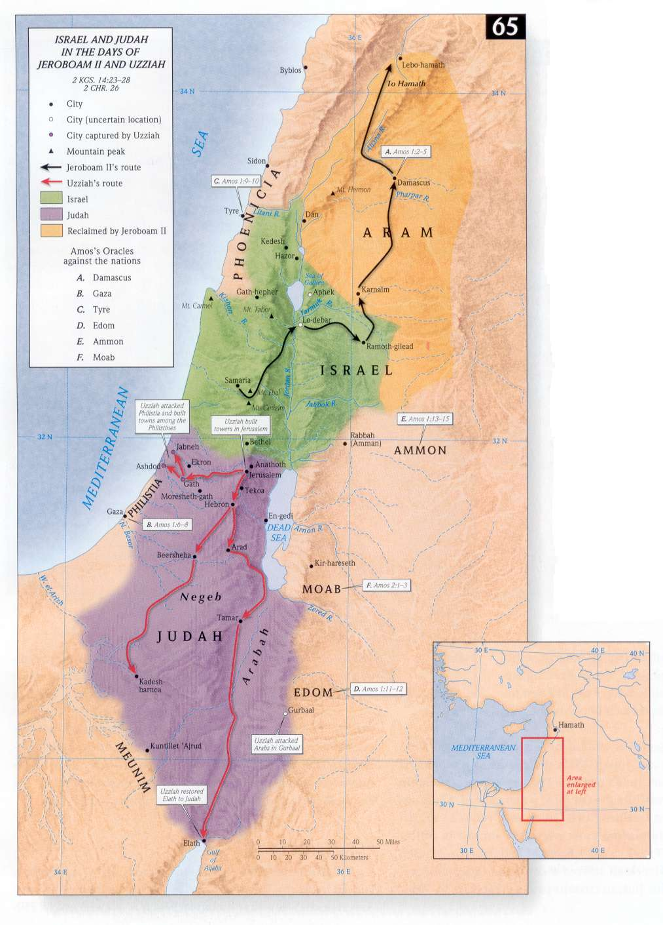
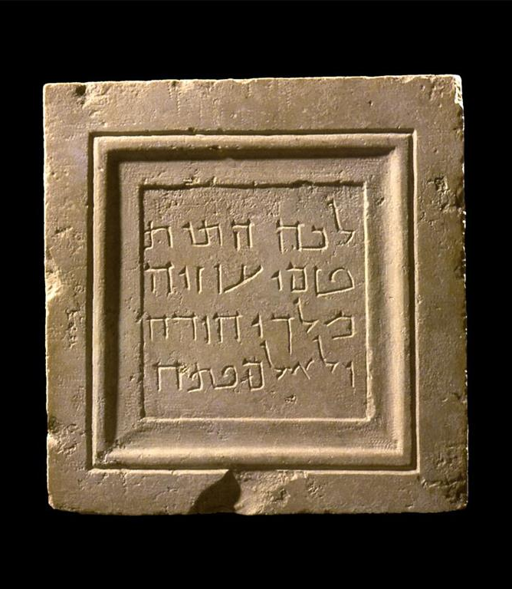
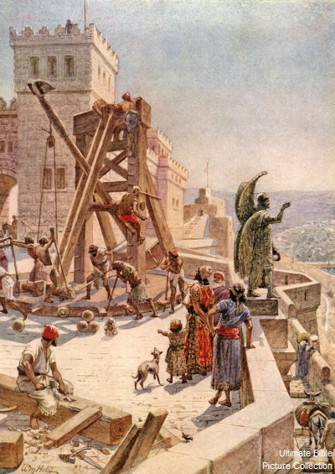
The Reign of Uzziah of Judah (792-740 BC)
Uzziah reigned 52 years, built and fortified Jerusalem, and the cities of Judah; towers, cisterns and isolated posts such as Tamar and Ezion Geber
Successful wars with Philistines and Arabs (2 Chr 26:6-7)
Agricultural activities: Royal Estates, Desert farming and herding in Transjordan and control over the Negeb trade routes (2 Chr 26:8-10)
All of Judah’s citie show a flourishing, vigorous economy and strong military (2 Chr 26:11-15)
The palace at Ramat Rahel, a site 3 miles south of Jerusalem (biblical Beth Hakerem), was probably built during Uzziah’s reign to oversee the royal estate in the Rephaim Valley

Slide 11
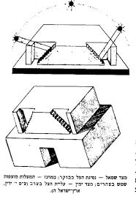
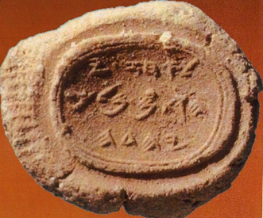
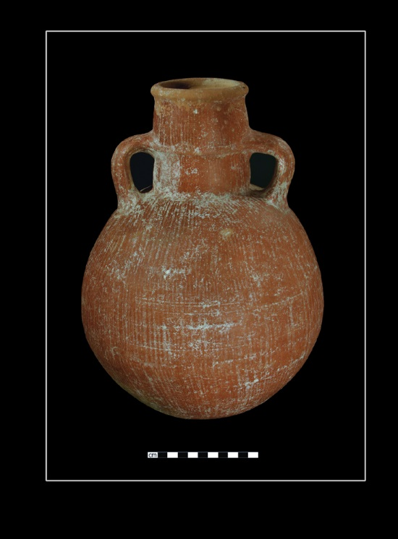
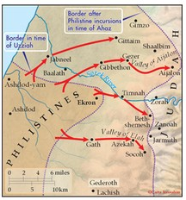
The Reign of Ahaz (735-716 BC)
Ahaz was a weak king that trusted in diplomacy and vassaldom rather than in the LORD
The Dial of Ahaz (2 Kgs 20:5-11; Isaiah 38:8)
LPDW (Ashdod Ware)
Philistine Incursions from the west and a Appeal to Assyria for help (2 Chr 28:16-20)
The Syro-Ephraimite War (Isaiah 7)

Slide 12
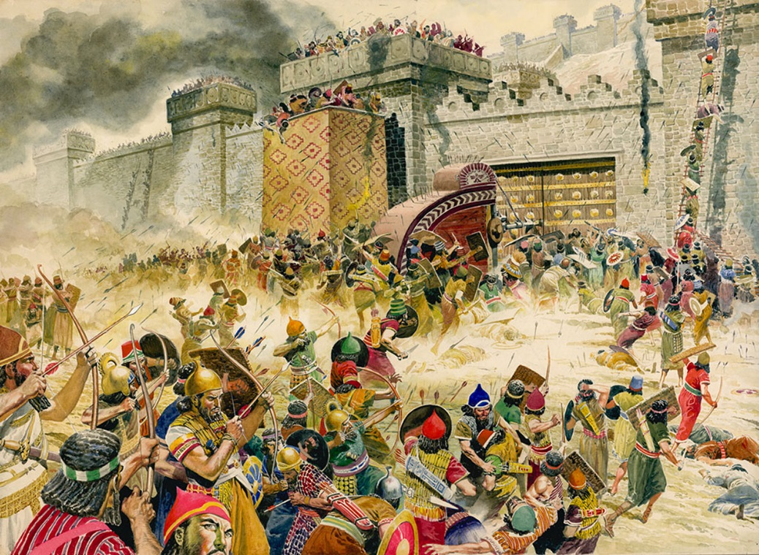
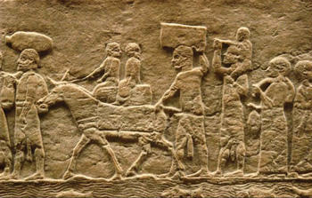
The Fall of Israel (732-722 BC)
The Fall of the Jehu Dynasty after the death of Jeroboam II and political turmoil
The Invasion of Tiglath-Pileser III in 734-732 BC, and the fall of Gilead, Galilee and the cities of Hazor and Megiddo during the reign of Pekah (2 Kgs 15:29). Israel is confined to the Hill Country of Manasseh and Ephraim and much of her population deported.
Israelite king Hoshea attempts to enlist Egyptian aid to revolt against Assyria, but fails and Samaria falls after a long siege in 722 BC to Sargon II.
Assyria deports most of the population to northern Assyria, leading to legends about the ten lost tribes of Israel.

Slide 13
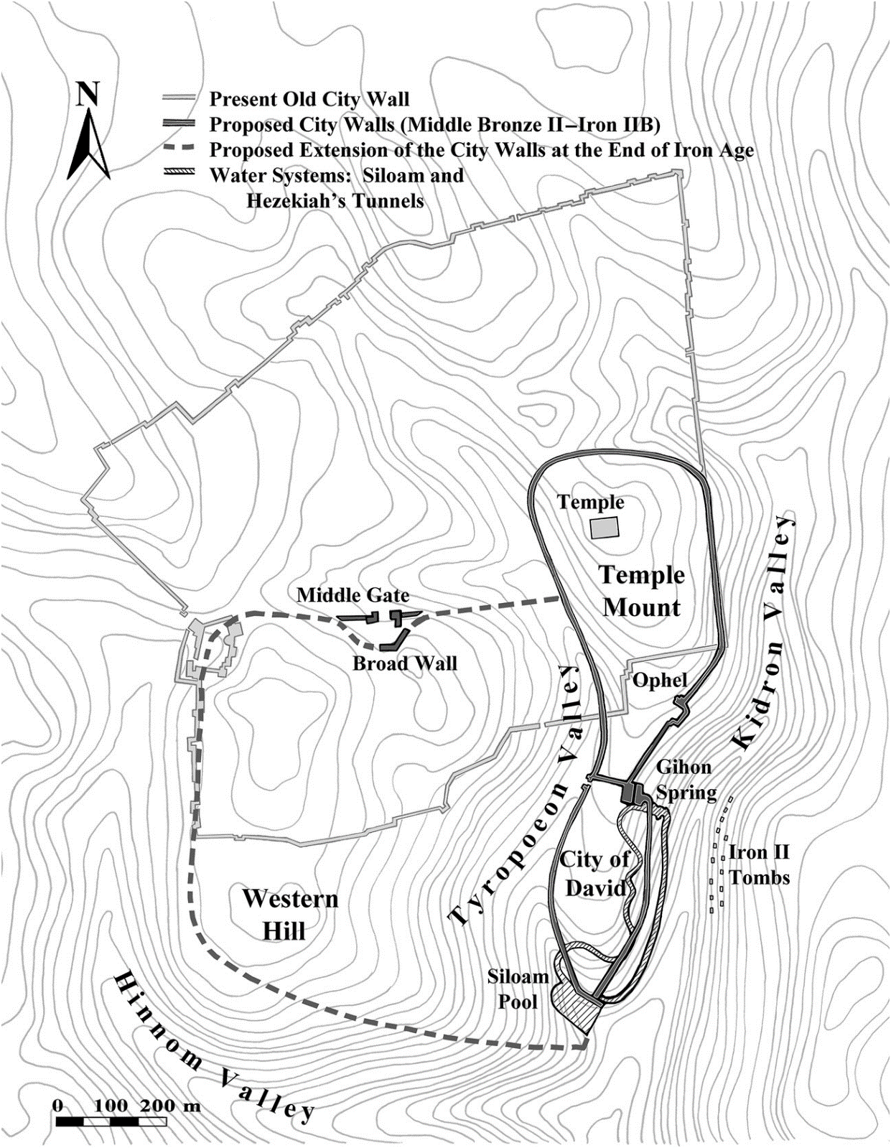
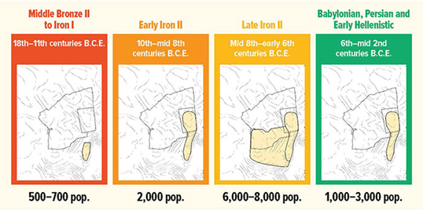
The Growth of Jerusalem during the Ninth-Eighth Century
Expansion began during the ninth century; a 600 foot section of city wall destroyed and suburbs mentioned (2 Kgs 14:13-14, 22:14; 2 Chr 25:23-24, 34:22; Zph 1:10-11)
Expansion was steady growth, not a sudden influx of refugees from the north
Cemeteries framed the city on all sides
Segments of walls and multiple occupational phases attest to a long Iron Age occupation on the Western Hill (Mount Zion)
The Garden of Uzza was a royal palace and burial place on the Western Hill (2 Kgs 21:18,26, 24:6 LXX)

Slide 14
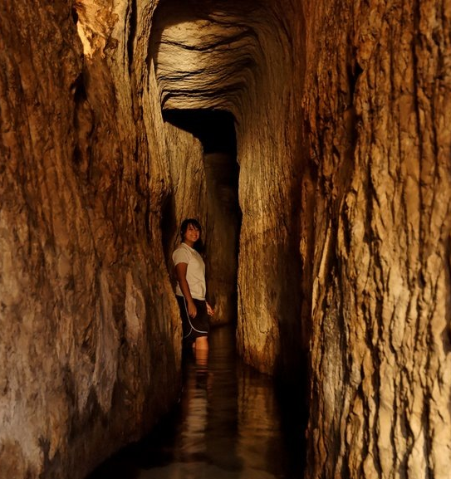
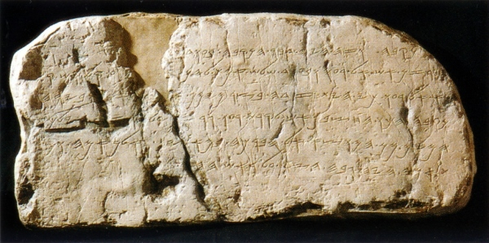
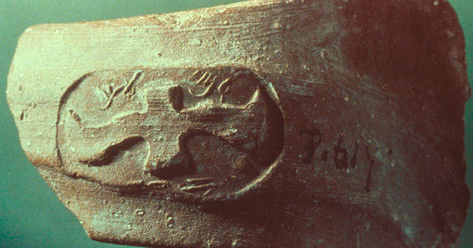
The Reign of Hezekiah (716-687 BC)
Hezekiah was a vigorous ruler and prepared to revolt against Assyria, amassing conspirators from the region as well as from Egypt (Tirhakah; 2 Kgs 19:9) and Babylonia (Merodach-Baladan; 2 Kgs 20:12; 2 Chr 32:31; Isaiah 39:1-8)
He brought water into the city of Jerusalem from the Gihon Spring (2 Chr 32:30) via a long rock cut tunnel 533 m (1748 feet) in length. The Shiloah Inscription preserves an account of this great work
He fortified Jerusalem and the cities of Judah and amassed large amounts of supplies (2 Chr 32:27-29)
The Royal (lmlk) Jars of Judah
Hezekiah launched his revolt in 705/4, when Sargon II died in battle.

Slide 15
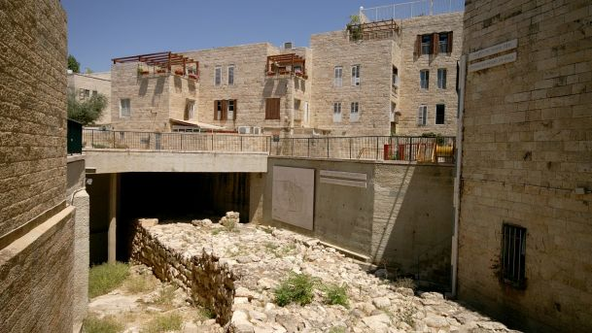
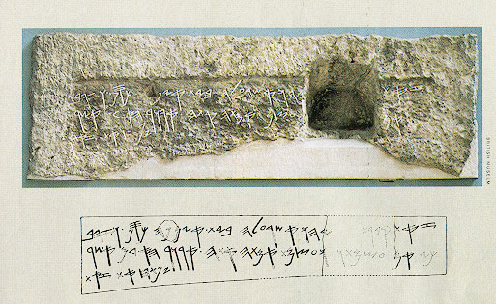
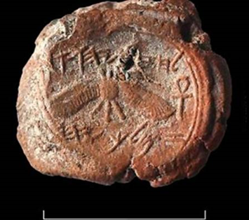
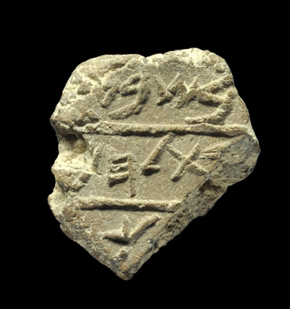
Archaeology and Hezekiah
The Broad Wall (Neh 3:8) discovered in the Jewish Quarter in 1970
Isaiah 22:15-16; a strong comment against Shebna, the royal steward and his tomb
A bulla of King Hezekiah and another mentioning Bethlehem concerning taxes
The Assyrian Invasion of 701 BC against Judah and Hezekiah has become a chronological cornerstone of biblical history

Slide 16
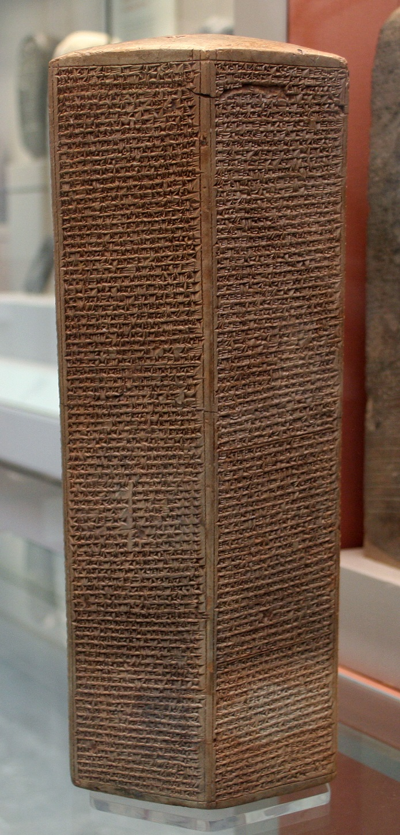
Sennacherib’s Invasion of Judah (701 BC)
As to Hezekiah, the Jew, he did not submit to my yoke, I laid siege to his strong cities, walled forts, and countless small villages, and conquered them by means of well-stamped earth-ramps and battering-rams brought near the walls with an attack by foot soldiers, using mines, breeches as well as trenches. I drove out 200,150 people, young and old, male and female, horses, mules, donkeys, camels, big and small cattle beyond counting, and considered them slaves. Himself I made a prisoner in Jerusalem, his royal residence, like a bird in a cage. I surrounded him with earthwork in order to molest those who were his city's gate. Thus I reduced his country, but I still increased the tribute and the presents to me as overlord which I imposed upon him beyond the former tribute, to be delivered annually. Hezekiah himself, did send me, later, to Nineveh, my lordly city, together with 30 talents of gold, 800 talents of silver, precious stones, antimony, large cuts of red stone, couches inlaid with ivory, nimedu-chairs inlaid with ivory, elephant-hides, ebony-wood, boxwood and all kinds of valuable treasures, his own daughters and concubines.
2 Kgs 18:13 summarizes this invasion: “In the fourteenth year of King Hezekiah’s reign, Sennacherib king of Assyria attacked all the fortified cities of Judah and captured them.”

Slide 17




The Fall of Lachish (701 BC)
Lachish, Judah’s second largest city fell to Sennacherib after a bitter siege and battle. Assyrian artists captured this epic event and created large stone panels commemorating it, which were displayed in Sennacherib’s throne room at Nineveh. It depicts the city, its inhabitants, Assyrian atrocities and Sennacherib himself.
Excavations at Lachish have added to our knowledge of what happened and demonstrate the tenacity and resolve of the population of this great city.

Slide 18

The Deliverance of Jerusalem from Assyria
No destruction layer in Jerusalem corresponds to the miraculous event recorded in the OT
185,000 Assyrians die outside the walls of Jerusalem and Sennacherib returns home, later to be murdered by his sons (2 Kgs 19:25)
Sennacherib’s inscriptions and reliefs also strongly imply that Jerusalem was not conquered
Herodotus (ca. 484-425 BC), the Greek historian writes about a plague that affected Assyrian troops in the region (Histories ii,141).
Judah and Hezekiah survive, but the kingdom is devastated and later becomes an Assyrian vassal state under Hezekiah’s son and successor, Manasseh
The Rise of Royal Zion Theology

Slide 20
Image Credits
King, P. J., The Eighth, The Greatest of Centuries? Journal of Biblical Literature 108: 3-15, 1989.
Biblical Archaeology Society Library: Philip J. King Image https://www.google.com/search?rlz=1C1EVTC_enUS545US546&biw=1920&bih=959&tbm=isch&sa=1&ei=FzEcWtmQIJXijwTusaYY&q=philip+j.+king+boston+college&oq=philip+j.+king+boston+college&gs_l=psy-ab.3...25717.27809.0.27912.15.15.0.0.0.0.113.958.14j1.15.0....0...1c.1.64.psy-ab..0.0.0....0.FSdwfhFZyWM#imgrc=CKdL--9su_YWxM:
Tiglath-Pileser III Campaign map: https://www.pinterest.com/pin/319474167288027232/
K.A. Kitchen Image: https://www.conservativebookclub.com/authors/k-a-kitchen
Map of Nineveh: https://en.wikipedia.org/wiki/Nineveh
Wiseman, Donald J., Jonah’s Nineveh. Tyndale Bulletin 30: 29-51, 1979.
Donald J. Wiseman Image: https://www.google.com/search?rlz=1C1EVTC_enUS545US546&biw=1920&bih=959&tbm=isch&sa=1&ei=ATQcWtWqKIngjwSllJmQAQ&q=donald+j+wiseman+jonah%27s+nineveh&oq=donald+j+wiseman+jonah%27s+nineveh&gs_l=psy-ab.12...133679.137065.0.139454.14.12.2.0.0.0.90.747.12.12.0....0...1c.1.64.psy-ab..0.0.0....0.NcjyXM27__E#imgrc=vcA99w0sSeTF_M:
Map of Assyria: http://www.freeinfosociety.com/media.php?id=268
Map of Israel and Judah: http://www.resourcemelb.catholic.edu.au/object.cfm?o=118&pid=578&showrm=true&uptam=false
Map of Israel and Judah during the Eighth Century: https://www.google.com/search?q=israel+and+judah+eighth+century&rlz=1C1EVTC_enUS545US546&source=lnms&tbm=isch&sa=X&ved=0ahUKEwiz_76Po9_XAhXI34MKHZjfDTkQ_AUICygC&biw=1920&bih=959#imgdii=vqHLbVhiYfNNXM:&imgrc=V5qR29-QSAVQ1M:
Beth Shemesh: http://britishbibleschool.com/biblos/tel-beth-shemesh
The Shephelah: http://goodshepherdpceducation.blogspot.com/2010/10/world-of-bible-class-oct-17-2010-class.html
Edwin Thiele Image: http://creationwiki.org/Edwin_Thiele
Model of Megiddo: https://www.bibleistrue.com/qna/pqna50.htm
Samaria Ivories: http://www.lebtahor.com/Observe/origins/origins%20of%20yom%20hakippurim%20day%20of%20atonements.htm and https://www.metmuseum.org/exhibitions/listings/2014/assyria-to-iberia/blog/posts/phoenicia-and-the-bible
K-A Image: https://0lem.wordpress.com/2013/11/22/othergods/
Map of K-A: https://www.baslibrary.org/biblical-archaeology-review/38/6/2?ip_login_no_cache=%15%03%AAy%19%22U%84
Uzziah tombstone: http://www.museumsinisrael.gov.il/ar/items/Pages/ItemCard.aspx?IdItem=ICMS_IMJ_353190
Map of Philistine incursions during the days of Ahaz: http://store.carta-jerusalem.com/carta-map-bank/360-philistine-conquests-in-the-days-of-ahaz.html
Fall of Samaria: http://www.illustrationartgallery.com/acatalog/info-LawrenceSamariaLL.html
Samaria deportees: http://www.biblearchaeology.org/post/2009/05/28/Nahum2c-Nineveh-and-Those-Nasty-Assyrians.aspx
Shanks, H., Ancient Jerusalem: The Village, the Town, the City. Biblical Archaeology Review May/June, 2016. https://www.biblicalarchaeology.org/daily/biblical-sites-places/jerusalem/ancient-jerusalem/
Jerusalem Map: https://www.cambridge.org/core/books/cambridge-world-history/jerusalem-capital-city-created-in-stone-and-in-imagination/15B11FE0A07FB42D513C7640D03F1987
Ahaz bulla: https://dwellingintheword.wordpress.com/2011/03/07/481-2-kings-16/
Hezekiah’s Tunnel: http://blog.bibleplaces.com/2009/01/hezekiahs-tunnel-q.html
Siloam (Shiloah) Inscription: http://www.biblehistory.net/newsletter/pool_siloam.htm
LMLK jar handle: http://cojs.org/author/anne/page/19/
Broad wall: https://www.haaretz.com/israel-news/travel/tourist-tip-of-the-day/the-broad-wall-of-jerusalem-that-fended-off-the-assyrians.premium-1.517030
Royal Steward inscription: http://prophetess.lstc.edu/~rklein/Documents/judah.htm
Bethlehem seal impression: https://phys.org/news/2012-05-ancient-bethlehem-unearthed-jerusalem.html
Shema Seal: https://watchjerusalem.co.il/2016/12/21/uncovering-the-bibles-buried-cities-megiddo/
Hezekiah bulla: http://www.truth-that-matters.com/israelnews.htm
Lachish Image and Reliefs: https://emp.byui.edu/SATTERFIELDB/Rel302/Lachish/Lachish.htm
Sennacherib Prism: https://en.wikipedia.org/wiki/Sennacherib%27s_Annals

Slide 21
Eighth Century Archaeological Highlights
Kuntillet Ajrud inscriptions
Samaria Ivories
Samaria Ostraca
Shema Seal
Uzziah’s tombstone
Royal (lmlk) jars
Royal steward inscription
Ahaz bulla
Lachish reliefs
Sennacherib prism
Bethlehem bulla
Hezekiah bulla
Siloam Inscription
Broad Wall
Hezekiah’s Tunnel

