Slide 1
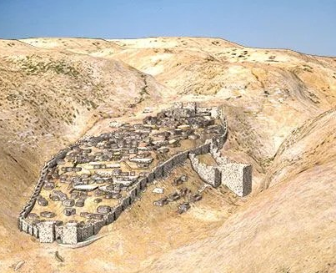
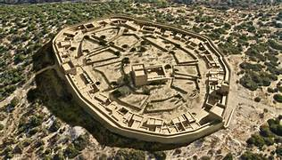
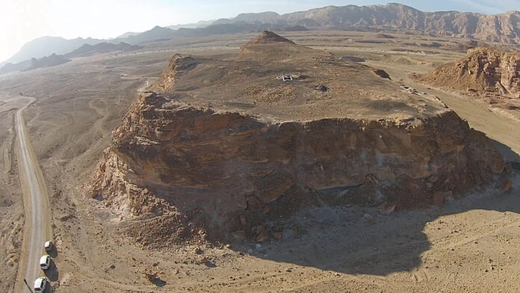
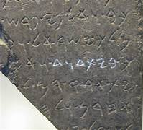
Archaeology and the Historical David Jeffrey P. Hudon Ph.D. Biblicalelearning.org
Recent discoveries have provided dramatic evidence supporting the biblical accounts of David’s life and reign
Khirbet Qayafa (upper left), an Israelite town from the time of Saul and David (reconstruction by artist)
Jerusalem (City of David) during David’s reign (reconstruction by artist; upper right)
Slave’s Hill at Timna; a copper mining operation (lower left)
Close up of the Tel Dan Stele fragment that mentions the “House of David” (lower right)

Slide 2
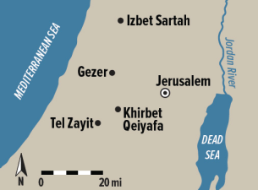
An Archaeologist Looks at the Life of David
Lecture Content
A Biblical Portrait of David’s Life and his Legacy
David’s Early Years: Bethlehem and the Rephaim Valley: Giloh
Gibeah of Saul: Capital of Israel and Nob
The Elah Valley: David defeats Goliath Zorn’s article
Gath: David’s time under Achish; Ziklag; Mount Gilboa
The Wilderness of Judah; Carmel, Masada, En Gedi, Arrowheads
Jerusalem: Map and Map of David’s Kingdom
Bethsaida
Rabbath Ammon
Newly discovered inscriptions: Tel Dan, Moabite Stele, Karnak Temple
Khirbet Qayafa (Sha’arim); gates, fortifications, admin building, temple, inscription, thumb print jar handles
Timna Valley and Edom Lowlands: Mount Timna Gateway, KEN

Slide 3
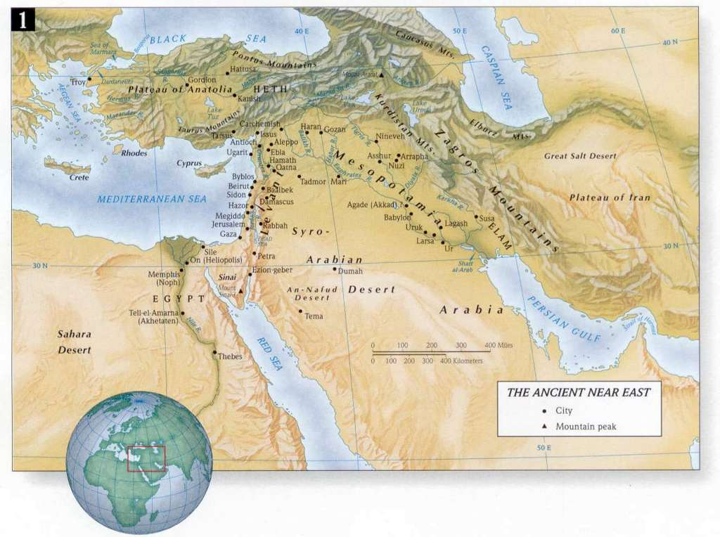
The World of King David: The Ancient Near East in ca. 1000 BC, A Power Vacuum

Slide 4
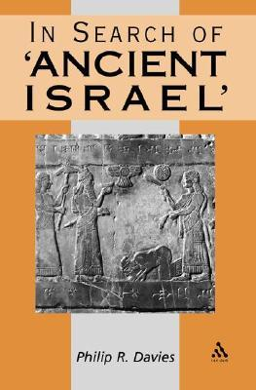
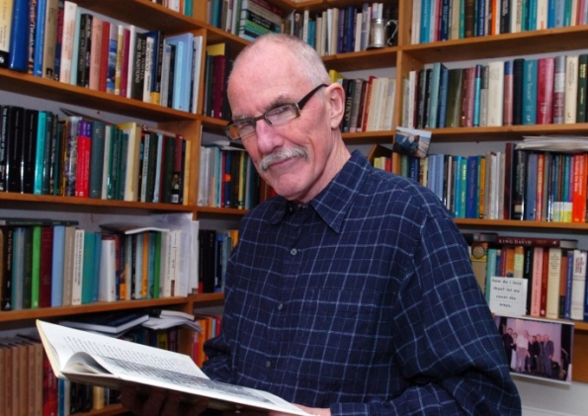
The Minimalist Challenge
Philip R. Davies (University of Sheffield): "King David is about as historical as King Arthur."

Slide 5
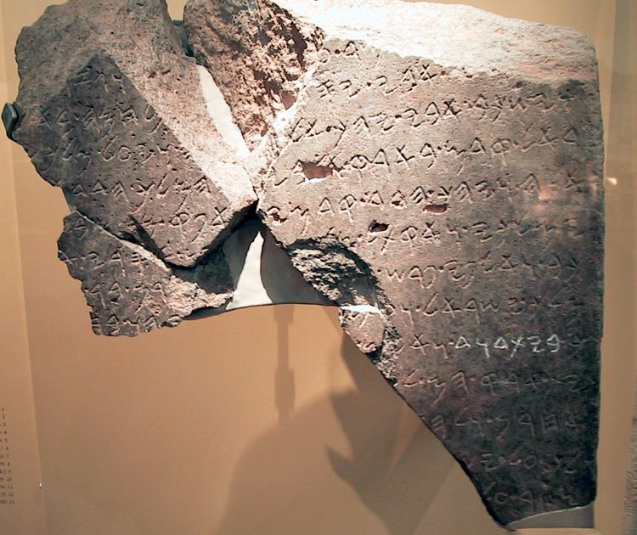
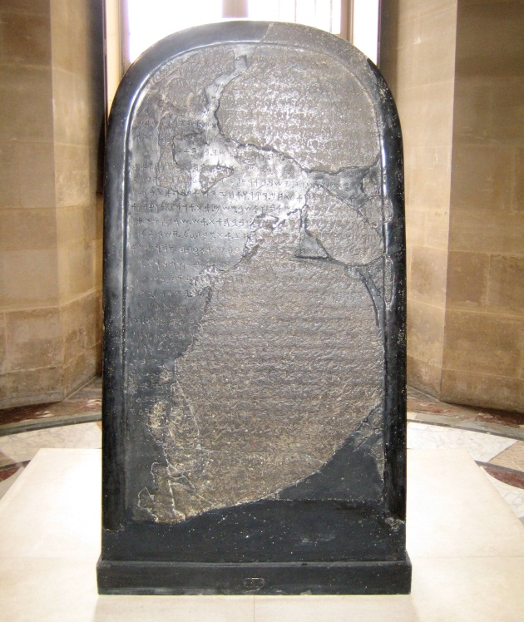
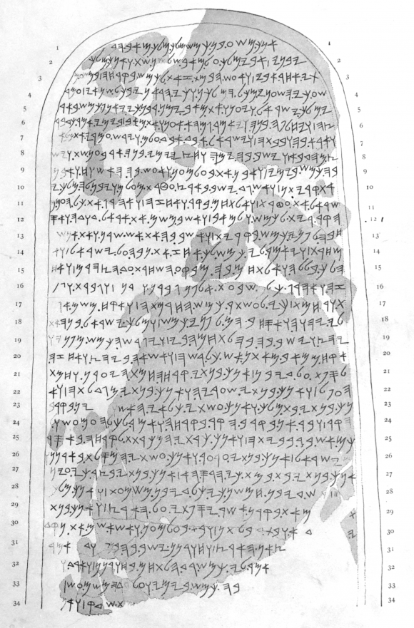
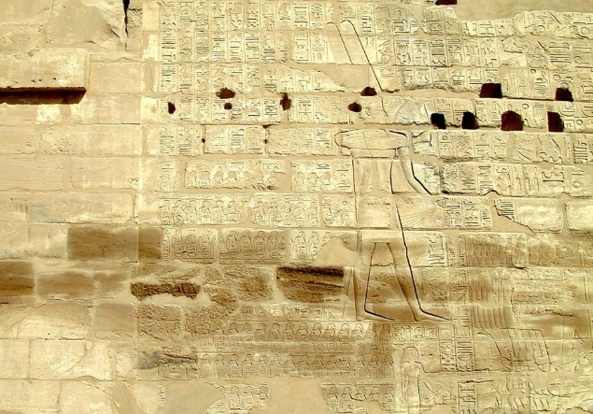
The Historical David
The Tel Dan Stela was discovered at Tel Dan in July 1993 (Biran and Naveh 1993). Then, in June 1994, two additional joining fragments were found (Biran and Naveh 1995). Together these pieces represent only a fraction of a much longer inscription. The language is Aramaic and it celebrates the victory of a king of Aram over Israel and Judah. It is the first royal inscription to be found in Israel. The most stunning aspect of the document is the reference to Judah as the “House of David.” For the first time, it was thought, the name David appeared in an extra-Biblical document. At about the same time, however, two French scholars, André Lemaire (1994) and Émile Puech (1994), independently recognized the same phrase in the Mesha Inscription [848 BC], which has been around for well over 100 years. It now likely that the name David is in a third inscription. Egyptologist K.A. Kitchen believes that the phrase “highland of David” appears in the Shishak inscription on the Bubastite portal in the Temple of Amun at Karnak, Egypt (1997: 39–41). All this at a time when a number of scholars were challenging the existence of the United Monarchy and a king name David!

Slide 6
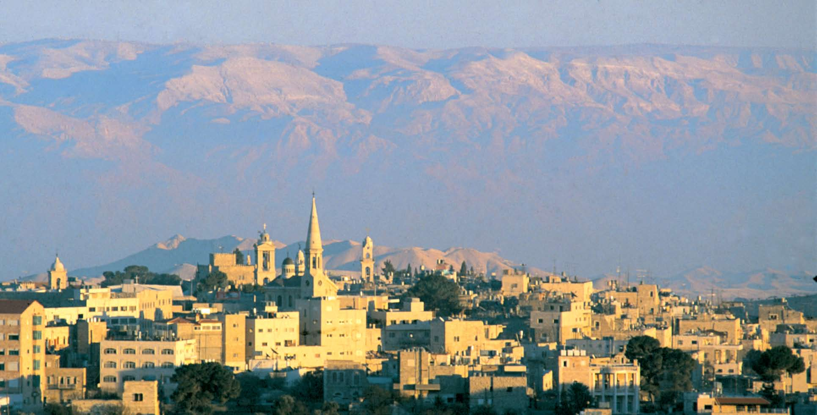
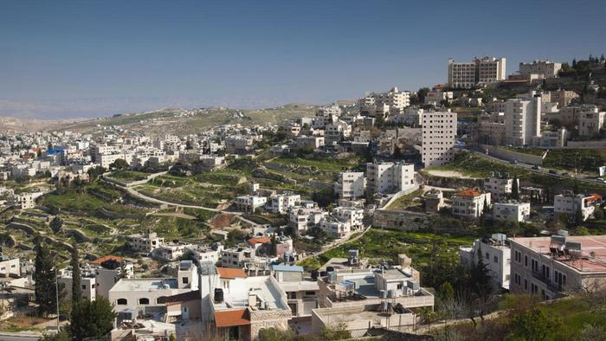
Bethlehem of Judah

Slide 7
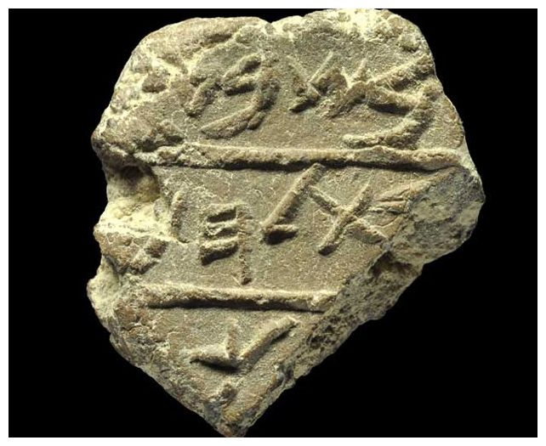
Bethlehem Seal “Bulla” recently found in Jerusalem
Probably originally affixed to an important administrative tax document, this “bulla” or clay sealing stamp was discovered in Jerusalem and dates to about 700 BC. It is the oldest known reference to Bethlehem outside of the Bible!
Translation: “in the seventh (year)… Bethlehem… (mele)ch”

Slide 8
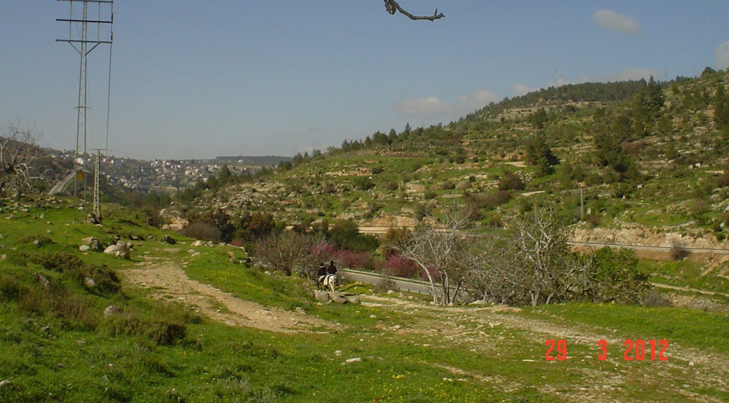
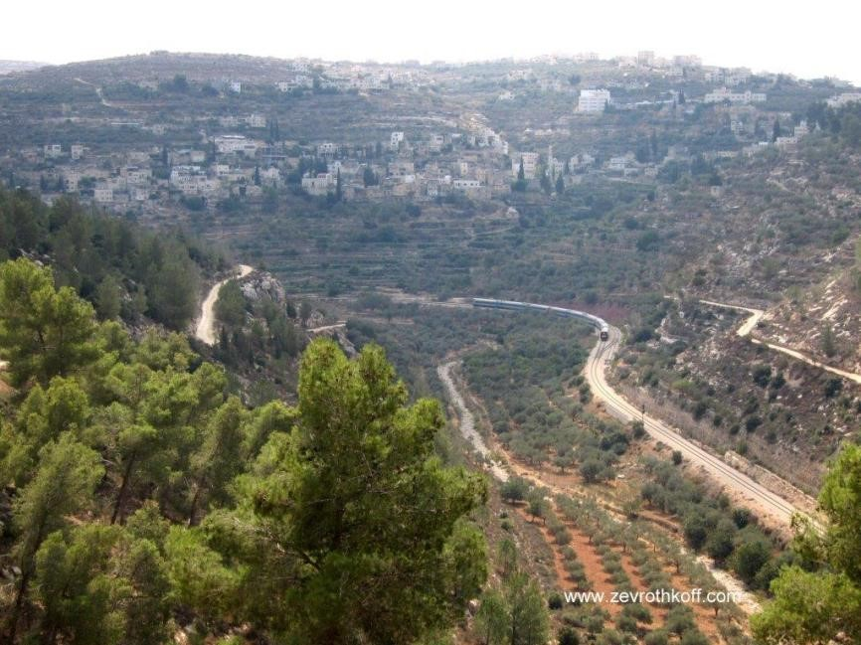
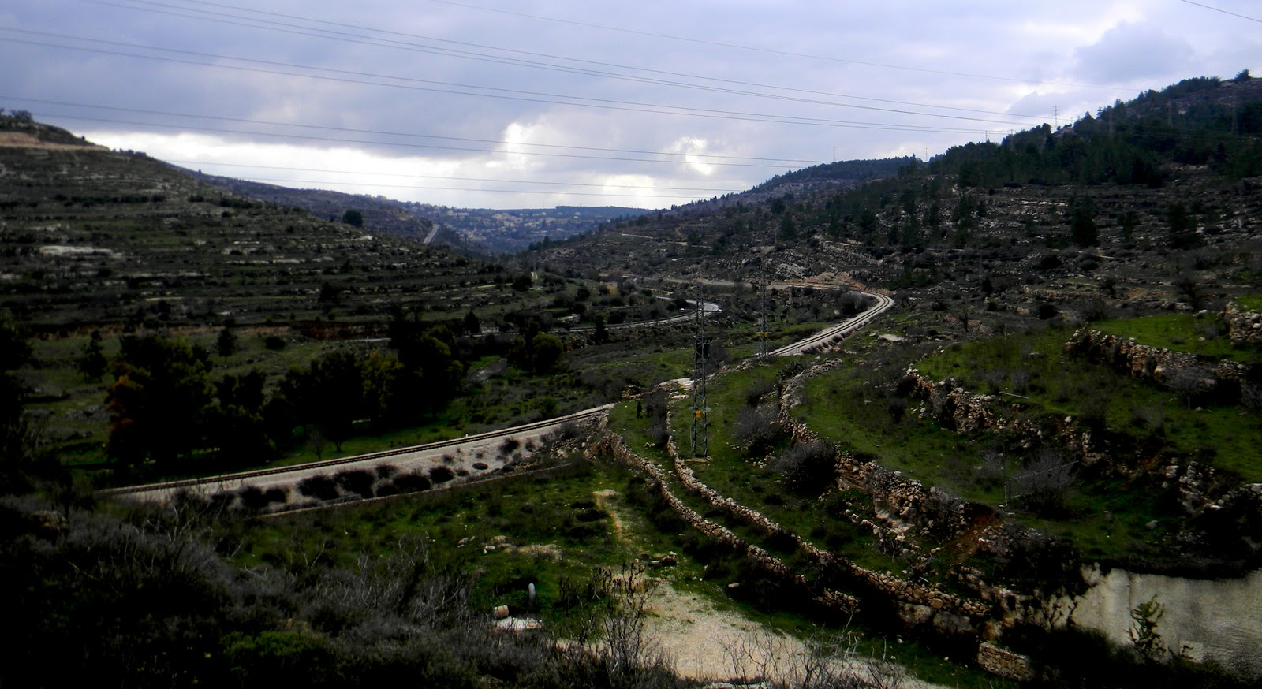
The Rephaim Valley: Breadbasket and Battleground of Jerusalem

Slide 9
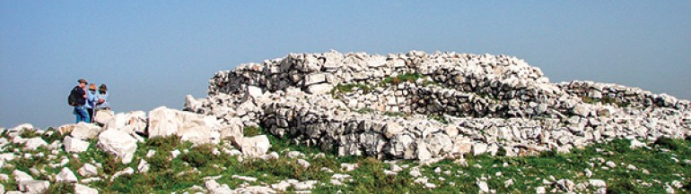
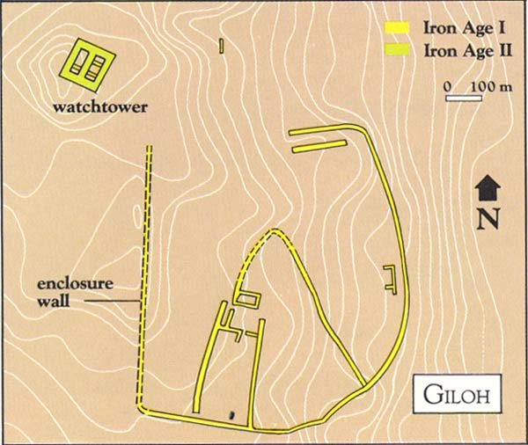
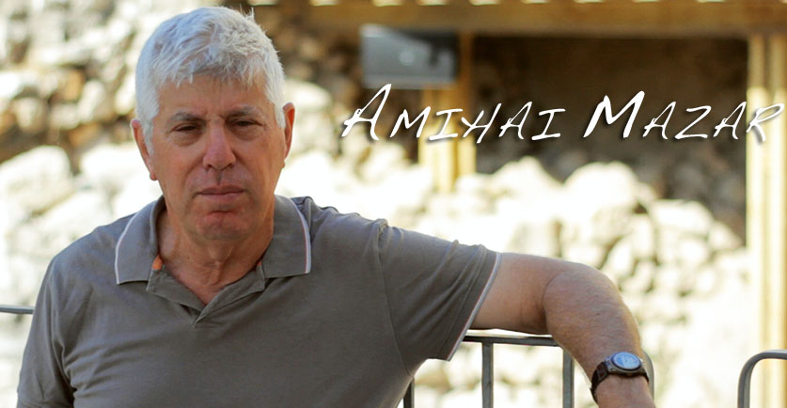
Tel Giloh: Biblical Ba’al Perezim (Mount Perezim)? 2 Samuel 5:20; 1 Chronicles 14:11; Isaiah 28:21

Slide 10
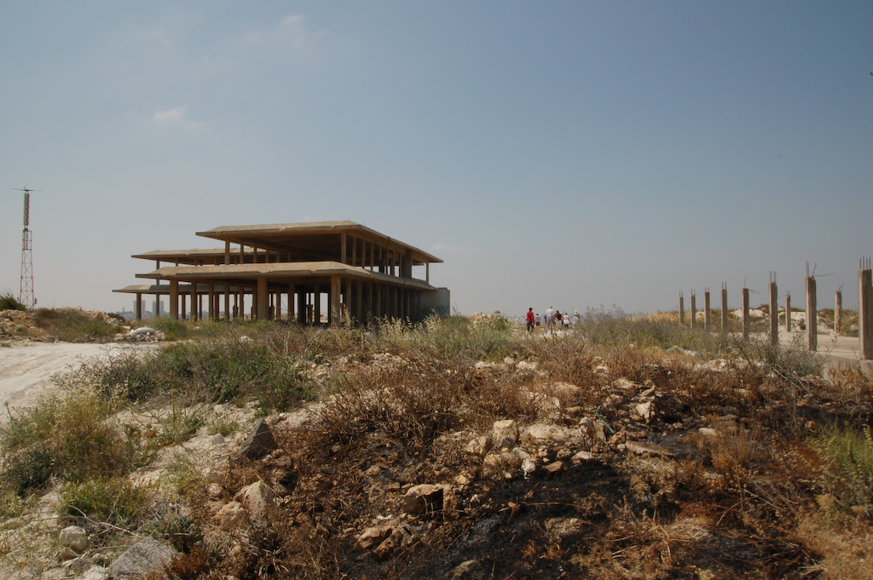
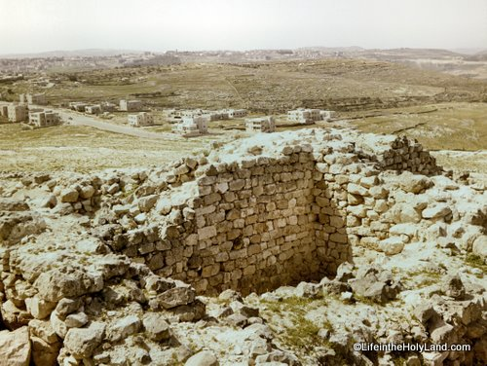
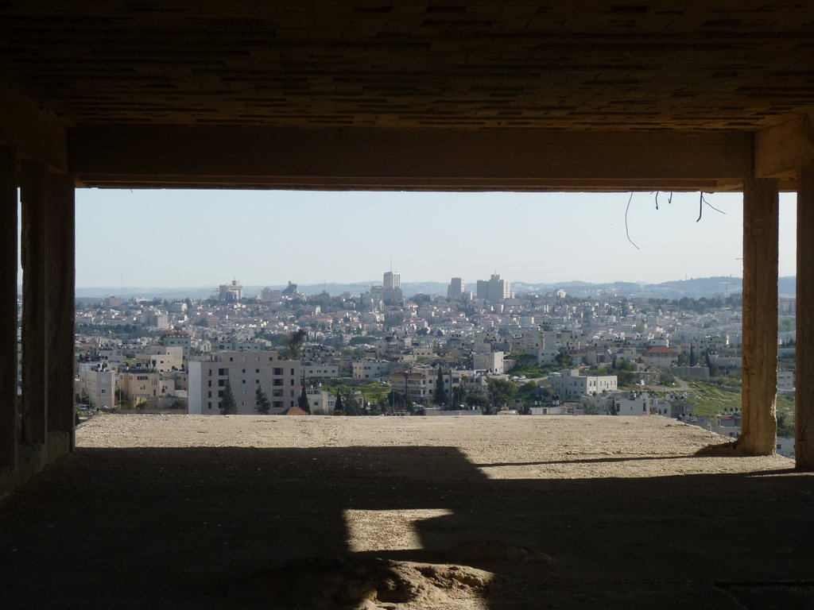
Gibeah of Saul (Tell el-Ful)

Slide 11
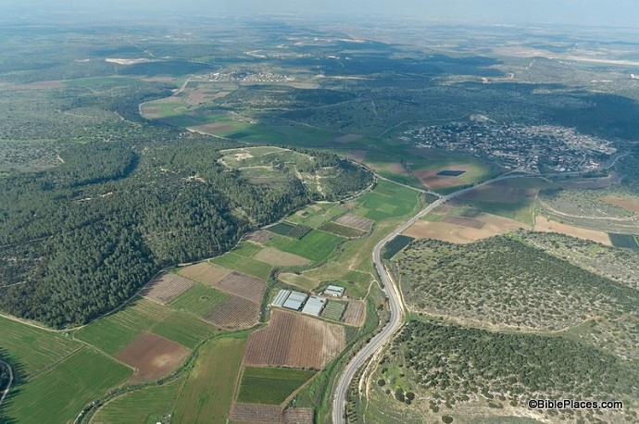
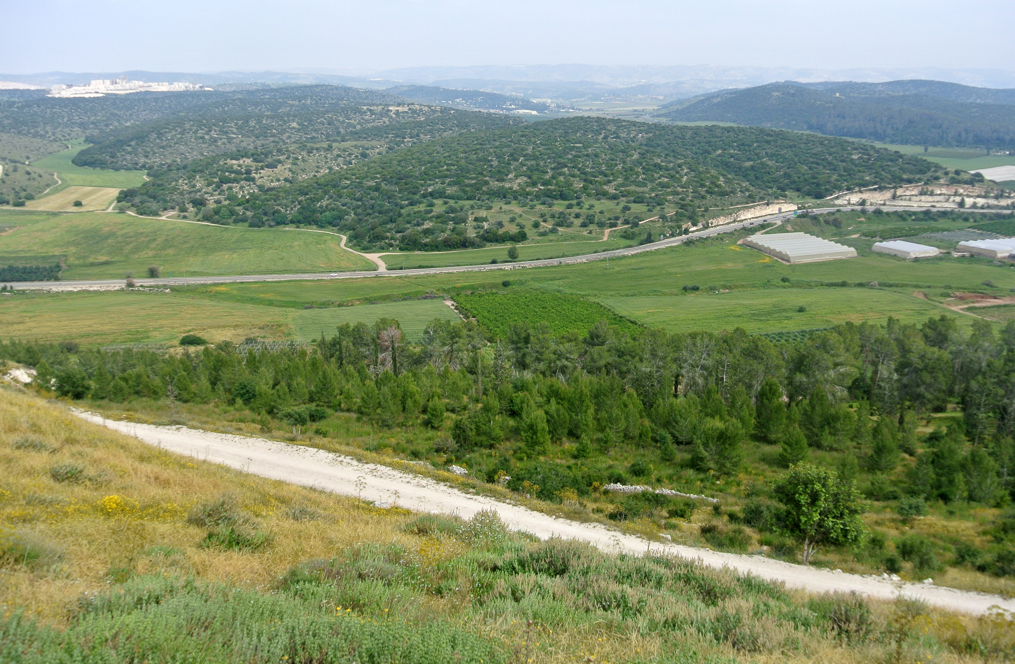
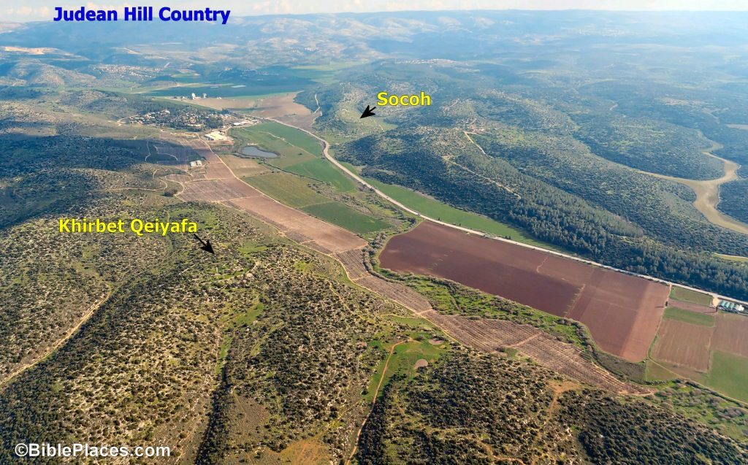
The Elah Valley: Where David fought Goliath 1 Samuel 17

Slide 12
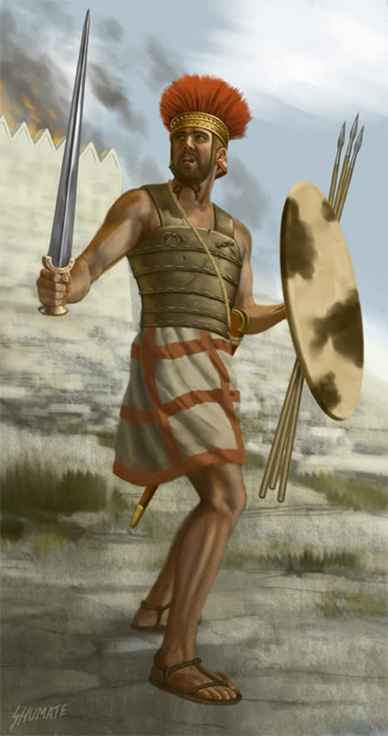
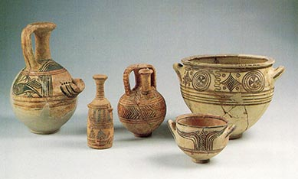
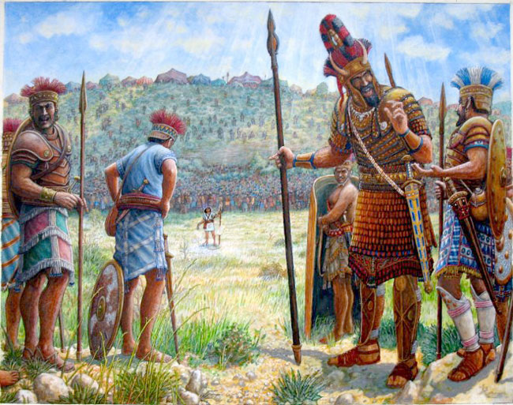
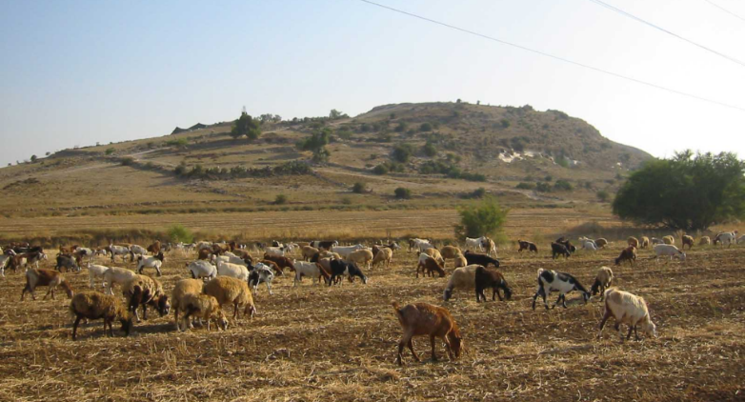
Goliath of Gath
Based upon his name, Goliath was not an ethnic Philistine, but a remnant of the giant Sons of Anak (Joshua 11:21). At the city of Gath, the hometown of Goliath (below right), an inscribed potsherd (broken piece of pottery) was found with a variant of his name (right). The description of Goliath’s armor and weaponry fits our understanding of Greek warfare during this period

Slide 13
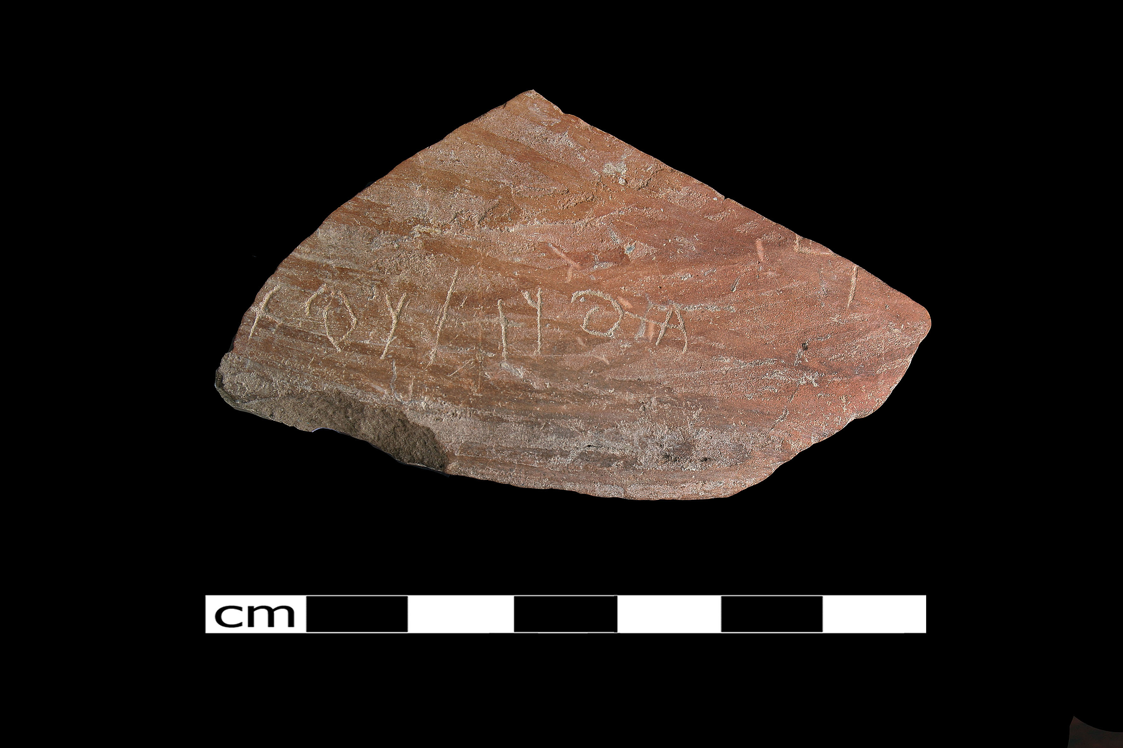
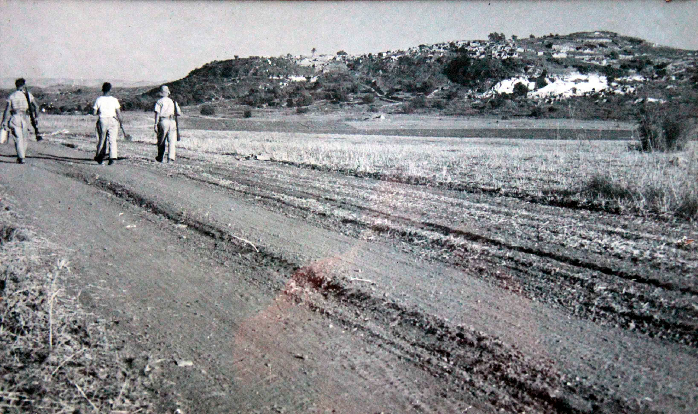
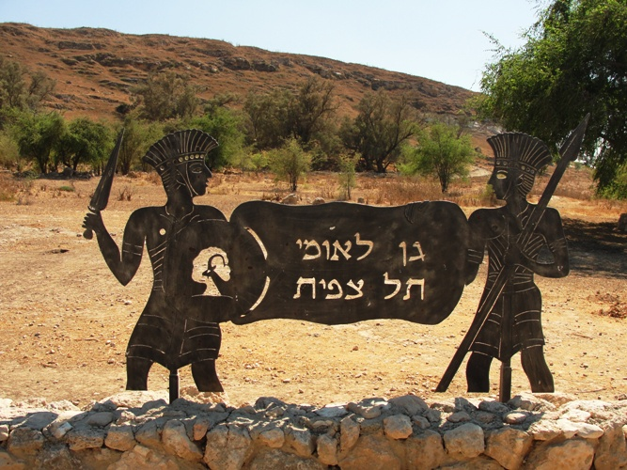
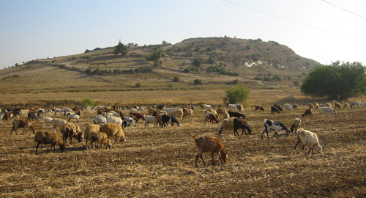
Philistine Gath: Tell es Safi

Slide 14
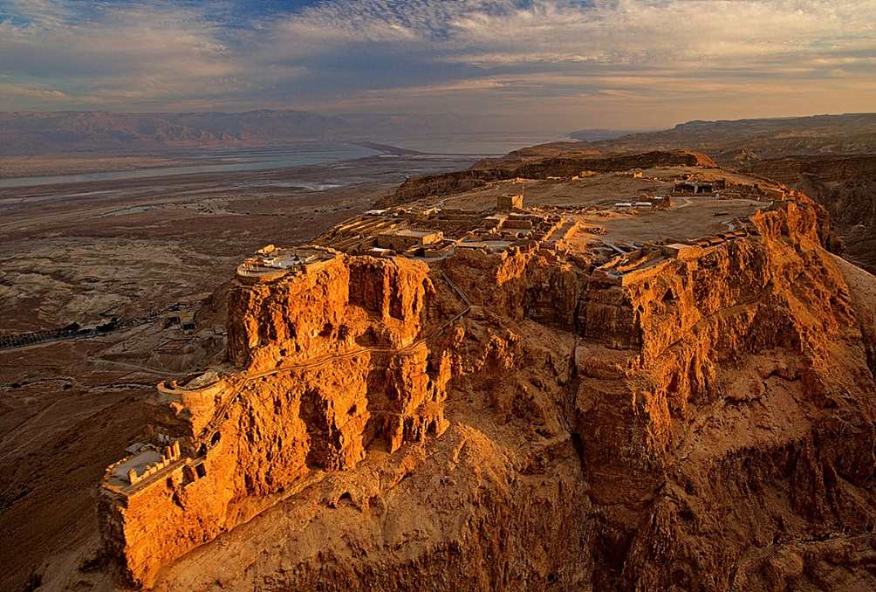
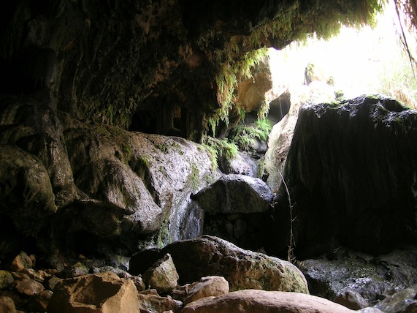
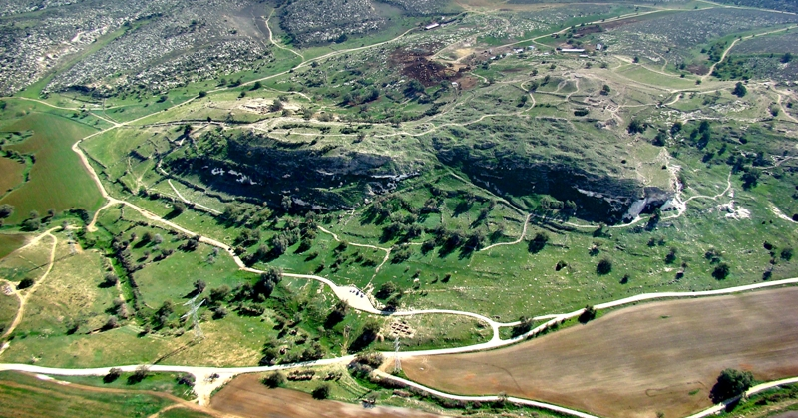
David the Renegade 1 Samuel 18-27
Saul’s Jealousy of David turns violent and David is forced to flee. He maintains his friendship with Jonathan, Saul’s son. David and his small band of men spend much time near En Gedi (below left) hiding in caves (right)
Saul’s Journey to the Dark Side results in the atrocity at Nob, where he murders all of the priests
David and his men protect Nabal and David marries Abigail
David’s vassalage to Achish of Gath (below right) fulfills the maxim: “the enemy of my enemy is my friend.” Yet David protects Israelite settlements instead of attacking them, settling at Ziklag and launching raids against Amalekite raiders
David refused participation in the battle against Saul and Israel at Gilboa, excusing him from any involvement in Saul’s death.

Slide 15
The Battle at Mount Gilboa 1 Samuel 28-31 Oh, how the mighty have fallen!
The Death of Saul
Saul sought the LORD, but the LORD did not answer him.
Saul visited a witch at Endor (crossing over Philistine lines) to try to raise up Samuel.
Israel was soundly defeated; Saul’s three sons were killed and Saul fell on his sword to avoid capture.
Saul’s body and those of his sons were hung from the walls of Beth Shan.

Slide 16
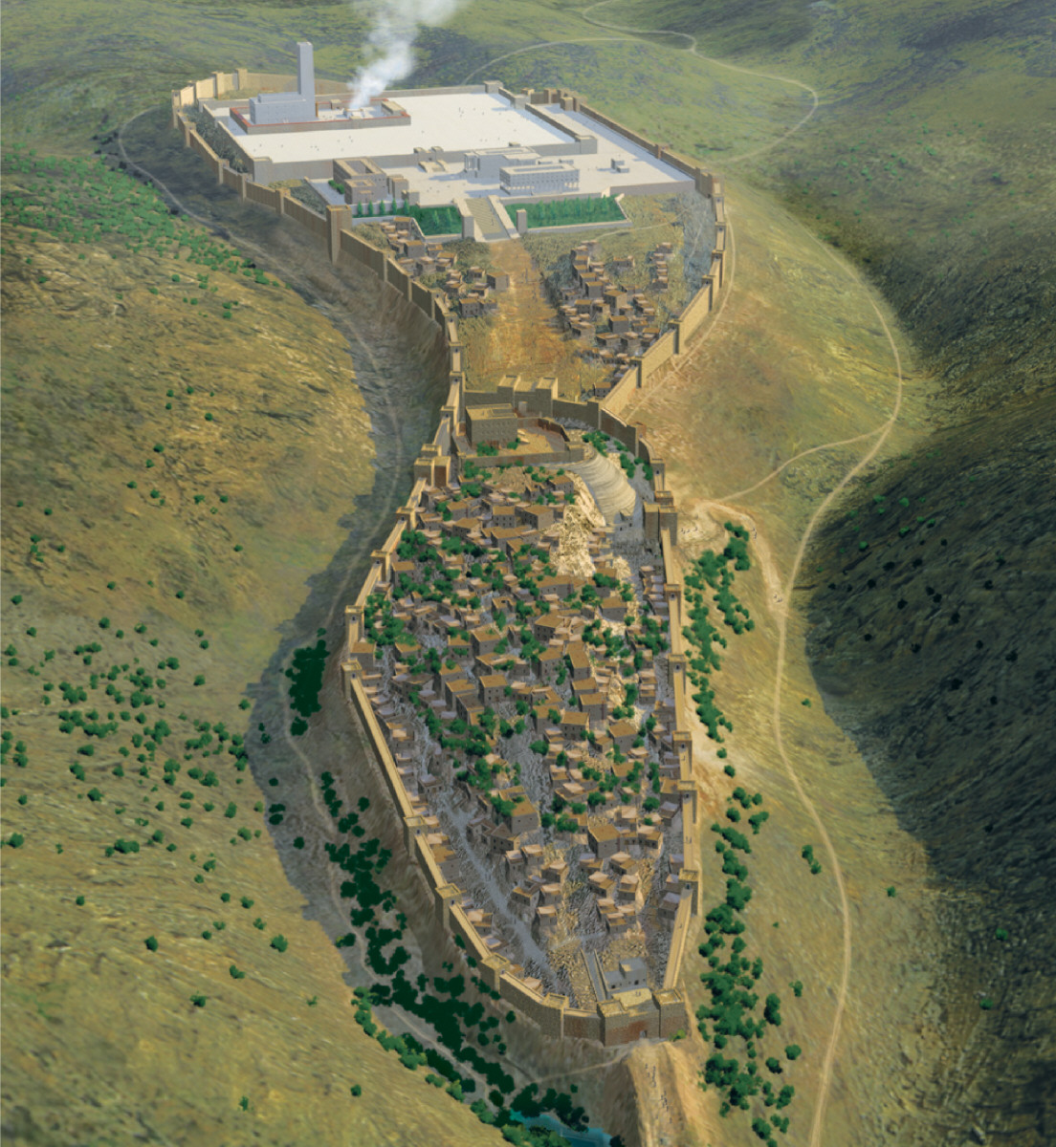
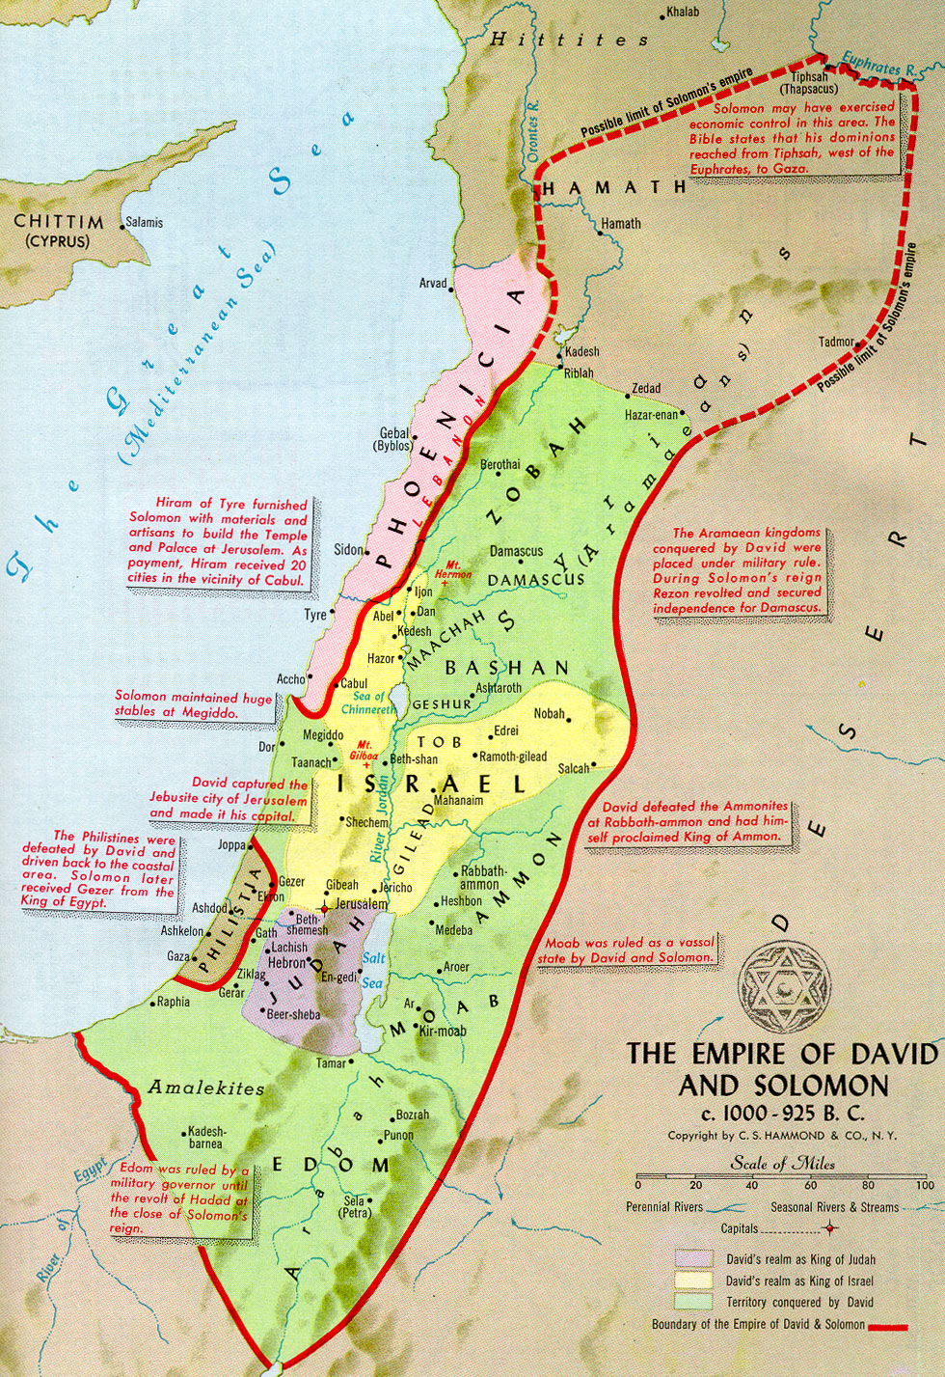

Slide 17
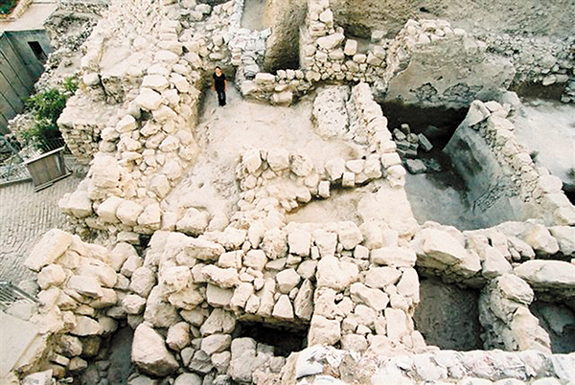
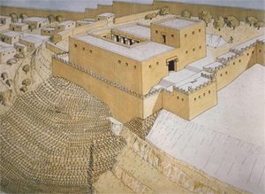
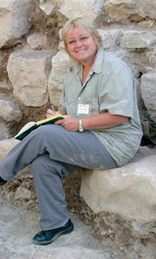
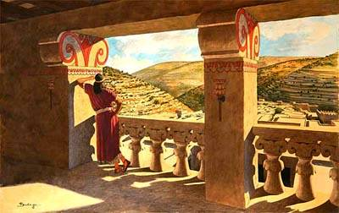
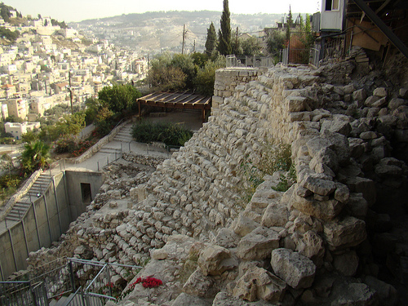
King David’s Jerusalem
David built a palace in Jerusalem with the assistance of King Hiram of Tyre (2 Samuel 5:11)
Wall fragments and at least one capital from a column of this palace has been discovered

Slide 18
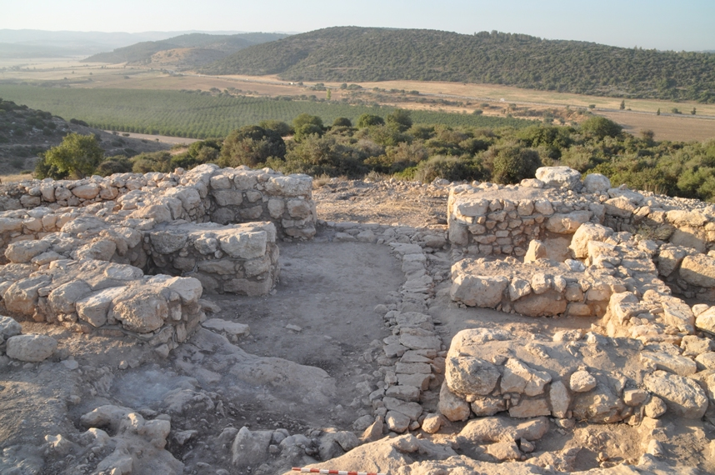
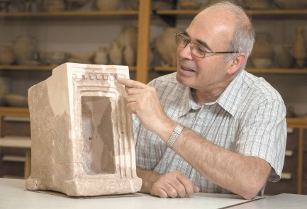
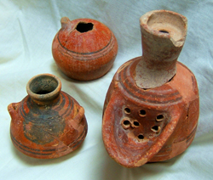
King David’s Palace at Sha’arim
Sha’arim (Two Gates) appears twice in the Old Testament:
1 Samuel 17:52: When the Philistines saw that their hero was dead, they turned and ran. Then the men of Israel and Judah surged forward with a shout and pursued the Philistines to the entrance of Gath and to the gates of Ekron. Their dead were strewn along the Shaaraim road to Gath and Ekron. When the Israelites returned from chasing the Philistines, they plundered their camp. 1 Chronicles 4:31 (a town list of Simeon) mentions Sha’arim.
The site of Khirbet Qayafa overlooks the Elah Valley at the exact location of the duel between David and Goliath.
It was excavated from 2007-2013 by Yosef Garfinkel. Two four chamber gates, a massive casemate wall and a palace were found, along with an important ostracon, a large amount of pottery, including storage jars with thumb impressed handles.
The massive construction of Khirbet Qeiyafa and its urban planning clearly indicate central authority in Judah in the early 10th century BC, the time of King David.

Slide 19
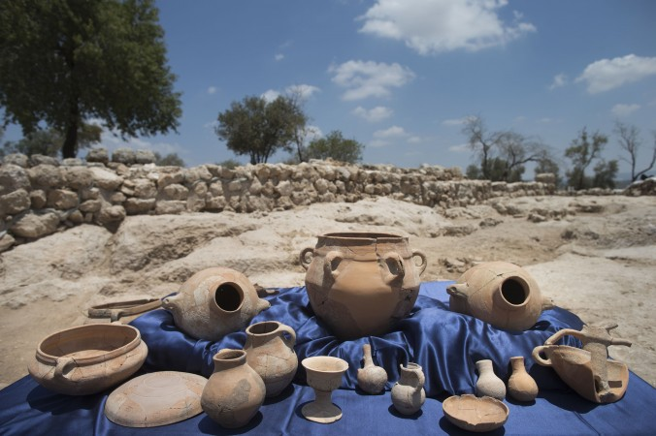
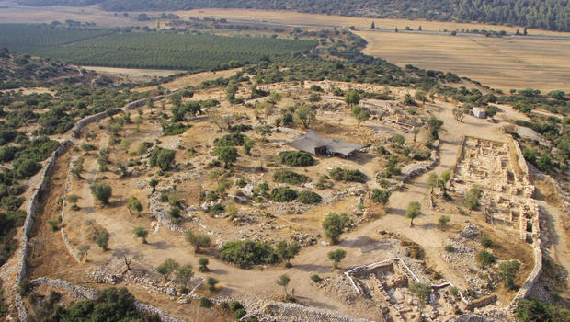
Sha’arim: An Israelite Border Town from the Time of King David 1 Samuel 17:52; 1 Chronicles 4:31

Slide 20
The Royal Tombs of the Davidic Dynasty: The City of David, Jerusalem

Slide 21
Fenan: Khirbat en Nahas and Royal Copper Mines

Slide 22
Timna Valley: King David’s and Solomon’s Mines and Fortifications

