Slide 1
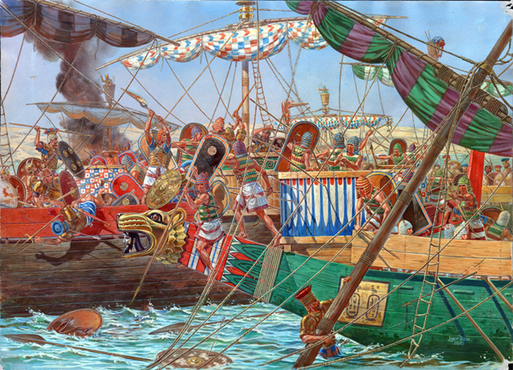
The Sea Peoples
Their origin and the reasons behind their migration are shrouded in mystery. Although from the Aegean and Greece, the Philistines may have also come from Cyprus. Possible motives for this large migration include famine, war or simply expansionist desires. Their arrival along the western coast of the Mediterranean was ca. 1177 BC.
Five groups of Sea Peoples are mentioned in Egyptian records: Sikkelim, Tjekkar, Denyen, Sherden and Peleset (Philistines)
The Sea Peoples migrated on both land and sea to the Levant and Egypt
A horrific land and sea battle with Egypt at Pelusium is commemorated at the temple at Medinet Habu at Karnak. The five groups of Sea Peoples then settled along the eastern Mediterranean coastline

Slide 2
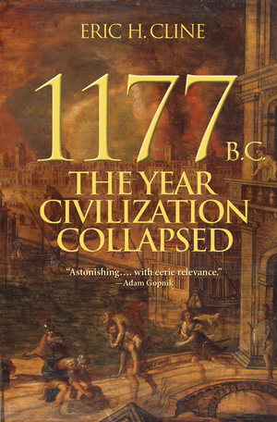
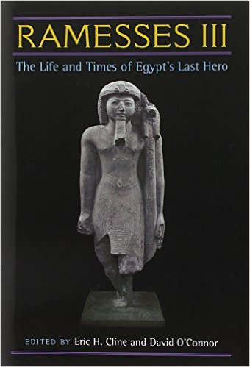
Recent books on This Momentous Historical Event by Eric Cline

Slide 3
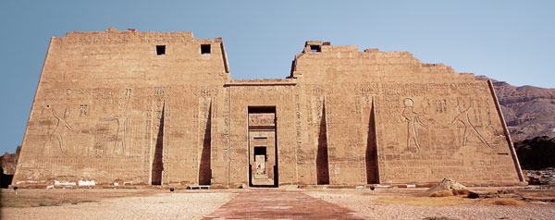
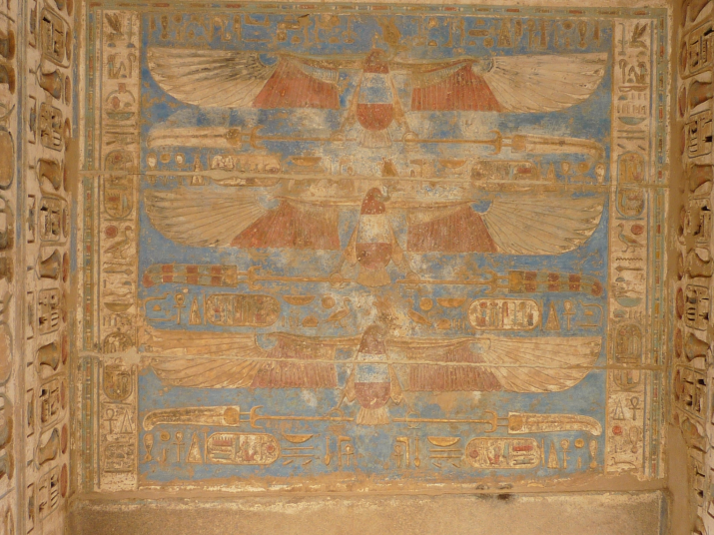
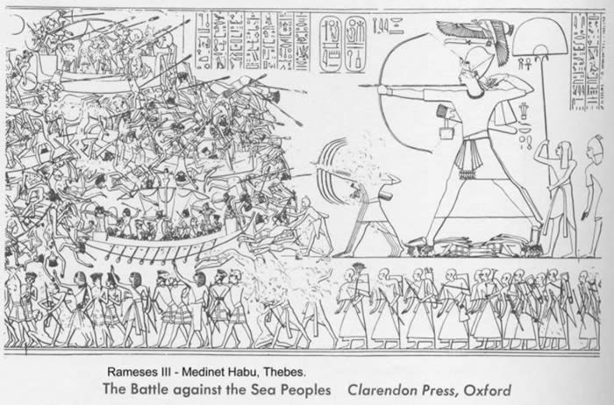
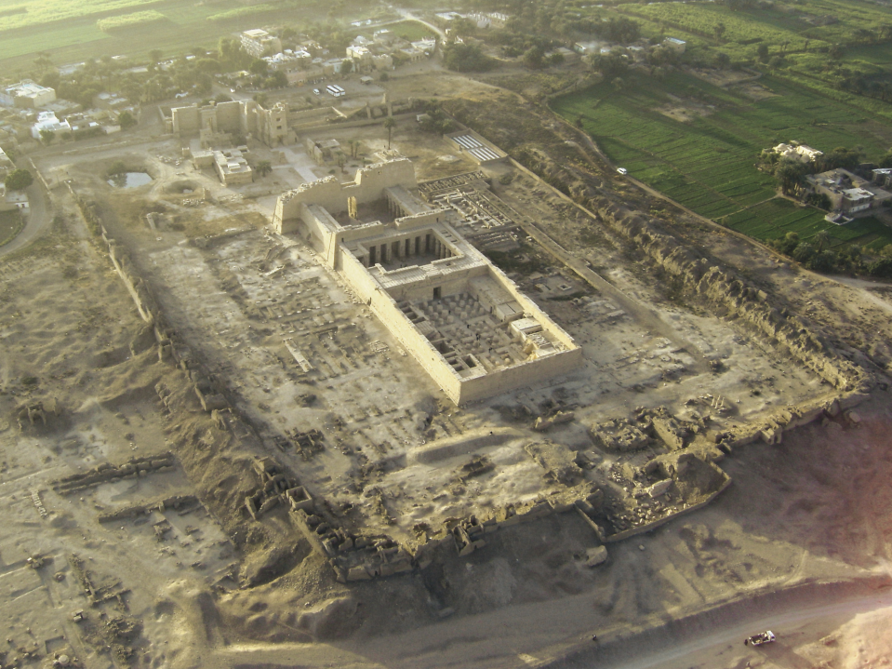
Rameses III and the Land/Sea Battle against the Sea Peoples

Slide 4
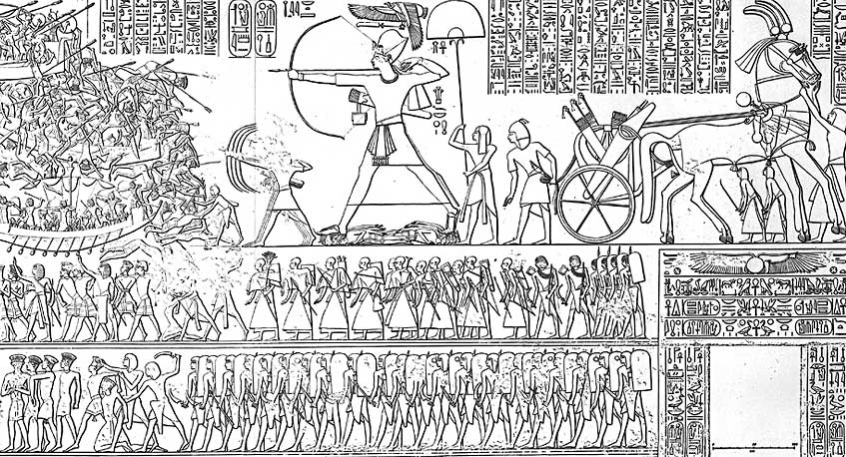
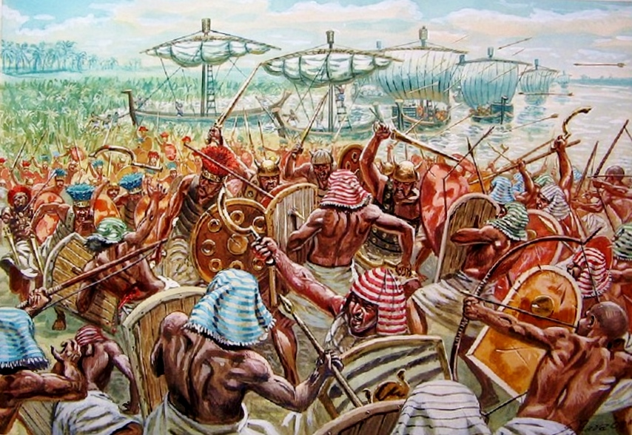
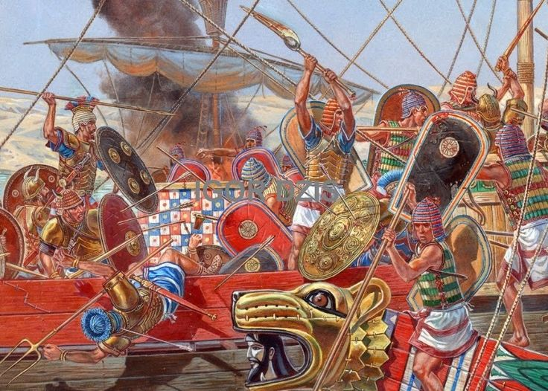
An Epic Battle: 1177 B.C.

Slide 5
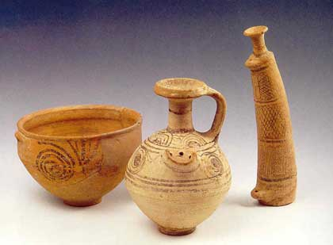
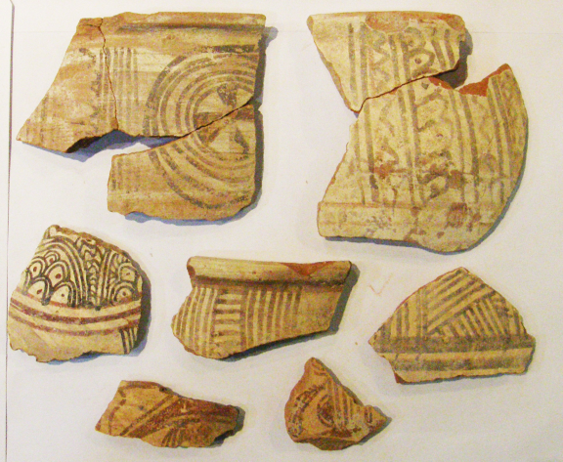
The Philistines
Map of Philistine Cities
and Conquests
The Philistine Market at Ashkelon

Slide 6
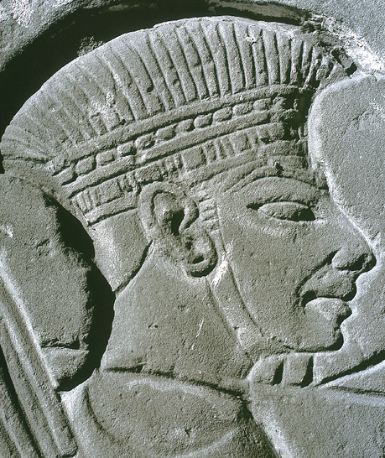
The Archaeology of the Philistines
All along the coast of Syria and Canaan, cities were destroyed and then rebuilt and inhabited by a different culture clearly of Aegean origin in the early 13th century BC. The lone exception is the site of Tel Qasile (ancient name unknown) near Tel Aviv on the Yarkon River, which was founded as a Philistine site.

Slide 7
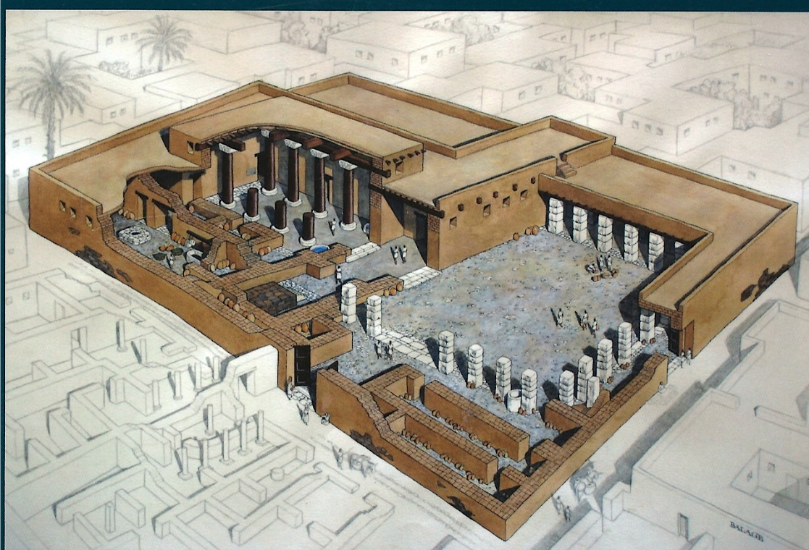
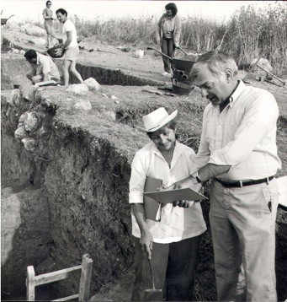
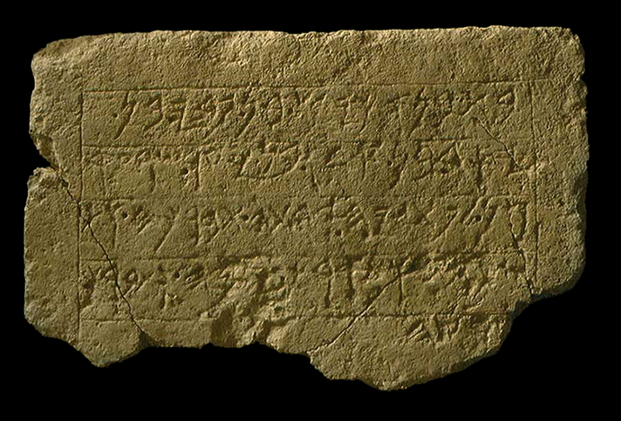
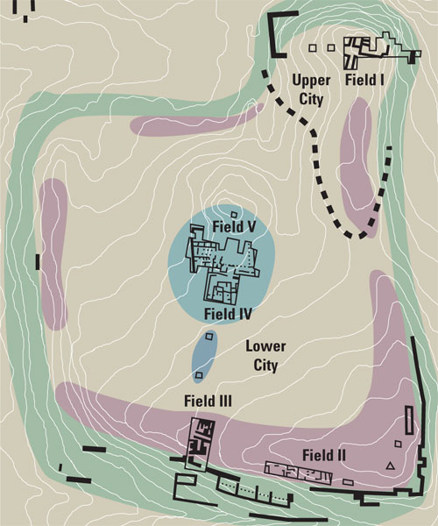
The Philistine Pentopolis: Ekron
Ekron: Subservient to Gath and Ashdod, Ekron expanded to a large 50 acre industrial city during the seventh century BC and processed more olive oil than anywhere else during that time. A dedicatory inscription for the temple to the left was found at the site (below) it mentions Ekron, thus confirming the identification of the site, as well as five of its rulers, including Ikausu (Achish), son of Padi, who built the sanctuary. Padi and Ikausu are known as kings of Ekron from the 7th-century Neo-Assyrian Royal Annals

Slide 8
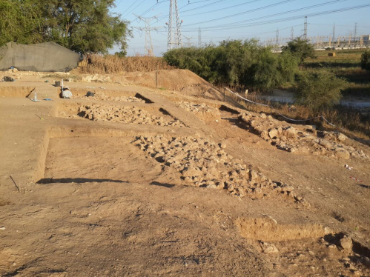
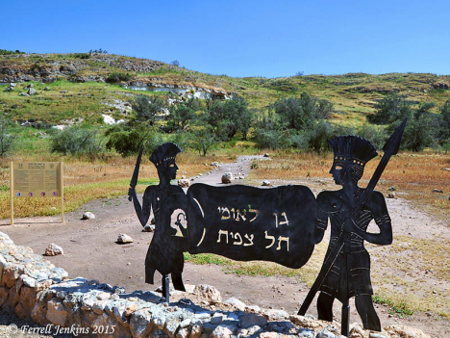
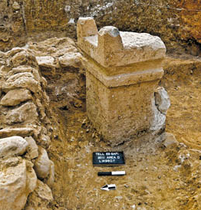
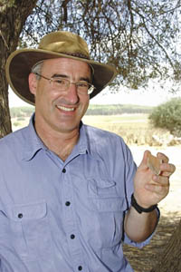
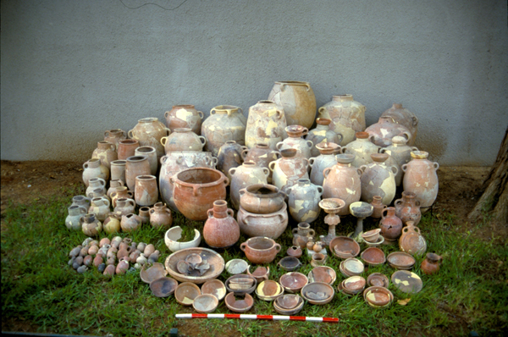
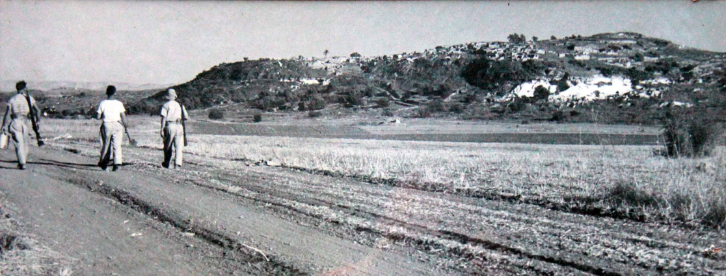
The Philistine Pentopolis: Gath
Gath: Is identified with Tell es-Safi and is currently under excavation. Gath reached its peak in the ninth century BC and covered 90 acres, the largest city in the Levant at that time. The hometown of Goliath, Gath was destroyed by Hazael of Aram-Damascus a the end of the ninth century and again by Sennacherib of Assyria 100 years later.

Slide 9
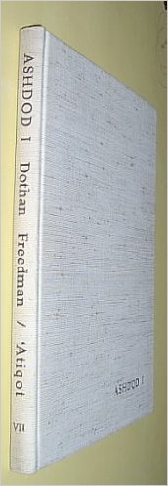
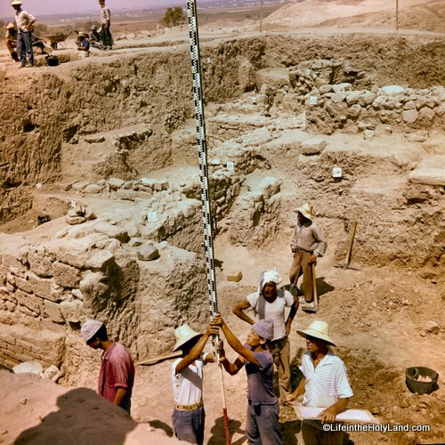
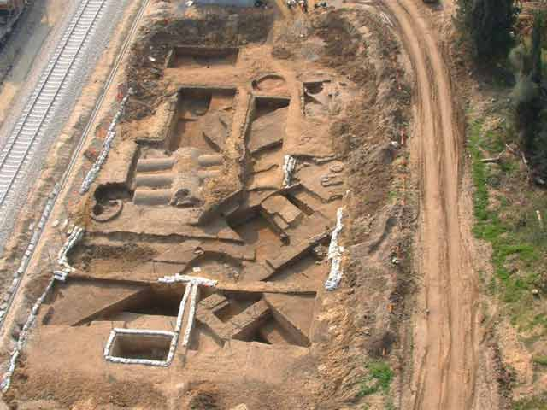
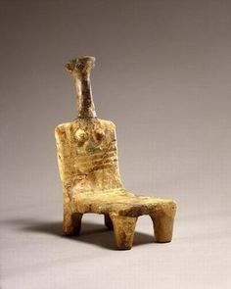
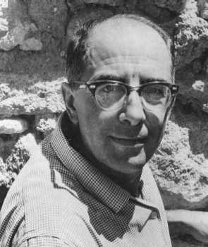
The Philistine Pentopolis: Ashdod
Ashdod: Tel Ashdod is located 7 km from the coastline of the Mediterranean and had two port cities. Excavated by Moshe Dothan from 1962-1972, it boasted several spectacular discoveries relating to the Philistines, Israelites and Assyrians, including a massive gateway, Ashdod ware pottery, a unique figurine “Ashdoda” (below) and a huge Assyrian administrative center at the base of the site.

Slide 10
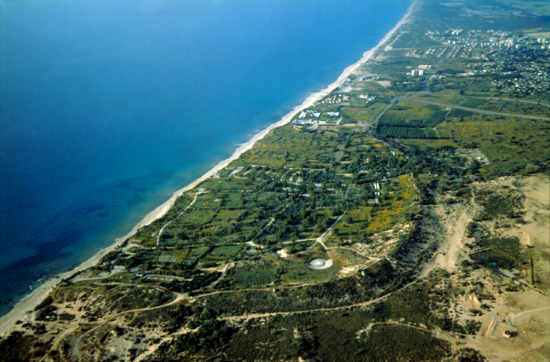
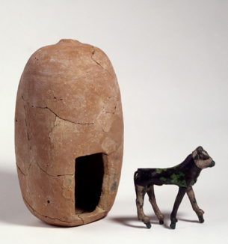
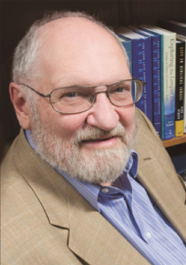
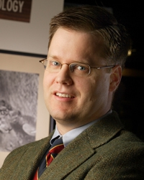
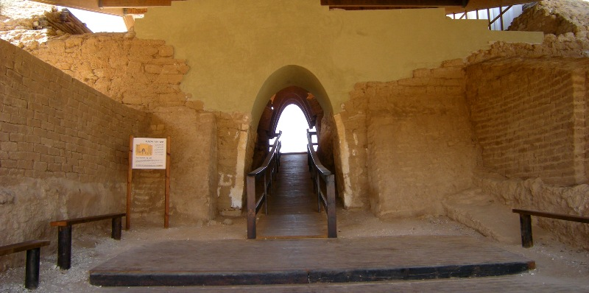
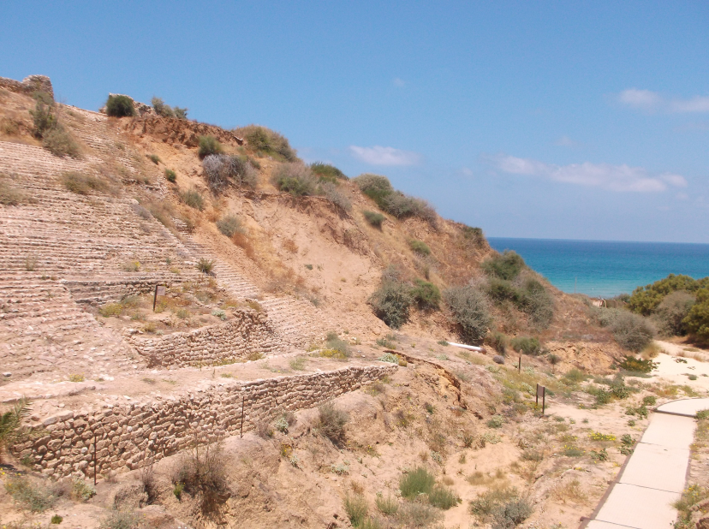
The Philistine Pentopolis: Ashkelon
Ashkelon was one of two Philistine cities on the coastline with a huge semi circular rampart. Ashkelon was destroyed by Nebuchadnezzar in 604 BC. It is currently being excavated by Larry Stager and Dan Master (Harvard University and Wheaton College) and is one of the most heavily funded digs in the Middle East.

Slide 11
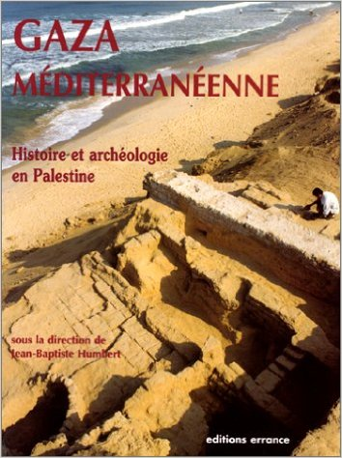
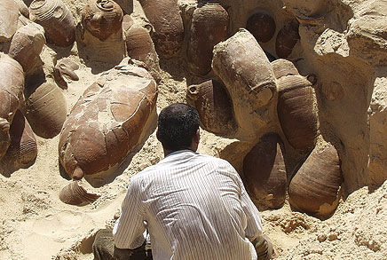
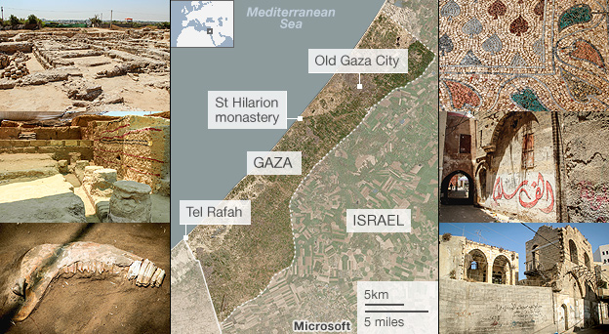
The Philistine Pentopolis: Gaza
Gaza: Limited excavations due to the ancient tell located in Gaza City. Recent work by Jean Baptiste Humbert created much controversy.

Slide 12
The Philistines as Israel’s Adversary
The Philistines established five City States (related to the Greek polis) ruled by a Lord or seren: Ekron, Gath, Ashdod, Ashkelon and Gaza
The Philistines were advanced in metallurgy and expert smelters of Iron, something unknown by the Israelites (1 Samuel 13:19-22)
They were fierce, intimidating warriors with advanced, state of the art weaponry
Highly developed in material culture, architecture and pottery, the Philistines were the cultural equivalent of Paris and New York during the period of the Judges and 1-2 Samuel.

Slide 13
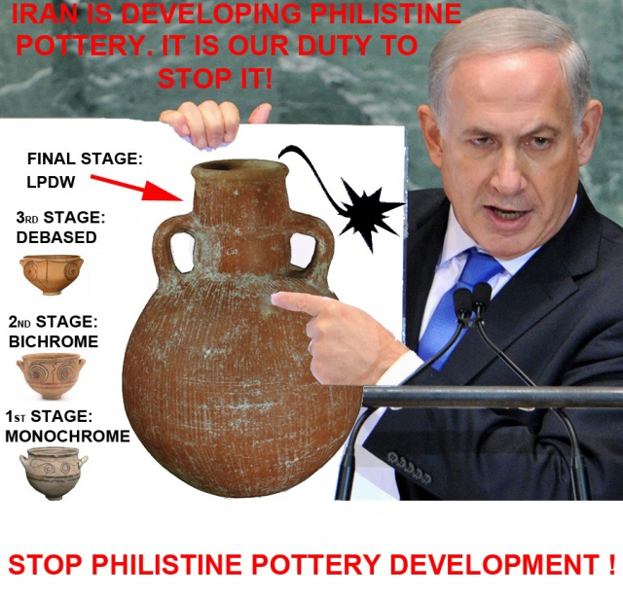
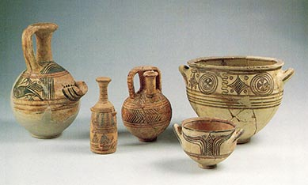
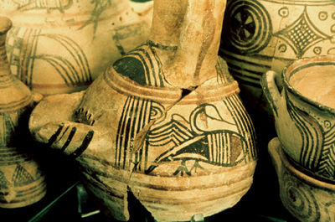
Philistine Pottery Much more developed and appealing than Israelite pottery. The artistic designs and forms came from Mycenaean ware from the Aegean Sea region and Cyprus (LPDW means Late Philistine Decorated Ware or “Ashdod Ware”)

Slide 14
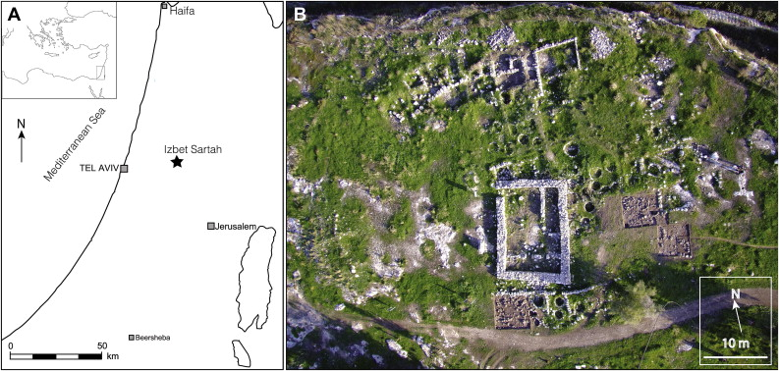
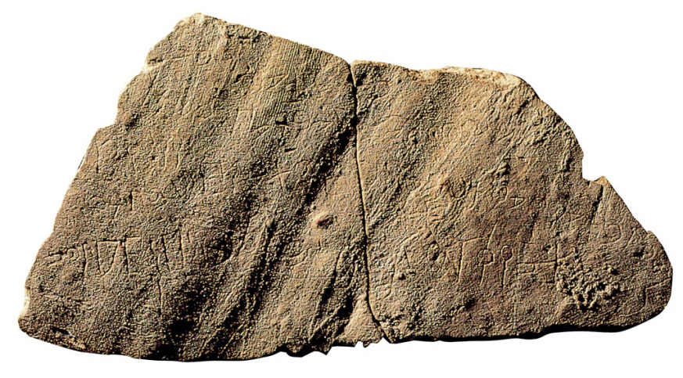
The Israelites
On the other hand, the Israelite tribes were not united, but only loosely confederated
The Israelite material culture (architecture and pottery) were still very rustic
The Israelite Settlement confined to the Hill Country and foot hills
Biblical Ebenezer (Izbet Sartah) near Aphek is a good example of an Israelite village during the days of Samuel. One of the earliest Hebrew inscriptions (from Samuel’s time, see below), was found there

Slide 15
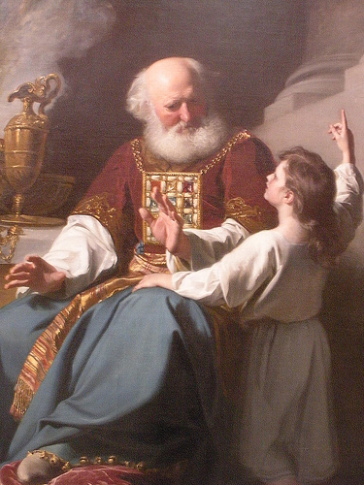
Samuel at Shiloh

Slide 16
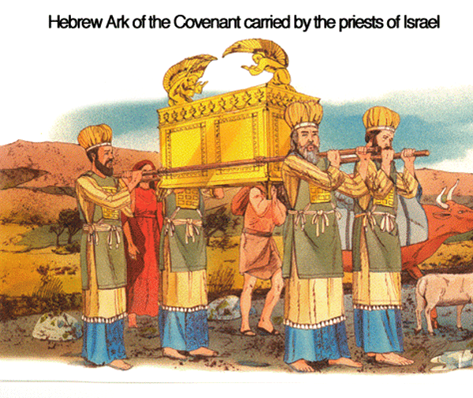
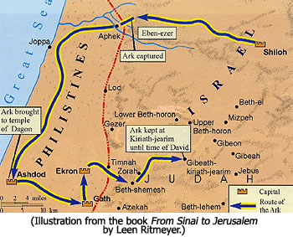
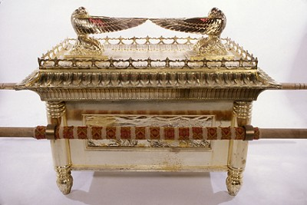
The Ark Narrative

Slide 17
From Theocracy to Monarchy: Israel’s Quest for a King
1 Samuel 8:10-21
¹⁰ Samuel told all the words of the Lord to the people who were asking him for a king. ¹¹ He said, “This is what the king who will reign over you will claim as his rights: He will take your sons and make them serve with his chariots and horses, and they will run in front of his chariots. ¹² Some he will assign to be commanders of thousands and commanders of fifties, and others to plow his ground and reap his harvest, and still others to make weapons of war and equipment for his chariots. ¹³ He will take your daughters to be perfumers and cooks and bakers. ¹⁴ He will take the best of your fields and vineyards and olive groves and give them to his attendants. ¹⁵ He will take a tenth of your grain and of your vintage and give it to his officials and attendants. ¹⁶ Your male and female servants and the best of your cattle and donkeys he will take for his own use. ¹⁷ He will take a tenth of your flocks, and you yourselves will become his slaves. ¹⁸ When that day comes, you will cry out for relief from the king you have chosen, but the Lord will not answer you in that day.”
¹⁹ But the people refused to listen to Samuel. “No!” they said. “We want a king over us.²⁰ Then we will be like all the other nations, with a king to lead us and to go out before us and fight our battles.”
²¹ When Samuel heard all that the people said, he repeated it before the Lord. ²² The Lord answered, “Listen to them and give them a king.”

Slide 18
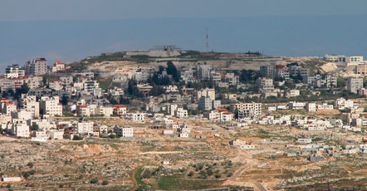
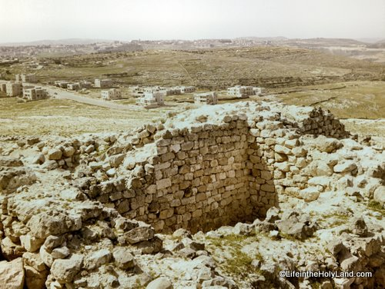
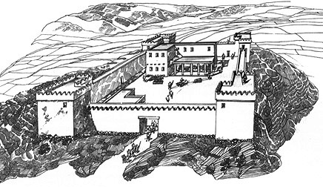
The Reign of Saul Below are views of Tell el Ful, the site of ancient Gibeah of Saul, where his capital was located. I once rented a car from a dealer at the foot of this ancient city! The unfinished building below was to be one of King Hussein of Jordan’s palaces. He, like Saul, enjoyed the great panoramic views from Gibeah. However, the Six Day War in 1967 ended with Israel controlling this site and all of the West Bank. The drawing below depicts what Saul’s palace looked like.

Slide 19
David and Goliath
Faith Lessons from David
We should be more concerned abut God’s honor than about ourselves (17:26, 36, 46-47)
God’s past faithfulness in our lives should encourage us to take larger steps of faith (17:34-37)
When we face battles that look impossible, we must remember that the battle is the LORD’s. David fought Goliath, but only as God’s instrument. The battle was really between Goliath and the LORD (17:47).

Slide 20
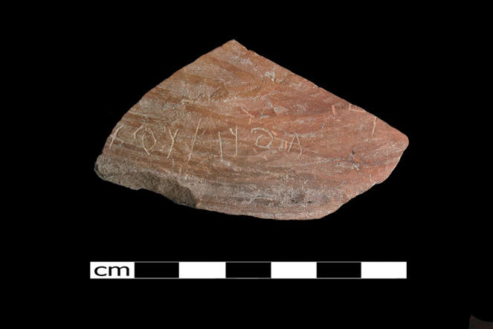
Goliath of Gath
Based upon his name, Goliath was not an ethnic Philistine, but a remnant of the giant Sons of Anak (Joshua 11:21). At the city of Gath, the hometown of Goliath (below right), an inscribed potsherd (broken piece of pottery) was found with a variant of his name (right). The description of Goliath’s armor and weaponry fits our understanding of Greek warfare during this period

Slide 21
The Elah Valley from Azekah
Looking East over the area of the confrontation between David of Israel and Goliath of Gath

Slide 22
David the Renegade 1 Samuel 18-27
Saul’s Jealousy of David turns violent and David is forced to flee. He maintains his friendship with Jonathan, Saul’s son. David and his small band of men spend much time near En Gedi (below left) hiding in caves (right)
Saul’s Journey to the Dark Side results in the atrocity at Nob, where he murders all of the priests
David and his men protect Nabal and David marries Abigail
David’s vassalage to Achish of Gath (below right) fulfills the maxim: “the enemy of my enemy is my friend.” Yet David protects Israelite settlements instead of attacking them, settling at Ziklag and launching raids against Amalekite raiders
David refused participation in the battle against Saul and Israel at Gilboa, excusing him from any involvement in Saul’s death.

Slide 23
The Battle at Mount Gilboa 1 Samuel 28-31 Oh, how the mighty have fallen!
The Death of Saul
Saul sought the LORD, but the LORD did not answer him.
Saul visited a witch at Endor (crossing over Philistine lines) to try to raise up Samuel.
Israel was soundly defeated; Saul’s three sons were killed and Saul fell on his sword to avoid capture.
Saul’s body and those of his sons were hung from the walls of Beth Shan.

Slide 25
Recent Study of Goliath
Reconsidering Goliath: An Iron Age I Philistine Chariot Warrior. BASOR 360 (2010): Jeffrey R. Zorn

Slide 26
First Samuel
Outline
A Period of Transition (1-15)
Samuel’s Birth and Call (1:1-3:21)
The Ark Narrative (4:1-7:17)
Saul Becomes Israel’s First King (8-12)
Saul Reveals His Heart (13-15)
David’s Rise and Saul’s Decline (16-31)
David’s Anointing and Introduction to Saul’s Court (16)
David’s Victory over Goliath (17)
David’s Struggles with Saul (18-27)
Saul’s Final Battle and Death (28-31)

Slide 27
The Samson Account: Judges 13-16
… and another failed attempt by Hollywood to accurately capture a biblical account on the big screen. This movie was released in 1949.

Slide 28
The Philistine Temple at Tell Qasile New Light on Samson’s Death (Judges 16:23-30) When Israeli archaeologists excavated a Philistine provincial town, Tell Qasile, located in the suburbs of Tel-Aviv, they uncovered the first known Philistine temple. Amazingly, the entire roof of this temple was supported by two central pillars (below right), just like the much larger but similarly constructed Philistine temple of Dagan in Gaza, where the Philistines made Sampson stand between the pillars while mocking him and his God. Sampson prayed and pushed against both pillars, collapsing the entire roof upon himself, the Philistine Lords and a huge audience.

