Slide 1
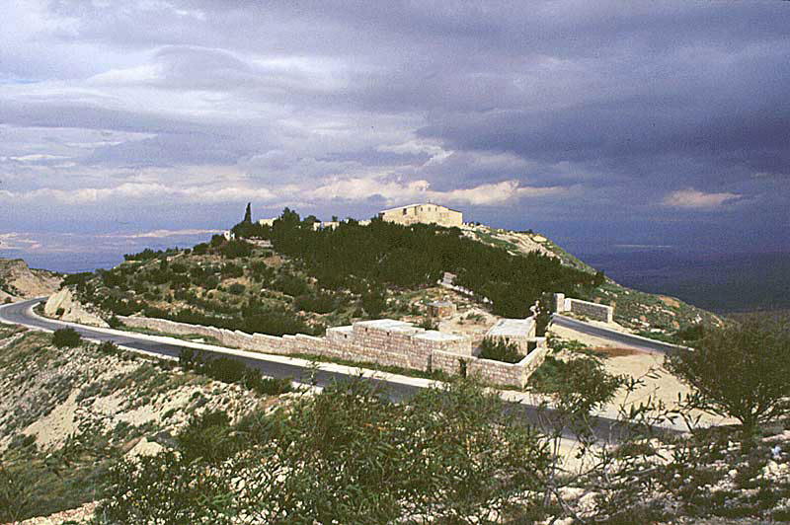
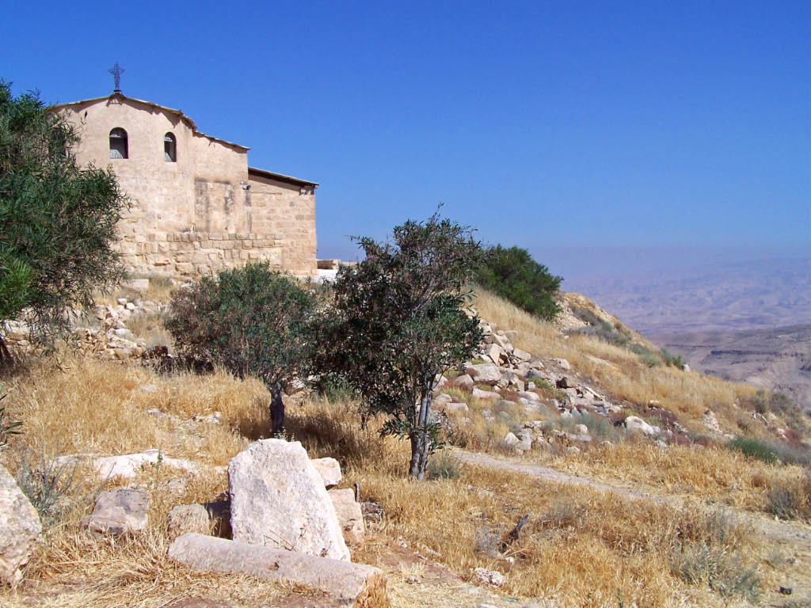
The Archaeology of Deuteronomy,
Joshua and Judges
Mount Nebo and the Byzantine memorial shrine to Moses. A Franciscan Monastery is also part of this complex
Then Moses went up from the lowlands of Moab to Mount Nebo, to the top of Pisgah, eastwards from Jericho, and the LORD showed him the whole land: Gilead as far as Dan; the whole of Naphtali; the territory of Ephraim and Manasseh, and all Judah as far as the western sea; the Negeb and the Plain; the valley of Jericho, the Vale of Palm Trees, as far as Zoar. The LORD said to him, This is the land which I swore to Abraham, Isaac and Jacob that I would give to their descendants. I have let you see it with your own eyes, but you shall not cross over into it. There in the land of Moab, Moses the servant of the LORD died, as the LORD had said. He was buried in a valley in Moab opposite Beth-peor, but to this day no one knows his burial-place. Moses was a hundred and twenty yeas old when he died; his sight was not dimmed nor had his vigor failed. The Israelites wept for Moses in the lowlands of Moab for thirty days. (Deuteronomy 34:1-8)

Slide 2
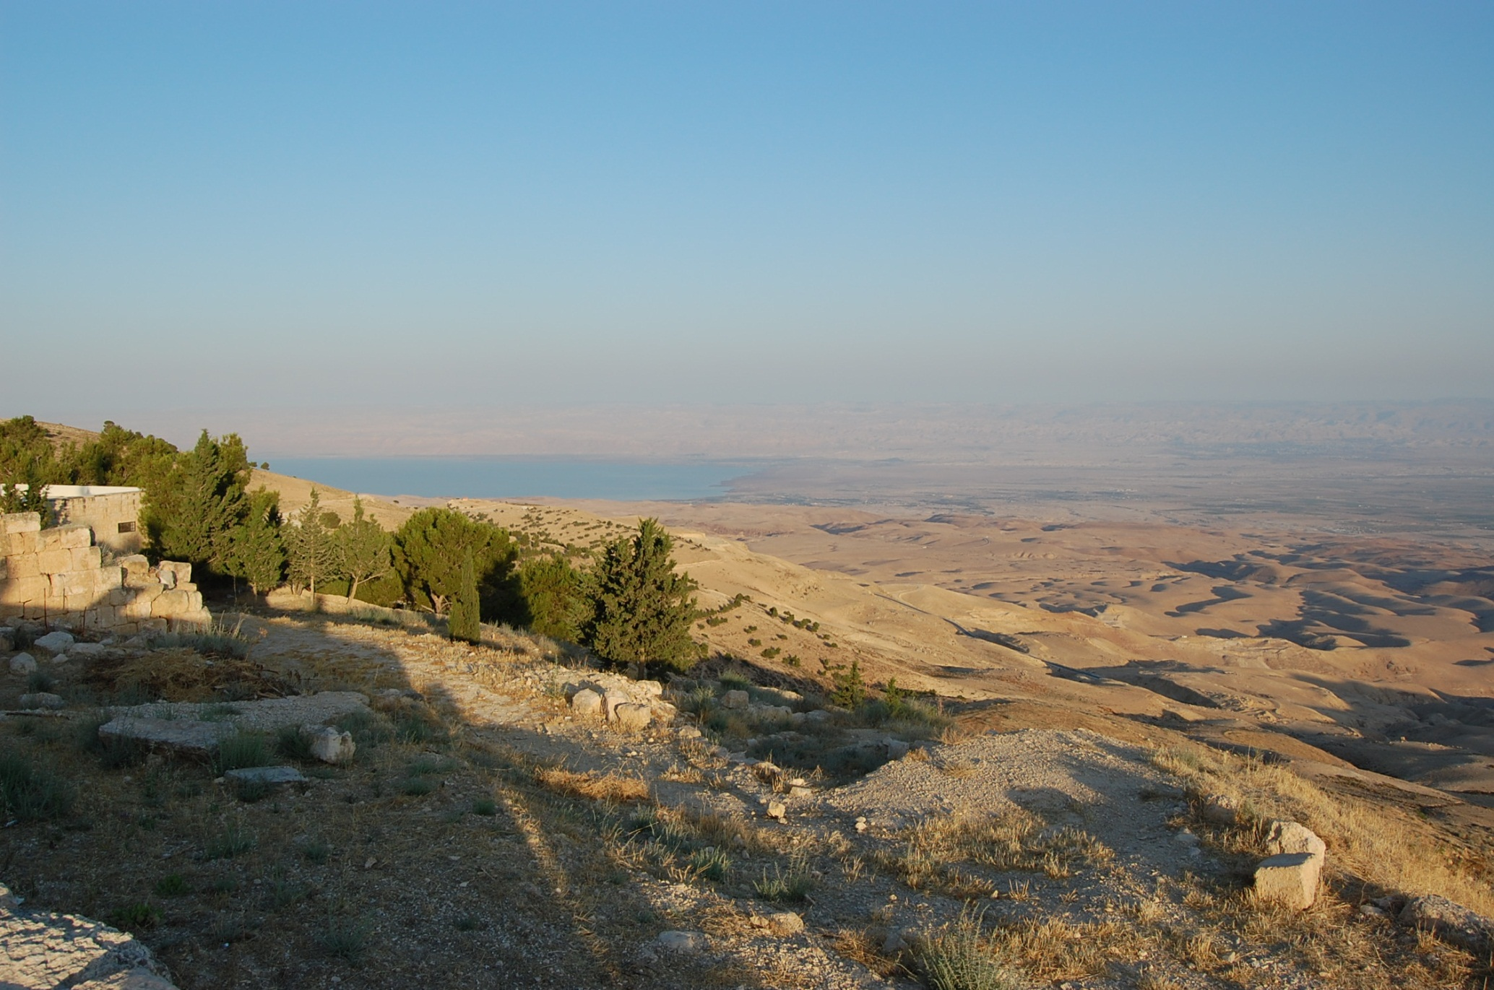
The Plains of Moab from Mount Nebo

Slide 3
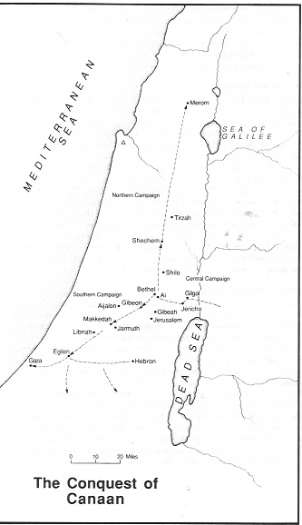
The Book of Joshua: The Epic of Conquest
Joshua 2: Spies sent to “look over the land” and reconnoiter Jericho.
Joshua 3-4: Crossing the Jordan on and the erection of a monument.
Joshua 5: Circumcision at Gilgal.
Joshua 6: The Fall of Jericho.
Joshua 7: The Sin of Achan and its Consequences
Joshua 8: Ai is Destroyed and the Covenant renewal at Mount Ebal.
Joshua 9: The Gibeonite Deception.
Joshua 10: The Sun Stands Still, the Death of the Five Kings and the Southern Campaign.
Joshua 11: The Northern Campaign.
Joshua 12: List of the Defeated Kings.
Joshua 13: The Land not Taken.
Joshua 14-22: Division of the Land.
Joshua 23-24: Joshua’s Farewell Speech and the Covenant Renewal at Shechem.

Slide 4
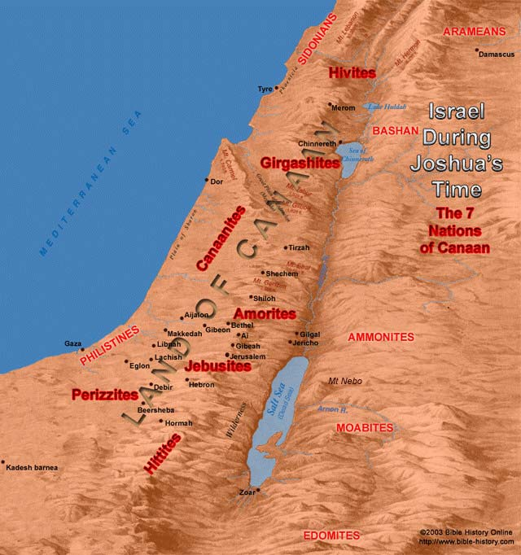

The Conquest of Canaan: Joshua 1-12
At the time of Joshua (ca. 1400 BC), the land of Canaan was inhabited by various peoples shown on the map to the left. The first twelve chapters of the book of Joshua deal with Israel fighting a series of military engagements against these inhabitants and conquering Canaanite cities. The material culture of the Canaanites and the others listed here reveal an extremely evil and immoral society

Slide 5
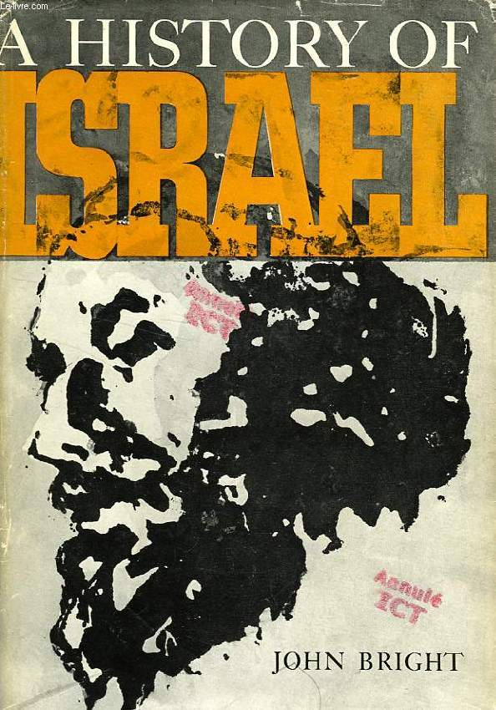
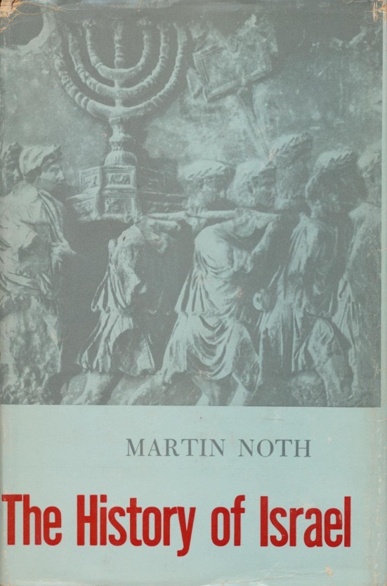
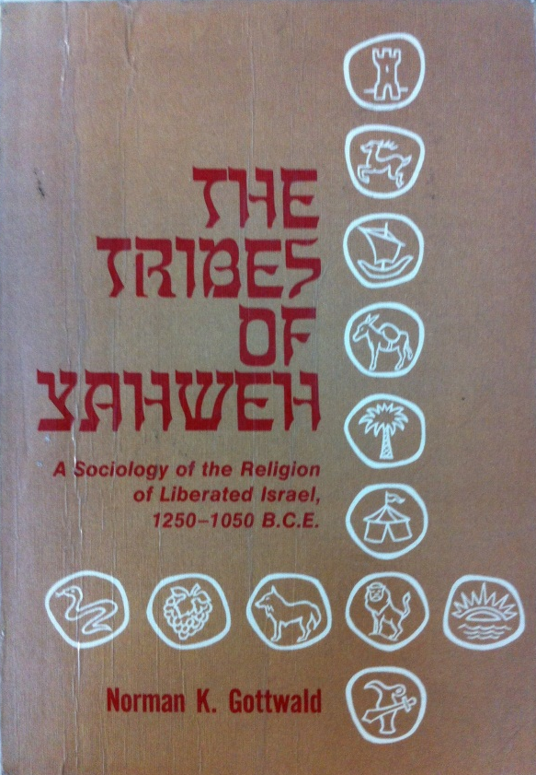
The Conquest of Canaan: Three Views
A Unified Military Conquest: Many scholars recognize the Book of Joshua as a faithful record of events and interpret the events of the book as historical. Notable among those who follow this position are American archaeologists William F. Albright, G. Ernest Wright, John Bright and Israeli scholar Yigael Yadin.
A Peaceful Immigration: These scholars view the Book of Joshua as telescoping a long settlement process into a shorter narrative. They suggest Israel infiltrated Canaan slowly and peacefully. Warfare broke out a later stages, but only involving some, not all, of the tribes. This view does not have such a high regard for the historicity of the biblical account as the first view. German scholars Albrecht Alt and Martin Noth , as well as Israeli archaeologists Yohanan Aharoni and Israel Finkelstein support this view.
A Social Revolution: This extreme theory, based on Marxist ideology, argues that the Israelite tribes were actually indigenous Canaanites that launched a peasant revolt against their overlords and began a new rural society in the hill country, thus largely abandoning their urban roots. Yes, I’m serious! This is actually a popular view among liberal scholars, despite the fact that it has been discredited archaeologically and naturally has absolutely no biblical basis. This “revolting” peasant view is supported by American biblical scholars George Mendenhall, Norman Gottwald and William Dever.

Slide 6
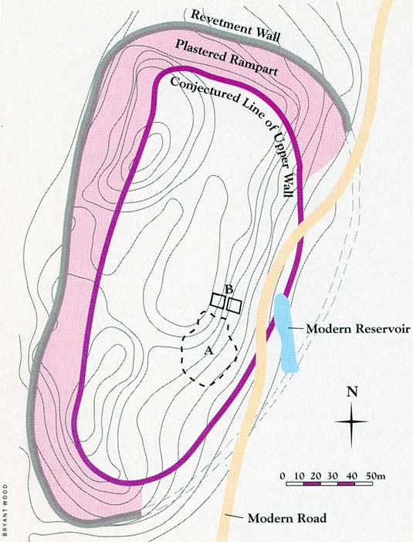
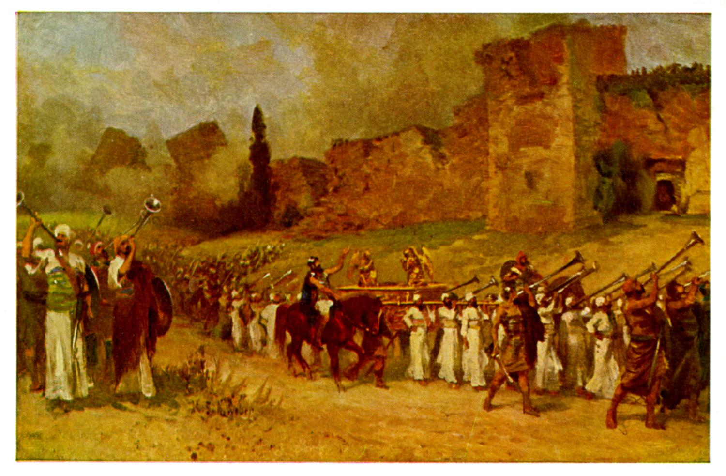
Jericho: The City of the Palms
The Plan of Old Testament Jericho at the time of Joshua
Artistic Depiction of the Destruction of Jericho in Joshua 6

Slide 7
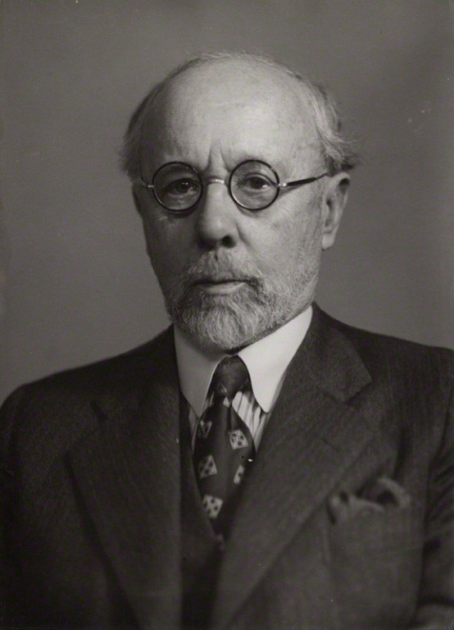
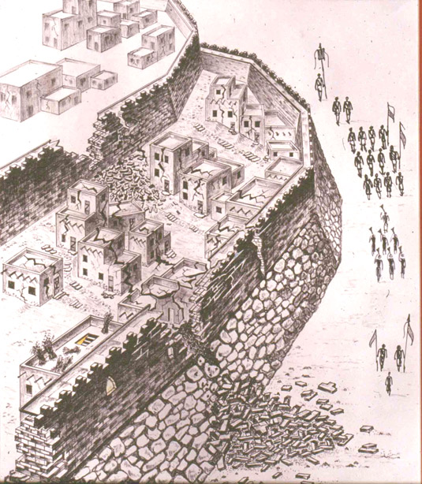
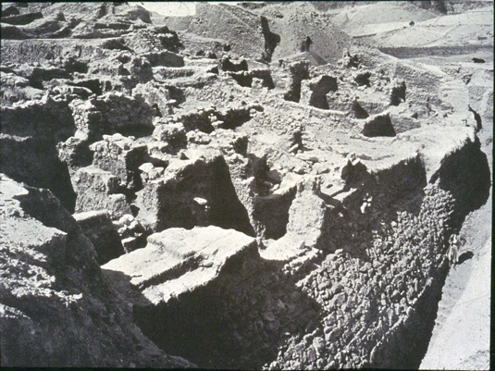
The Walls of Jericho
Jericho has been excavated several times, including work done by John Garstang (to the left) during the 1930’s. Garstang claimed he found the fallen walls from Joshua’s conquest. Later work by Kathleen Kenyon at the site during the 1950’s (see the following slide) concluded he was mistaken and found very little remains dating to Joshua’s city.

Slide 8
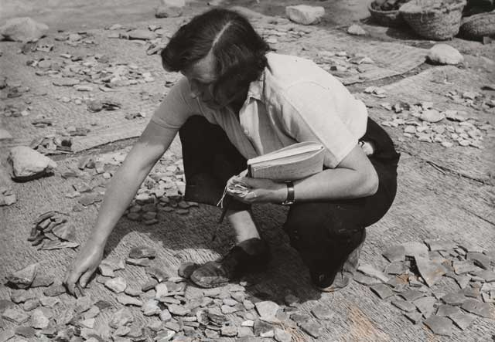
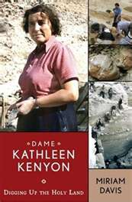
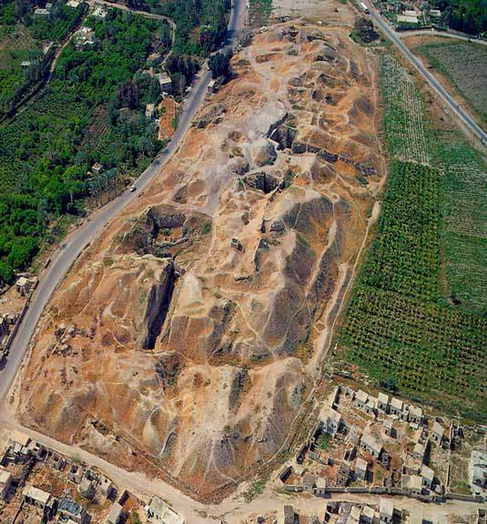
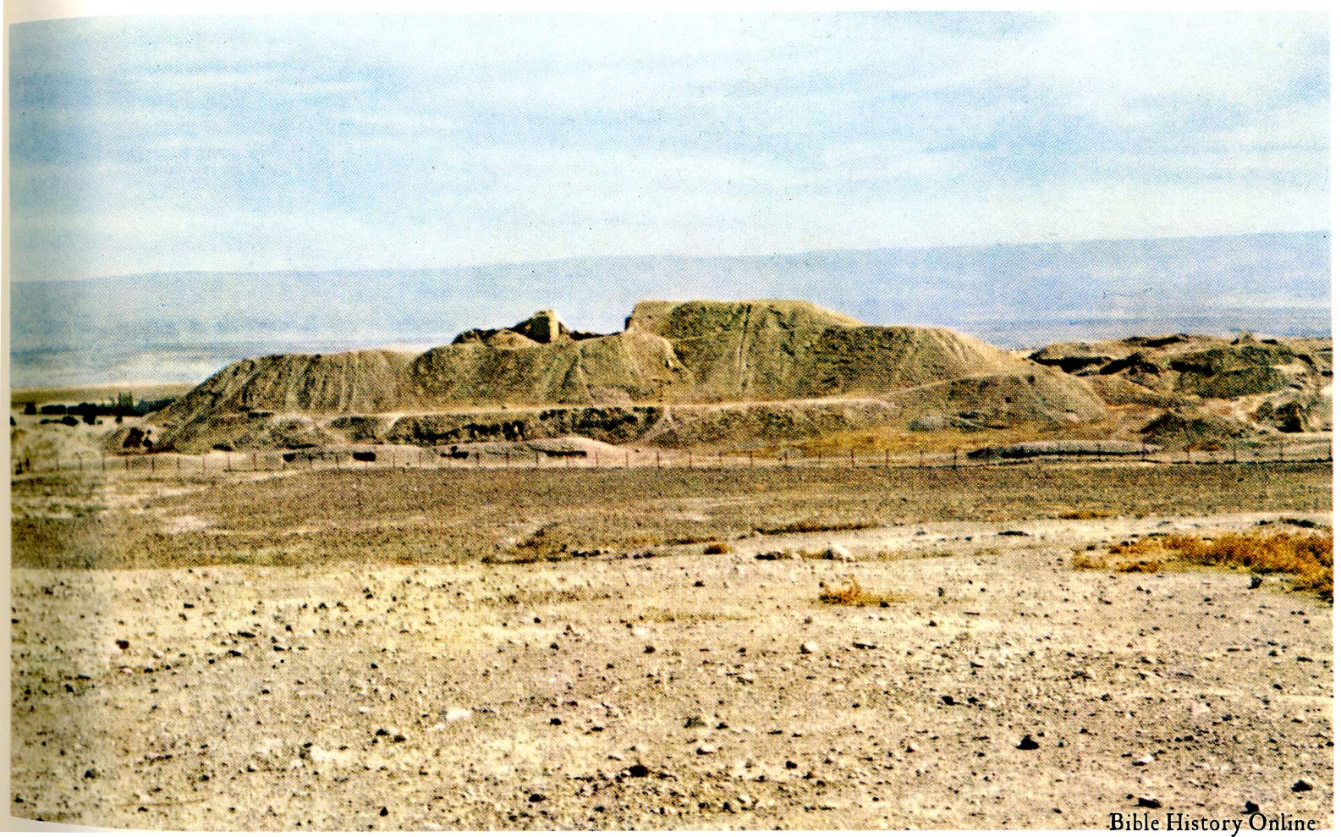
Jericho and One of Its Excavators
Aerial View of Tell es Sultan (Jericho)
Dame Kathleen Mary Kenyon

Slide 9
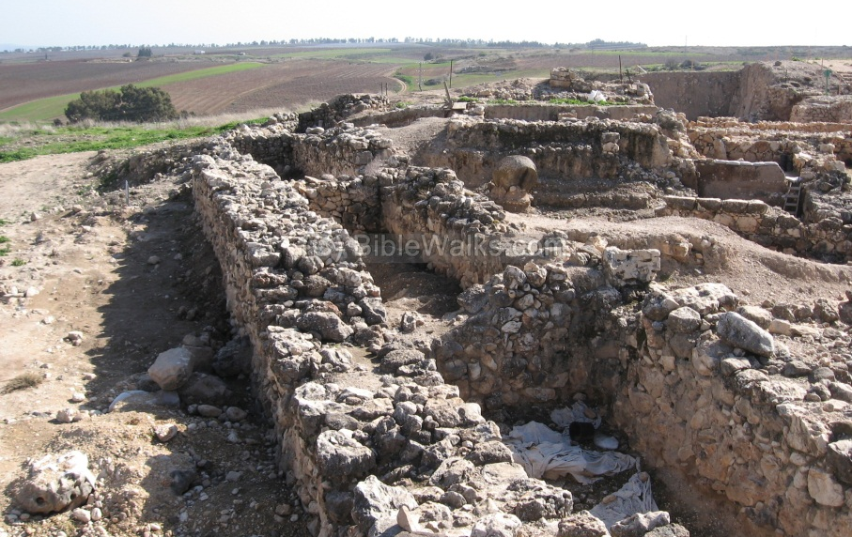
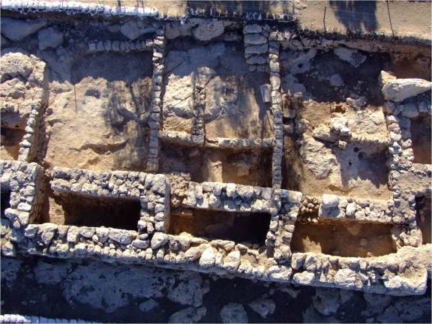
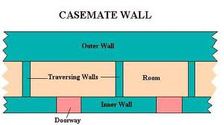
Rahab’s House: A Casemate Room?
Casemate walls are parallel walls with rooms for living or storage between them. In time of war, these rooms are filled with dirt or rubble to provide added thickness against attacks with battering rams. The Casemate wall below dates from the time of King David at Khirbet Qayafa. Hiding the spies among the flax stalks on the roof tells us it was springtime (flax harvest; Joshua 2:6)
Plans of Casemate walls

Slide 10
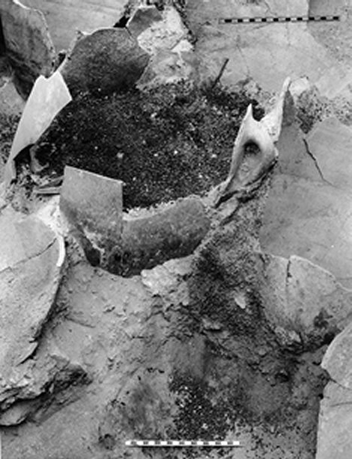
When Did the Walls of Jericho Fall Down?
Two Theories regarding the Current Archaeological Evidence
The Late Bronze Age (ca. 1550-1200 BC) is attested at Jericho, including houses and tombs, but most of the remains are mud brick and have weathered away.
Jericho was destroyed and burned at the end of the Middle Bronze Age (ca. 1550 BC). This city and its walls actually existed into the LB period and testify to the Joshua account. Storage jars containing grain were not looted, but burned. This is rather unique. Most armies would have confiscated food before torching the city. However, the Israelites were commanded to not take anything.

Slide 11
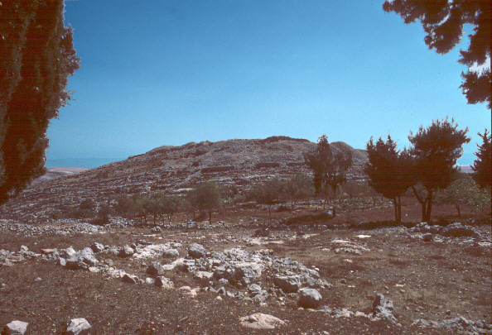
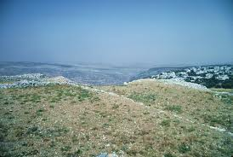
Et Tell: Biblical Ai
Ai was the second city in Canaan that Joshua conquered and its subjugation required the army to climb into the hill country north of Jerusalem from the Jordan Valley. The account of the defeat of Ai is rich in detail with geographical descriptions of the terrain. The site was excavated at three different times, most recently from 1964-1972. Ai presents a problem for correlating archaeology with the biblical account as there is no evidence of occupation or destructive activity at the time of Joshua.
View from the Summit of Ai
View of Biblical Ai (Et Tell)

Slide 12
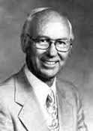
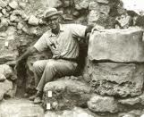
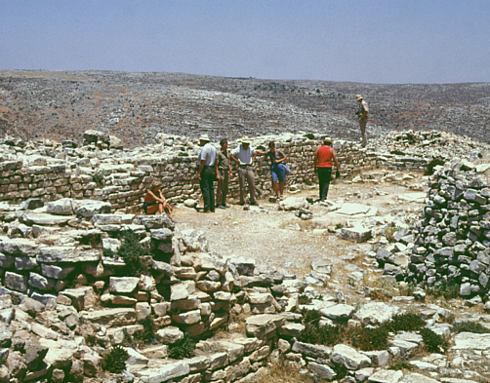
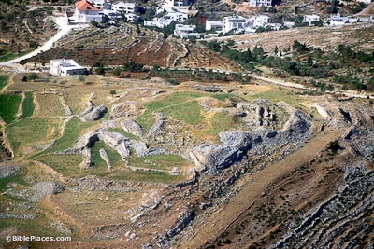
Joseph Callaway and the Problem of Ai
Joseph Callaway, a devout Christian, was disappointed by not finding confirmation of Joshua’s battle and destruction of Ai, but found important remains from Abraham’s time (the Early Bronze Age) and an Israelite village from the period of the Judges.
Joseph Callaway (1920-1988) wrote ‘Was My Excavation of Ai Worthwhile?’ in 1985 in Biblical Archaeology Review
An Early Bronze Age Temple at Ai

Slide 13
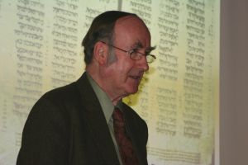
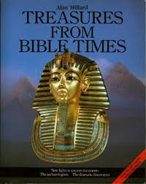
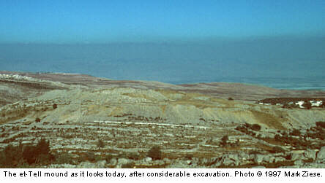
Alan Millard’s Response to the Problem of Ai
The fact that Ai and Et Tell mean “ruin” in Hebrew and Arabic provides the key to understanding the biblical account. The Early Bronze Age (ca. 2400 BC) remains with 23 foot high walls formed a makeshift citadel or “stockade” for the surrounding Canaanite population, even though the city was in ruins.
Alan R. Millard,
University of Liverpool

Slide 14
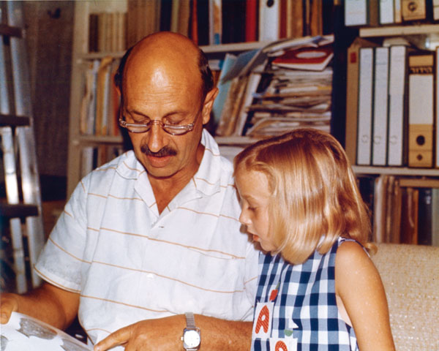
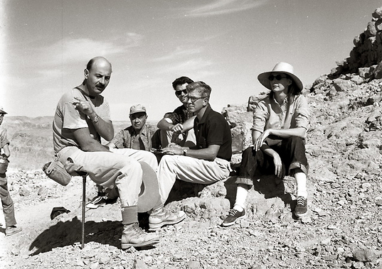
Yigael Yadin: Soldier, Statesman and Archaeologist (1917-1984)
Yigael Yadin was a famous Israeli general and archaeologist, who led an expedition to Hazor in 1955. The amazing discoveries he made were published in media outlets worldwide. A gifted speaker, Yadin held huge audiences captive to his dramatic recounting of his finds that shed much light on biblical history.

Slide 15
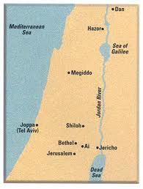
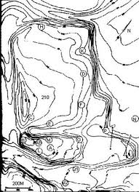
Hazor and Joshua’s Northern Campaign
In Joshua 11:1-15, Jabin, the king of Hazor, formed a military pact with neighboring kingdoms against Israel when news of Joshua’s conquests reached him. Gathering at the Waters of Merom in the Galilee, this huge army was crushed by Joshua’s Israelite army and the great city of Hazor “formerly head of all those kingdoms” was utterly destroyed and burned.
Plan of Hazor, which is the largest Old Testament city in Israel spreading over 180 acres
Major Canaanite Cities mentioned in Joshua and Judges

Slide 16
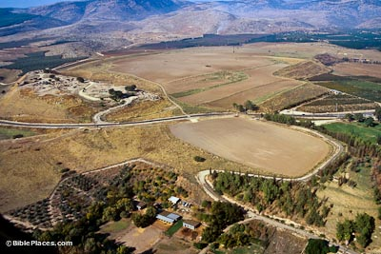
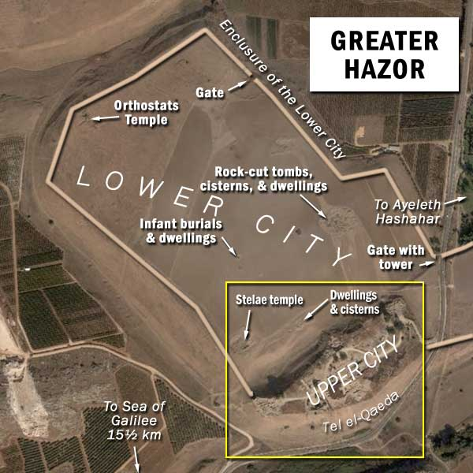
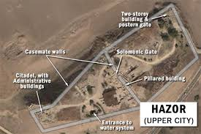
Hazor: The Head of all These Kingdoms (Joshua 11:10)

Slide 17
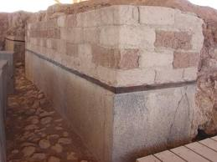
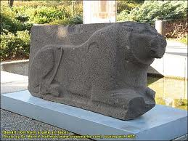
The Canaanite Palace at Hazor
Pictured below are the impressive remains of the Canaanite palace destroyed by Joshua.
A Basalt Lion Orthostat
Corner of the Palace Wall

Slide 18
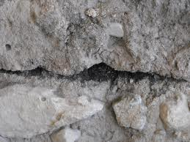
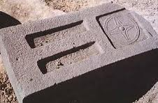
The Destruction at Hazor
Joshua 11:1-11
The Great Bronze Age city of Hazor, the capital city of Canaan, was violently destroyed during the 15th century BC (by Joshua) and later during the 13th century BC (by Deborah and Barak). Israeli archaeologists have been excavating this huge city on and off since 1955 and have found decisive confirmation of Joshua’s account.
Canaanite Offering Table violently knocked over
Ash Layer at Hazor

Slide 19
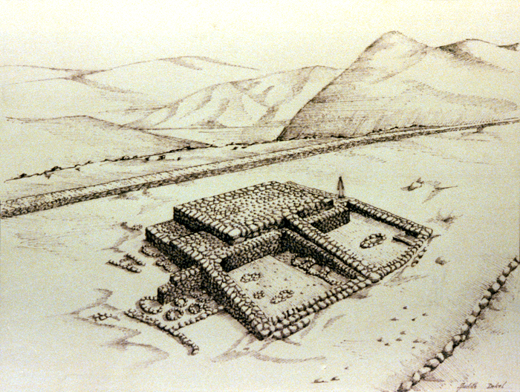
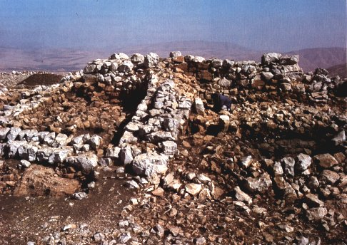
Joshua’s Altar on Mount Ebal
(Joshua 8:30-35)
In 1981, maverick Israeli archaeologist Adam Zertal made an amazing discovery. He claimed to have found an altar near the summit of Mount Ebal dating to the time of the Israelite settlement. Did he indeed find Joshua’s altar? Many scholars strongly disagreed and claimed his structure was a watchtower or part of a farmstead building. The debate continues regarding the interpretation of this structure and Zertal has yet to publish his final report. See a picture of Zertal, who was badly wounded while serving with the IDF in the Yom Kippur War in 1973, in a slide below.

Slide 20
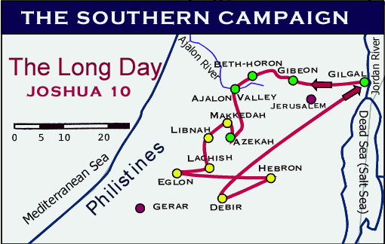
The Southern Campaign and the Defeat of the Five Kings
Joshua 10

Slide 21
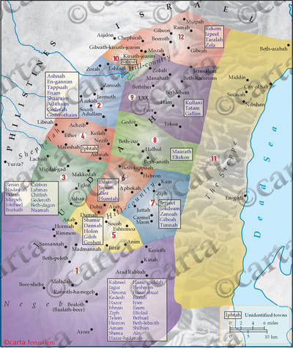
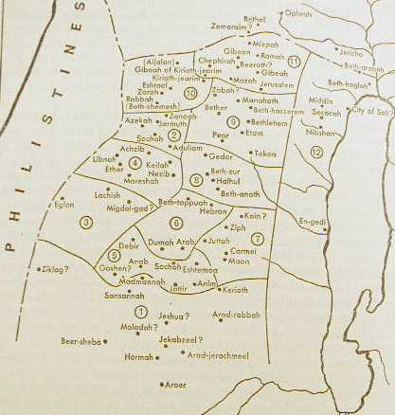
The Districts and Towns of Judah
Joshua 15 preserves a detailed description and city list of the tribal territory of Judah, which ultimately became the Kingdom of Judah after the division of the monarchy. A very tedious and boring read for the uninitiated, the tribal allotments and city lists in Joshua 13-21 contain a wealth of historical and geographic information for biblical scholars. Some of these lists were revised and updated by later kings such as Judah’s below, which dates to the reign of Uzziah.

Slide 22
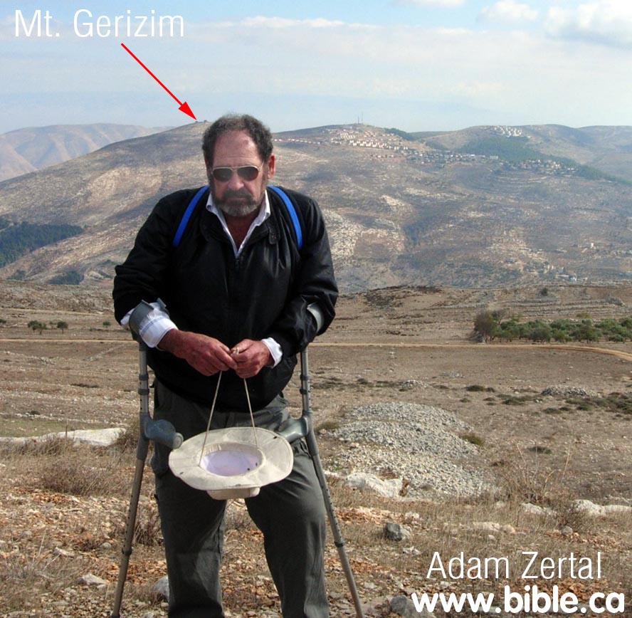
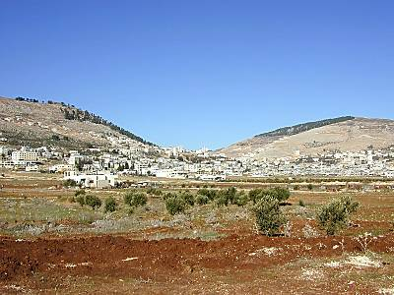
The Covenant Renewal at Shechem
(Joshua 23-24)
The scene of Joshua’s farewell address to the Israelite nation
Mount Gerizim and Mt. Ebal with Shechem in the center. The topography here forms a natural amphitheater for assembling and addressing a nation
Archaeologist Adam Zertal with Mount Gerizim in the background

Slide 23
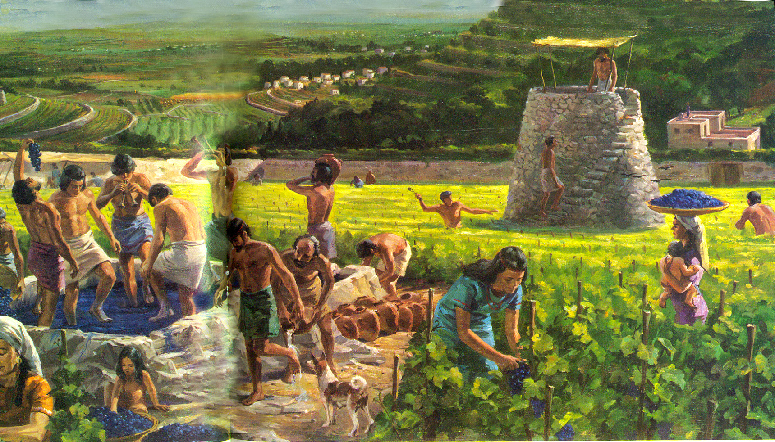
The Israelite Settlement in the Book of Judges

Slide 24
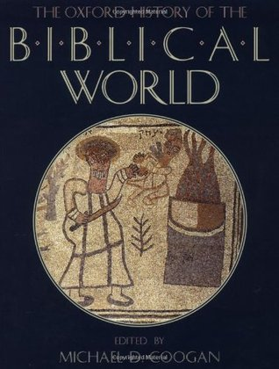







Some Influential Studies of the Israelite Settlement

Slide 25




Pharaoh Merneptah (1213-1203 BC)
This 19th dynasty Pharaoh was not the vigorous ruler like his father, Rameses II, but he made history when he erected a monument and temple relief that mentioned Israel for the first time outside of the Bible.

Slide 26


Slide 27



The Waters of Nephtoah
Joshua 15:9: From the hilltop the boundary headed toward the spring of the waters of Nephtoah, came out at the towns of Mount Ephron and went down toward Baalah (that is, Kiriath Jearim).

Slide 28



Iron Age I Collar Rim Jars: An Israelite Ethnic Indicator?
Collar rim jars were a new pottery form that appears in Canaan at the time of the Israelite Settlement (ca. 1200-1000 BC). Although not always found at Israelite sites, these jars have commonly been associated with the Israelite tribes. First called this name by W. F. Albright due to the rib around the neck of the vessel resembling a clerical collar!

Slide 29



Israelite Pottery
Israelite pottery during the Period of the Judges (Iron Age I) was basic, no nonsense ware without designs or slip. Yet it was generally well made and durable. Artistic development and new forms appeared during the reigns of David and Solomon.

Slide 30


The Israelite Four Room House
The four room house was an Israelite innovation that appears in Iron I-II contexts. It offered the best “bang for the buck” for village and country life. Below left is a four room house from Gezer. Many variations exist but the essential layout is three parallel long rooms backed by a broad room. Manfred Bietak actually discovered a four room Israelite house in Egypt.

Slide 31



The Four Room House at Ebenezer
1 Samuel 4 mentions Ebenezer as the Israelite camp facing the Philistines at Aphek. This was a very large four room house at this site, known today as Izbet Sartah and probably belonged to an Ephraimite tribal chief. 1, 2, and 3 denote parallel rooms, while 4 is the broad room in back. The Israelites were defeated and lost the Ark of the Covenant to the victorious Philistine army.

Slide 32


The Archaeology of the Israelite Settlement: Fortified Villages
Israelite villages were often attached four room houses arranged in a circular pattern to form a casemate wall with one small opening. In remote areas, extended families (bet av) and clans established farmsteads, or clusters of dwellings.

Slide 33



Agricultural Terrace Farming in Israel
The Hill Country of Manasseh, Ephraim, Benjamin and Judah was rugged and difficult to clear and farm. The Israelites developed the art of terrace farming in order to take advantage of available land for olives and viticulture. Grains were usually grown in more level areas such as the valley floor.

Slide 34



Israelite Lined Storage Pits
Another probable Israelite innovation were underground silos that were lined with a mixture of lime and olive pits, which was able to preserve grains and possibly other food stuffs over a long period of time.

Slide 35

What did Israelites Eat?

Slide 36


Daily Meals
Israelites usually ate three daily meals, but not in equal proportion. Small bowls were used for both food and drink
Bread (leḥem) was the main food staple and eaten every meal
Breakfast was a light meal with bread or fruit
Lunch was also light, with bread, grain (Ruth 2:14), olives and figs
Dinner was larger and eaten together. A lentil or vegetable, served in a common bowl was sopped up with bread (Genesis 25:29-34; 2 Kings 4:38-41)
Meat was usually reserved for festive occasions and food consumption varied with the current economic conditions

Slide 37

The Book of Judges:
A Chronological Outline

Slide 38


Theology and Geography in Judges

Slide 39
Judges 1: An Assessment
Judges 1 is a form of Annalistic Military Reporting that begin with a chronological note and generally arrange events geographically, telescope somewhat long periods into brief spans of time and often include hyperbole and the involvement of a diety. Judges 1 is a summary account of military campaigns that shares parallels to the annals of contemporary king Tiglath-pileser I of Assyria (1114-1076 B.C.). This king treads upon dangerous people, lays low those not submissive, and pacifies the rebellious. Ashur commanded him to conquer the land of Mushri and he laid low their warriors, burnt, razed and destroyed their cities and defeated their allies. He made their great city a mound of ruins from the flood, decapitated their men, captured booty and property and piled stones over their destroyed city. The similarity in language demonstrates that Judges fits well into the period it describes.
Judges 1 in contrast to other annalistic records from the ancient near east, records more failures than successes and, in some ways, is an anti-conquest account. It is not political propaganda celebrating achievements, but an account lamenting their failed attempt to occupy the land and to obey and follow the LORD. Moreover, Judges 1 provides an explanation for the deplorable and disastrous history of Israel for the next three centuries. (Block 2009: 104-5)

Slide 40
Judges 1-2: Notes
Asked the LORD: Kings and leaders usually consulted their gods before a military engagement or campaign and often used oracles. The Israelites may have used the Urim and Thummim (Numbers 27:21; 1 Samuel 28:6).
The Peoples of Canaan: Canaanites (1:1), Perizzites (1:5), Jebusites (1:21), Hittites (1:26), Amorites (1:34-36)
Negev near Arad and Hormah (1:16-17): A semi arid basin east of Beer sheba that was controlled by Bedouin during this time. The City of the Palms (1:16; 3:13): May refer to Jericho or Tamar.
The Land that Remained Unconquered and the resulting (dire) Consequences (1:27-2:5)
Land Inheritance (naḥaloth): The land given by God as an allotment for a tribe, clan or family as an estate in Joshua and Judges (e.g., Judges 2:6; 1 Kgs 21:1-3).
The LORD tests (nsh) Israel (2:22): Defined as refine and performed as quality control (loyalty check) and quality enhancement (attempt to improve loyalty). The other nations do not represent the test. Rather, the ability of Israel to listen to (hear and obey) the LORD’s voice is the test.

Slide 41

The Historical-Geographical Riddle of Debir
Judges 1:1-20 recounts the conquest and settlement of the tribes of Judah and Simeon in the Hill Country south of Jerusalem.
Debir (Kiriath Sepher), a Canaanite city in the Hill Country south of Hebron remained to be taken. Caleb offered his daughter Achsah to the man who took Debir. Othniel took the city, but Achsah recognized the land as part of the Negeb and asked for the upper and lower springs near the town. Caleb gave them to her as well.
Debir became a Levitical city (Joshua 21:15) after its conquest, first by Joshua, then by Othniel

Slide 42



Identifying a Biblical Town: The Case of Debir
W. F. Albright (1924) identified Debir with an ancient mound in the Shephelah called Tell Beit Mirsim (in Arabic) because the occupational history matched that of Debir and the existence of springs in the area. Some scholars questioned Albright, but his authority was just to great to be challenged.
Kurt Galling (1954) surveyed Khirbet Rabud in the southern Hill Country and suggested that it, not Tell Beit Mirsim, be identified with Debir.
Moshe Kochavi (1974) surveyed and excavated Khirbet Rabud, discovered two springs nearby and confirmed that it, not Tell Beit Mirsim, was biblical Debir.

Slide 43

Ehud: The Left Handed Judge
An artist’s depiction of the left handed judge Ehud standing before Eglon, King of Moab just before killing him in the inner chamber of his palace near Jericho.
Judges 3:12-30

Slide 44

Notes on Ehud and Moab
Eglon, King of Moab oppresses Israel for 18 years. Eglon can mean “little bull” or “calf” or it may be a pun on the word for “round or rotund.”
Moab expanded across the Jordan River, with Ammonite and Amalekite assistance, and occupied Jericho (in Benjaminite territory). The city of the palms may also refer to Tamar, but here to Jericho. Eglon’s presence at Jericho demonstrates the plight of Israel. They are cut off from crossing the Jordan Valley to Gadite and Reubenite territory and the Moabites are using Jericho as a staging area for further expansion to the west.
The Moabite presence at Jericho, including Eglon’s palace shows they are oblivious to the curse in Joshua 6:26.
Ehud was a left handed man, perhaps ambidextrous, had an injured, deformed or handicapped right hand, or was trained for war as a left handed soldier. He was from Benjamin (e.g., son of the right hand). Being left handed here probably hints at Ehud being an outcast or a second class tribal standing. It is considered unclean in Middle east culture.
A double edged sword (3:16) is for thrusting, not hacking. A cubit is about 18” long.
The stelae near Gilgal (3:19) are boundary stones and inscribed with texts commemorating Moabite conquests.

Slide 45



Ehud’s Clever Assassination Plan
Are there ethical concerns with Ehud’s action?
Eglon’s Palace: A Bit Hilani styled building.
Upper room (3:20) is a raised throne room; porch (3:23) is a pillared portico
The Hebrew words itter (from to bind), aliyya ham-meqera (upper chamber or room over the beams) and misdaron (hidden place).

Slide 46

Mount Tabor and the Jezreel Valley
The defeat of Sisera’s Canaanite army by Deborah and Barak (Judges 4-5)

Slide 47

Gideon and the Midianites:
Recreating the selection of Gideon’s army at the Spring of Harod

Slide 48

The Hill of Moreh
The location of the Midianite Camp attacked by Gideon (Judges 7)

Slide 49


The Sea Peoples and the Philistines

Slide 50

Rameses III and the Land/Sea Battle against the Sea Peoples

Slide 51




An Epic Battle: 1177 B.C.

Slide 52

The Samson Account: Judges 13-16
… and another failed attempt by Hollywood to accurately capture a biblical account on the big screen. This movie was released in 1949.

Slide 53


The Philistine Temple at Tell Qasile
New Light on Samson’s Death (Judges 16:23-30)
When Israeli archaeologists excavated a Philistine provincial town, Tell Qasile, located in the suburbs of Tel-Aviv, they uncovered the first known Philistine temple. Amazingly, the entire roof of this temple was supported by two central pillars (below right), just like the much larger but similarly constructed Philistine temple of Dagan in Gaza, where the Philistines made Sampson stand between the pillars while mocking him and his God. Sampson prayed and pushed against both pillars, collapsing the entire roof upon himself, the Philistine Lords and a huge audience.

Slide 54


The Geographical Setting of the Judges

Slide 56

The Mountain of the LORD
Isaiah 2:1-5
This is what Isaiah son of Amoz saw concerning Judah and Jerusalem:
In the last days the mountain of the Lord’s temple will be established
as the highest of the mountains; it will be exalted above the hills, and all nations will stream to it. Many peoples will come and say, “Come, let us go up to the mountain of the Lord, to the temple of the God of Jacob. He will teach us his ways, so that we may walk in his paths.”
The law will go out from Zion, the word of the Lord from Jerusalem.
He will judge between the nations and will settle disputes for many peoples. They will beat their swords into plowshares and their spears into pruning hooks. Nation will not take up sword against nation, nor will they train for war anymore.

Slide 57


Slide 58


Slide 59

The Book of Judges

Slide 60



Philistine Pottery
Much more developed and appealing than Israelite pottery. The designs came from Mycenaean forms from the Aegean.

