Slide 1

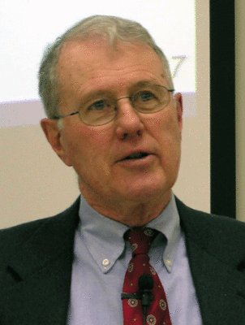
Major Prophets
Lecture 21: Introduction to Daniel
Dr. Robert Vannoy
ReNarrated by Dr. Perry Phillips
© 2023 Robert Vannoy & Ted Hildebrandt

Slide 2
Major Prophets
Daniel
A. Introductory Remarks
1. Problems with Date and Authorship
    a. Reasons for the Late Date
    1) Assumption that Predictive Prophecy Does Not Happen
    2) Alleged Historical Errors
    3) Alleged Late Linguistic Features
    4) Conclusion
  2. Some General Remarks on the Content of the Book in Relation to Its
  Purpose
    a. Daniel 1-6 The Historical Section

Slide 3
Major Prophets
Summary of the Content of Daniel 1-6
1. Daniel 1
2. Daniel 2
3. Daniel 3
4. Daniel 4
5. Daniel 6
6. Summary of Daniel 1-6
7. Historical Context of Empires and Jewish Persecution

Slide 4
Major Prophets
Video based on audio from Dr. Vannoy’s class at Biblical Theological
Seminary. It was renarrated by Dr. Perry Phillips because the original audio
was scratchy and it was turned into video by Ted Hildebrandt for Biblicalelearning.org.

