Slide 1

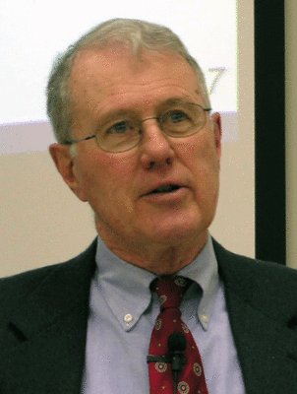
Kings
Lecture 9: High Places – Asa, Jeroboam – Golden Calves
Dr. Robert Vannoy
ReNarrated by Dr. Perry Phillips
© 2023 Robert Vannoy & Ted Hildebrandt

Slide 2
Kings
  High Places – Asa of Judah
  Asa Continued – 1 Kings 15 – Victory over Zerah the Cushite
  Asa’s Alliance with Ben-Hadad – 1 Kings 15:18ff
C. The First Two Dynasties of Israel
1. Dynasty of Jeroboam – 1 Kings 11:26-14:20
a. Jeroboam Becomes King – 1 Kings 12:1-20
  b. Jeroboam Establishes or Originates Illegal Worship – 1 Kings 12:25-33
  c. The Prophet from Judah – 1 Kings 13

Slide 3
Kings
Video based on audio from Dr. Vannoy’s class at Biblical Theological
Seminary. It was renarrated because the original audio was scratchy
and it was turned into video by Ted Hildebrandt for Biblicalelearning.org.

