Slide 1

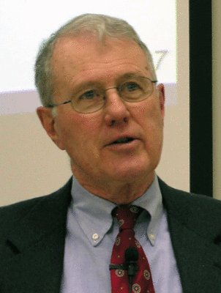
Kings
Lecture 7: Solomon – Back to Egypt, Heart turns Idolatry
Dr. Robert Vannoy
ReNarrated by Dr. Perry Phillips
© 2023 Robert Vannoy & Ted Hildebrandt

Slide 2
Kings
F. 1. Peace with a Flaw – 1 Kings 9:10-25
2. The Turning Point – 1 Kings 9:26-10:25
3. Back to Egypt – 1 Kings 10:26-29 – On Horses and Chariots
Trusting the Lord – Strength in Weakness not in Chariots
Survey of Horses and Chariots in Scripture
G. Conclusions
1. 1 Kings 11 – Solomon’s Heart Turned Away
God’s Warning 1 Kings 9:4
  2. Solomon’s Adversaries --1 Kings 11:14-25
  Rising of the Messianic Ideal King

Slide 3
Kings
Video based on audio from Dr. Vannoy’s class at Biblical Theological
Seminary. It was renarrated because the original audio was scratchy
and it was turned into video by Ted Hildebrandt for Biblicalelearning.org.

