Slide 1

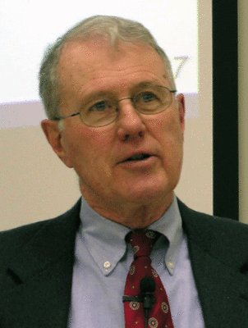
Exodus to Exile
Lecture 7B: Joshua – Jericho and Ai
Dr. Robert Vannoy
ReNarrated by Dr. Ted Hildebrandt © 2023 Robert Vannoy & Ted Hildebrandt

Slide 2
Exodus to Exile
III. C. The Conquest of Canaan – Joshua 5:13-12:24 1. Taking of Jericho
2. Herem – Devoted and Accursed – Set Apart to the Lord [destroyed or put in the Lord’s treasury]
3. Cursed Jericho not to be Rebuilt & Ahab
4. Archaeological Evidence at Jericho a. Early Work at Jericho
b. Work of K. Kenyon at Jericho
c. Recent Work of Bryant Wood on Jericho evidence
5. Failure at Ai and Achan’s Sin a. Initial Attack

Slide 3
Exodus to Exile
b. Achan’s Taking Devoted Things
c. Archaeology of Et-Tel and Debate on Identifying the Site as Ai
d. Livingston’s Identification of Alternative Site
e. Questions on Identifying Bethel as Beitin (El Bireh)
Video based on audio from Dr. Vannoy’s class at Biblical Theological Seminary. It was renarrated because the original audio was scratchy and it was turned into video by Ted Hildebrandt for Biblicalelearning.org.

