Slide 1

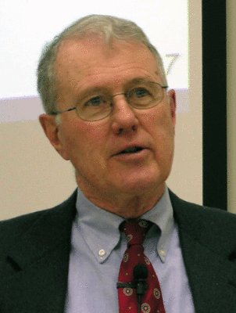
Deuteronomy: Specialized Studies
Lecture 10B: Centralization of Worship in Deuteronomy 12, Halwarda’s Article
Dr. Robert Vannoy
ReNarrated by Dr. Perry Phillips © 2023 Robert Vannoy & Ted Hildebrandt

Slide 2
Deuteronomy: Specialized Studies
III. The Centralization of Worship and Its Implications for the Date of Deuteronomy
A. D. Halwarda’s “The Place the Lord Will Choose” [on Deut. 12]
1. Statement of the Problem – a la Wellhausen -- 621 BC
a. Wellhausen’s 3 Stages of the Place of Worship [Multiple sanctuaries, Prophetic Opposition to Multiple Sanctuaries, Centralize post-exilic
b. Significance of Deuteronomy 12 for the Wellhausen Theory
c. 3 Phases in Israel’s Worship Altars’ Locations
1. Law Code – Exod. 20
2. Deuteronomy 12 Centralization to One Place
3. Prophets as Innovators

Slide 3
Deuteronomy: Specialized Studies
2. Halwarda’s Response to Wellhausen’s Deuteronomy 12 Theory
a. Multiple Altars Sanctioned in Historical Books (cf. 1 Kgs. 18-19) Elijah & Prophets of Baal on Mt. Carmel
b. No Prophetic Opposition to Multiple Altars
c. Samuel Had Many Altars
d. David “Sacrifice” at Bethlehem Recognized and Accepted
e. Deuteronomy 12 & David’s Desire to Build God a House
f. Absalom and the Hebron Sanctuary
g. Rest and Peace Only Possible in Solomon’s Day – no in Joshua’s Day

Slide 4
Deuteronomy: Specialized Studies
Video based on audio from Dr. Vannoy’s class at Biblical Theological Seminary. It was renarrated because the original audio was scratchy and it was turned into video by Ted Hildebrandt for Biblicalelearning.org.

