Slide 1
Welcome to
Mastering NT Greek
By Ted Hildebrandt © 2003
Baker Academic

Slide 2
Introductory Matters
Welcome
Syllabus read through & course introduction

Slide 3
Why study Greek?
God has spoken – study as the highest form of worship—2 Tim. 3:16; Heb. 1:1; 4:12; Ps. 119:11; Jn. 6:63; 2 Pet. 1:21. On reading love letters
Context determines meaning
Why not just read it in an English translation? E.g. “trunk—
Car
Tree
Luggage
Body

Slide 4
ei]rh<nh--peace?
  Semantic Domains between languages may not match up exactly
  Lk 2:14 (peace?); “Glory to God in the highest and on earth peace”
  Mk 5:34 (health); unclean woman touches Jesus, healed
  “Go in peace and be freed from your suffering”
  Lk 2:29 (tranquility) "Sovereign Lord, as you have promised, you now dismiss your servant in peace.
  Lk 11:21(safe/secure) When a strong man, fully armed, guards his own house, his possessions are safe.”
  Luke 10:5 (Blessing) "When you enter a house, first say, 'Peace to this house.'
  1 Thessalonians 5:3 (no war) While people are saying, "Peace and safety," destruction will come on them suddenly,

Slide 5
di<kaioj--righteous
Cultural impact
Causal: Because Joseph righteous → did not want to make a public example
Concessive: Despite Joseph being righteous → he did not want to….
Joseph is righteous = not wanting to…
Mat 5:20; 6:33 new righteousness

Slide 6
Why study Greek?
Thinking for yourself: Ps 119:11, 105
Seeing things closely: author’s style,
Things that matter in a “whatever” culture: Jn 6:63
Learning English through Greek--1 Kgs 8
Beware--Power corrupts: “In the Greek it means…”

Slide 7
How should we study Greek?
Goal – the dream
Memorizing—27 chants
Time, Consistency, Persistence
Discipline (bottom line), buddy system
Vocab building
Grammatical muscle building (verbs, nouns, adjectives, pronouns, article, etc.)
Morphology: sg/pl.; m/f; 1st person…
Inch by inch it’s a cinch, yard
Humility (“in the Greek this means”)

Slide 8
What is Koine Greek?
Stages of Greek Language
Pre-Homeric (1400-1100 BC)
Mycenaean= Linear B
Epic (Homer 800 BC)
Classical (500-300 BC) – dialects: Ionic→
Attic [Athens], Doric, Aeolic
Koine/Hellenistic (330 BC – AD 330)
Byzantine (330-1453)
Modern (1453 – present)
Katharevousa (official until 1976);
Demotike –common oral

Slide 9
What is Koine Greek?
Semitic background-alpha-bet (ox + house; Greeks added vowels), right to left;
Boustrophedon
Three influences: Semitic, literary koine, vernacular koine (Wallace, 28)
Koine as Holy Spirit Greek→ Common
God speaks the language of the people

Slide 10
Classical/Koine shifts: Diacrhonic/Synchronic
Shifts in meaning Classical to Koine [synonyms] (ἕτερος/heteros//ἄλλος/allos: 2 Cor 11:4; Gal. 6:1) Classical clear separation: another=additional//different
KJV 2 Corinthians 11:4 For if he that cometh preacheth another (allon) Jesus, whom we have not preached, or if ye receive another (eteron) spirit, which ye have not received, or another (eteron) gospel, which ye have not accepted, ye might well bear with him.
KJV Galatians 1:6 I marvel that ye are so soon removed from him that called you into the grace of Christ unto another (heteron) gospel:
Galatians 1:7 Which is not another (allo); but there be some that trouble you, and would pervert the gospel of Christ.

Slide 11
Koine (333BC-300AD)
Hellenism – Alexander (333 B.C.)—universal--LXX
Incredible timing: Gal. 4:4 “in the fullness of time God sent his son…”
Uncials/Miniscules & manuscripts
Inspiration and copying processes:
text criticism [lower criticism] versus higher criticism (source, form, redaction criticism)

Slide 12
Alphabet
α / Α Alpha sounds like “a” in father
β / Β Beta sounds like “b” in Bible
γ / Γ Gamma sounds like “g” in gone
δ / Δ Delta sounds like “d” in dog
ε / Ε Epsilon sounds like “e” in met

Slide 13
Alphabet (cont.)
ζ / Ζ Zeta sounds like “z” in
daze when it begins a word,
“dz” when it's in the middle
of a word
η / Η Eta sounds like “e” in obey
θ / Θ Theta sounds like “th”
think

Slide 14
Alphabet (Cont.)
ι / Ι Iota short sounds like initial “i” in
sit
long sounds like the second “i” in
machine
When it begins a name = “y” ( Ἰησοῦς
Yesus)
κ / Κ Kappa sounds like “k” in
kitchen
λ / Λ Lambda sounds like “l” in law

Slide 15
Alphabet (Cont.)
μ / Μ Mu sounds like “m” in mother
ν / Ν Nu sounds like “n” in new
ξ / Ξ Xsi sounds like “x” in axe

Slide 16
Alphabet (Cont.)
ο / Ο Omicron sounds like “o” in not
some pronounce it like modern Greek
long “o” as in “obey” others like the
“ou” in thought
π / Π Pi sounds like “p” in peach
ρ / Ρ Rho sounds like “r” in rod

Slide 17
Alphabet (Cont.)
σ / Σ Sigma sounds like “s” in set
sigma looks like “ς” when it comes
at the end of a word (final sigma,
σοφός)
τ / Τ Tau sounds like “t” in talk
υ / Υ Upsilon sounds like “oo” in
“hoops”

Slide 18
Alphabet (Cont.)
φ / Φ Phi sounds like “ph” in phone
χ / Χ Chi sounds like “ch” in chemical
ψ / Ψ Psi sounds like “ps” in lips
ω / Ω Omega sounds like “o” in tone

Slide 19
Whole Alphabet Chant through
α β γ δ ε ζ η θ ι κ λ μ ν ξ ο π ρ σ τ υ φ χ ψ ω
Α Β Γ Δ Ε Ζ Η Θ Ι Κ Λ Μ Ν Ξ Ο Π Ρ Σ Τ Υ Φ Χ Ψ Ω

Slide 20
Double Consonants
θ
ξ
φ
χ
ψ

Slide 21
Easy to confuse letters
η (with n)
ν (with v)
ρ (with p)
χ (with x)
ω (with w)

Slide 22
Nasal gamma
When gamma comes before γ, κ, χ, ξ it is pronounced like an “n”
ἄγγελος = angelos

Slide 23
Vowels
α, ε, η, ι, ο, υ, ω
Always Short: ε, ο
Always Long: η, ω
Long or short: α, ι, υ

Slide 24
Vowel Chart
Short
ε
ο
Long
η
ω
Both α, ι, υ

Slide 25
Diphthongs -- 2 vowels = 1 sound
αι as in "aisle"
ει as in "eight"
οι as in "oil"
υι as in "suite"
αυ as in "sauerkraut"
ευ, ηυ as in "feud“
ου as in “boutique"

Slide 26
Iota Subscripts
ᾳ, ῃ, ῳ

Slide 27
Diaeresis ¨
Cancels the diphthong effect – keeps the two vowels separate.
Ἠσαϊας = ‘Η –σα-ι -ας

Slide 28
Phonetic Chart
Labials (lips) π β φ
Dentals (teeth) τ δ θ
Velars (tongue/ κ γ χ
roof)

Slide 29
Phonetic Addition
Labial + σ = ψ (π + σ = ψ)
Palatal + σ = ξ (κ + σ = ξ)
Dental + σ = σ (τ + σ = σ)

Slide 30

Chapter 1 Vocabulary
ἄγγελός, -ου, ὁ
  angel

Slide 31
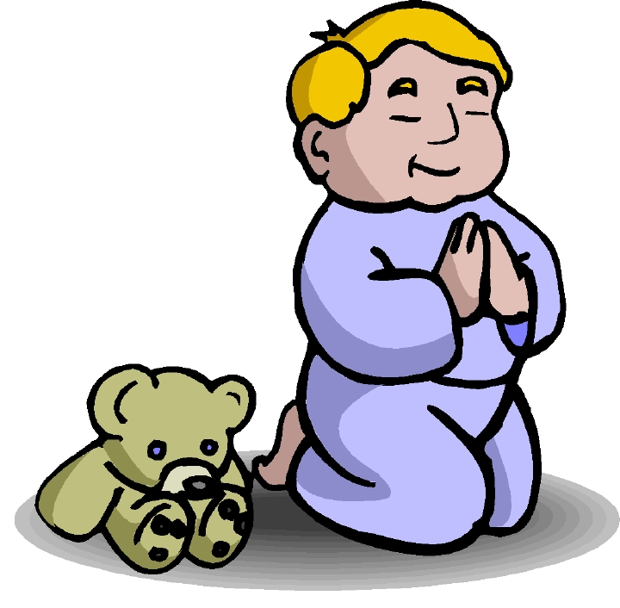
Chapter 1 Vocabulary
ἀμήν
  truly, verily

Slide 32
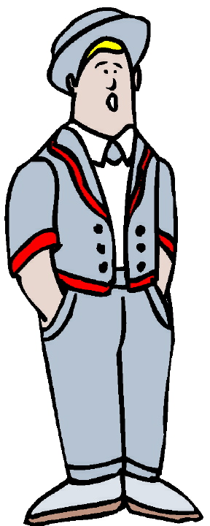
Chapter 1 Vocabulary
ἄνθρωπος, -ου, ὁ
  man, human

Slide 33
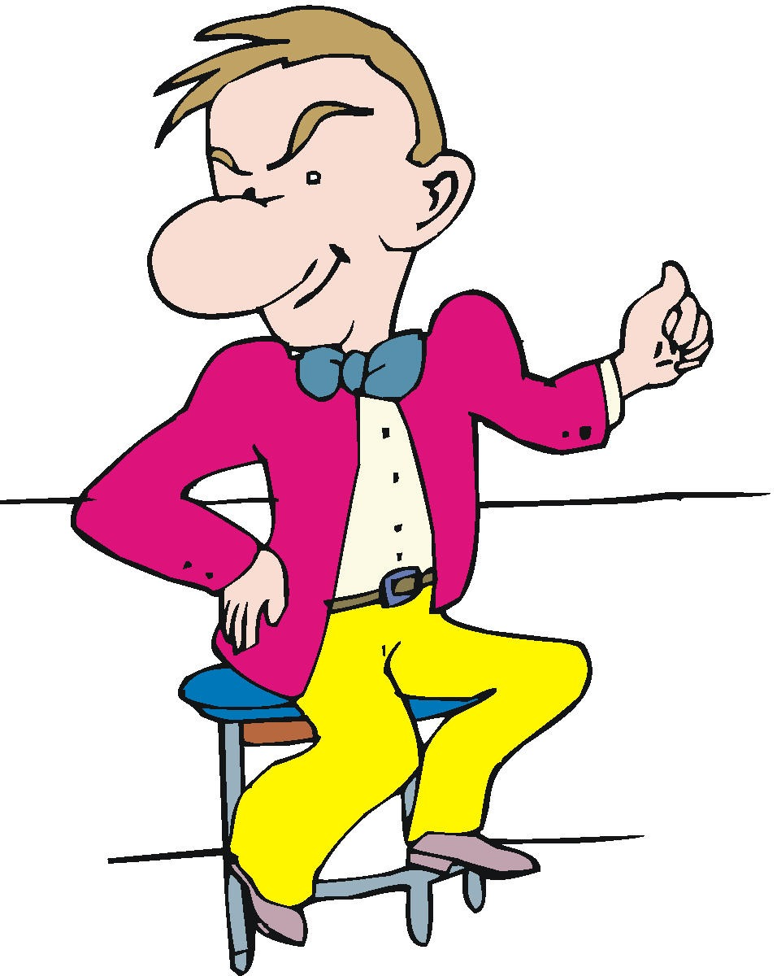
Chapter 1 Vocabulary
ἐγώ
  I--ego

Slide 34
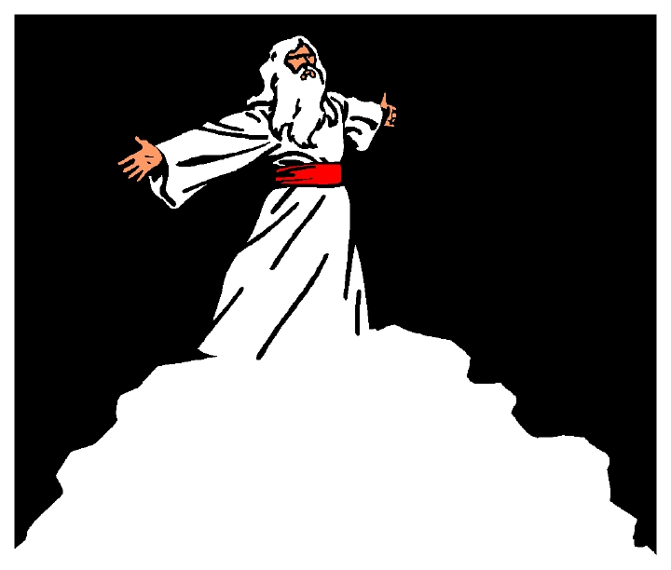
Chapter 1 Vocabulary
θεός, -οῦ, ὁ
  God

Slide 35

Chapter 1 Vocabulary
καί
  and

Slide 36

Chapter 1 Vocabulary
καρδία, -ας, ἡ
  heart

Slide 37

Chapter 1 Vocabulary
λέγω
  I say

Slide 38
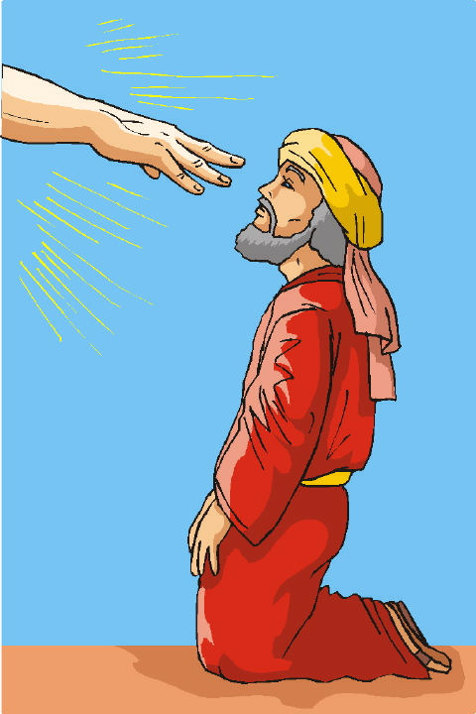
Chapter 1 Vocabulary
προφήτης, -ου, ὁ
  prophet

Slide 39
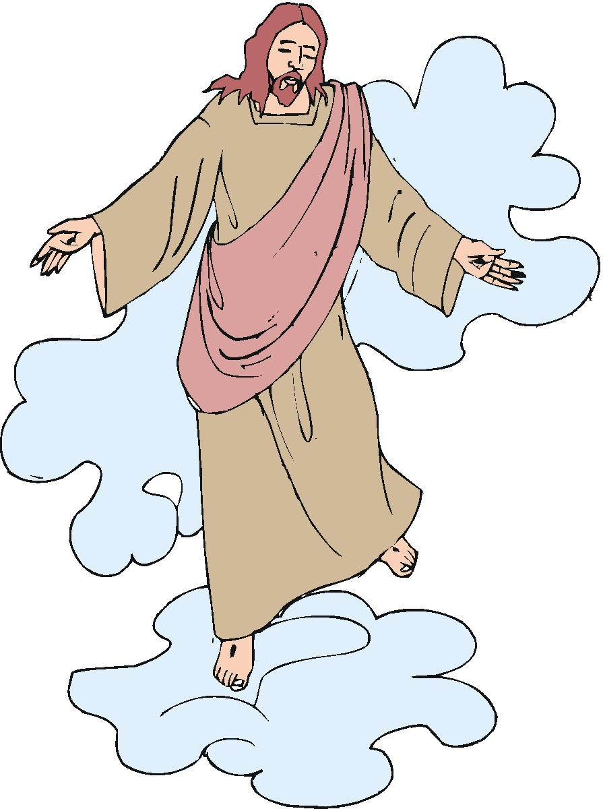
Chapter 1 Vocabulary
Χριστός, -οῦ, ὁ
  Christ,
  Messiah,
  anointed one

Slide 40
Alphabet Razzle/Dazzle - Call out the name drill
χ
ξ
δ
σ
β
λ
κ

Slide 41
Alphabet Razzle/Dazzle Drill
θ
η
ρ
υ
ψ
τ
γ

Slide 42
Alphabet Razzle/Dazzle Drill
φ
μ
ζ
α
ι
π
ω

Slide 43
Alphabet Razzle/Dazzle Drill
γ
ψ
λ
κ
σ
ζ
β

Slide 44
Alphabet Drill Teams Drill
θ
φ
ρ
τ
ν
δ
ξ

Slide 45
Alphabet Drill Teams Drill
π
η
ω
χ
μ
ι
ε

Slide 46
Uncial capital Letters Drill
Ξ
Ρ
Σ
Ζ
Β
Λ
Ω

Slide 47
Uncial capital Letters Drill
Γ
Θ
Υ
Μ
Φ
Δ
Κ

Slide 48
Uncial capital Letter Drill
Ν
Η
Ψ
Α
Π
Ο
Τ

Slide 49
Diphthong sound offs
ει
αι
οι
υι
αυ
ευ
ηυ
ου

Slide 50
Vocabulary
ἀγνία
ἀμήν
ἀπολογία
ἀπόστολος
δαίμων
διάκονος
εἰκών
ἐπιστολή

Slide 51
θεραπεία
θρόνος
κόσμος
λεπρός
μάρτυς
παραβολή
πρεσβύτης
ῥαββι

Slide 52
σάββατον
σχίσμα
ὕβρις
ὑποκριτής
φαντασία
φιλοσοφία
ὡσαννά

