Slide 1
Mastering NT Greek
24. Imperishable Imperatives
By Ted Hildebrandt © 2003
Baker Academic

Slide 2
Warm-ups

Slide 3
Rapping the Lord’s Prayer
Πάτερ ἡμῶν ὁ ἐν τοῖς οὐρανοῖς father our the one in heaven
ἁγιασθήτω τὸ ὄνομά σου make holy name your
ἐλθέτω ἡ βασιλεία σου let come kingdom your
γενηθήτω τὸ θέλημά σου, let be will your

Slide 4
Rapping the Lord’s Prayer
ὡς ἐν οὐρανῷ καὶ ἐπὶ γῆς· as in heaven also on earth
τὸν ἄρτον ἥμῶν τὸν the bread our
ἐπιούσιον δὸς ἡμῖν σήμερον· daily give us today

Slide 5
Rapping the Lord’s Prayer
καὶ ἄφες ἡμῖν τὰ ὀφειλήματα ἡμῶν and forgive us trespasses our
ὡς καὶ ἡμεῖς ἀφήκαμεν as also we have forgiven
τοῖς ὀφειλέταις ἡμῶν the ones trespassing us

Slide 6
Rapping the Lord’s Prayer
καὶ μὴ εἰσενέγκῃς ἡμᾶς and do not lead us εἰς πειρασμόν into temptation ἀλλὰ ῥῦσαι ἡμᾶς ἀπὸ but deliver us from τοῦ πονηροῦ the evil one

Slide 7
2-1-2 Paradigms - Chant this
2 1 2
λόγος γραφή ἱερόν
λόγου γραφῆς ἱεροῦ
λόγῳ γραφῇ ἱερῷ
λόγον γραφήν ἱερόν
λόγοι γραφαί ἱερά
λόγων γραφῶν ἱερῶν
λόγοις γραφαῖς ἱεροῖς
λόγους γραφάς ἱερά

Slide 8
3rd Declension Chantables
χαρίς ὄνομα, πίστις
χάρις ὄνομα πίστις
χάριτος ὀνόματος πίστεως
χάριτι ὀνόματι πίστει
χάριτα ὄνομα πίστιν
χάριτες ὀνόματα πίστεις
χαρίτων ὀνομάτων πίστεων
χάρισι(ν) ὀνόμασι(ν) πίστεσι(ν)
χάριτας ὀνόματα πίστεις

Slide 9
PAI Verb Chant
λύω λύομεν
λύεις λύετε
λύει λύουσι(ν)

Slide 10
The "is" verb PAI -- εἰμί
εἰμί ἐσμέν εἶ ἐστέ ἐστί(ν) εἰσί(ν)

Slide 11
Imperfect εἰμί
ἤμην ἦμεν ἦς ἦτε ἦν ἦσαν

Slide 12
Person Personal Pronoun Chant
Singular Plural
Nom. ἐγώ σύ ἡμεῖς
Gen. μου σου ἡμῶν Dat. μοι σοι ἡμῖν Acc. με σε ἡμάς
αὐτός, αὐτη, αὐτό (he, she, it)

Slide 13
Present Middle/Passive Indicative
λύομαι, -ομεθα -ῃ, -εσθε -εται, -ονται
I am loosed/am being loosed
I loose myself/am loosing [for myself]

Slide 14
Shape of the Future in Greek
λύσω λύσομεν I will loose We will loose
λύσεις λύσετε You will loose You all will loose
λύσει λύσουσι(ν) S/he/it will loose They will loose
Chant this one

Slide 15
Future Middle Paradigm
λύσομαι -όμεθα -ῃ -εσθε -εται -ονται
I will loose (for myself) We will loose (for ourselves) …

Slide 16
Demonstrative and Relative Pronouns Summary
ἐκεῖνος, ἐκείνη, ἐκεῖνο = that
οὗτος, αὕτη, τοῦτο τούτου, ταύτης, τούτου = this
ὅς ἥ ὅ = Relative (who, which) οὗ ἧς οὗ

Slide 17
Imperfect Active Paradigm of λύω
Chant: ἐλυον, ν, ς, ε, μεν, τε, ν I was loosing, …

Slide 18
Imperfect Middle/Passive (IM/PI)
Chant: ἐλυόμην ου, ετο, ομεθα, εσθε, οντο
I was being loosed

Slide 19
Second Aorist Active Chant
ἔλαβον ν, σ, ε, μεν, τε, ν

Slide 20
Second Aorist Middle Chant
ἐγενόμην -ου, -ετο, -ομεθα, -εσθε, -οντο

Slide 21
Aorist Stem Changes -- 8 to know
ἔρχομαι == ἦλθον (I came, went)
βλέπω == εἶδον (I saw)
λέγω == εἶπον (I said)
γίνομαι == ἐγενόμην (I became)
γινώσκω == ἔγνων (I knew)
ἔχω == ἔσχον ( I had)
λαμβάνω == ἔλαβον (I took)
εὑρίσκω == εὗρον (I found)

Slide 22
1st Aorist Active Paradigm
Learn: ἔλυσα: I loosed… --, ς, ε, μεν, τε, ν

Slide 23
1st Aorist Middle Paradigm
Learn: ἐλυσάμην: I loosed for myself -ω, -ατο, -αμεθα, -ασθε, -αντο

Slide 24
Chanting the Present Particple Chant
Present Active: ptc = participle
Nom. λύων λύουσα λῦον Gen. λύοντος λύουσης λύοντος
Present Middle/Passive
Nom. λυόμενος λυομένη λυόμενον Gen. λυομένου λυομένης λυομένου

Slide 25
Aorist Participle Chant
First Aorist Active 3-1-3 (chant)
Nom. λύσας λύσασα λύσαν Gen. λύσαντος λυσάσης λύσαντος
Nom. λυθείς λυθεῖσα λυθέν Gen. λυθέντος λυθείσης λυθέντος
First Aorist Middle 2-1-2 (non-chant)
Nom. λυσάμενος λυσαμένη λυσάμενον Gen. λυσαμένου λυσαμένης λυσαμένου

Slide 26
Perfect Participle Chant
Perfect Active Participles (know these)
3 1 3 λελυκώς λελυκυῖα λελυκός λελυκότος λελυκυίας λελυκότος
Perfect Middle/Passives Participles
2 1 2 λελυμένος λελυμένη λελυμένον λελυμένου λελυμένης λελυμένου

Slide 27
Infinitive Endings to Chant
λύειν (to loose)
Present: ειν εσθαι
Second Aorist: εῖν εσθαι ῆναι
First Aorist: αι ασθαι ῆναι
Perfect: ναι σθαι
Hint: often when seeing an "αι" on the end of a verb suspect an infinitive.

Slide 28
Subjunctive Chant
PAS λύω, λύῃς, λύῃ, λύωμεν, λύητε, λύωσι(ν)
PM/P S λύωμαι, -ῃ, ῃται, -ωμεθα, -ησθε, -ωνται

Slide 29
Imperatives

Slide 30
Imperative Introduction
Moods:
Indicative -- statement of fact
Subjunctive -- possibility (may/might)
Imperative – command—just do it
Aspect not tense -- type of action not time of action
Present = process/immediacy/foreground
Aorist = whole/complete/background

Slide 31
Person:
English only 2nd person: you go!
Greek has 2nd and 3rd person:
You go!
Let her go!

Slide 32
Forms endings for Chant
Present (e toe-te-toesan, etc.)
-ε, -τω, -τε, -τωσαν (Active) -ου, -σθω, -σθε, -σθωσαν (M/Pas)
First Aorist
-ν, -τω, -τε, -τωσαν (Active) -αι, -σθω, -σθε, -σθωσαν (Mid) -τι, -τω, -τε, -τωσαν (Pas)
Second Aorist = root shift + reg. present endings (passive= -τι …)

Slide 33
Present (process/immediacy) Imperative
Active Singular Plural
2 λῦε λύετε 3 λυέτω λυέτωσαν
Mid/Pass
2 λύου λύεσθε 3 λυέσθω λυέσθωσαν
Translation: You loose! Let him loose! Be loosed!

Slide 34
First Aorist (whole/complete) Imperative
Active Singular Plural
2 λῦσον λύσατε 3 λυσάτω λυσάτωσαν
Middle
2 λῦσαι λύσασθε 3 λυσάσθω λυσάσθωσαν
Translation: You loose! Let him loose! Loose yourself!

Slide 35
First Aorist (whole/complete) Imperative
Active Singular Plural
2 λύθητι λύθητε 3 λυθήτω λυθήτωσαν
Translation: Be loosed! Let him be loosed!

Slide 36
Second Aorist (whole/complete) Imperative (λείπω: I leave)
Active Singular Plural
2 λίπε λίπετε 3 λιπέτω λιπέστωσαν
Middle
2 λιποῦ λίπεσθε 3 λιπέσθω λιπέσθωσαν
Translation: You leave! Let him leave! Leave for yourself!

Slide 37
Second Aorist/Undefined Imperative
Passive Singular Plural
2 λείφθητι λείφθητε 3 λειφθήτω λειφθήτωσαν
Translation: Be gone! Let it be gone!

Slide 38
Imperative of εἰμί
Singular Plural
2 ἴσθι ἔστε
3 ἔστω ἔστωσαν
(you) be, let her be… let them be

Slide 39
3 ways to translation Imperatives
1) As a command: you go, you put
2) As a prohibition: μή + Imperative
you can also use οὐ + indicative
or μή + subjunctive too
3) As an entreaty: pretty please (especially when speaking to a superior)

Slide 40
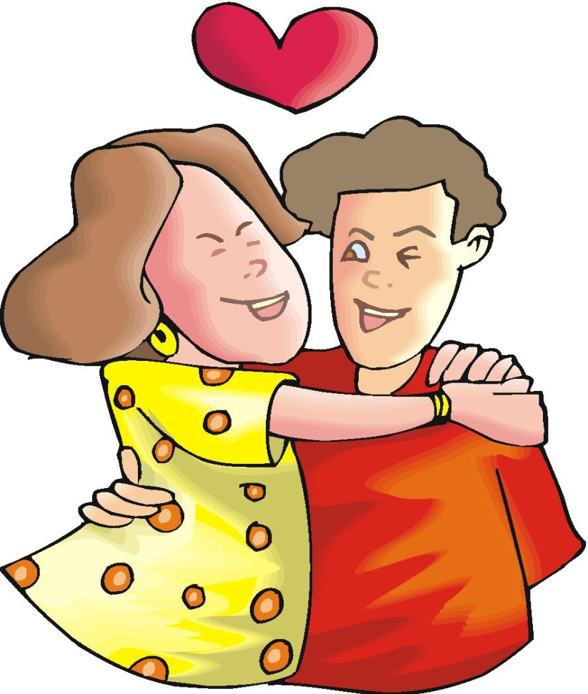
Chapter 24 Vocabulary
ἀγαπητός, -ή, -όν
beloved

Slide 41
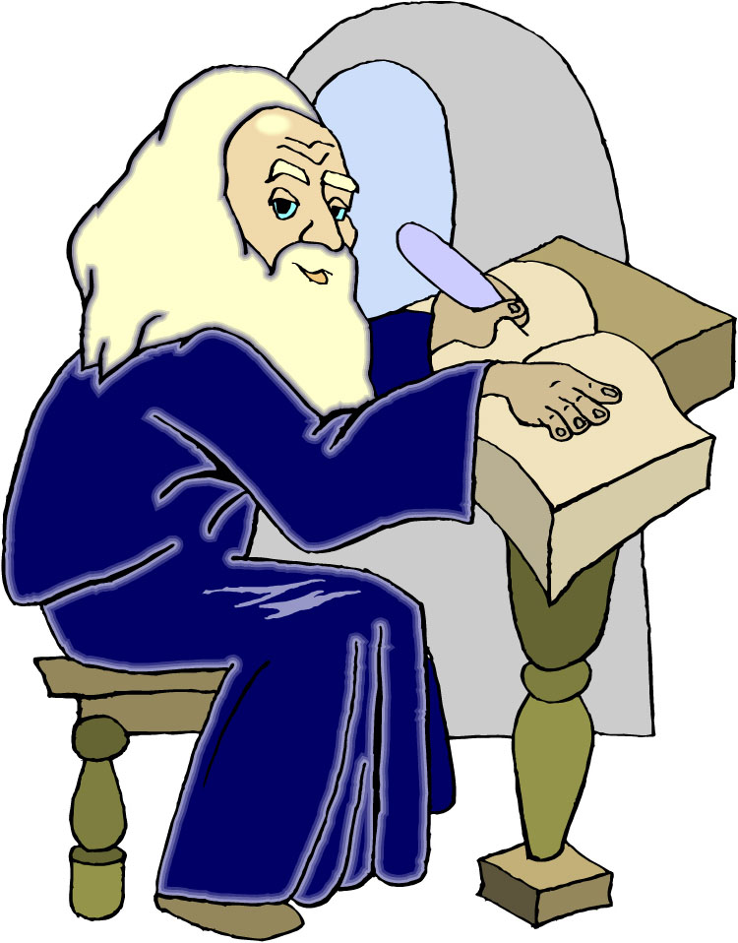
Chapter 24 Vocabulary
γραμματεύς, -έως, ὁ
scribe

Slide 42
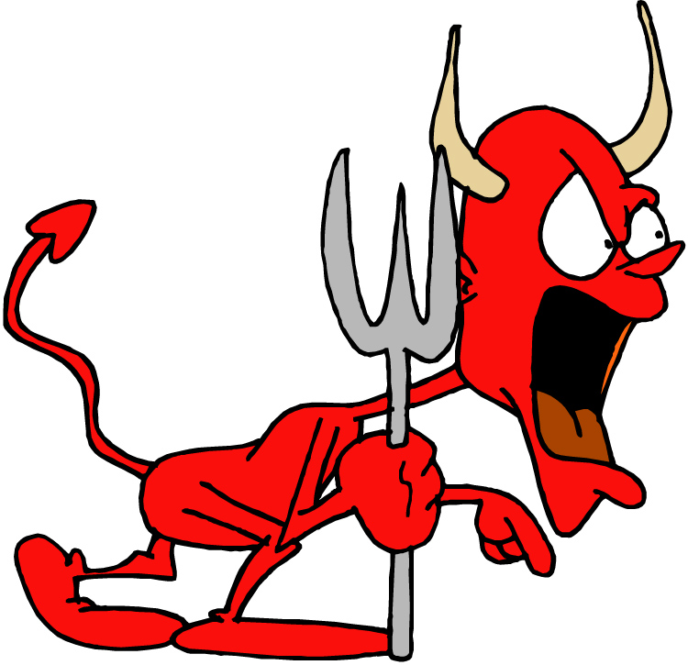
Chapter 24 Vocabulary
δαιμόνιον, -ου, τό
demon

Slide 43
Chapter 24 Vocabulary
δοκέω
I think

Slide 44
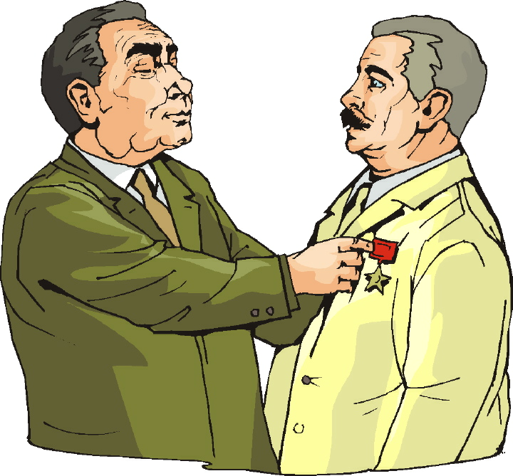
Chapter 24 Vocabulary
δοξάζω
I glorify, honor

Slide 45
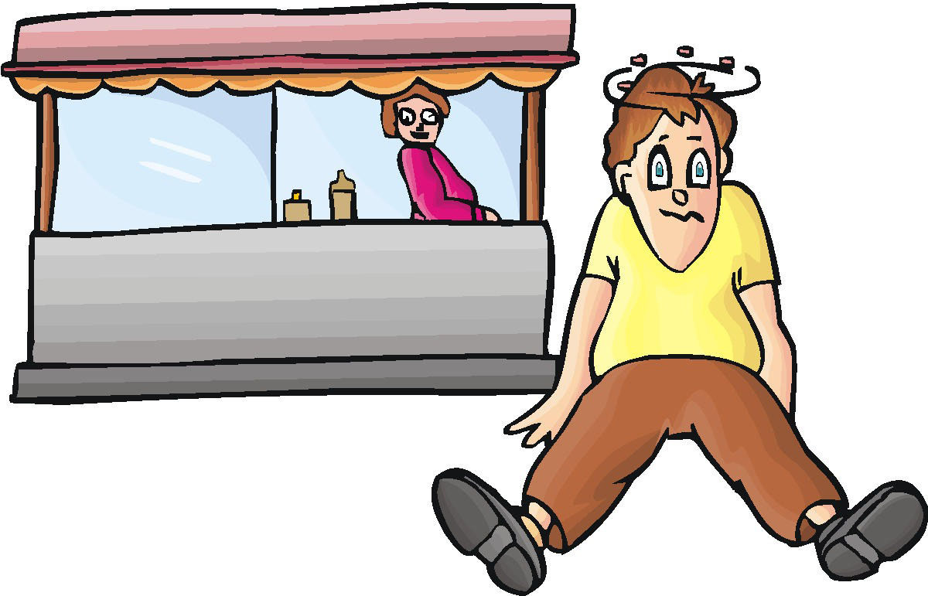
Chapter 24 Vocabulary
ἔξω
outside

Slide 46
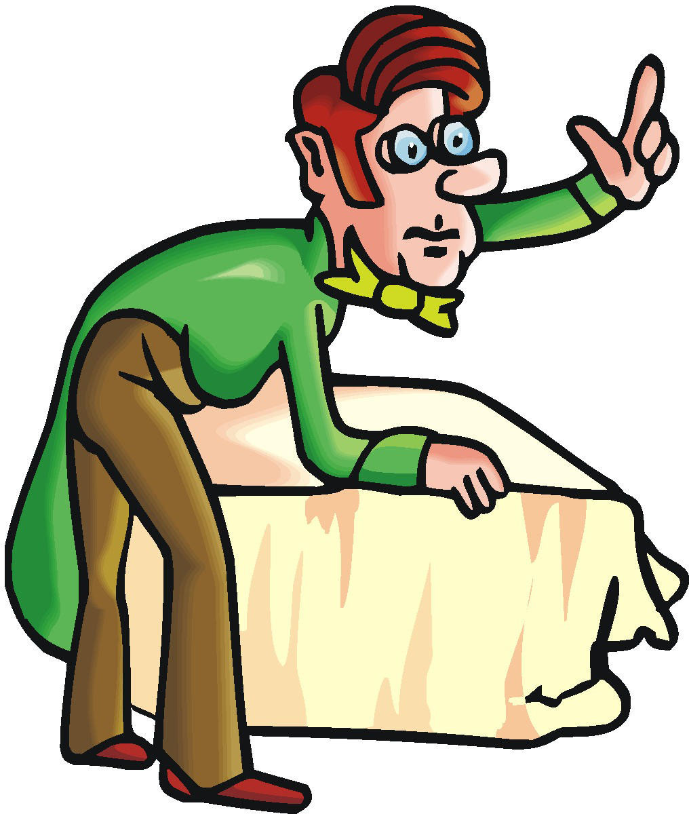
Chapter 24 Vocabulary
ἐρωτάω
I ask

Slide 47
Chapter 24 Vocabulary
θέλημα, -ατος, τό
will

Slide 48
Chapter 24 Vocabulary
θρόνος, -ου, ὁ
throne

Slide 49
Chapter 24 Vocabulary
ὄρος, -ους, τό
mountain

Slide 50
Review Vocabulary

Slide 51
Chapter 23 Vocabulary
ἄγω
I lead, bring
ἀπολύω
I set free
εἴτε
if, whether
ἐντολή, -ῆς, ἡ
commandment
καρπός, -οῦ, ὁ
fruit

Slide 52
Chapter 23 Vocabulary
πιστός, -ή, -όν
faithful
πρεσβύτερος, -α, -ον
elder
ῥῆμα, -ατος, τό
word
σάββατον, -ου, τό
Sabbath
φέρω
I bear, carry

Slide 53
Chapter 22 Vocabulary
αἰτέω
I ask
αἰώνιος, -ον
eternal
ἀποκτείνω
I kill
κεφαλή, -ῆς, ἡ
head
πίνω
I drink

Slide 54
Chapter 22 Vocabulary
πλοῖον, -ου, τό
boat
πῦρ, -ός, τό
fire
τηρέω
I keep, guard
ὕδωρ, -ατος, τό
water
χαίρω
I rejoice

Slide 55
Chapter 21 Vocabulary
ἀνοίγω
I open
βαπτίζω
I baptize
εὐαγγέλιον, -ου, τό
gospel
μαρτυρέω
I witness
πέμπω
I send

Slide 56
Chapter 21 Vocabulary
προνηρός, -ά, -όν
evil, bad
πρόσωπον, -ου, τό
face
σημεῖον, -ου, τό
sign, miracle
στόμα, -ατος, τό
mouth
ὑπάγω
I go away

Slide 57
Chapter 20 Vocabulary
ἀναβαίνω
I go up
ἄρχω
I rule, begin (in mid.)
ἕκαστος, -η, -ον
each, every
ἐκβάλλω
I drive out
κἀγώ
and I, but I

Slide 58
Chapter 20 Vocabulary
καταβαίνω
I go down
μᾶλλον
more, rather
μήτηρ, -ός, ἡ
mother
ὅπου
where, since
ὥστε
therefore, so that

Slide 59
Chapter 19 Vocabulary
ἀκολουθέω
I follow
ἐνώπιον
before
θάλασσα, -ης, ἡ
sea, lake
κάθημαι
I sit
καιρός, -οῦ, ὁ
time

Slide 60
Chapter 19 Vocabulary
οὔτε
and not, nor, neither
πίπτω
I fall
πούς, ποδός, ὁ
foot
προσέρχομαι
I come/go to
προσεύχομαι
I pray

Slide 61
Chapter 18 Vocabulary
genna<w
I beget
dikaiosu<nh, -hj, h[
righteousness
e]a<n
if, when
ei]rh<nh, -hj, h[
peace
oi#da
I know

Slide 62
Chapter 18 Vocabulary
oi]ki<a, -aj, h[
house
o[ra<w
I see
peripate<w
I walk
pw?j
how?
fobe<omai
I fear

Slide 63
Chapter 17 Vocabulary
εἰ
if, that
ἐσθίω
I eat
ζάω
I live
ζητέω
I seek
ἤ
or, either

Slide 64
Chapter 17 Vocabulary
καλέω
I call
λαλέω
I speak, say
παρακαλέω
I urge, exhort
πληρόω
I fill, complete
ποιέω
I do, make

Slide 65
Chapter 16 Vocabulary
αἰων, -ῶνος, ὁ
Age, eternity
ἀλλήλων
one another
ἀριερεύς, -έως, ὁ
High priest
γυνή, -αικός, ἡ
woman
δύναμαι
I can, am able

Slide 66
Chapter 16 Vocabulary
ἔθνος, -ους, τό
nation
ὅσος, -η, -ον
as great as
πόλις, -εως, ἡ
city
τέ
And, and so
χείρ, χειρός, ἡ
hand

Slide 67
Chapter 15 Vocabulary
ἄλλος, -η, -ο
other
ἄρτος, -ου, ὁ
bread
δεῖ
it is necessary
ἐξουσία, -ας, ἡ
authority
ἕτερος, -α, -ον
different

Slide 68
Chapter 15 Vocabulary
ἔτι
yet, still
ὀφθαλμός, -οῦ, ὁ
eye
τέκνον, -ου, τό
child
τόπος, -ου, ὁ
place
φῶς, φωτός, τό
light

Slide 69
Chapter 14 Vocabulary
αἷμα, -ματος, τό
blood
αἴρω
I raise, take up
διδάσκω
I teach
ἴδιος, -α, -ον
one's own
καλός, -ή, -όν
good

Slide 70
Chapter 14 Vocabulary
μέλλω
I am about to, intend
ὁδός, -οῦ, ἡ
way
πολύς, πολλή, πολύ
much, many
σῶμα, -ματος, τό
body
ψυχή, -ῆς, ἡ
soul, life

Slide 71
Chapter 13 Vocabulary
ἀνήρ, ἀνδρός, ὁ
man, husband
βασιλεύς, -ἐως, ὁ
king
δύναμις, -εως, ἡ
power, miracle
ὄνομα, -ματος, τό
name
πᾶς, πᾶσα, πᾶν
each, every, all

Slide 72
Chapter 13 Vocabulary
πατήρ, πατρός, ὁ
father
πιστις, πίστεως, ἡ
faith, belief
πνεῦμα, -ατος, τό
spirit, wind
σάρξ, σαρκός, ἡ
flesh, body
χάρις, -ιτος, ἡ
grace, kindness

Slide 73
Chapter 12 Vocabulary
ἀποθνῄσκω
I die
ἐκεῖ
there
ἕως
until
ἰδού
behold

Slide 74
Chapter 12 Vocabulary
ἵνα
in order that, that
Ἰωάννης, -ου, ὁ
John
μέν
on the one hand, indeed
ὅλος, -η, -ον
whole, entire

Slide 75
Chapter 12 Vocabulary
ὅτε
when
σύν
with

Slide 76
Chapter 11 Vocabulary
ἀπέρχομαι
I go away, leave
ἐκεῖνος
that
Ἰουδαῖος, -α, -ον
Jewish
καθώς
as, just as

Slide 77
Chapter 11 Vocabulary
ὅς, ἥ, ὅ
who, which
ὅταν
when
πάλιν
again
οὗτος, αὗτη, τοῦτο
this

Slide 78
Chapter 11 Vocabulary
Πέτρος, -ου, ὁ
Peter
ὑπέρ
for, about (gen.)
above, beyond (acc.)

Slide 79
Chapter 11 Vocabulary
ὑπέρ
for, about (gen.)
above, beyond (acc.)

Slide 80
Vocabulary Ch. 10
life
ζωή, -ῆς, ἡ
death
θάνατος, -ου, ὁ
I judge
κρίνω
I remain
μένω
only, alone
μόνος, -η, -ον

Slide 81
Vocabulary Ch. 10
now
νῦν
and not, nor
οὐδέ
Paul
Παῦλος
I save
σῴζω
then
τότε

Slide 82
Vocabulary Ch. 9
I answer
ἀποκρίνομαι
I send
ἀποστέλλω
I throw
βάλλω
I become
γίνομαι
I come in
εἰσέρχομαι

Slide 83
Vocabulary Ch. 9
I go out
ἐξέρχομαι
I come/go
ἔρχομαι
I wish
θέλω
thus, so
οὕτως
I go
πορεύομαι

Slide 84
Vocabulary Ch. 8
he/she/it
αὐτός, -ή, -ό
land, earth, region
γῆ, -ῆς, ἡ
I, we
ἐγώ, ἡμεῖς
day
ἡμέρα, -ας, ἡ
that, so that
ὅτι

Slide 85
Vocabulary Ch. 8
so, then, therefore
οὖν
crowd
ὄχλος, -ου, ὁ
from
παρά (with Gen.)
beside, with
παρά (with Dat.)
alongside, beside
παρά (with Acc.)

Slide 86
Vocabulary Ch. 8
you / you (pl)
σύ / ὑμεῖς
by, at the hands of
ὑπό (with Gen.)
under, below
ὑπό (with Acc.)

Slide 87
Vocabulary -- Ch. 7
good
ἀγαθός, -ή, -όν
Holy
ἅγιος, -α, -ον
righteous
δίκαιοις, -α, -ον

Slide 88
Vocabulary – Ch. 7
I am
εἰμί
Jewish, a Jew
Ἰουδαῖος, -α, -ον
Great
μέγας, μεγάλη, μέγα

Slide 89
Vocabulary -- Ch. 7
dead
νεκρός, -ά, -όν
no, not
οὐ, οὐκ, οὐχ
first
πρῶτος, -η, -ον
voice
φωνή, -ῆς, ἡ

Slide 90
Chapter 6 Vocabulary
ἀπό (Gen.)
from
διά (Gen.)
through
διά (Acc.)
on account of
εἰς (Acc.)
into

Slide 91
Chapter 6 Vocabulary
ἐκ (Gen.)
out of, from
ἐν (Dat.)
in
ἐπί (Gen.)
on, over
ἐπί (Dat.)
on, at, against, on the basis of

Slide 92
Chapter 6 Vocabulary
ἐπί (Acc.)
on, to, toward, against
κατά (Gen.)
down, against
κατά (Acc.)
according to
μετά (Gen.)
with

Slide 93
Chapter 6 Vocabulary
μετά (Acc.)
after, behind
περί (Gen.)
about, concerning
περί (Acc.)
around, near
πρός (Acc.)
to

Slide 94
Ch. 5 -- Vocabulary
love
ἀγάπη, -ης, ἡ
truth
ἀλήθεια, -ας, ἡ
sin
ἁμαρτία, -ας, ἡ
kingdom
βασιλεία, -ας, ἡ
writing, Scripture
γραφή, -ῆς, ἡ

Slide 95
Ch. 5 -- Vocabulary
I raise up
ἐγείρω
assembly, church
ἐκκλησία, -ας, ἡ
work
ἔργον, -ου, τό
disciple
μαθητής, -οῦ, ὁ
Hour
ὥρα, -ας, ἡ

Slide 96
Ch. 4 -- Vocabulary
I love
ἀγαπάω
I write
γράφω
but, and
δέ
servant, slave
δοῦλος, -ου, ὁ
I find
εὑρίσκω

Slide 97
Ch. 4 -- Vocabulary
temple
ἱερόν, -οῦ, τό
People
λαός, -οῦ, ὁ
law
νόμος, -ου, ὁ
house
οἶκος, -ου, ὁ
as, about, how
ὡς

Slide 98
Ch. 3 -- Vocabulary
but, yet
ἀλλἀ
apostle, sent one
ἀπόστολος, -ου, ὁ
I see
βλέπω
for, then
γάρ
I know
γινώσκω

Slide 99
Ch. 3 -- Vocabulary
Jesus
Ἰησοῦς, -οῦ, ὁ
I take, receive
λαμβάνω
I loose
λύω
heaven
οὐρανός, -οῦ, ὁ
I believe
πιστεύω

Slide 100
Ch. 2 -- Vocabulary
brother
ἀδελφός, -οῦ, ὁ
I hear, obey
ἀκούω
glory, fame
δόξα, -ης, ἡ
I have
ἔχω
world
κόσμος, -ου, ὁ

Slide 101
Ch. 2 -- Vocabulary
Lord, sir
κύριος, -ου, ὁ
word
λόγος, -ου, ὁ
Peter
Πἑτρος, -ου, ὁ
son
υἱός, -οῦ, ὁ
Pharisee
Φαρισαῖος, -ου, ὁ

Slide 102
Ch. 1 -- Vocabulary
angel, messenger
ἄγγελος, -ου, ὁ
verily, truly
ἀμήν
man, humankind
ἄνθρωπος, -ου, ὁ
I
ἐγώ
God
θεός, -οῦ, ὁ

Slide 103
Ch. 1 -- Vocabulary
and, also, even
καί
heart
καρδία, -ας, ἡ
I say
λέγω
prophet
προφήτης, -ου, ὁ
Christ, Messiah
Χριστός, -οῦ, ὁ

Slide 104
In Order Vocabulary Review

Slide 105
Ch. 1 -- Vocabulary
angel, messenger
ἄγγελος, -ου, ὁ
verily, truly
ἀμήν
man, humankind
ἄνθρωπος, -ου, ὁ
I
ἐγώ
God
θεός, -οῦ, ὁ

Slide 106
Ch. 1 -- Vocabulary
and, also, even
καί
heart
καρδία, -ας, ἡ
I say
λέγω
prophet
προφήτης, -ου, ὁ
Christ, Messiah
Χριστός, -οῦ, ὁ

Slide 107
Ch. 2 -- Vocabulary
brother
ἀδελφός, -οῦ, ὁ
I hear, obey
ἀκούω
glory, fame
δόξα, -ης, ἡ
I have
ἔχω
world
κόσμος, -ου, ὁ

Slide 108
Ch. 2 -- Vocabulary
Lord, sir
κύριος, -ου, ὁ
word
λόγος, -ου, ὁ
Peter
Πἑτρος, -ου, ὁ
son
υἱός, -οῦ, ὁ
Pharisee
Φαρισαῖος, -ου, ὁ

Slide 109
Ch. 3 -- Vocabulary
but, yet
ἀλλἀ
apostle, sent one
ἀπόστολος, -ου, ὁ
I see
βλέπω
for, then
γάρ
I know
γινώσκω

Slide 110
Ch. 3 -- Vocabulary
Jesus
Ἰησοῦς, -οῦ, ὁ
I take, receive
λαμβάνω
I loose
λύω
heaven
οὐρανός, -οῦ, ὁ
I believe
πιστεύω

Slide 111
Ch. 4 -- Vocabulary
I love
ἀγαπάω
I write
γράφω
but, and
δέ
servant, slave
δοῦλος, -ου, ὁ
I find
εὑρίσκω

Slide 112
Ch. 4 -- Vocabulary
temple
ἱερόν, -οῦ, τό
People
λαός, -οῦ, ὁ
law
νόμος, -ου, ὁ
house
οἶκος, -ου, ὁ
as, about, how
ὡς

Slide 113
Ch. 5 -- Vocabulary
love
ἀγάπη, -ης, ἡ
truth
ἀλήθεια, -ας, ἡ
sin
ἁμαρτία, -ας, ἡ
kingdom
βασιλεία, -ας, ἡ
writing, Scripture
γραφή, -ῆς, ἡ

Slide 114
Ch. 5 -- Vocabulary
I raise up
ἐγείρω
assembly, church
ἐκκλησία, -ας, ἡ
work
ἔργον, -ου, τό
disciple
μαθητής, -οῦ, ὁ
Hour
ὥρα, -ας, ἡ

Slide 115
Chapter 6 Vocabulary
ἀπό (Gen.)
from
διά (Gen.)
through
διά (Acc.)
on account of
εἰς (Acc.)
into

Slide 116
Chapter 6 Vocabulary
ἐκ (Gen.)
out of, from
ἐν (Dat.)
in
ἐπί (Gen.)
on, over
ἐπί (Dat.)
on, at, against, on the basis of

Slide 117
Chapter 6 Vocabulary
ἐπί (Acc.)
on, to, toward, against
κατά (Gen.)
down, against
κατά (Acc.)
according to
μετά (Gen.)
with

Slide 118
Chapter 6 Vocabulary
μετά (Acc.)
after, behind
περί (Gen.)
about, concerning
περί (Acc.)
around, near
πρός (Acc.)
to

Slide 119
Vocabulary -- Ch. 7
good
ἀγαθός, -ή, -όν
Holy
ἅγιος, -α, -ον
righteous
δίκαιοις, -α, -ον

Slide 120
Vocabulary – Ch. 7
I am
εἰμί
Jewish, a Jew
Ἰουδαῖος, -α, -ον
Great
μέγας, μεγάλη, μέγα

Slide 121
Vocabulary -- Ch. 7
dead
νεκρός, -ά, -όν
no, not
οὐ, οὐκ, οὐχ
first
πρῶτος, -η, -ον
voice
φωνή, -ῆς, ἡ

Slide 122
Vocabulary Ch. 8
he/she/it
αὐτός, -ή, -ό
land, earth, region
γῆ, -ῆς, ἡ
I, we
ἐγώ, ἡμεῖς
day
ἡμέρα, -ας, ἡ
that, so that
ὅτι

Slide 123
Vocabulary Ch. 8
so, then, therefore
οὖν
crowd
ὄχλος, -ου, ὁ
from
παρά (with Gen.)
beside, with
παρά (with Dat.)
alongside, beside
παρά (with Acc.)

Slide 124
Vocabulary Ch. 8
you / you (pl)
σύ / ὑμεῖς
by, at the hands of
ὑπό (with Gen.)
under, below
ὑπό (with Acc.)

Slide 125
Vocabulary Ch. 9
I answer
ἀποκρίνομαι
I send
ἀποστέλλω
I throw
βάλλω
I become
γίνομαι
I come in
εἰσέρχομαι

Slide 126
Vocabulary Ch. 9
I go out
ἐξέρχομαι
I come/go
ἔρχομαι
I wish
θέλω
thus, so
οὕτως
I go
πορεύομαι

Slide 127
Vocabulary Ch. 10
life
ζωή, -ῆς, ἡ
death
θάνατος, -ου, ὁ
I judge
κρίνω
I remain
μένω
only, alone
μόνος, -η, -ον

Slide 128
Vocabulary Ch. 10
now
νῦν
and not, nor
οὐδέ
Paul
Παῦλος
I save
σῴζω
then
τότε

Slide 129
Chapter 11 Vocabulary
ἀπέρχομαι
I go away, leave
ἐκεῖνος
that
Ἰουδαῖος, -α, -ον
Jewish
καθώς
as, just as

Slide 130
Chapter 11 Vocabulary
ὅς, ἥ, ὅ
who, which
ὅταν
when
πάλιν
again
οὗτος, αὗτη, τοῦτο
this

Slide 131
Chapter 11 Vocabulary
Πέτρος, -ου, ὁ
Peter
ὑπέρ
for, about (gen.)
above, beyond (acc.)

Slide 132
Chapter 11 Vocabulary
ὑπέρ
for, about (gen.)
above, beyond (acc.)

Slide 133
Chapter 12 Vocabulary
ἀποθνῄσκω
I die
ἐκεῖ
there
ἕως
until
ἰδού
behold

Slide 134
Chapter 12 Vocabulary
ἵνα
in order that, that
Ἰωάννης, -ου, ὁ
John
μέν
on the one hand, indeed
ὅλος, -η, -ον
whole, entire

Slide 135
Chapter 12 Vocabulary
ὅτε
when
σύν
with

Slide 136
Chapter 13 Vocabulary
ἀνήρ, ἀνδρός, ὁ
man, husband
βασιλεύς, -ἐως, ὁ
king
δύναμις, -εως, ἡ
power, miracle
ὄνομα, -ματος, τό
name
πᾶς, πᾶσα, πᾶν
each, every, all

Slide 137
Chapter 13 Vocabulary
πατήρ, πατρός, ὁ
father
πιστις, πίστεως, ἡ
faith, belief
πνεῦμα, -ατος, τό
spirit, wind
σάρξ, σαρκός, ἡ
flesh, body
χάρις, -ιτος, ἡ
grace, kindness

Slide 138
Chapter 14 Vocabulary
αἷμα, -ματος, τό
blood
αἴρω
I raise, take up
διδάσκω
I teach
ἴδιος, -α, -ον
one's own
καλός, -ή, -όν
good

Slide 139
Chapter 14 Vocabulary
μέλλω
I am about to, intend
ὁδός, -οῦ, ἡ
way
πολύς, πολλή, πολύ
much, many
σῶμα, -ματος, τό
body
ψυχή, -ῆς, ἡ
soul, life

Slide 140
Chapter 15 Vocabulary
ἄλλος, -η, -ο
other
ἄρτος, -ου, ὁ
bread
δεῖ
it is necessary
ἐξουσία, -ας, ἡ
authority
ἕτερος, -α, -ον
different

Slide 141
Chapter 15 Vocabulary
ἔτι
yet, still
ὀφθαλμός, -οῦ, ὁ
eye
τέκνον, -ου, τό
child
τόπος, -ου, ὁ
place
φῶς, φωτός, τό
light

Slide 142
Chapter 16 Vocabulary
αἰων, -ῶνος, ὁ
Age, eternity
ἀλλήλων
one another
ἀρχιερεύς, -έως, ὁ
High priest
γυνή, -αικός, ἡ
woman
δύναμαι
I can, am able

Slide 143
Chapter 16 Vocabulary
ἔθνος, -ους, τό
nation
ὅσος, -η, -ον
as great as
πόλις, -εως, ἡ
city
τέ
And, and so
χείρ, χειρός, ἡ
hand

Slide 144
Chapter 17 Vocabulary
εἰ
if, that
ἐσθίω
I eat
ζάω
I live
ζητέω
I seek
ἤ
or, either

Slide 145
Chapter 17 Vocabulary
καλέω
I call
λαλέω
I speak, say
παρακαλέω
I urge, exhort
πληρόω
I fill, complete
ποιέω
I do, make

Slide 146
Chapter 18 Vocabulary
genna<w
I beget
dikaiosu<nh, -hj, h[
righteousness
e]a<n
if, when
ei]rh<nh, -hj, h[
peace
oi#da
I know

Slide 147
Chapter 18 Vocabulary
oi]ki<a, -aj, h[
house
o[ra<w
I see
peripate<w
I walk
pw?j
how?
fobe<omai
I fear

Slide 148
Chapter 19 Vocabulary
ἀκολουθέω
I follow
ἐνώπιον
before
θάλασσα, -ης, ἡ
sea, lake
κάθημαι
I sit
καιρός, -οῦ, ὁ
time

Slide 149
Chapter 19 Vocabulary
οὔτε
and not, nor, neither
πίπτω
I fall
πούς, ποδός, ὁ
foot
προσέρχομαι
I come/go to
προσεύχομαι
I pray

