Slide 1
Proverbs
August H. Konkel
McMcaster Divinity College
March 2022

Slide 2
Proverbs
Session 6
Wisdom as a Tree of Life
Proverbs 3:13–20
august h. konkel

Slide 3
TREE OF LIFE IN THE PAST
Tree of life in the midst of the garden (Gen 2:9)
Life comes from God heart-beat by heart-beat
Life depends on a relationship with God
Tree of knowledge of good and evil
Good and evil is a merism meaning “all knowledge,” cf. Gen 31:24
Eating of the tree was a claim to be a god
Eating of the tree brings mortality (no access to the tree of life)

Slide 4
TREE OF LIFE IN THE FUTURE
Tree of life beside the river in the new earth (Rev 22:2)
Vision of John is a restoration of the garden
Tree yields fruit of life continuously, each month of the year
Tree of life accessible to the redeemed (Rev 22:14)
Blessed are those with “washed garments”
These have the right to enter the city
Life is derived from the words of truth (Rev 22:19; cf. 2:7)
Denial of the words severs one from the tree of life
Faith for life is to accept truth of John’s vision

Slide 5
TREE OF LIFE IN THE PRESENT
Wisdom Makes a Person Blessed (Prov 3:13-15)
Wisdom is the blessedness of being approved by God (Ps 1:1 [’ashrey])
This is the blessedness of the beatitudes (Matt 5:3-12)
Wisdom in the Present is a tree of life (Prov 3:16-18)
Tree of life yields blessedness (me’ushshar)
Tree of life leads to bounty (no`am) and peace
All creation is ordered by wisdom (Prov 3:19-20)
Wisdom enables us to understand the order of “nature”
Wisdom enables us to understand the moral order of relationships

Slide 6
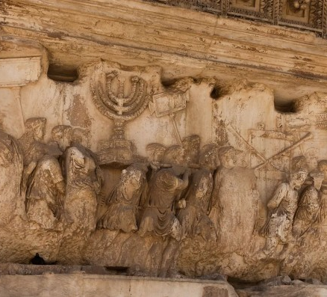
MENORAH AS A TREE OF LIFE
Panel on the Arch of Titus Depicts Menorah of the Temple
Arch Commemorated Roman Victory Over Jerusalem
Menorah became Official Symbol of Israel

