Slide 1
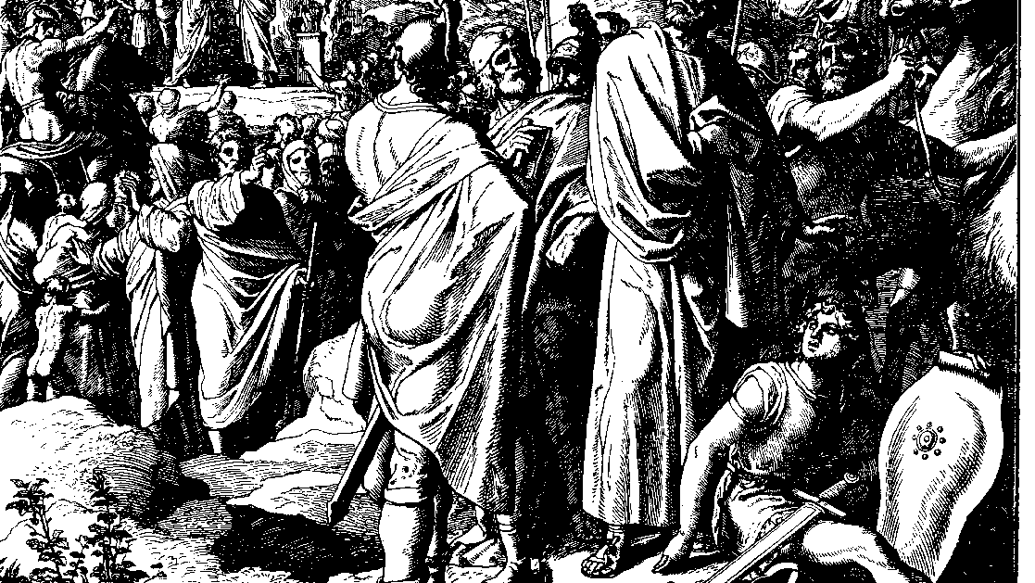
The Books of Chronicles
August H. Konkel
McMcaster Divinity College
October 2021

Slide 2
Historical Israel
session 9
august h. konkel

Slide 3
Expansion of the Kingdom (18:1-13)
Victory over Philistia and Moab (1-2)
Victory over Syria (3-11)
Victory over Edom (12-13)

Slide 4
Administration of the State (18:14-17)
Military leaders
Administrative officials
Priests and scribes
Palace guards

Slide 5
Victories over Ammonites and Arameans (19:1–20:3)
Provocation of Ammon (19:1-3; cf. 1 Sam 10:27 in NLT or NRSV)
Ammonite alliance with Syria (19:4-7)
Defeat of the alliance (19:8-15)
Defeat of Arameans and alliance with David (19:16-19)
Destruction of Ammonite capital (20:1-3)

Slide 6
Victories over Philistines (20:4-8)
War in Gezer over ‘sons of Rapha’
Defeat of the brother of Goliath
War in Gath and defeat of the giant

