Slide 1
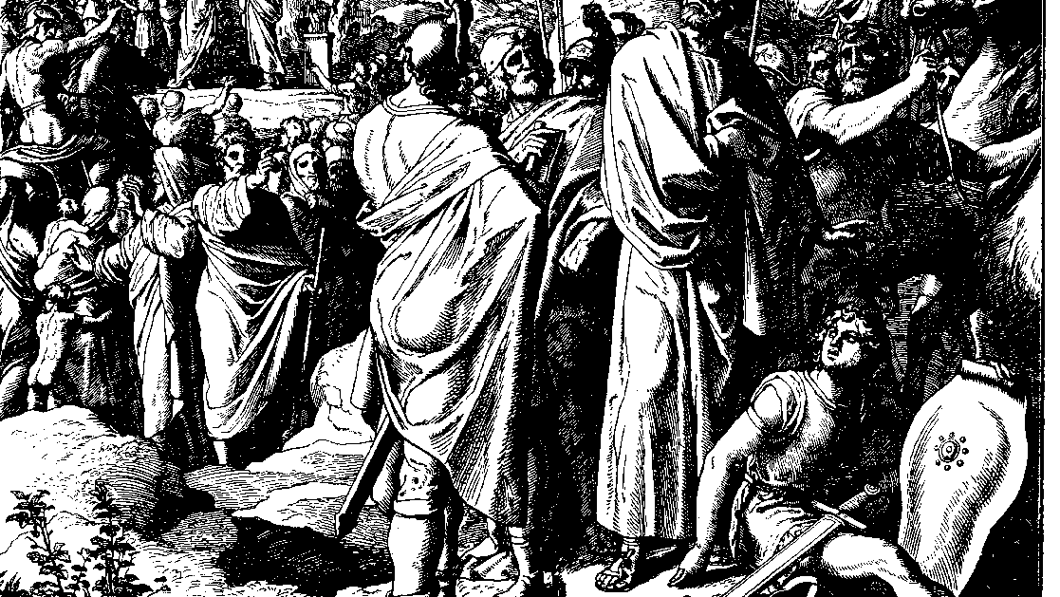
The Books of Chronicles
August H. Konkel
McMcaster Divinity College
October 2021

Slide 2
The Nation of Israel
session 6
august h. konkel

Slide 3
Northern tribes (7:1-40; cf. Gen 46:8-27)
Issachar and Benjamin (1-11)
Large numbers have to do with calculations of lunar and solar cycles
Tribes are presented as the armies of the Lord.

Slide 4
Northern tribes (7:1-40; cf. Gen 46:8-27)
Dan, Naphtali, Zebulun, and Manasseh (12-19)
Name of Dan is lost (v. 12); only sons are listed
Dan and Naphtali (vv. 12, 13) are the two sons of Bilhah
Zebulun is omitted
Records of Manasseh (17-19) [Transjordan and Aramean influence]

Slide 5
Northern tribes (7:1-40; cf. Gen 46:8-27)
Ephraim (20-29)
Linear genealogy of 8 generations (vv. 20-21a)
Raid in which two brothers are killed
Second linear genealogy leads to Joshua (vv. 25-27; cf. Josh 19:49-50)
Ephraim of 7:22 may not be the patriarch, who never lived in Canaan

Slide 6
Northern tribes (7:1-40; cf. Gen 46:8-27)
Asher (30-40)
Traditionally Asher is west of Naphtali
Names of the Chronicler suggest a more southern region

Slide 7
Military record of Israel (8:1-9:1a)
Family of Benjamin (1-3)
Militia at Jerusalem (4-28)
Militia of Ehud (4-7) [Masoretic text displacements, cf. v. 6]
Militia of Shaharaim (8-28)
Divorce of two wives in Moab (8)
Chiefs of Shaharaim (9-13)
Five militia units (14-28)

Slide 8
Military record of Israel (8:1-9:1a)
Militia at Gibeon (29-32)
Benjamite territory was not really separate from Judah (cf. v.32)
Family of Saul derived from this militia (Ner is a son of Jeiel, cf. 9:36)
Family of Saul (33-40)

Slide 9
Registration of all Israel (9:1-2)
Conclusion to the introduction of Israel in 2:1
Reference to the first or principal residents of Jerusalem (v. 2)

Slide 10
Inheritance of All Israel (9:1b-34)
Official records of Israel (1b-2)
Jerusalem as the center of Israel (3-9)
Priestly families of Israel (10-13)
Levites and their duties (14-16)
Gatekeepers (17-33)
Summary of all Israel (34)

