Slide 1
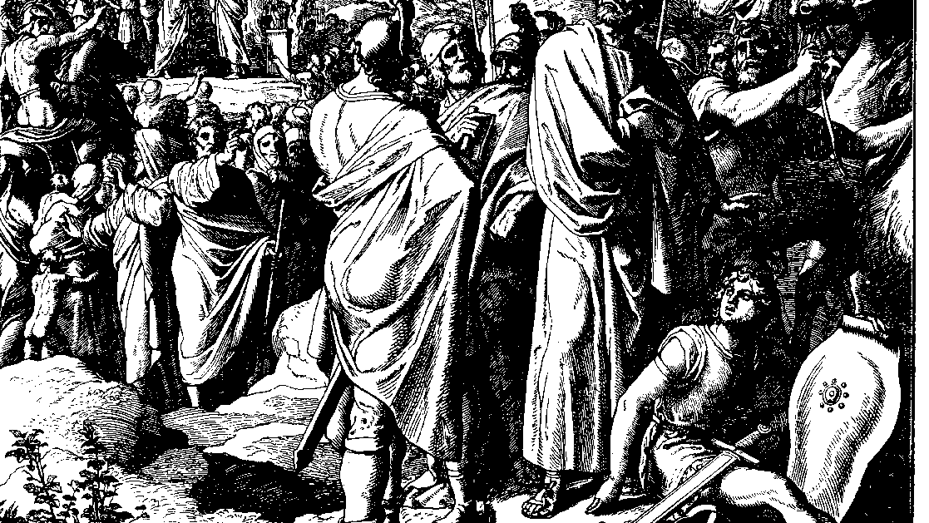
The Books of Chronicles
August H. Konkel
McMcaster Divinity College
October 2021

Slide 2
Rally Round the Temple
session 5
august h. konkel

Slide 3
Levites (6:1-30)
Priestly lineage to the exile (1-15)
Levitical lineage to time of David (16-30)
Sons of Levi (16-19)
Seven sons of Gershom (20-21)
Priestly lineage of Kohut (22-28) [lineage of Samuel]
Seven sons of Merari (29-30)

Slide 4
Musicians and Priests (31-53)
Assignments of David (31-32)
Guild of Heman (33-38)
Guild of Asaph (39-43)
Guild of Ethan (44-49)
Priests through Aaron (50-53)

Slide 5
Cities of Residence for Levites (54-81)
Priestly cities in Judah, Simeon, and Benjamin (54-60; cf. Josh 21:10-18)
Cities of Kohut, Gershom, and Merari (61-63; cf. Josh 21:5-7)
Summary of Levitical cities (64-65; cf. Josh 21:8-9)
Levitical cities in all Israel (66-81; cf. Josh 21:20-42)
All Levitical cities are cities of refuge (vv. 55, 67)

