Slide 1
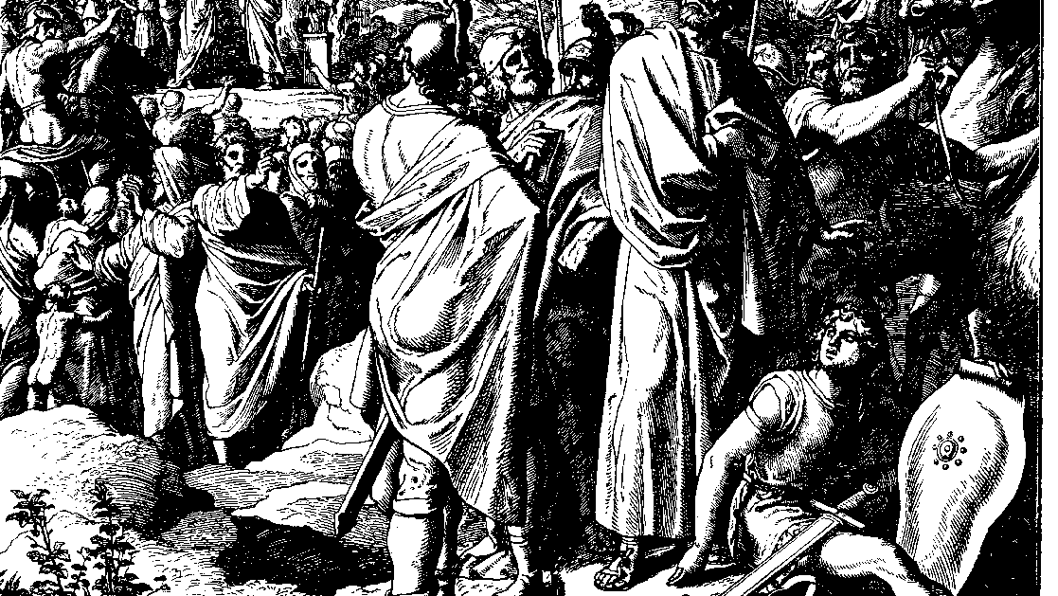
The Books of Chronicles
August H. Konkel
McMcaster Divinity College
October 2021

Slide 2
The Lion of Judah
session 4
august h. konkel

Slide 3
Records of Judah (4:1-23)
Distinguished families of Judah (1-8)
Families of Caleb (1-2) cf. 2:19, 24, 50-54)
Etam (v. 3) has links to Hur (son of Caleb)
Ashur (vv. 5-8) is father of Tekoah (cf. 2:24), son of Hezron
Distinction of Jabez (9-10 cf. 2:55) [cf. Bruce Wilkinson]
Calebites (not sons of Hezron) and Kenizzites (11-15)
Distinguished groups of Judah (16-23)

Slide 4
Simeon within Judah (4:24-43)
Family of Simeon (24-27)
Settlements of Simeon (28-33; cf. v. 31, Josh 19:1-9)
Simeon princes (34-38)
Princes are otherwise unknown
May be linked to distinguished cities
Expansion at the time of Hezekiah into Philistine area (39-41)
Expansion into Edom (42-43)

Slide 5
Tribal Status (5:1-2)
Reuben forfeited the privilege of firstborn (Gen 35:22, 49:3-4)
Joseph has the right of firstborn (Gen 48:5, 22)
Judah became the ruling tribe (Gen 49:8-12)

Slide 6
Transjordan tribes (5:3-26)
Sons and residences of Reuben (1-10)
Gad in Bashan and Gilead (11-17)
War with the Hagrites (18-22; cf. Ps 83:6)
Descendants of Ishmael (cf. Gen 25:15)
Tribe of Reuben was expanding to the east
Tribe of Manasseh in area of Bashan
Exile of Transjordan tribes (23-26)

