Slide 1
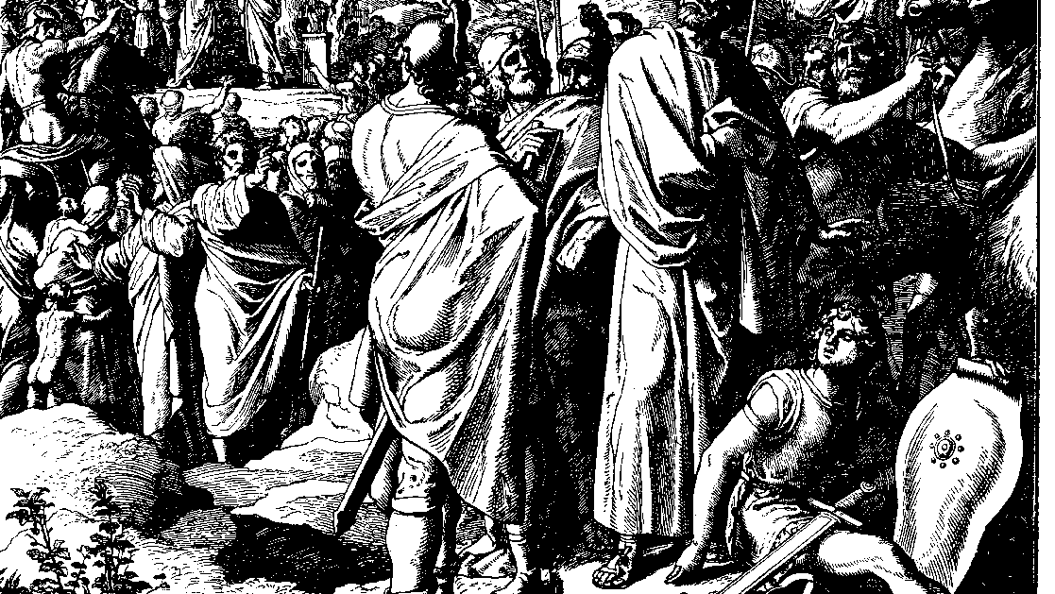
The Books of Chronicles
August H. Konkel
McMcaster Divinity College
October 2021

Slide 2
Election of David
session 3
august h. konkel

Slide 3
Royal Tribe (2:3-55)
Sons of Judah
Sons of Hezron
Sons of Jerahmiel
Sons of Ram
Sons of Caleb

Slide 4
Sons of Judah (3-9)
Sons of his Canaanite wife
Sons of Tamar (daughter in law of Judah)
Perez and Zerah
Zerah father of Achan
Perez is father of Hezron
Hezron is father of Ram, Caleb, and Gilead

Slide 5
Sons of Hezron and Ram (10-24)
Sons of Ram:
Boaz and Jesse (cf. Ruth 4:18-22)
David is seventh son of Jesse (cf. 1 Sam 16:1-13, epic poetic language)
Zeriah and Abigail are sisters
Caleb in Judah (v. 18; not son of Jephunneh in Joshua)
Hezron married daughter of Machir who begat Gilead (vv. 21, 23)

Slide 6
Clans in Judah (25-41)
Jerahmeel is first born of Hezron
Ram is firstborn of Jerahmeel
Sheshan is a descendant of Ram
Sheshan has only daughters, descendants are through an Egyptian (v. 34)
Descendants are given for 20 generations (to time of the exile)
Calebite settlements at Hebron (42-55)

Slide 7
Family of David (3:1-24)
Family of David (1-9)
Sons in Hebron to Ahinoam, Abigail, and Maakah (Absalom)
Sons born in Jerusalem (Solomon is the fourth)
Kings of Judah (10-14)
List given as found in Kings
Period of 350 years

Slide 8
Family of David (3:1-24)
Family of Josiah (15-18)
Jehoahaz (fourth son, 2 Chr 36:1)
Jehoiakim (Eliakim, second son, 2 Chr. 36:4)
Jehoiachin (son of Jehoiakim, 2 Chr 36:9)
Taken captive into Babylon
Zedekiah (Mattaniah, 2 Chr 36:10)
Descendants of the exile (19-24)

