Slide 1
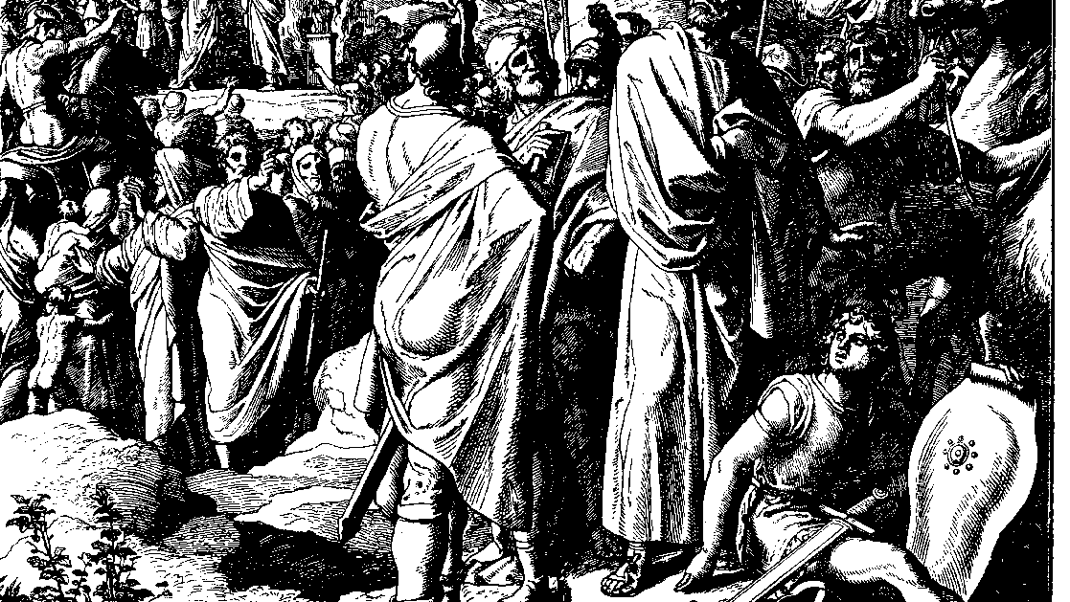
The Books of Chronicles
August H. Konkel
McMcaster Divinity College
October 2021

Slide 2
Reversals of Fortune
session 24
august h. konkel

Slide 3
Outline of Chronicles
Nation of Promise: 1 Chr 1-9:34
Founding of the Kingdom: 1 Chr 9:35-20:8
Preparation for the Temple: 1 Chr 21:1-29:30
Reign of Solomon: 2 Chr 1:1-9:31
Israel until the Exile of the North: 10:1-28:27)
Healing under Hezekiah: 29:1-32:23
Humiliation and Hope: 33:1-36:23

Slide 4
Manasseh and Amon (33:1-25)
Idolatry and captivity of Manasseh (33:1-11)
Cult places restored
Practice of cult child dedications and necromancy
Taken captive to Babylon
Humbling of Manasseh and restoration (33:12-20)
Restoration of fortifications
Restored temple worship and removed cult worship (v. 17)
Reign of Amon (33:21-25)

Slide 5
Renewal under Josiah (34:1–35:27)
Purification of Israel (34:1-13)
Discovery of the Book of the Covenant (34:14-33)
Mandate to covenant renewal (Deut 31:9-13)
Josiah approved as a humble king (34:27)

Slide 6
Renewal under Josiah (34:1–35:27)
Passover Celebration (35:1-19)
No Passover as this one previously; priests conducted the offerings
Other animals were offered during the feast of unleavened bread
Death of Josiah (35:20-27)
Assyrian power was weakened, Josiah attempted to take control in north
Egyptians reduce Judah to a vassal state

