Slide 1
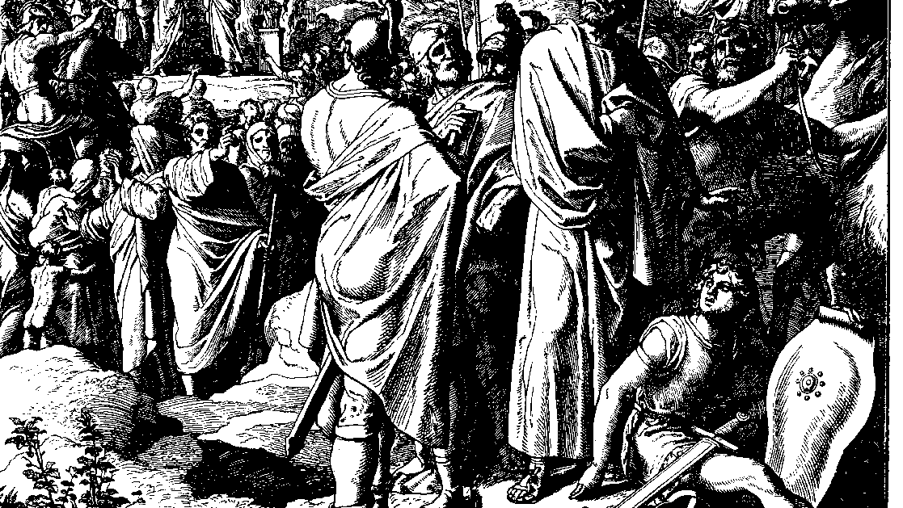
The Books of Chronicles
August H. Konkel
McMcaster Divinity College
October 2021

Slide 2
Faithful King
session 23
august h. konkel

Slide 3
Provisions for Temple Worship (31:2-21)
Contributions to the temple (31:2-10)
Administration of contributions (31:11-19)
Summary of Hezekiah’s restoration (31:20-21)

Slide 4
Deliverance and Healing in the Land (32:1-33)
Divine protection and provision (32:1-23)
Tried and found faithful (32:24-31)
Summary of a faithful king (32:32-33)

