Slide 1
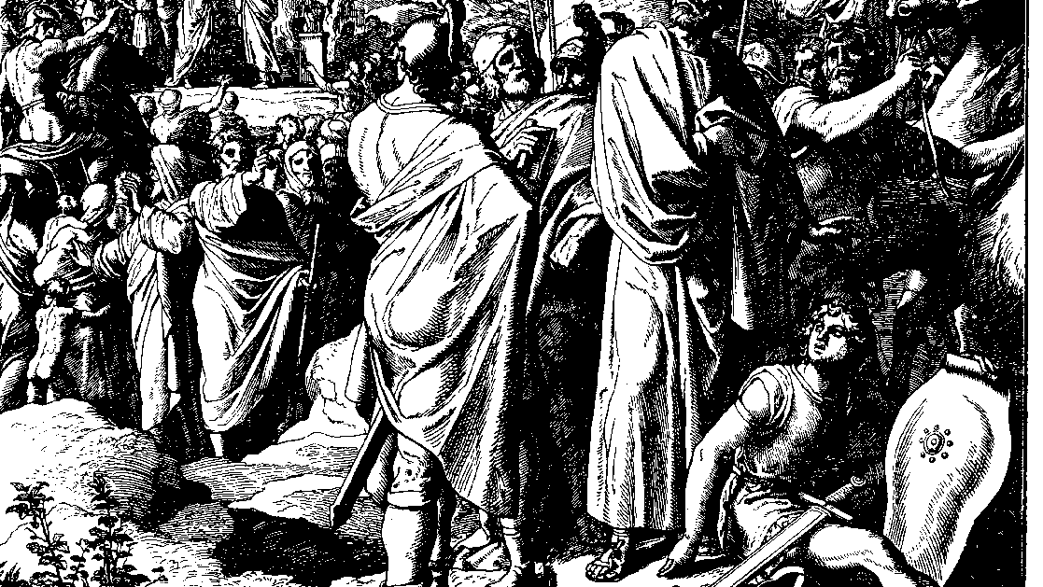
The Books of Chronicles
August H. Konkel
McMcaster Divinity College
October 2021

Slide 2
Restoration of Worship
session 22
august h. konkel

Slide 3
Outline of Chronicles
Nation of Promise: 1 Chr 1-9:34
Founding of the Kingdom: 1 Chr 9:35-20:8
Preparation for the Temple: 1 Chr 21:1-29:30
Reign of Solomon: 2 Chr 1:1-9:31
Israel until the Exile of the North: 10:1-28:27)
Healing under Hezekiah: 29:1-32:23
Humiliation and Hope: 33:1-36:23

Slide 4
Restoration of the temple (29:1-36)
Summary of Hezekiah’s Reign (29:1-2)
Exhortation to Restoration (29:3-11)
Restoration of the Sanctuary (29:12-19)
Rededication of the Temple (29:20-30)
Sacrifices of Praise (29:31-36)

Slide 5
Celebration of the Passover (30:1–31:1)
Summons to the Passover pilgrimage (30:1-12)
Observance of the festival (30:13-22)
Violations of regulations due to overwhelming success
Seeking the Lord and healing of the people (cr. 2 Chr 7:14)
Continuation of Celebration (30:23–31:1)

